Slide 1
We Are Focused on Good Work
Fall 2014
Spring 2015
Accreditation
100% TMC/ADTs
Basic Skills Plan
Student Equity Plan
Tablet Initiative (Pilot #1)
College Hour Activities
BA Degree Submitted
Positive Attendance
Cleaner Schedule
eCatalog
Enrollment Growth
Final Exam Schedule
Prof Development Expansion
SLOs
Course Caps
Hiring
BA Degree Implementation?
Tablet Initiative (Pilot #2)
Reorganization
1st Draft of Educ Master Plan
Schedule 1-Year in Advance
Prof Development Expansion
Expand DE (Coordinator, Plan, Services, AA Degree?)
Enrollment Growth
Engage-Learn-Advance Assessment
Enrollment Efficiency
SLOs

Slide 2
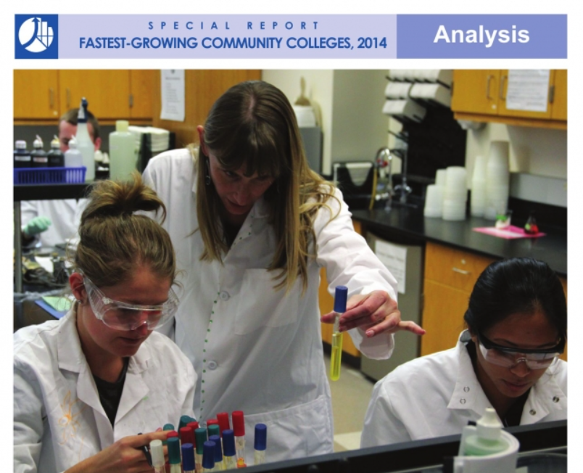
Students Are Benefitting from Your Efforts
Enrollment Growth
Student Opinion Spring 2014
Community College Week recently ID’d Crafton as the 9th fastest growing college in the country (enrollments from 5,000 to 10,000)
95% satisfied with instruction and overall ed experience
93% believe receiving a great education
96% believe library resources meet needs and tutoring services readily available
92% satisfied with overall services for students
96% believe campus is clean, well-maintained, grounds are well-cared for.
92% believe computer labs are adequate and accessible

Slide 3
Students Are Benefitting From Your Efforts
Retention Rates
Success Rates
91.0%
74.0%
6th Highest in California
16th Highest in California
Crafton Hills College
All California CCs
From California Community College Chancellor’s Data Mart

Slide 4
Retention and Success Comparisons—Inland Empire
#1 in Inland Empire for Combined Score
 | Enrollment Count | Retention Rate | Success Rate | Combined Rate | CA Rank | IE Rank
Crafton Hills | 14,372 | 91.0% | 74.0% | 82.5% | 4 | 1
Chaffey | 49,681 | 90.3% | 71.5% | 80.9% | 17 | 2
Desert | 23,026 | 87.5% | 71.9% | 79.7% | 28 | 3
Moreno Valley | 16,470 | 86.7% | 71.3% | 79.0% | 47 | 4
Copper Mountain | 4,066 | 87.6% | 70.2% | 78.9% | 50 | 5
Palo Verde | 4,953 | 87.1% | 70.9% | 78.6% | 55 | 6
Norco | 17,922 | 86.1% | 70.6% | 78.3% | 60 | 7
Victor Valley | 28,520 | 91.2% | 64.6% | 77.9% | 71 | 8
San Bernardino | 31,691 | 87.9% | 66.8% | 77.3% | 78 | 9
Riverside | 39,474 | 85.6% | 66.8% | 76.2% | 89 | 10
Mt. San Jacinto | 36,894 | 84.6% | 67.4% | 76.0% | 92 | 11
Spring 2014 Credit Courses from California Community College Chancellor’s Data Mart
Combined Rate = Average of Retention and Success Rates

Slide 5
Retention and Success Comparisons—California
#4 in California for Combined Score
 | Enrollment Count | Retention Rate | Success Rate | Combined Rate | CA Rank
Taft | 14,265 | 94.2% | 82.2% | 88.2% | 1
Feather River | 5,038 | 94.4% | 77.6% | 86.0% | 2
Lake Tahoe | 5,387 | 90.1% | 76.8% | 83.5% | 3
Crafton Hills | 14,372 | 91.0% | 74.0% | 82.5% | 4
Foothill | 28,511 | 88.9% | 75.9% | 82.4% | 5
Sequoias | 34,642 | 91.0% | 73.7% | 82.3% | 6
Santa Barbara | 56,366 | 90.4% | 74.2% | 82.3% | 7
Gavilan | 13,221 | 88.0% | 75.8% | 81.9% | 8
Ohlone | 23,437 | 87.2% | 76.6% | 81.9% | 9
Mendocino | 8,769 | 89.1% | 74.7% | 81.9% | 10
Napa | 16,116 | 89.9% | 73.7% | 81.8% | 11
Deanza | 49,916 | 88.4% | 75.2% | 81.8% | 12
Spring 2014 Credit Courses from California Community College Chancellor’s Data Mart
Combined Rate = Average of Retention and Success Rates

Slide 6
Completion Trend and Comparisons
Degree/Certificate Completion
Completion Rate
 | CA Rank | IE Rank
Chaffey | 11 | 1
Mt. San Jacinto | 29 | 2
San Bernardino | 35 | 3
Victor Valley | 37 | 4
Riverside | 49 | 5
Norco College | 50 | 6
Copper Mountain | 54 | 7
Crafton Hills | 55 | 8
Desert | 69 | 9
Moreno Valley | 87 | 10
Palo Verde | 111 | 11
To be IE #1 and CA top 10 we need ~820 grads
2013-2014 Degree and Chancellor Approved Certificate Completion
From California Community College Chancellor’s Data Mart
Rate = #of Degree/Certificate Completers/Enrolled Students

Slide 7


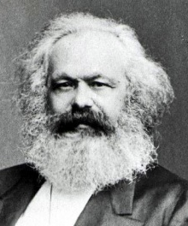
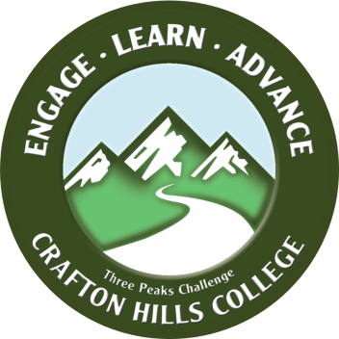
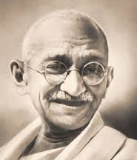



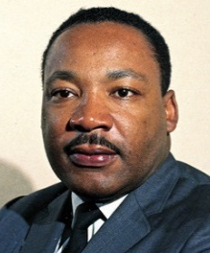
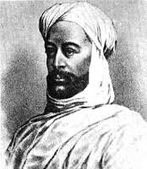
Support Students and Build Community
3 Peaks Challenge
Love
Encourage students to summit three peaks: Engage, Learn and Advance.
Do what these people encouraged . . .
Build community around love.

