Slide 1
http://www.jibjab.com/view/15F1NwG0Tf6XwzeStd3-Nw

Slide 2
Welcome
Spring 2015

Slide 3

Crafton Hills College?

Slide 4
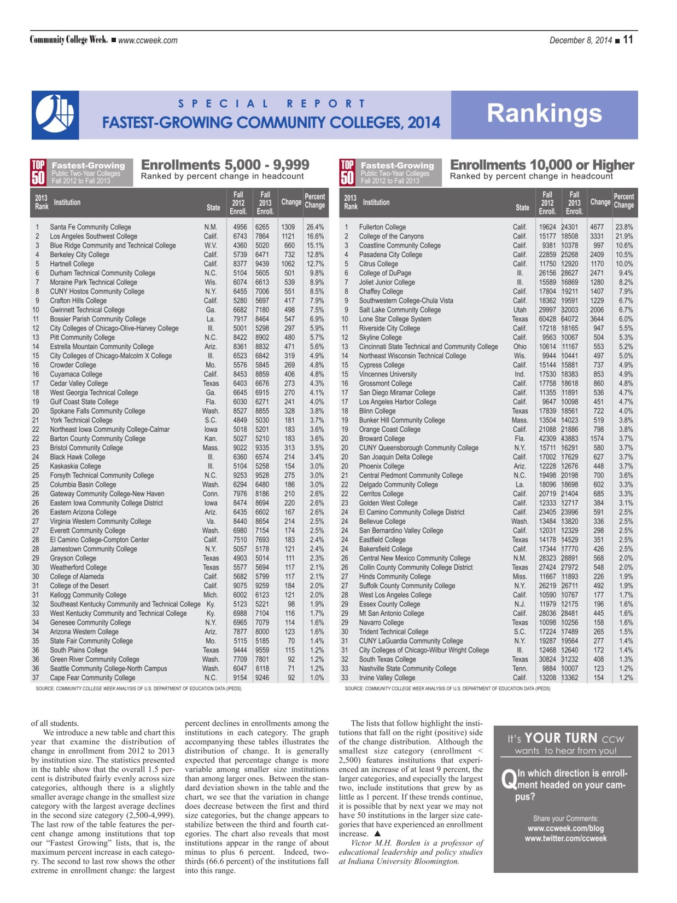
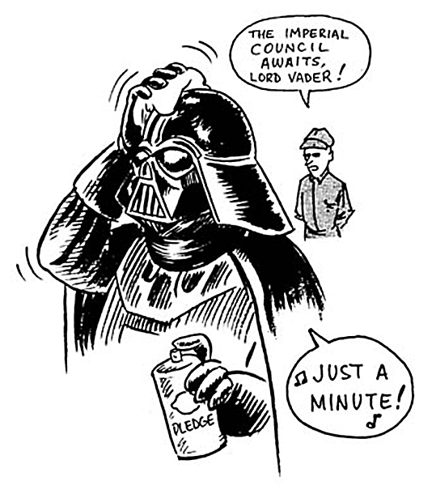
Crafton the 9th Fastest Growing Community College in the Nation
(5,000 – 9,999)

Slide 5

Welcome Back!
Jimmy Urbanovich
Julie McKee
Karen Childers

Slide 6

“New-ish” Employees
Kevin Limoges
Laura Oliver
Kristina Heilgeist
Daniel Johnson
Zayne Peraza
Nicole Williams

Slide 7
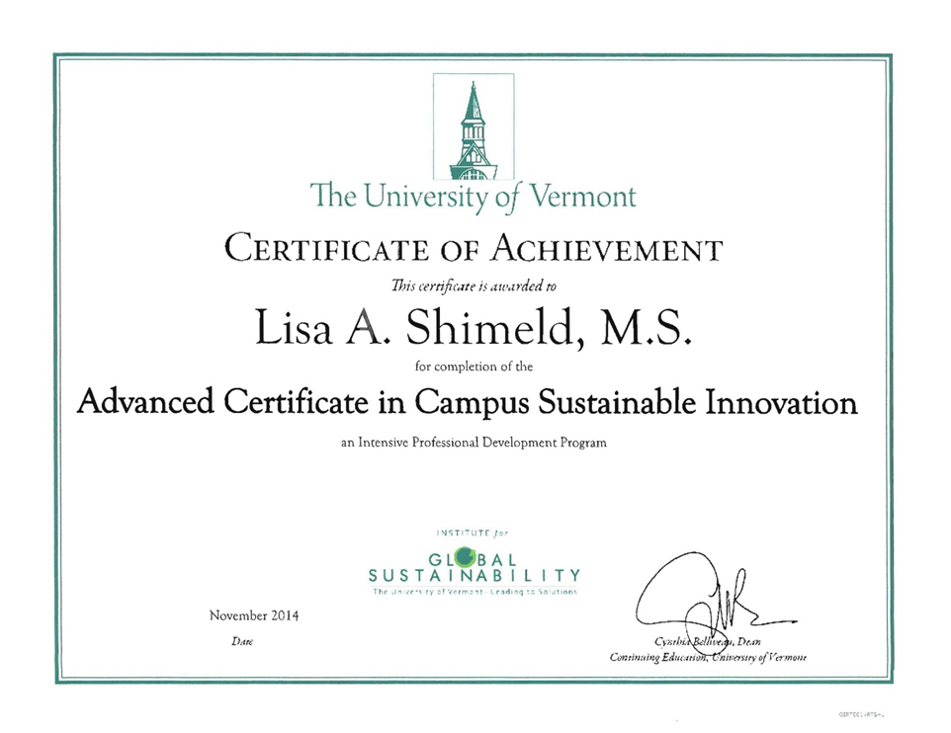
Congratulations
Ruby Zuniga
Dr. Keith Wurtz

Slide 8
Years of Service Recognition
35 Years
Brad Franklin
30 Years
Kirsten Colvey
Jim Holbrook
Barbara Williams
Laura Winningham
25 Years
T.L. Brink
Sherri Bruner-Jones
Patrick Kirkhart
Janine Ledoux
Lynn Lowe
Ralph Rabago
Lisa Shimeld
June Yamamoto

Slide 9
Hiring Update
Faculty Positions
Business
Chemistry
Math
Tutoring Coordinator
Fire
Respiratory
Health and Wellness
Counselors
DSPS
Classified Positions
2 Custodians!!!!
Student Services Technicians
Evaluator
Research Assistant

Slide 10
Foundation Support
The CHC Foundation is investing back into the campus
For Programs…
Program Support (Equipment, Supplies, Services)
  Foundation Dedicated $35,800
  Foundation Grants Funding an Additional $144,000
Increase and Create New Infusion Funds
  $13,500 added this year
President’s Circle
  Innovation mini-grants $5,000
  Other Support $13,000

Slide 11
Foundation Support
For Students…
Scholarships
  Awarded $76,500 in 2013-2014
  Projecting $90,000 in 2014-2015
Emergency Textbook Loans
  Have helped 367 Students stay in school with $87,000 in support
Match for COACH Project up to $2000

Slide 12
Foundation Direction
Increase the bottom line – Goal is $4M
  More planned gifts and corporate/foundation grants
  More endowed scholarships and programs
  More program support including partial funding for athletics and Veteran’s services
Engage alumni
Strengthen Board participation

Slide 13
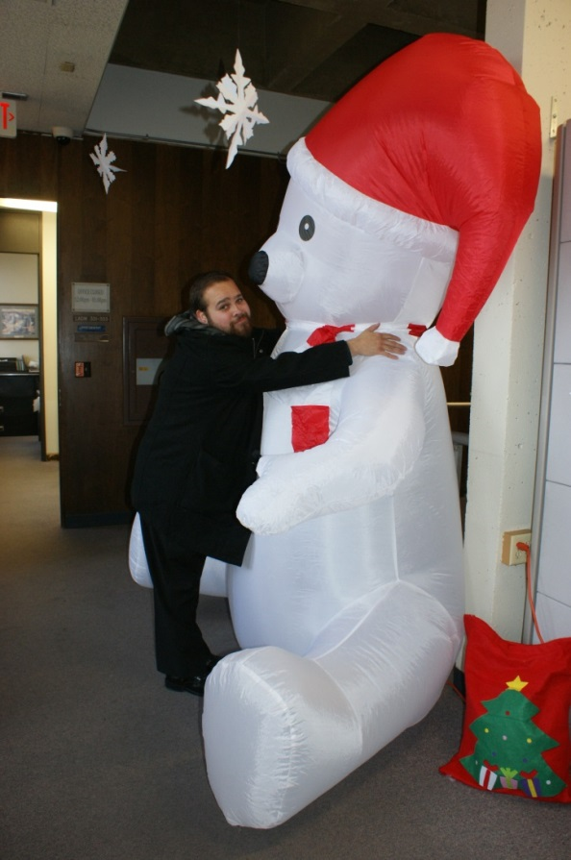
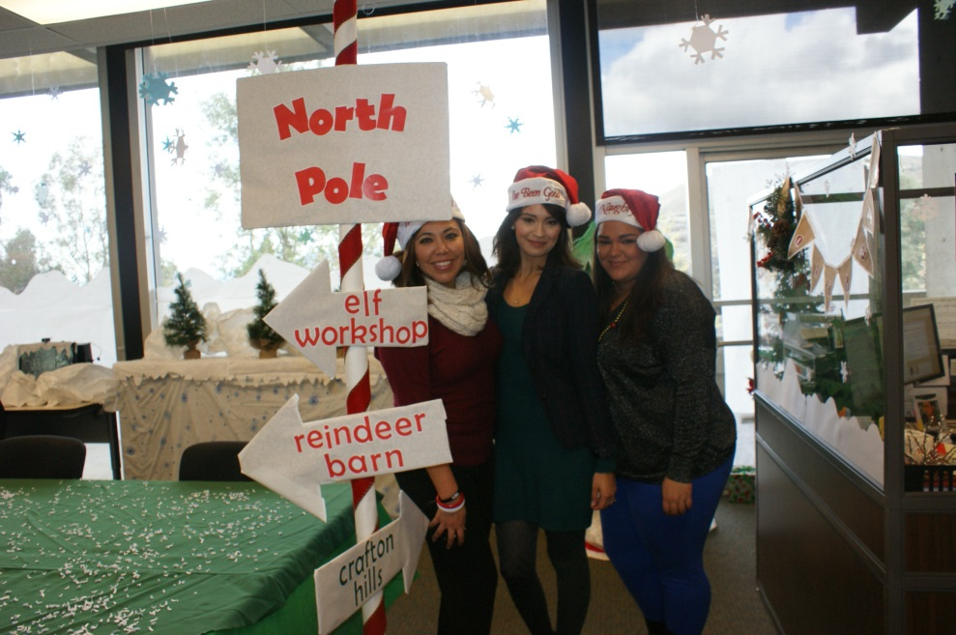
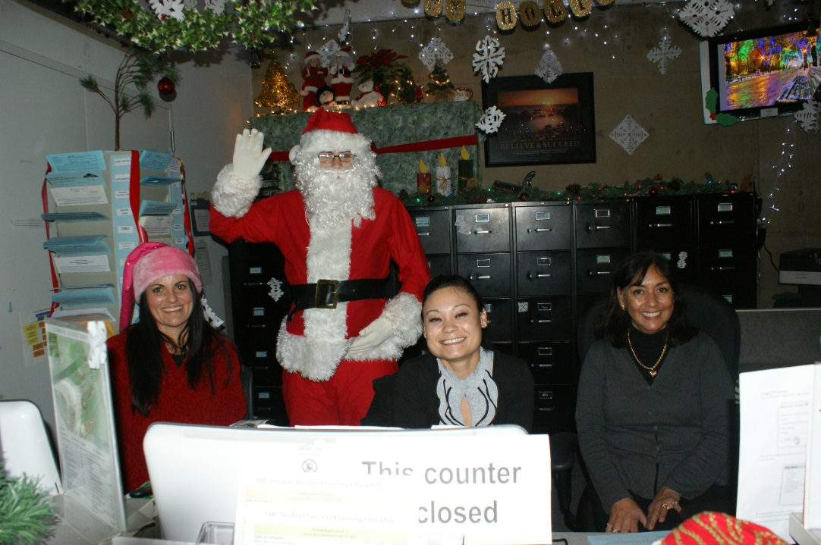
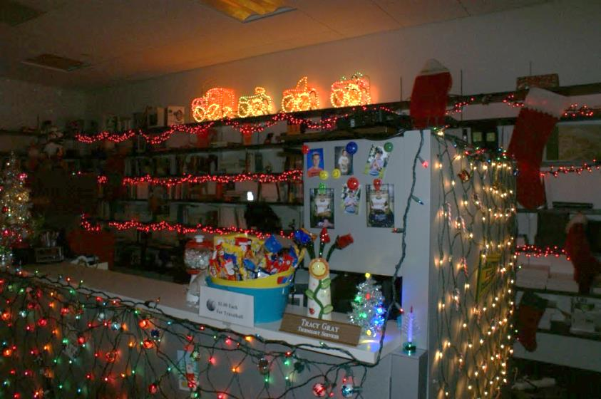
Over the Top Fun

Slide 14
Student Services Updates
In a "learning college" learning is the mission, the purpose, the core value. Every policy, program, and practice is designed to support and create improved and expanded learning for students. ∼Terry O’Banion
Rebeccah Warren-Marlatt

Slide 15
Student Services Strategic Directions
Integrated and Mandatory Key Intake Programs, Placement in appropriate Programs of Study, Careful Monitoring of Student Success, and Creation of Student Success Pathways
Promoting Equity, Access, and Inclusion, Valuing Diversity, and Supporting Student Connection
Promotion of Deep Learning through Experiences and Courses
Inclusion, Development, and Empowerment of Staff
Continuous Quality Improvement and Effective Resource Utilization

Slide 16
Student Success and Support Plan
Title 5, section 55531:
  Orientation
  Assessment and Placement
  Counseling, Advising, and Educational Planning
  Follow-up Services for At-Risk Students

Slide 17
SSSP Budget
Item | Initial | Actual
Adjunct Counselors | 129,094 | 287,094
Senior Student Services Technician | 105,720 | 105,720
Student Services Technician (partial) |  | 43,336
Substitute and Out of Class |  | 12,754
Secretary II (increase in salary range) | 6,888 | 6,888
Paid Counseling Interns | 15,813 | 3,000
Counselor (Re-Entry and Follow-up) |  | 97,450
Software License |  | 48,000
Travel |  | 15,000
Advertisement |  | 1,300
Non-Instructional Supplies |  | 5,000
Accuplacer Test Units | 9,008 | 9,008
Benefits | 70,977 | 70,977
Subtotal SSSP | 347,500 | 705,527
District Match (2:1) | 1,032.672 | 1,411.054
Grand Total | 1,380,172 | 2,116,581

Slide 18
Student Equity Plan
All of us in the academy and in the culture as a whole are called to renew our minds if we are to transform educational institutions--and society--so that the way we live, teach, and work can reflect our joy in cultural diversity, our passion for justice, and our love of freedom.
                -bell hooks
Notes:
Plan as a tool for institutional mprovement. Process was collaborative.

Slide 19
Student Equity Goals
Increase access for individuals with disabilities and students aged 20-39
Improve course success rates among foster youth
Increase math throughput rates among African American and economically disadvantaged students
Increase degree and certificate completion rates among males, African Americans, Hispanics, Native Americans, and students aged 20-34
Increase transfer rates among African American, Hispanics, and Students aged 20-24

Slide 20
Activities
Targeted outreach
Weekend, online, and/or hybrid course delivery
Identify and support foster youth
Provide interventions to increase success in English and Math
Provide interventions to increase degree and certificate completion

Slide 21
Budget
Resource | 2014-15 Cost | Ongoing Cost
.25 Research Assistant | $11,000 | $20,048
.50 Professional Development Coordinator | $25,000 | $50,000
1.0 Benefits, Foster Youth Counselor | $11,000 | $22,000
Professional Development | $25,000 | $10,700
Tutoring/Instructional Support | $150,748 | $100,000
.25 Re-Entry Counselor | $12,500 | $25,000
Distance Education Coordinator | $25,000 | $50,000
Total | $277,748 | $277,748

Slide 22
In the Works
Educational Planning Initiative http://cccedplan.org/rfp-notice
Student Services Research and Assessment Agenda
Behavioral Intervention Team (BIT)
AAUW/University of Redlands Partnership
Online Catalog
Online Counseling
Title IX/Sexual Assault: Student/Faculty Awareness
Development of a Foster Youth Program
Implementation of new BOG rules
Implementation of new Pell Rules
Notes:
The team has been working hard on developing the EPI. The EPI is a response to SB 1456 to provide the technology needed to help students gain comprehensive education planning and assist Counselors in identifying the needs of students. Over the last few months we have developed user stories and personas and developed the RFP. The RFP is currently being conducted and we are expecting the top 3 vendors to demonstrate how they will meet the needs defined in the RFP. Because of the sensitivity to the RFP and confidentiality at this time, any questions from the group will need to be directed to the State Program Director. The RFP is posted online.
new BOG rules that go into effect for FALL 2016 but we must advertise this year
Cyndi Gunderson serves as the catalog specialist until the position is filled. I continue to oversee the project (Instruction /Student Services collaboration)
NEXT STEPS: Minor tweaks left to fix, reconvene catalog workgroup, begin Workflow setup.
ANY student who is paid for 6 or more units and drop below 6 MUST pay back money. (FALL 2015)
foster youth program at CHC. I am currently developing an outreach plan and creating posters/information flyers to distribute to various group homes and foster youth agencies. I am working with the John Burton Foundation to be able to provide textbooks for our foster youth students who are not EOPS eligible.

Slide 23
Leadership and Advancement
John Muskavitch: Region IX Rep, CCCSFAAA
Ben Mudgett, Robert McAtee: CHC Representatives, Statewide Educational Planning Initiative
Dr. Rejoice Chavira, Region IX Rep, CalWORKS Association, EOPSA CSSO Representative, Region IX Advocacy Chair
Dr. Rebeccah Warren-Marlatt, Region IX CSSOs
Kirsten Colvey, CHC Representative, AB86 Planning Group
Trinette Barrie, Strengths Quest Trainer
Frances Southerland, Communications Officer, statewide CCCAA
Rebecca Orta, hired as Senior Student Service Technician
Ben Mudgett, Reclassification to Lead Evaluator
Veronica Lehman, Reclassification to FA Specialist

Slide 24
Accreditation Update
Presentation to the Commission
Commission approval for
  Art History AA-T
  Early Childhood Education AA-T
  Studio Arts AA-T
  Geography AA-T
  Kinesiology AA-T
  Spanish AA-T
  Computer Science AS-T

Slide 25
Academic Senate Update
Denise Allen

Slide 26
Administrative Services Update
Mike Strong

Slide 27


Administrative Services Update
Construction: the churn
Budget
PPR Resource Requests
Safety - IIPP
Fitness Center and Open Swim

Slide 28
Classified Senate Update
Michelle Tinoco

Slide 29
Instruction Update
Bryan Reece

Slide 30
We Are Focused on Good Work
Fall 2014
Spring 2015
Accreditation
100% TMC/ADTs
Basic Skills Plan
Student Equity Plan
Tablet Initiative (Pilot #1)
College Hour Activities
BA Degree Submitted
Positive Attendance
Cleaner Schedule
eCatalog
Enrollment Growth
Final Exam Schedule
Prof Development Expansion
SLOs
Course Caps
Hiring
BA Degree Implementation?
Tablet Initiative (Pilot #2)
Reorganization
1st Draft of Educ Master Plan
Schedule 1-Year in Advance
Prof Development Expansion
Expand DE (Coordinator, Plan, Services, AA Degree?)
Enrollment Growth
Engage-Learn-Advance Assessment
Enrollment Efficiency
SLOs

Slide 31
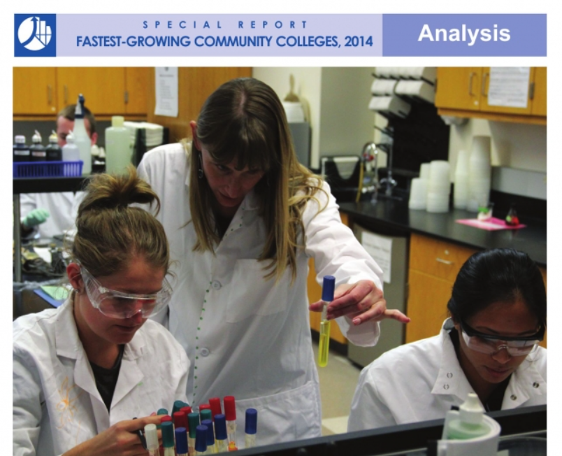
Students Are Benefitting from Your Efforts
Enrollment Growth
Student Opinion Spring 2014
Community College Week recently ID’d Crafton as the 9th fastest growing college in the country (enrollments from 5,000 to 10,000)
95% satisfied with instruction and overall ed experience
93% believe receiving a great education
96% believe library resources meet needs and tutoring services readily available
92% satisfied with overall services for students
96% believe campus is clean, well-maintained, grounds are well-cared for.
92% believe computer labs are adequate and accessible

Slide 32
Students Are Benefitting From Your Efforts
Retention Rates
Success Rates
91.0%
74.0%
6th Highest in California
16th Highest in California

Slide 33
Retention and Success Comparisons—Inland Empire
#1 in Inland Empire for Combined Score
 | Enrollment Count | Retention Rate | Success Rate | Combined Rate | CA Rank | IE Rank
Crafton Hills | 14,372 | 91.0% | 74.0% | 82.5% | 4 | 1
Chaffey | 49,681 | 90.3% | 71.5% | 80.9% | 17 | 2
Desert | 23,026 | 87.5% | 71.9% | 79.7% | 28 | 3
Moreno Valley | 16,470 | 86.7% | 71.3% | 79.0% | 47 | 4
Copper Mountain | 4,066 | 87.6% | 70.2% | 78.9% | 50 | 5
Palo Verde | 4,953 | 87.1% | 70.9% | 78.6% | 55 | 6
Norco | 17,922 | 86.1% | 70.6% | 78.3% | 60 | 7
Victor Valley | 28,520 | 91.2% | 64.6% | 77.9% | 71 | 8
San Bernardino | 31,691 | 87.9% | 66.8% | 77.3% | 78 | 9
Riverside | 39,474 | 85.6% | 66.8% | 76.2% | 89 | 10
Mt. San Jacinto | 36,894 | 84.6% | 67.4% | 76.0% | 92 | 11
Spring 2014, Credit Courses

Slide 34
Retention and Success Comparisons—California
#4 in California for Combined Score
 | Enrollment Count | Retention Rate | Success Rate | Combined Rate | CA Rank
Taft | 14,265 | 94.2% | 82.2% | 88.2% | 1
Feather River | 5,038 | 94.4% | 77.6% | 86.0% | 2
Lake Tahoe | 5,387 | 90.1% | 76.8% | 83.5% | 3
Crafton Hills | 14,372 | 91.0% | 74.0% | 82.5% | 4
Foothill | 28,511 | 88.9% | 75.9% | 82.4% | 5
Sequoias | 34,642 | 91.0% | 73.7% | 82.3% | 6
Santa Barbara | 56,366 | 90.4% | 74.2% | 82.3% | 7
Gavilan | 13,221 | 88.0% | 75.8% | 81.9% | 8
Ohlone | 23,437 | 87.2% | 76.6% | 81.9% | 9
Mendocino | 8,769 | 89.1% | 74.7% | 81.9% | 10
Napa | 16,116 | 89.9% | 73.7% | 81.8% | 11
Deanza | 49,916 | 88.4% | 75.2% | 81.8% | 12
Spring 2014, Credit Courses

Slide 35
Completion Trend and Comparisons
Degree/Certificate Completion
Completion Rate
 | CA Rank | IE Rank
Chaffey | 11 | 1
Mt. San Jacinto | 29 | 2
San Bernardino | 35 | 3
Victor Valley | 37 | 4
Riverside | 49 | 5
Norco College | 50 | 6
Copper Mountain | 54 | 7
Crafton Hills | 55 | 8
Desert | 69 | 9
Moreno Valley | 87 | 10
Palo Verde | 111 | 11
To be IE #1 and CA top 10 we need ~820 grads
2013-2014 Degree and Certificate Completion Rate

Slide 36


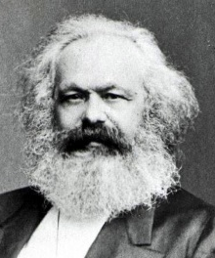

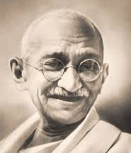



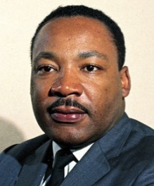
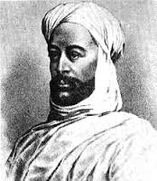
Support Students and Build Community
3 Peaks Challenge
Love
Encourage students to summit three peaks: Engage, Learn and Advance.
Do what these people encouraged . . .
Build community around love.

Slide 37
President’s Remarks
January 9, 2015

Slide 38


Revisiting a Few BHAGs
CHERYL!!!

Slide 39
BHAGs
Build a culture that is collaborative, innovative, appreciative, fun, and action-oriented
As a campus, embody our new values: academic excellence, inclusiveness, creativity, and the advancement of each individual
Develop people to perform at a level of excellence and to achieve their career goals
Enhance participative decision making allowing all voices to be expressed
Build systems and processes to sustain and enhance student success and a quality learning environment

Slide 40
My Vision
All students achieve their goals
Students become continuous learners
We connect with students
Education is not the filling of a pail but the lighting of a fire
– William Yeats

Slide 41
Recommendations for Moving Forward
Assess and Adjust Speed
Address Pathways
Help Students Set Goals
Consider a Regional Approach
Review the Work We’re Doing
Enhance Seamless Service
Connect in the Classroom
Continue to Build Culture

Slide 42


1. Assess and Adjust Speed

Slide 43

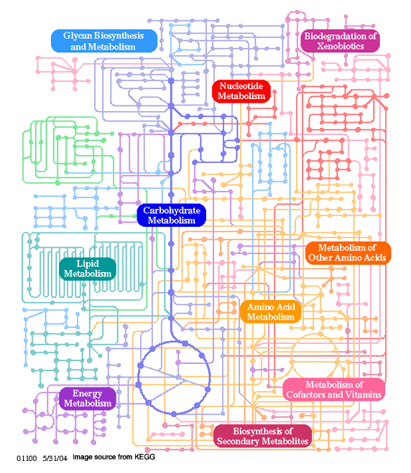
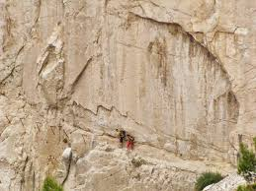

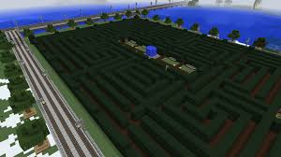
2. Address Pathways

Slide 44


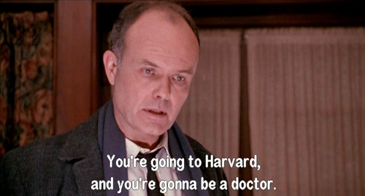
3. Help Students Set Goals

Slide 45
Student Development
Required Performance
Job Specific Skills
Critical Thinking
Interpersonal/Team
Communication
Info Literacy
Continuous Learners

Slide 46
4. Consider a Regional Approach
So Cal
Inland Empire
Area
Local

Slide 47
Student Development
CE
B&I
4 Year
Non-credit
K-12
Credit
Required Performance
Job Specific Skills
Critical Thinking
Interpersonal/Team
Communication
Info Literacy

Slide 48
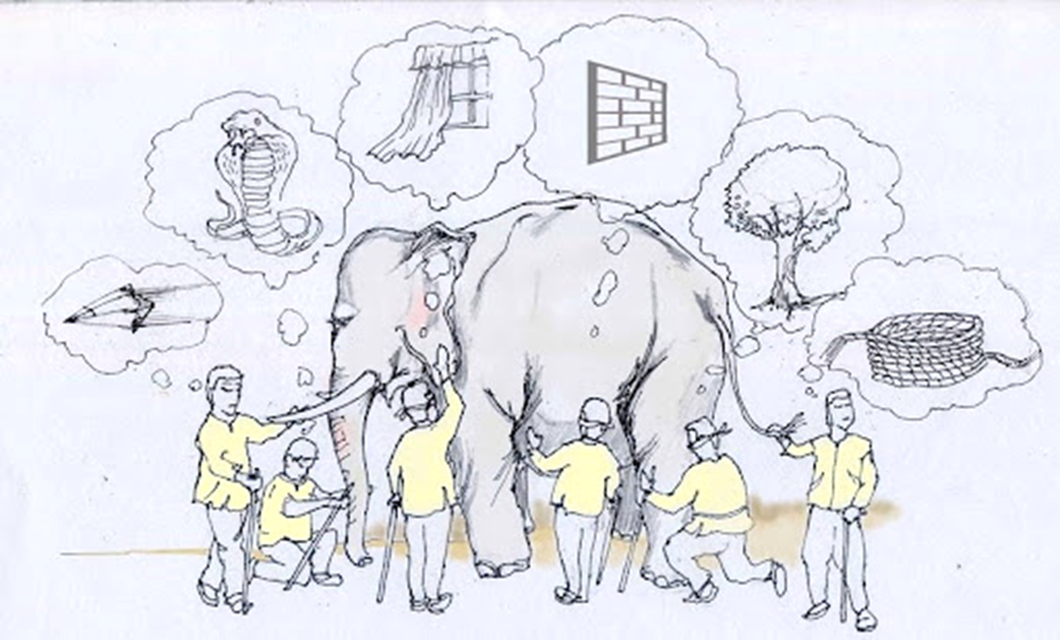
5. Review the Work We’re Doing
Look at the whole elephant

Slide 49

PATHWAYS FOR STUDENT SUCCESS
CRAFTON HILLS COLLEGE

Slide 53
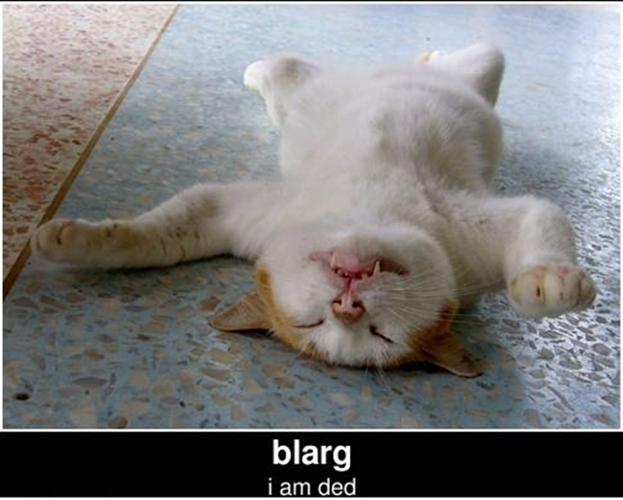





Slide 54

Pathways & Partnerships
Steering Committee
Look at the whole elephant
Review projects with external organizations
  LLU Gateway, Region 9 Workforce Development, etc.
Provide recommendations
Assist with communication
Representation from across campus
Meet 3-4 times per year

Slide 55
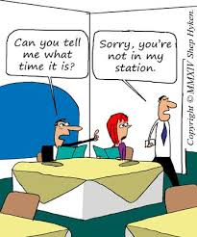

6. Enhance Seamless Service

Slide 56

Students don’t care…
What division you work in
What your job is
Who your “enemies” are
Where your funding comes from

Slide 57
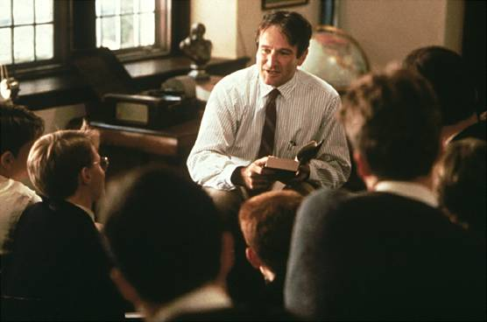
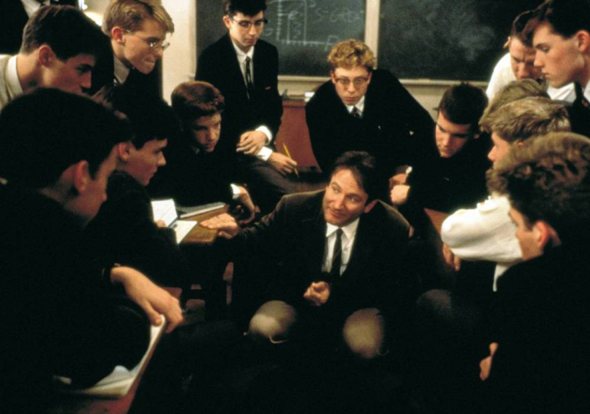

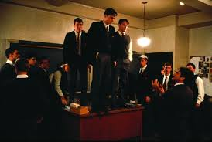

7. Connect in the Classroom

Slide 58



8. Continue to Build Culture

Slide 59
Planning & Decision Making
Planning processes and decision-making are
collaborative when people across departments, divisions, and job classifications are working together to share knowledge and build consensus toward a common purpose.
evidence based when they are informed by the analysis of reliable and objective evidence balanced with collective wisdom.

Slide 60
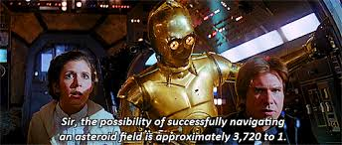
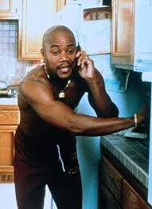

-------DATA!

Slide 61



Slide 62
Student Senate Update
Crystal Sultzbaugh

Slide 63

Professional Development

Slide 64
Professional Development
https://www.youtube.com/watch?v=l4dz5KSYbTs

Slide 65

Professional Development

Slide 66
Announcements

Slide 67

Some Final Thoughts

Slide 68
https://www.youtube.com/watch?v=l-gQLqv9f4o

