Slide 1

CHC: What’s happening, spring 2014
Spring In-Service, January 10, 2014

Slide 2
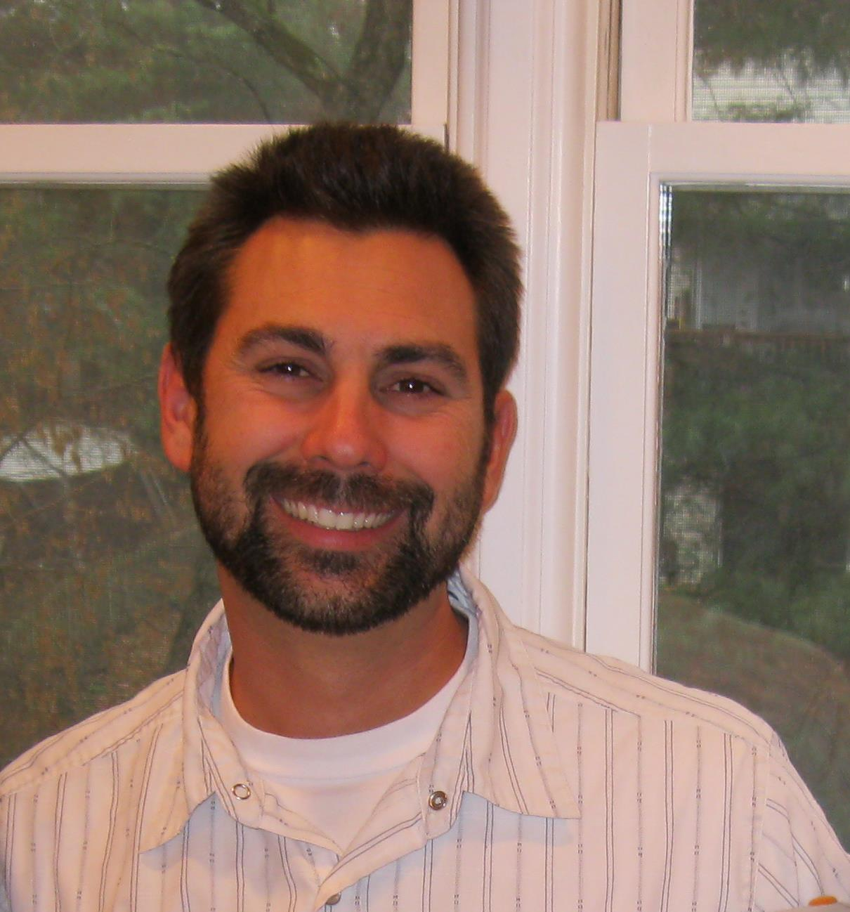
Welcome Dr. Jeff Cervantez
Assistant Professor, Philosophy and Religious Studies

Slide 3
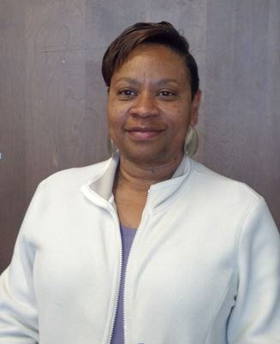
Welcome, Mary Bender!
Administrative Secretary, Division of Career and Technical Education and Human Development

Slide 4
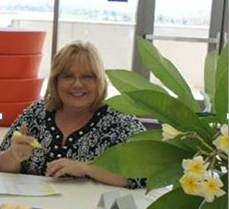
Welcome Cyndi St. Jean!
Administrative Assistant II, Office of the President
Notes:
You may recognize Cyndi who is the new Administrative Assistance for the President. She has been a long-term substitute and worked in the Resource Development and Grants Office at both Crafton and Valley. Cyndi brings a wealth of experience in office management and accounting practices, having worked at the Children’s Fund, Martha Green’s Doughlectibles, and San Bernardino County. She and her husband own their own construction firm and Cyndi is the Past President of the National Association of Women in Construction. A long time resident of Redlands, Cyndi is active in the community serving in a variety of organizations. She is a delight to work with and you will enjoy her warm, friendly personality.

Slide 5
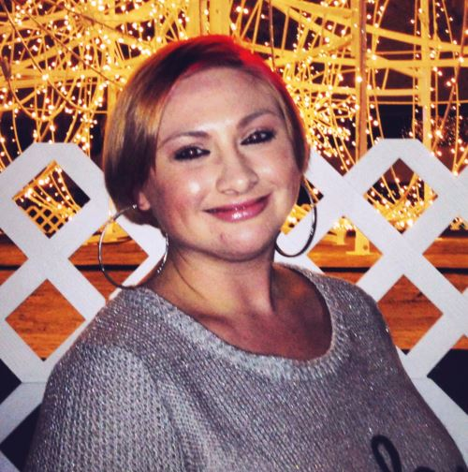
Welcome Alicia Hallex!
Student Services Technician II, Disabled Student Programs and Services
Notes:
Alicia will be helping students with disabilities with their technology and academic needs. She has worked part-time at both CHC and CSUSB’s Disabled Student Services. She graduated with honors from Crafton Hills College with an AA in Psychology in 2007, and went on to earn a bachelor’s degree from Cal State, San Bernardino. She is now in the second year of her master’s degree in Educational Counseling at the University of Redlands.

Slide 6
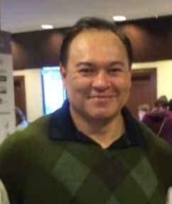
Welcome Back, Joe Cabrales!
  Dean, English and Math, January through June
  Dean, Student Services as of July 2014
Notes:
Dean Joe Cabrales is returning to CHC after spending last semester on loan to SBVC, where he served as the Interim Vice President of Student Services. During Spring semester Joe will be serving as the Interim Dean of English and Math through June.

Slide 7
Construction, ppr resource requests, & budget
Administrative Services

Slide 8
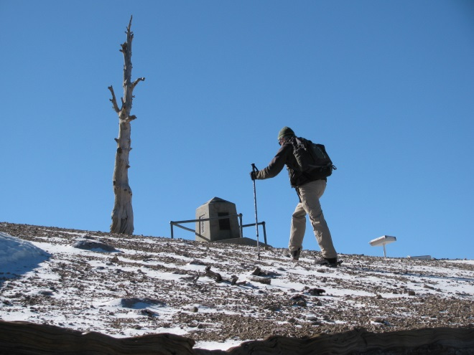
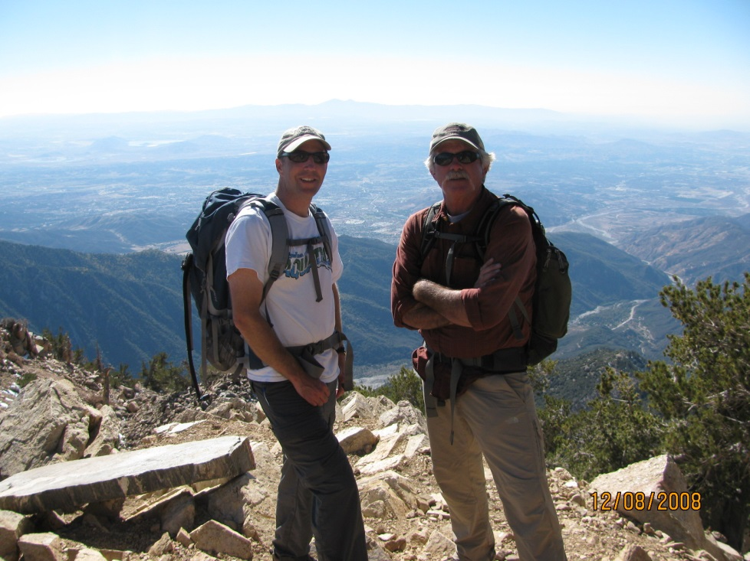
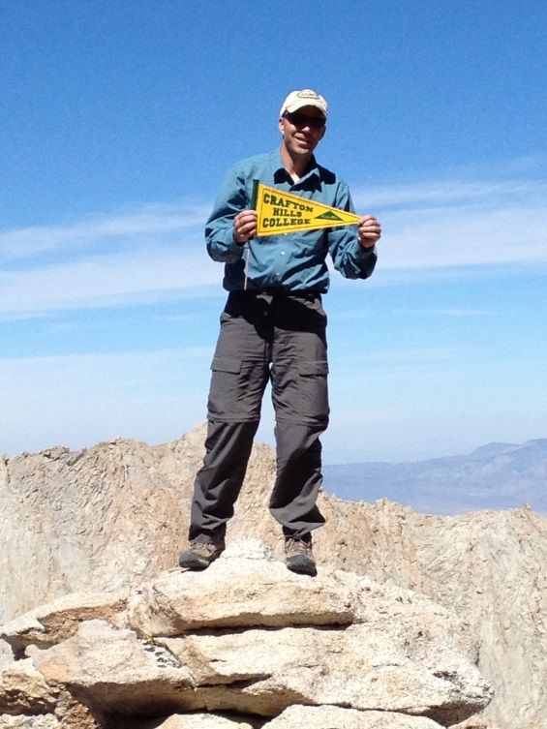
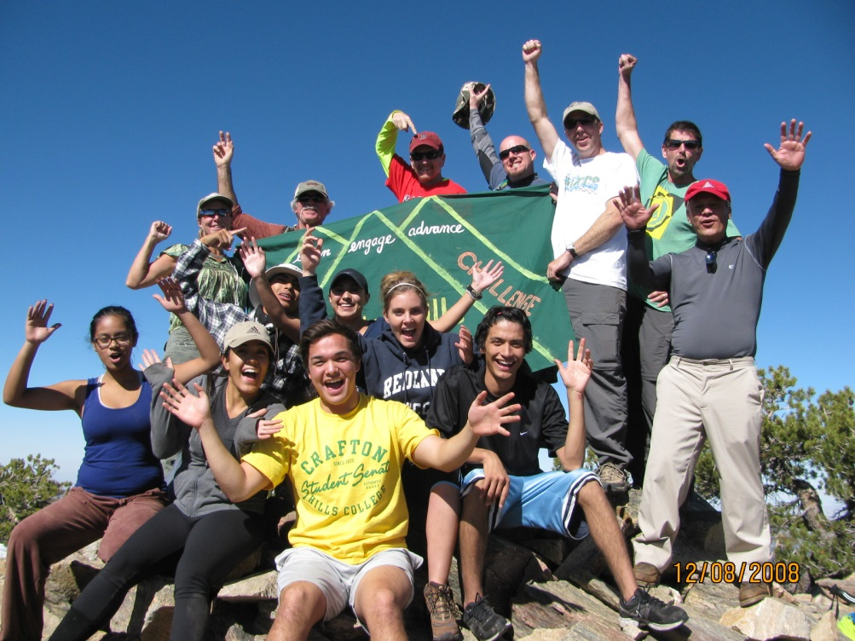
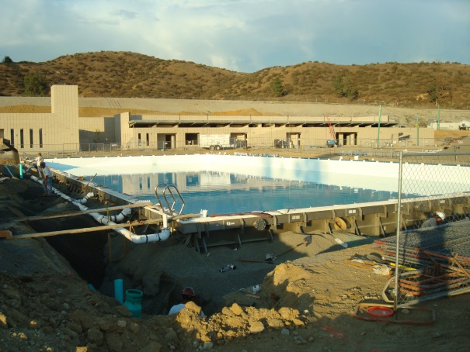
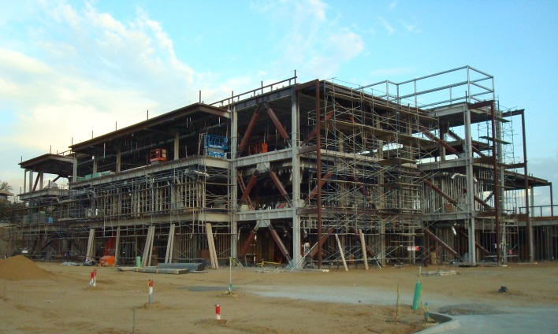
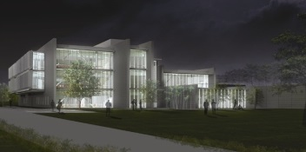
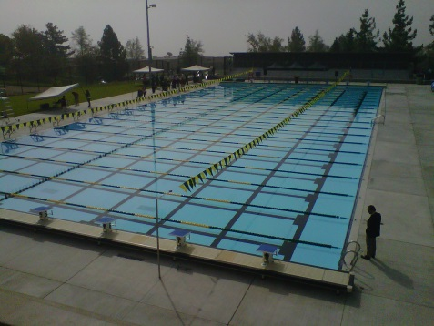
The Mountain of Construction

Slide 9
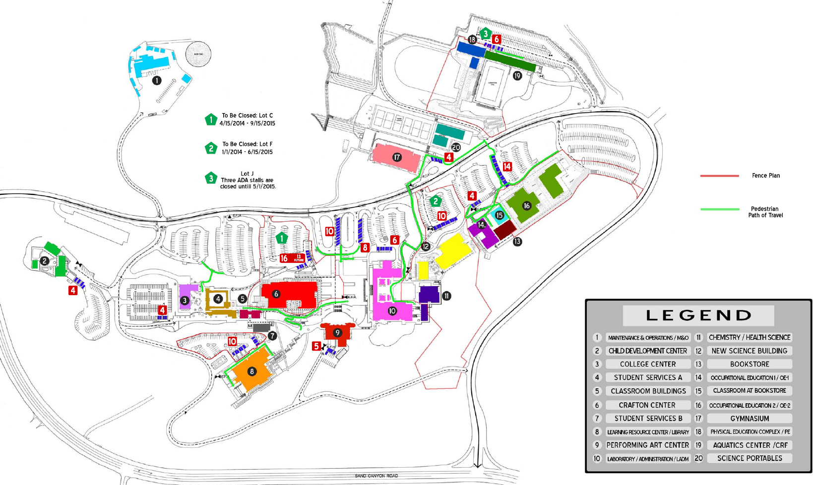

Slide 10
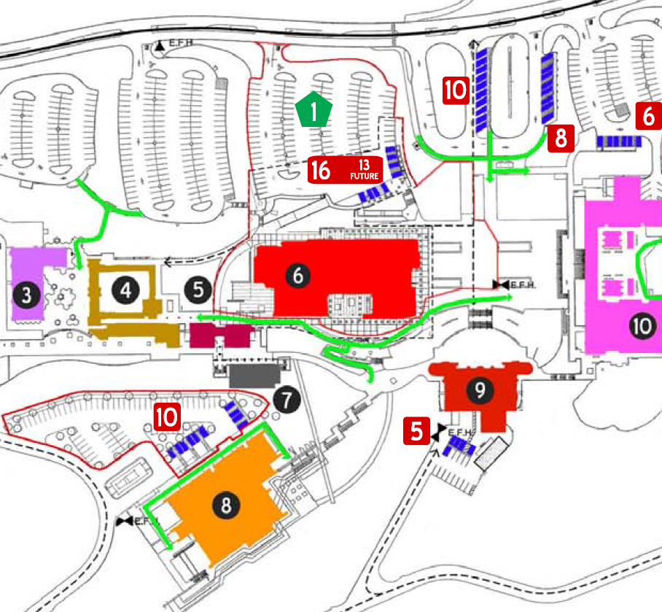
Lot C
LADM
Crafton
Center
PAC
LRC Lot
LRC

Slide 12
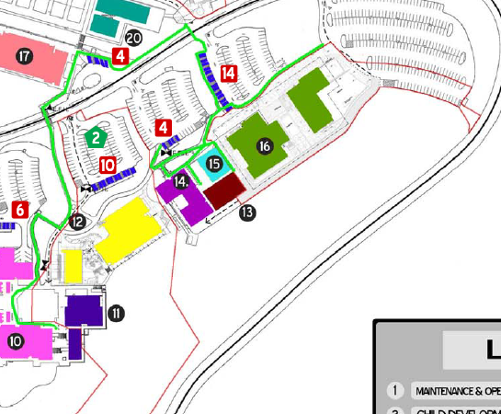
Lot I
OE2
Lot F
BC
OE1
Science

Slide 13
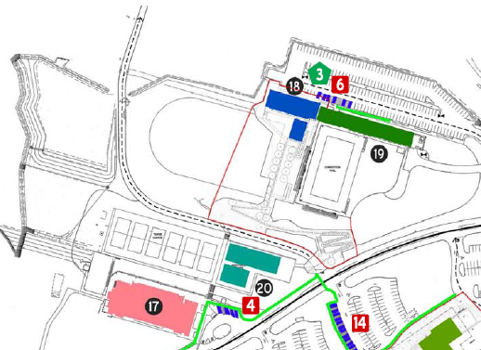
Lot J
PE Complex
Aquatics Center

Slide 14
Parking
Parking Gains
  + 264 stalls
    LRC Parking
      +62 stalls
    Chapman Heights
      +202 stalls
Parking Losses
  235 stalls:
    Lot F closed
      -82 stalls (26 staff)
      Staff stalls offset by added staff in Lot E
    Lot C
      -143 stalls (38 staff)
      Staff stalls offset by added staff in LRC Lot

Slide 15
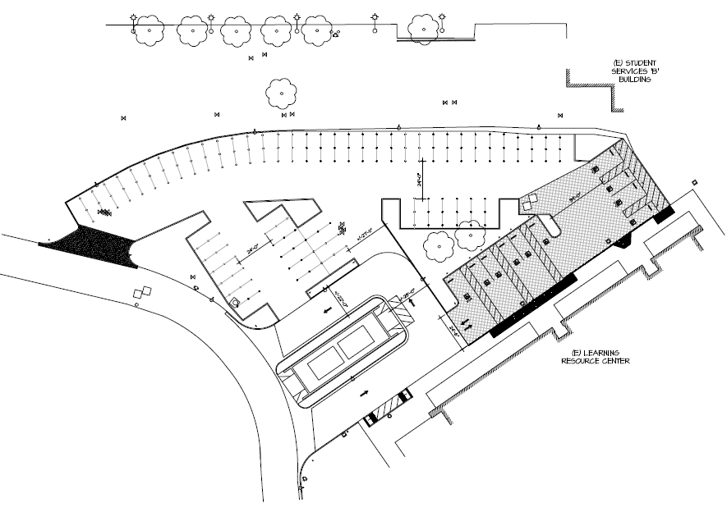
LRC Lot
    +62 stalls,
    +10 ADA
    Temp Lot
    No stairwell to SSB/SSA
    Ped Access through LRC
    Backdoor
    Staff Lot
    Open May 2014

Slide 16
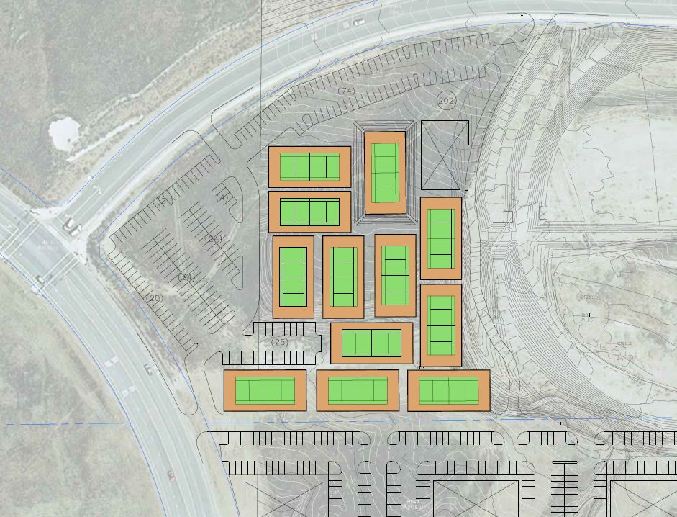
Sand Canyon/Chapman Heights Lot (Proposed)
202 Stalls
Free parking
OMNI Trans free w/ Student ID
Complete by Aug. 2014

Slide 17
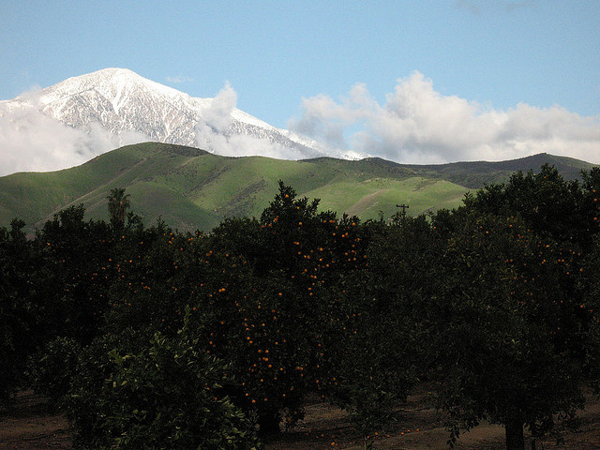
Mountain of Construction
Where we are going
Where we have come

Slide 18
2012-13 PPR Resource Request Update
440 Objectives
159 Request funding for a total of $4,908,718
55/159 (35%) are funded or partially funded
  21 (13%) have been funded and completed totaling $1,684,138
  34 (21%) are partially complete/funded

Slide 19
Energy Savings Program
Energy Savings Program
  September 2012-August 2013
    Estimated Savings = $214,914
      Amounts to an 18% savings over the established “baseline”
Solar Farm
  Generated 78% CHC electrical consumption Feb-Sept. 2013
  Savings: $202,896

Slide 20
Budget
2014 Budget Status:
  50% through FY2014 and 48.3% spent
State guaranteed +2.26% in “access” funding
District committed to +4% growth (access) in addition to the State’s 2.26%
CHC 2013-14 FTES Target = 4208
Strategy = Exceed target and establish new baseline
College Brain Trust

Slide 21
Enrollment Management
Educational Technology
Educational Master Plan

Slide 22
Enrollment Planning
 | 1/13 | Late
Courses | 265 | 64
Sections | 586 | 86
Seats | 17,923 | 3,017
Enrolled | 13,429 | 1,790
Open | 4,494 | 1,227
Fill | 74.9% | 59.3%
Wait | 1,273 | 529
Demand | -3,221 | -698
Strategic Growth: Align Course Offerings with Student Demand
What Students “Want”
What Students “Need”
What We Offer
Administrative and Academic Issues We Need to Address Together
Ed Planning and Degree Audit Address Shape Student Needs
Priority Registration for Basic Skills Courses
College Readiness Prerequisites on 200 Level Courses
Programs/Courses with too Many Offerings; too Few Offerings
Cap Issues: Small Enrollments Learn; Large Enrollments Earn
Politics of Growth and Allocation: Civil and Persistent

Slide 23
Education Technology Initiative
DEVICE
Establish Platform for Innovation
Improve Communications
Streamline Teaching “Busywork”
Track Student Progress
Reduce Book Prices
Integrate Assessment & Testing
Move Closer to Sustainability
Connect Services with Classroom

Slide 24
Education Technology Initiative
Timeline
Planning—Spring 2014
Pilots—Fall 2014
Adoptions—Spring 2015
Implementation—Fall 2015
Administrative and Academic Issues We Need to Address Together
BlackBoard Integration
Smart Classrooms
Wireless Campus
Support for Students, Faculty and Staff
Partnerships
Work with PT Faculty, PT Students and PT Staff

Slide 25

Education Master Plan
Why Should I be Concerned About the EMP?
Importance of the Classroom
Importance of Wrapping Support around the Classroom
Services (Support and Academic), Infrastructure (Physical, Digital, Technological), Professional Development (Staff, Managers and Faculty)
EMP formally identifies what we will wrap around the classroom and how we plan to do it.

Slide 26

Education Master Plan
Example Projects Under Consideration . . .
Ed Planning and Degree Audit
College Readiness Prerequisites
Enrollment Management
Construction
Professional Development
Transfer Services
Basic Skills Strategy
Campus Communications
Achievement Gap
Teaching Best Practices
Engagement-Learning-Advance Assessment
Community Involvement/Support
Planning and Decision-Making
Budgeting and Resource Allocation
The Hardest Part of Education Master Planning

Slide 27

Assessment

Slide 28
Spring 2014
Outcomes Assessment Objectives
Identify a database to manage all outcomes assessment data
Work with campus to map ILOs to all course outcomes
Work with campus to map program level outcomes to course outcomes
Develop annual course, program, and ILO assessment calendar
Develop a process for collecting and compiling assessment data
Notes:
Keith

Slide 29
Outcomes Assessment Roles
Faculty/Staff develop outcomes statement
Use 4-Level Rubric campus adopted to assess students
Following services offered by the research office
  Help with developing approach for assessing outcome
  Create scannable surveys and/or forms to collect and enter data into outcomes assessment database
  Enter data into e-Lumen or other database
  Create and maintain assessment database
1. Outcomes Statement
2. Means of Assessment
3. Criteria (Benchmark)
4. Summary of Evidence
5.Use of Results
Faculty/Staff identify what learned from assessment and develop plan for improvement, if needed.
Faculty complete outcomes assessment process by recording all five steps in the planning and program review web tool (This is not a research office function).
Faculty/Staff summarize results based on aggregated data. If research office compiled data in Step 2, research office will provide aggregated data to unit.
Developed by Faculty/Staff
Notes:
Keith

Slide 30
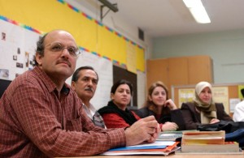
Assembly Bill 86
Re-Envisioning Adult Education

Slide 31

Adult Education and AB 86
One in five Californians lacks a high school diploma
Over 50% of these have less than a ninth-grade education
The systems responsible for adult education don’t always play well together
We need an integrated approach

Slide 32

AB 86
Regional approach
Community Colleges as leaders
Re-allocates resources
Planning to occur 2013-2015
Development of consortia
Notes:
$25 million to CCCCO to fund planning and implementation grants ($22.5 million for regional grants)
(K-12, ROP, WIB, etc)

Slide 33

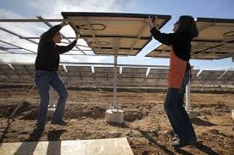

Focus Areas
Basic Skills, High School Equivalency
Citizenship and ESL
Adults with Disabilities
Short Term CTE programs
Apprenticeship programs

Slide 34

Major Objectives and Purpose
Evaluate existing programs
Determine regional needs
Integrate programs
Address gaps
Collaborate across segments
Use existing structures
Advancement

Slide 35

CHC Left lane Student success project
  Every CHC student will Engage, Learn, and Advance

Slide 36

Five Major Goals
Improve student success in basic skills
Make sure every CHC student has an educational plan
Clarify educational pathways
Expand Left Lane to serve a larger population
Increase capacity through professional development

Slide 37

Basic Skills Improvement
Increase access to tutors
Develop Directed Learning Activities
Develop an assessment preparation course
Add sections of basic skills as needed
Increase use of technology in the classroom

Slide 38

Clear Pathways
Build out instructional website content
Create pathways for undecided majors
Redesign the CHC website around educational pathways
Create additional pathways to meet community needs

Slide 39

Educational Planning
Purchase and implement Student Adviser
Implement Degree audit
Explore effective practices

Slide 40

Serve a Larger Population
Calimesa, Beaumont, Banning
Expand SOA3R
Expand Summer Bridge

Slide 41

Revitalize Professional Development
Identify needs
Identify a full-time coordinator and staff support
Increase the skills of faculty and tutors in basic skills course design, delivery, and support

Slide 42
Three-Year Budget = $1,555,834
 | 2013-2014 | 2014-2015 | 2015-2016
Total | $364,178 | $595,329 | $596,327
Per Student Cost (Approximate) | $910.45 | $992.22 | $851.90
From Reserves | $148,000 | $170,000 | $160,000

Slide 43
Accreditation: Beyond Compliance
CHC’s Progress to Date
  Chairs have been appointed
  Templates for information and evidence collection distributed
  Much of the evidence has been collected
  A writer has been identified
Notes:
Introducing Jimmy Urbanovich

Slide 44

What Can You Do?
Look for weekly emails from the IEAOC chairs
Read the drafts critically and closely
Provide your input
Volunteer to answer a question or two
Assess your course outcomes and service area outcomes this year.

Slide 45


Marks to Hit
Finish information and evidence collection by February
Writing throughout spring
Campus review in April-May
Board report in June
Submittal to ACCJC in July
Site Visit in October

Slide 46
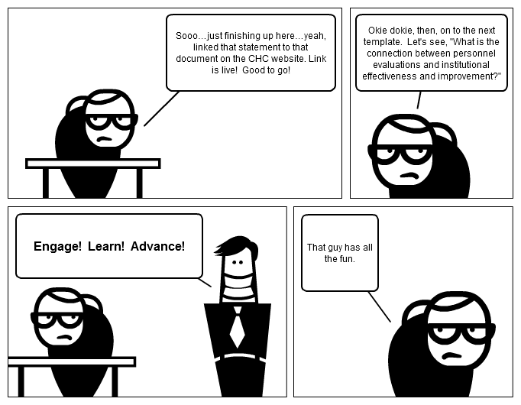
Keep it Lighthearted
Notes:
We owe the comic strips you’ll see on Monday mornings to Kristi Simonson. See if you can guess the players.
Next, I’d like to introduce Jimmy Urbanovich, who will tell us about an exciting new program to help our students to become more fully engaged as members of our community and our society.

