Slide 1
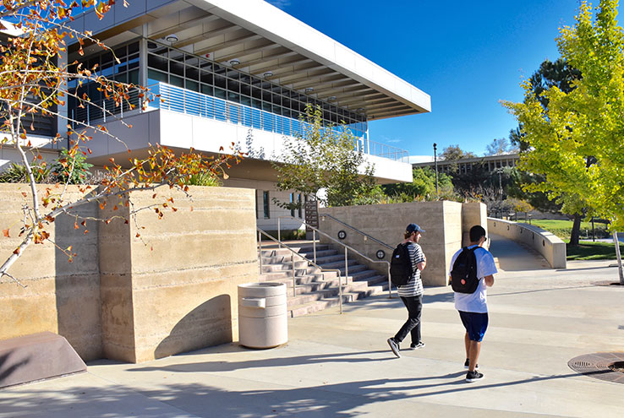

Mike Strong
Vice President, Administrative Services
Notes:
Following guidelines
Changes over summer – Facemasks, All-District Meeting, email on facemask updates Aug 2nd,

Slide 2




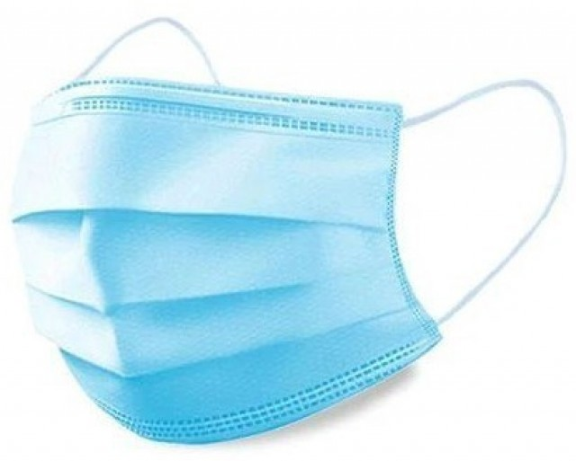
Reopening Safely
Covid supplies in classrooms
How to get more supplies:
  Custodians will be monitoring & restocking as needed
  Send a request through Division Dean or Manager
    Manager’s office to submit work order
SBCCD Covid Updates: https://sbccd.edu/covid-19-updates/index.php
Notes:
Working through the changes over the summer; as changes happened emails were sent to the taskforce and all-District meeting on July 6th
Follow Guidelines
Q&A – place questions in the chat

Slide 3


Parking – Fall 2021
Not required for Staff or Student parking areas
Notes:
New Permit system in Spring 2021

Slide 4
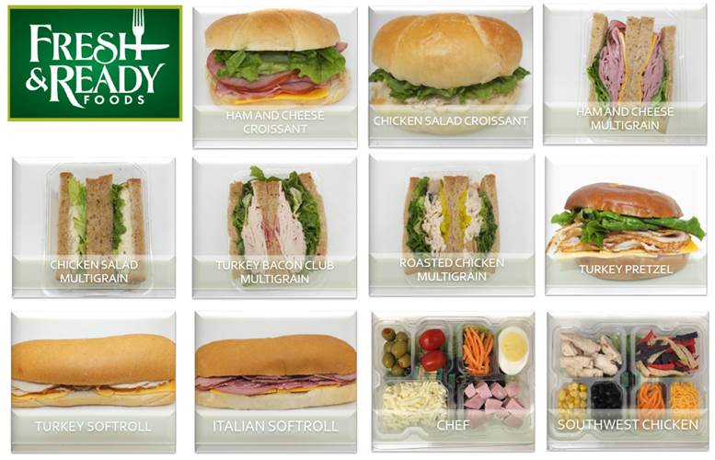

Food Services – Fall 2021
Campus Store
  Sandwiches, Salads, Wraps, Fruit, Drinks, Breakfast and Protein Bars, Candy

Slide 5

Computer Replacement Update
Leadership change
Total desktops to replace = 180-ish
Total Replaced = 90-ish
Monitors backordered, Scheduled delivery = October 1st-ish
Scheduled completion by December
Notes:
Anthony-Interim Director

Slide 6

Measure CC Capital Construction Project Highlights – for 2021-22
A lot
Of Construction

Slide 7
Measure CC Capital Construction Project Highlights – for 2021-22
Public Safety Training Center
  Finalizing Plans 2021
  Construction: September 2022-July 2023
PAC
  Finalizing Plans 2021
  Construction: August 2022-April 2024
CNTL2
  Finalizing Plans – Fall 2021
  Construction Start – Summer 2022
CDC
  Finalizing Plans – Fall 2021
  Construction – Spring-Summer 2022
Infrastructure
  Campus-Wide Security
    Construction Spring 2022
  Campus-wide Accessibility and Site Improvements
    Construction: Spring-Summer 2022
  Solar Upgrades
    Construction 2022-23
  Campus-wide Lighting Controls –
    Completion Aug 2021
  Campus-wide Irrigation
    Completion Sept. 2021
  Central Plant Controls
    Completed Summer 2021

Slide 8
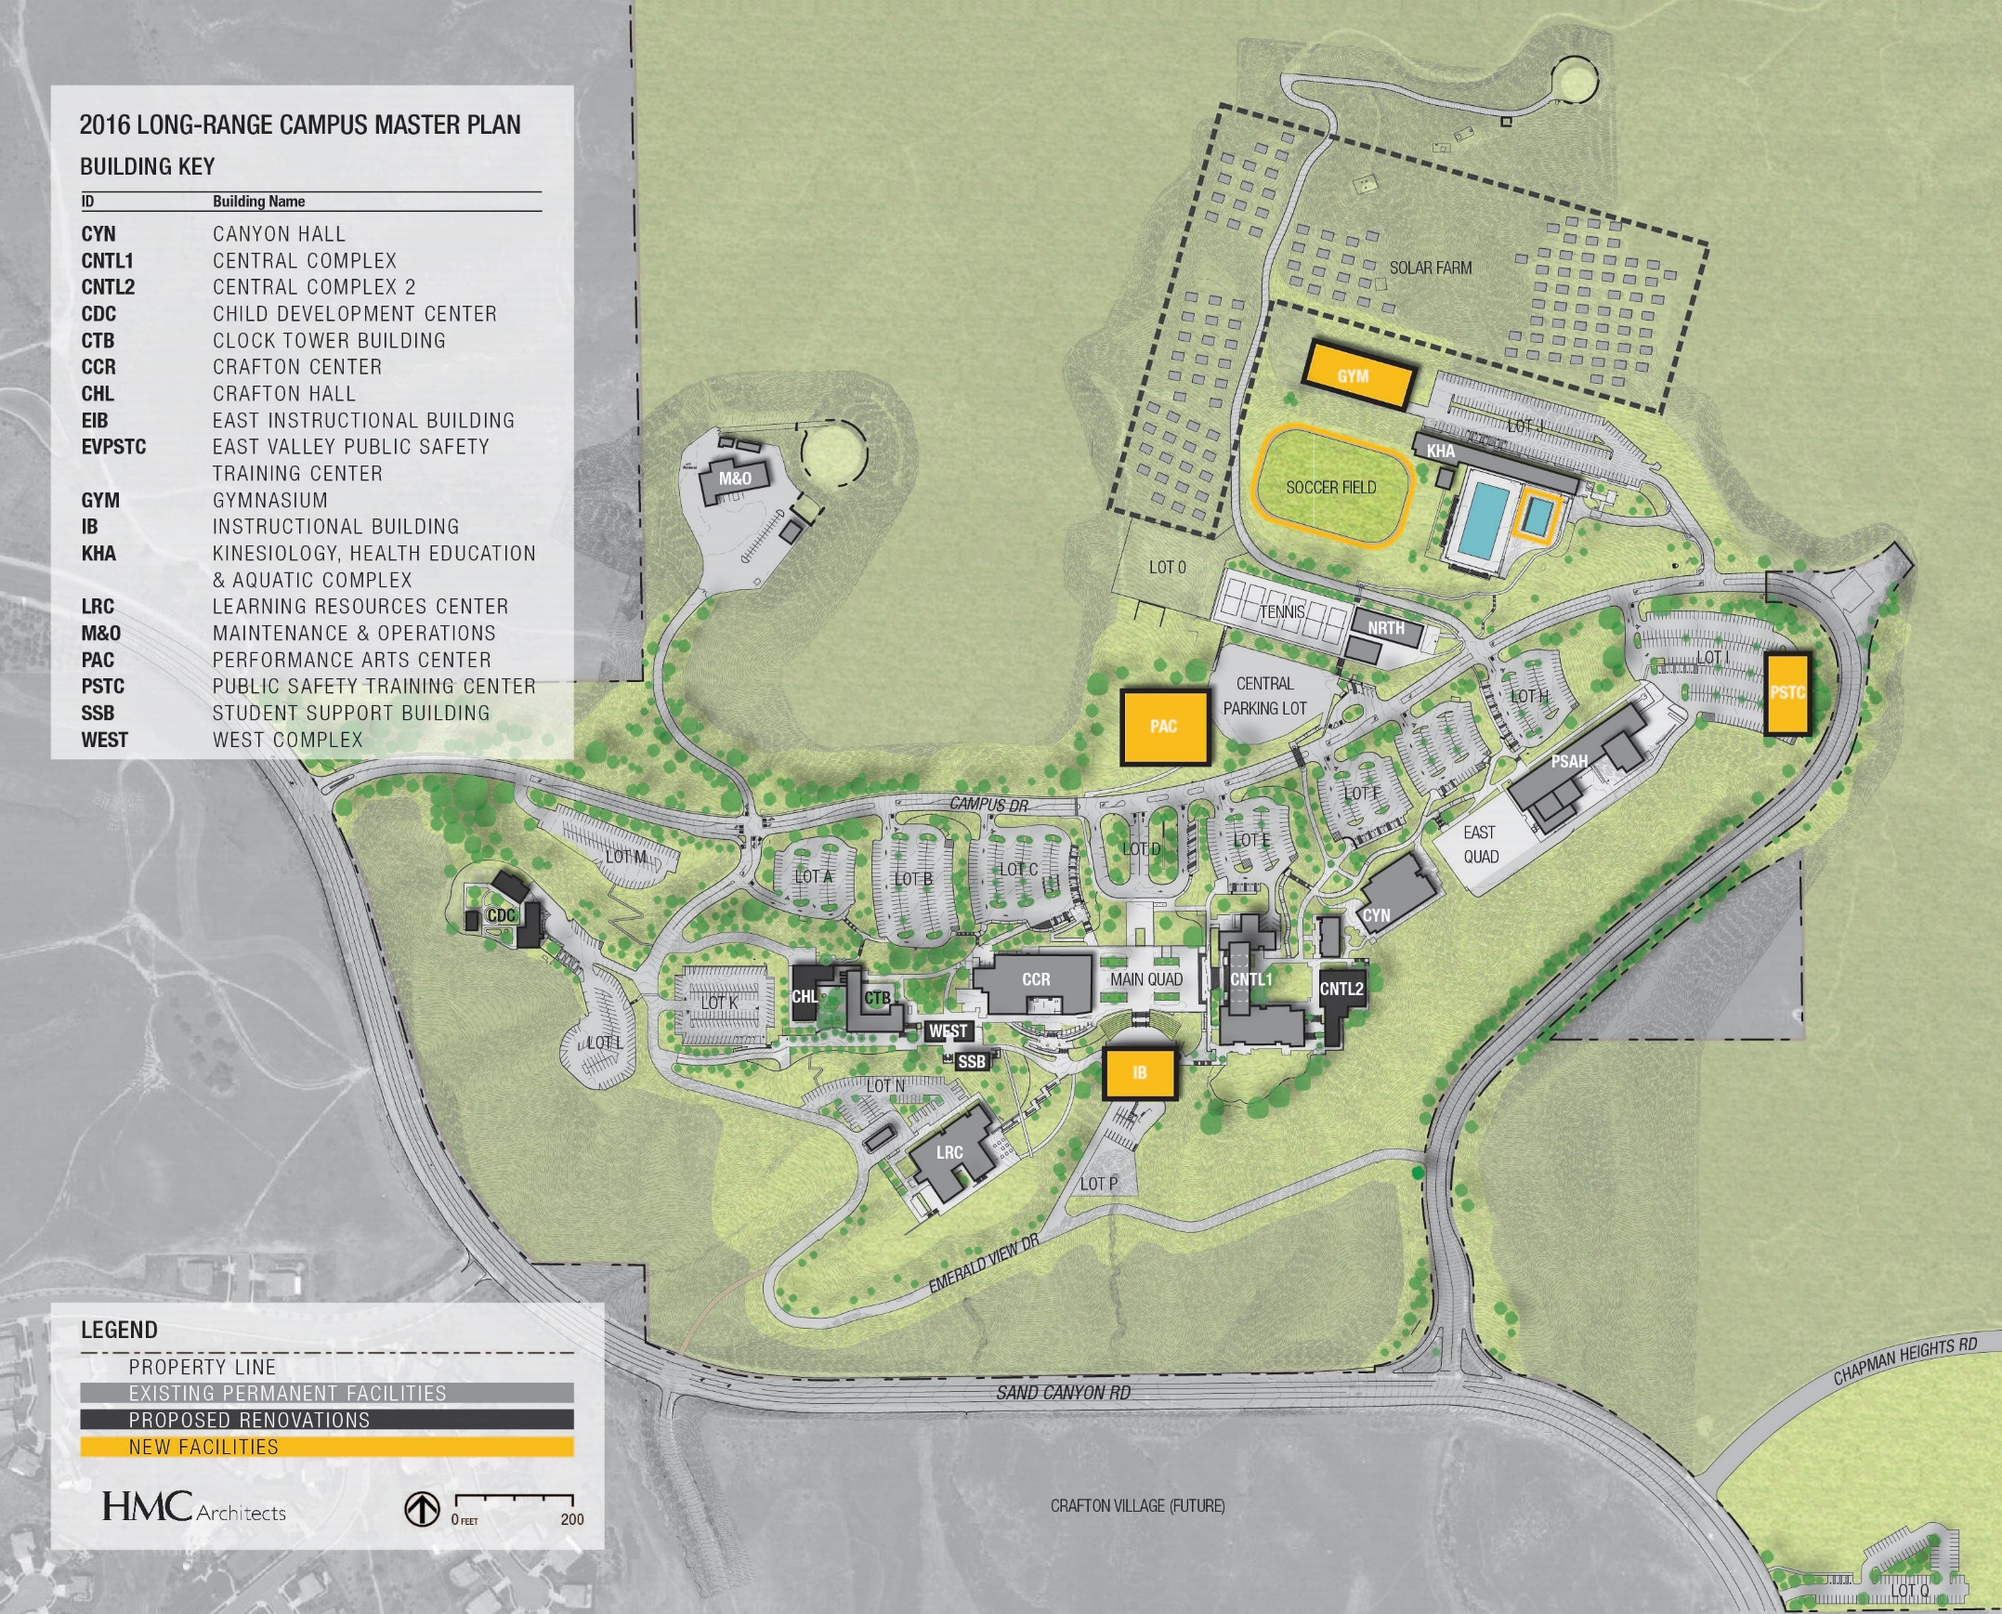
Facility Master Plan Addendum
-------
Finalization & Approval
Fall 2021

Slide 9

2021 FMP Addendum
  Life to center of campus
  Increase utilization and efficient use of existing spaces (LRC, SSB, CNTL2, NRTH, CHL)
  Creates larger classrooms to increase efficiencies + support active learning
  Considers future expansion of parking
  Expansion of athletics
  Protects for future growth
  No funding wasted on temporary space needed to house depts during construction (Swing Space)
  Progress towards zero net energy
  Efficient use of Measure CC funds
  No old buildings left untouched
  Overall - no increase to square footage on campus
Purpose + Vision

Slide 10

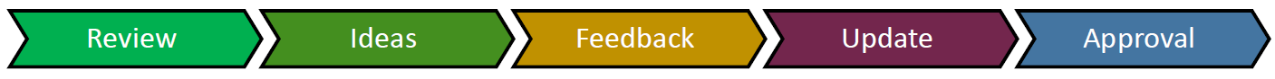
Next Steps
1/26/21 Crafton Council
FMP Update Timeline
Review reprioritized projects from FMP 2020
Review Program considerations by building
2/9/21 Crafton Council
Continue review Program considerations by building
Distribute documents for campus-wide discussions
2/23/21 Crafton Council
Report progress on campus-wide discussions
3/9/21 Crafton Council
Discuss feedback from campus-wide discussion
Review plan with input + ideas
4/13/21 Crafton Council
Present revised plan with updates + share with campus
4/27/21 Crafton Council
CC approval of direction
4/27/21 - 5/25/21
Memorialize direction for addendum with HMC
5/25/21 Crafton Council
Present draft addendum for 1st review
8/24/21 Crafton Council
Review final draft of FMP Addendum + share back with Senates
9/14/21 Crafton Council
Crafton Council approval of FMP Addendum + submit to BOT for approval
10/14/21 Board Meeting
Board approval

