Slide 1

SPRING 2018 IN-SERVICE
FRIDAY, JANUARY 12, 2018

Slide 2
HAPPY NEW YEAR!
HAPPY NEW SEMESTER!

Slide 3
VISION
Access
Student Success
More comprehensive (Growth)

Slide 4
STUDENT SUCCESS
Compared to Inland Empire community colleges (San Bernardino and Riverside Counties), CHC has:
The highest course success rate in basic skills courses
The second highest course success rate in credit, degree applicable, and transferable courses
The third highest vocational course success rate
#1 for the CTE Completion Rate
#1 for the Completion Rate

Slide 5
STUDENT SUCCESS & EQUITY
Reduced the number of disproportionate impacts from 32 to 28
Eliminated disproportionate impact in math and English throughput for Hispanic students
Distance Education course success and course completion rates exceed statewide rates (72.9% and 90.1% vs. 62.3% and 81.4%)

Slide 6
TRANSFER
California State University
University of California
University of Redlands
University of La Verne

Slide 7
CAREER TECHNICAL EDUCATION
PROGRAM GRADUATION
Fire Academy (44)
Respiratory Care (31)
Radiologic Technician (8)
EMT (138)
Paramedic (30)

Slide 8
State Chancellor Eloy Ortiz Oakley
With enrollment flat or declining across much of the state, a comprehensive new funding formula (for the first time in more than a decade) will be focused on linking a portion of the budget to improving student outcomes as outlined in the Chancellor’s Vision for Success.

Slide 9
PER FTES FUNDING
K–12 $11,601
California Community Colleges (CCC) $ 7,949
California State University (CSU) $14,723
University of California (UC) $26,391

Slide 10
STUDENT SUPPORT
Increased outreach and recruitment efforts (DSPS, Counseling, EOPS, Financial Aid, Student Life)
Counseling and Admissions and Records services supported Dual Enrollment and Amazon partnership
Student Services training on DACA
Maxient, a tracking software for student conduct, Title IX, and Clery reporting

Slide 11
STUDENT SUPPORT, continued
LEA Medical-Cal Billing Option for the College to bill for certain health services
85% of Commencement 2017 graduates participated in BOTH the Graduation Breakfast and the Commencement Ceremony
Student Ambassador Program
Tour guides gave tours to over 1,600 prospective students

Slide 12
RESOURCES
Financial Aid granted, in Fall 2017:
7242 BOGGs
(in a single semester, surpassed 2016-17 BOGGs by 94!)
855 PELL Grants
299 CAL Grants
199 FTSSG
47 CCCCG

Slide 13
RESOURCES, continued
Over $740,000 from career-focused funding sources like Strong Workforce; Perkins; CTE Transitions; and Project RAMP-UP.
$303,500 San Manuel ISEEK grant to provide employment opportunities for 60 students in 20 departments across the campus
$20,000 Truth Initiative’s Tocacco-Free College Program
$25,000 Southern California Edison for STEM Scholarships
$10,000 Bank of America for Veteran’s Resource Center
$8,000 Inland Empire United Way for Emergency Funds for students and High School Visitation Day

Slide 14
PROFESSIONAL DEVELOPMENT
All counselors received OnCourse training. Principles are being implemented in courses and workshops, as well as in individual counseling sessions.
Faculty selected to participate in State Chancellor’s Office sponsored pilot program designed to support and improve teaching methodologies & strategies among CTE teachers.
Hosted the conferences California Community College Assessment Association, CSU EAP, California Foster Youth Connection, County of San Bernardino/Walden After Care Foster Youth Employment, County of San Bernardino Foster Youth Independent Living Program, Understanding Trauma and Supporting Educational Success Training for Foster Youth.
Professional Development Committee organized over 40 events for both flex days and over the semester.

Slide 15
FOUNDATION SUPPORT
Awarded $112,450 in scholarships to 130 students.
Provided $8,902 in Emergency Textbook Loans to help 48 students continue their education.
Provided funding for events and activities including: Roadrunner Rally, HS Visitation Day, Arts Day, Student Recognition Dinner, Three Peaks Challenges, Herbivore Festival, Grad Breakfast, and Tea with the Deans.

Slide 16
FOUNDATION SUPPORT, continued
Provided funding for programs such as: Honors Institute, Veterans Resource Center, Fire Academy, COACH, Transfer application fee waivers, and the Study Abroad Program.
Overall the CHC Foundation raised $721,037 and infused $352,974 back into the College. The CHC Foundation holds $2.6 million in assets and we are committed to building our endowment so that the funds raised now will continue to support the college in-perpetuity.

Slide 17
INSTITUTIONAL DEVELOPMENT
ACCJC Midterm Report completed
SSSP/Equity/Basic Skills Plan Integration
Guided Pathways
Tableau dashboard for use with program review, enrollment management, planning, and evidence-based decision making
Committee Chairs Training
Completed “Churn 2”
Renovations of CNTL, CTB, and PAC buildings
Obtained LEED Platinum certification on the Crafton Center
Non-potable water system installation received IEEP Red Tape to Red Carpet Award

Slide 18
WHAT’S NEW?
Hobson’s and Starfish
Acceleration in Math and English Basic Skills (Math is the Inland Empire’s first to adopt the co-requisite model)
New block class schedule
“Free textbook” label in class schedule
Veterans Resource Center
STEM Center
Student Lingo, a series of Online Counseling workshops
New Guardian Scholars Program (EOPS)
Athletics

Slide 19
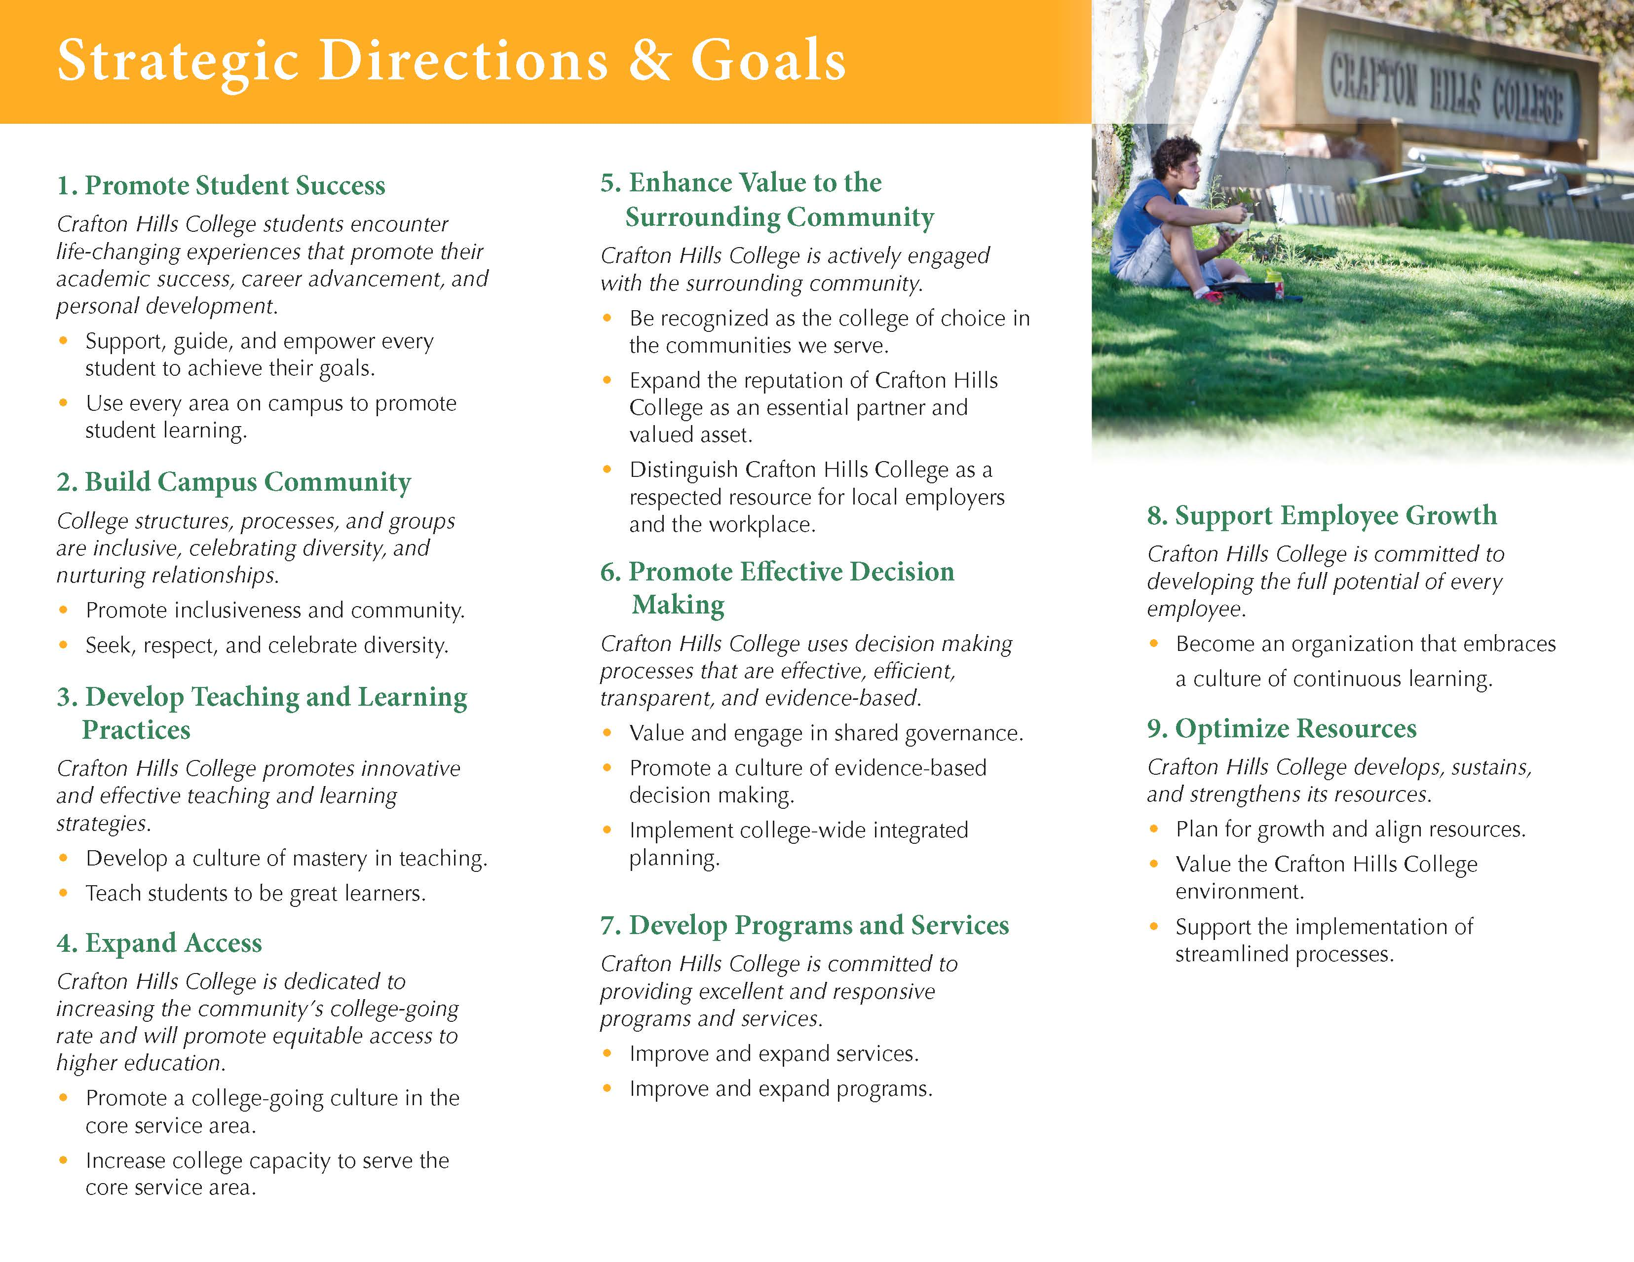
EDUCATIONAL MASTER PLAN

Slide 20
STRATEGIC OBJECTIVES
Achieve the applicable goals in the Distance Education Plan (1.1.4)
Expand enrollment and services to underrepresented groups (4.2.3)
Align course offerings with student needs and demands (7.2.1)
Expand access to programs (i.e. international students, transfer model curriculum, and dual enrollment with K-12 partners) (7.2.6)
Refine and revise the Resource Allocation Model (RAM) to meet campus needs (9.1.3)
Ensure institutional planning informs the allocation of resources (9.1.5)

Slide 21
NEXT STEPS
Open forums
Planning session

Slide 22
INSTRUCTION OFFICE UPDATE
Enrollment on Track…mostly…
Notes:
We are on track in terms of projections to be able to achieve the FTES that we budgeted for. If we can help our selves by improving FTES generation/ productivity, that will improve our budget and gets closer to do the things we would like to do.

Slide 23
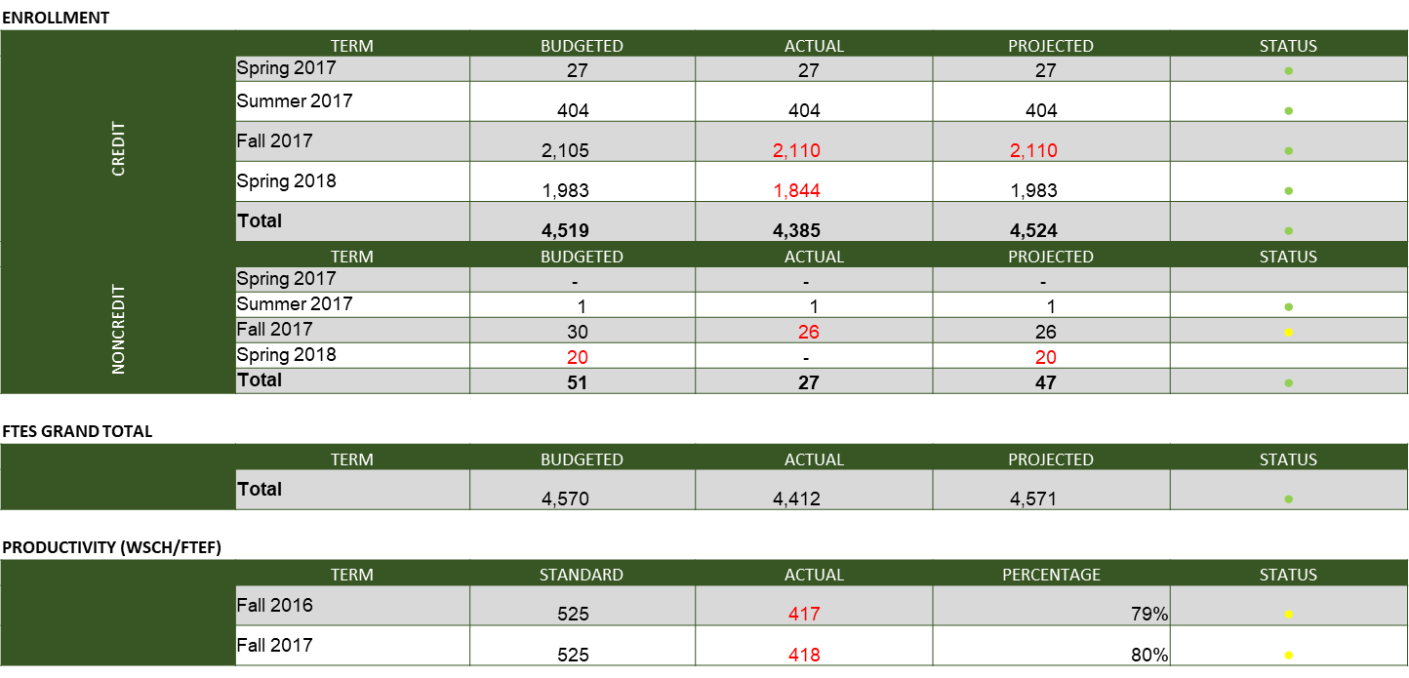

Slide 24
OFFICE OF INSTRUCTION, continued
Improving enrollment:
  Retention
  Growing
Guided Pathways
Dual Enrollment
AEBG/ ESL
STEM
Tutoring Center
State level :
  New Online College
  Curriculum System
Notes:
Each year, almost 50 % of the students who start college, do not come back to the following semester. So, retention, while it helps the students, it can also be a growth strategy. You can help and many already do that, by being attuned to the student experience and figuring our what they need help with and linking them to that help: DSPS, Tutoring, Fin Aid, Counseling, Food Pantry, and adapting classroom practices that have been validated by research to help students stay and be successful in class. We have PD activities…
Improving enrollment:
retention
Growing DE
Noncredit
We are also working on improving the schedule by making it more student centered. Offer more of what the students demand and at times and modalities that they prefer. Chairs approved the time blocks…
We are offering more DE, more DE courses, and more DE faculty
Hoping to offer more noncredit
Focus as we move forward will be: Guided Pathways
Dual Enrollment: leading the effort, clarifying goals and plans forward
AEBG/ ESL: tried to move this project forward but it seems that there was a bit of confusion around it. We are hoping to address the concerns and move forward with it.
STEM: plan is to have it staffed by the 22nd. Will update you on that soon…
Tutoring Center: Patti moved to VC. We will be working on addressing the needs of the Center while we go through the hiring process and also address some issues that were brought to our attention prior to Patti’s leaving.
Much more…, CTE projects, Amazon, deans positions permanent staffing, UCR pathways, RIM,…
State level :ULV implementation
New Online College
Curriculum System

Slide 25

ACCREDITATION
Midterm Report submitted
  Commission meets January 10-12, 2018
  Notification in February
“The New” ACCJC
  Commission’s new Portfolio Model
  Vice President Gohar Momjian, CHC’s Assigned Liaison
IEAOC:
  Revising the Institutional Assessment Plan
  Sharing the Standards with committees
  Increasing the number of courses assessed.
Notes:
Liaison services include ISER training 18 months before due date. Help to choose peer reviewers. Answer questions about ACCJC standards or policies. Provide advice on our site visit. Help organize our accreditation efforts through the ALO. Bring lessons learned from their portfolio colleges. Ensure information provided to the Commission is complete and that it contains context based on their knowledge of our college. Be the point of contact between the college and the Commission.

Slide 26

INTEGRATED PLANNING (SSSP, Equity, BSI)
Promote Basic Skills Completion
  MMAP Assessment, Educational Planning, tutoring, redesign of Developmental Education sequences
Close Achievement Gaps
  Ed planning, early alert, first year experience program, professional development, tutoring, research-based initiatives and practices

Slide 27
INTEGRATED PLANNING, continued
Success rates—Degrees, Certificates, Transfer
  Ed planning, MMAP, guided pathways, structured career exploration, tutoring, support for basic skills co-requisite courses, guided major exploration

Slide 28
INTEGRATED PLANNING, continued
Deeper collaborations with school districts, workforce agencies and community partners
  SOA³R, dual enrollment, course sequences for adult learners, Multiple Measures assessment, SSSP/AEBG services for adult school learners, noncredit basic skills course sequences
Improve support for students on or at-risk of being on academic or progress probation
  Starfish, identification of at-risk students, educational planning, online workshops, mandatory tutorial support

Slide 29
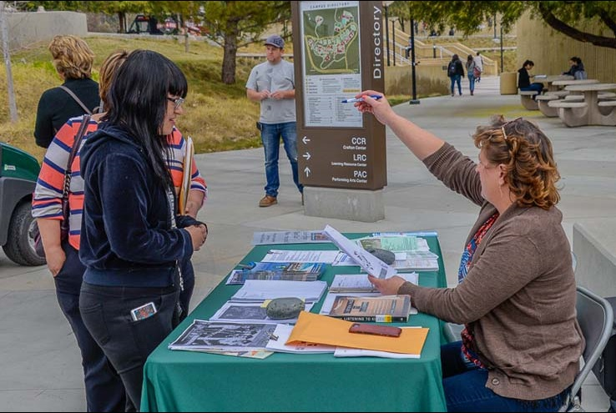
STUDENT SERVICES UPDATE
Answer Centers
Degree Planner and Starfish
High school partnerships
Service pathway for online students
Service pathways that meet individual students’ needs
AVID for Higher Education
Paperless workflow
Title IX training

Slide 30
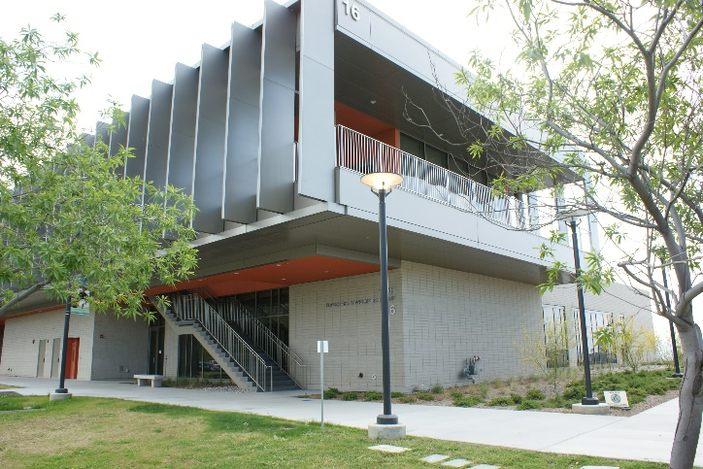
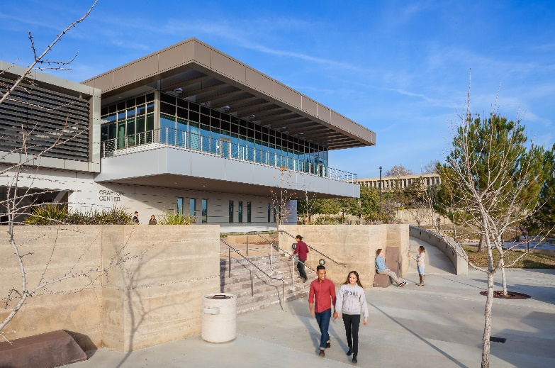
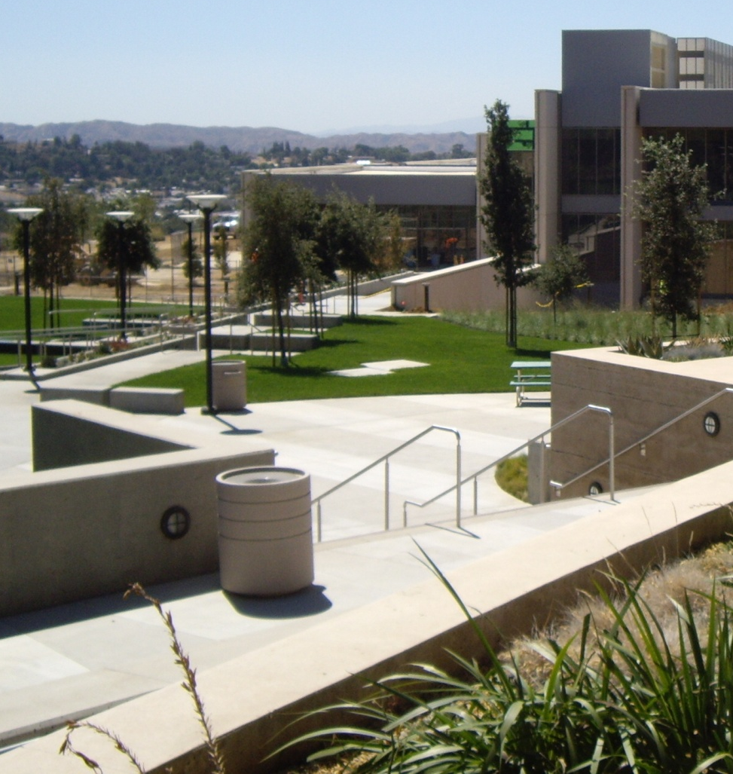
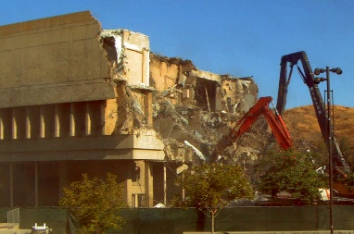
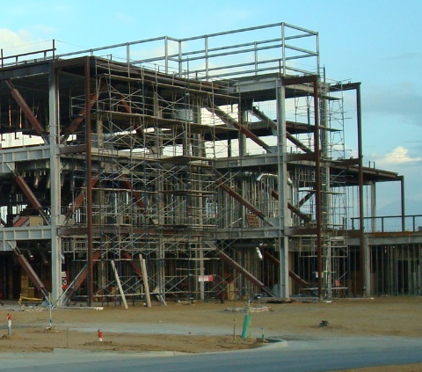
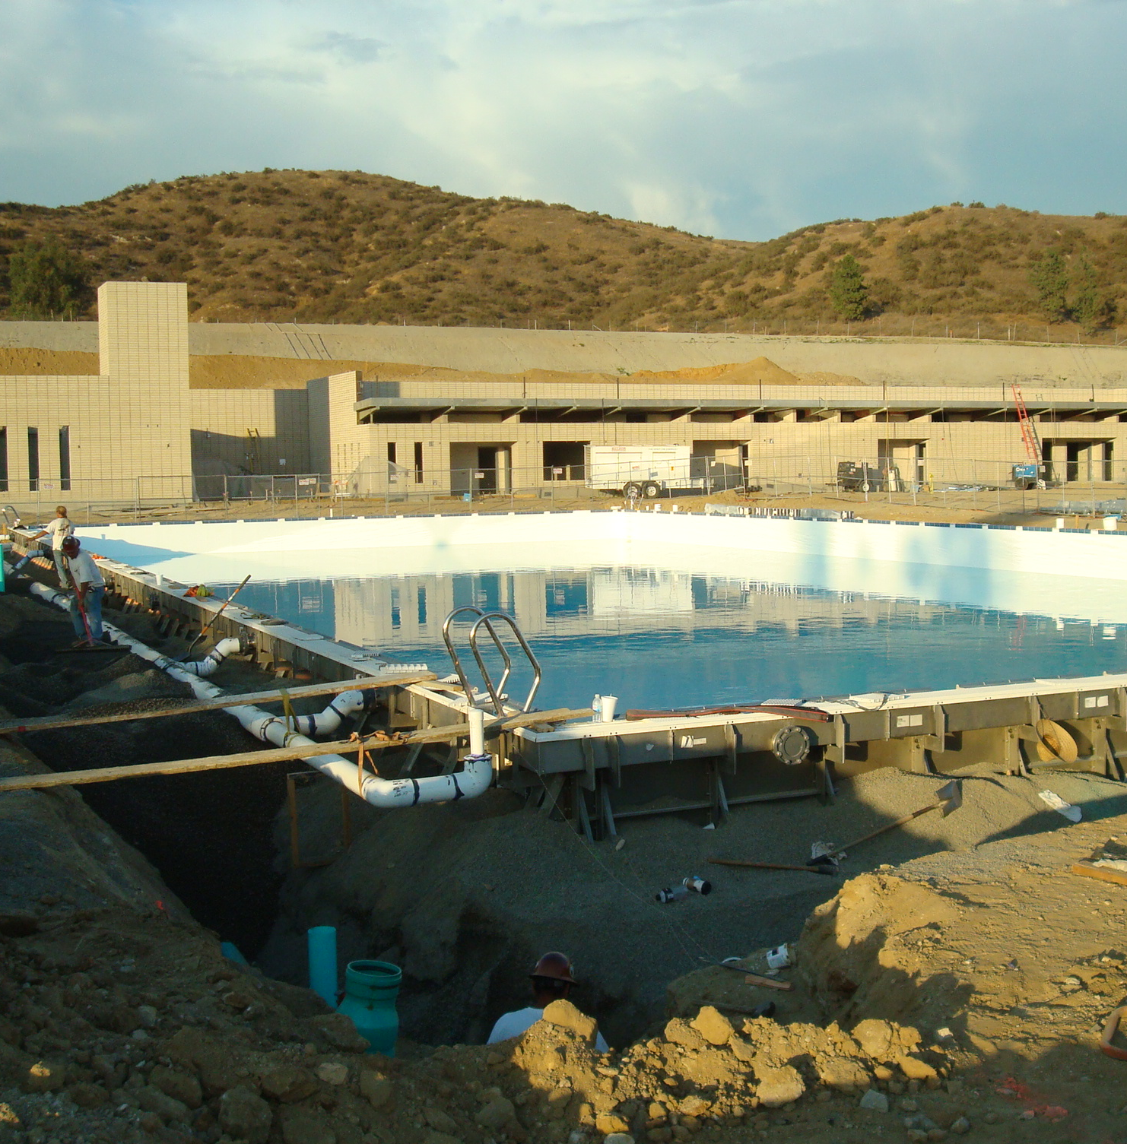
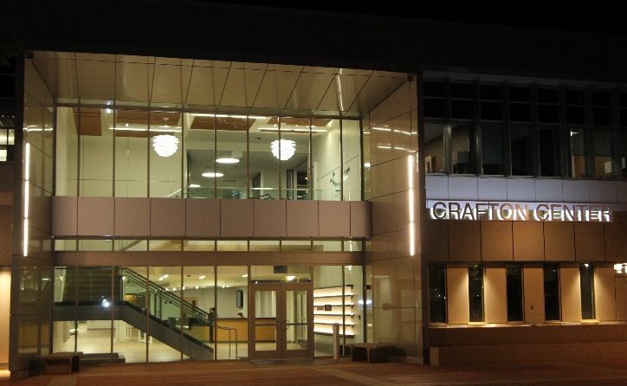


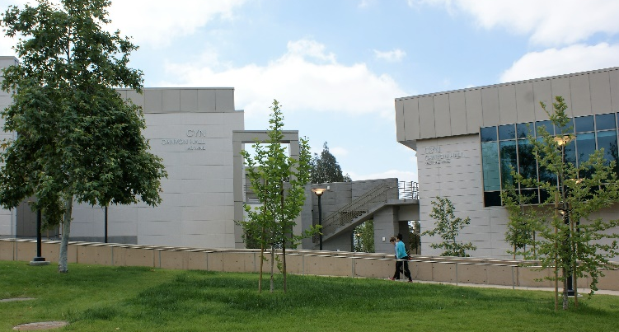
ADMINISTRATIVE SERVICES UPDATE
2017-18 | 2016-17 | 2015-16 | 2014-15 | 2013-14 | 2012-13 | 2011-12 | 2010-11 | 2009-10 | 2008-09
Churn 2 | Reno CNTL CTB | PSAH CYN CCR Churn 1 | In const. | Demo OE2 Const. new bdgs | Solar Farm | Campus Lighting Upgrade | LRC KHA Old Library Demo | In const. NRTH | Campus Infrastructure
Notes:
Congratulations and Thank You

Slide 31
FACILITIES MASTER PLAN
NEXT STEPS
Local Bond

Slide 32
BUDGET
Hopes high, expectations low
Developmental Budget 2018-19

Slide 33
PLANNING & PROGRAM REVIEW
505 Total Prioritized Objectives in 2016-17 PPR
312/505 requested resources
66/312 are funded or partially funded

Slide 34
BOOKSTORE UPDATE
Follett
Transition around spring break
Satellite Store – Making way for Printshop and TESS
  Food, snack, and supplies options

Slide 35
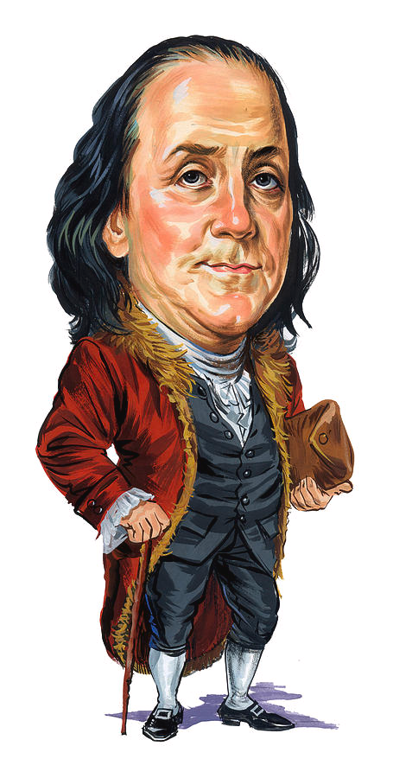
Benjamin Franklin
“When you're finished changing, you're finished.”

Slide 36
ACADEMIC SENATE REPORT
Mark McConnell, President

Slide 37
CLASSIFIED SENATE REPORT
Ben Gamboa, President

Slide 38
STUDENT SENATE REPORT
Junior Gutierrez, President

Slide 39
SBCCD BOARD OF TRUSTEES REPORT
Joseph Williams, President

Slide 40
CHANCELLOR REPORT
Bruce Baron, Chancellor

Slide 41
GUIDED PATHWAYS WORKSHOP
Kathy Bakhit, Vice President of Instruction
Rebeccah Warren-Marlatt, Vice President of Student Services
Keith Wurtz, Dean of Institutional Effectiveness, Research & Planning

