Slide 1

NEW ROADRUNNERS

Slide 2
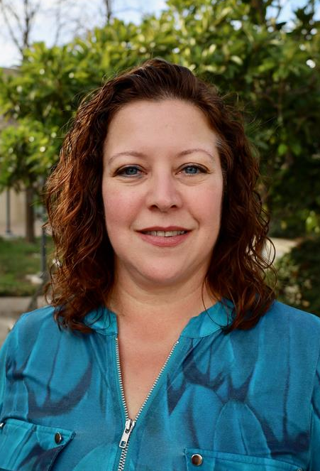
Welcome!
Michelle (Toni) Parsons
Associate Dean of Instructional Support

Slide 3
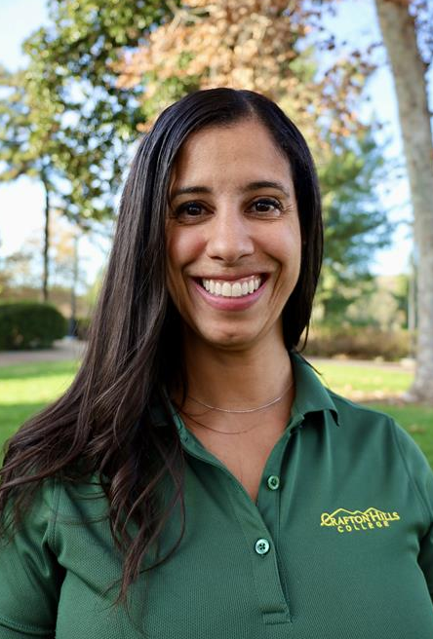
Welcome!
Jenny Cunvong
Development Coordinator
Institutional Advancement

Slide 4
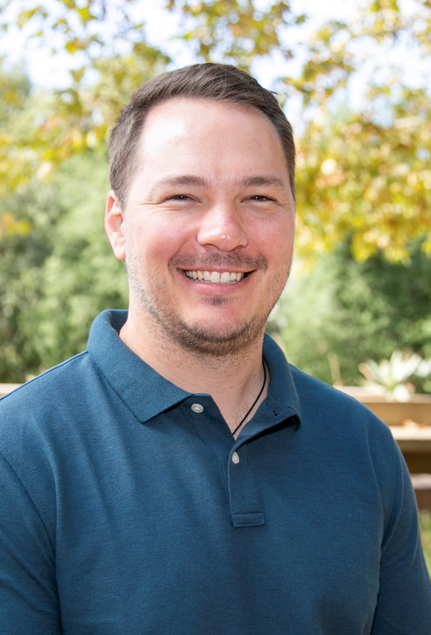
Welcome!
Doug Ferguson
Alternative Media and Assistive Technology Specialist

Slide 5
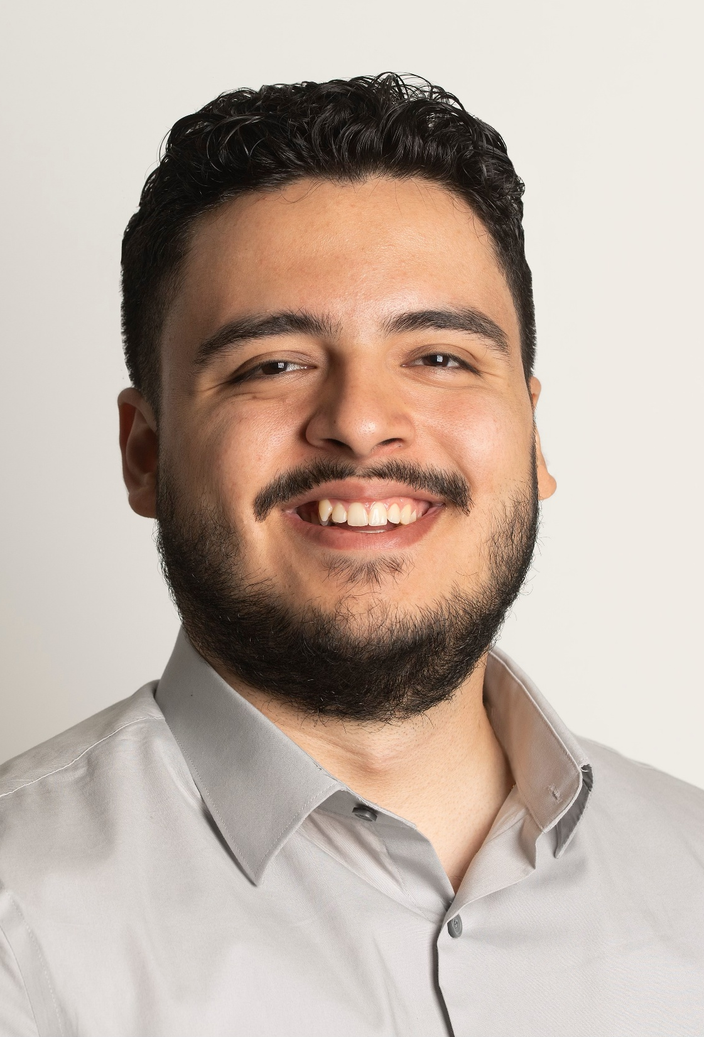
Welcome!
Sergio Guzman
Admissions and Records Specialist

Slide 6
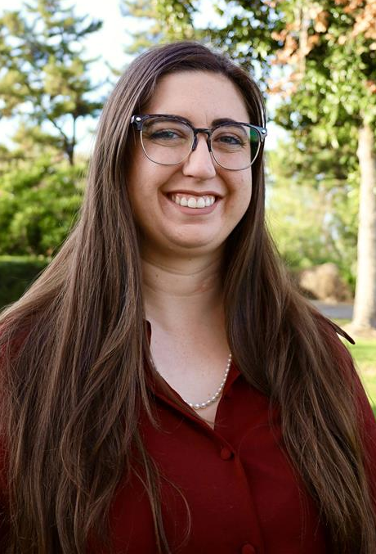
Welcome!
Robin Jones
Admissions and Records Evaluator

Slide 7

Welcome!
Allie Montero
Faculty,
Nursing

Slide 8
PROMOTED ROADRUNNERS

Slide 9

Congratulations!
Luna Lagrima
Promoted to Admissions and Records Specialist

Slide 10
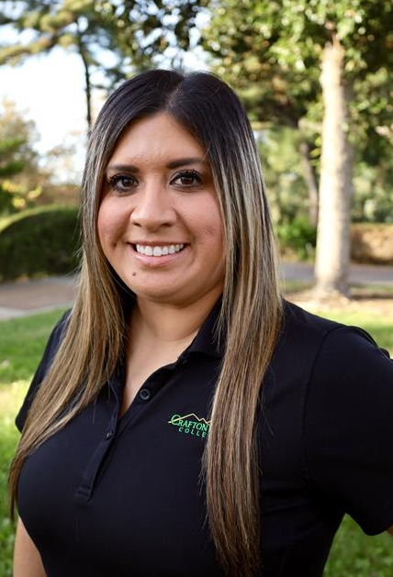
Congratulations!
Kaila Wheeler
Promoted to Administrative Assistant III

Slide 11

Congratulations!
Jazmin Navarro
Promoted to Child Development Teacher

Slide 12
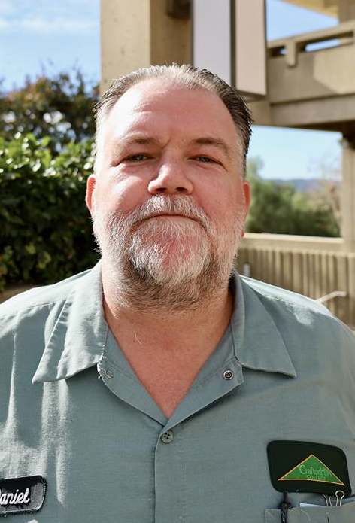
Congratulations!
Daniel Johnson
Promoted to Lead Custodian

Slide 13
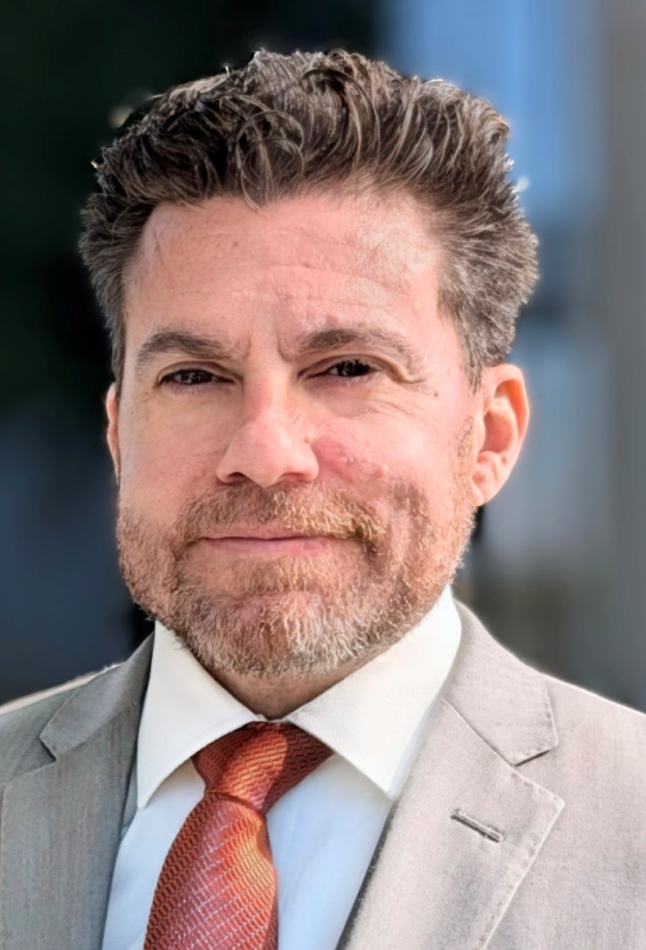
Congratulations!
Nick Reichert
English Faculty

Slide 14
WELCOME FUTURE ROADRUNNERS

Slide 15
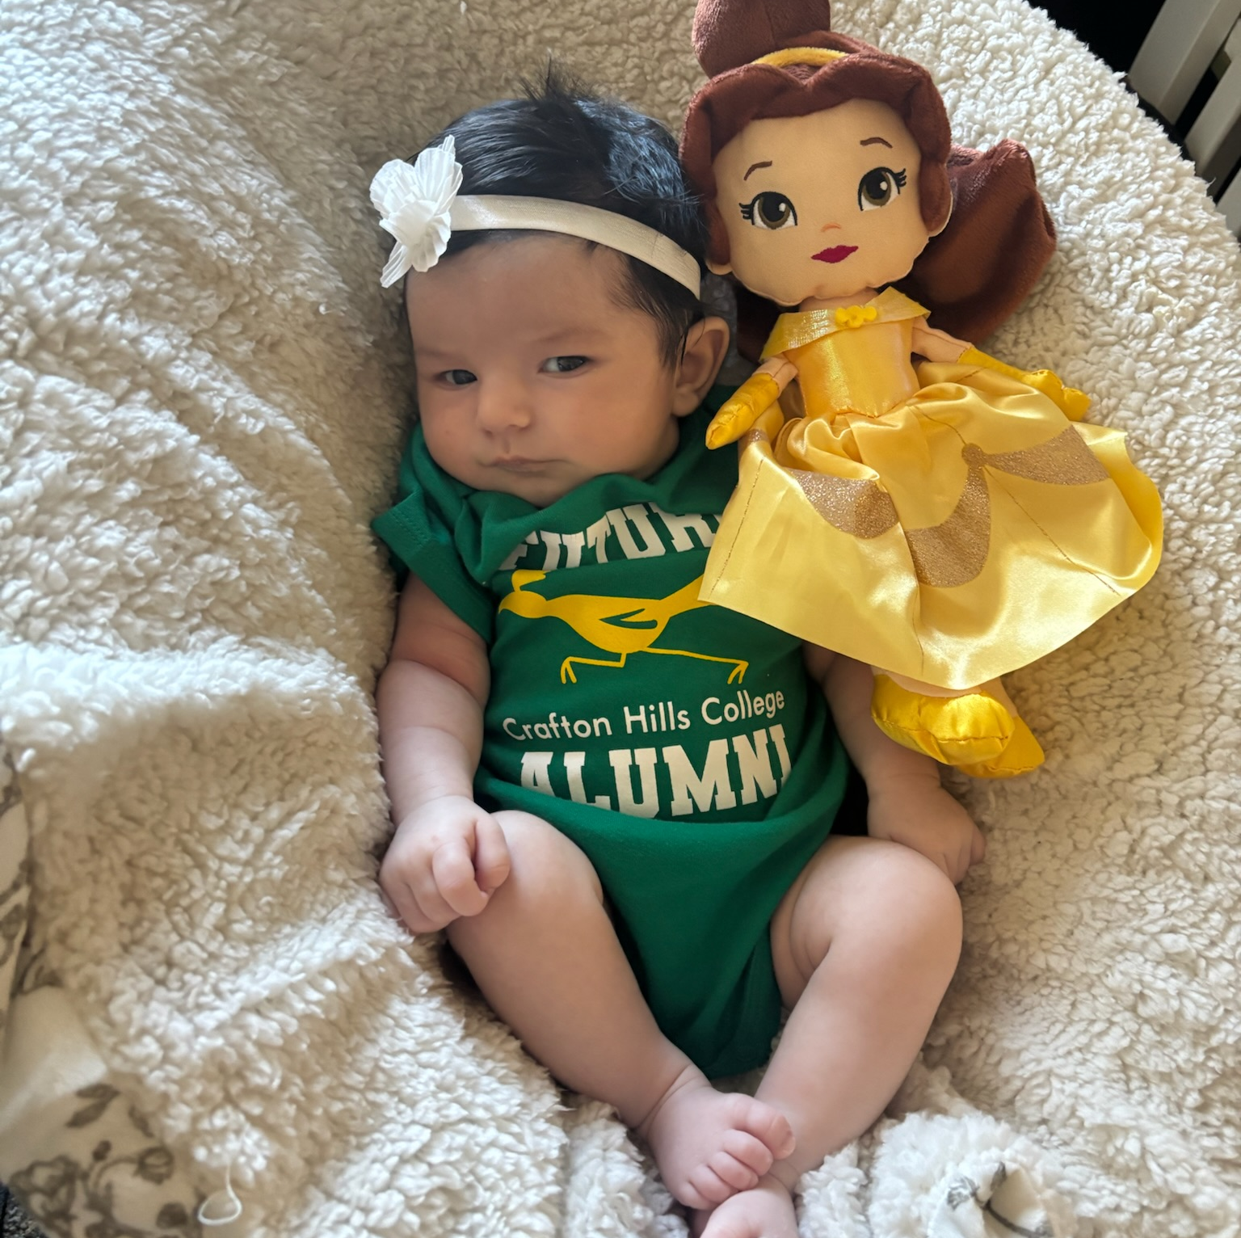
Congratulations on your future Roadrunner!
Larry Aycock

Slide 16
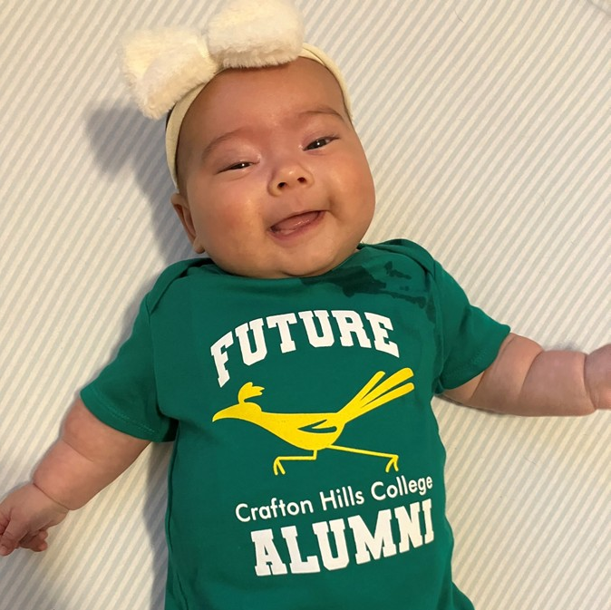
Congratulations
on your future Roadrunner!
Jimmy Grabow

Slide 17
INSTITUTIONAL EFFECTIVENESS, RESEARCH, AND PLANNING

Slide 18

Continuous Improvement in Action: Responding to Campuswide Feedback

Slide 19

Areas of Focus
  Enhancing communication across campus
  Mental health and well-being
  Planning & program review annual
  prioritization process

Slide 20
The Role of Campuswide Feedback
Areas of focus were influenced by campuswide feedback stemming from the Fall 2023 Campus Climate Survey findings
149 Respondents
Survey items measured on a four-point scale (4 – strongly agree; 3 – agree; 2 – disagree; 1 – strongly disagree)
Typically observed 75%-80% agreement rate (i.e., rating of 3+)
Complete Campus Climate Survey Findings: https://www.craftonhills.edu/about-chc/research-and-planning/documents/rrn2844_campusclimatesurvey_2023fa_final.pdf

Slide 21

Pertinent Findings: Communication
Communication
  Respondents expressed a desire for greater communication concerning campus decisions and institutional processes
  Survey Items
    1. Communication across campus is timely and
    accurate (57% agreement)
    2. If I need information about Crafton, I know
    where to find it (70% agreement)
    3. The Crafton campus community is doing
    what it needs to stay informed (70%
    agreement)

Slide 22
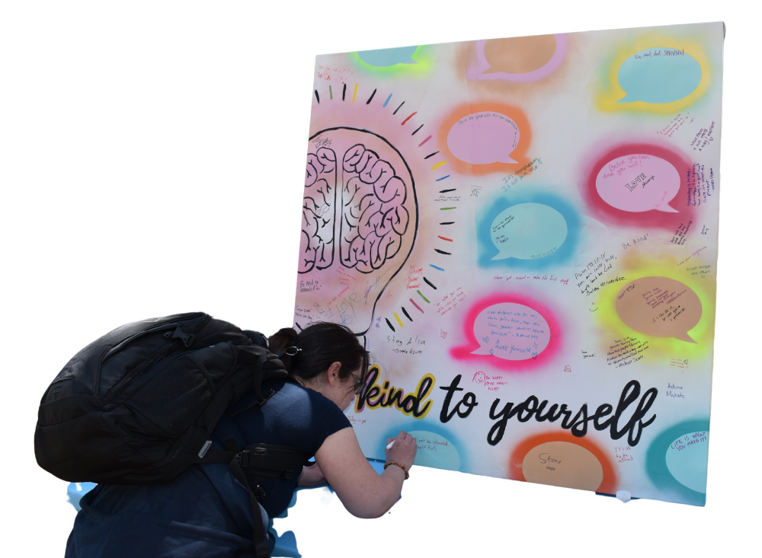

Pertinent Findings: Mental Health & Well-Being
Mental Health and Well-Being
  Comments reflected the need for greater mental health and well-being funding and support for faculty and staff
  Survey Item
    1. There are sufficient trainings centered on enhancing
    employee well-being and mental health (62% agreement)

Slide 23
Pertinent Findings: Planning & Program Review (PPR) Prioritization
PPR Prioritization
  Comments reflected the need for greater transparency about the processes used for PPR-related budgeting and funding
  Survey Items
    1. Overall, planning and decision-making processes at Crafton are effective (71% agreement)
    2. Overall, planning and decision-making processes at Crafton are efficient (71% agreement)
    3. The annual process of prioritizing objectives at CHC is transparent (72% agreement)

Slide 24
INSTITUTIONAL ADVANCEMENT

Slide 25
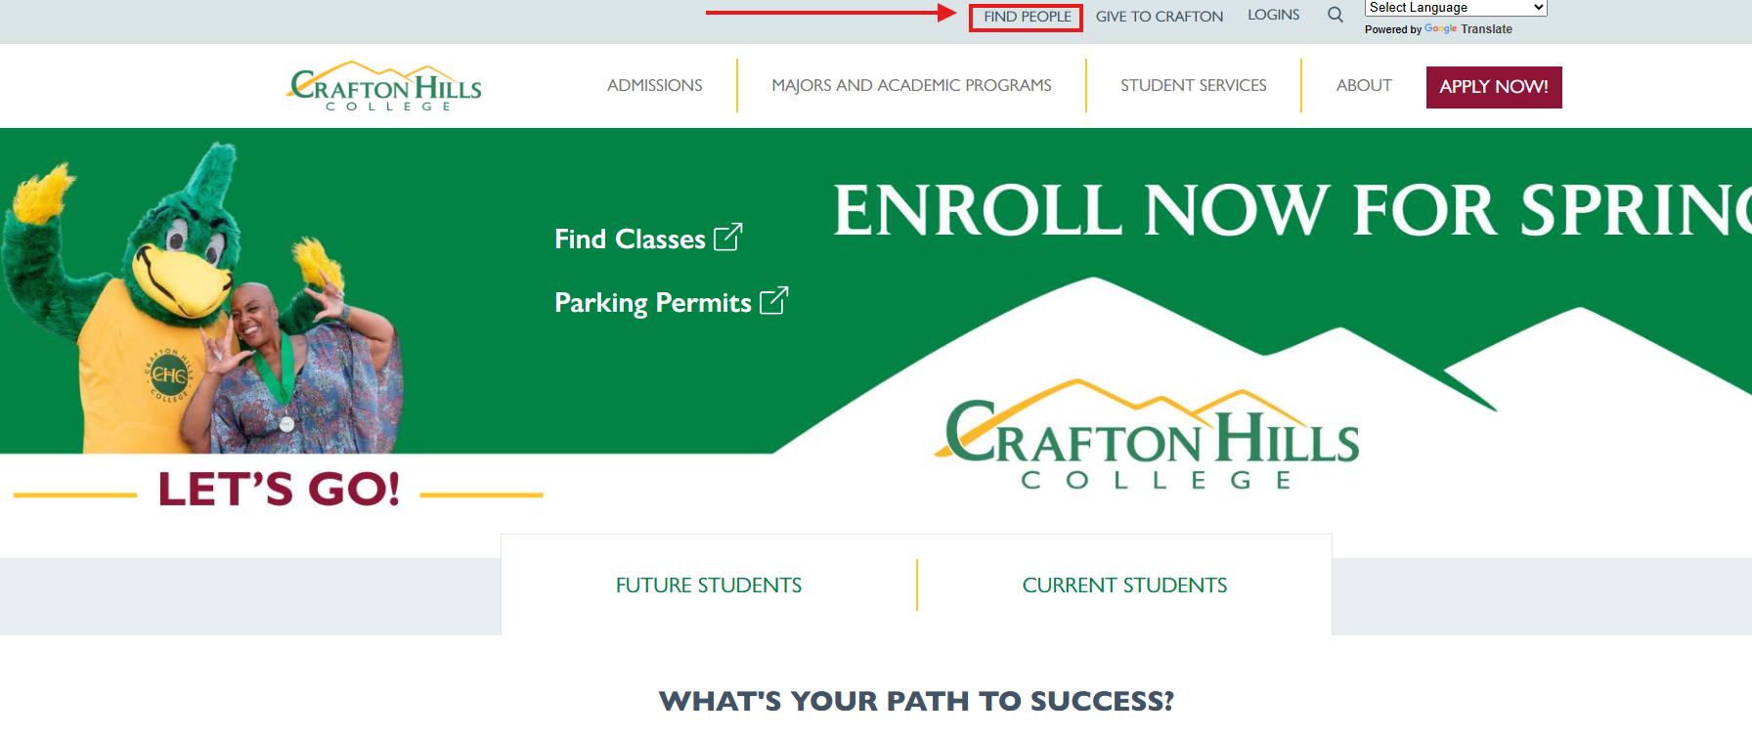
Employee Directory Update

Slide 26
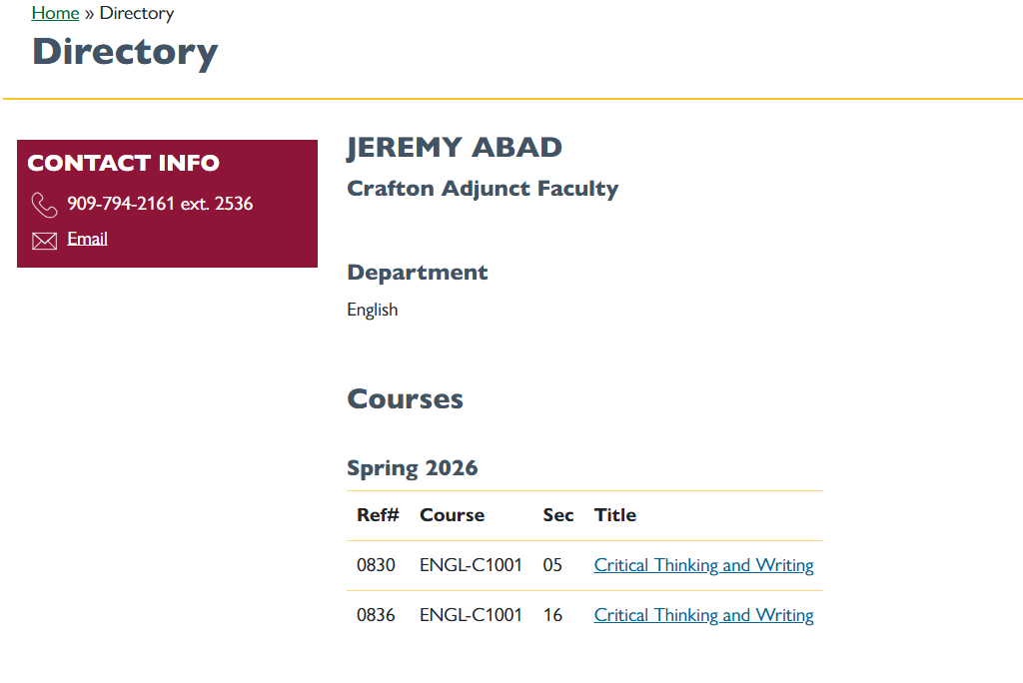
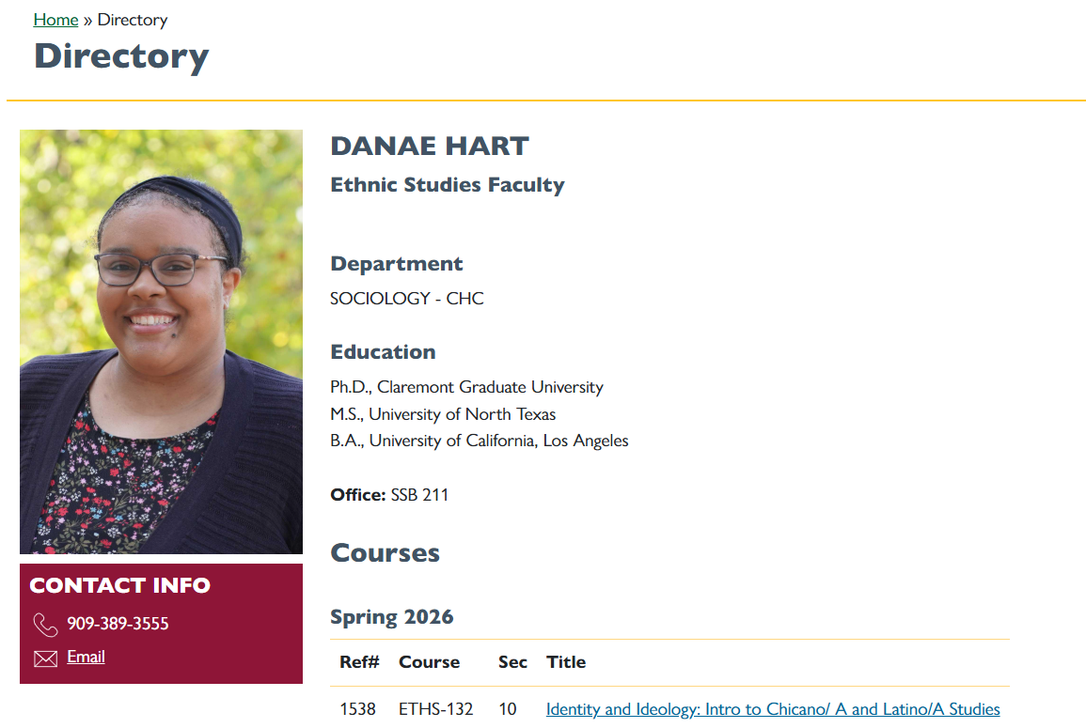
Employee Directory Update

Slide 27
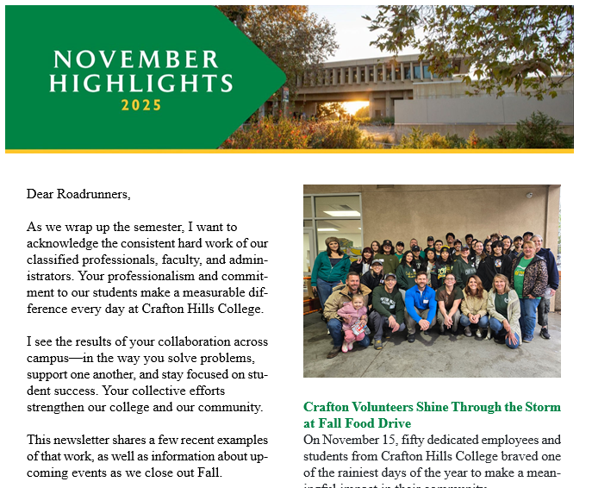
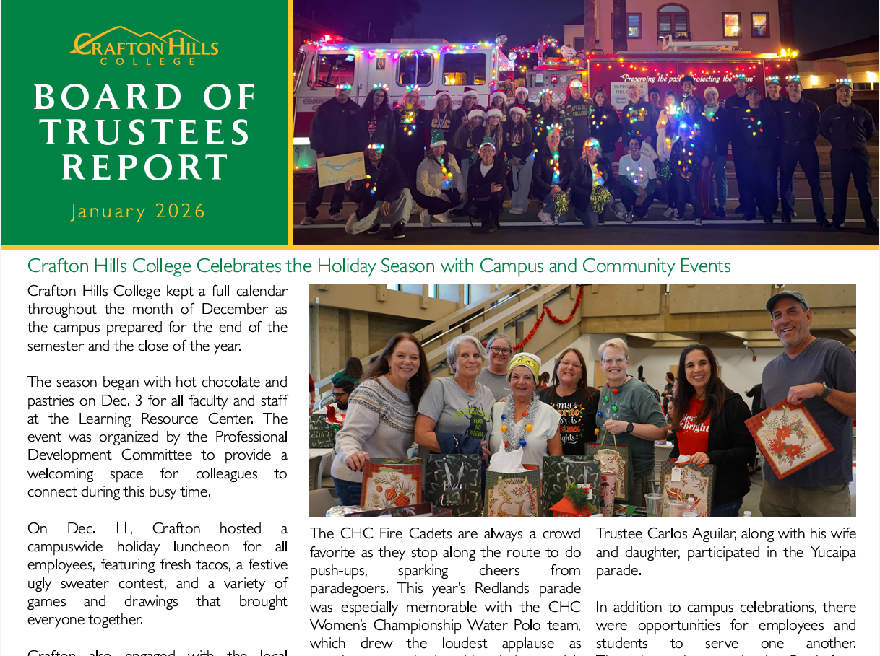
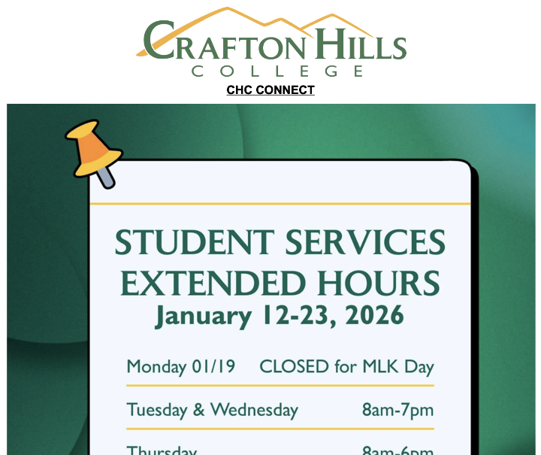

Communications
CHC Connect – Every Thursday
  Dates and Deadlines
  General Announcements
Weekly Calendar – Every Monday
  Event and Activities Information
Monthly Board Reports
  Highlights Campus, Students, Alumni, Awards, Events
Monthly President’s Letters
  Highlights Employees and Departments

Slide 28
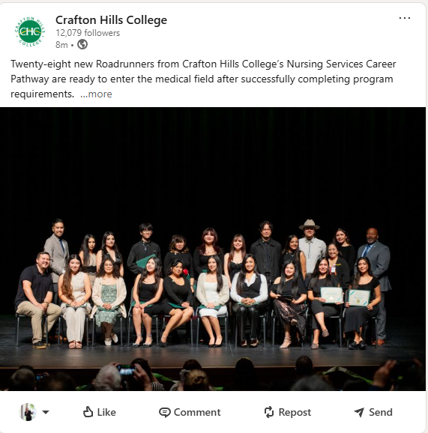
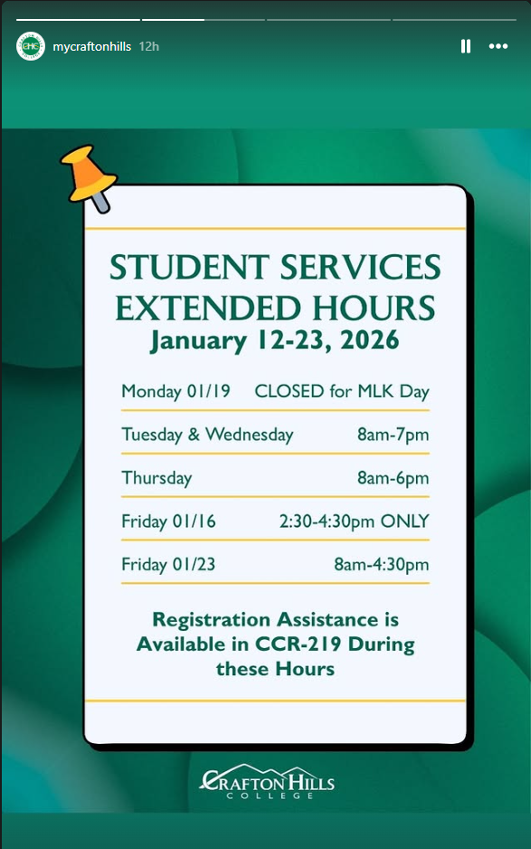
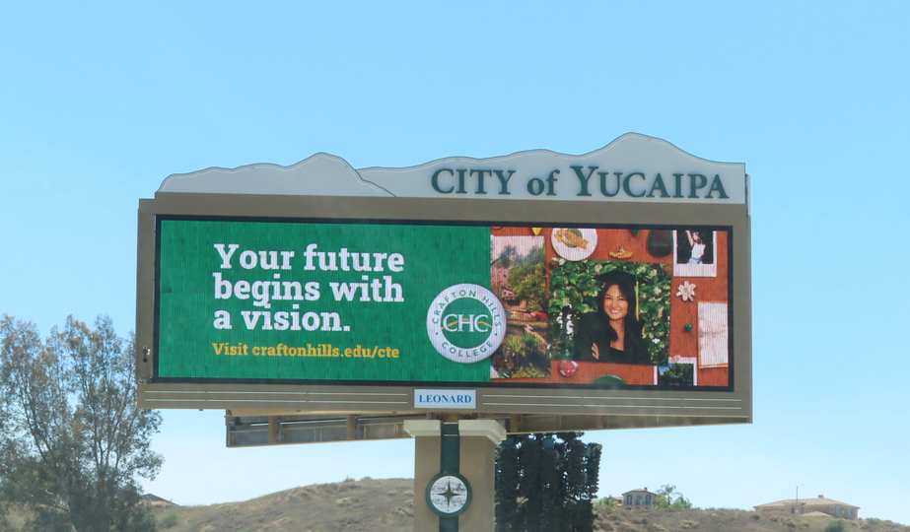


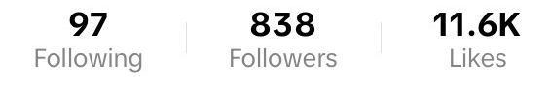
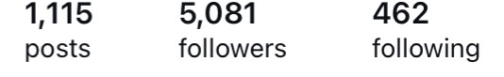
Communications
Social Media
  Instagram, TikTok, Facebook, YouTube, LinkedIn
Out of Home
  Billboards, Public Presentations, Press Releases
Alumni Facebook
CHC Facebook
TikTok
Instagram

Slide 29
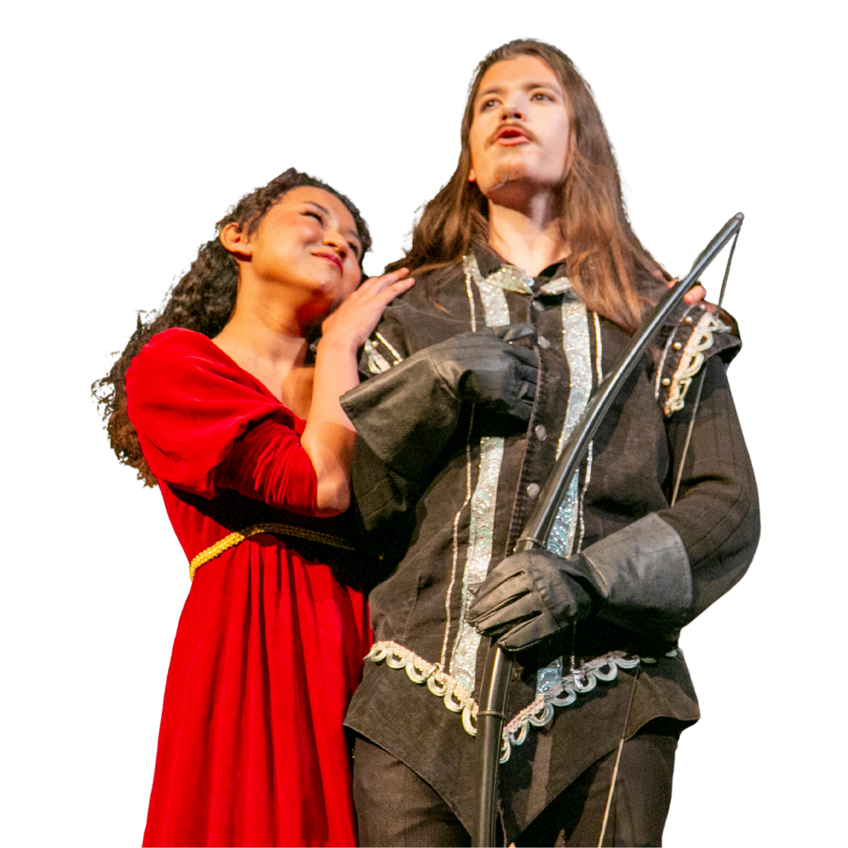
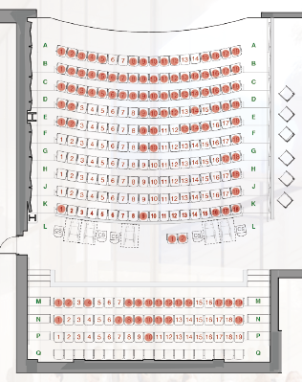
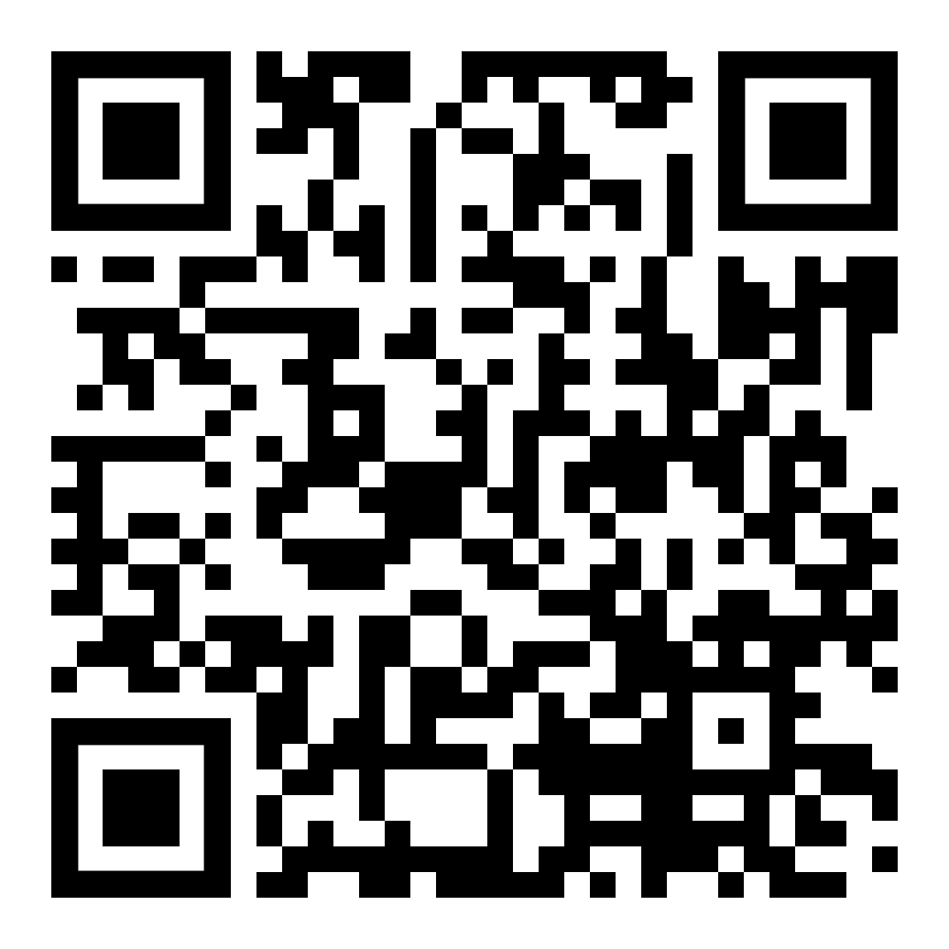
Performing Arts Endowment
Sponsor a Seat
Scan to Sponsor a Seat!

Slide 30

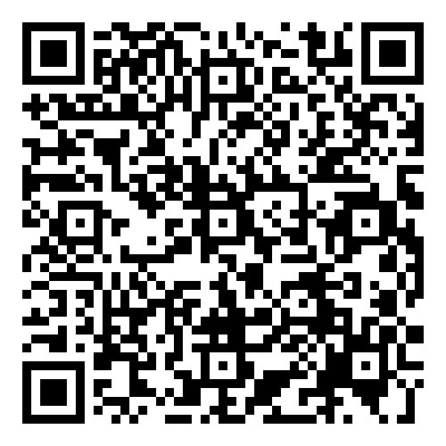

Invitation to Join President’s Circle
In 2025
  436 scholarships
  89 emergency grants
  32 transfer application waivers
Scan to Join the Team!

Slide 31
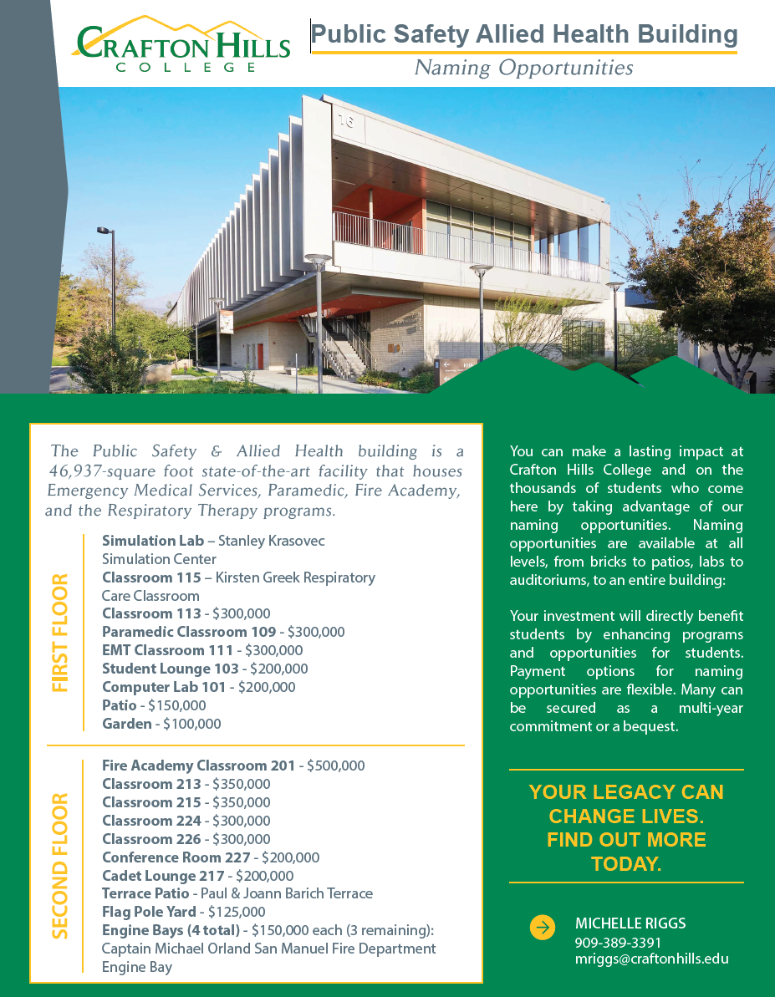
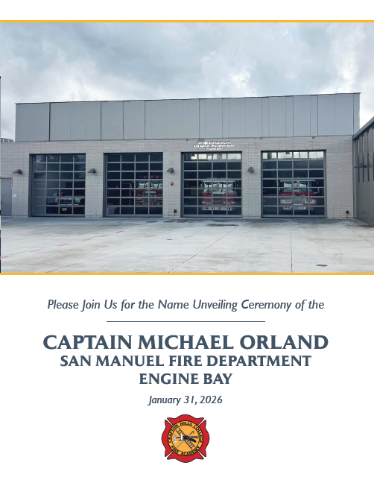
Captain Michael Orland Naming Ceremony

Slide 32

Student Scholarships Available
Encourage Students to Apply
One Application Matches You to Hundreds of Opportunities!
Earth Science/ Geology
English/ Literature
Foster Youth/ EOPS
Environmental Science
Veterans
Accounting
Engineering
EMS
Education/ Teaching
Music
SAS
Honors Program
Mathematics

Slide 33
INSTRUCTIONAL SERVICES

Slide 34
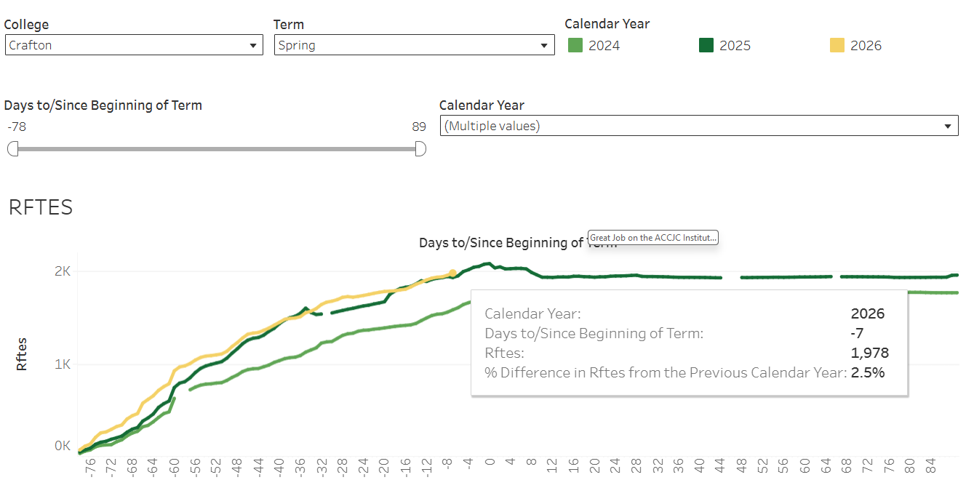
Spring 2026 Enrollments
As of January 13, 2026, the RFTES increased from 1,929 in Spring 2025 to 1,978 in Spring 2026, a 3% (n = 49) increase
Crafton is currently 6 RFTES above the Spring 2026 target of 1,972.
Notes:
The RFTES at Valley has increased from 4,357 in Spring 2025 to 4,374 in Spring 2026, a 0.4% (n = 17) increase.

Slide 35

Great Job on the ACCJC Institutional Self-Evaluation (1)
Fall 2024
Crafton’s Self-Evaluation Approach Developed
December 15, 2026
Institutional Self-Evaluation Report due
Spring 2027
Peer Review – Team ISER Review
Fall 2027
Peer Review – Focused Site Visit
January 2028
Commission Action
Spring 2025
IEAOC Meets with Committees to begin writing Standards I and II
Summer 2025
Begin reviewing drafts of Standards I and II
Spring 2026 – Summer 2026
Review draft ISER in all constituent groups, and recommend approval
Fall 2026
Submit to Board of Trustees, and open Forums to prepare for Fall 2027 visit
Fall 2025
IEAOC Meets with committees to begin writing Standards III and IV
Complete drafts of Standards I and II

Slide 36
Great Job on the ACCJC Institutional Self-Evaluation (2)
Fall 2024
Crafton’s Self-Evaluation Approach Developed
December 15, 2026
Institutional Self-Evaluation Report due
Spring 2027
Peer Review – Team ISER Review
Fall 2027
Peer Review – Focused Site Visit
January 2028
Commission Action
Spring 2025
IEAOC Meets with Committees to begin writing Standards I and II
Summer 2025
Begin reviewing drafts of Standards I and II
Spring 2026 – Summer 2026
Review draft ISER in all constituent groups, and recommend approval
Fall 2026
Submit to Board of Trustees, and open Forums to prepare for Fall 2027 visit
Fall 2025
IEAOC Meets with committees to begin writing Standards III and IV
Complete drafts of Standards I and II

Slide 37
Great Job on the ACCJC Institutional Self-Evaluation (3)
Fall 2024
Crafton’s Self-Evaluation Approach Developed
December 15, 2026
Institutional Self-Evaluation Report due
Spring 2027
Peer Review – Team ISER Review
Fall 2027
Peer Review – Focused Site Visit
January 2028
Commission Action
Spring 2025
IEAOC Meets with Committees to begin writing Standards I and II
Summer 2025
Begin reviewing drafts of Standards I and II
Spring 2026 – Summer 2026
Review draft ISER in all constituent groups, and recommend approval
Fall 2026
Submit to Board of Trustees, and open Forums to prepare for Fall 2027 visit
Fall 2025
IEAOC Meets with committees to begin writing Standards III and IV
Complete drafts of Standards I and II

Slide 38
Great Job on the ACCJC Institutional Self-Evaluation (4)
Fall 2024
Crafton’s Self-Evaluation Approach Developed
December 15, 2026
Institutional Self-Evaluation Report due
Spring 2027
Peer Review – Team ISER Review
Fall 2027
Peer Review – Focused Site Visit
January 2028
Commission Action
Spring 2025
IEAOC Meets with Committees to begin writing Standards I and II
Summer 2025
Begin reviewing drafts of Standards I and II
Spring 2026 – Summer 2026
Review draft ISER in all constituent groups, and recommend approval
Fall 2026
Submit to Board of Trustees, and open Forums to prepare for Fall 2027 visit
Fall 2025
IEAOC Meets with committees to begin writing Standards III and IV
Complete drafts of Standards I and II

Slide 39
Great Job on the ACCJC Institutional Self-Evaluation (5)
Fall 2024
Crafton’s Self-Evaluation Approach Developed
December 15, 2026
Institutional Self-Evaluation Report due
Spring 2027
Peer Review – Team ISER Review
Fall 2027
Peer Review – Focused Site Visit
January 2028
Commission Action
Spring 2025
IEAOC Meets with Committees to begin writing Standards I and II
Summer 2025
Begin reviewing drafts of Standards I and II
Spring 2026 – Summer 2026
Review draft ISER in all constituent groups, and recommend approval
Fall 2026
Submit to Board of Trustees, and open Forums to prepare for Fall 2027 visit
Fall 2025
IEAOC Meets with committees to begin writing Standards III and IV
Complete drafts of Standards I and II

Slide 40

Accreditation Update (continued)
ISER
  Due to ACCJC on December 15, 2026
  Team Review in Spring of 2027
    Provide ACCJC Team a 5% random of
    sample of DE sections from Fall 2026
    to evaluate Regular and Substantive
    Interaction (RSI)
    ACCJC Team will use DE Assessment
    Tool for Peer Reviewers to evaluate
    RSI
    Reviewers go through online classes
    week by week
  Focused Site Visit in Fall 2027
Notes:
Reviewers should have a level of access to the LMS (typically ‘instructor’ level) that allows them to observe activities where this interaction takes place, such as on discussion boards, other postings, and communications regarding learning content, feedback on assignments, etc. It is the institution’s responsibility to provide any additional access to relevant documentation to verify regular and substantive interaction. The institution must have methods to ensure that the instructor’s interaction with students is substantive and regular.

Slide 41
Great Job Meeting the AB607 Requirements to Prominently Display the Estimated Cost for Each Section
AB607 requires us to “prominently display…that may include a link to a sperate internet web page the estimated costs for each [section] all required course materials and fees” within the following timeline:
  40 percent by January 1, 2025
  55 percent by January 1, 2026
  65 percent by January 1, 2027
  75 percent by January 1, 2028

Slide 42
Burden Free Access to Instructional Materials – January 26, 2026
Requires all community college districts to ensure burden-free access to instructional materials for students.
Mandates districts to adopt policies ensuring students have access to textbooks and supplemental materials by the first day of class
Purpose is to reduce both financial and administrative barriers throughout the academic term.
Three Important Components of Meeting this Requirement for Students
  Placing book orders and instructional materials prior to start of section and in enough time for materials to be available.
  Converting sections to Open Educational Resources (OER) / Zero Textbook Cost (ZTC)
  Correctly identifying OER / ZTC Sections

Slide 43

Great Job with Developing and Offering Sections with Open Educational Resources
The percent of OER sections being offered / correctly identified increased from 19% in Spring 2025 to 55% in Spring 2026

Slide 44
Progress on Title IIA at Crafton
Specific Guidance from the CCCCO to Colleges
  Need to show progress and intentionality
  CCCCO reassuring system to not panic.
  Ensure that any new contact is accessible.
  First recommendation for faculty is to make syllabus accessible.
Crafton Hills College
  Director of DE, Cynthia Hamlett, is working with five Faculty to Start
  Regularly send simple accessibility guidelines
  Exploring hiring classified professional to support instructional faculty
  Flex and In-Service Trainings
  Create agenda and minutes templates that meet accessibility standards
Notes:
Most, if not all colleges, are not in compliance.

Slide 45
STUDENT SERVICES

Slide 46
Veterans Resource Center
New student engagement and professional networking opportunities:
  Veteran students attended the America Conference to increases professional networking, awareness of resources, and student advocacy for veterans.
2. Improved well-being and family support:
  VRC is providing free haircuts to veteran’s and their dependents.
  It helped reduce financial strain and promotes dignity, inclusion, and community care.
3. Holistic health and retention:
  Wellness-focused programs, developed in collaboration with Health and Wellness, address mental, physical, and emotional needs—supporting academic success and persistence.

Slide 47
Mental Health & Wellness Initiatives
Enhanced Student Support Services
  Increased Clinical Capacity: Now staffing three full-time therapists with an additional position in progress to reduce wait times.
  24/7 Access with TimelyCare: Virtual mental health support available to all students anytime, anywhere, ensuring no one is left without help after hours.
2. Peer & Specialized Support Groups
  Focused Group Therapy: Men's Support Group, Dedicated sessions for Anxiety & Depression, Grief & Loss, and First-Generation Student Challenges.
  Skill-Building Workshops: Monthly "Surviving & Thriving" seminars focused on stress management and suicide awareness.
3. Faculty & Staff Professional Development
  Healing-Centered Training:
  Classroom Partnerships:

Slide 48
Crafton's Leadership Academy for Student Success (CLASS)
Was selected as a Model Program for the California Adult Education Program (CAEP) Summit:
Equity-Centered Bridge: Intentionally designed to close gaps for adult, first-generation, and returning learners by removing systemic barriers before the fall term.
Integrated College Experience: Combines credit-bearing coursework (COUNS-100) with career readiness and social-emotional learning to build immediate “college identity.”
Results-Driven Support: Achieved 100% fall enrollment through mandatory milestones: Educational Plans, Financial Aid completion, and EOPS/SAS connections.
Scalable Innovation: A sustainable, cost-effective pipeline model leveraging campus resources and community partnerships for statewide replicability.
Multilingual Program Success!
Alex Jaco and Chloe De Los Reys are working together to enhance and execute the multilingual programming to support and expand ESL courses.

Slide 49
Counseling Model Update
Key Outcomes:
Strong Early Momentum (0–14 Units)
  SEP students increased by 448 (1,906 → 2,354)
  Indicates effective front-loaded counseling and onboarding
2. Improved Persistence Support (15–29 Units)
  SEP students increased by 191 (853 → 1,044)
  No-SEP students declined (112 → 79)
  Demonstrates successful follow-up and transition counseling as students persist
3. Completion-Focused Culture (30+ Units)
  Very low No-SEP counts at advanced unit levels
  SEPs are the norm for students approaching completion
  Reflects consistent counseling engagement across the student lifecycle

Slide 50
EQUITY CHAMPION AWARD

Slide 51
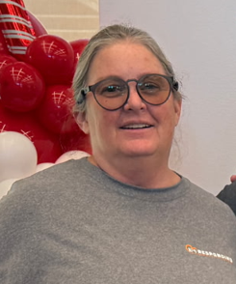
Classified Professional Equity Champion Award
Rosemarie Hansen, Laboratory Technician II Biological Sciences
Nomination Statements
“Rosemarie Hansen goes above and beyond as a science lab tech. She is always looking for creative ways to help students, whether they can't afford the high cost of science materials, or because they simply don't know what to do”.
“In department, committee, and senate meetings, Rose always has students' needs in mind. Students are her priority and helping reach and support our diverse student population is a natural part of who she is.”
Rosemarie Hansen

Slide 52
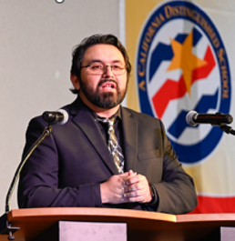
Faculty Equity Champion Award
Dr. Christopher Olivera, Professor of Microbiology and Chair of Kinesiology & Public Education.
Faculty mentor for First-generation, Latinx, and LGBTQ+ students, Academic Senate VP of Support
Nomination Statements
“Dr. Olivera’s daily actions exemplify the heart of an Equity Champion, someone who leads not through position, but through purpose.”
“Dr. Olivera is known for his consistent, personal investment in student success. He arrives early, stays late, and regularly tutors and mentors' students often beyond his own advisees."
He models academic excellence while maintaining genuine compassion, creating a learning environment where students feel seen and supported. Many of his mentees have gone on to graduate school or professional roles in public health and healthcare, crediting his guidance as transformative.
Dr. Christopher Olivera

Slide 53
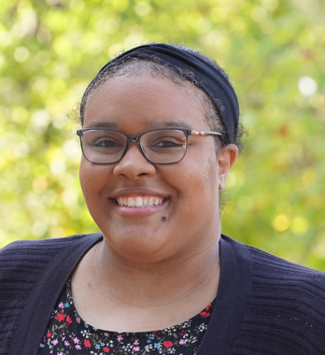
Faculty Equity Champion Award
Dr. Danae Hart, Assistant Professor in Ethnic Studies
Dr. Hart advises Student Clubs, serves on Academic Senate, Student Equity Committee, and the Labor Union.
Nomination Statements
“Dr. Hart's comprehensive impact as an equity leader in policy, curriculum, students and colleagues show a deep commitment to transforming Crafton Hills College into a place of justice, inclusion, and belonging. It is my privilege to nominate her as the Faculty Equity Champion.”
“Dr. Hart exemplifies every criterion for this award through her tireless advocacy, innovative leadership, and genuine commitment to creating an inclusive campus community”.
Dr. Danae Hart

Slide 54
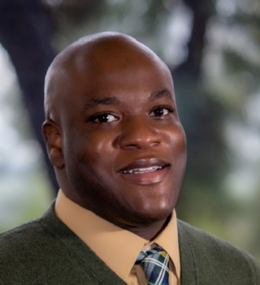
Administrator Equity Champion Award
Dr. Willie Blackmon, Dean of Student Services
Dr. Blackmon serves as a mentor to many students and employees, Co-Chair of the A2MEND Conference, Co-Chair of Black History Month Workgroup, member of Dual Enrollment Committee.
Nomination Statements
“He goes above and beyond to ensure the success of staff and students.
“Dedicated, personable and humble, he treats every student with the utmost respect.”
“Willie is one of the most welcoming people I have ever met. He can be seen greeting and waving to students that he passes in the hallway.
Dr. Willie Blackmon

Slide 55

Department Equity Champion Award
Students Served
  Fall 2024: 6,370 Fall 2025: 7,185
Nomination Statements
The Counseling Department not only employs a variety of employees with diverse and multicultural backgrounds, but they also celebrate diversity.
Students of all cultures are treated with utmost respect regardless of their backgrounds.
Employees are welcome to practice their first language with other employees, and we are grateful that they utilize their multilingual skills to serve students.
Every member of the counseling department is both competent and caring. The environment is highly warm and welcoming. Working as a student worker, I have never felt for any moment anything other than supported and encouraged to meet challenges and goals.
Counseling Department

Slide 56

Equity Champion Honorable Recognition
Administrator
Nicholas Reichert
Classified Professional
Rebecca Abeyta
Department
Tutoring Center
Faculty
David Gerhartz
Marina Kozonova

Slide 57
ADMINISTRATIVE SERVICES

Slide 58
STUDENT FEE BALLOT MEASURE
Student Activities Fee (ASB) & Rec Fee
Notes:
Delmy

Slide 59
Why Change the Fee?
Historical fee revenue & services
  Student Activities Fee
    Current Fee amount & revenue
    Current services
  Recreation Fee
    Current Fee amount & revenue
    Current services
Notes:
Mike

Slide 60
Student Activities Fee – Revenue Projections
From $9.50/semester (opt-in) to $4/semester mandatory with an increase of $.25 each year to max of $6/semester.
Notes:
Mike

Slide 61
Proposed Vision: Additional Student Activities Fee Funds
Increased ASB Fee revenue would be used to support student activities and engagement, including:
  Start-up funding for new student clubs
  Student travel for academic and professional conferences
  Course-related and club field trips
  Guest speakers, performers, and campus programming
  Campus-wide events and student traditions
  Others determined by the Student Senate?
  Note: Fund Oversight—All ASB funds are overseen by the Associated Student Senate and allocated through an open, public process.
Notes:
Ericka

Slide 62
Recreation/Wellness Fee – Budget Projections
From $8.00/semester (opt-in) to $6/semester mandatory with an increase of $1.00 each year to max of $12/semester.
PROJECTED REVENUE & EXPENSES W/ FEE CHANGE
New Gym: + Open Gym Hours
REVENUE W/ NO CHANGE TO FEE
Notes:
Mike

Slide 63

Proposed Vision: Recreation & Physical Wellness Fee
Use of Funds:
  Fee revenue would be used to support and improve campus
  recreation and wellness facilities, including:
  Increased open-use hours for fitness center, pool, and dance
  studios
  Increased recreational swim availability
  Support related operational costs
  Funding would also support student employment opportunities,
  including fitness attendants and lifeguards.
Notes:
Heather

Slide 64
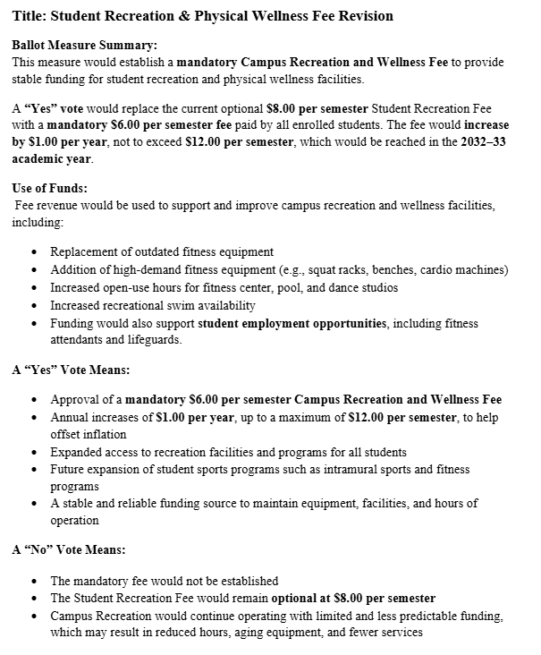
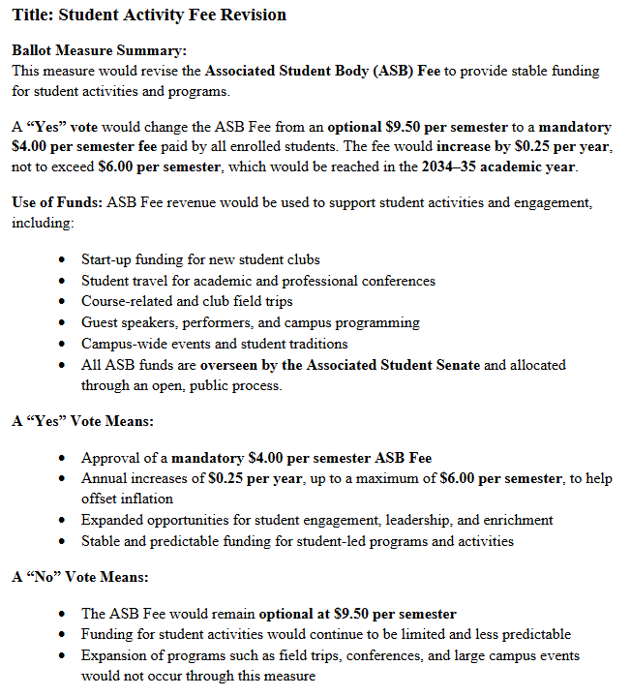
Next Steps – Ballot Measure
Notes:
Ericka

Slide 65

Campus Climate Survey Findings - Resources
25%-47% of Respondents indicated “Don’t know” or “No opinion” on questions around resource planning and allocation process.
  Report on funded resource requests
  Funding sources for resource requests
  Process resource requests are reviewed and funded

Slide 66














Funded Resource Requests 2023-24
  Some funded items of 2023-24
65
One-Time Resource Requests
36 Funded

Slide 67
Funding for PPR Resource Requests
PARS Trust PPR “Endowment”
Investment
$2.7M
Gains
$1,052,047
PPR Fund Balance 2025
$3,622,047
Distribution (2020)
$130K

Slide 68


Funding for PPR Resource Requests – Cont’d
Leveraging the PARS Trust PPR Funds
PPR Funding 2022-25
Salary Savings
Lottery Funds
Grant Funds
Bond Funds

Slide 69
PPR Process to Fund Resource Requests
Departments Submit PPR
Area combines & prioritizes requests
President’s Cabinet reviews prioritization, funding & discusses w/ Crafton Council
PPR Committee combines & prioritizes area requests – sends to Crafton Council & Pres Cabinet
Managers informed of funded requests for procurement

Slide 70
Group Activity: Reflecting on Our EMP Contributions

Slide 71
Overview of EMP
The Educational Master Plan (EMP) is CHC’s roadmap for actualizing its college mission
The strategic directions (SD) are the college’s overarching EMP goals
The EMPC is charged with developing the EMP and monitoring its progress
  The progress on each SD is documented each semester
  The EMPC reviews and approves such progress before it shared with our district chancellor and board of trustees
You can find the most recent update for each SD here: https://drive.google.com/file/d/13tLqM_LTrAgSact4pUmpE8zKAL6wsDx3/view?usp=sharing

Slide 72
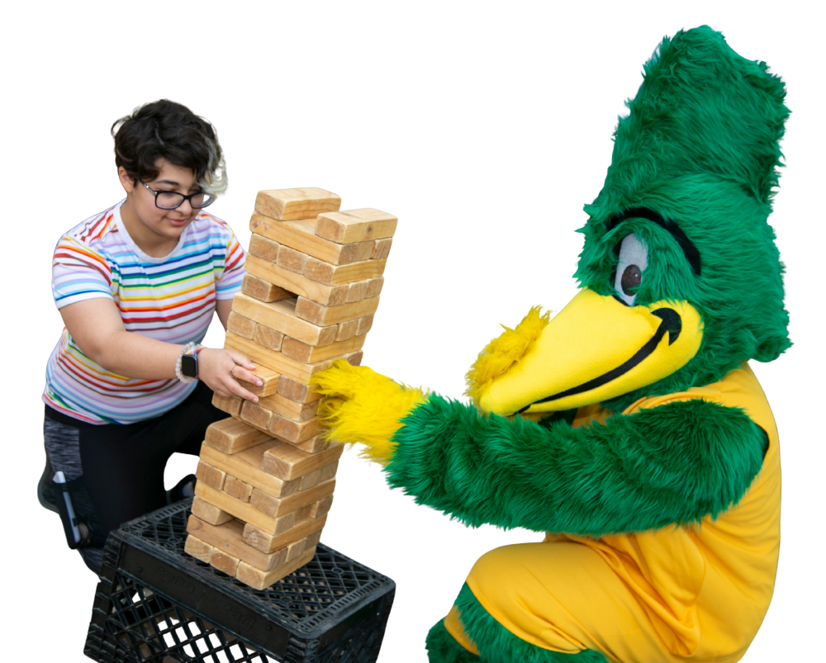
Activity Instructions
Instructions
  Respond to Discussion &
  Strategy Questions for
  assigned strategic direction(s)
  Complete Action Prompts

