Slide 1
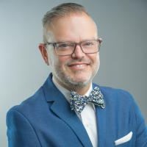
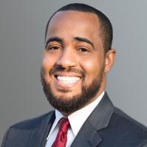
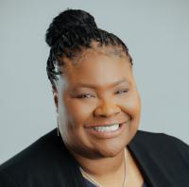
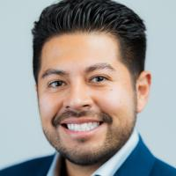
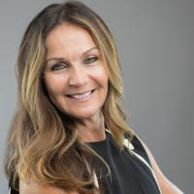
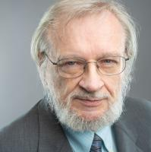
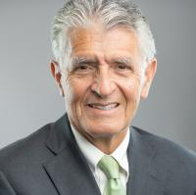
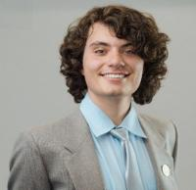
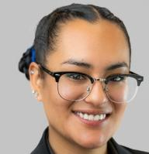
SBCCD Board of Trustees
Board Chair
Dr. Nathan Gonzales
Board Vice Chair
Joseph R. Williams
Board Clerk
Dr. Cherina Betters
Trustee
Carlos Aguilera
Trustee
Dr. Stephanie Houston
Trustee
John Longville
Trustee
Frank Reyes
Student Trustee
Hadi Natour
Student Trustee
Nelva Ruiz-Martinez

Slide 2

New & Promoted Roadrunners

Slide 3
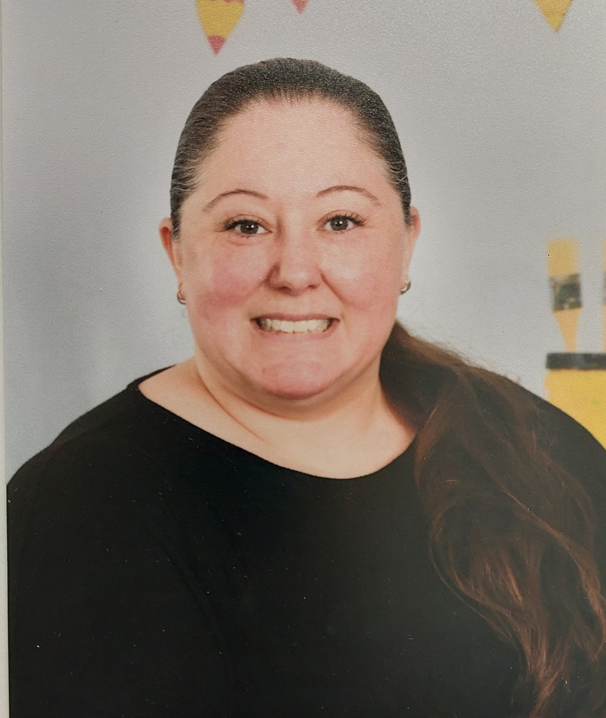
Welcome! Erin Blackwell Teacher, Child Development Center

Slide 4
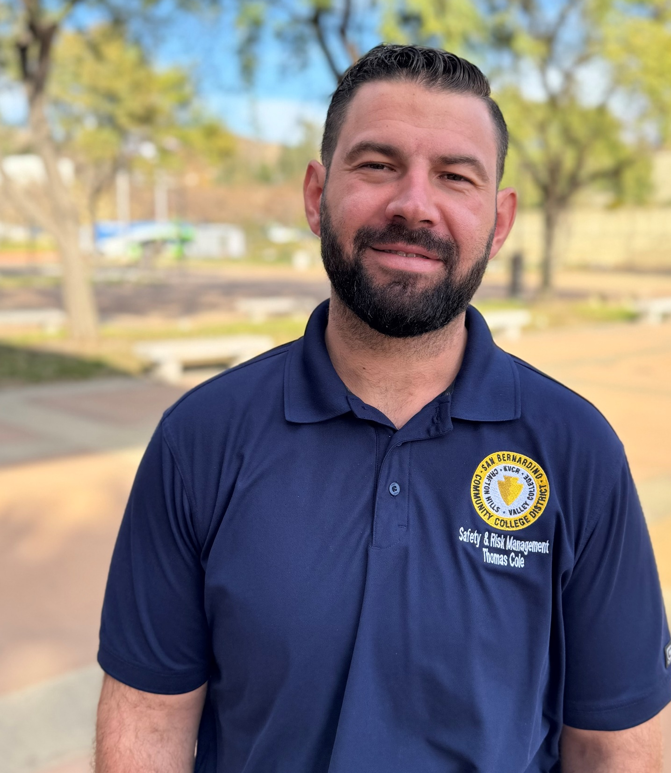
Welcome! Thomas Cole Campus Safety Specialist, Administrative Services

Slide 5
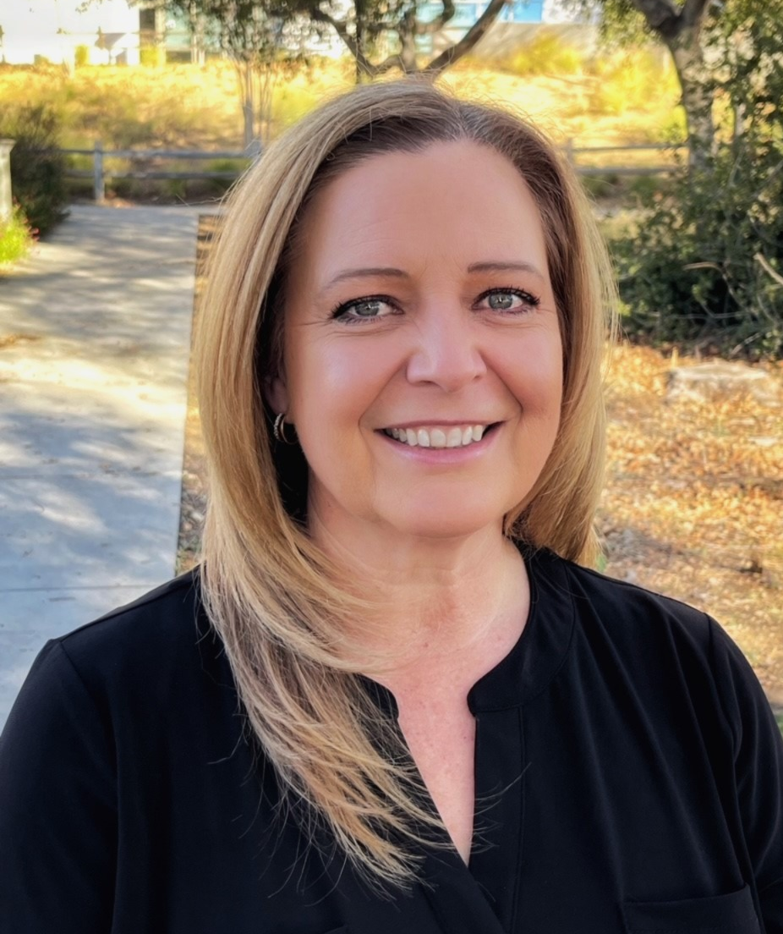
Congratulations! Carrie Audet Assistant Director, Foundation

Slide 6
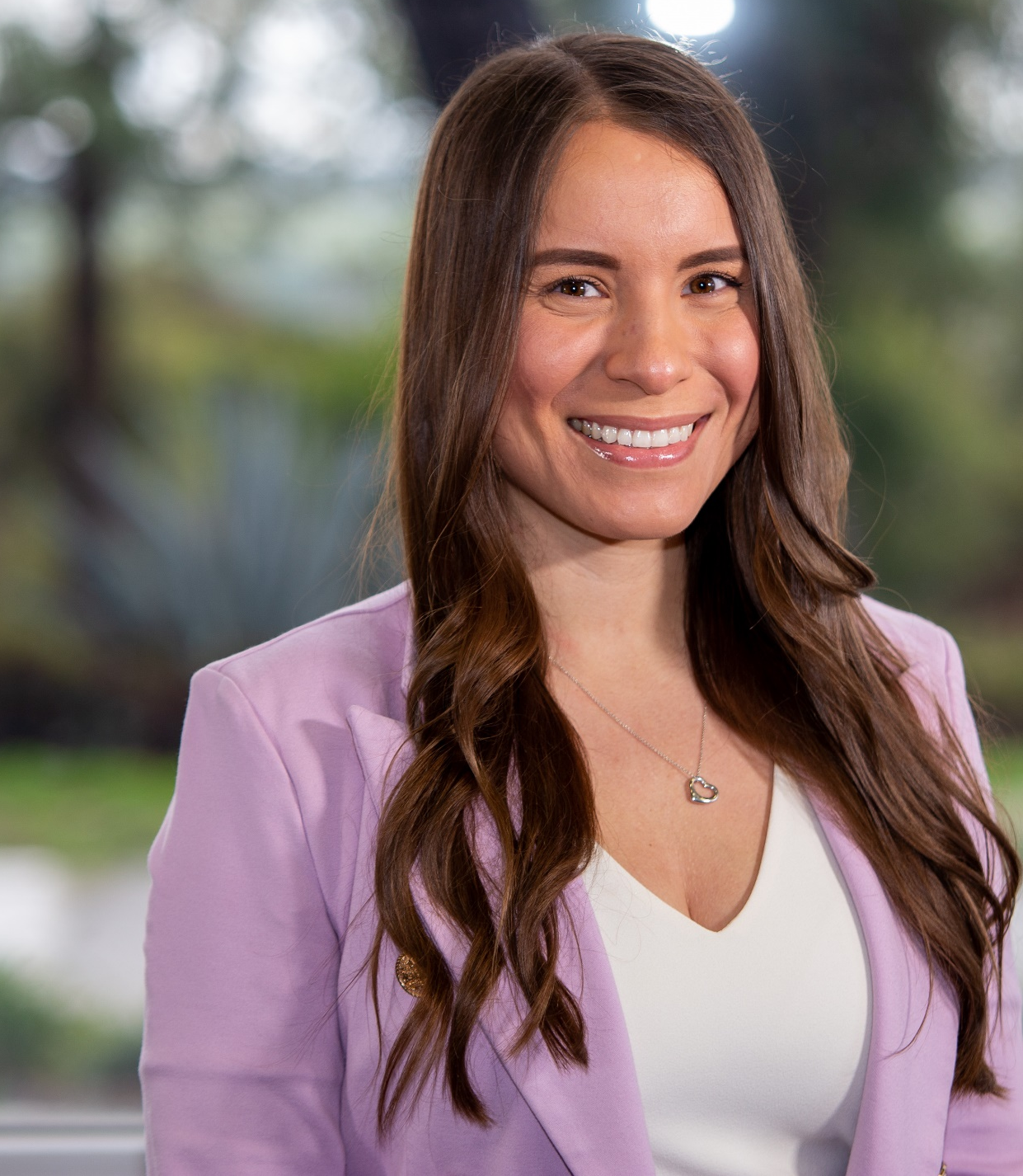
Congratulations! Belinda Navarrete Counselor, Student Services

Slide 7
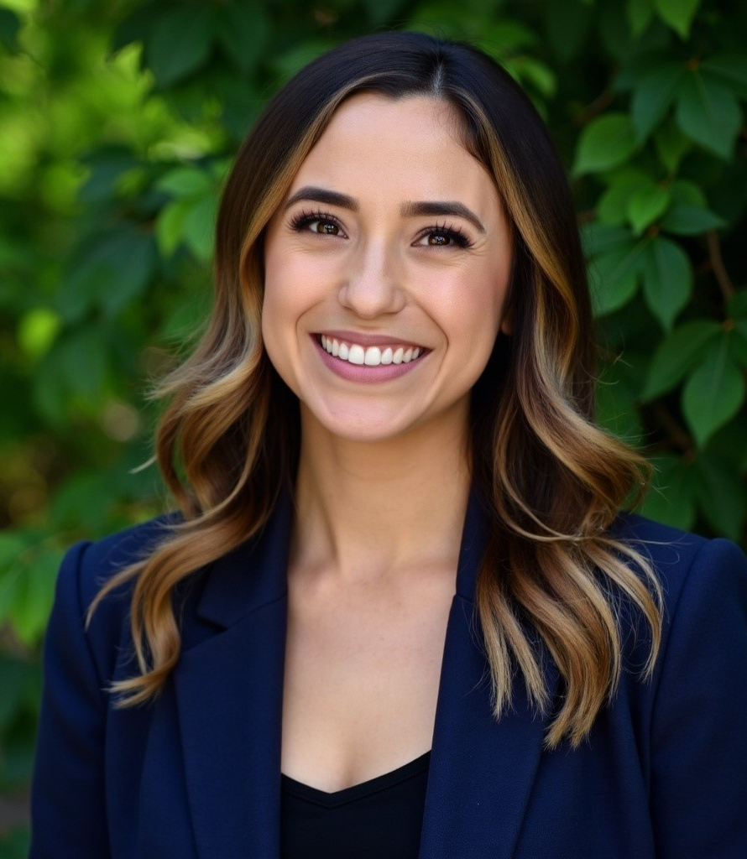
Congratulations! Sara Sosa Counselor, Student Services

Slide 8
Welcome Future Roadrunners

Slide 9
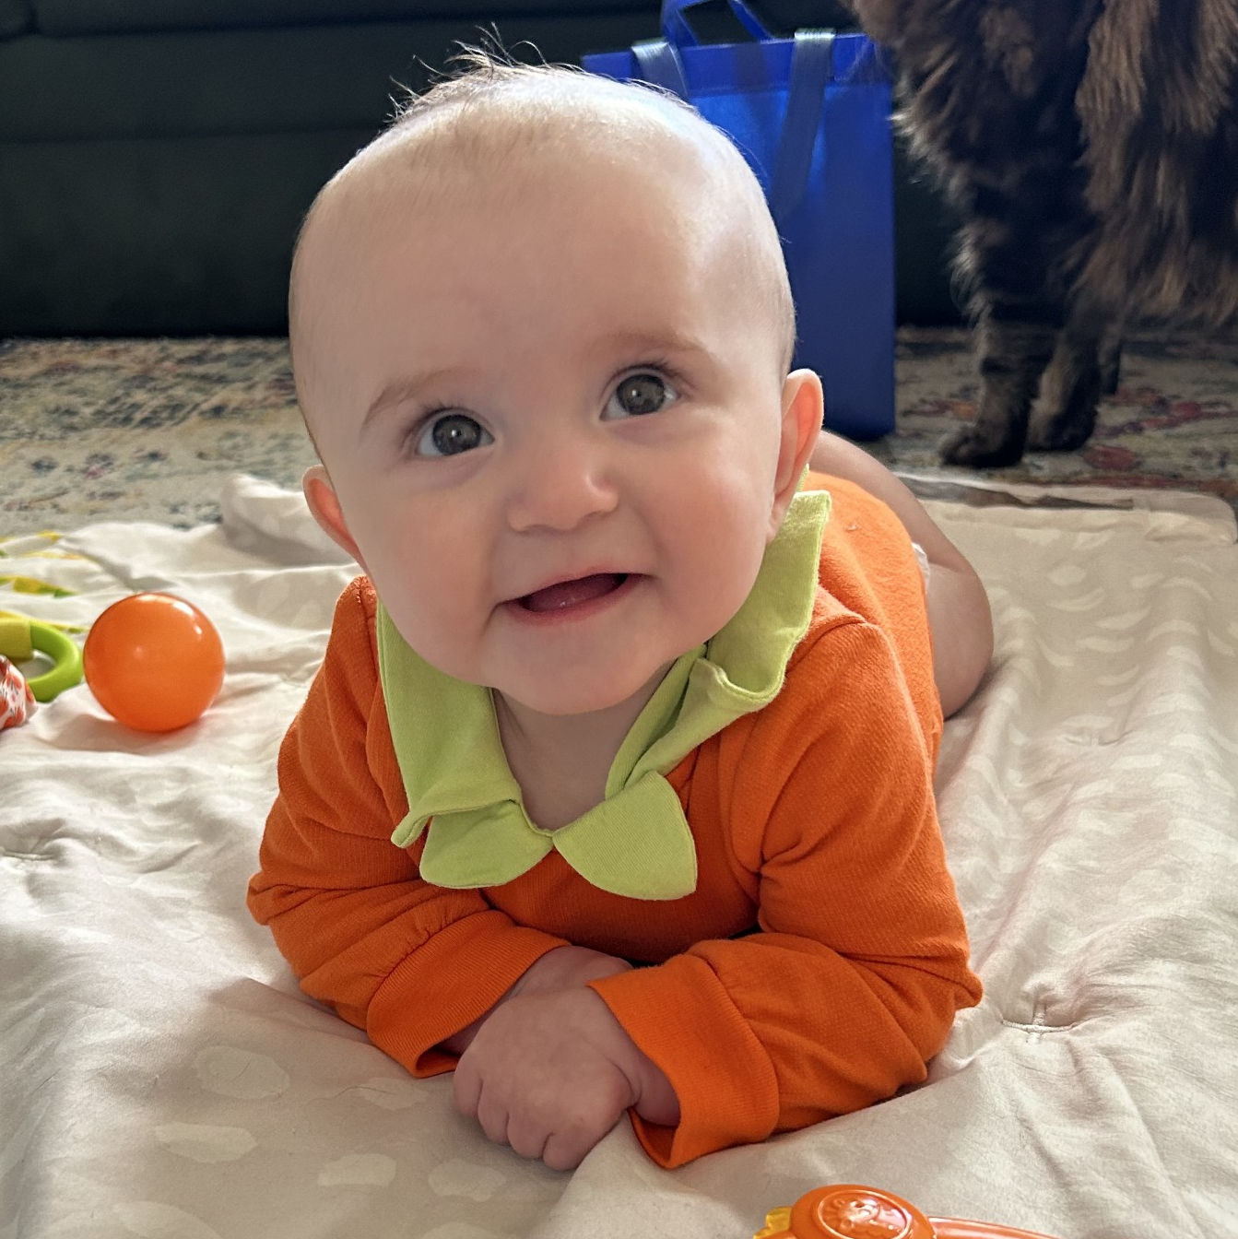
Congratulations on your future Roadrunner! Alex Beechko

Slide 10
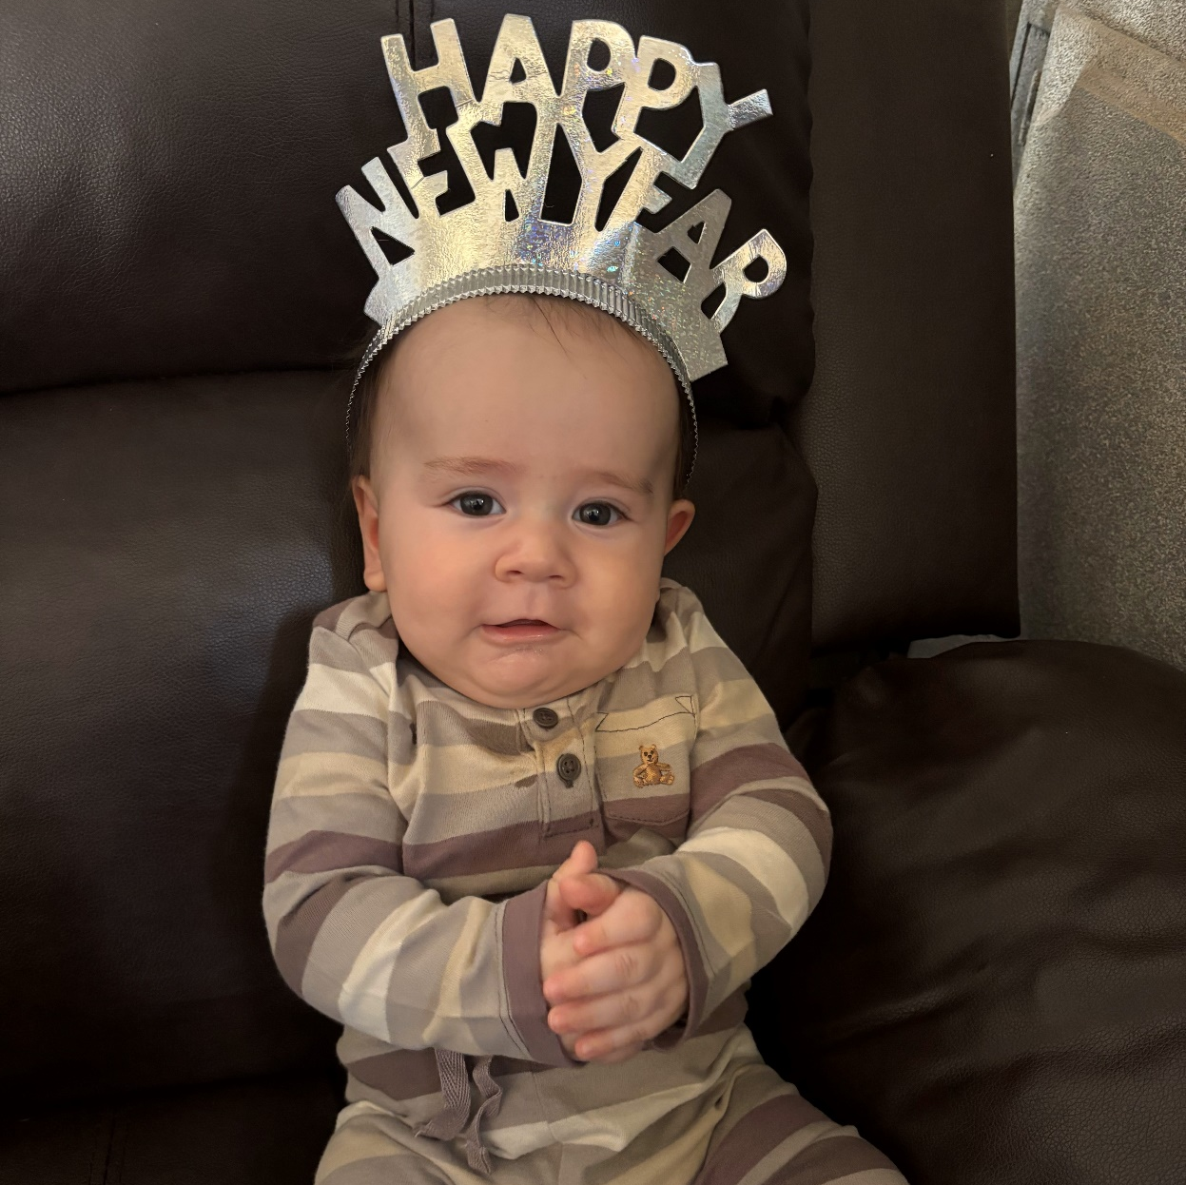
Congratulations on your future Roadrunner! Michelle Riggs

Slide 11
Administrative Services

Slide 12
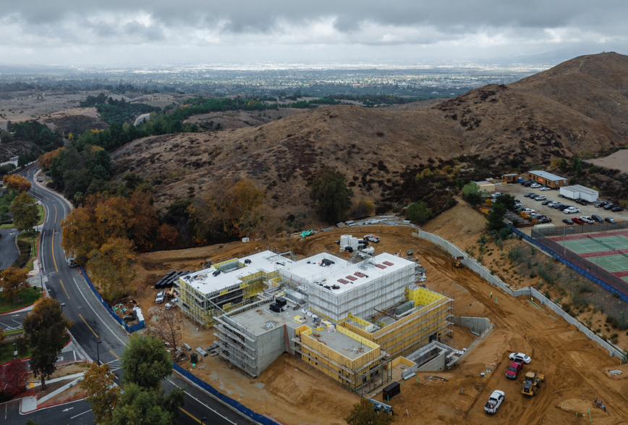



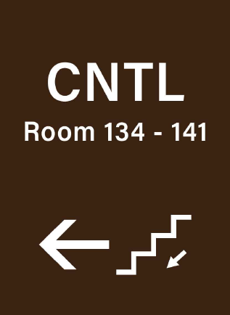

Administrative Services Update
PAC Construction
Wayfinding Prj.
Summer 2025
Photo by: Ethan Linstrom, Bright Photoworks
for Events Scheduling

Slide 13
Instructional Services

Slide 14
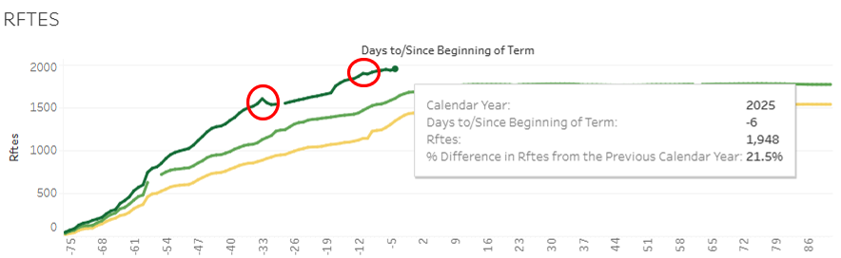
Spring 2025 Enrollments
The RFTES increased from 1,603 in Spring 2024 to 1,948 in Spring 2025, a 22% increase
Crafton is currently 125 RFTES above the Spring 2025 target
Great Job Everyone!

Slide 15
ACCJC Institutional Self-Evaluation Timeline Overview
Fall 2024
Crafton’s Self-Evaluation Approach Developed
December 15, 2026
Institutional Self-Evaluation Report due
Spring 2027
Peer Review – Team ISER Review
Fall 2027
Peer Review – Focused Site Visit
January 2028
Commission Action
Spring 2025
IEAOC Meets with Committees to begin writing Standards I and II
Fall 2025
IEAOC Meets with committees to begin writing Standards III and IV
Spring 2026 – Summer 2026
Review draft ISER in all constituent groups, recommend approval, and submit to Board
Fall 2026
Open Forums to prepare for Fall 2027 visit

Slide 16
Student Services

Slide 17
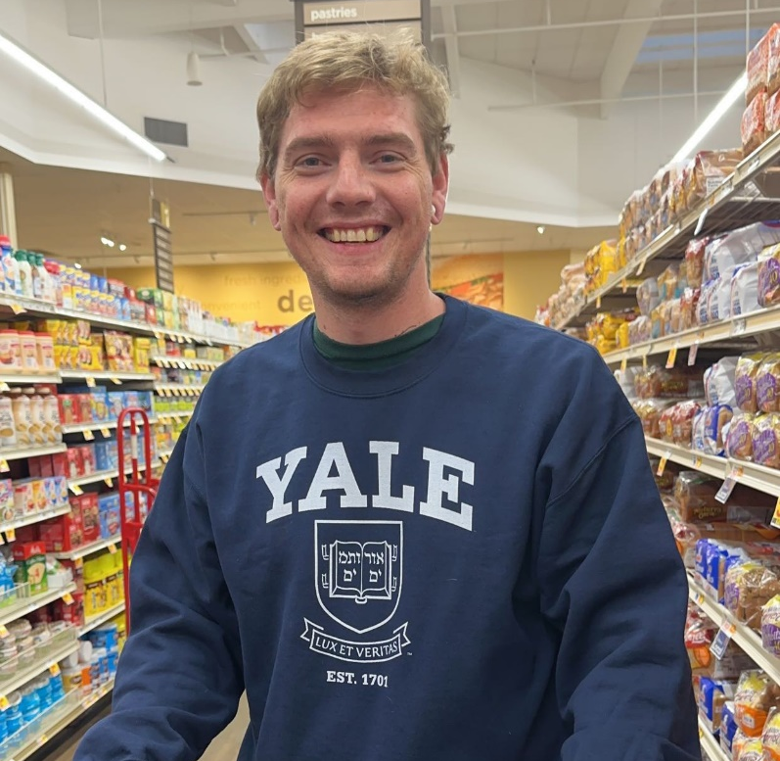
Student Equity Champion Award
Jared Shaw is majoring in Psychology and Art.
He currently works in the research department and he is an active member of the Art Club and the Honors Program.
Jared will also be serving as the Student Senate President in the Spring semester.
Nomination Statements
“Jared has always looked out for others, having a sensitivity to helping students who are not as visible or may not have as loud of a voice as everyone else, believing that no student should be left behind.”
“He has also helped advocate for the support of students, such as helping the previous Student Trustee, Michelle Ly, in crafting a SSCCC resolution pushing for having free/low-cost textbooks standardized across the state of California.”
Jared Shaw

Slide 18
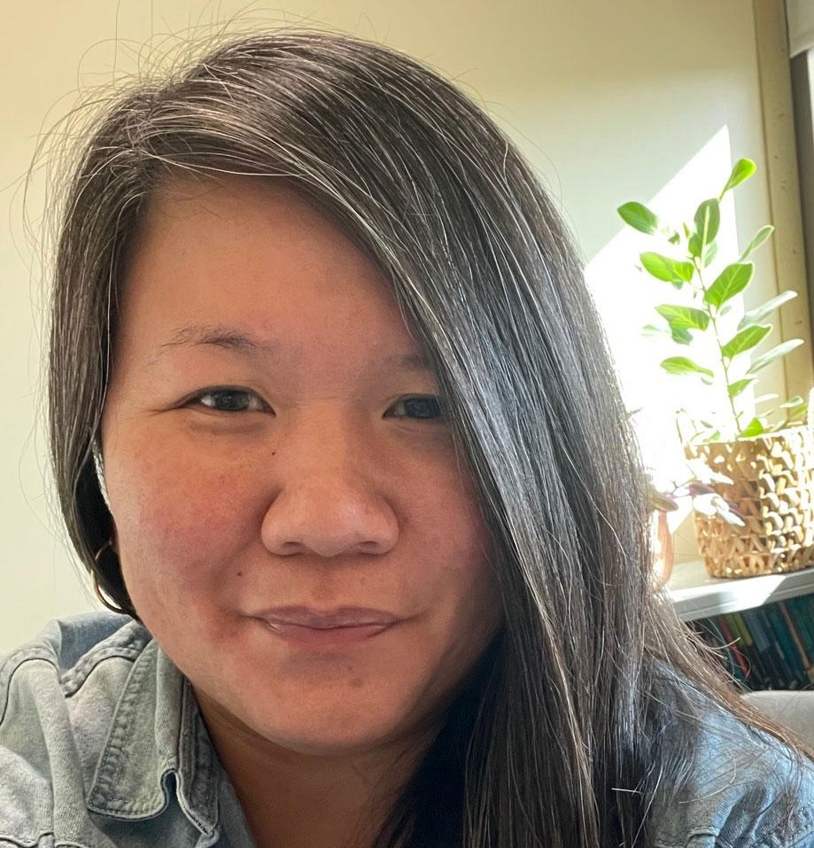
Employee Equity Champion Award
Chloe De Los Reyes, is an Associate Professor, and serves as the Multilingual Faculty Lead in the English Department
Chloe also serves as a member of SEAC, VESPA and is the Secretary for APIA.
Nomination Statements
“Chloe consistently engages with various cultural events, actively contributing to discussions and fostering an environment of support.”
“Her dedication to supporting ESL learners is characterized by a profound sense of empathy and dedication.”
“I saw the changes she made to her syllabus and it gave a strong message of support to her students, utilizing language that promotes inclusivity and equity.”
“Chloe is a role model to the campus on how to be an Equity Champion!'”
Chloe De Los Reyes

Slide 19
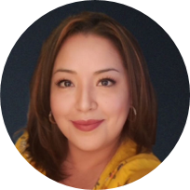
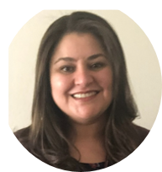
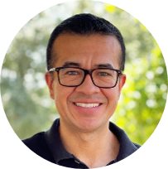
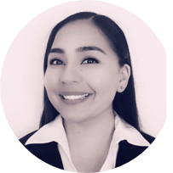
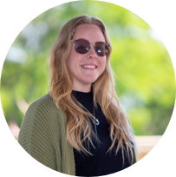
Department Equity Champions: Office of Institutional Effectiveness, Research & Planning
Nomination Statements
“The department plays a pivotal role in advocating for the needs of underrepresented groups on campus, including racial and ethnic minorities, LGBTQ+ students, students with disabilities, and first-generation college students.
Through leadership in equity initiatives, the department drives efforts like diversity training and campus-wide discussions to close equity gaps and foster inclusivity.
The department has supported over 89 faculty that completed USC Race and Equity Training.
The department took lead with the Vision Aligned Reporting (VAR)- a statewide effort designed to identify and eliminate student equity gaps in the access of services provided by student support services.
Ruby Zuniga
Ola Sabawi
Gio Sosa
Diana Vaichis
Jessica Beverson

Slide 20
Equity Champion Honorable Mentions
Faculty:
Diane Pfahler
Sandra Ruiz
Herberth Jaco
Nicholas Reichert
Students:
Ross Wallbank
Hadi Natour
Departments:
Career Center
Student Senate
Tutoring Center
EOPS
Paramedic Program

Slide 21
Student Services Updates
Development of 2025-28 Student Equity Plan - Spring 2025.
Associate Dean of Health and Wellness - Spring 2025.
Multicultural Center Workgroup will continue to meet to ensure we open our doors in Fall 2025.

Slide 22
One Book/One College

Slide 23
Thank you, One Book Team!
Sara Butler
Ciera Divens
Ed Ferrari
Kashaunda Harris
Monica Khalaj-LeCorre
Heather King
Eugenia Livingston
Natalie Lopez
Ericka Paddock
Michelle Riggs
Leslie Swindell
Kay Weiss
More members welcome! Please email Sara to join the team.

Slide 24
Criteria for Book Selections
1
Addresses issues of Equity and Inclusion
4
Has a message that can develop empathy
2
Relevant to the current student population
5
Helps build community amongst students and employees
3
Interdisciplinary and accessible

Slide 25



Slide 26
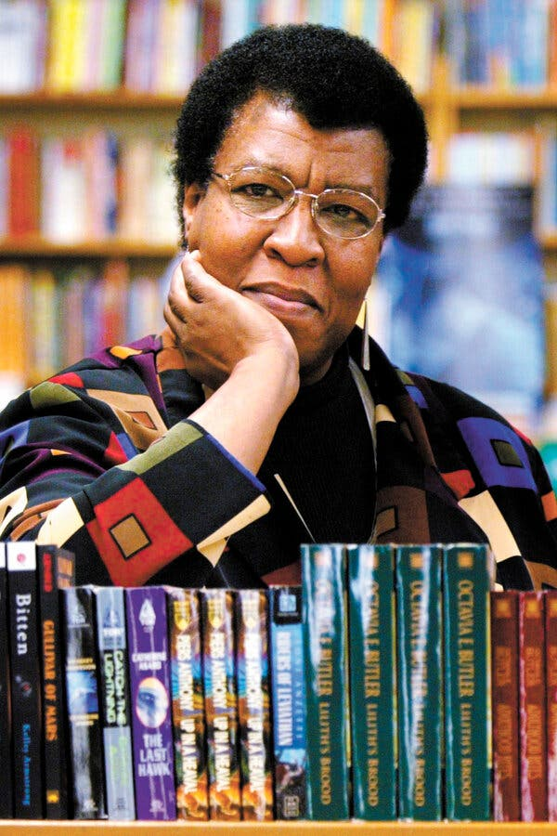
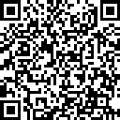
Adopting the book in your classes
Faculty wanting to use the book in their curriculum may pick up the book today.
Faculty who already have their copy and adopted in Fall, please scan the below QR code.

Slide 27

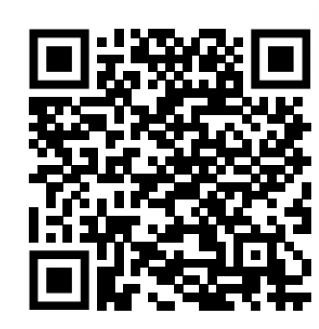
Parable of the Sower, OBOC site
Please share with your students and check back for updates.

Slide 28
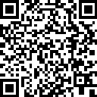
OBOC in 2025-2026
To make a suggestion for the OBOC selection next academic year, submit by 1/31/25.

Slide 29

