Slide 1

New & Promoted Roadrunners

Slide 2
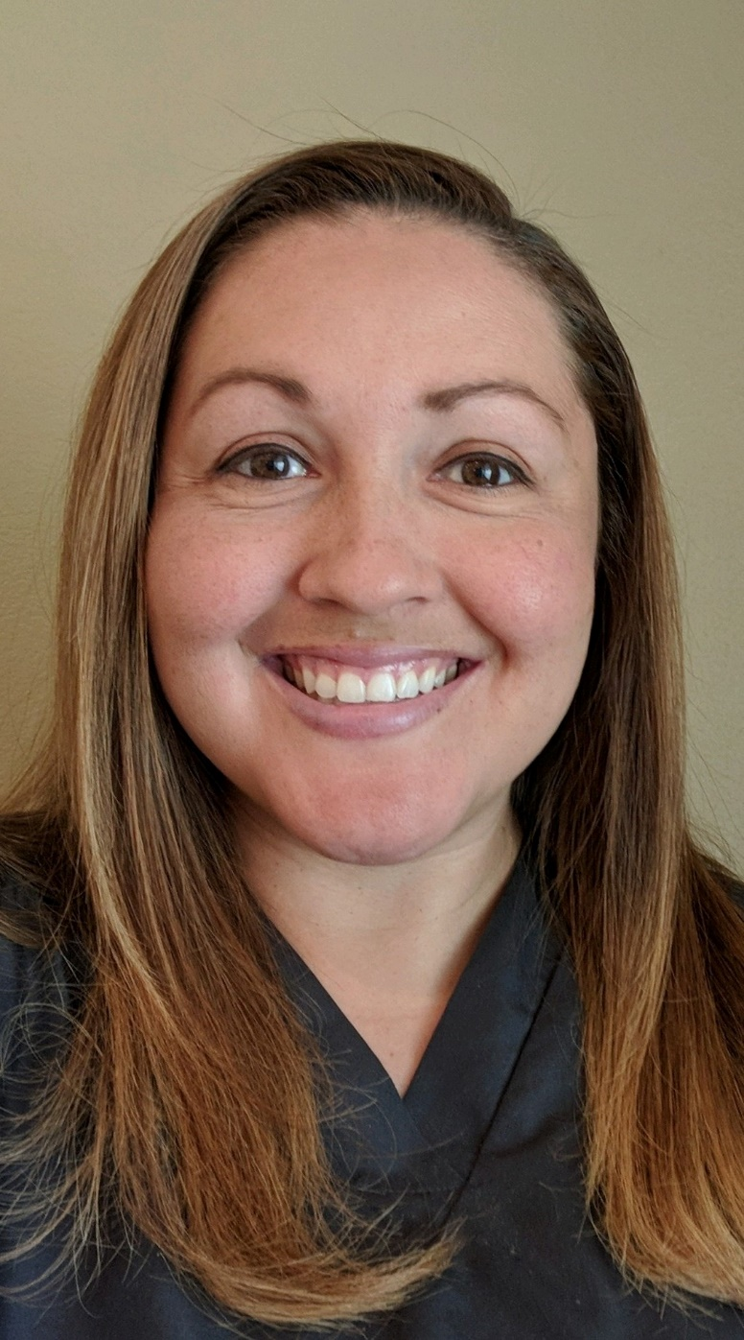
Welcome!
Valerie Sevilla
Full Time Instructor,
Respiratory Care

Slide 3
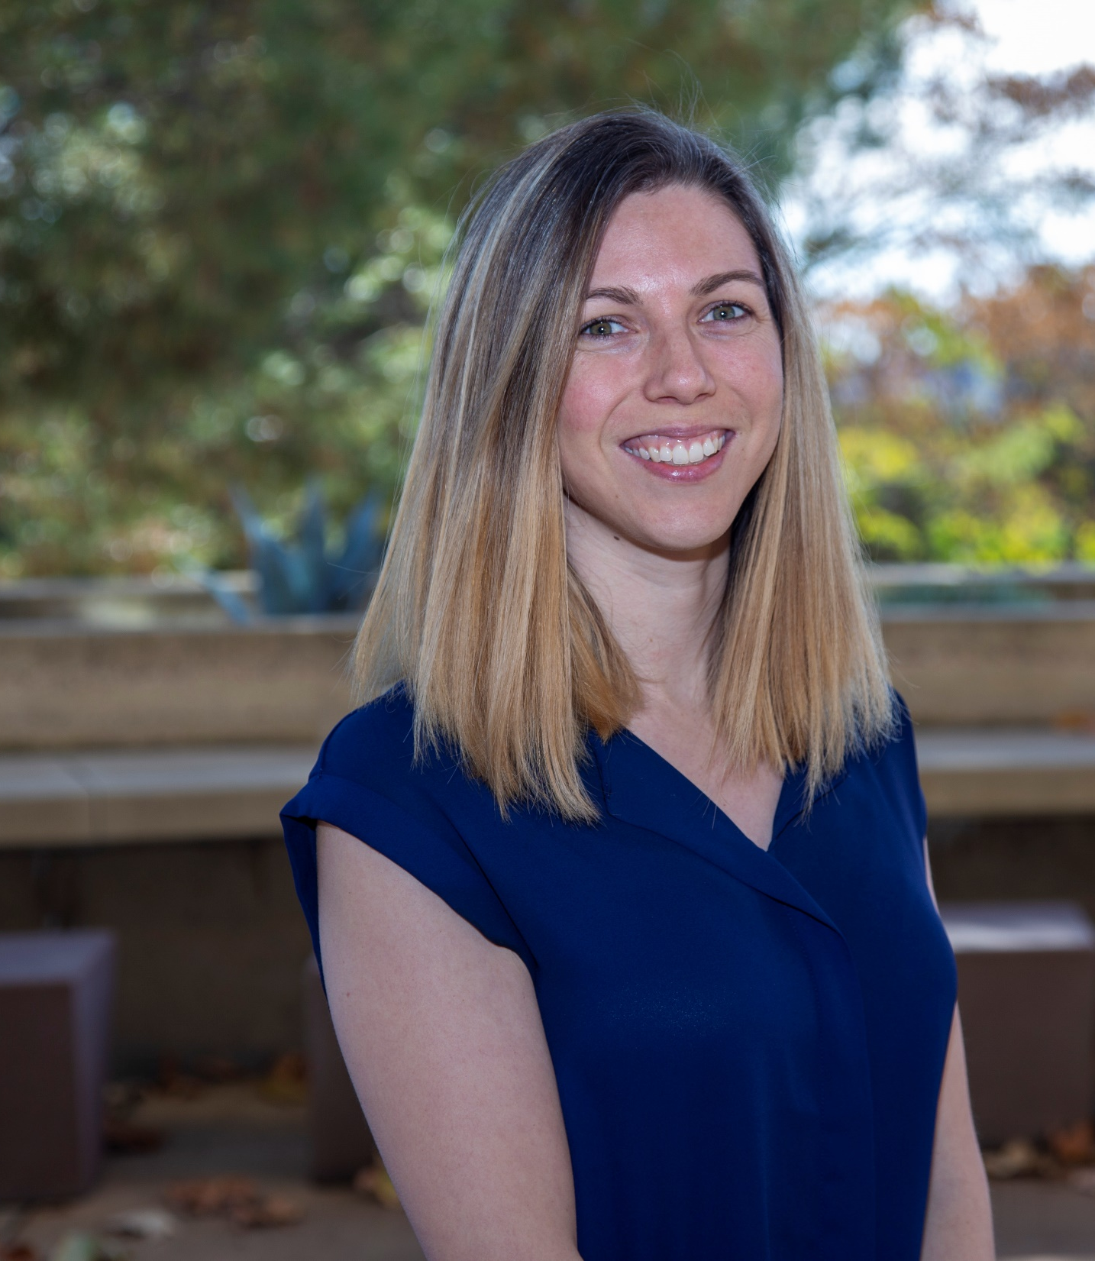
Welcome!
Caroline Aguirre
Administrative Assistant, STEM/MESA

Slide 4
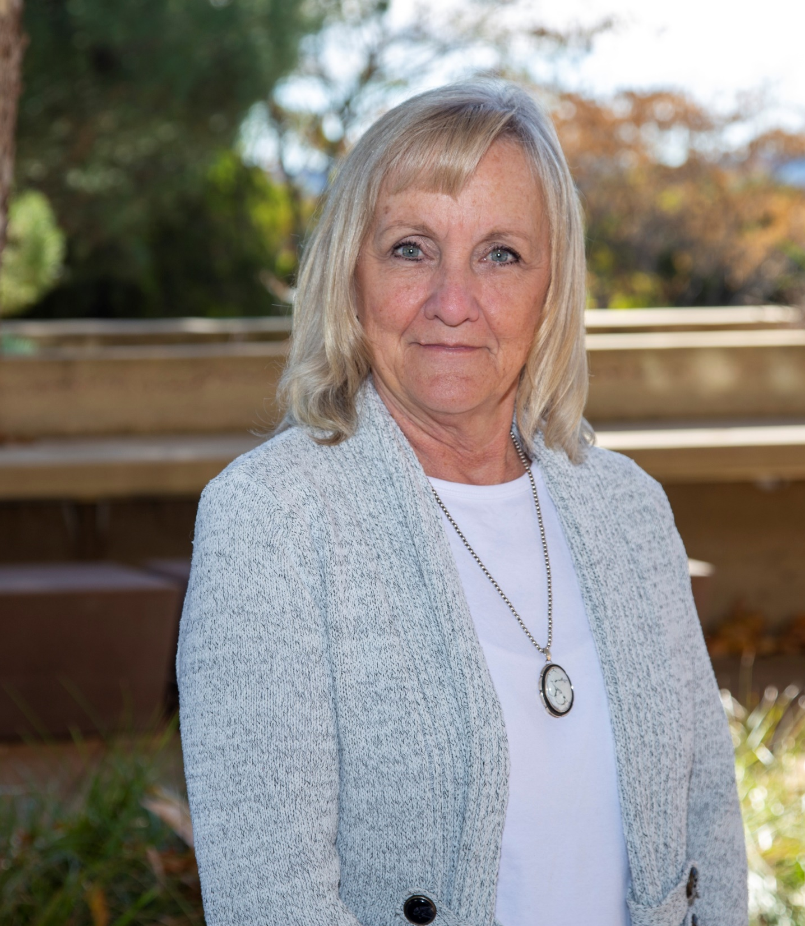
Welcome!
Ellen Benefiel
Development Assistant, Institutional Advancement

Slide 5
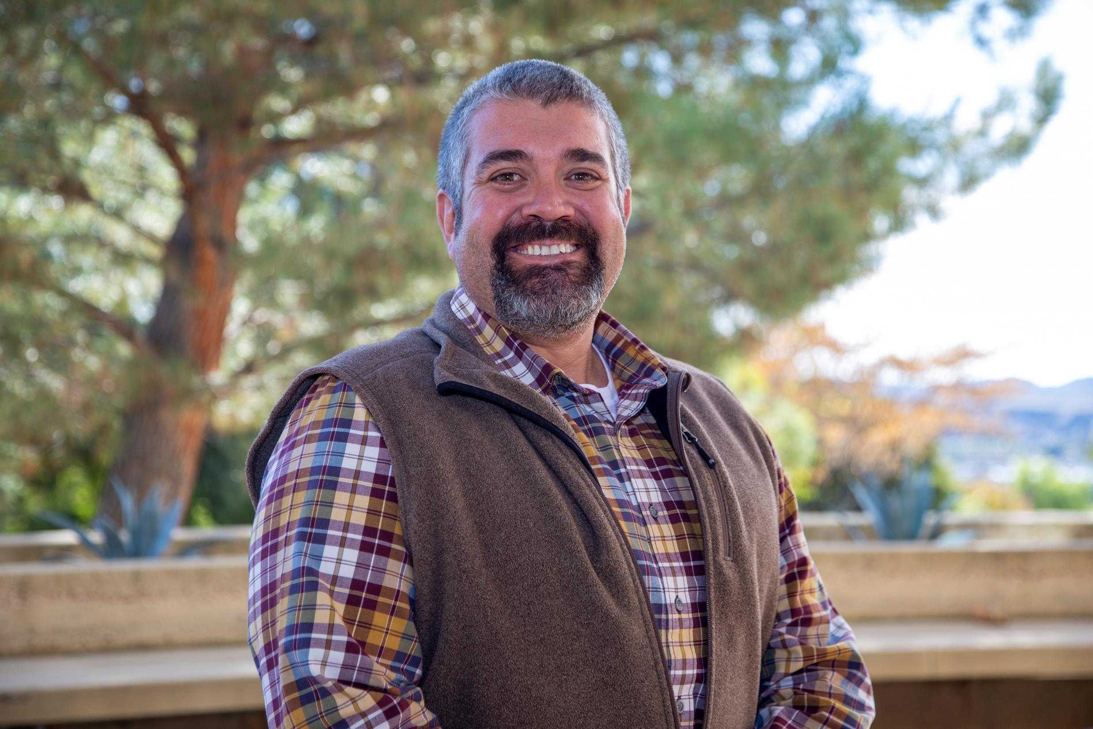
Welcome!
Demian Brunty
Director, Facilities

Slide 6
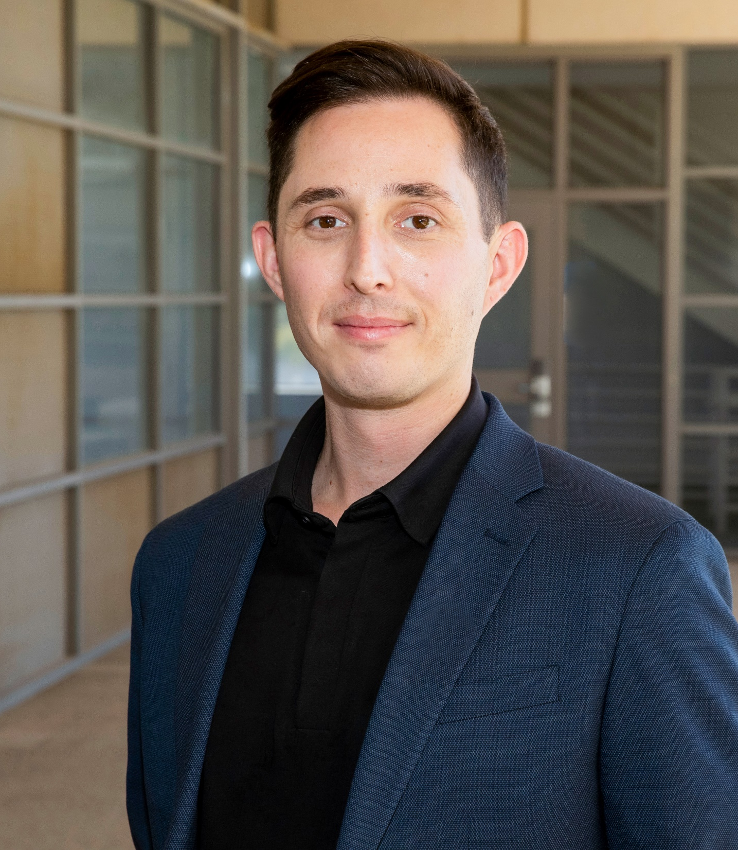
Welcome!
Geoffrey Escher
Catalog Data Specialist, Office of Instruction

Slide 7
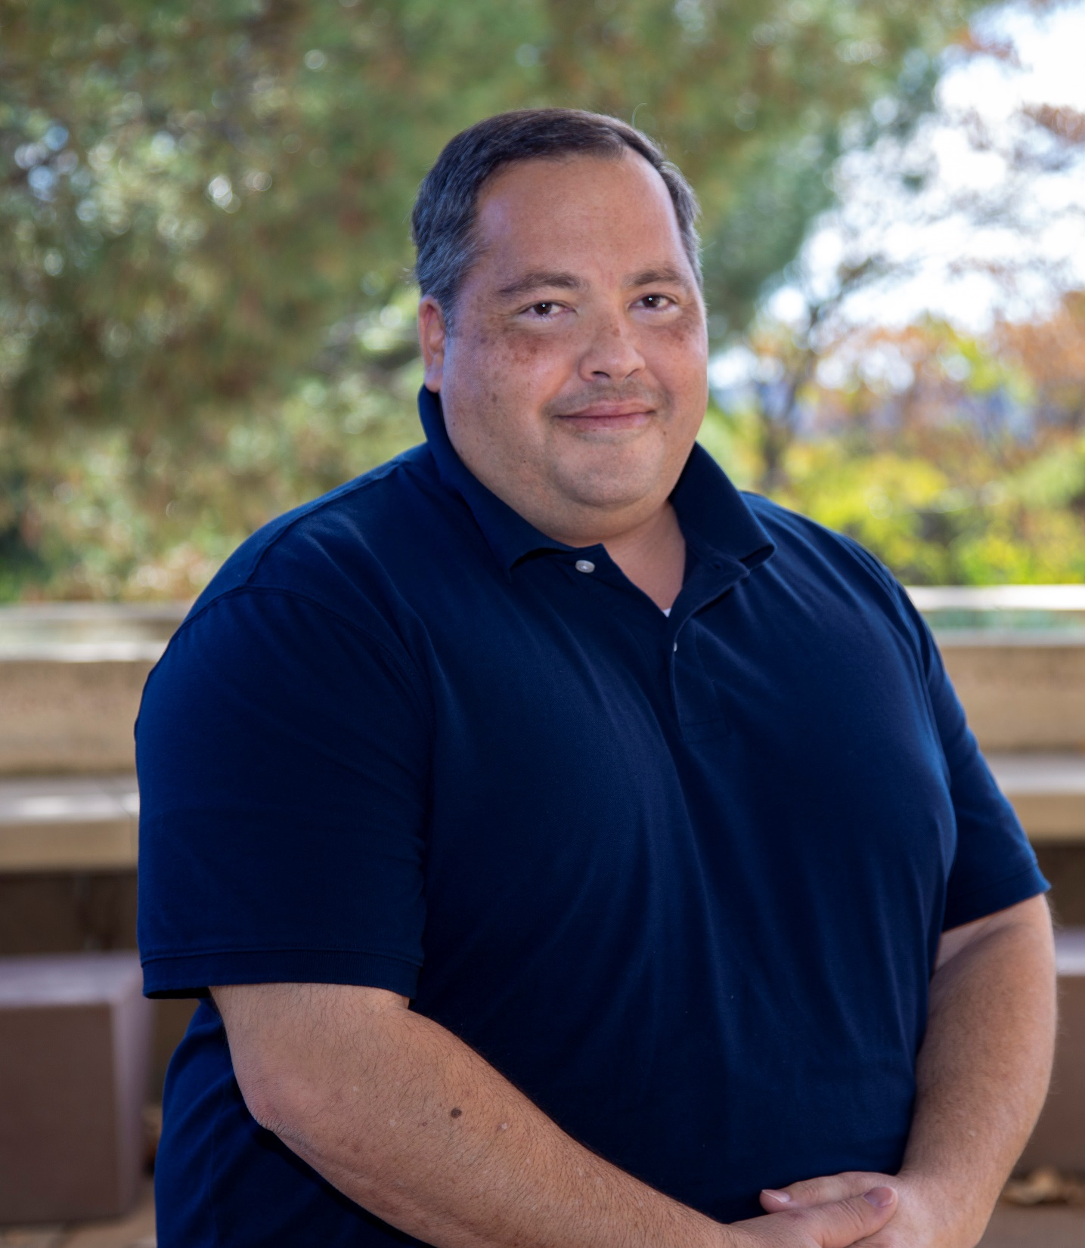
Welcome!
Aaron Oxendine
Director, Technology Services

Slide 8
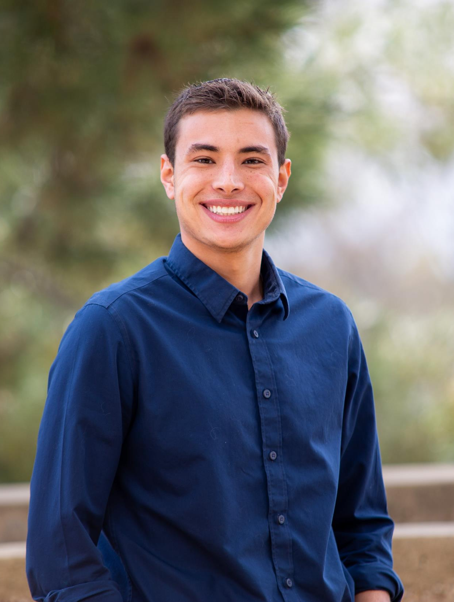
Congratulations!
Zachary Cortz
Student Engagement Specialist, Student Life

Slide 9
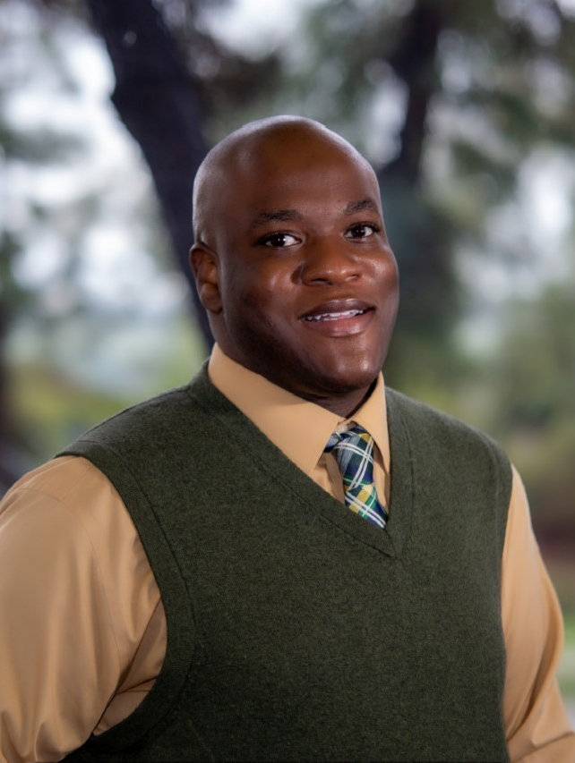
Congratulations!
Willie Blackmon
Dean, Student Services (Permanent)

Slide 10
Dr. Janee Both Gragg

Slide 11

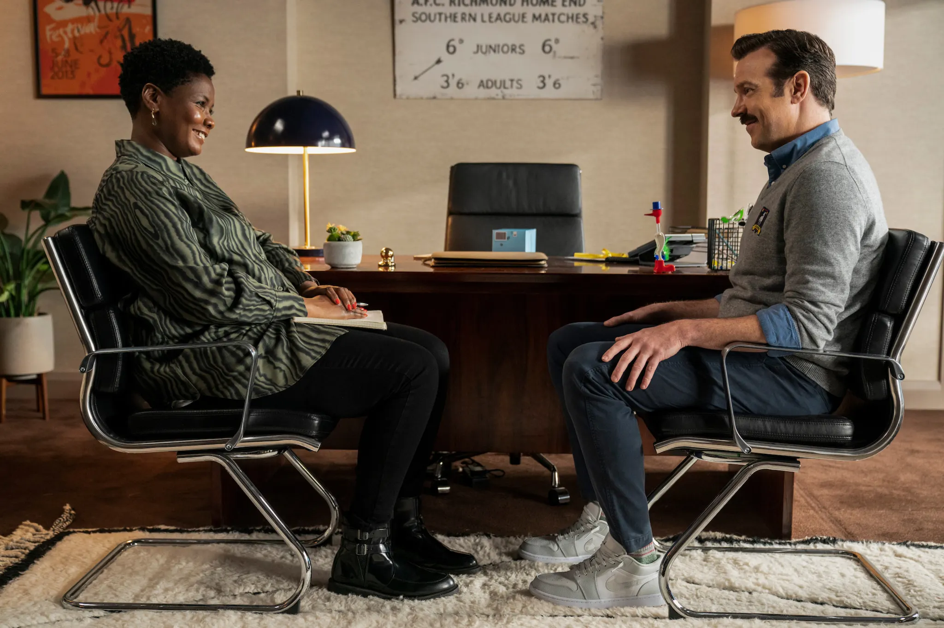
Finding Sharon Fieldstone
An initiative to support workforce wellbeing at Crafton Hills College

Slide 12



Collaborative efforts to co-create a customized program

Slide 13


Why ACTW
Our History
Our Mission
Our Vision
Our Values
Our Focus

Slide 14
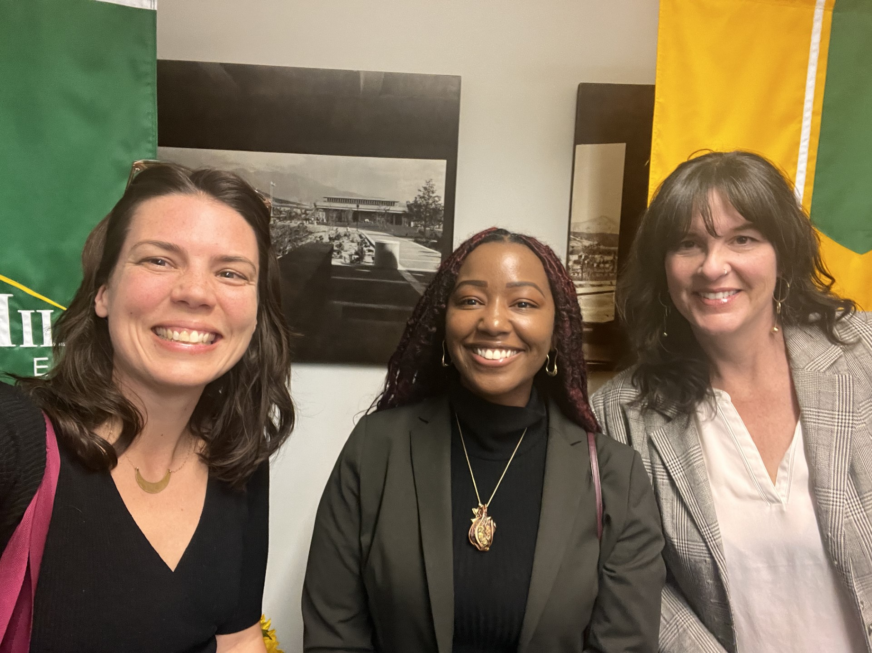
Why Now
Changes in the workforce landscape
Continued difficulty accessing mental health resources.
Increases in number of people experiencing mass trauma and loss
Stigma associated with accessing care is slowly decreasing.
Trends toward workplace emphasize the importance of integrating opportunities to feel safe, learn, grow, connect, and belong in our places of employment.

Slide 15
Project Goals:
Improving workforce well-being
Providing customized programming
Engaging employees in exploring ways to sustainably scale, support and implement activities and services
Enhancing university and community partnerships
Identifying and distributing approaches to supporting workforce well-being in higher education

Slide 16
Project Objectives:
Using evidence to guide programing choices and curriculum development
Assessing baseline needs & interests of pilot participants
Targeting (but not limited to) topics and skill development around work-life balance, emotional & physical health, family, health advocacy, elder care, and divorce
Evaluating & refining curriculum

Slide 17
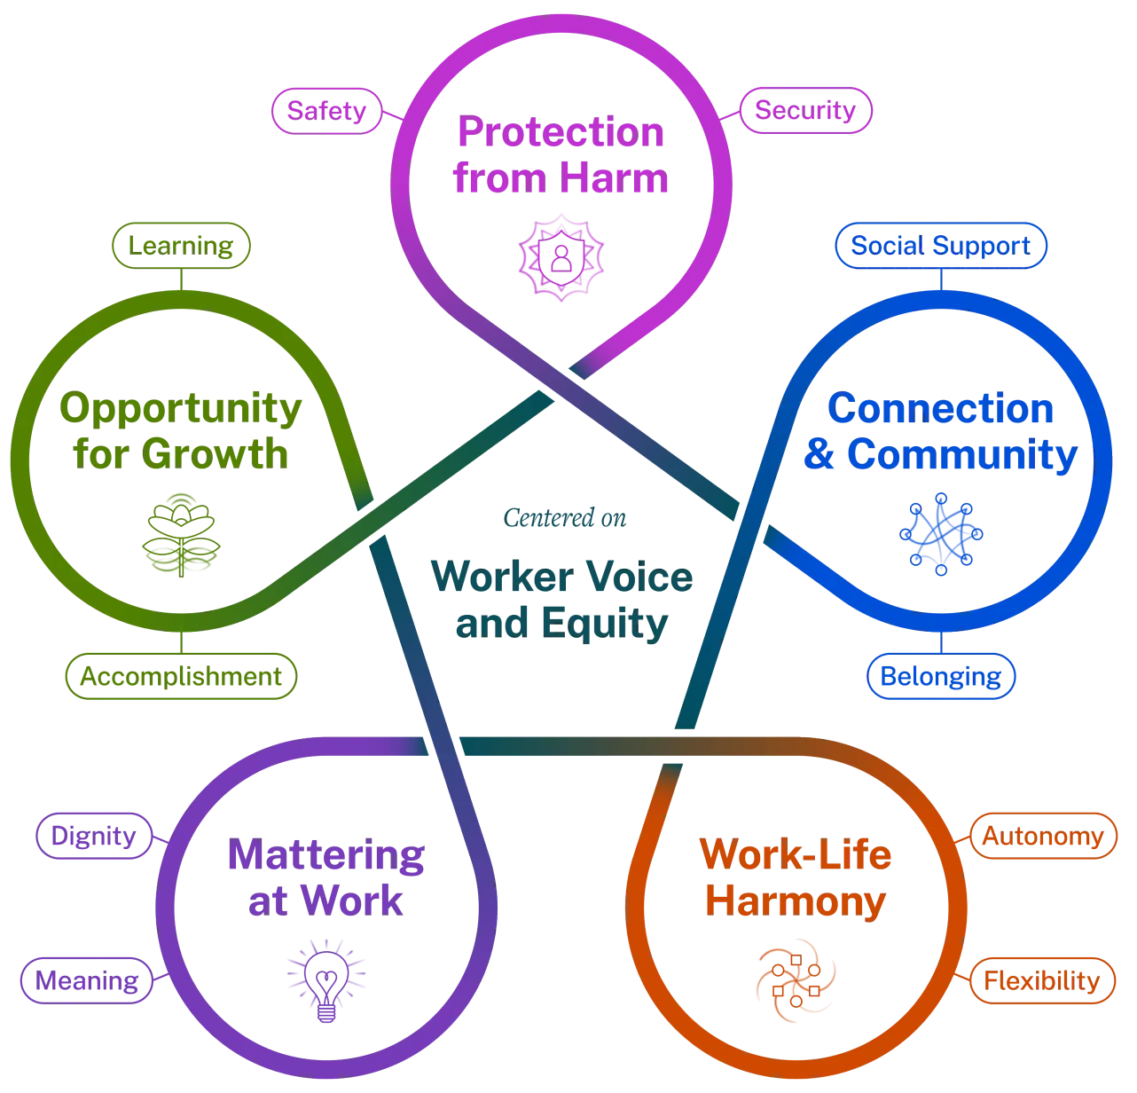
With attention to post-COVID need this pilot project:
Is inspired by the Surgeon General’s 2022 Workplace Mental Health and Well-being Initiative
AND

Slide 18
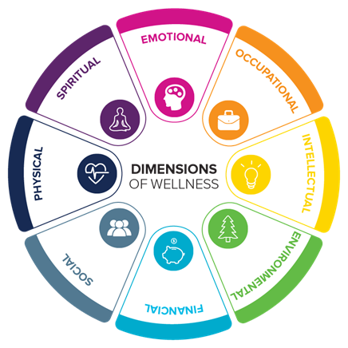
Grounded in SAMHSA’s 8 Domains of Wellness

Slide 19

The Program
Workplace Wellness Training

Slide 20
On-site Service Delivery
6 hours of on-site service delivery from a range of health and wellness providers
  Workshops
  Individual/dyadic/triadic consultations
Vetted off-site service providers

Slide 21

Final Report
End of June

Slide 22

ACTW would like to acknowledge this project in the context of a larger movement associated with IE 2030. With the goal of moving communities from the need for critical resources to one of vital conditions, intentional care is given to creating a well-being economy. Here, wellness is at the center of economic growth, business strategies, and policy design.

Slide 23

One Book One College

Slide 24
Thank you, One Book Team!
Judy Cannon
Rejoice Chavira
Chloe de los Reyes
Ciera Divens
Ed Ferrari
Kashaunda Harris
Monica Khalaj-LeCorre
Eugenia Livingston
Natalie Lopez
Ericka Paddock
Michelle Riggs

Slide 25
Spring, 2024
When | Where | What | Note
January 24 at noon | Library | Gallery Walk Opening | Come explore the Smithsonian display related to the internment of Japanese-Americans
Ongoing | Library | Gallery Walk | View the Smithsonian posters housed in the library and invite your students to share their reflections
1st and 3rd Thursday at 2:00pm | Library | Book Discussion | You do NOT have to have read the book to participate!
February 7 at 12:00 |  | Reading a Graphic Novel
February 21 at 12:00 | Zoom | Documentary Screening: A Question of Loyalty
March 6 at 12:00 |  | Honors Presentation
March 27 at 12:00 | LRC 226 | Documentary Screening – Children of the Camps
April 9 at 4:30 | PAC | An Evening with George Takei | A Q&A with the author
April 17 at 12:00 | Zoom | Guest Speaker Pat Hayashi | Meet Mr. Hayashi who was born in an internment camp

Slide 26

Gallery Walk
Stop by the library and view the posters Righting a Wrong: Japanese Americans and World War II
Each Poster poses questions. You are encouraged to share reflections on those questions
Bring your class to the library to add to the dialogue!

Slide 27
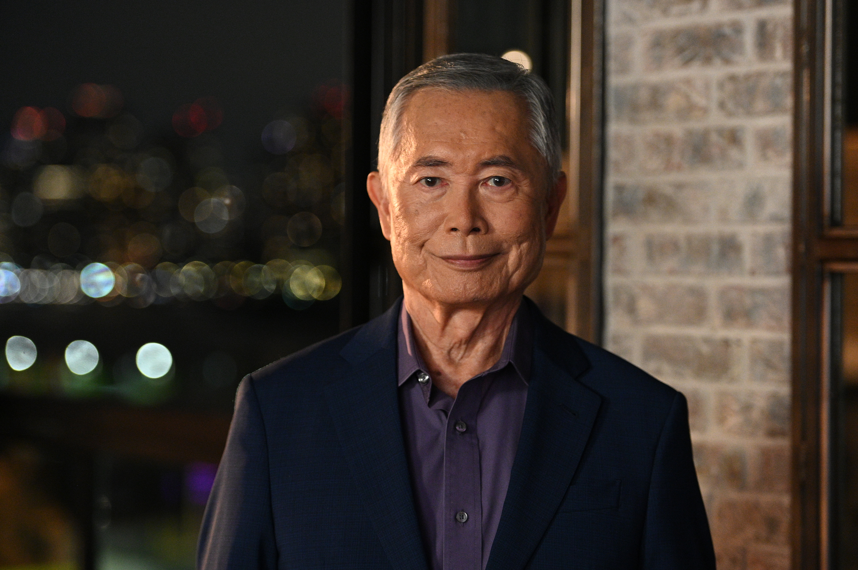
George Takei
April 9
4:30pm

Slide 28

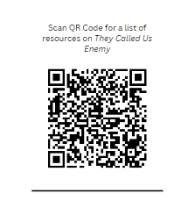
Additional Resources

Slide 29
2024 — 2025
What does the future have in store?

Slide 30
Criteria for Book Selections
1
4
Has a message that can develop empathy
Addresses issues of Equity and Inclusion
2
Relevant to the current student population
5
Helps build community amongst students and employees
3
Interdisciplinary and accessible

Slide 31
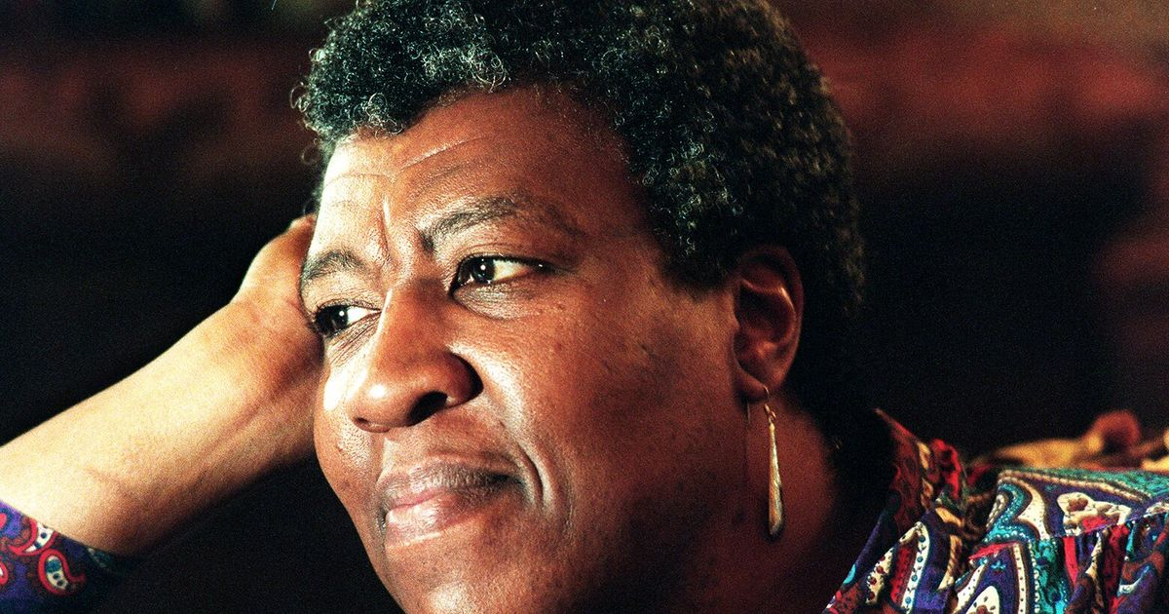
Octavia Butler

Slide 32


gripping dystopian novel science fiction
engages with many of the most prominent social issues of our time
is kind of having a moment

Slide 33

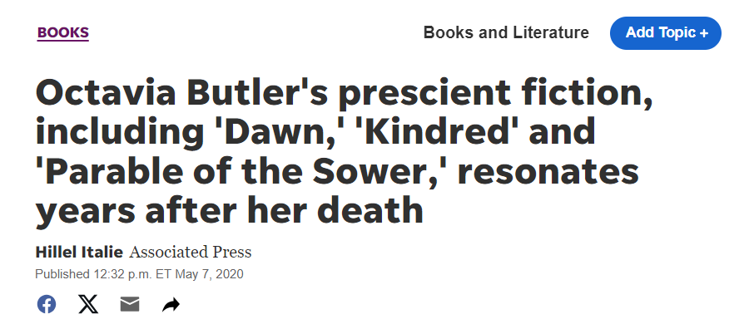
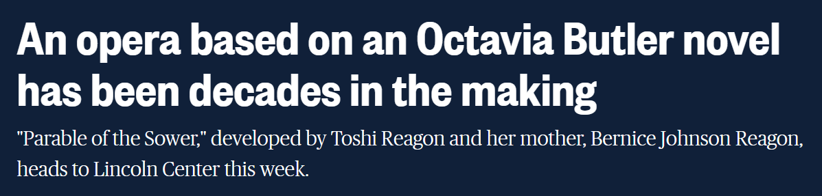


Slide 34



One Book, One … ?

Slide 35
Thank you!
(And watch this space).

Slide 36
Instruction Update

Slide 37
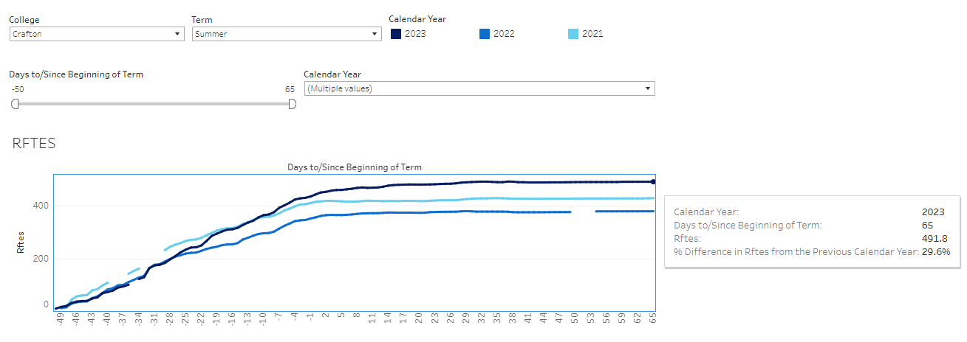
Summer 2023 Enrollments
The RFTES increased from 380 in Summer 2022 to 492 in Summer 2023, a 30% increase
Great Job Everyone!
Sumer 2023 Target is 430

Slide 38
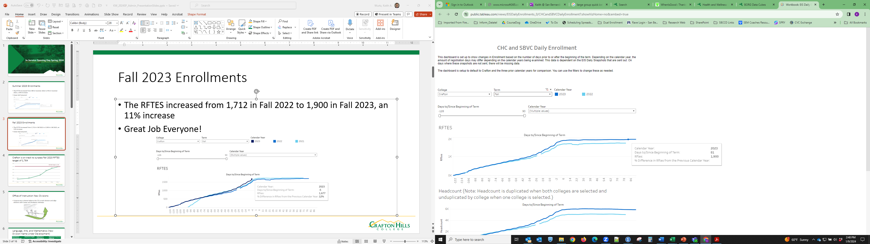
Fall 2023 Enrollments
The RFTES increased from 1,712 in Fall 2022 to 1,900 in Fall 2023, an 11% increase
Great Job Everyone!
Fall 2023 Target is 1,764

Slide 39
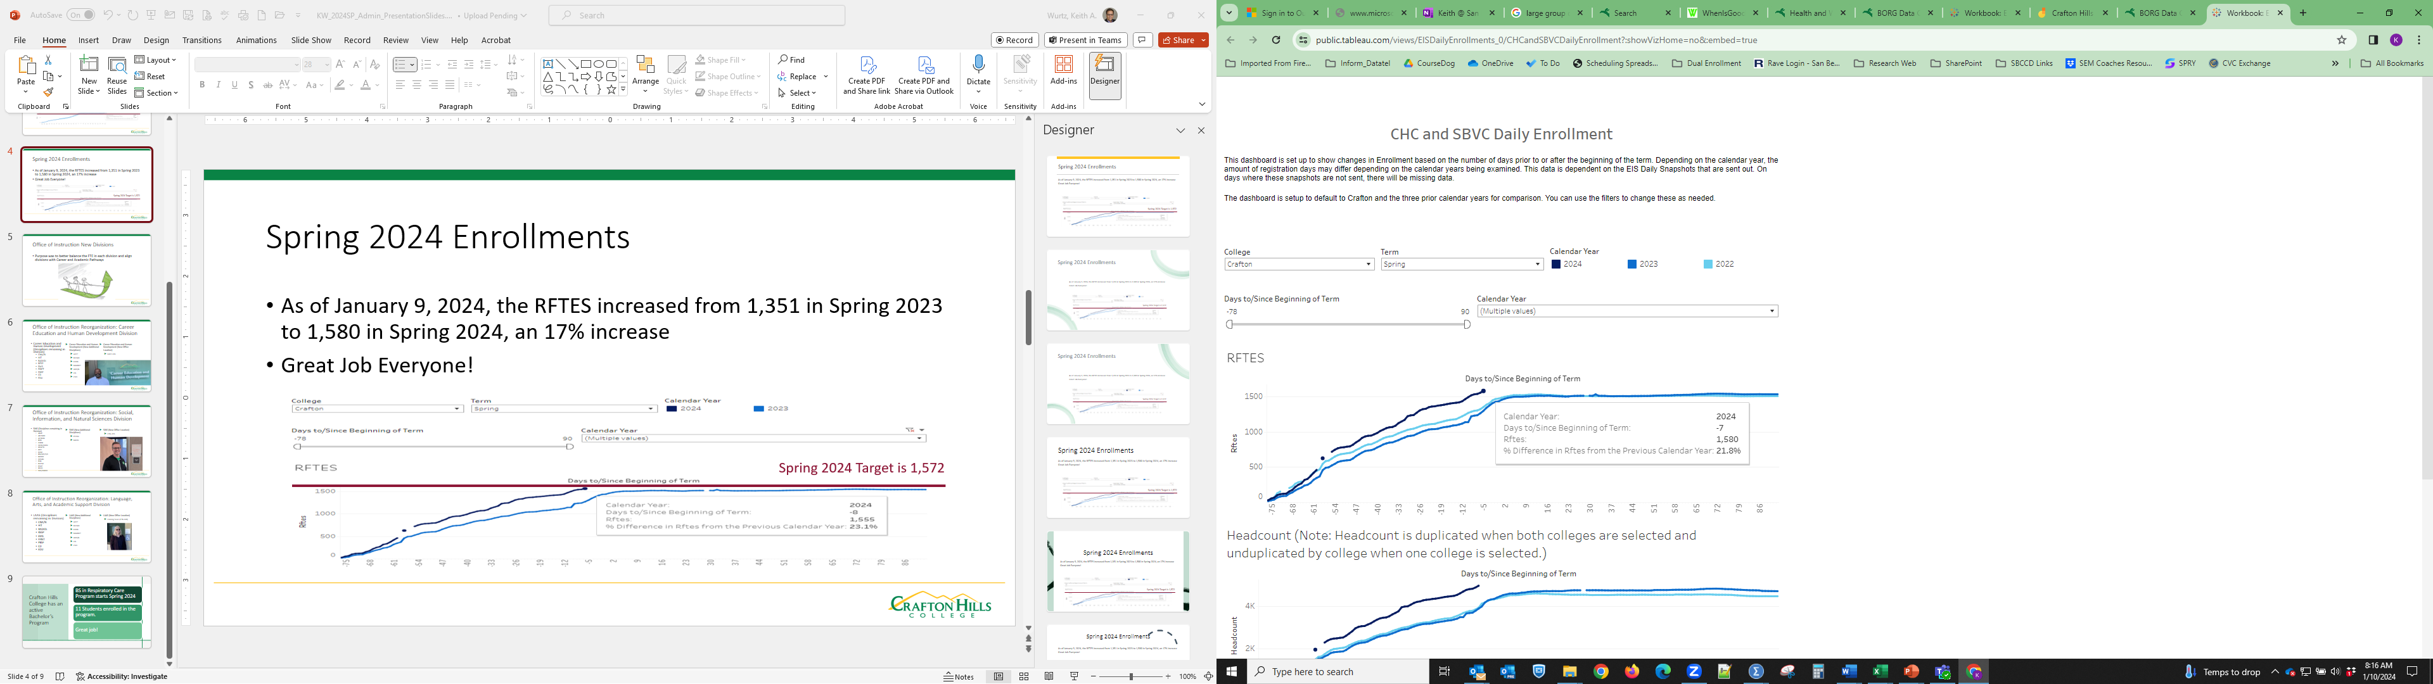
Spring 2024 Enrollments
As of January 9, 2024, the RFTES increased from 1,351 in Spring 2023 to 1,580 in Spring 2024, a 22% increase
Great Job Everyone!
Spring 2024 Target is 1,572

Slide 40

Office of Instruction New Divisions
Purpose was to better balance the FTE in each division and align divisions with Career and Academic Pathways

Slide 41
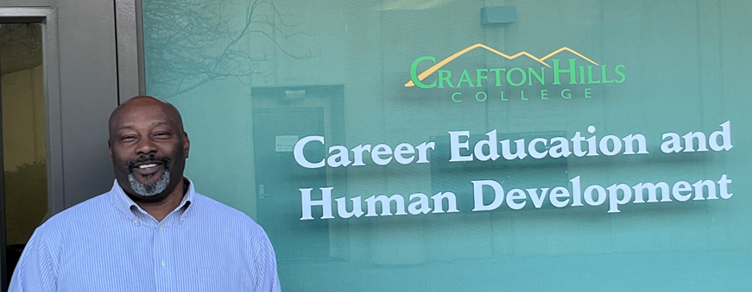
Office of Instruction Reorganization: Career Education and Human Development Division
Career Education and Human Development (Disciplines remaining in Division)
  CNA/N
  HIT
  RADIOL
  RESP
  EMS
  FIRET
  PBSF
  CD
  EDU
Career Education and Human Development (New Additional Disciplines)
  ACCT
  BUSAD
  ECON
  MARKET
  WFP/N
  CIS
  CSCI
Career Education and Human Development (New Office Location)
  EAST-103

Slide 42
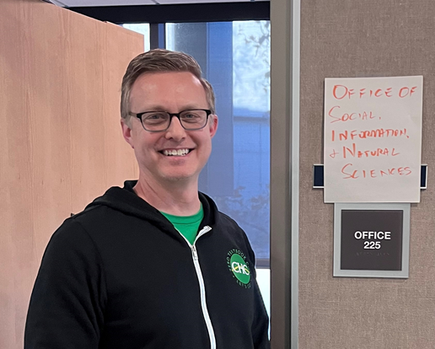
Office of Instruction Reorganization: Social, Information, and Natural Sciences Division
SINS (Disciplines remaining in Division)
  ANAT
  ANTHRO
  ASTRON
  BIOL
  CHEM
  GEOG/GEOL
  HEALTH
  HIST
  HUM
  KIN/D/F/S/X
  MICRO
  OCEAN
  PHIL
  PHYSIC
  POLIT
  RELIG
  SOC/SOWO
SINS (New Additional Disciplines)
  PSYCH
  MATH
SINS (New Office Location)
  CYN-225

Slide 43
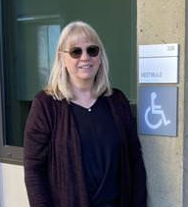
Office of Instruction Reorganization: Language, Arts, and Academic Support Division
LAAS (Disciplines remaining in Division)
  CNA/N
  HIT
  RADIOL
  RESP
  EMS
  FIRET
  PBSF
  CD
  EDU
LAAS (New Additional Disciplines)
  ACCT
  BUSAD
  ECON
  MARKET
  WFP/N
  CIS
  CSCI
LAAS (New Office Location)
  Coming Soon (CTB-338)

Slide 44
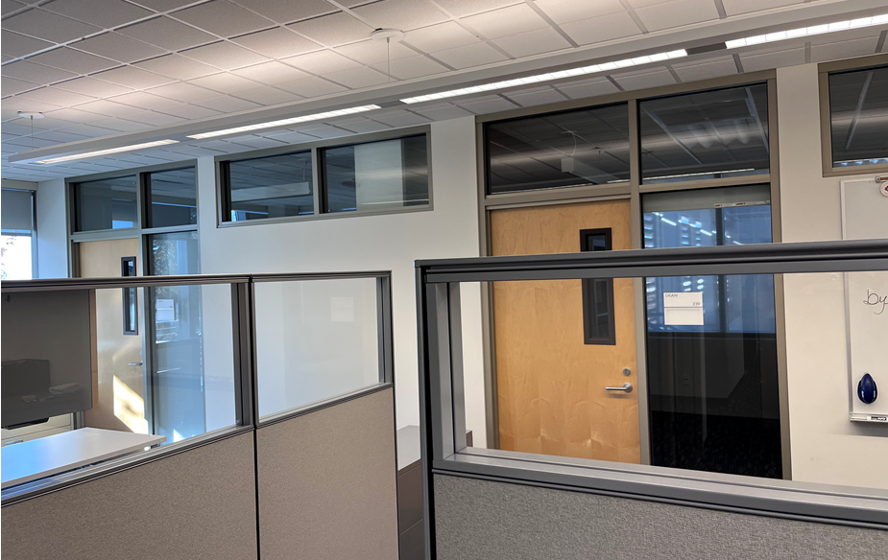
Office of Institutional Effectiveness, Research, and Planning
Coming Soon to the Campus Center
Dr. Giovanni Sosa
Ola Sabawi
Diana Vaichis
Ruby Zuniga
Jessica Beverson

Slide 45
Crafton Hills College has an active Bachelor’s Program
BS in Respiratory Care Program starts Spring 2024
11 Students enrolled in the program.
Great job!

Slide 46
Student Services Update

Slide 47

Crafton Hills College Ranked in UC Admissions in the Region
University of California Admission Rates 2022-23
School | Enrollment Fall 22 | Applied | Admits | Enrolled | Admit %
Crafton Hills | 4,481 | 134 | 104 | 74 | 77.61%
College of the Desert | 11,742 | 192 | 141 | 97 | 73.44%
Mt. San Jacinto | 16,788 | 381 | 275 | 192 | 72.18%
Norco College | 9,612 | 228 | 163 | 116 | 71.49%
Chaffey | 19,895 | 325 | 225 | 159 | 69.23%
Riverside | 19,808 | 608 | 404 | 285 | 66.45%
Copper Mountain | 1,577 | 20 | 13 | 11 | 65.00%
Moreno Valley | 9,162 | 185 | 118 | 93 | 63.78%
Barstow | 3,216 | 20 | 12 | 7 | 60.00%
SBVC | 11,262 | 114 | 63 | 41 | 55.26%
Victor Valley | 13,185 | 112 | 56 | 35 | 50.00%
Palo Verde | 4,730 | 6 | 0 | 0 | 0.00%
Notes:
Crafton has been recognized as the top college in the region for UC Admission rates in the most recent 2022-2023 admission cycle. Crafton continues to outperform all other colleges in the region with our UC admission rates even when total enrollment is accounted for. In the previous two admission cycles (2020-2021 and 2021-2022) Crafton was ranked 2nd.

Slide 48
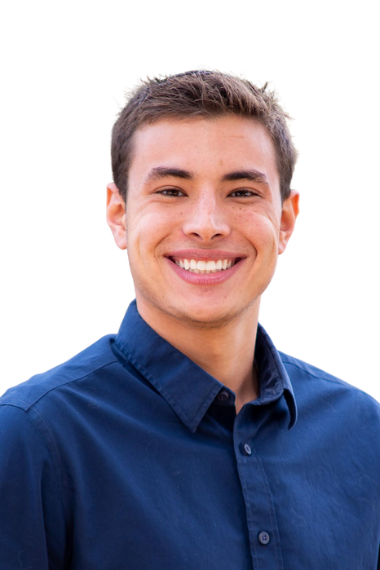

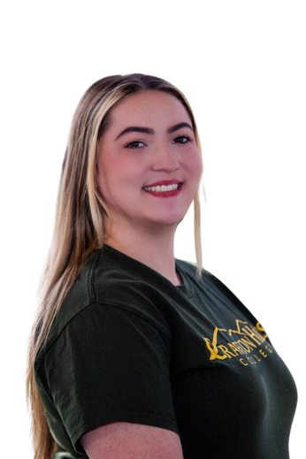
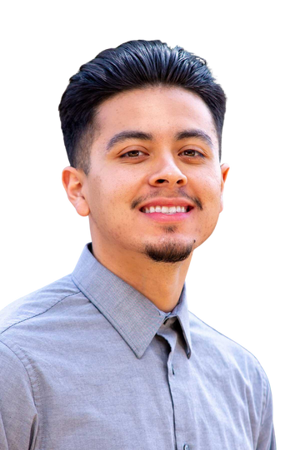
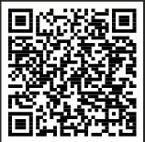
Kresge Grant Reauthorization for
Completion Coaches
Who They Are
What They Do
  Support Counseling department initiatives
  Serve as mentors to students in unit cohort
  Celebrate student milestones
  Facilitate workshops
  Monitor Starfish Flags
  Monitor student progress toward completion
0-14
Units
15-29
Units
Zachary Cortz
CHC ‘2020
UCR '2022 & CBU 2024
Alexis Ford
CHC ‘2021
CSUSB ‘2023
30-44
Units
45-60+
Units
Lauren Means
CHC ‘2022
CSUSB ‘2024
Lorenzo Ramirez
CHC ‘2021
UCR ‘2024
Find out more
about the team
Notes:
Crafton was awarded a grant reauthorization by the Kresge Foundation to fund our Completion Coaches for an additional two years.
The Completion Coaches' role is to connect students with resources on campus, provide mentorship and workshops, and help students through our experience at Crafton Hills College so students can be successful at Crafton.

Slide 49

Marketing Highlights
English & Spanish Spring 2024 Campaigns
Financial Aid
Bachelor’s of Respiratory Care
KVCR Alumni PSAs
Participated in the regional campaign “Ready Career Education”
Methods
Radio Broadcast
Social Media-Instagram, YouTube, TikTok
iHeart Streaming
Billboards
Digital Ads
Target Audience
The primary attributes for digital targeting included the following criteria:
  Adults 18-25
  High school seniors or employed students
  Specific to zip codes identified for CHC
Secondary attributes to target:
  Students who have applied but not enrolled
  High School seniors
  Currently enrolled students
  Men of Color

Slide 50
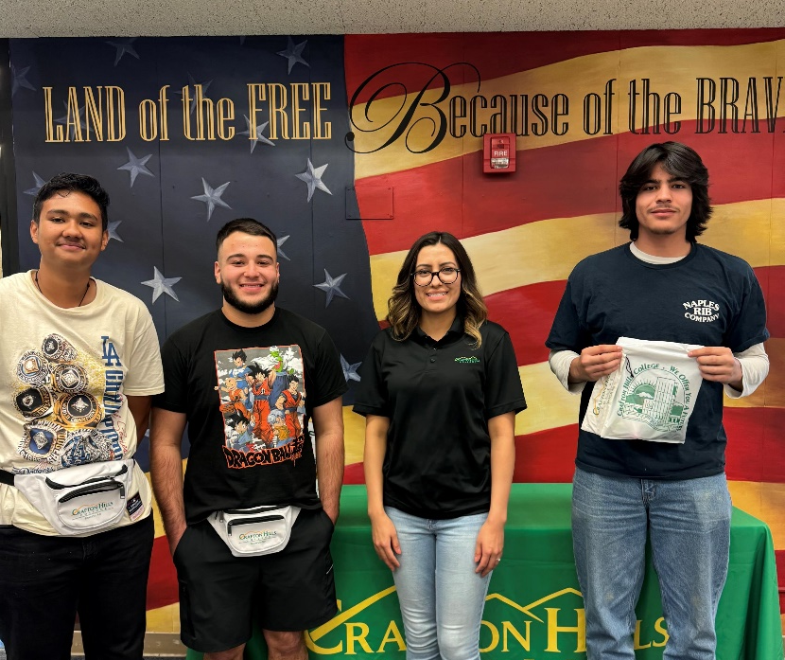
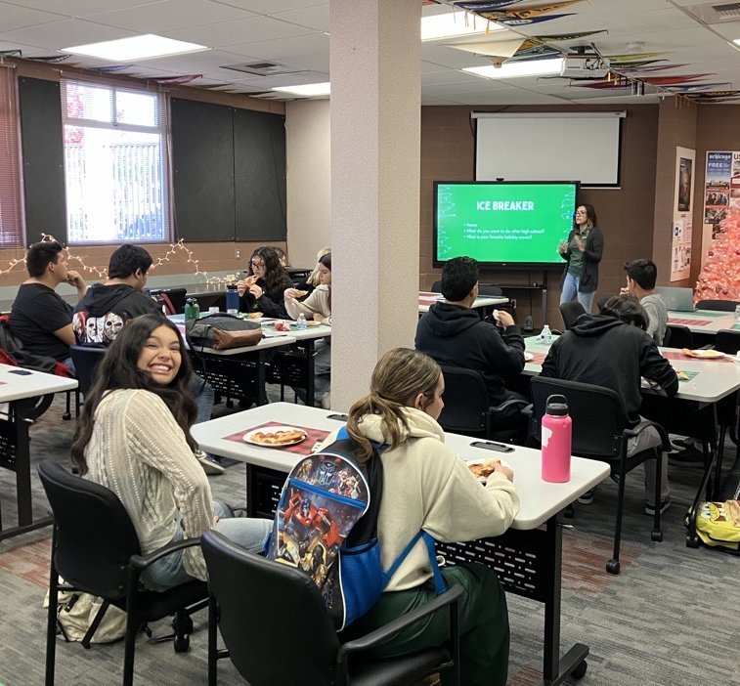
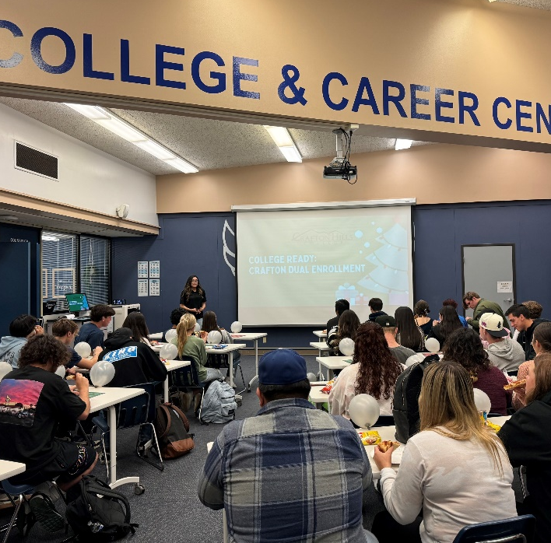
Dual Enrollment and Outreach Updates
Outreached celebrated High School students during CHC 1st Dual Enrollment Appreciation Luncheon at YHS and REV.
We congratulated students on completing 6 units or more and talked about the benefits of Dual Enrollment.

Slide 51
CHC Participated in Dual Enrollment Leadership Academy
The Dual Enrollment Leadership Academy focused on:
  The development of equitable outcomes for strategic student groups who have not been college-bound or are underrepresented in higher education.
  The expansion of High-leverage practices and student support services for Dual Enrolled students.
CHC Team
Keith Wurtz, VP of Instruction | Willie Blackmon, Dean of Student Services (Achieved Dual Enrollment Certification)
Dan Word, Dean of Career Education & Human Development | Belinda Navarette, Coordinator for School Relations (Achieved Dual Enrollment Certification)
Diana Farley, Citrus Valley Highschool Counselor/ CHC Adjunct Dual Enrollment Counselor | Soutsakhone Xayaphanthong, CHC Counselor (Achieved Dual Enrollment Certification)
Shana Delmonico, Redlands East Valley/ CHC Adjunct Dual Enrollment Counselor | Vaughan Kusko, Redlands High School/ CHC Adjunct Dual Enrollment Counselor

Slide 52
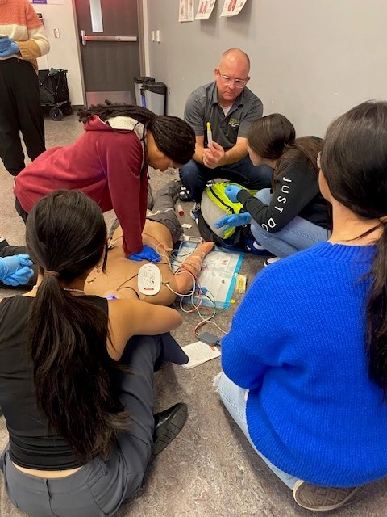
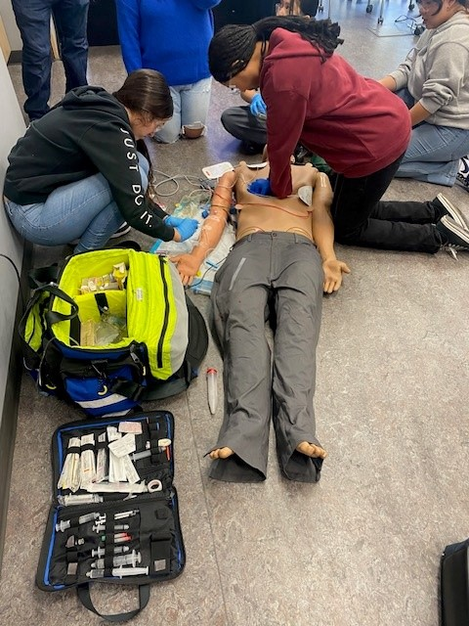
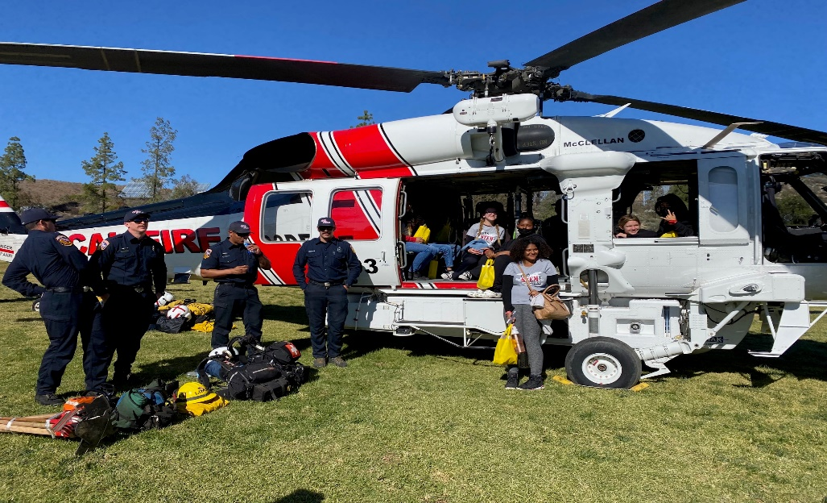
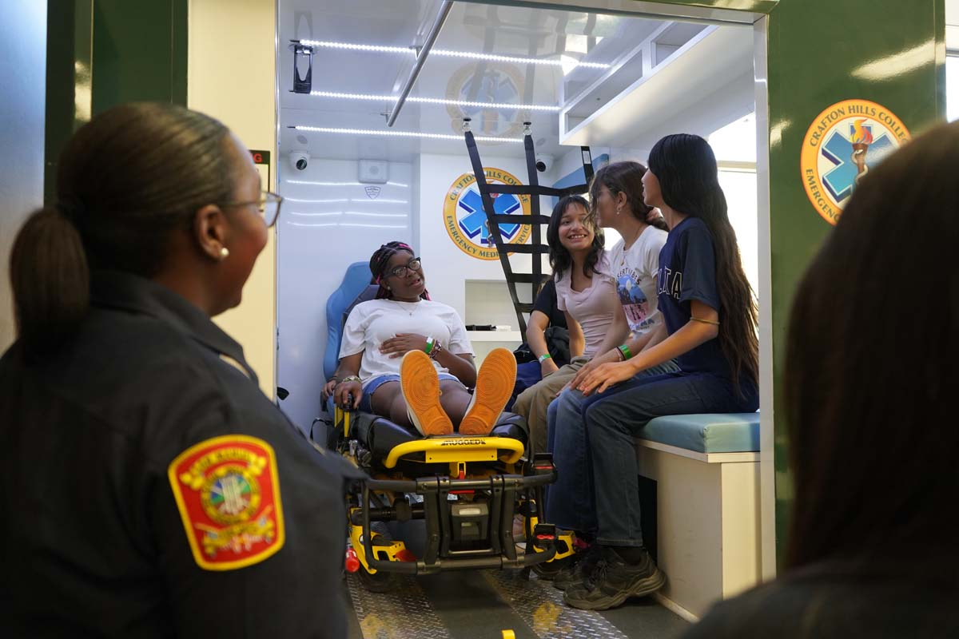
Outreach Highlights
The Colton-Redlands-Yucaipa Regional Occupation Program and Crafton Hills College collaborated to introduce students to opportunities in emergency medical services.
During their campus visit they completed labs with faculty members on simulated mannequins. This allowed students to have a hands-on experience of real-life medical scenarios. John Grounds was a staple in these events!
Girl Scouts learned about careers in emergency medical services, radiology technology, respiratory care, and fire technology.
During their time at Crafton Hills College, they toured the CAL FIRE HAWK, fire engines, EMT lab, reviewed X-rays, and learned about CPR.

Slide 53
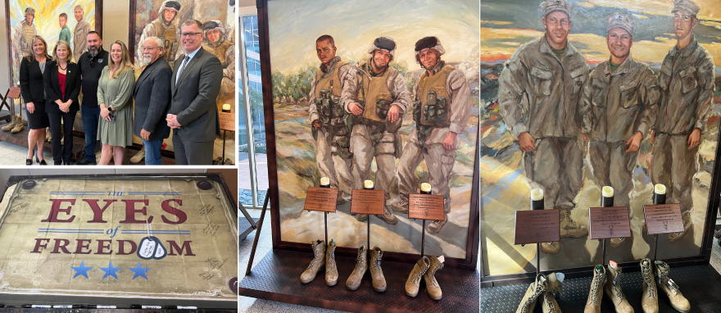
Community Veterans Outreach Event - Eyes Of Freedom Event
CHC Veteran’s Department hosted The Eyes of Freedom Memorial. This was a traveling memorial of life-size mural paintings that paid tribute to the 23 fallen Marine and Navy men who all belonged to the same unit.

Slide 54
Registration and Student Assistance
Please consider Volunteering for the Student Welcome Tables.
  Tables will be open during the following times:
    Canyon Hall CYN Table: Tuesday -Thursday from 7:00 am-2:00 pm
    Parking Lot C, CNTL, & Quad Tables: Tuesday-Thursday 8:00 am-2:00 pm
    Online Answer Center: Tuesday-Thursday 8:00 am-5:00 pm
STOP. ADD. ENROLL (January 8th – 19th)
  This is a one-stop shop to support students with applications, registration, questions about parking, class location, books, and more!

Slide 55
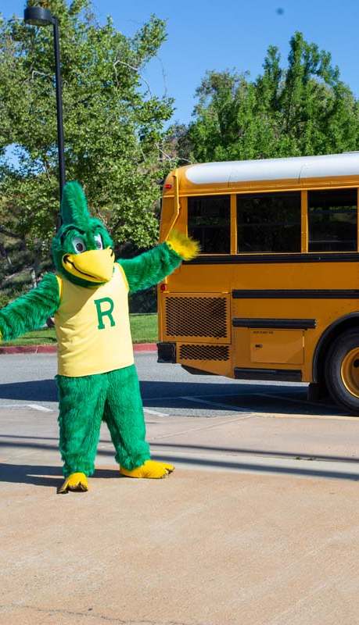
2024 Senior Day – Save the Date
Senior Day is an annual event where high school seniors from the Inland Empire region visit the campus.
The event is an opportunity for students to learn about programs, certificates, support services, and financial aid.
Students will get to meet faculty, and staff who assist them on their educational journey and academic goals.
April 12, 2024

Slide 56
Supporting Chosen or Preferred Names and Pronouns
To add a preferred/chosen name, students must submit a Student Information Update form online via the Admissions & Records Office webpage.
After submitting the request, students will receive confirmation emails informing them when it is
processed, which usually takes up to two business days.
Preferred or Chosen Names will appear on:
  Class Roster
  Canvas
  SLO Cloud
Pronouns
  Pronouns are how we refer to each other in the third person.
  You should not guess someone’s gender or pronouns by their appearance.
  If someone lets you know their pronouns, use them even if the person is not present.
  If you accidentally use the wrong pronoun, apologize and correct yourself.

Slide 57
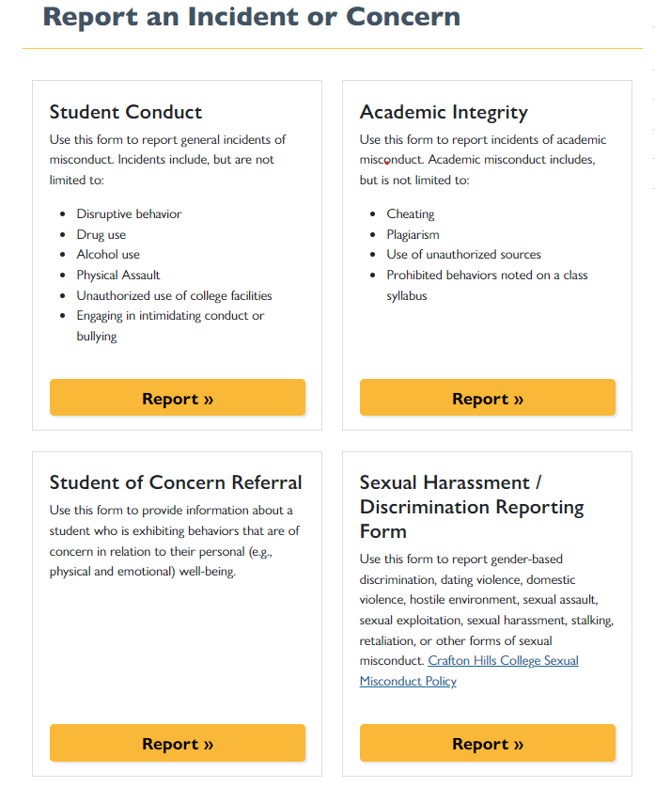
Faculty Support Review
More Information:
  www.craftonhills.edu/faculty-and-staff/student-conduct/index.php

Slide 58
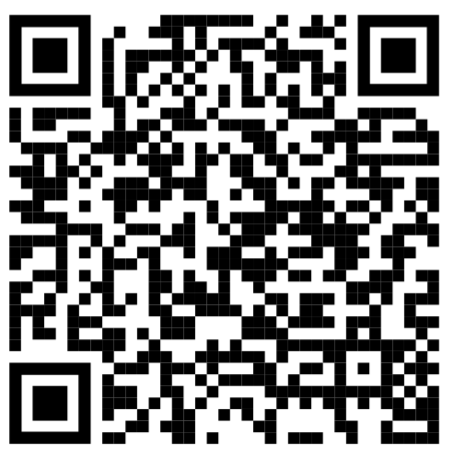
Behavior Intervention Team (BIT)
Who We Are:
  Diverse team composed of faculty, staff, and managers that work to promote the health and safety of our campus community.
Lead Contact:
  Vannesa Ramirez, Interim Director of SAS and Health & Wellness Center
  cvramirez@craftonhills.edu
More Information:
  https://www.craftonhills.edu/faculty-and-staff/behavior-intervention-team/index.php
What We Do:
  Receive information about students of concern and determine appropriate intervention plans.
  Connect students with resources.
  Monitor the status of each student who is referred.
  Maintain appropriate levels of confidentiality and handle matters with professional discretion.
Notes:
The Behavioral intervention Team (BIT) promotes the health and safety of our students, faculty and staff by providing an environment where individuals are free to work and learn in a safe and supportive environment. The Behavioral Intervention Team responds to non-immediate concerns and takes a proactive approach to discuss potential issues, intervene early, and provide support and behavioral response to students displaying behaviors of concern before they rise to the level of crisis.
The Team serves as a central network focused on caring prevention and early intervention for students experiencing serious distress or engaging in harmful or disruptive behaviors. The BIT will assess and assist students who exhibit behaviors of concern and intervene appropriately

Slide 59
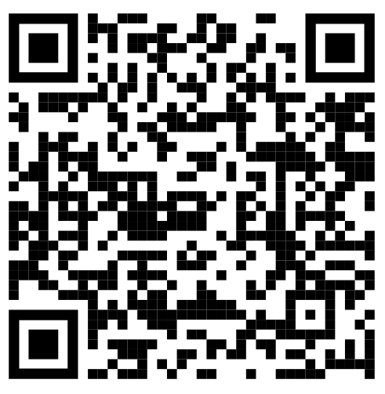
Student Conduct & Academic Integrity
What We Do:
  Ensure that students are abiding by the Student Code of Conduct.
Lead Contact:
  Dr. Ivan Peña, Dean of Student Services and Counseling (Lead Student Conduct Officer)
  mpena@craftonhills.edu
More Information:
  https://www.craftonhills.edu/faculty-and-staff/student-conduct/index.php
Example of Student Code of Conduct Violations:
  Disruptive behavior
  Drug or alcohol use
  Physical assault
  Unauthorized use of college facilities
  Engaging in intimidating conduct or bullying
  Cheating & Plagiarism
Notes:
Student Conduct reporting form is provided to encourage faculty, staff, students, and other community members to report observed behavior that warrants concerns for the safety of the campus community or violations of our Academic Integrity Policy.

Slide 60
Title IX - Sexual Harassment / Discrimination Reporting
What We Do:
  Ensure that students are abiding by the Student Code of Conduct.
Lead Contact:
  Dr. Willie Blackmon, Dean of Student Services and Enrollment Services
  wblackmon@craftonhills.edu
More Information:
  www.craftonhills.edu/faculty-and-staff/student-conduct/title-ix-and-sexual-misconduct/index.php
Examples include:
  Gender-based discrimination
  Dating violence
  Domestic violence
  Hostile environment
  Sexual assault
  Sexual exploitation
  Sexual harassment
  Stalking
  Retaliation, or other forms of sexual misconduct

Slide 61
Title IX Changes
Dr. Willie Blackmon serves as Title IX Coordinator
Dr. Delmy Spencer serves as Title IX Decision Maker
Informal Resolution: When a student requests an Informal Resolution, the Title IX Coordinator will review the matter to confirm it is appropriate.
  Participation in an Informal Resolution process is voluntary, and the parties must consent in writing to participate.
Formal Resolution: The process begins when a Complainant or Title IX Coordinator signs a formal complaint and initiates a formal resolution. The Title IX Coordinator will review the formal complaint to ensure the case falls within the scope and jurisdiction of CHC's Title IX Sexual Harassment and Related Conduct Policy.
The websites are currently being reviewed and will be updated soon. This update will include District Definitions and will be posted on the site soon.
Student-to-employee cases go to HR.

Slide 62
Administration Update

Slide 63
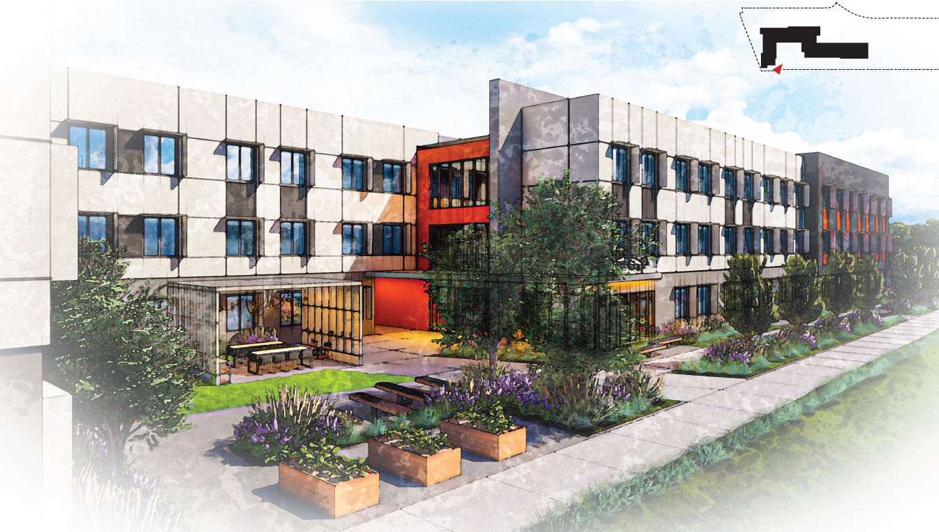
Student Housing – Construction Grant Status
Notes:
Looks like the state would need to fund at least $457M in student housing grants in 2024-25 for any money to trickle down our way any time soon. Currently, the state “intends” to issue $75M/year in student housing grants to CCC’s for the next 5 years

Slide 64


Facilities Master Plan – It’s That Time Again
The purpose of the Facility Master Plan is “to support the Strategic Directions and Goals of the Educational Master Plan.”
Crafton Hills College, Comprehensive Master Plan 2017, p.1.002

Slide 65
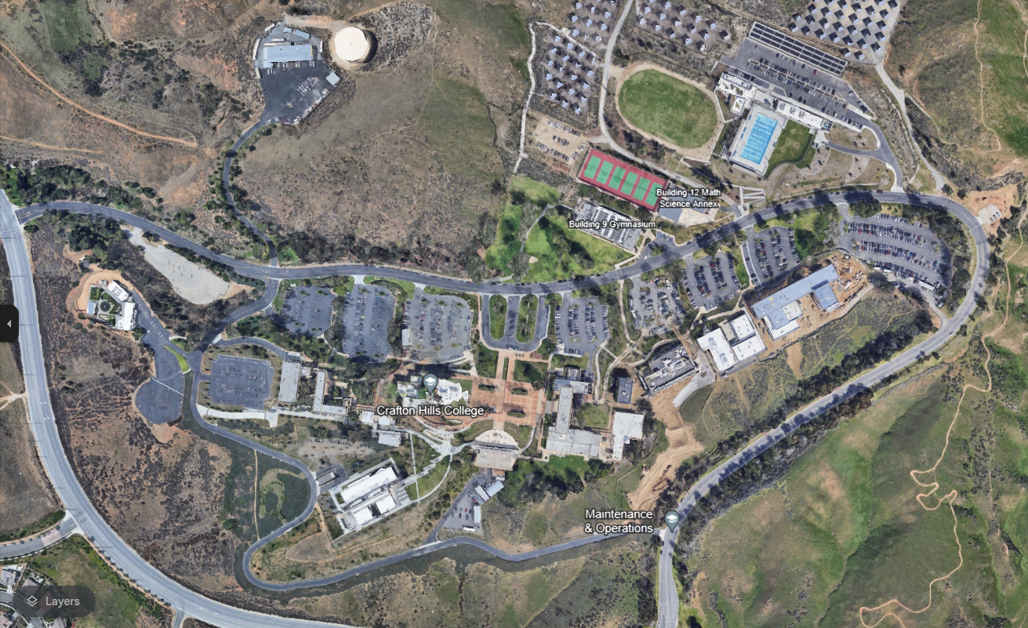
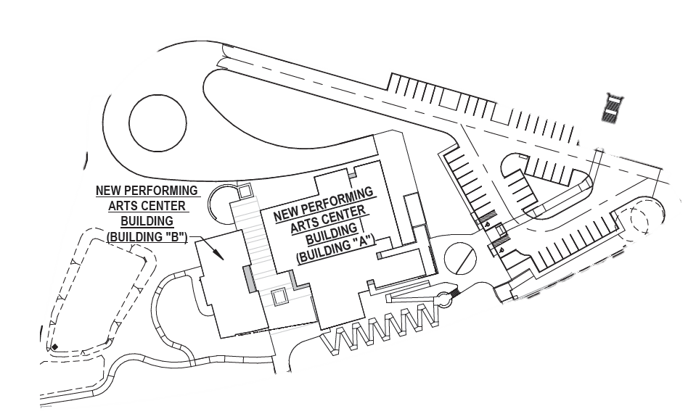
Campus Dr Improvements 6/24
PAC Construction 6/23-5/25
CHL Renovation 4/24-8/24
CNTL 2 Renovation 12/23-8/24
Construction Activities 2024

Slide 66
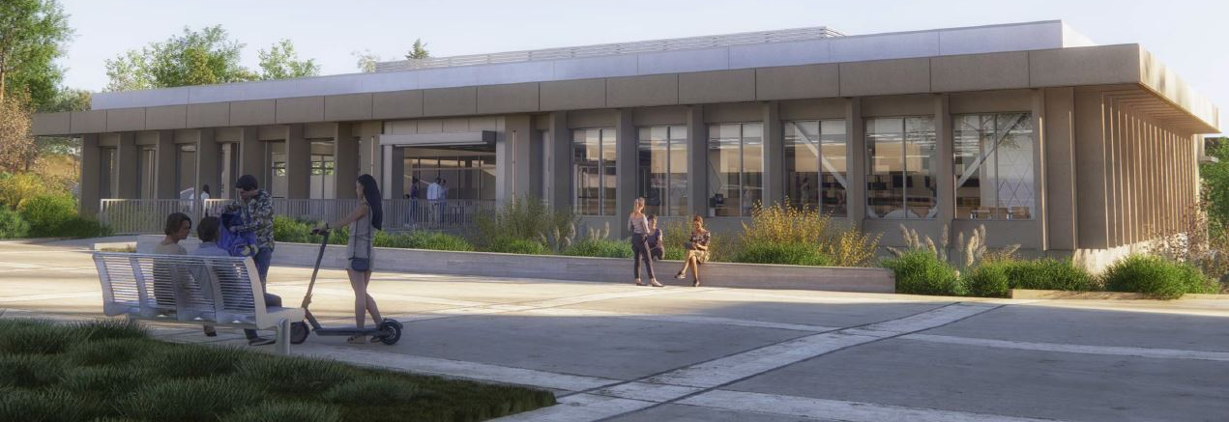
Instruction Building Design
Completing Spring 2024

Slide 67
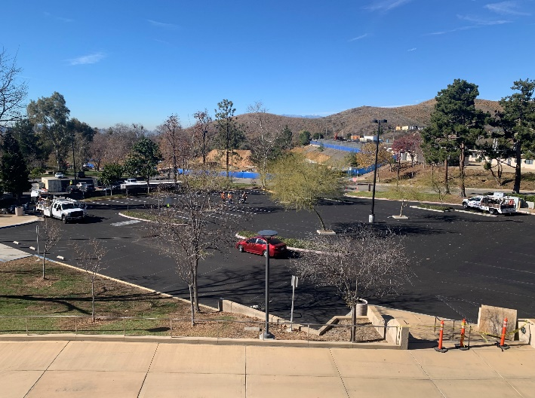
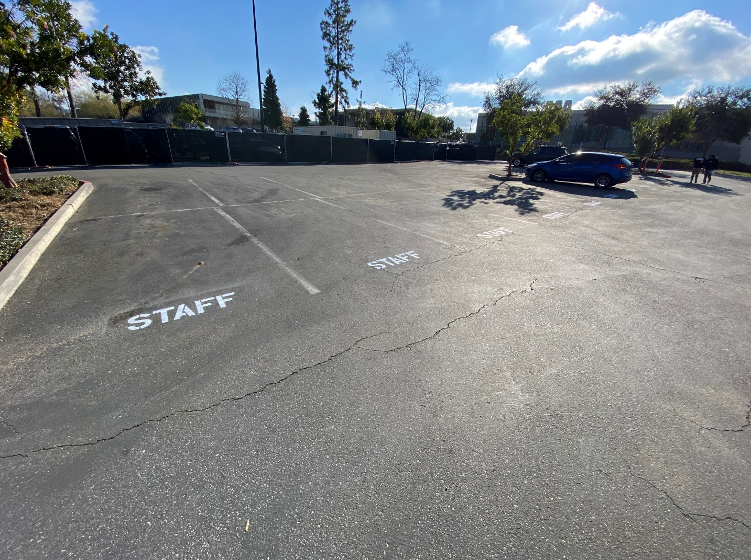
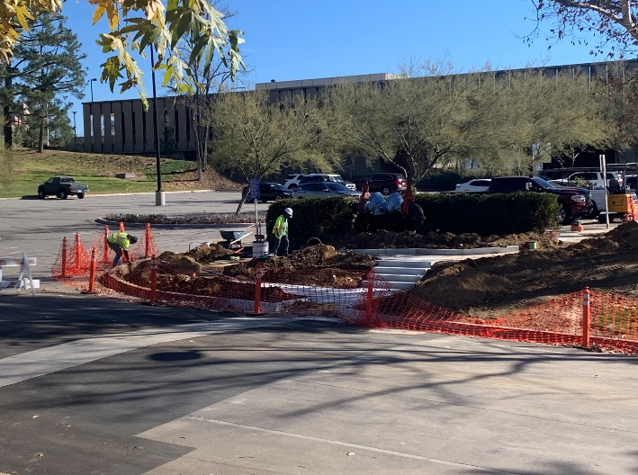
Parking & ADA Improvements

Slide 68
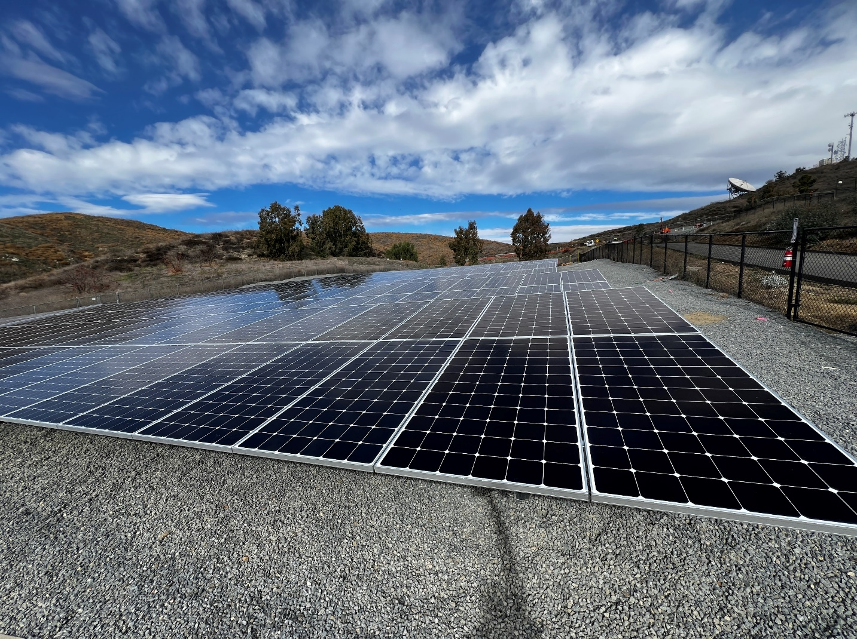
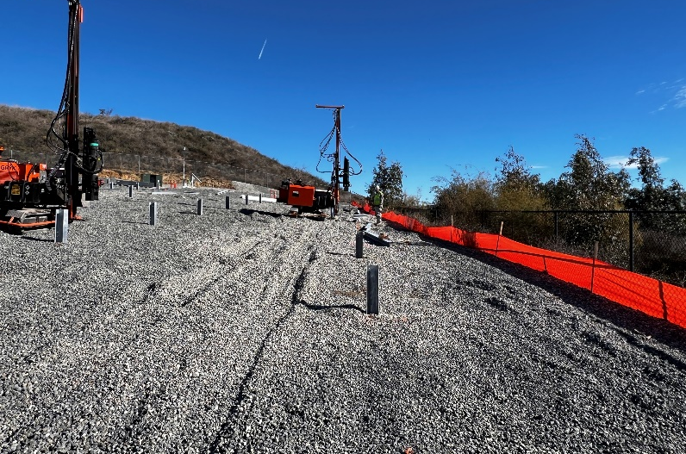
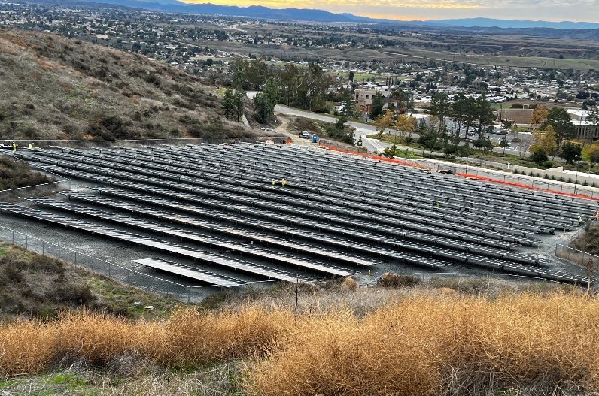
Solar Farm Upgrade

Slide 69



Performing Arts Center Progress

Slide 70


Public Safety Training Center

Slide 71
President’s Message

Slide 72


Slide 73






The Importance of Evolution….

Slide 74


Slide 75


Slide 76

“I think Barbie’s been capturing people’s attention since the day she was invented. She is an icon but she’s a very complicated one," Robbie told EW. "There’s been times when Barbie has been ahead of her times and there’s been times when she’s been behind her times, but she’s always been evolving. I feel like this movie’s the next evolution.”

Slide 77


Slide 78


Next Ken Evolution…….

Slide 79

Harnessing the Power of AI….

Slide 80

On-Campus Housing Evolution….

Slide 81
Compressed Calendar Evolution….
Moving to a 16, 16, 12 Week “Year-Round” Calendar
71% of SBCCD Students attend part-time (6-9 units)
Shorter-Term classes have higher success rates
Opportunity for Standard 8 Week Short-Term Classes
Efficiency in Standardized Time Blocks
65 of 116 CA Comm. Colleges have moved to a Compressed Calendar
Supported by Guided Pathways
Supports Equity in Success, Access and Completion
Enhances Dual Enrollment
Decreases Time to Completion

Slide 82


