Slide 1

Spring 2019 In-Service
Welcome

Slide 2
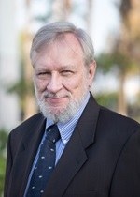
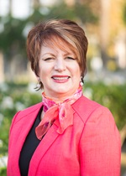
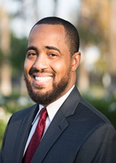
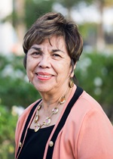
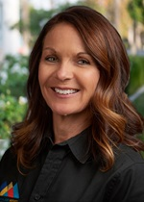
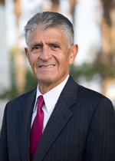
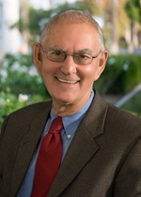
San Bernardino Community College District
Board of Trustees
Board President
John Longville
Board Vice President
Dr. Anne Viricel
Board Clerk
Joseph Williams
Trustee
Gloria Macias Harrison
Trustee
Dr. Stephanie Houston
Trustee
Frank Reyes
Trustee
Dr. Don Singer
Student Trustees
Autumn Blackburn, San Bernardino Valley College
Elijah Gerard, Crafton Hills College

Slide 3
Dr. Kevin Horan
President, Crafton Hills College

Slide 4





Building for Success

Slide 5
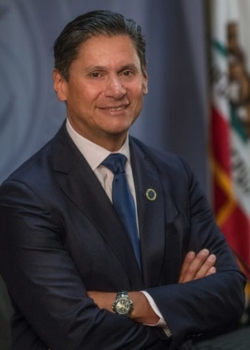
State: Vision for Success
  Increase by at least 20 percent annually the number of students earning an associate degree, credential, certificate, or specific skill set.
  Increase the number of students who transfer to UC and CSU by 35 percent each year.
  Reduce the average number of excess credits accumulated by students who complete their degrees or certificates.
  Increase the number of students in career education programs who secure jobs in their field of study by 15 percent.
  Close achievement gaps once and for all.
From Chancellor, California Community Colleges Chancellor’s Office: “Strategic Vision—Letter to the Field 7.21.2017”
Notes:
Bob

Slide 6

The Real Reason Unicorns are Extinct……

Slide 7
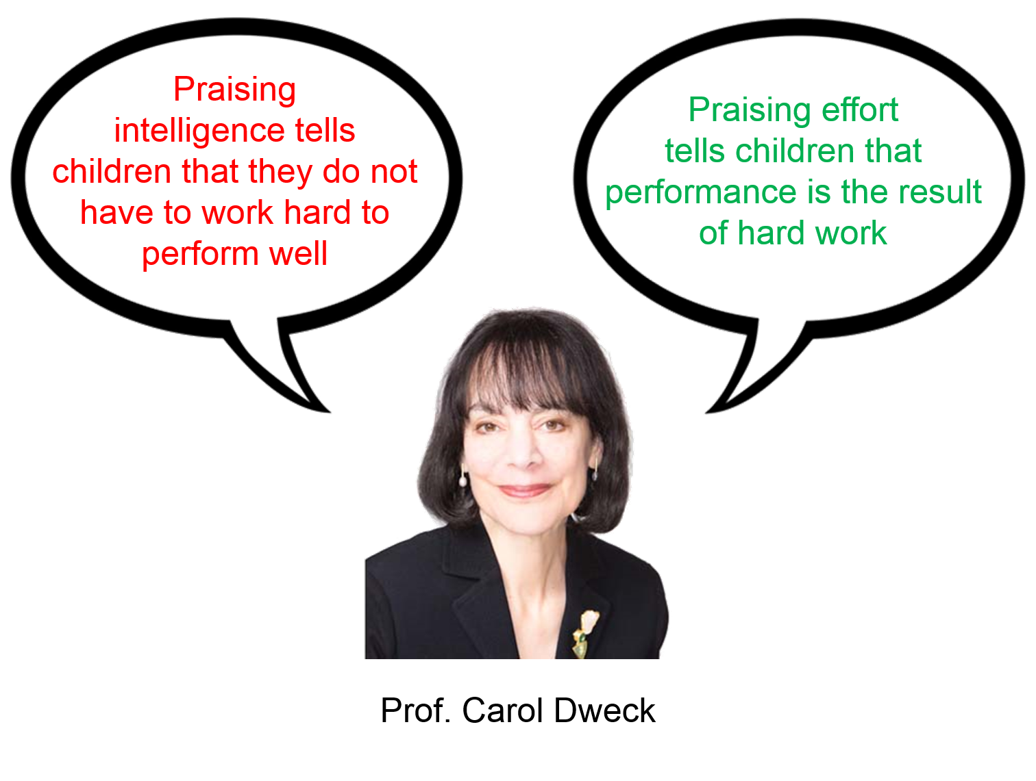

Slide 8
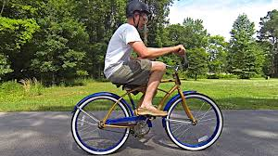
The Backwards Bike
https://www.youtube.com/watch?v=MFzDaBzBlL0
Smarter Every Day

Slide 9


Slide 10
Mark McConnell
Academic Senate President

Slide 11
Brandice Mello
Classified Senate President

Slide 12
Elijah Gerard
Student Trustee, on behalf of the CHC Associated Students

Slide 13
Area Updates
Dr. Keith Wurtz
Michael Strong
Dr. Rebeccah Warren-Marlatt

Slide 14
Dr. Keith Wurtz
Vice President, Instruction

Slide 15
Instructional Update
The RFTES increased from 2,106 in Fall 2017 to 2,150 in Fall 2018, a 2% increase
+2%
Notes:
In Spring 2019 we are currently 31 RFTES below where we were at this time last year.

Slide 16
Instructional Update
The WSCH/FTEF ratio (efficiency) increased from 435 in Fall 2017 to 441 in Fall 2018, a 1% increase
+1%

Slide 17





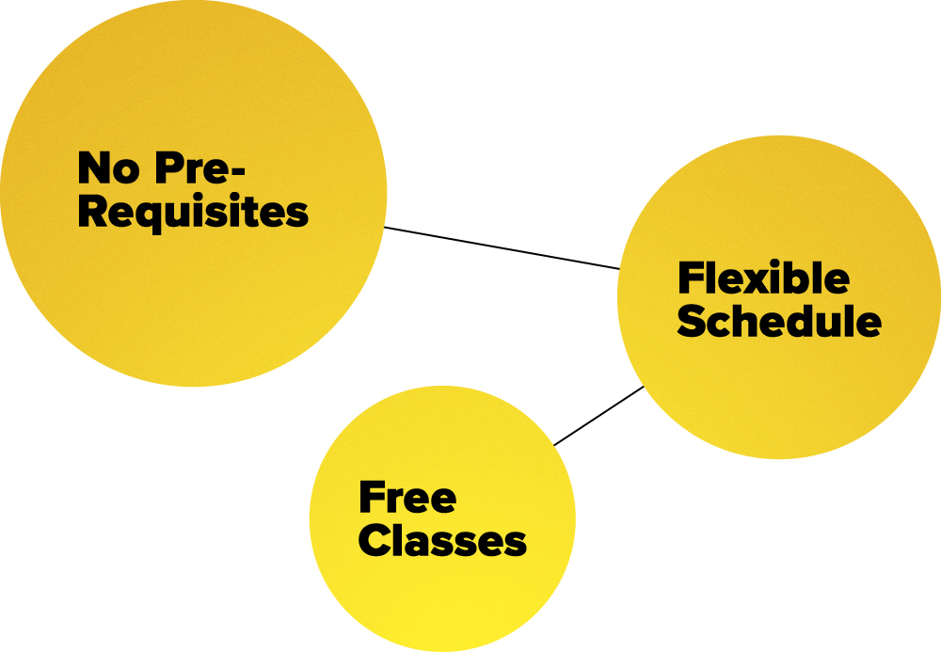

Instructional Objectives for 2018-2019
Develop CCAP Agreements
Continue to develop new programs
Begin planning for writing of ISER
Continue to develop dual enrollment
Support GP & AB705
Increase efficiency and enrollments
Continue to develop non-credit
Notes:
Strengthen and further develop the student athletic program
Soup-a-palozza on February 1 in LRC-110 from 12-1:30

Slide 18
Dr. Rebeccah Warren-Marlatt
Vice President, Student Services

Slide 19
Student Services Updates
AVID for Higher Education
Degree Planner, Spring 2019
Guided Pathways
Mental Health Grant

Slide 20
And…
Student Equity Plan, 2019-2022
Veterans Resource Center Grant, $100,000
Undocumented Students
Truth Initiative

Slide 21
And…
Institutional Assessment Plan
Vetted spring, 2019
College Promise Dialogue
Caring Campus
CCCCO and IEBC

Slide 22
Mike Strong
Vice President, Administrative Services

Slide 23
Administrative Services Update

Slide 24
Program Review
Update
Mission & Strategic Plan
Assessment
Annual Program Review
Resource Allocation
Implementation
Effectiveness Review
Institutional Plan
370 Objectives Requesting Funding
$350K to Fund PPR

Slide 25
2017 FMP – CHC Measure CC Projects
Enriched Environments for Student Activities
PAC Renovation
Crafton Hall Renovation
East Valley Public Safety Training Center
West Complex Renovation
Student Support Building Renovation
Gym Demo
Notes:
SBVC – Career Pathway 1 (New Construction) & M&O Building Repurposing.
CHC – Performance Arts Center Renovation.
SBVC – Parking Structure (New Construction).
SBVC – Softball Field (New Construction).
SBVC – Student Services + Instructional Building (New Construction), Admin Building Repurposing, and Campus Center Repurposing.
CHC – Crafton Hall Renovation, West Complex Renovation, Student Support Building Renovation, and Gymnasium Demolition.
CHC – East Valley Public Safety Training Center (New Construction).
SBVC – Career Pathways, Phase 2 (New Construction) & PS/HLS building secondary effects
SBVC – Warehouse Facilities (New Construction).
SBVC – Library Repurposing.
CHC – Joint-use Tennis Facilities (New Construction).
SBVC – Greek Theater + Planetarium Renovation.
CHC – New Gymnasium (New Construction), including Soccer Field and Outdoor Kinesiology Laboratories.
CHC – Maintenance and Operations Additions (Ne Construction).
CHC – East Instructional Building (New Construction).
CHC – Teaching Pool (New Construction).
CHC – Central Complex 2 Renovation.
CHC – Child Development Center Renovation.

Slide 26
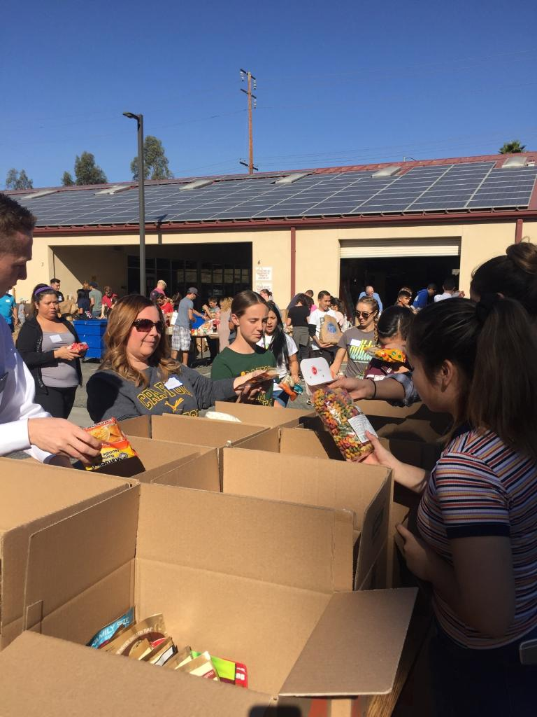
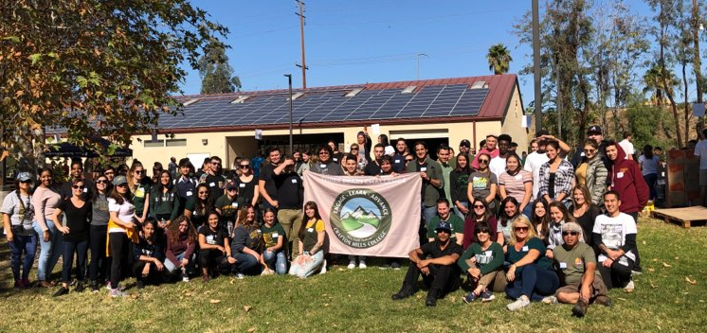
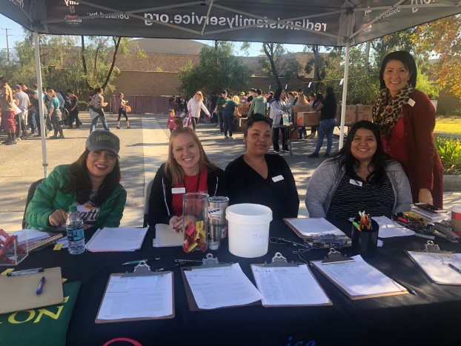
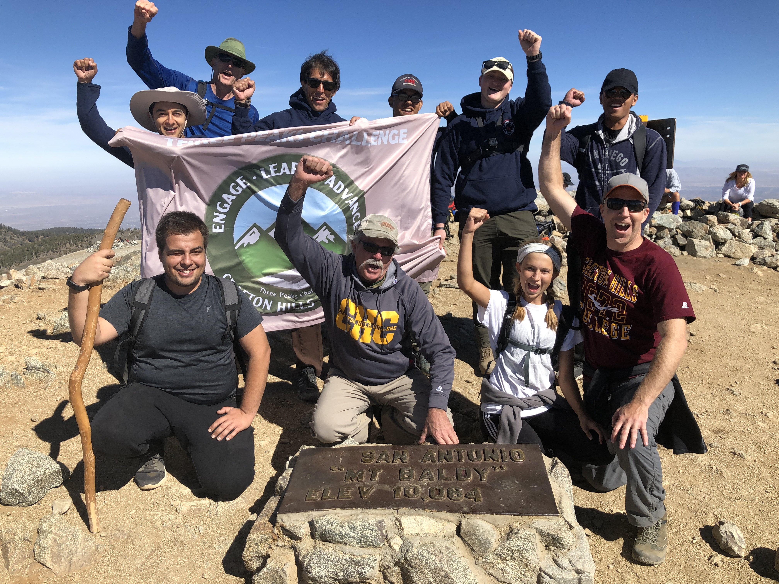
3 Peaks Challenge –Engage, Learn, Advance
Nov. 10, 2018 - 24,257 lbs of Food
Oct. 27, 2018 - Mt. Baldy Summit

Slide 27
Bruce Baron
SBCCD Chancellor

Slide 28
John Longville
SBCCD Board of Trustees, President

Slide 29
GUIDED PATHWAYS, PART I
STUDENT PANEL

Slide 30
FACILITATED BY
  Sherri Wilson, Professor, Mathematics
  Debbie Bogh, Professor, Counseling
WITH THANKS TO
  Brandi Mello, Senior Student Services Technician, University Transfer and Career Center

Slide 31

FEATURING
Cynthia Arnestad
Carlos Cervantes
Alexandra Coello
Megan Downard
Andrea Duarte
Craig Ellis
Maribel Kekong
Elijah Gerard
Kendall Green
Rudi Gutierrez
Jared Hudnall
Sandra Jones
Richard Kearns
William Link
Rodrigo Madrigal
Yami Mendoza
Victoria Pacheco
Michael Ventura
Brittany Washington

Slide 32
Overview
Part I
  Understanding our students
Part II
  Responding to student needs

Slide 33
Guided Pathways, Part I Objectives
Understand student challenges
Learn what helps a student:
  Decide on a major
  Stay in school
  Finish his or her goal successfully

Slide 34
Part I Instructions
A student will be seated at each table
Using the questions provided, interview the student
Ask any additional questions you might have
Take good notes on the questionnaire; you will use the information to tailor a Guided Pathways template just for your student
Be sure to select a Table Lead, who will serve as contact person when the Enrollment Strategies Committee reviews the results of this workshop.

Slide 35
Guided Pathways, Part II Objectives
Use what you have learned about your student to:
  Create an effective academic pathway
  Ensure he or she receives appropriate support

Slide 36
Part II Instructions
Using your notes, and consulting your student (who will still be seated at your table), complete the Guided Pathways Template.
  Craft an educational plan that will allow the student to finish in a reasonable timeframe, given his or her scheduling preferences.
  Be sure you are directly addressing the student’s challenges and support needs. These may vary by course and semester. The last page of your pathways template contains a partial list of services and support your student might need.
Be sure to include a title and brief description of the pathway (e.g. Pathway for a part-time, evening Math student whose goal is transfer to CSU)
Be sure to record the name of your Table Lead

Slide 37
Next Steps
The Enrollment Strategies Committee will coalesce the notes from your dialogue to create three-five pathways
These will be:
  Shared with the college
  Aligned with future scheduling
  Posted online for students to access
  Serve as a template for the development of future pathways
  Shared at the fall 2019 In-service.

Slide 38

Questions?

