Slide 1
In-Service Opening Day: Celebrating Lollipop Moments
Spring 2023 In-Service

Slide 2
New Roadrunners

Slide 3
Welcome! Duran Gaddy Fire Technology Instructor

Slide 4
Welcome! Sarah DeSimone EMS Instructor

Slide 5
Welcome! Ericka Sherman Basic Needs Coordinator

Slide 6
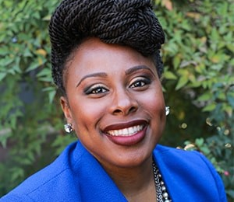
Welcome! LaTesha Hagler Associate Dean, Student Services EOPS

Slide 7
Welcome! Leslie Swindell Institutional Advancement Coordinator

Slide 8
Welcome! ZsaQuita Bender Admin Assistant Respiratory Care

Slide 9
Welcome! Yadira Quintal Child Development Assistant

Slide 10
Welcome! Pedro Chabolla Job Developer

Slide 11
Welcome! Henry Gomez HVAC Technician

Slide 12
Welcome! Roy Lee Myers III Custodian

Slide 13
Welcome! Brian Ramirez Custodian

Slide 14
Welcome! Estela Beltran Custodian

Slide 15
Welcome! Alvaro Sanchez-Reyes Custodian

Slide 16
Welcome! Melissa Bless Student Services Technician I, EOPS

Slide 17
Welcome! Evelyn Briones Senior Student Services Technician Outreach and Educational Partnerships

Slide 18
Welcome! Julie Lemus Senior Student Services Technician Counseling

Slide 19
Welcome! Craig Ellander Lab Assistant, EMS

Slide 20
Welcome! Liliana Molina Account Technician (transfer from SBVC)

Slide 21
Congratulations! Miguel Chaure Promoted to Lead Maintenance Technician

Slide 22
Congratulations! Brandi Bailes Interim SINS Dean

Slide 23
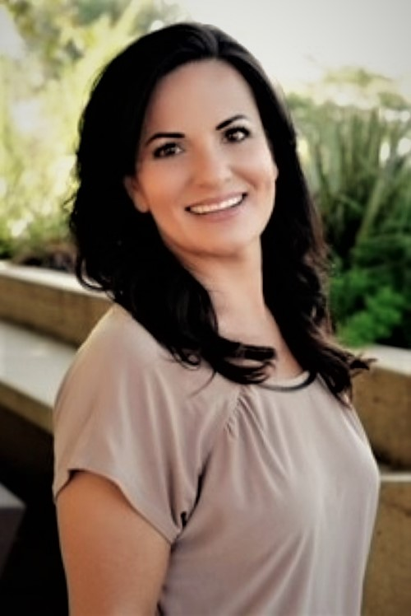
Congratulations! Veronica Lehman Interim Director of Financial Aid

Slide 24
Congratulations! Jamie Sierra Outreach and Educational Partnerships

Slide 25
Congratulations! Frances Southerland SAS

Slide 26
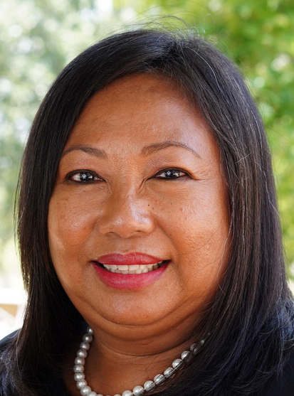
Congratulations! Rejoice Chavira Counseling

Slide 27
Welcome! Gabby Garcia Financial Aid Coordinator

Slide 28
Welcome! Manny Villegas Financial Aid Coordinator

Slide 30
“I was taking biology and got a ‘B,’ but I thought I had deserved an ‘A’. I went into Professor Sadler’s office and argued my point, and he agreed with me. I remember he swiveled his chair [to face me] and said, ‘You should be a lawyer.’
The “lollipop moment” at Crafton that changed Steve Soliman’s life.

Slide 31
Education Master Plan Update: We are almost there!

Slide 32
Facilities Update
CHC Administrative Services
Notes:
Overview of Construction Projects
& Potential Student Housing

Slide 33
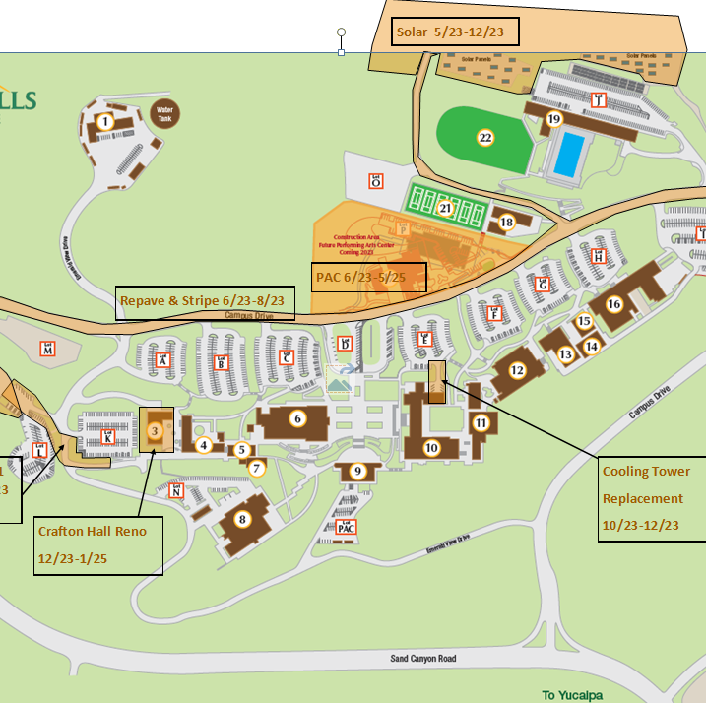
2023 Construction

Slide 34
Notes:
Review Projects – Handout
Inflation
Tree Removal

Slide 35
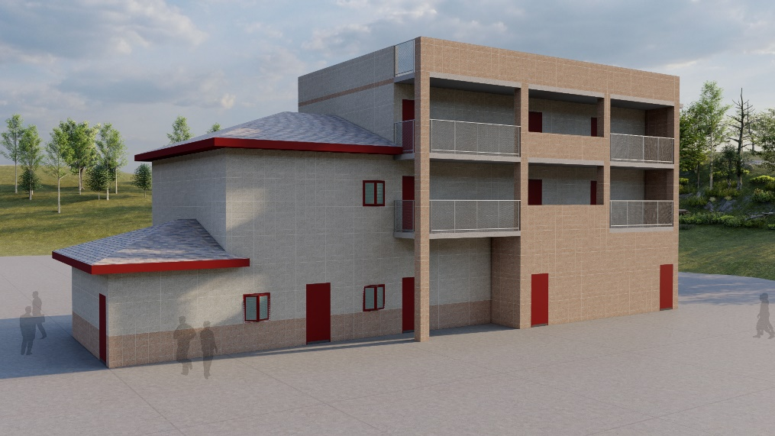
Training Center
Groundbreaking
Friday, January 20th at 1pm
JANUARY 20th
Training Center
Construction Dec. 2022-Jan. 2024

Slide 36
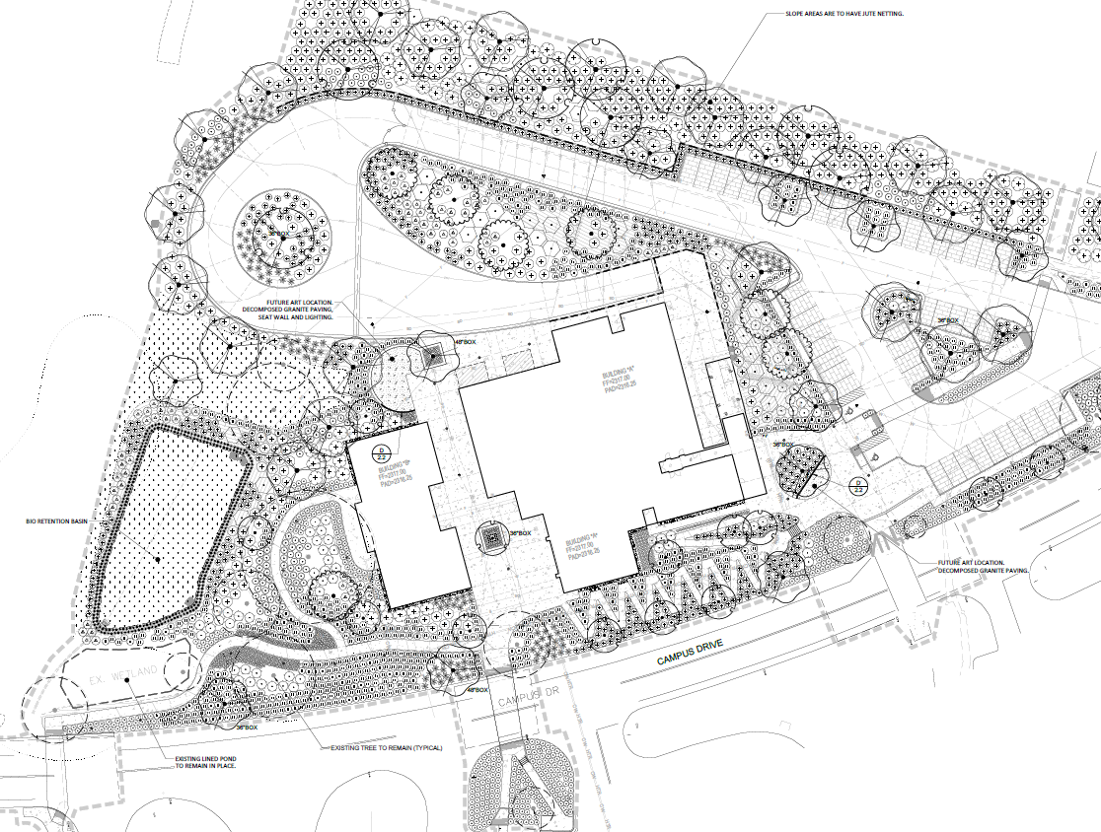
PAC Site Prep
Removing 15 trees
Adding 63 trees

Slide 37
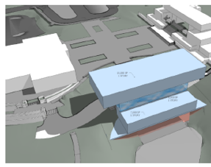
Instruction Building Design
Spring – Fall 2023

Slide 38
Student Housing – Strategic Objectives

Slide 39
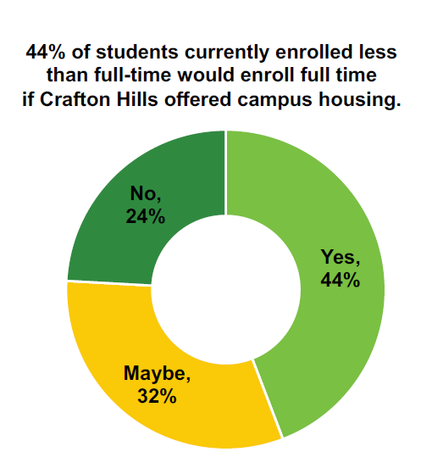
Student Housing – Enrollment Tool
Feasibility Study 2022-23
Notes:
State funded a feasibility study

Slide 40
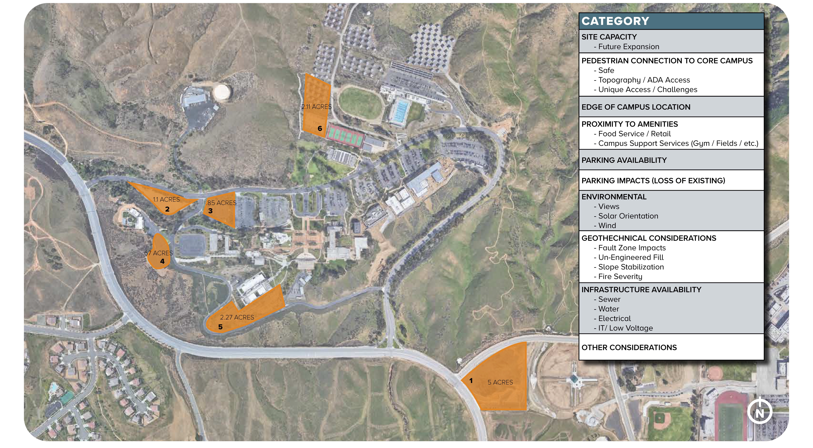
Student Housing – Site Options
Site 6 – Preferred Option

Slide 41
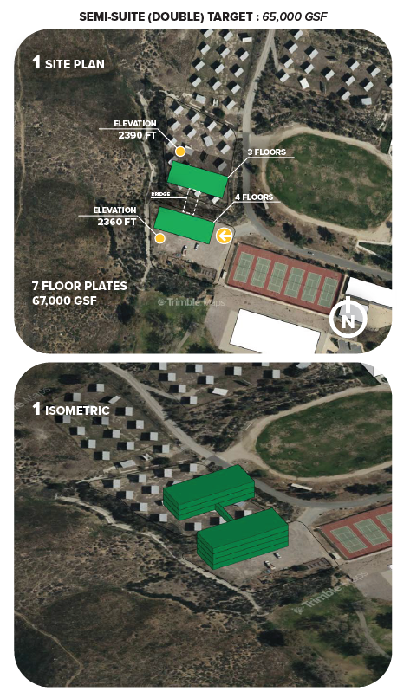
Student Housing – Massing Study
Target ~250 beds
Round 2 State Construction Grant
Funding 2023-24
Application due July 15th
Notes:
Prior 2022-23 budgets committed a total of $2.2 billion (one-time General Fund) for student housing construction grants over a three-year period, including $750 million planned for FY 2023-24. The Governor’s 2023-24 budget proposes delaying $250 million of the anticipated 2023-24 support for affordable student housing projects to the 2024-25 fiscal year. This would maintain $500 million for student housing construction grants in 2023-24.

Slide 42
Student Services Update

Slide 43
SS Updates
Virtual Cranium Café
Laserfiche & Dual Enrollment
Firekeepers Award
78% of our Fall 2022 term students had an educational plan completed with a Counselor.
Basic Needs Center developed a partnership with Jenny’s Laundry Service
Duck & Owl & Campus Garden Use
60 students received our holiday food baskets (highest to date)
Cash for College

Slide 44
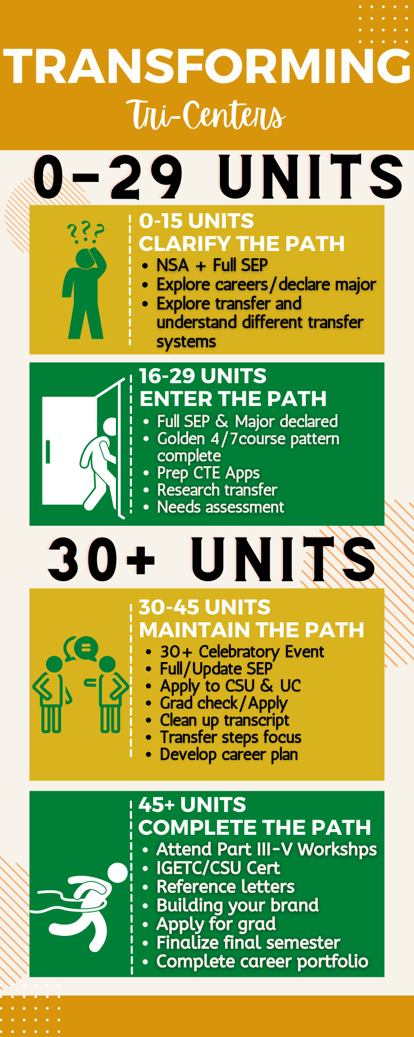
0-29 units
Outreach to students who do not have a comprehensive Student Educational Plan.
Programming, exploration and support for students who are undecided about their career and/or major.
Initial discussion of transfer options.
30 + units
Finish strong campaign - Graduation and transfer evaluations.
Targeted outreach to students who have completed 60 units or more.
Enhancement of job skills such as interviewing techniques and resume building.

Slide 45
Foundation Update

Slide 46
Feasibility Study
Outside Consultant Hired to Assess our Fundraising Potential for a Campaign
Case Statement to test feasibility of raising $10M
Fire Academy/Paramedic $5M
Scholarships/Emergency Funds $2M
Performing Arts $1M
Honors $1M
STEM $1M
Hosting Briefings to invite community members to learn about Crafton
Identify 60-70 individuals to interview

Slide 47
You’re invited! Groundbreaking Ceremony Jan 20 at 1 p.m.

Slide 48
You’re invited! Naming Ceremony Jan 21 at 1 p.m.
Notes:
Endowment created will provide each Resp Grad with a scholarship to offset cost of licensing/exam fees in perpetuity.

Slide 49
You’re invited! Night Out at Crafton Fundraiser April 6 at 5:30 p.m.
Notes:
Endowment created will provide each Resp Grad with a scholarship to offset cost of licensing/exam fees in perpetuity.

Slide 50
How We Support Students
762
407%
277
$226,500
# of students who received direct support from the Foundation last year.
Emergency Grants
2022
$18,763 – 41 students
2018
$3,700 – 10 students
Licensing Fees
$69,195 to support 277 Paramedic, Fire, Rad Tech, Respiratory Graduates
Scholarships
2022
$226,500 – 143 students
2018
$114,000 – 127 students
Notes:
Program support 2022 $13,275
EOPS, Honors, STEM, student internships.
5 years ago - $7,327.30

Slide 51
Growth over the past 5 years

Slide 52
Major Accomplishments
$187,000
293%
$761,390
$1.8M
Gala
2022
$187,000
336 Attendees
2018
$77,000
216 Attendees
President’s Circle
2022
102 members
2018
26 members
Because of You Campaign
Launched in 2019. Goal to raise $1M
Remaining Goal: $240K
San Manuel Grant
Support 60 cadets per year with $3,000.
$900K endowment. 5Y Goal: $900,000
Ultimate Goal: $5M
Notes:
Most of the gifts from CHC Foundation donors are restricted in use due to donor’s wishes. Because of You and President’s Circle Allow us flexibility to use funds how the College/Students need them most.

Slide 53
Enrollment Update

Slide 54
FTES Comparisons: Fall 2021 & Fall 2022
Difference: -5.76%
Difference: -1.24%

Slide 55
FTES Comparison: Spring 2022 & Spring 2023
Difference: -3.23%

Slide 56
MESA (Mathematics, Engineering, Science Achievement) Grant Update
Funding is $280,000 per year for five years beginning in January 2023, a total of $1.4 million
No required matching
In order to receive the funds,
Must have a FT Project Director
A dedicated and named space
Key Data Metrics
MESA transfers
Number of awards/degrees/certificates earned by MESA students
Transferable course success for MESA students
Credit course success
Degree application course retention and success

Slide 57
Equity Efforts
Providing instructors going through the evaluation process with disaggregated course success data and rosters for their courses
Working to provide disaggregated course success data and rosters to all instructors
Incorporating equity into the hiring process
LFMA One Book, One College working to document equity work in the Course Outlines of Record: Crafton Hall, 1PM-2:15PM.
Reviewed Culturally Relevant Syllabi in Adjunct Orientation
Reviewed disaggregated course success data and rosters in New Faculty Orientation Training

Slide 58
Introducing the
CHC One Book/One College
Common Read
2022-2023
Notes:
Kay

Slide 59
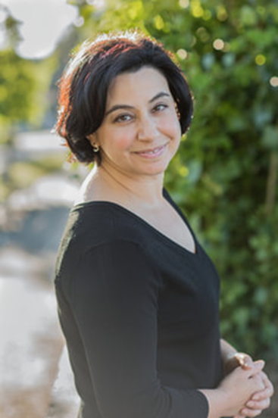
Save the Date!
Laurie Frankel will join us at Crafton Hills College
April 19
12:00-Campus Book Talk
Afternoon with our Composition and Creative Writing Students
6:00-President’s Circle Event
Notes:
Ericka

Slide 60
Questions?

Slide 61
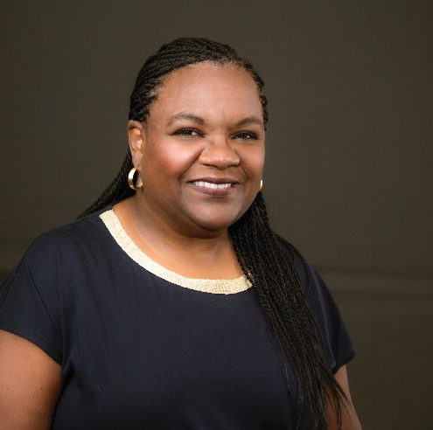
Dr. Regina Stanback Stroud
Disrupting Inequalty in the System

