Slide 1

New & Promoted Roadrunners

Slide 2
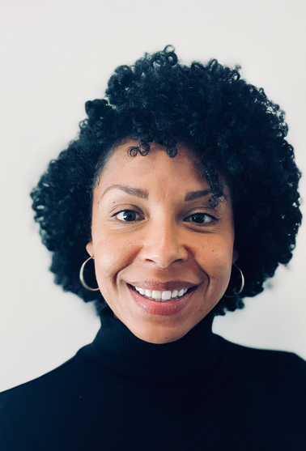
Welcome! Amanda Smith Associate Dean of Health and Wellness

Slide 3
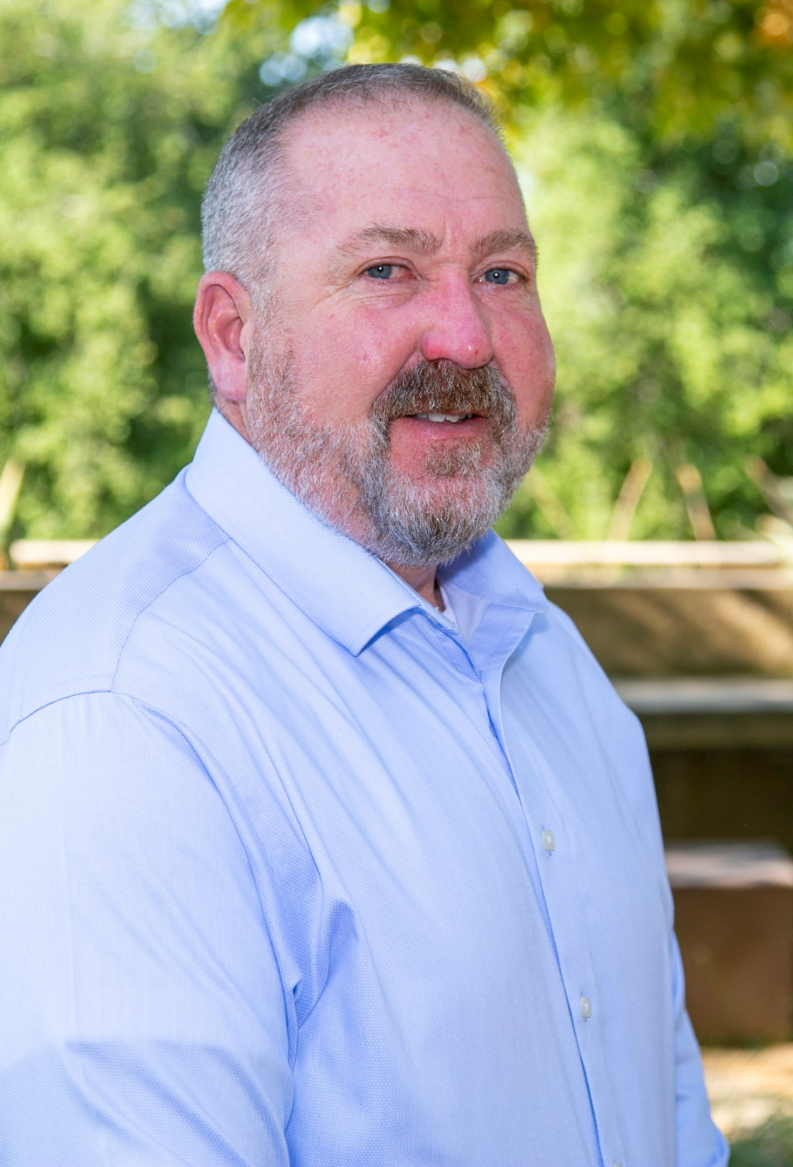
Welcome! Matt White Student Accessibility Services Director

Slide 4
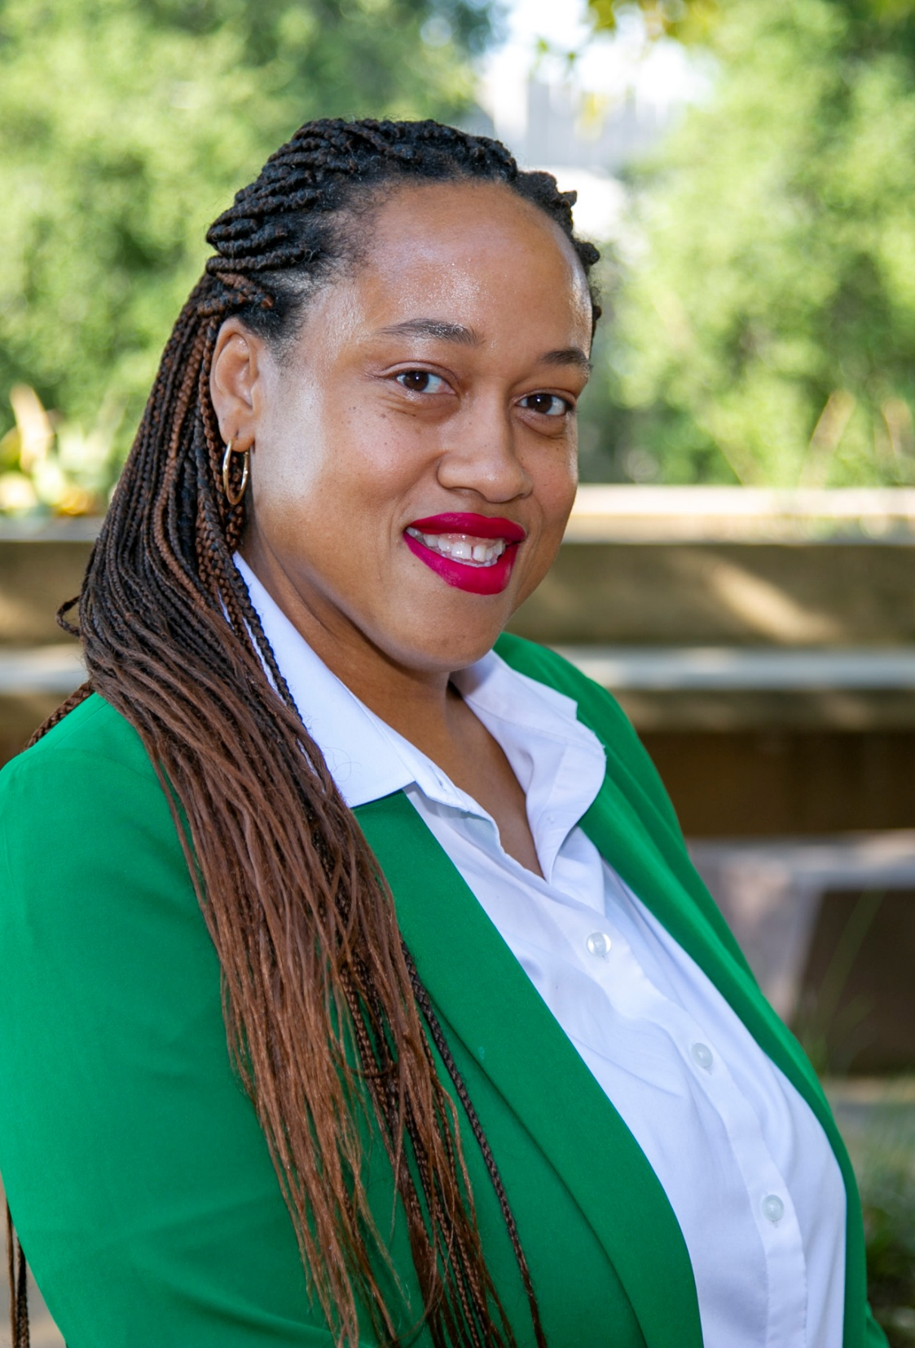
Welcome! Fatima Call Faculty, Multimedia

Slide 5
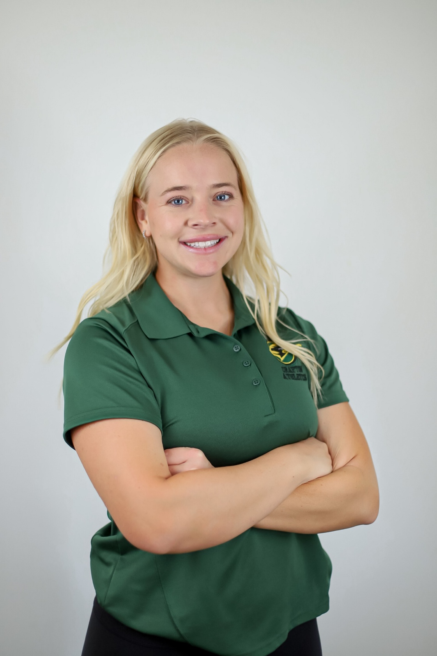
Welcome! Jordan Gordon Faculty, Kinesiology

Slide 6
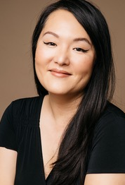
Welcome! Nancy Yuen Faculty, Ethnic Studies

Slide 7
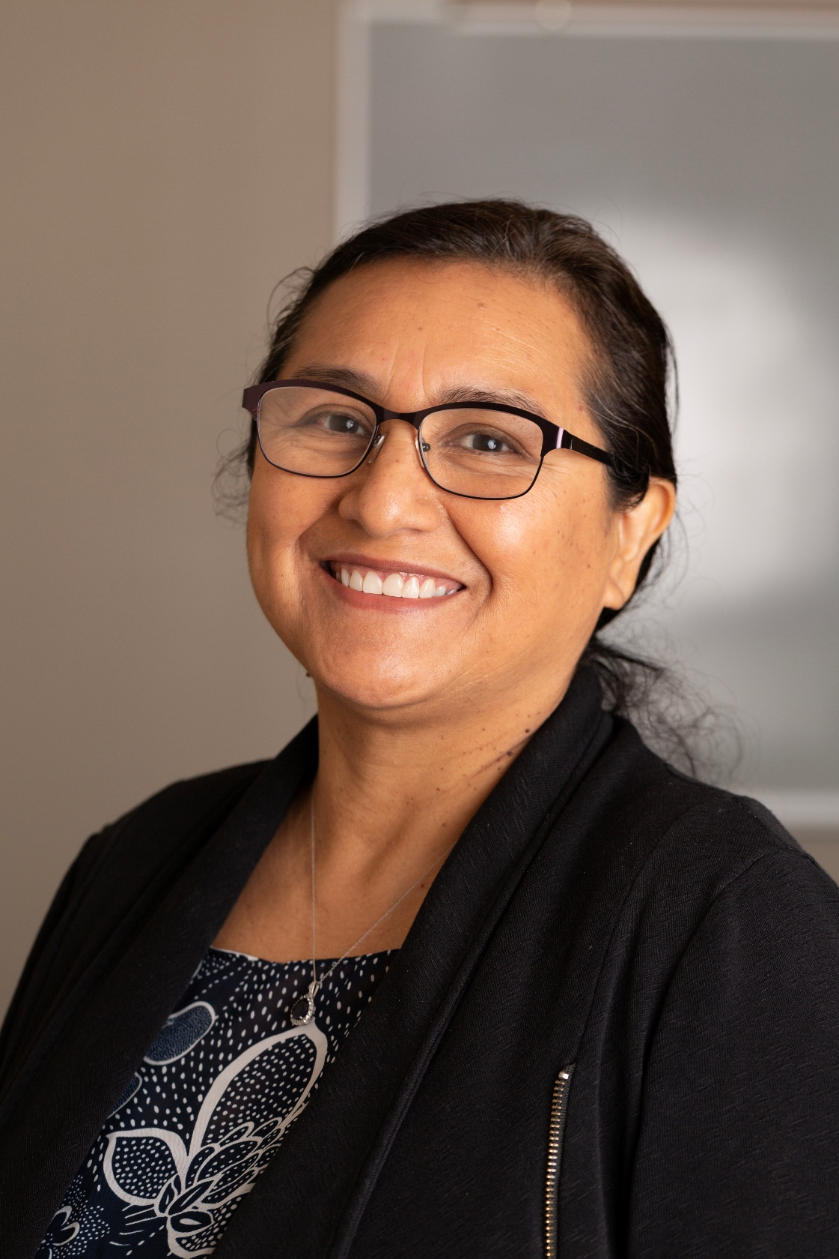
Welcome! Ana Mayo Faculty, Chemistry

Slide 8
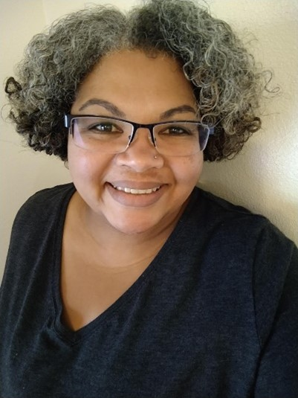
Welcome! Denise Jackson Faculty, Biology

Slide 9
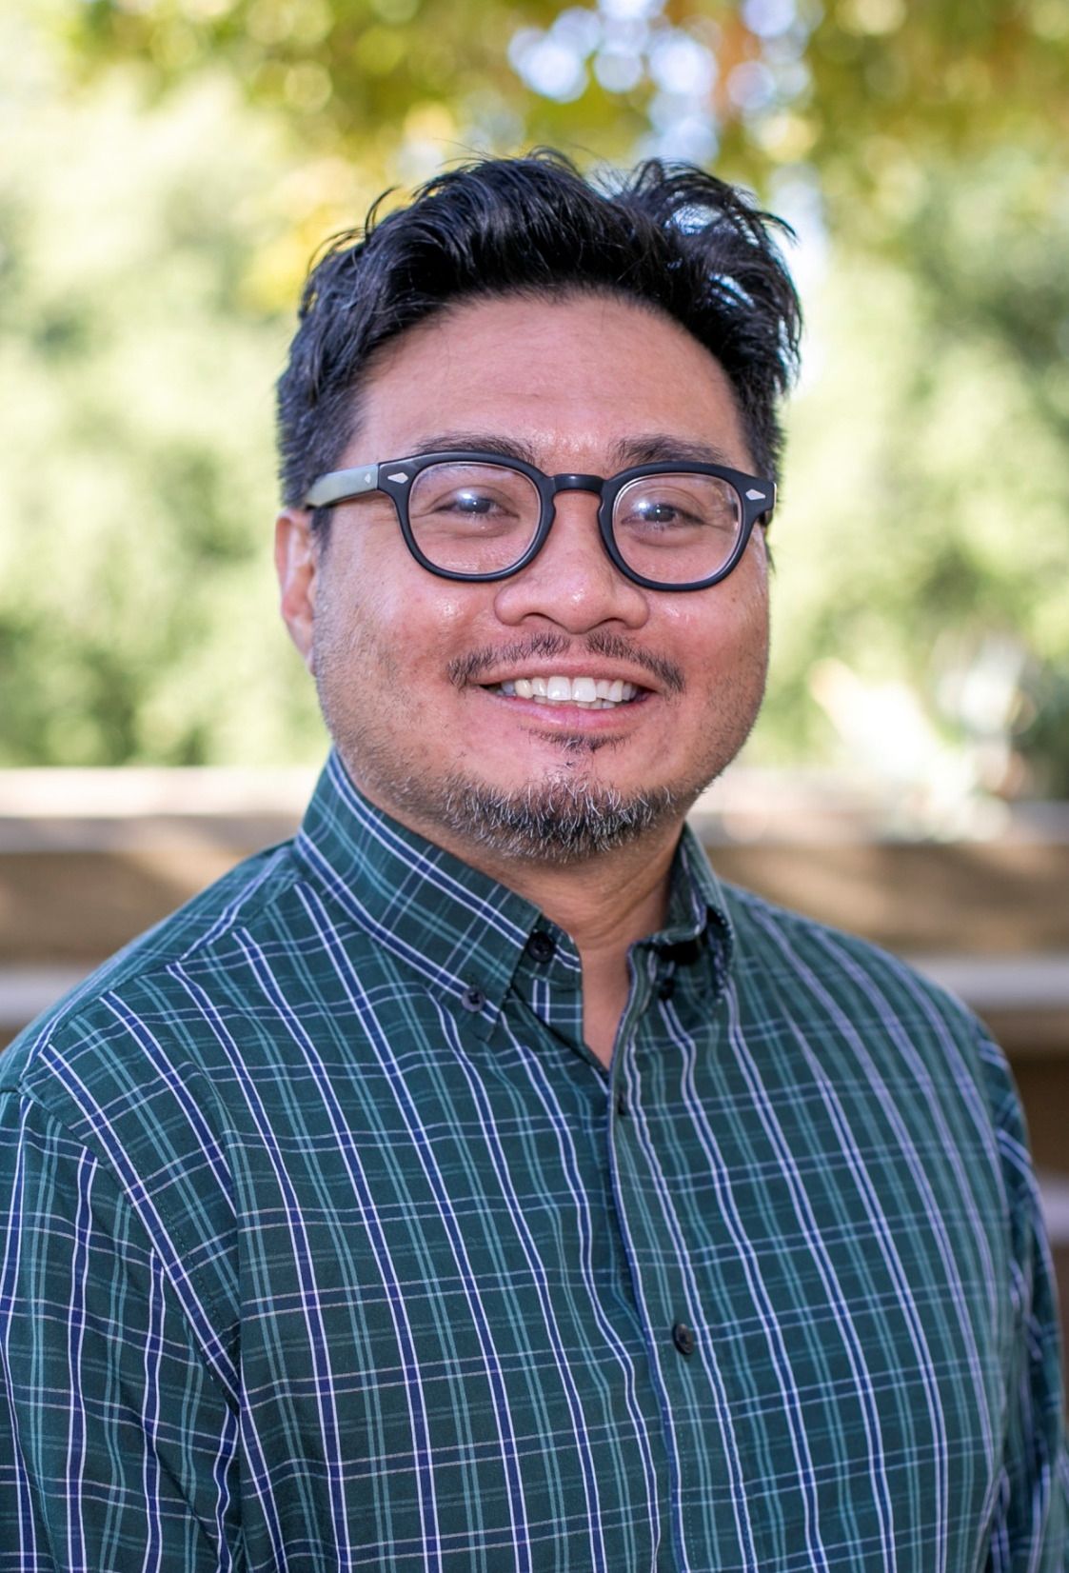
Welcome! Glenn Blanco Faculty, Anatomy & Physiology

Slide 10
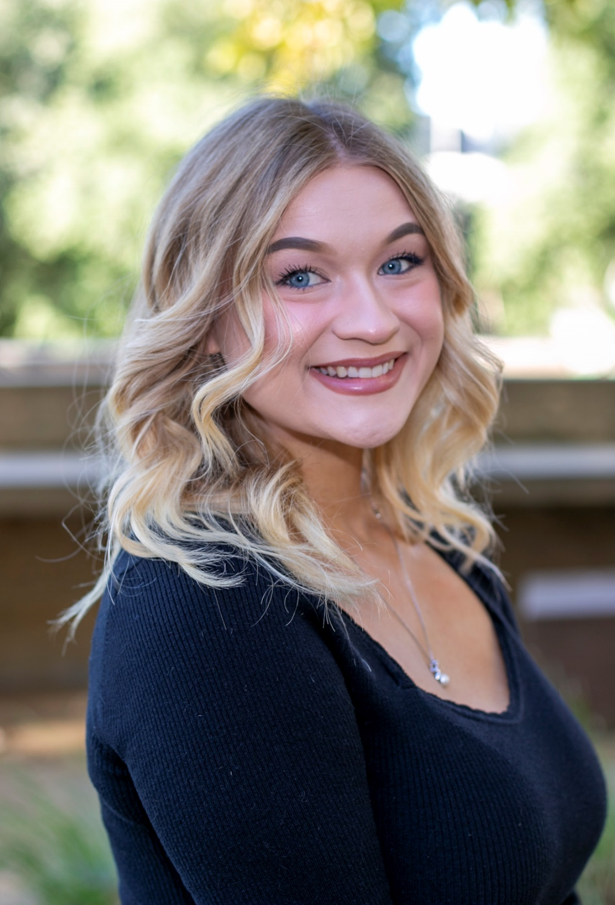
Welcome! Skylar Antoncew Faculty, EMS

Slide 11
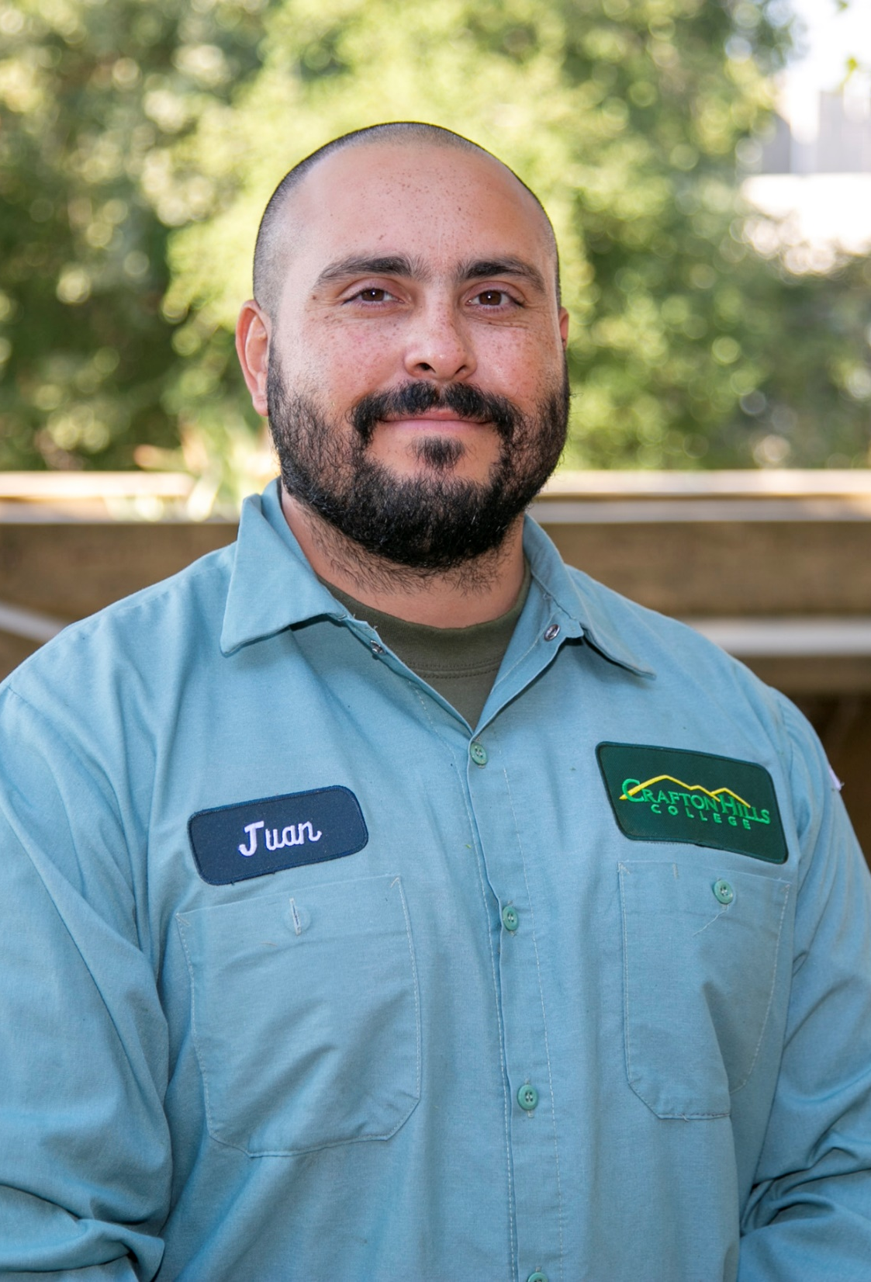
Welcome! Juan Javier Solis Grounds

Slide 12
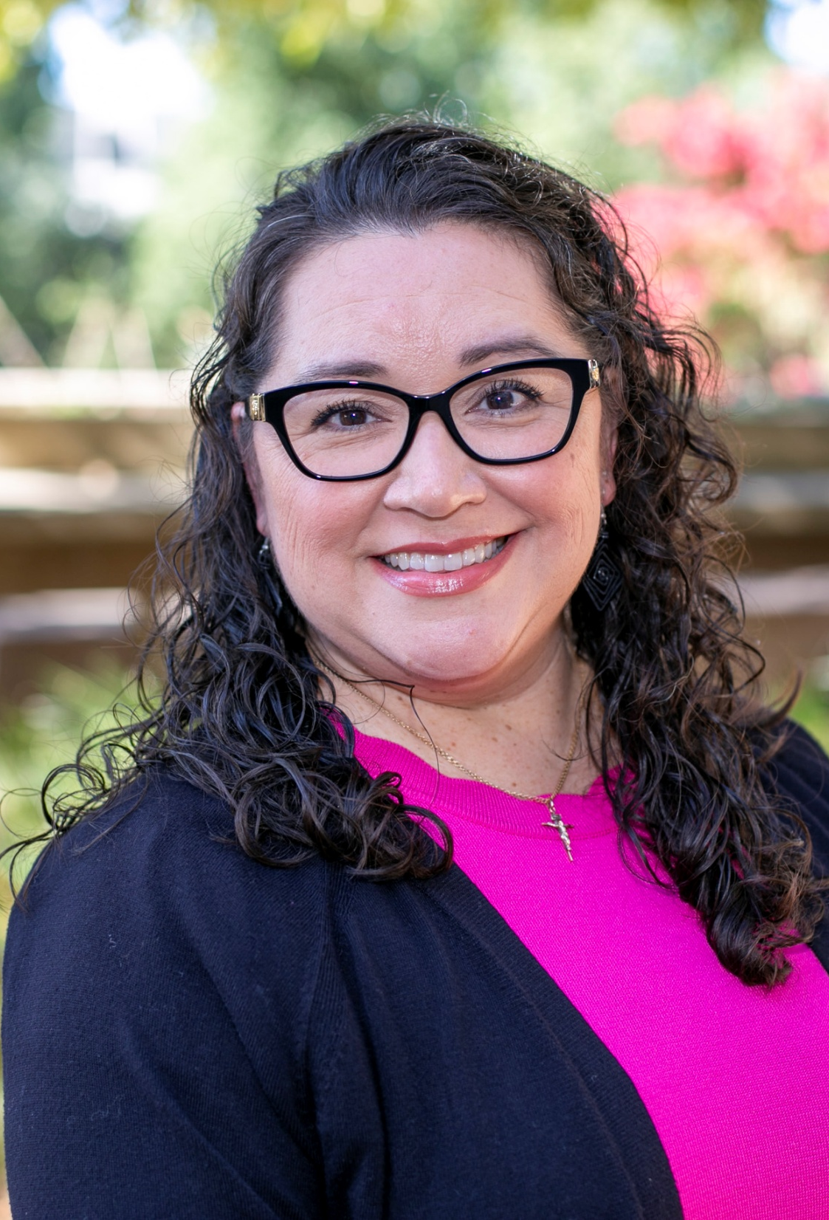
Welcome! Veronica Salceda Admin Coordinator

Slide 13
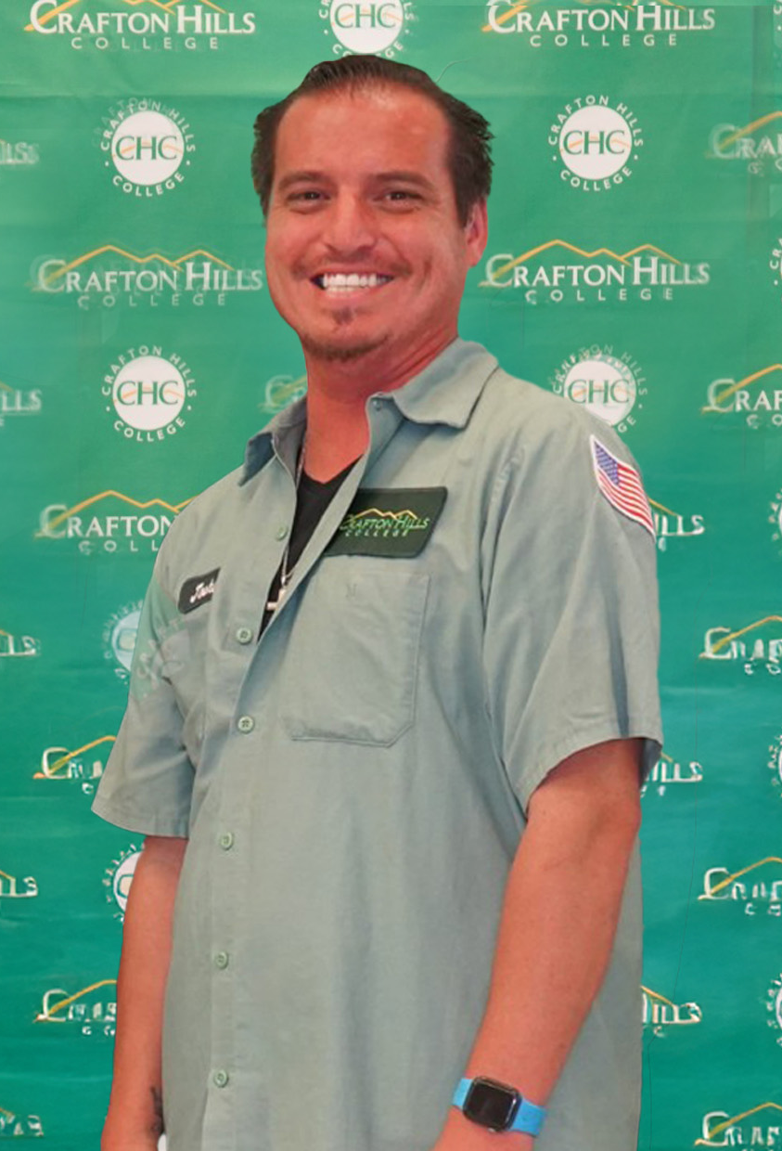
Congratulations Joshua Orosco Promoted to Custodial Supervisor

Slide 14
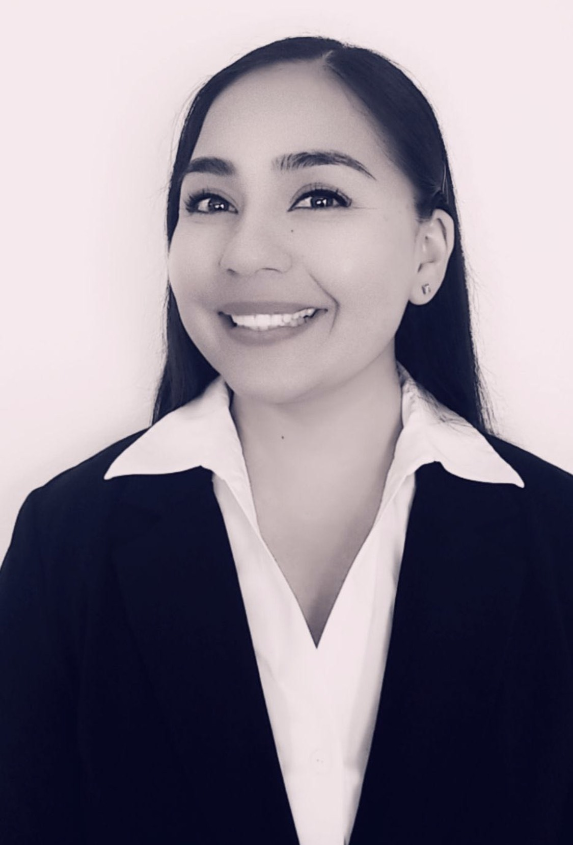
Congratulations Diana Vaichis Promoted to Senior Research and Planning Analyst

Slide 15
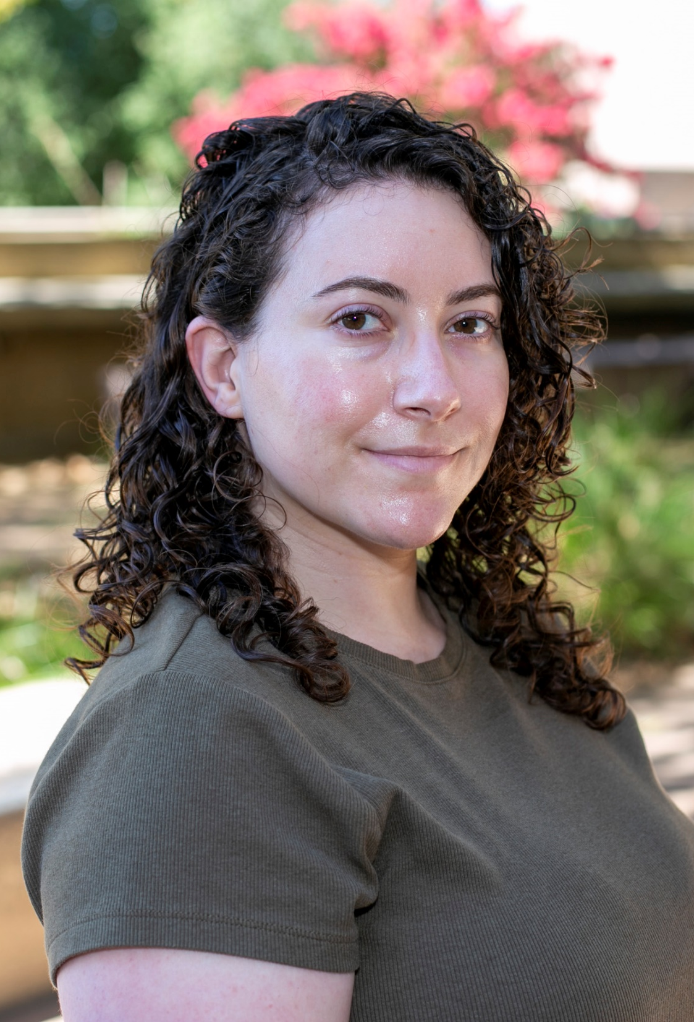
Congratulations Ali Raventos Promoted to Student Services Coordinator, Dual Enrollment

Slide 16
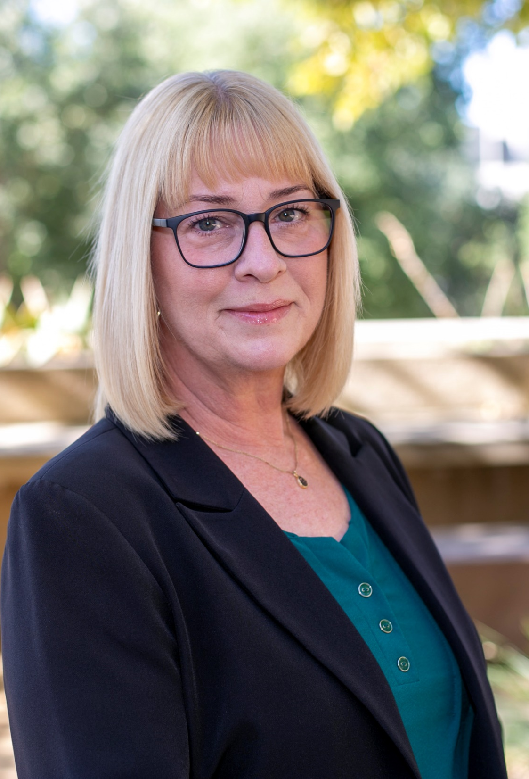
Congratulations Cynthia Hamlett Promoted to Interim Associate Dean Distance Education

Slide 17
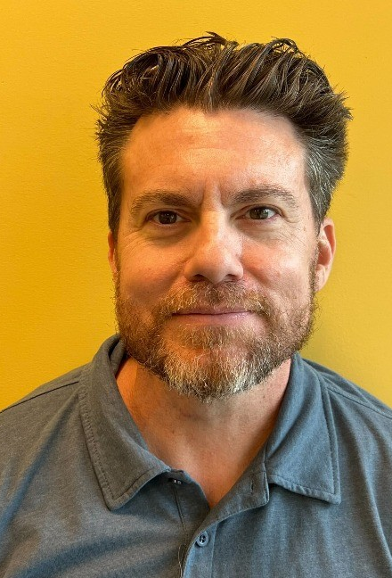
Congratulations Nick Reichert Promoted to Interim Associate Dean Instructional Support Services

Slide 18

Congratulations on Your Retirement! Karen Mottl Technology Support Specialist I

Slide 19
Welcome Future Roadrunners

Slide 20
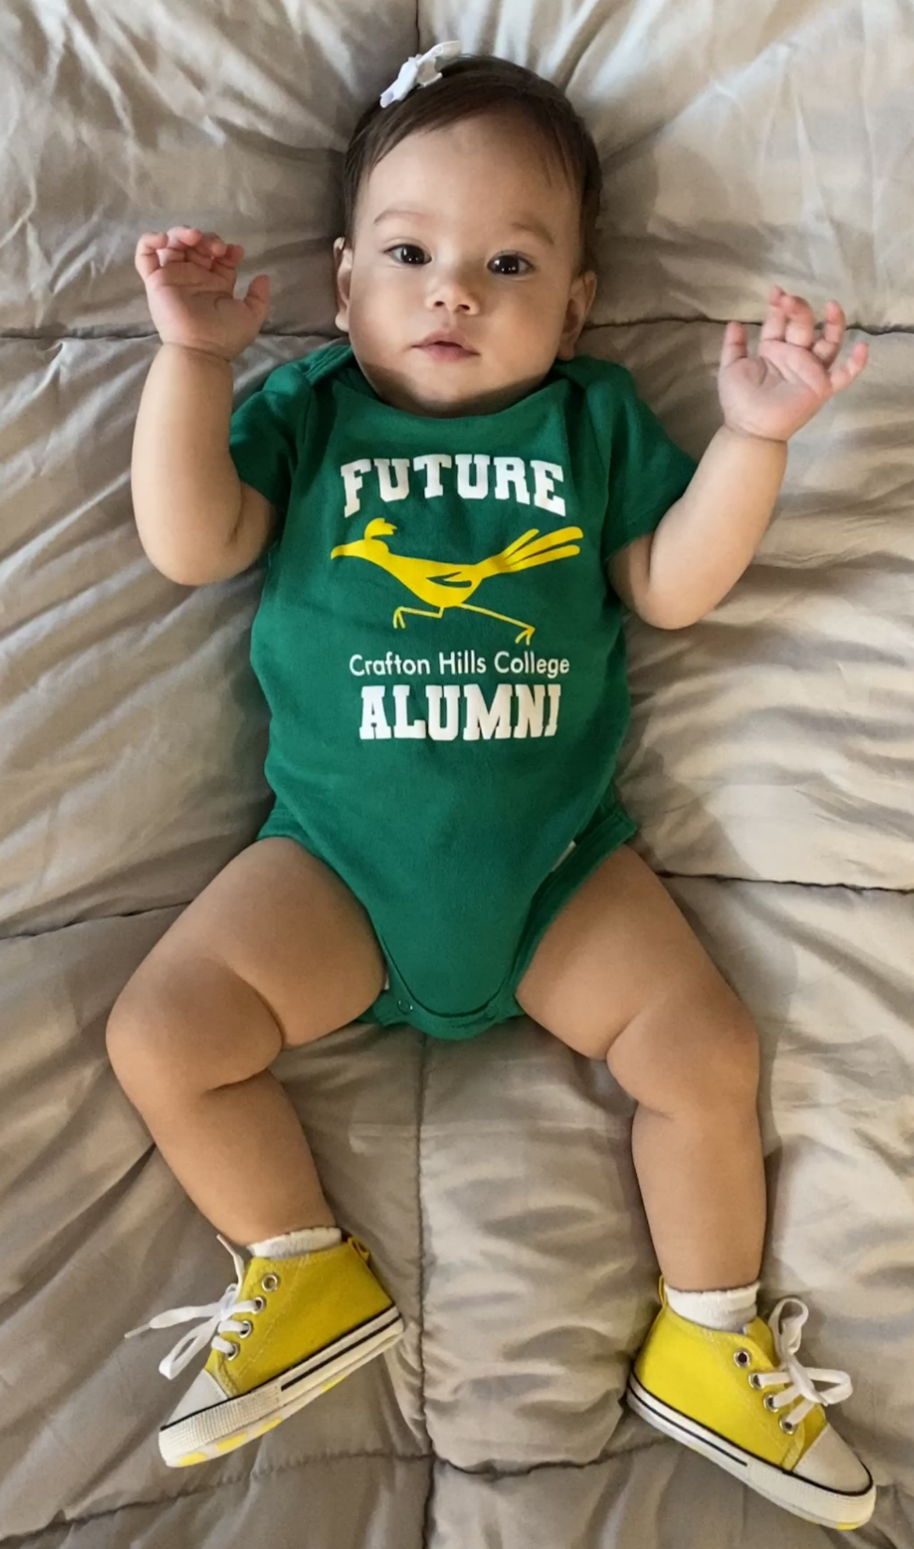
Congratulations on your future Roadrunner! Maita Jenieve D. Ready

Slide 21
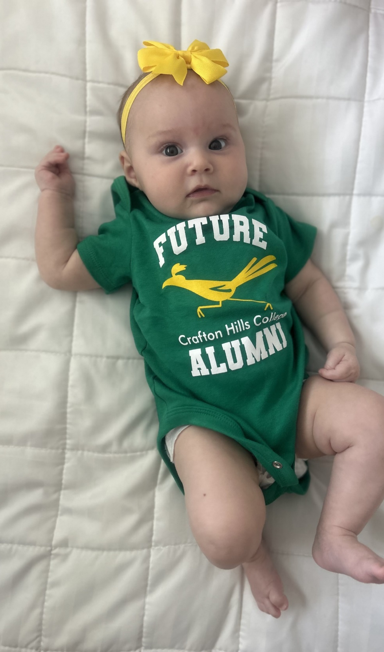
Congratulations on your future Roadrunner! Grandma Michelle Riggs

Slide 22
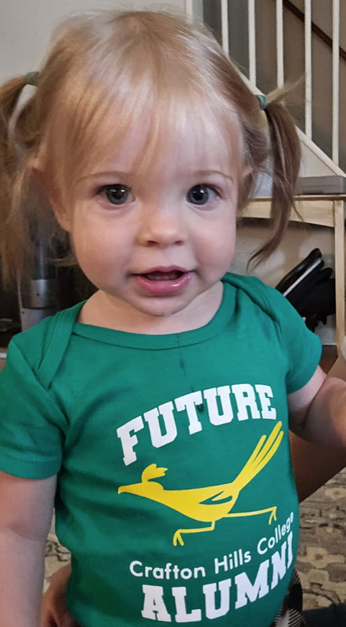
Congratulations on your future Roadrunner! Grandpa Mike Strong

Slide 23
One Book/One College
2025-2026

Slide 24
Thank you, One Book Team!
Krysten Audibert
Sara Butler
Ciera Divens
Ed Ferrari
Kashaunda Harris
Heather King
Eugenia Livingston
Natalie Lopez
Ericka Paddock
Delmy Spencer
Leslie Swindell
More members welcome! Please email Sara Butler to join the team.

Slide 25
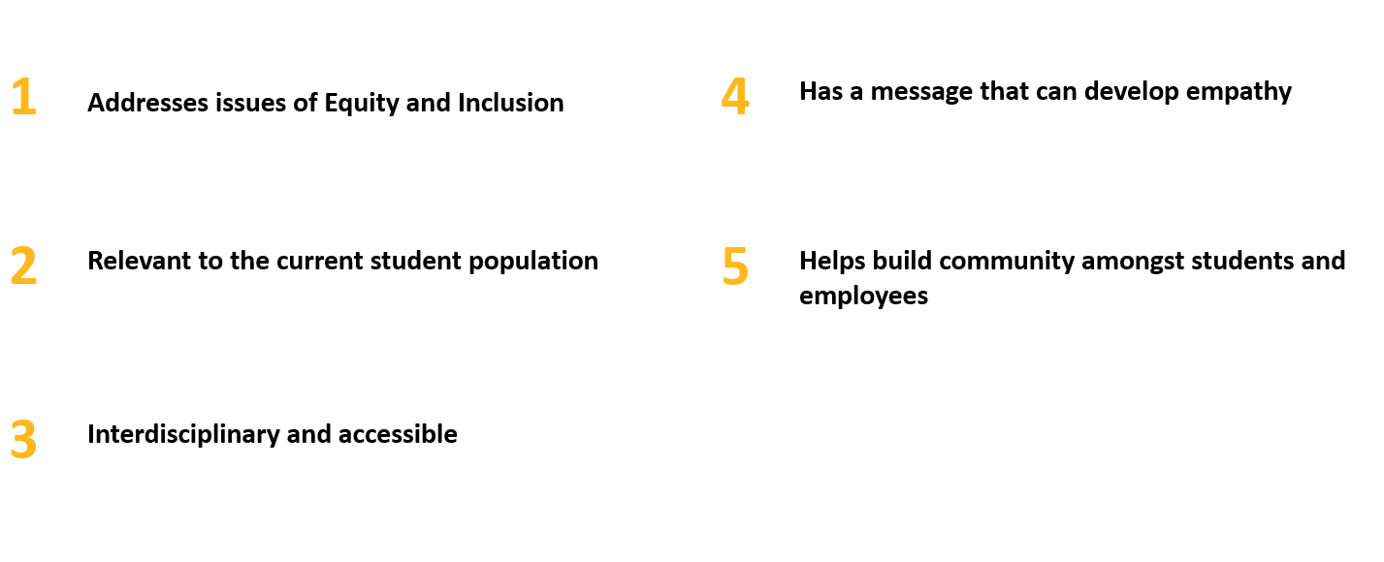
Criteria for Book Selections

Slide 26

…an all-deaf high school football team’s triumphant climb from underdog to undefeated, their inspirational brotherhood, a fascinating portrait for deafness in America, and the indefatigable head coach who spearheaded the team.

Slide 27
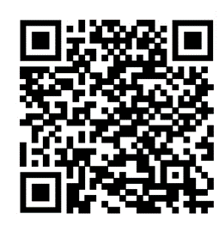
Books and Resources
Faculty wanting to use the book in their curriculum may pick up the book today.
Save the OBOC website to check for updates.

Slide 28
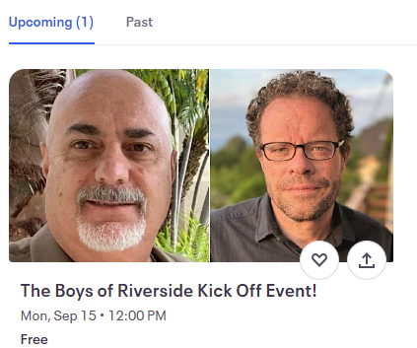
2025-2026 OBOC Events/Activities
Workshops
Speakers
Essay/Art Competition

Slide 29



Slide 30
Instructional Services

Slide 31
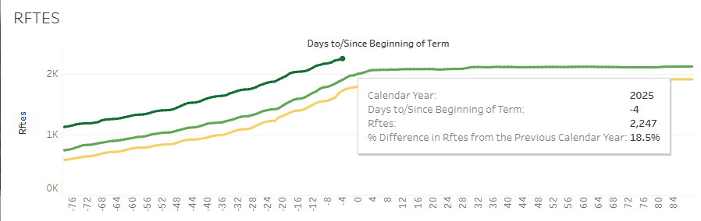
Fall 2025 Enrollments
The RFTES increased from 1,834 in Fall 2024 to 2,247 in Fall 2025, a 19% increase
Crafton is currently 55 RFTES above the Fall 2025 target of 2,192.
Great Job Everyone!

Slide 32
Great job helping with deterring Fraudulent Student Enrollments

Slide 33
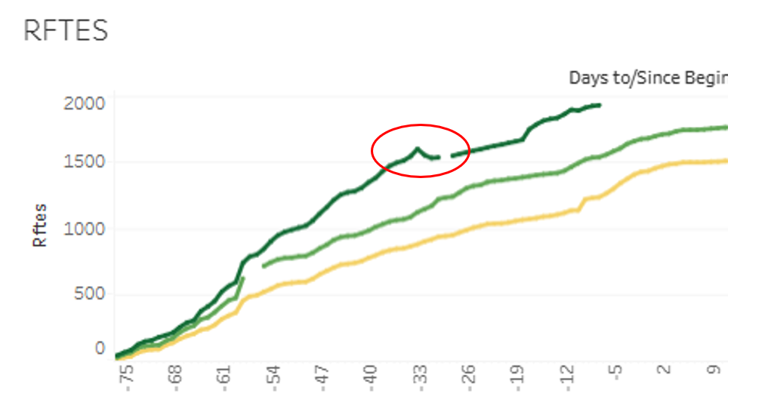
Spring 2025 Fraudulent Students
On December 19, 2024, 500 fraudulent students were identified
The Resident FTES enrollments decreased from 1,599 to 1,530, a decrease of 69 RFTES (4%)
Notes:
Currently Crafton is 10 RFTES above the target for Spring 2025

Slide 34
January - July 2025 Suspected Fraudulent Student Applications and Enrollments

Slide 35
January - July 2025 Federal Aid Written Off as Fraud

Slide 36
Great Job! The Course Success Rate is higher than it has ever been at Crafton Hills College

Slide 37
USC Race and Equity Training for Instructional Faculty to apply DEI Strategies in the Classroom
For the two groups still experiencing disproportionate impact, Black/African American and Latinx/Hispanic students, the course success rate has consistently increased over the last four years.
For Black/African American students the course success rate has statistically significantly and substantially increased from 65.1% in 2021-2022, to 72.2% in 2024-2025, a 7.1% increase (p < .001, ES = .15).
For Latinx/Hispanic students the course success rate has statistically significantly and substantially increased from 69.6% in 2021-2022, to 77.1% in 2024-2025, a 7.5% increase (p < .001, ES = .17).
Notes:
ES for entire population is .14 indicating the DI groups are doing a little better.

Slide 38
Great Job with Creating New Programs
9 students graduated in the spring with a Bachelor’s of Science in Respiratory Care
In 2024-2025 Created the following new programs
Phlebotomy Technician Certificate (Non-Credit)
Personal Trainer Certificate (Non-Credit)
Basic Spanish Language
Library Support Staff
Essential ASL and Deaf Culture for Customer Service Professionals (Non-Credit)
Technical Theatre Certificate
Mathematics for Medical Professionals (Non-Credit)

Slide 39

Great Job on the ACCJC Institutional Self-Evaluation
Fall 2024
Crafton’s Self-Evaluation Approach Developed
December 15, 2026
Institutional Self-Evaluation Report due
Spring 2027
Peer Review – Team ISER Review
Fall 2027
Peer Review – Focused Site Visit
January 2028
Commission Action
Spring 2025
IEAOC Meets with Committees to begin writing Standards I and II
Summer 2025
Begin reviewing drafts of Standards I and II
Spring 2026 – Summer 2026
Review draft ISER in all constituent groups, recommend approval, and submit to Board
Fall 2026
Open Forums to prepare for Fall 2027 visit
Fall 2025
IEAOC Meets with committees to begin writing Standards III and IV
Complete drafts of Standards I and II

Slide 40
Great Job on the ACCJC Institutional Self-Evaluation
Fall 2024
Crafton’s Self-Evaluation Approach Developed
December 15, 2026
Institutional Self-Evaluation Report due
Spring 2027
Peer Review – Team ISER Review
Fall 2027
Peer Review – Focused Site Visit
January 2028
Commission Action
Spring 2025
IEAOC Meets with Committees to begin writing Standards I and II
Summer 2025
Begin reviewing drafts of Standards I and II
Spring 2026 – Summer 2026
Review draft ISER in all constituent groups, recommend approval, and submit to Board
Fall 2026
Open Forums to prepare for Fall 2027 visit
Fall 2025
IEAOC Meets with committees to begin writing Standards III and IV
Complete drafts of Standards I and II

Slide 41
Great Job on the ACCJC Institutional Self-Evaluation
Fall 2024
Crafton’s Self-Evaluation Approach Developed
December 15, 2026
Institutional Self-Evaluation Report due
Spring 2027
Peer Review – Team ISER Review
Fall 2027
Peer Review – Focused Site Visit
January 2028
Commission Action
Spring 2025
IEAOC Meets with Committees to begin writing Standards I and II
Summer 2025
Begin reviewing drafts of Standards I and II
Spring 2026 – Summer 2026
Review draft ISER in all constituent groups, recommend approval, and submit to Board
Fall 2026
Open Forums to prepare for Fall 2027 visit
Fall 2025
IEAOC Meets with committees to begin writing Standards III and IV
Complete drafts of Standards I and II

Slide 42
Student Services Update
Fall 2025

Slide 43

Multicultural Center
Will be a space to celebrate cultural diversity and promote inclusivity.
It will provide a safe space for dialogue, connection, and belonging.
It will help us strengthen persistence, retention, and completion.

Slide 44
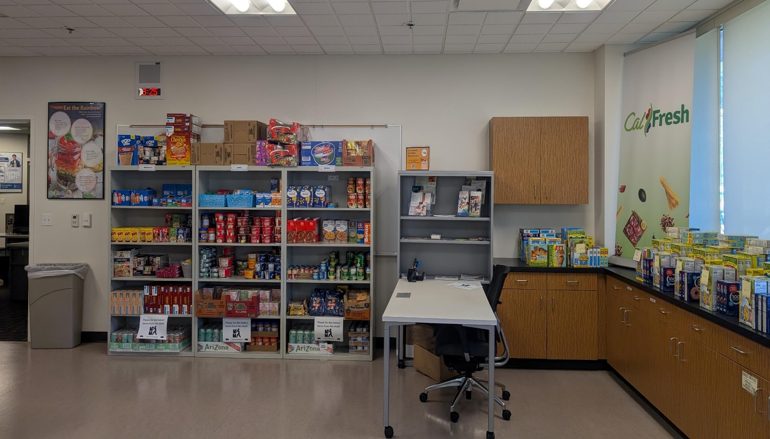
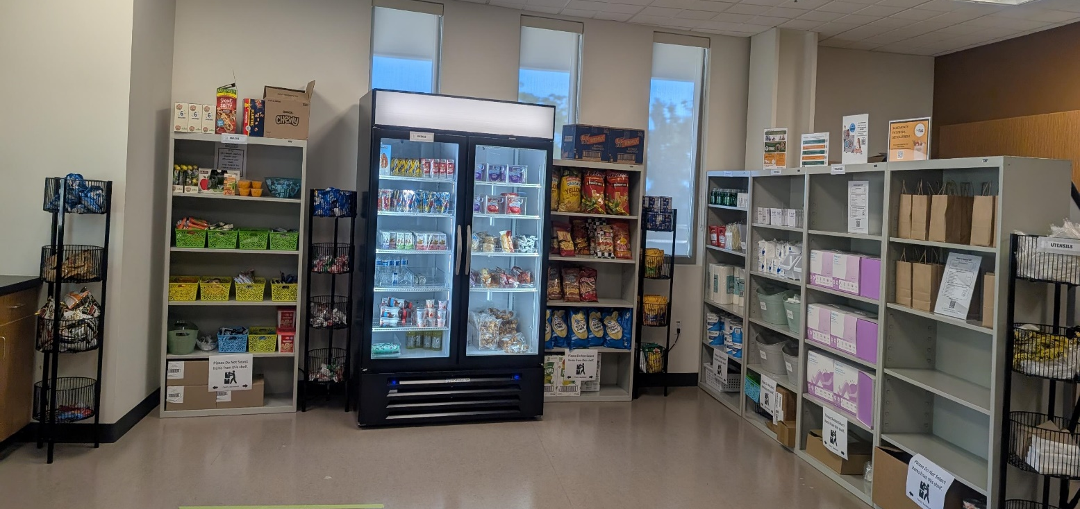
Basic Needs Center Expansion
2024-25 Food Pantry Usage
13,130 total visits
Over 400 Holiday Box Distributions
Over 500 Farm Fresh Box Distributions
100 Emergency Bags with food items + solar phone chargers + insulated cooler
Served over 515 Meals
Gift Cards
Bus Passes
Gas Cards
Groceries Gift Cards
Clothing Programs
Gift cards to Kohls or JCPenney
Laundry Vouchers

Slide 45
New Rising Scholars Program
Grant Cycle: 2025- 2028
Grant Allocation: $122,009 (for 3 years) Total $366,027
Purpose:
Provide equitable access to higher education for students impacted by the justice system
Reduce barriers to enrollment, retention, and completion
Goals:
Build a sense of belonging and connection to campus
Increase persistence, retention, and completion rates
Key Services:
Academic Counseling Priority registration
Peer mentoring Referrals to basic needs, housing, employment, and legal resources

Slide 46

Dreamers Scholars Program
Enrollment 2024-25:
FA24: 14 students * SP25: 19 students
Grants: $ 84,000 Parking Permits: $1,485
Grocery Gift Cards: $5,000 Textbook Assistance: $11,550
Presentations with Campus and Community Partners:
TODEC, Immigrant Defense & Legal Defense Monthly free workshops.
UndocuScholars: Monthly student engagement workshops and ally trainings for faculty/staff.
Campus Partnerships:
Crafton Health and Wellness – Mental health and well-being support
Crafton Financial Aid – Assistance with financial aid and scholarships
Crafton Basic Needs Center – Food, housing, and other essential resources

Slide 47

Lawyers In The Library
Crafton Hills College Library is excited to host "Lawyers in the Library" to provide our students with FREE legal guidance thanks to our friends at Inland County Legal Services.
Advising on legal issues, including:
Housing
Public Benefits
Consumer issues
Expungements
When & Where:
Third Thursday of every month (9/18, 10/16, 11/20)
3pm – 6pm LRC 206

Slide 48
Transfer Partnerships
Top UC Transfer Institution
Ranked #1 in UC transfer rates across the Inland Empire for the third consecutive year, demonstrating our commitment to equity and academic excellence.
Coyotes on the Horizon (CSUSB Partnership)
Guaranteed transfer pathway with CSUSB for students completing 24 units with a 2.0 GPA. Dual-enrollment benefits and early advising access strengthen student support.
UCLA ADT Pilot Program (Fall 2026)
Selected as one of only 10 colleges statewide for UCLA’s ADT Pilot. Provides priority consideration for ADT students applying to aligned UCLA majors.

Slide 49
Administrative Services Update
Fall 2025

Slide 50
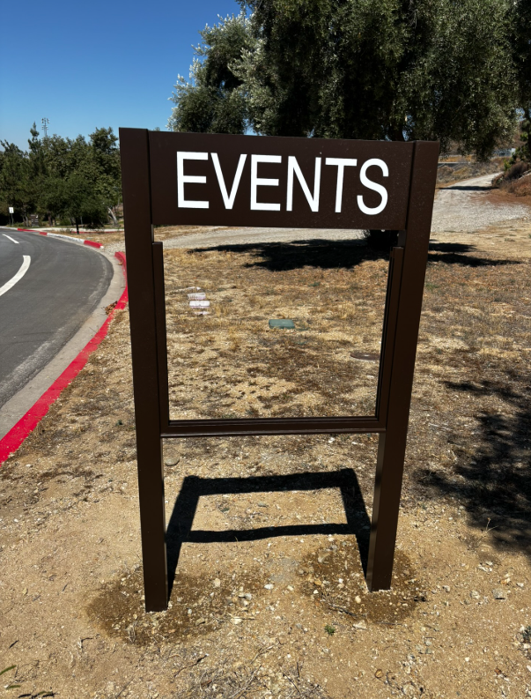
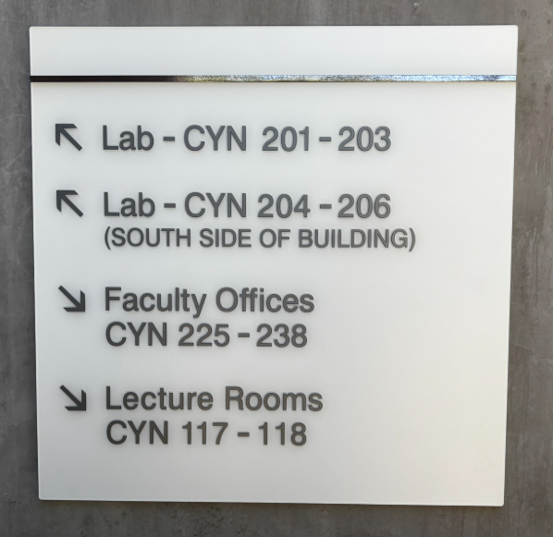
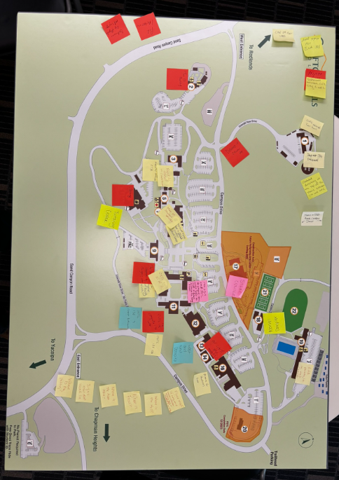
Wayfinding
Notes:
Mike

Slide 51
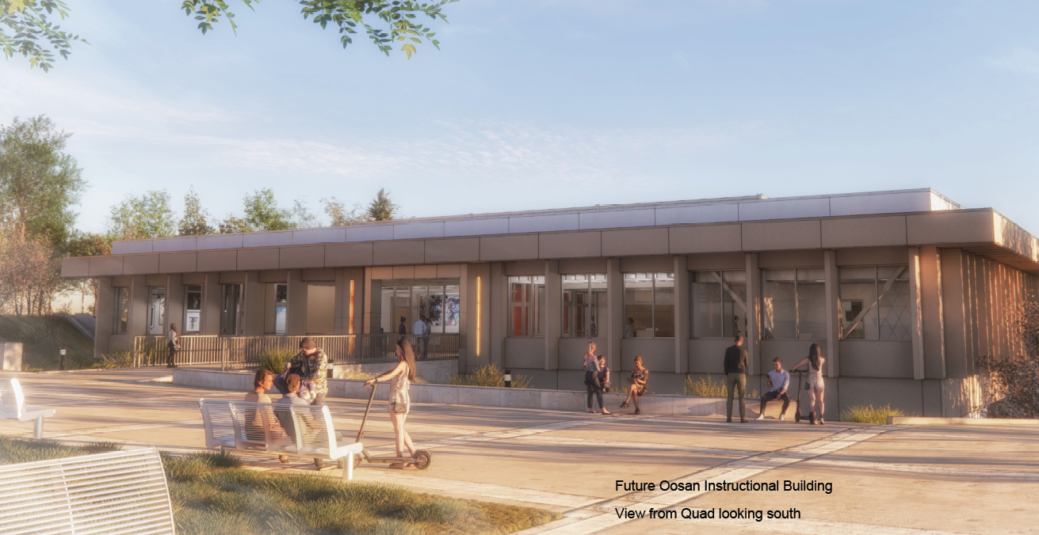
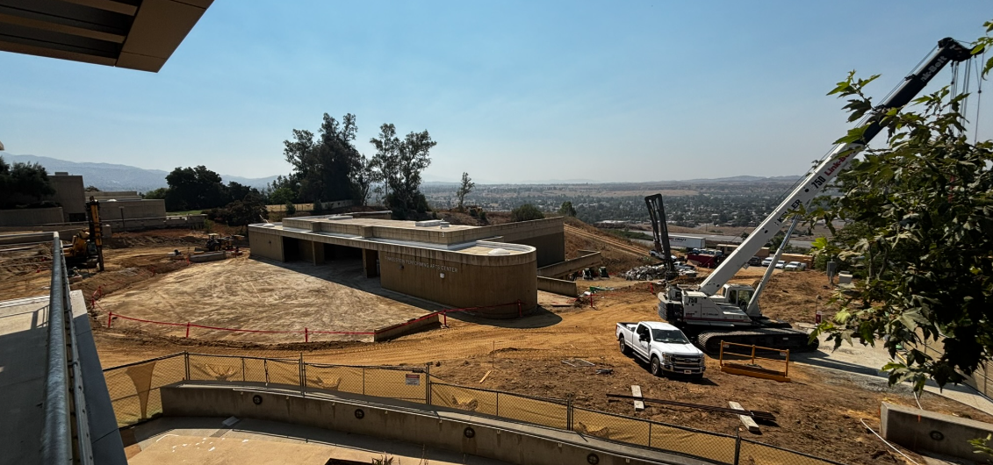
PAC Demo & Oosan Instructional Building Construction
Project Milestones:
Oct. 8, 2025: Demo Complete
Feb. 2026: Building Pad Certification
4/28/26: Structural Steel Complete
June 2027: Building Complete

Slide 52
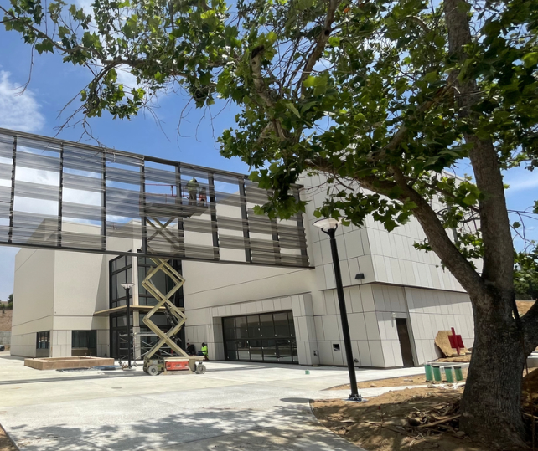
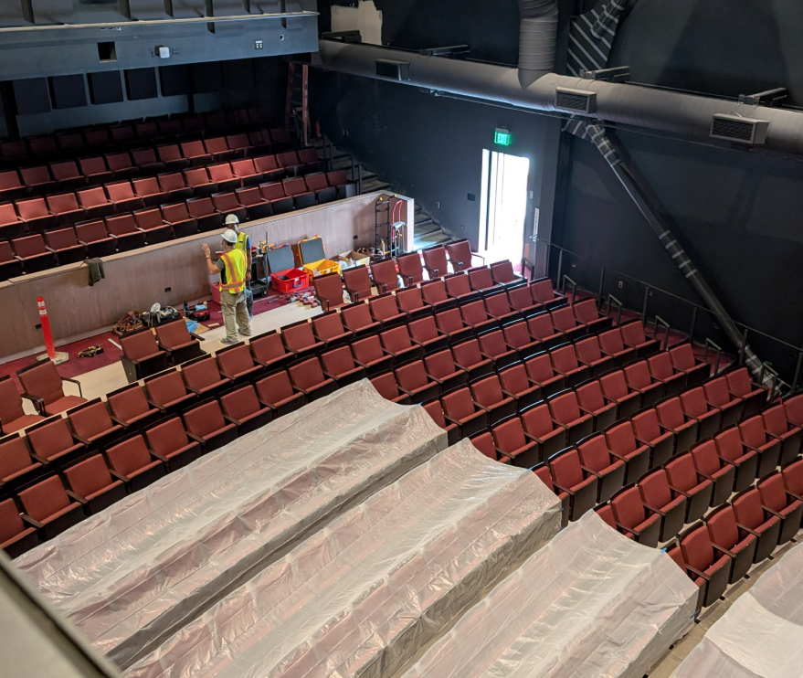
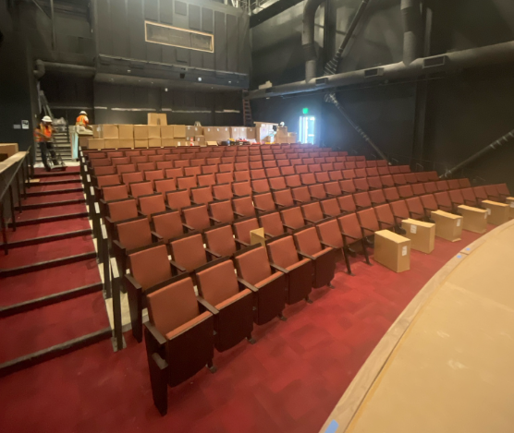
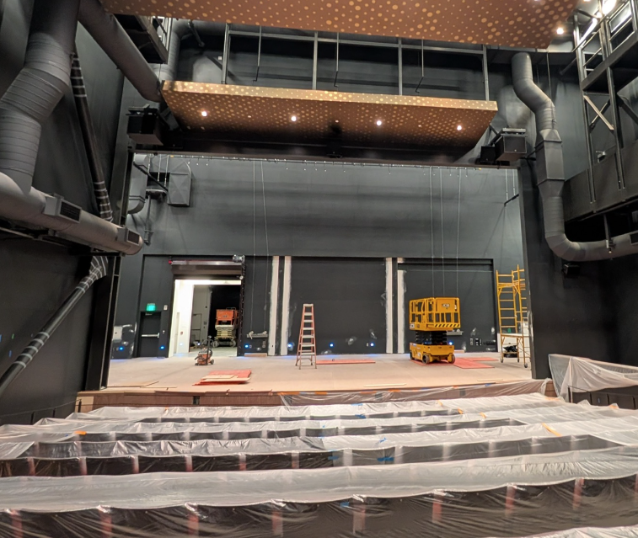
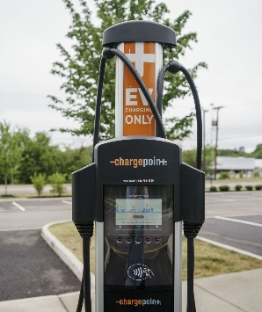
New PAC Open Fall 2025
09/19/25 -- 1 p.m. Grand Opening
4 EV Chargers to be installed Oct-Nov
Notes:
Mike

Slide 53
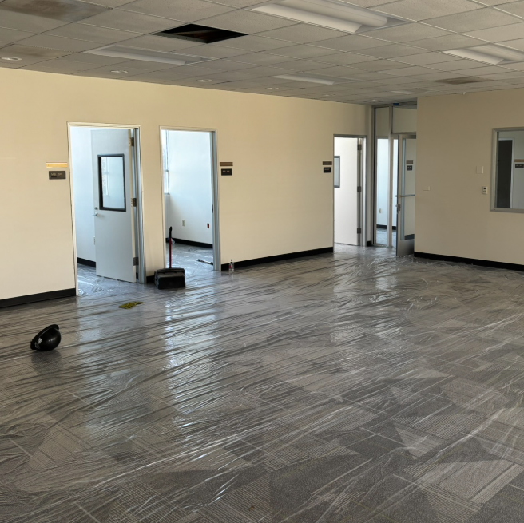
SSB Renovation
Multi-Cultural Center (2nd floor)
Aug. 18-19th – Furniture and Tech Install
Aug. 20-22nd – Move-in

Slide 54
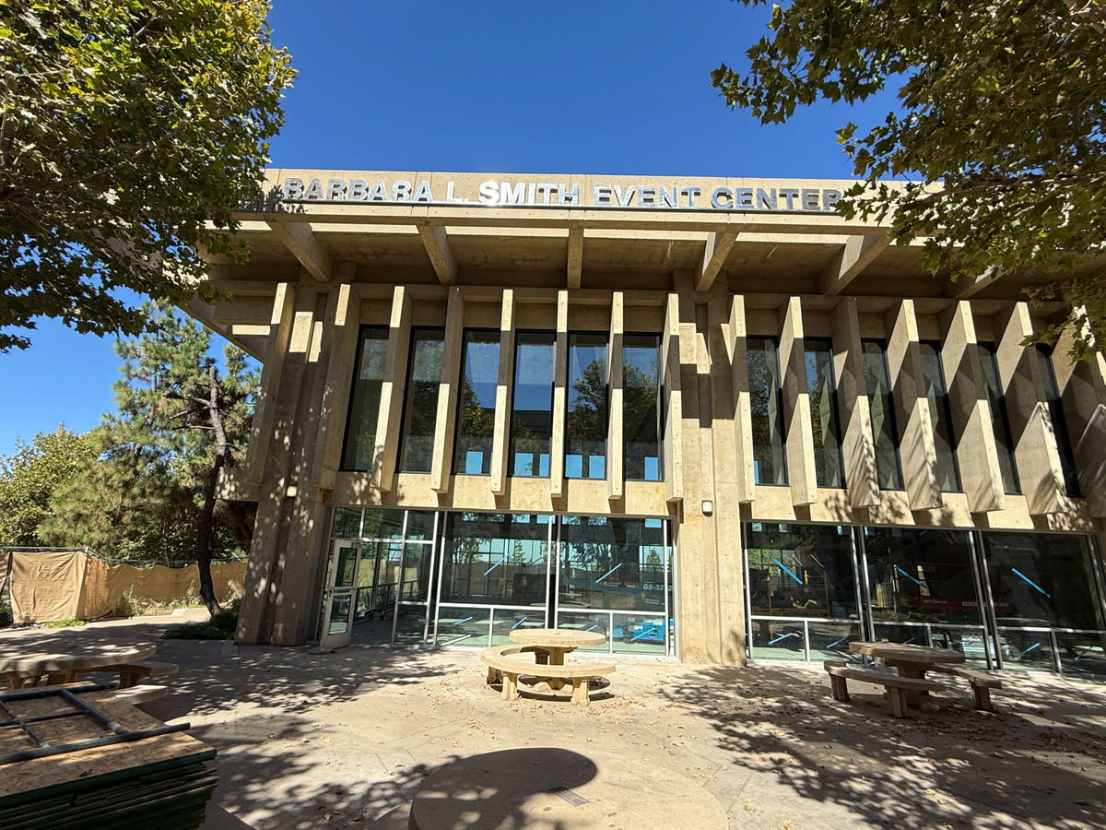
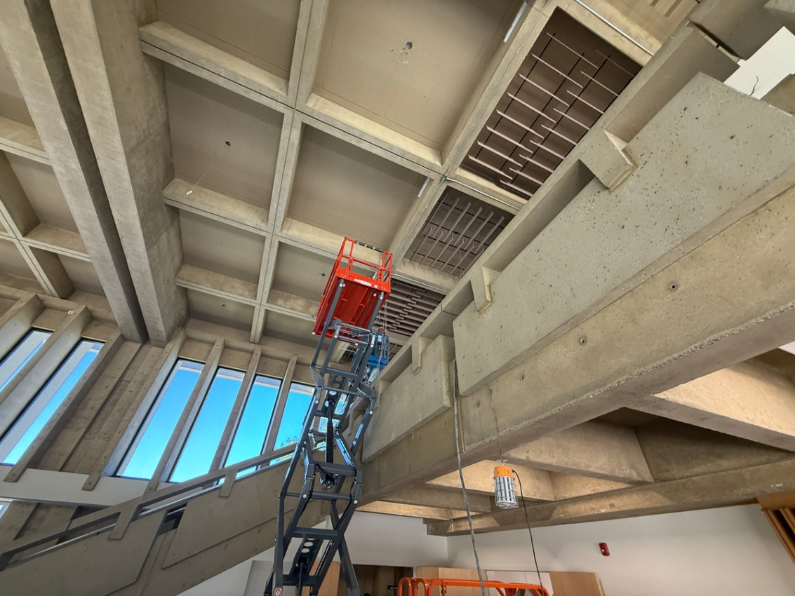
Barbara L. Smith Event Center
Event Center
Aug 25-30th - Furniture Install
Sept. 15th – Move-in

Slide 55
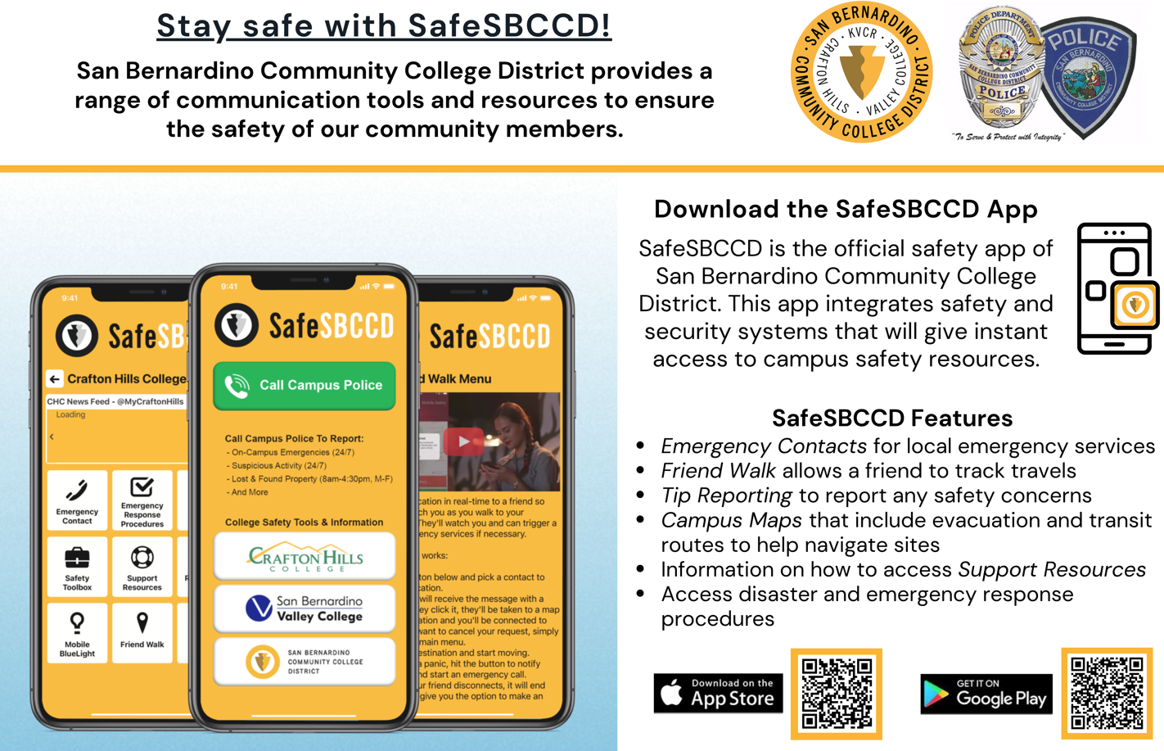

Slide 56
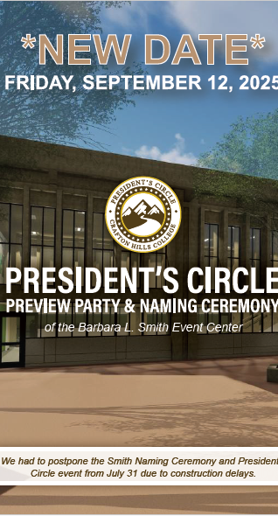
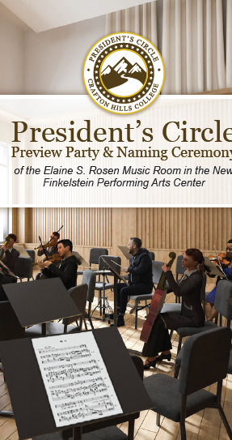
Two Naming Ceremonies
Elaine S. Rosen Music Room
August 6 – 5 p.m.
$550,000 Endowment
Provides scholarships for local high school students to attend Crafton Hills College. Supports recruitment of talented students for the Performing Arts program.
Funds regional competition expenses, internships, and production licensing.
Barbara L. Smith Event Center
September 12 – 5 p.m.
1.1M endowment
Unrestricted funds - creating a perpetual source of funding for the Foundation to meet the evolving needs of students.

Slide 57
Please Welcome
Dr. Gio Sosa, Dean of Institutional Effectiveness, Research, and Planning

Slide 58
Student Satisfaction Survey Findings
Spring 2024

Slide 59
Survey Overview
Five Major Survey Topic Areas
Belonging, Respect, and Fair Treatment (16 items)
Classroom Experience and Course Availability (11 items)
Campus Technology and Website (7 items)
Campus Facilities (9 items)
Student Support Services (32 items)
Survey items measured on a four-point scale (4 – high satisfaction; 1 – low satisfaction)
491 Respondents
Notes:
Gio

Slide 60
Average Scores by Topic Area
Response Count | Respect Belonging & Fairness | Classroom Experience & Course Availability | Campus Technology & Website | Campus Facilities | Student Support Services
491 | 3.51 | 3.38 | 3.34 | 3.42 | 3.38
No significant differences by ethnicity, gender, age group, enrollment type, term count, or unit load
Notes:
Gio

Slide 61
Marketing and Foundation Update
2024-2025

Slide 62
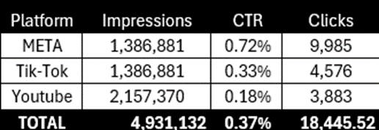
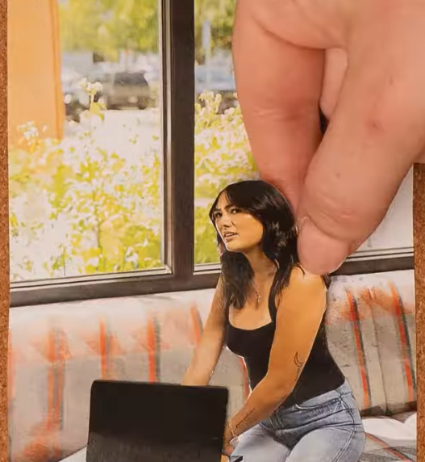
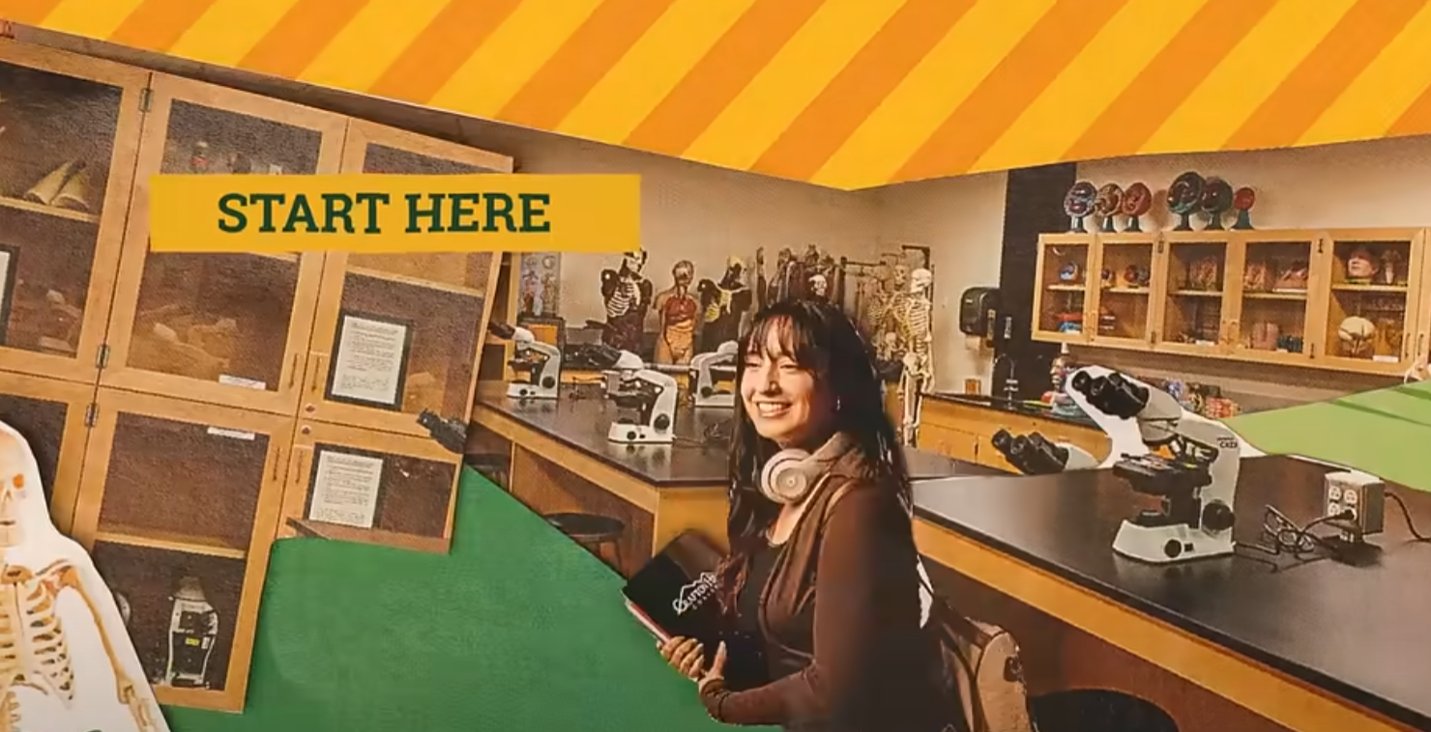
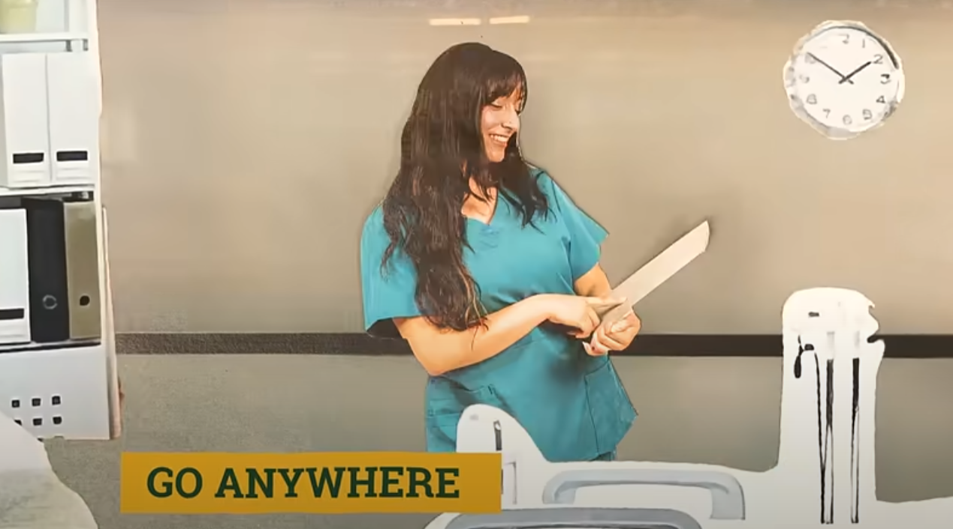
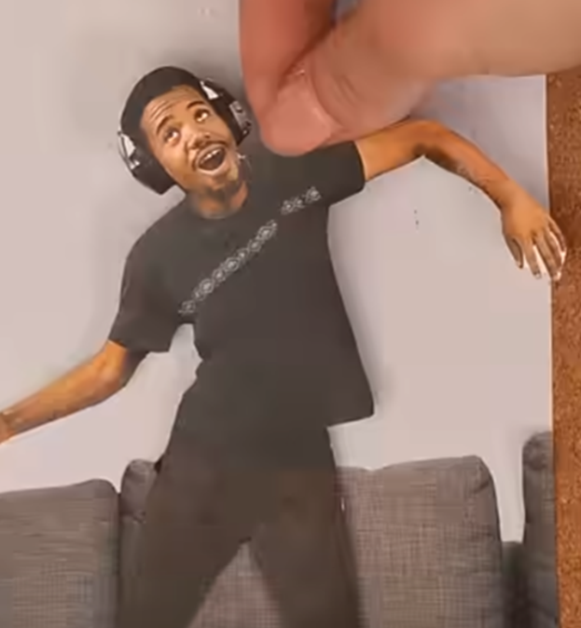
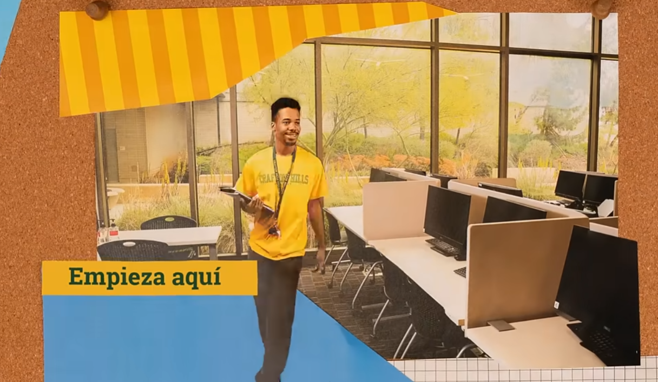

Fall Marketing Campaign
English/Spanish Radio, Digital, Social
Notes:
Gio

Slide 63
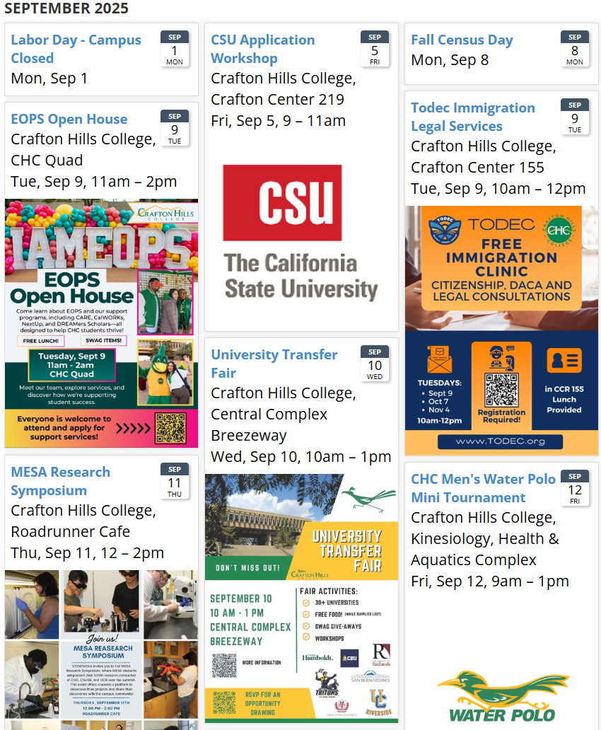
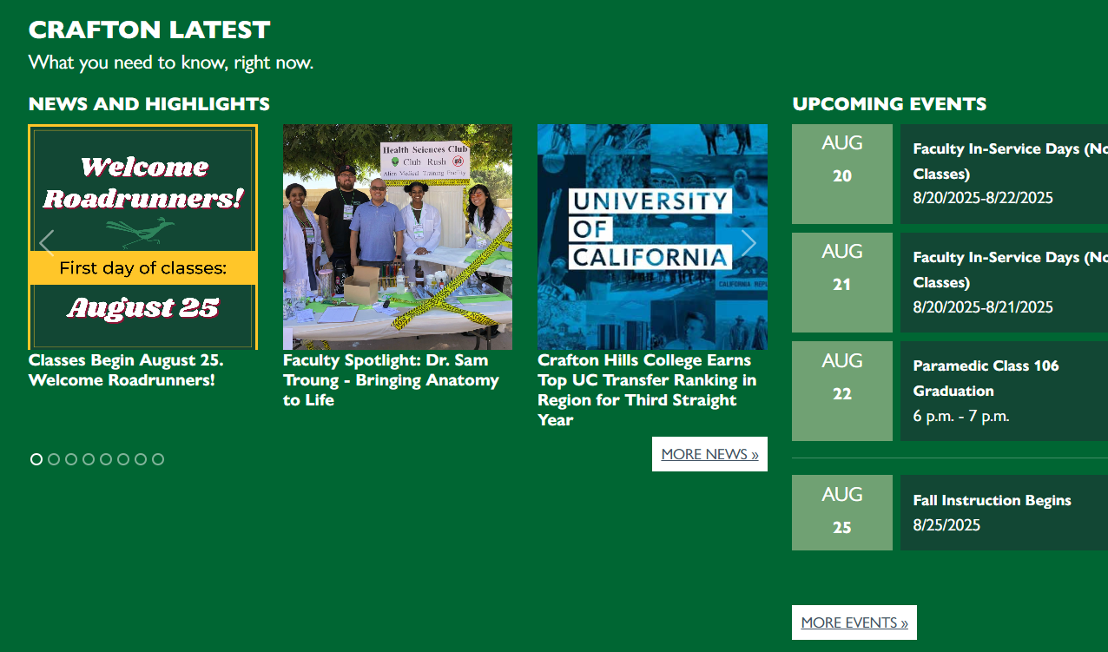
What is going on at CHC?
Check the Homepage Calendar. Add your events/activities.
Notes:
Gio

Slide 64

Casual Baseball Themed event in campus quad
In-N-Out burger, hot dogs, churros, soft-serve
Live & Silent Auction
Chargers/Raiders Tickets
Angels Tickets
Two eBikes
Palm Springs Package
2-night stay at Palms Casino
EMPLOYEE DISCOUNT $50

Slide 65

Foundation Asset Growth (2013–2025)
Removing Barriers and Creating Opportunities!
Textbook Loans
Emergency Grants
Transfer Fees
Scholarships
Internships
Paramedic Licensing Fees
Honors
STEM
Fire Academy

Slide 66


Performing Arts Endowment Sponsor a Seat

Slide 67


Employee Giving 2024-2025 = $112,040
85 Employees
23 Managers
40 Faculty
22 Classified Employees
13 District

Slide 68


Jazmyn Garcia
Marie Lena Wallis Olson Scholarship
Michelle E. Konzem Memorial Scholarship
“In Fall 2023, I returned to college after nearly a decade. Then I took a biology course, and everything changed. It felt like I had been waiting for this moment, and everything clicked. My goal now is to complete my bachelor’s degree in biology and advance to graduate studies in neuroscience. I'm especially interested in research on how adverse childhood experiences shape mental health and relationships in adulthood.”

