Slide 1

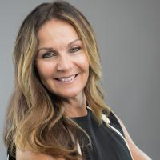
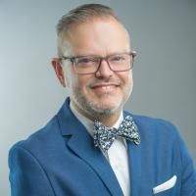
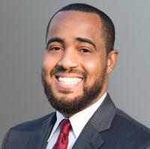
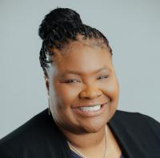
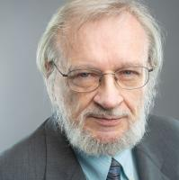
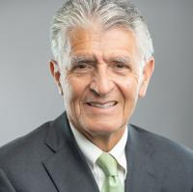
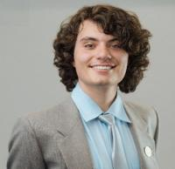
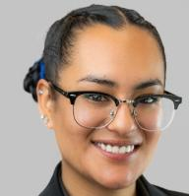
Board Chair
Dr. Stephanie Houston
Board Vice Chair
Dr. Nathan Gonzales
Board Clerk
Joseph R. Williams
Trustee
Dr. Cherina Betters
Trustee
John Longville
Trustee
Frank Reyes
Student Trustee
Hadi Natour
Student Trustee
Nelva Ruiz-Martinez

Slide 2

New & Promoted Roadrunners

Slide 3
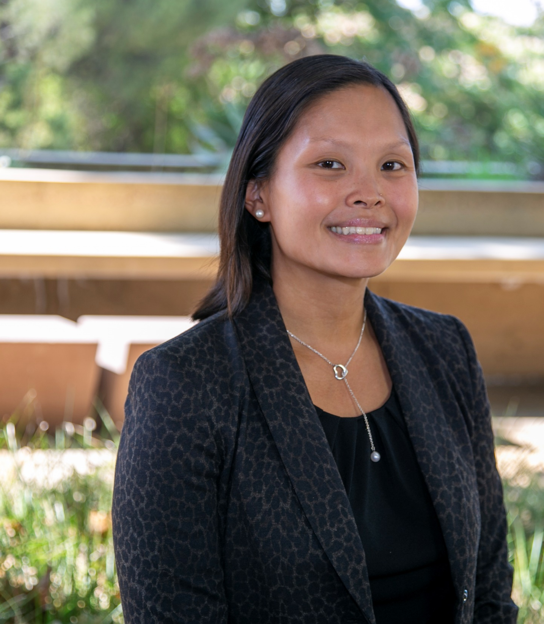
Welcome! Sara Butler Dean, Language, Arts & Academic Support

Slide 4
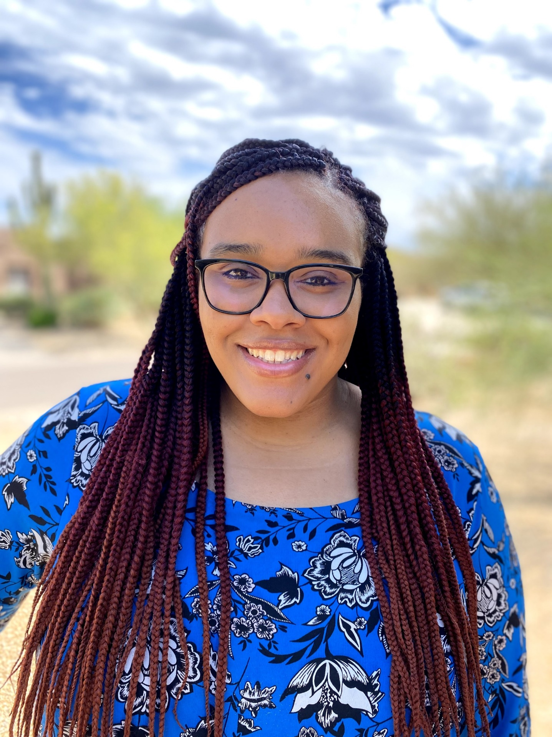
Welcome! Danae Hart Full Time Instructor, Ethnic Studies

Slide 5
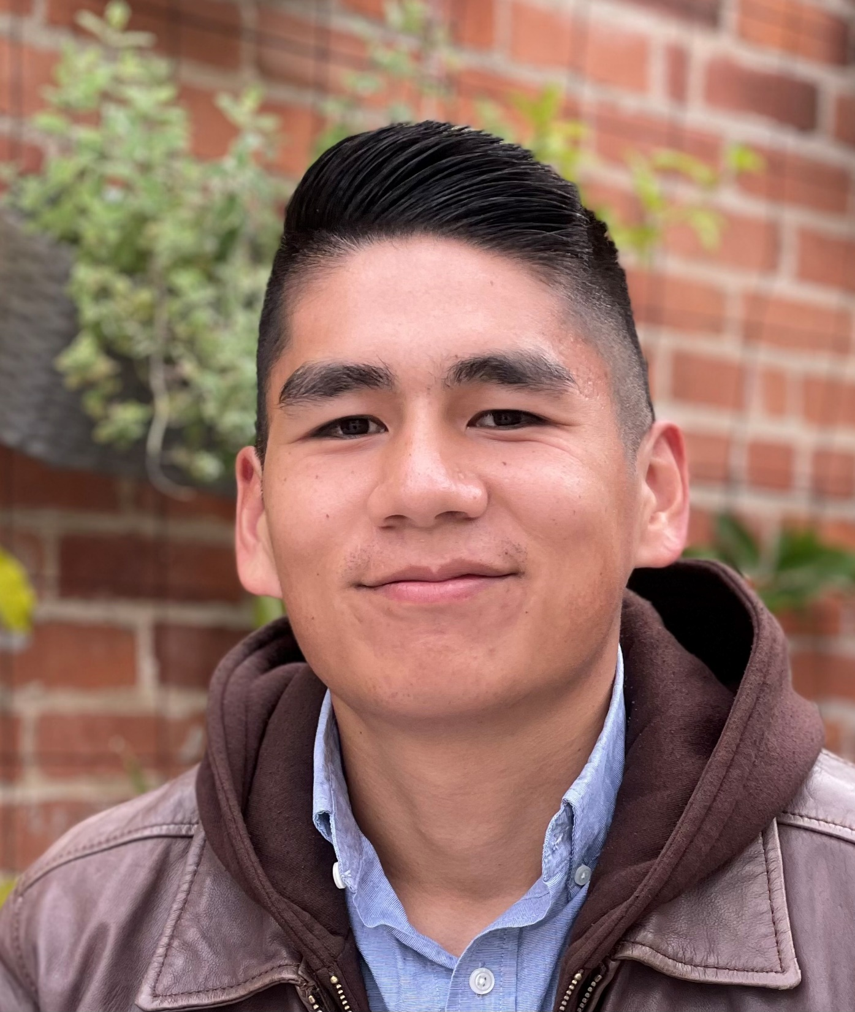
Welcome! Toshio Alvarado Lab Technician, Microbiology

Slide 6
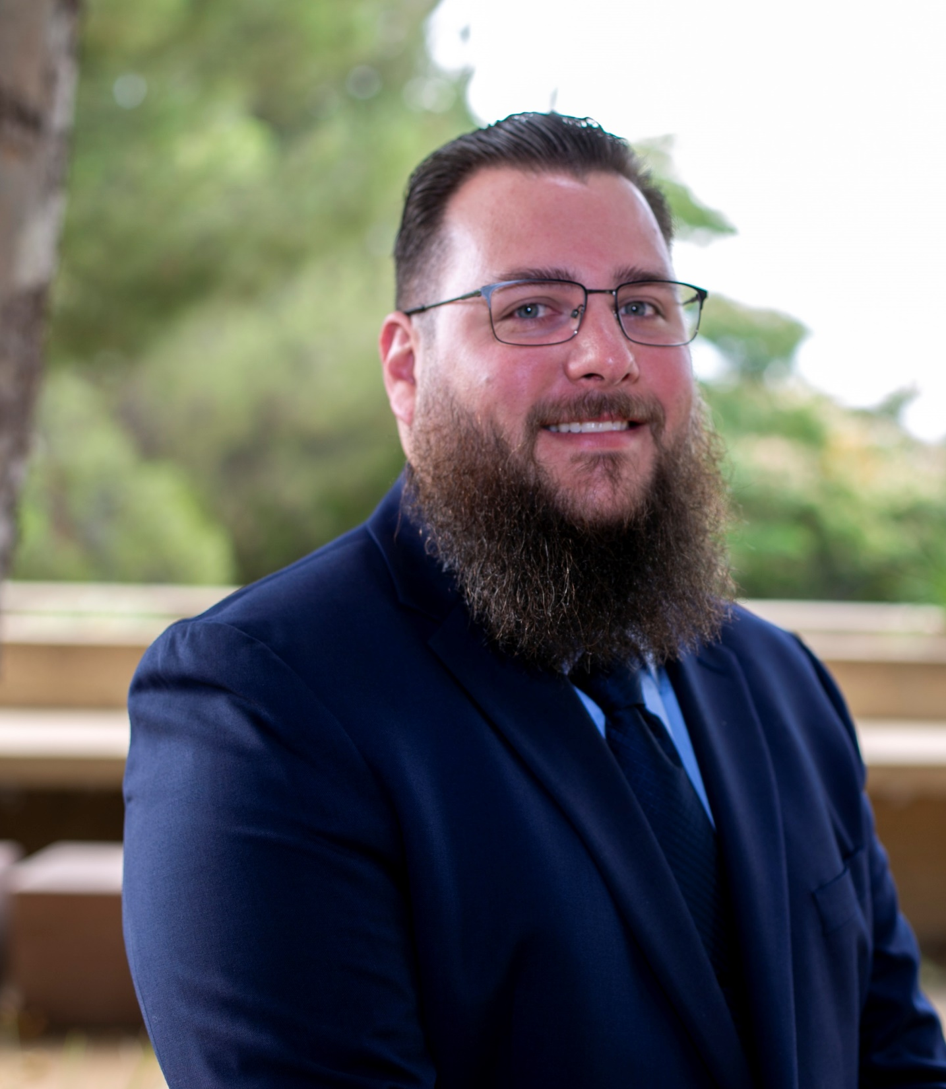
Welcome! Richard Blackmon Lab Technician,
Chemistry

Slide 7
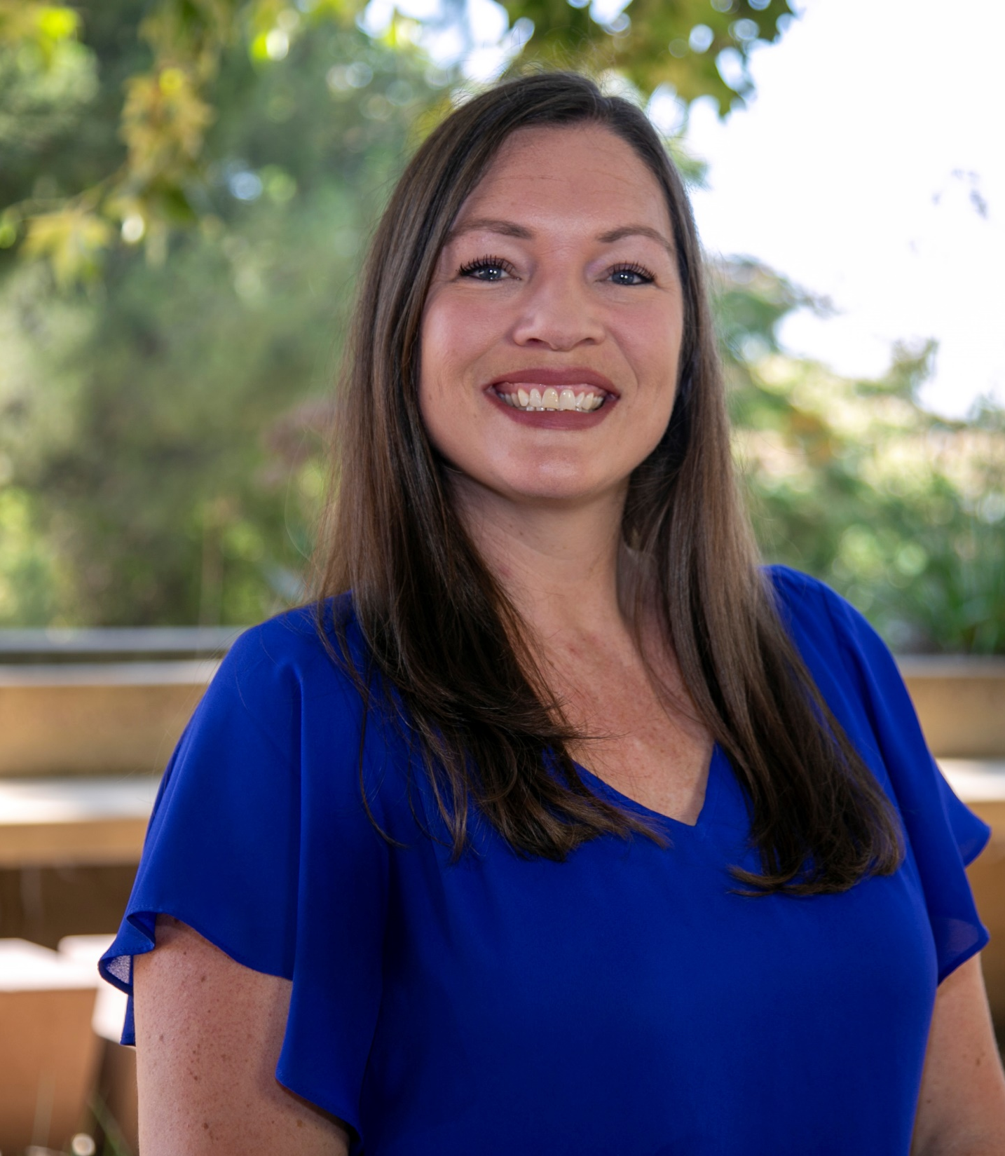
Welcome! Deanna Brown Director, Child Development Program

Slide 8
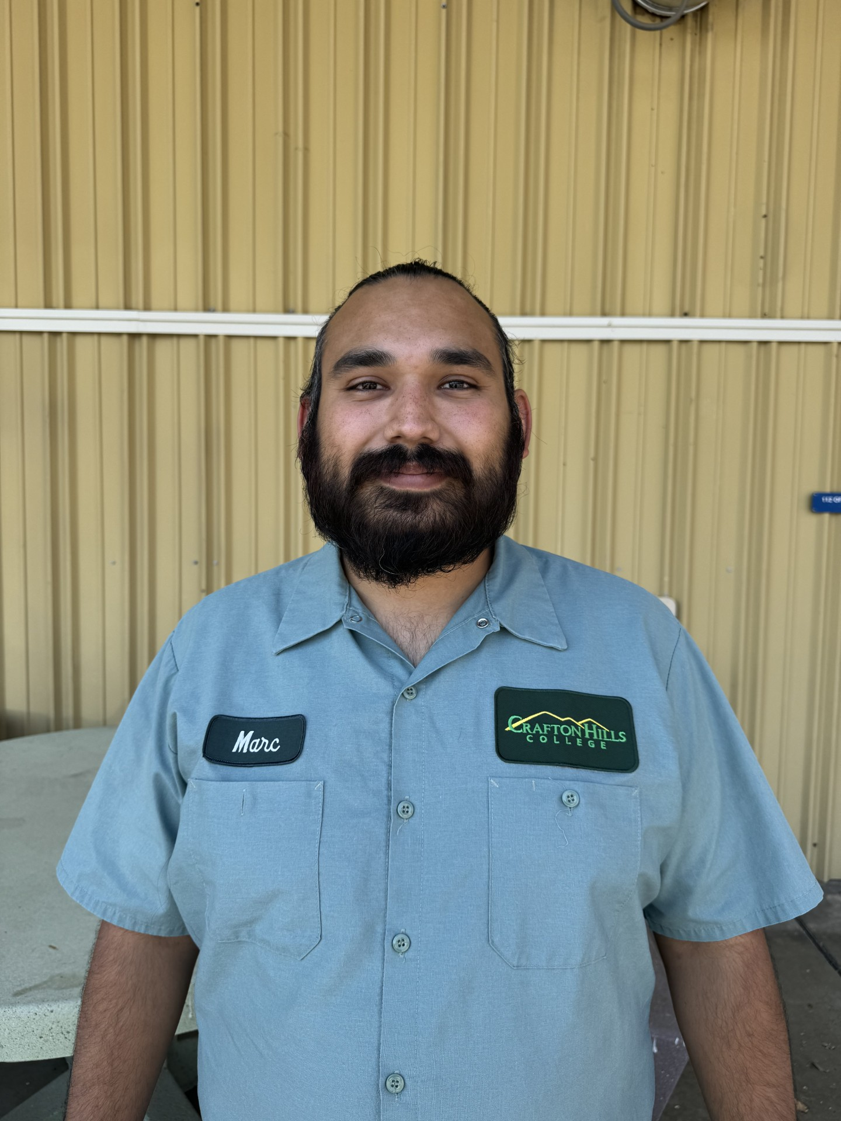
Welcome! Marc Anthony Chavez Custodian, Facilities

Slide 9
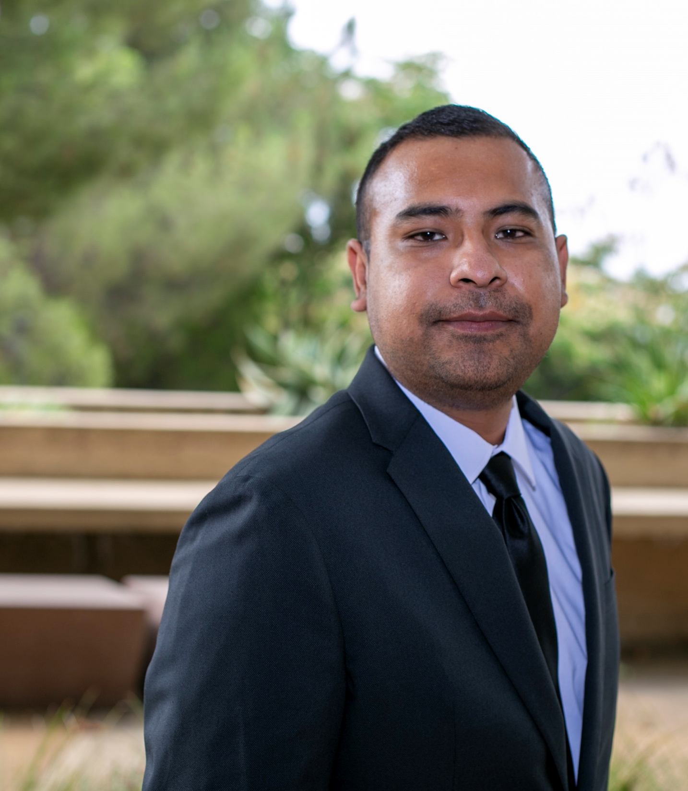
Welcome! Jaime Hernandez Technology Support Specialist, Technology Services

Slide 10
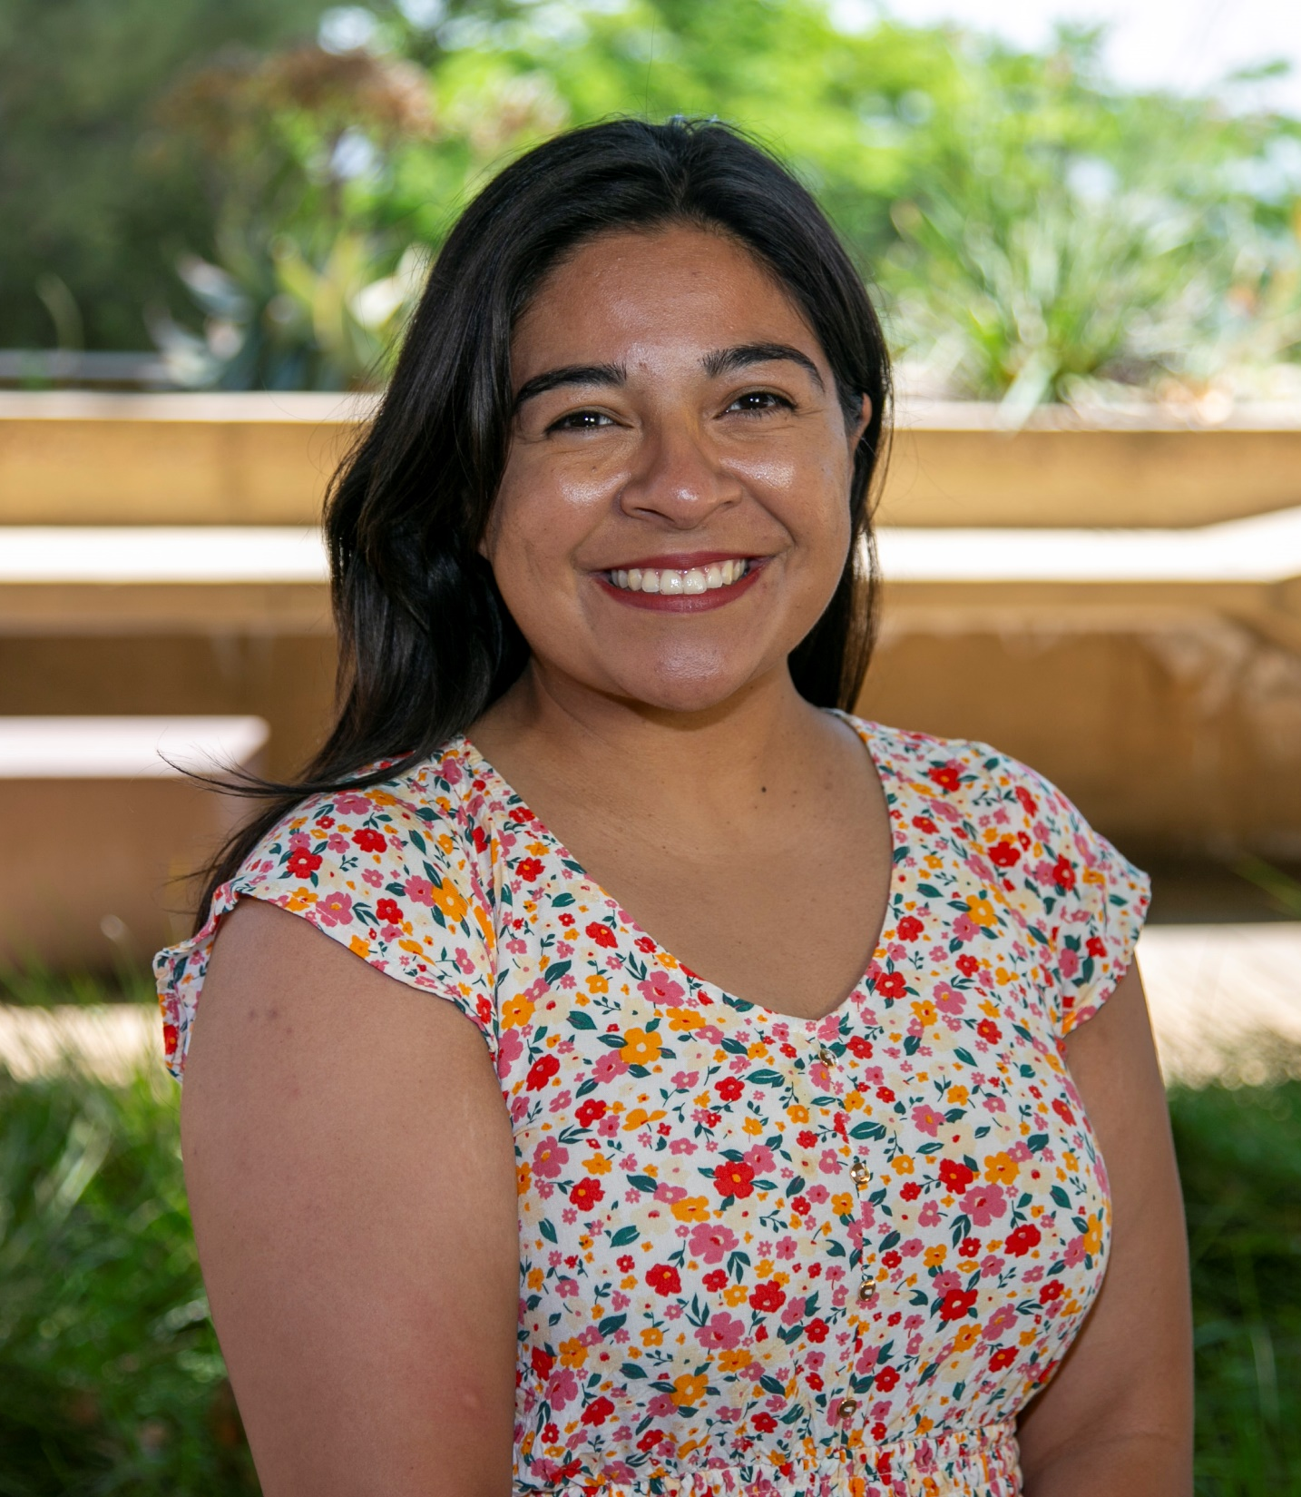
Welcome! Amity Lodevico Student Services Coordinator, EOPS

Slide 11
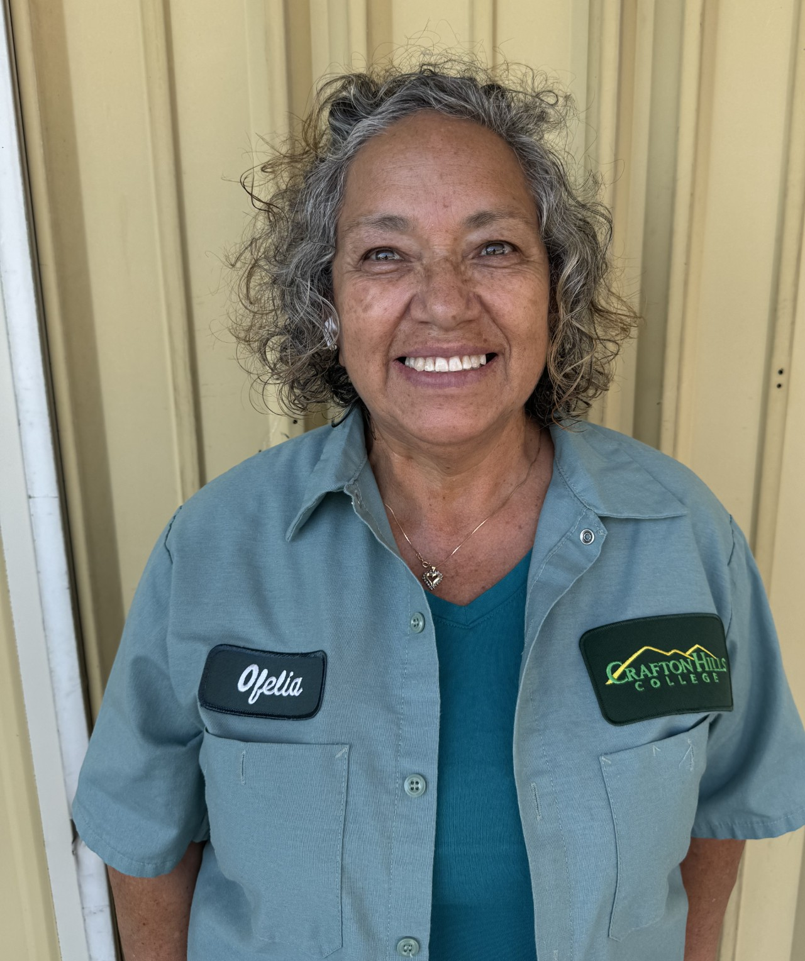
Welcome! Ofelia Nieto Leon Custodian, Facilities

Slide 12
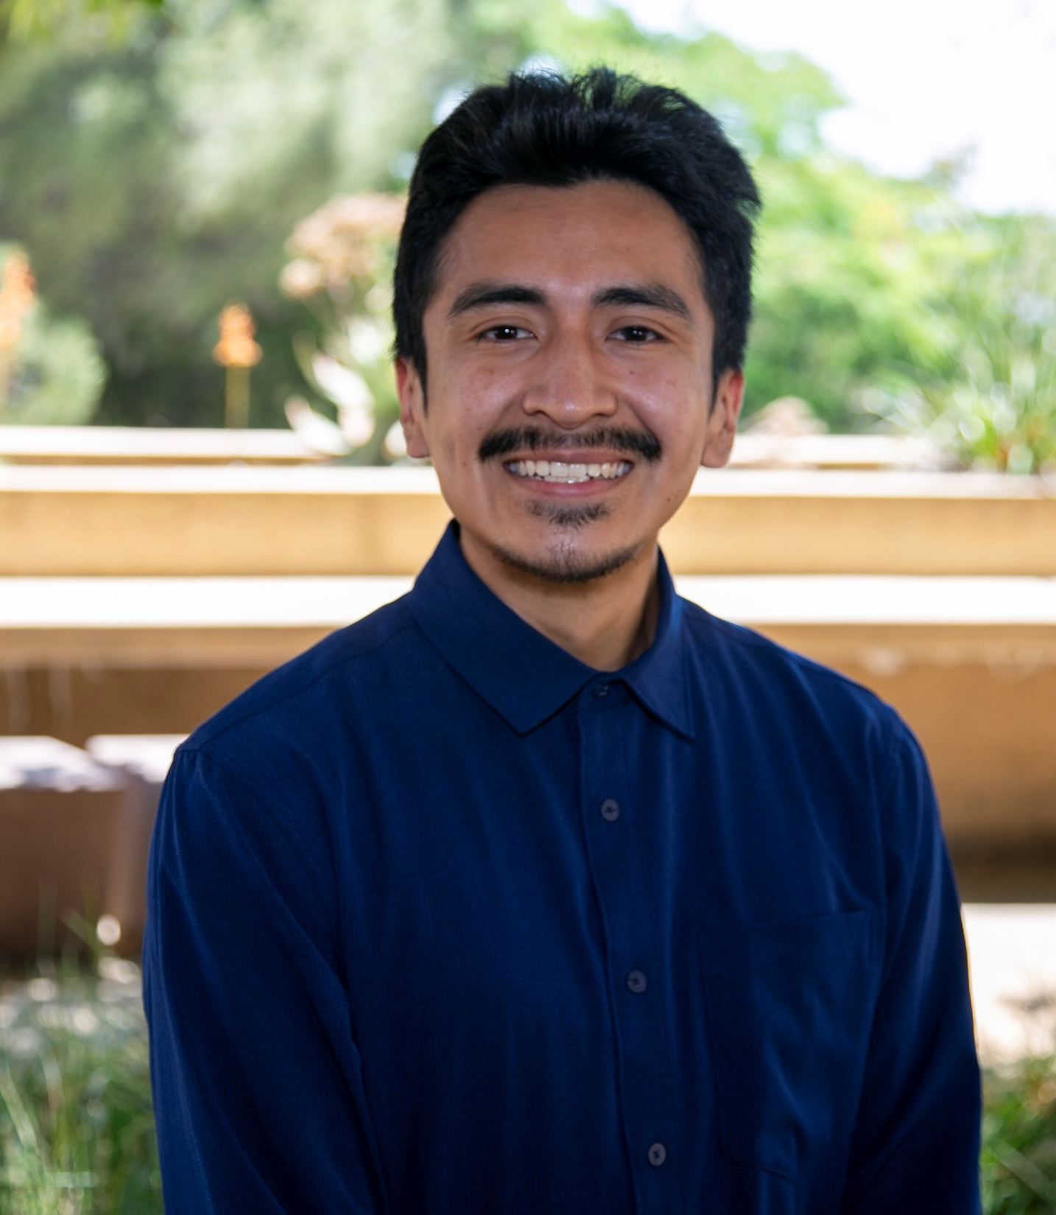
Welcome! Erick Pineda Program Assistant, Student Services & Counseling

Slide 13
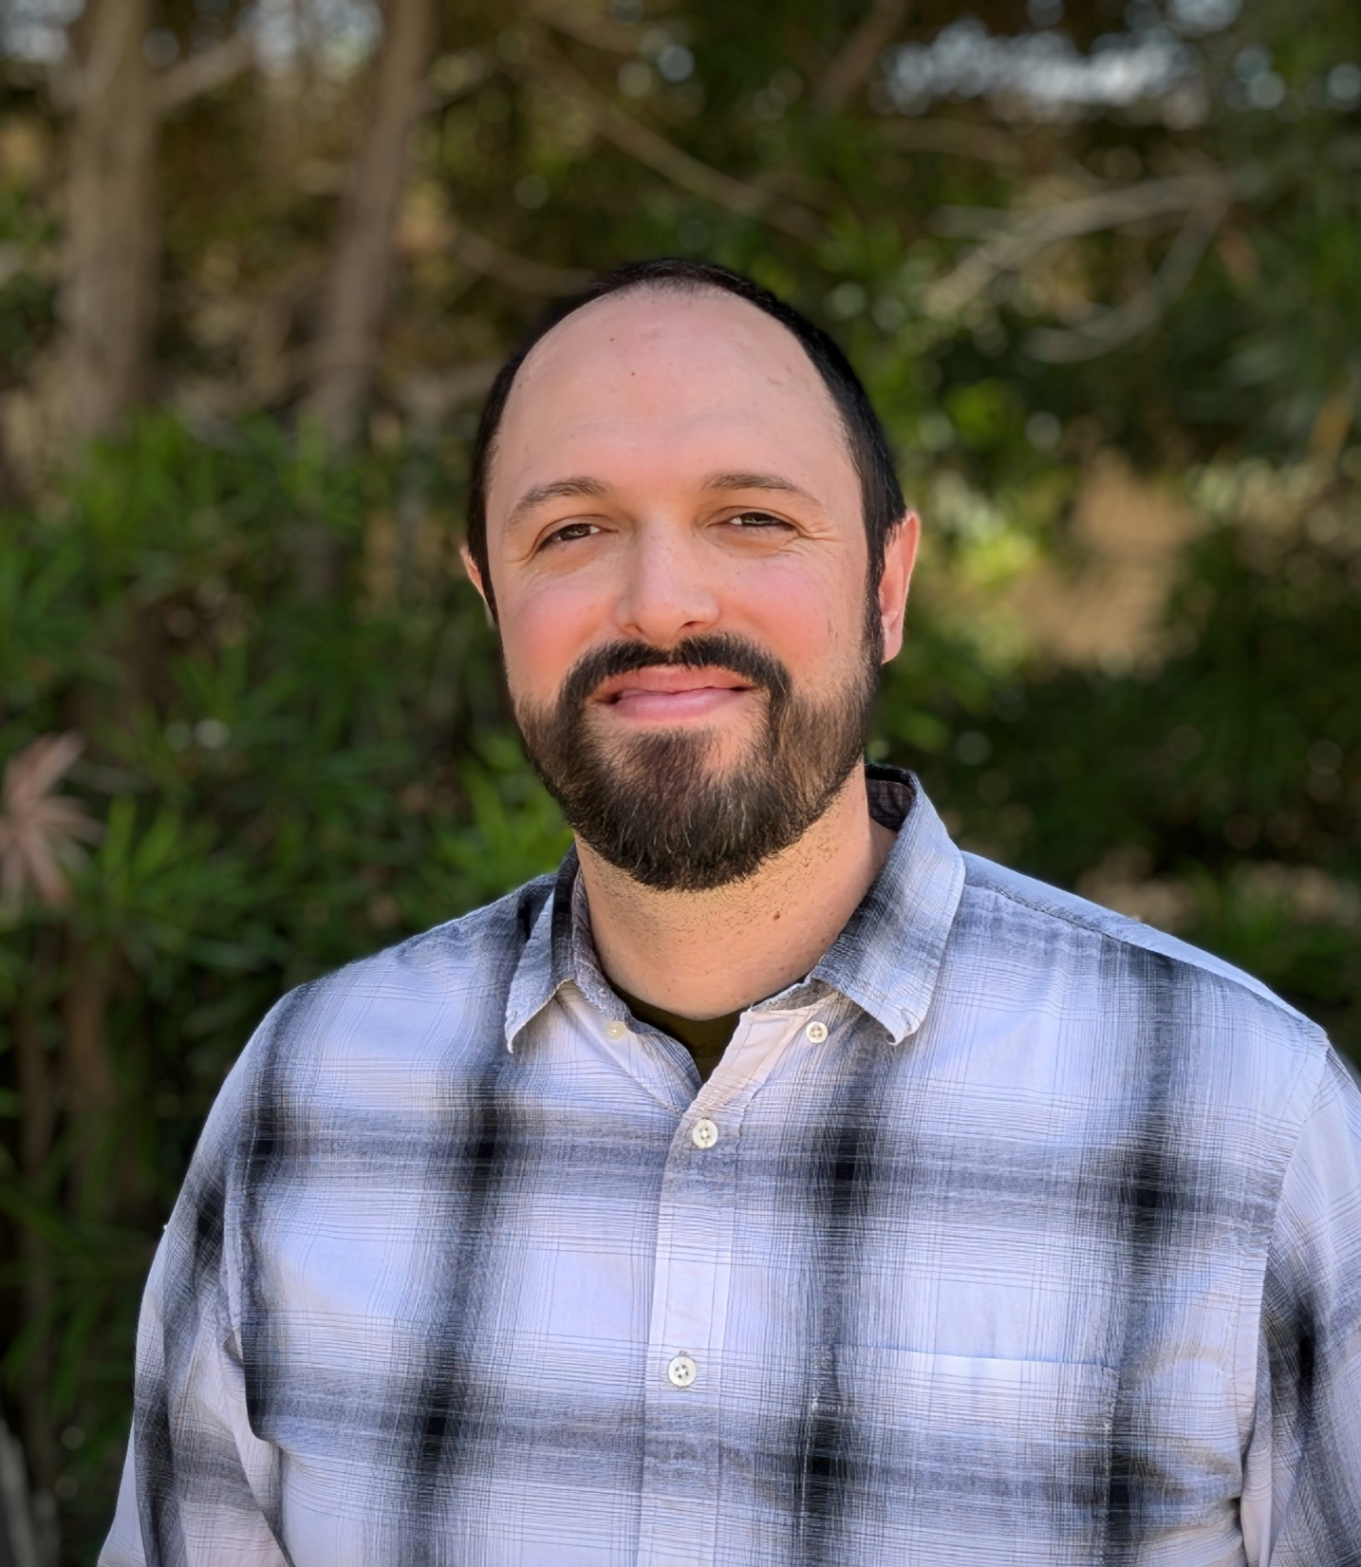
Welcome! Thomas Ramirez Lab Technician,
Geology

Slide 14
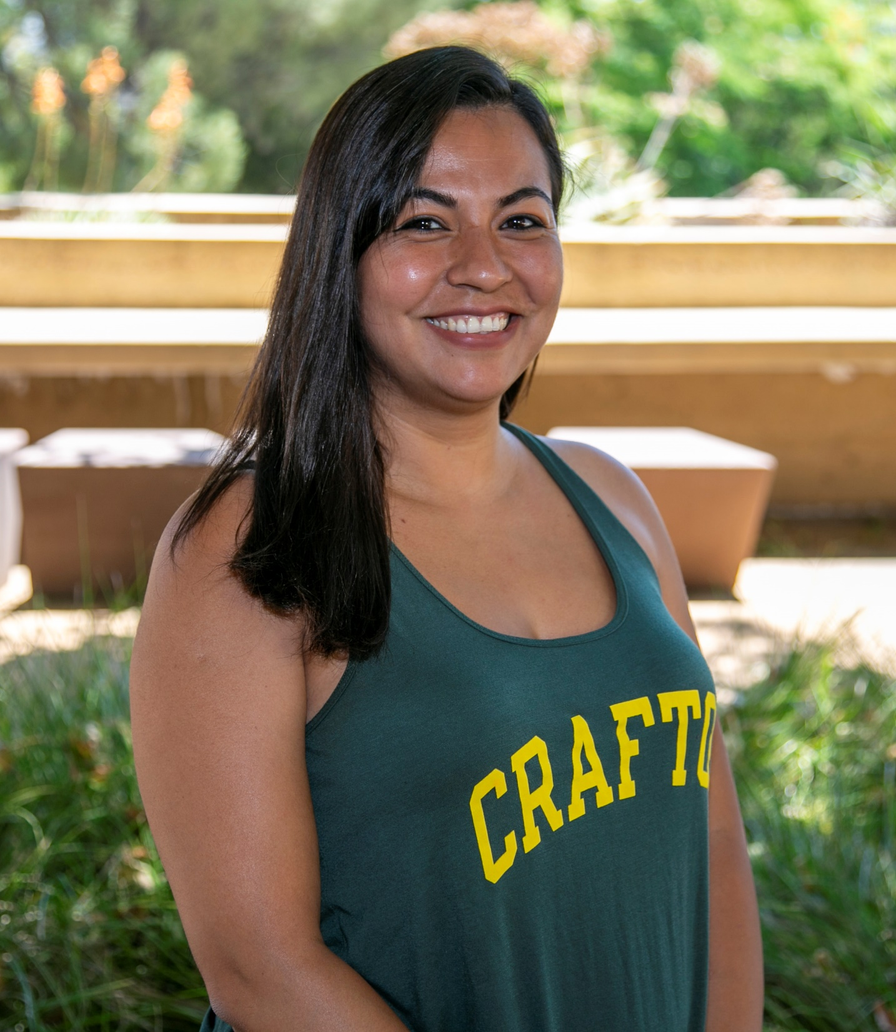
Welcome! Maribel Santana Alvarez Program Assistant, Student Services & Counseling

Slide 15
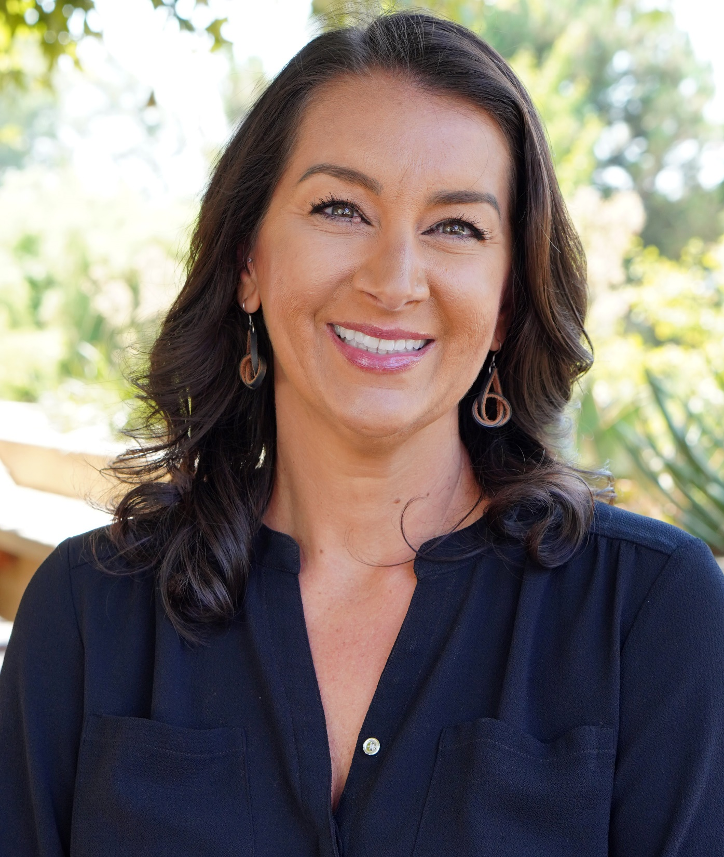
Congratulations! Amanda Ward Interim Associate Dean, Public Safety

Slide 16
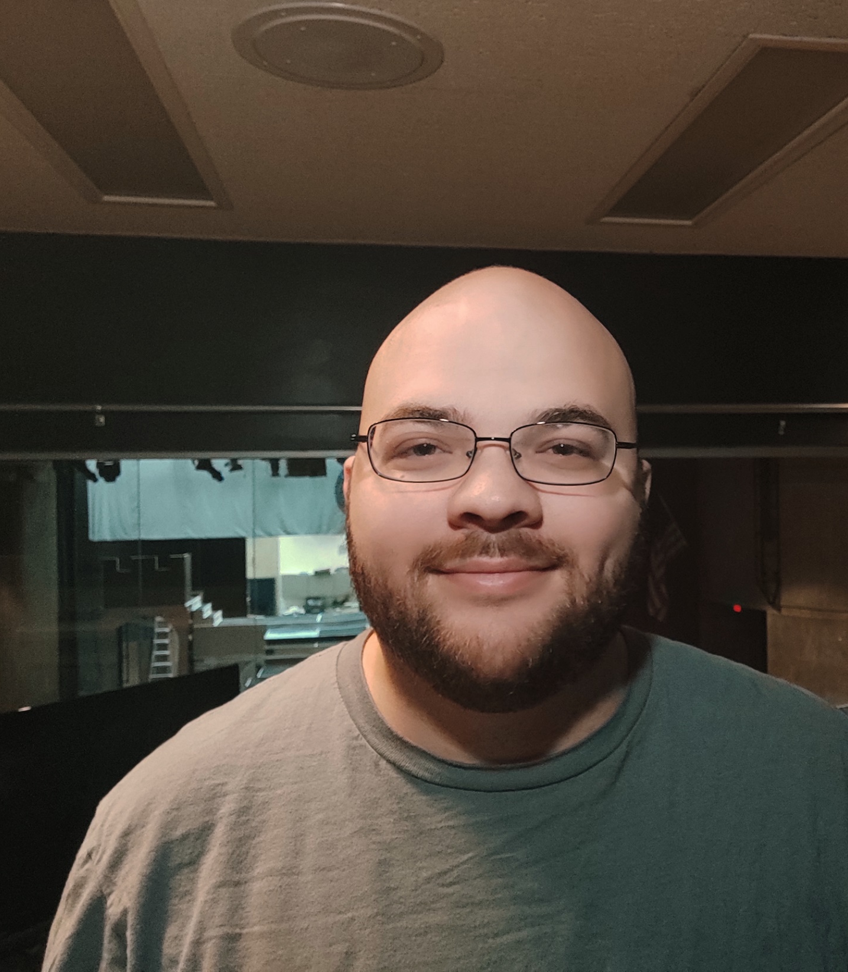
Congratulations! Arvid Zollinger Senior Technical Support, Theatre

Slide 17
Welcome Future Roadrunners

Slide 18
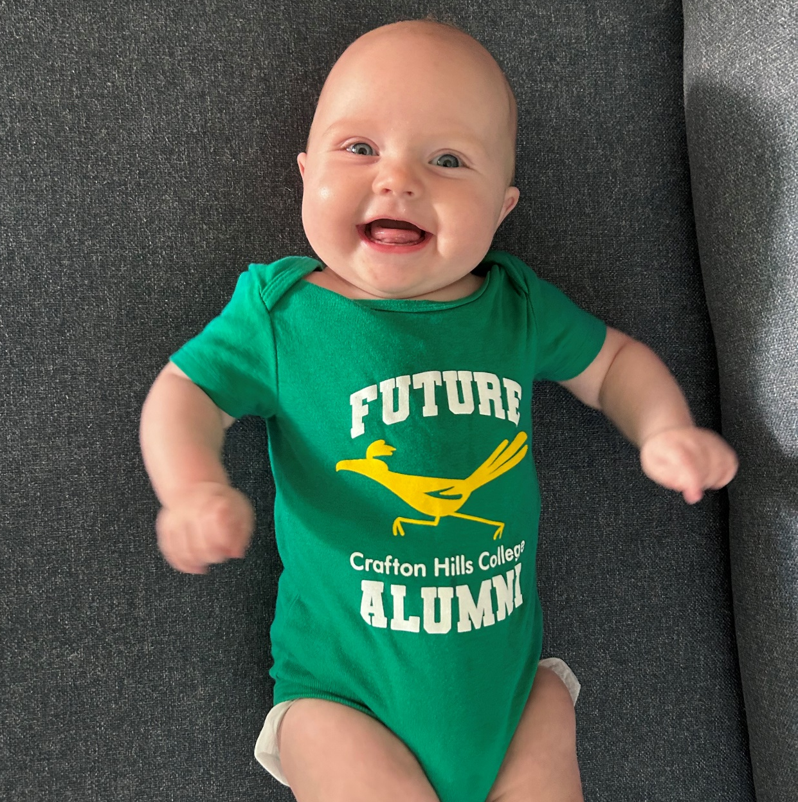
Congratulations on your future Roadrunner! Veronica Arrowood

Slide 19
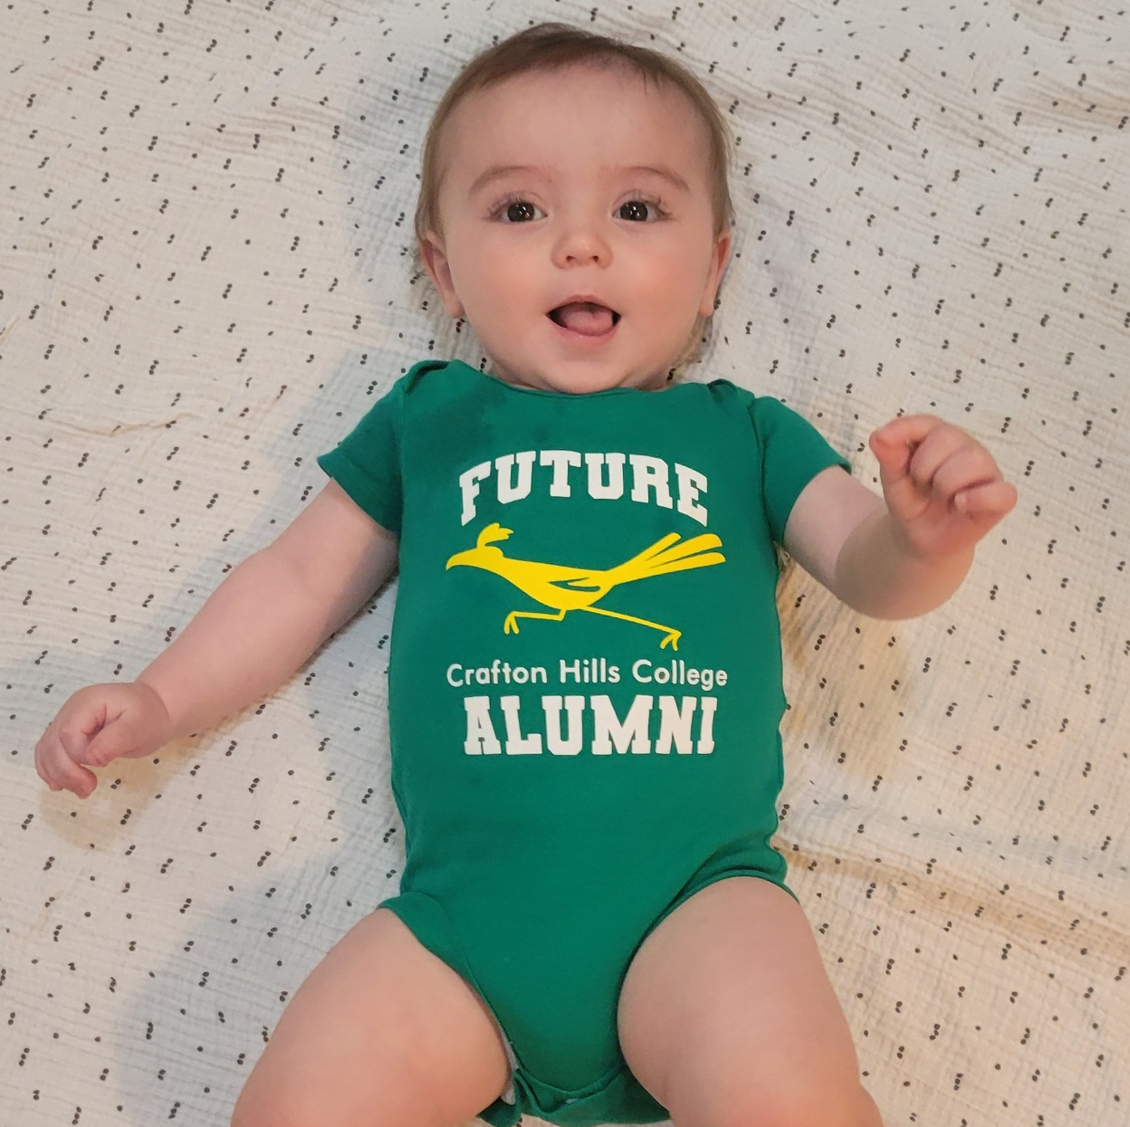
Congratulations on your future Roadrunner! Heather Chittenden

Slide 20
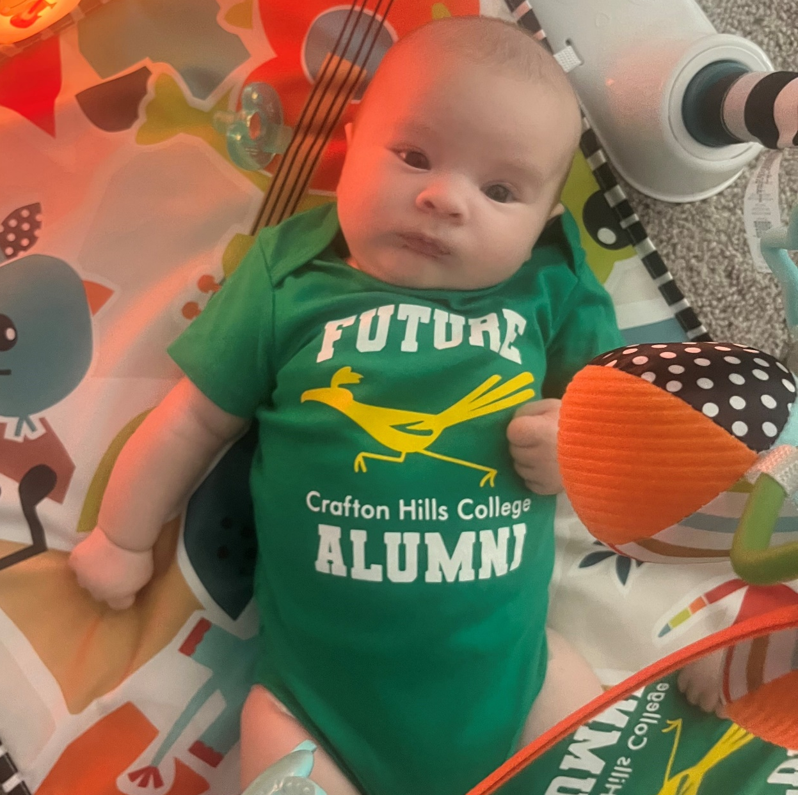
Congratulations on your future Roadrunner! Paul Jacques

Slide 21
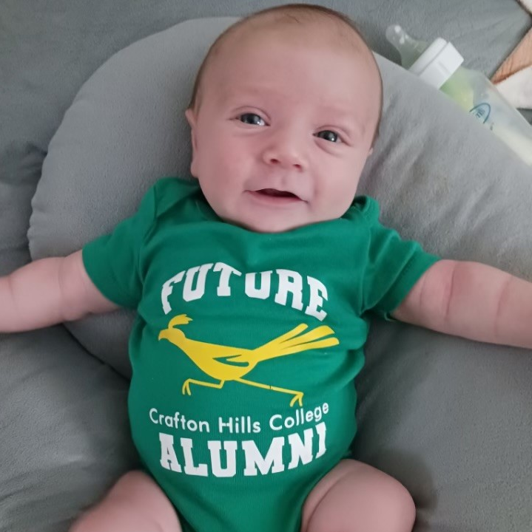
Congratulations on your future Roadrunner! Cyndie St. Jean

Slide 22
Instructional Services

Slide 23
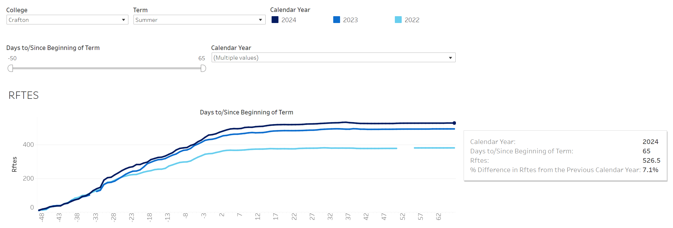
Summer 2024 Enrollments
The RFTES increased from 492 in Summer 2023 to 527 in Summer 2024, a 7% increase
Great Job Everyone!
Sumer 2024 Target is 543

Slide 24
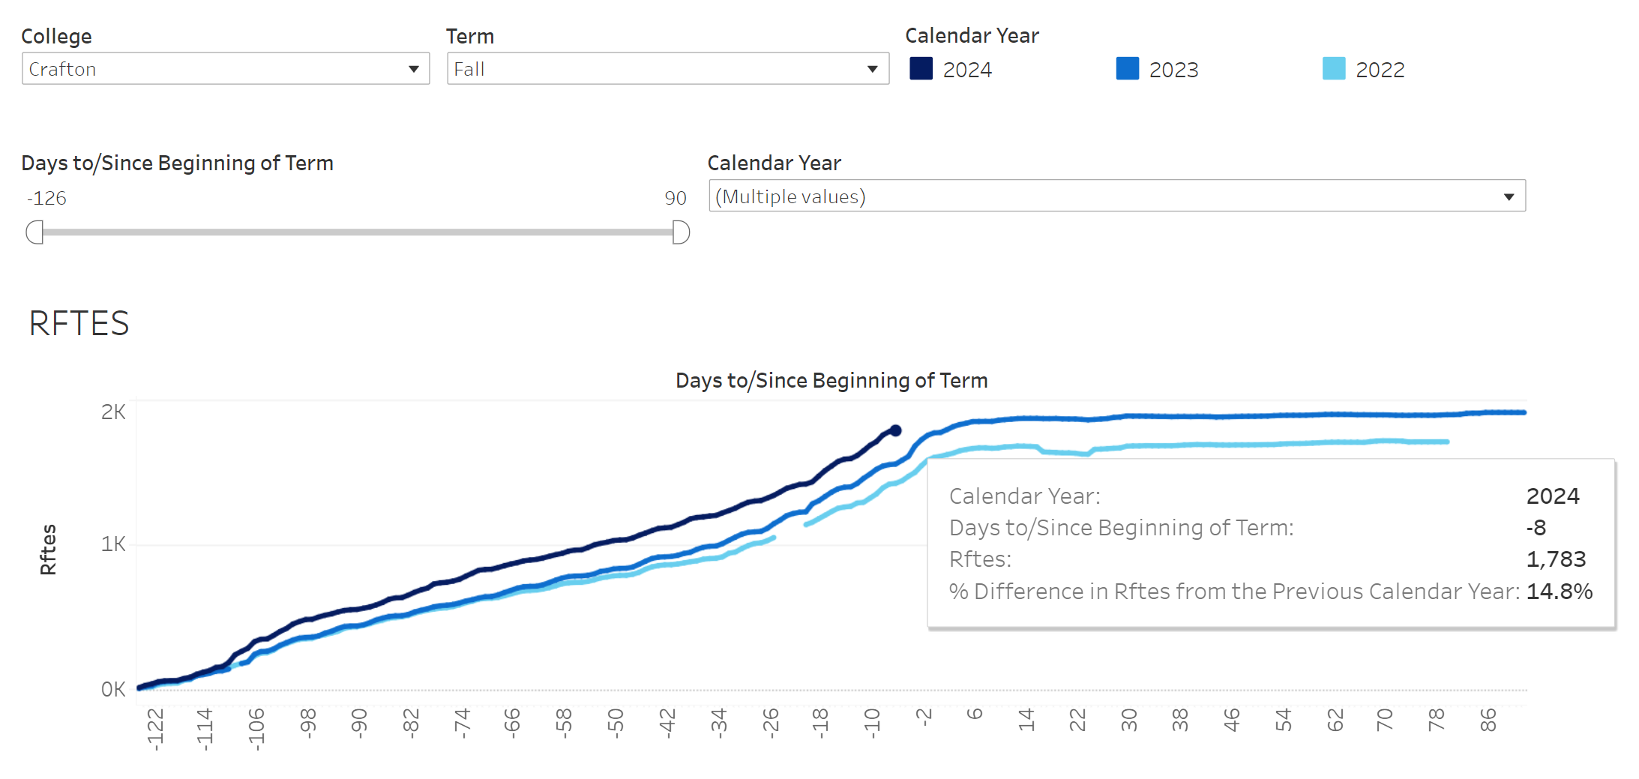
Fall 2024 Enrollments
The RFTES increased from in Fall 2023 to 1,533 in Fall 2024, a 15% increase
Great Job Everyone!
Fall 2024 Target is 1,974
Notes:
As of 8/4/24

Slide 25
Compressed 16-Week Calendar beginning in Fall 2025
Benefits of Compressed 16-Week Calendar
Research strongly indicates that students are more likely to be successfully in sections that are 16 weeks or less
Each semester, approximately 66% of students take less than 12 units, on average they take 7.2 units
A year-round approach toward education will enable students to progress towards their academic goals at a greater rate
Builds on Career and Academic Pathways and provides more opportunities for dual enrollment

Slide 26
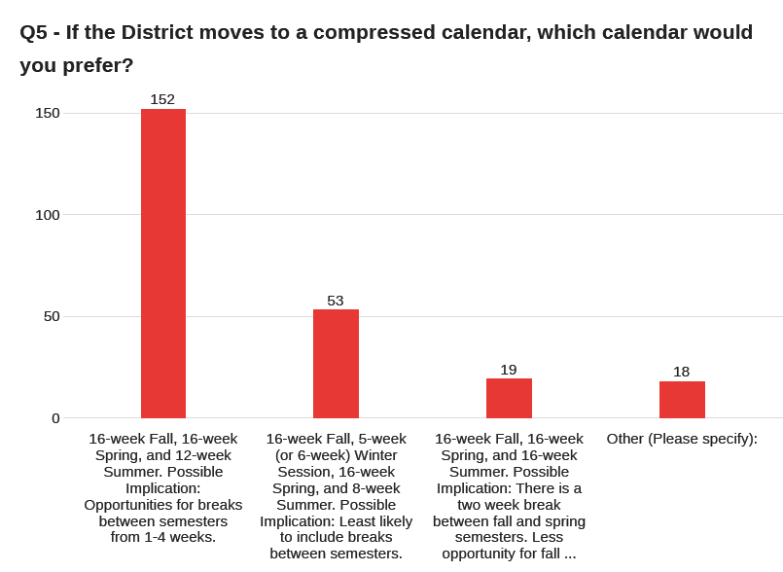
Most of the respondents to the survey preferred a 16-week fall, 16-week spring and 12-week summer
Notes:
All of the senates and constitutent recommended the adoption of compressed 16, 16, 12 week calendar with fall and spring breaks.

Slide 27
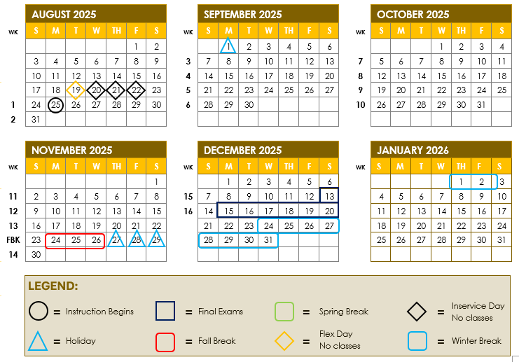
Fall 2025 Draft Calendar
Notes:
Fall Term starts August 25 and Ends December 20: 16 weeks.
Flex and In-Service would start August 19-22.
Finals week stays the same.
There is a fall break during Thanksgiving week.

Slide 28
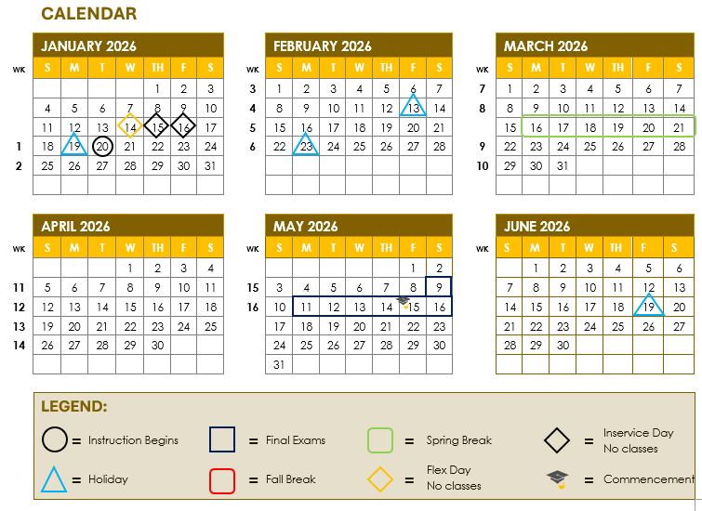
Spring 2026 Draft Calendar
Notes:
Spring Term starts January 20 and Ends May 16: 16 weeks, similar to current spring term start date.
Flex and In-Service would start January 14-16, similar to current spring flex/in-service dates.
Spring Break would occur where it does currently, the third week of March, March 16-21.
Finals week would be from May 11-16.

Slide 29
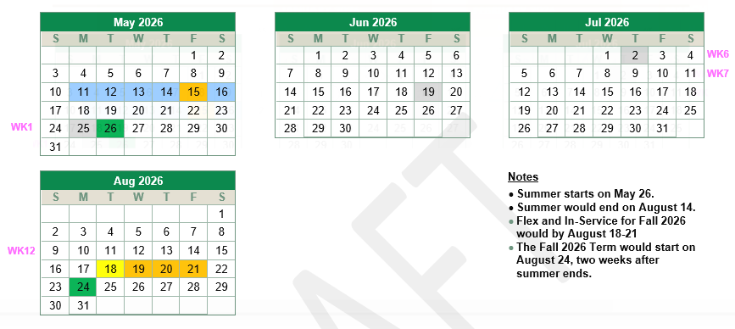
Summer 2026 Draft Calendar
Notes:
Summer starts on May 26.
Summer would end on August 14.
Flex and In-Service for Fall 2026 would by August 18-21
The Fall 2026 Term would start on August 24, two weeks after summer ends.

Slide 30
Future Steps
Work with Faculty Department Chairs on developing schedule for Fall 2025
District work with CTA to develop an approach to the approximately two weeks of time with now classes at the end of the spring semester

Slide 31
Student Services

Slide 32
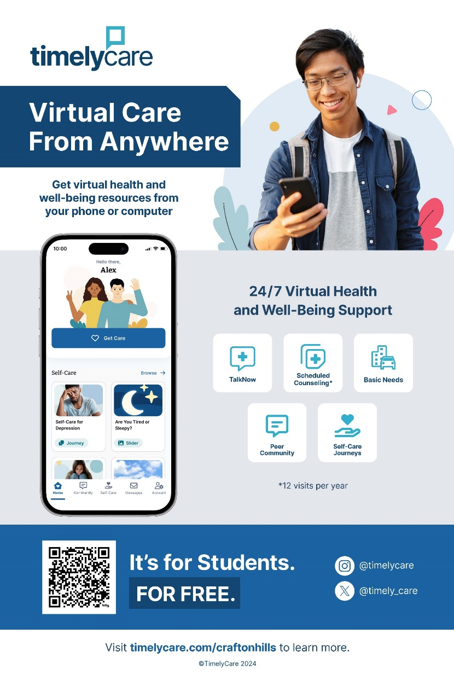
New Online Support Services - TimelyCare
Students will have access 24/7 to:
Diverse Provider Network: Access to culturally responsive care, including providers who identify as people of color and LGBTQIA+, with services in over 240 languages.
Mental Health Counseling Services: Choose the day, time, and mental health provider that works best for you. (12 visits per year)
Self-Care Content: Access to tools and resources, such as meditation and yoga sessions, helpful videos, and short articles from experts.
Basic Needs Support: Get connected to free or reduced-cost community resources, including food and housing assistance, transit support, childcare, and finances.

Slide 33

Coming Soon! Equity Champion Awards
The Student Equity and Achievement Committee (SEAC) is in the final stages to establishing Equity Champion Awards.
The award will recognize individuals and groups making significant contributions to inclusion at Crafton Hills College and to advancing the college’s vision of equity.
Application, coming in October!

Slide 34
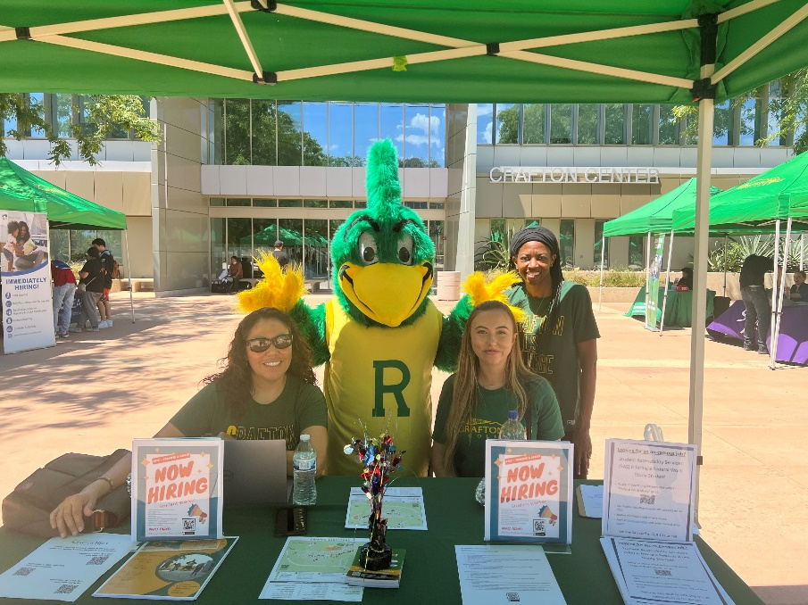
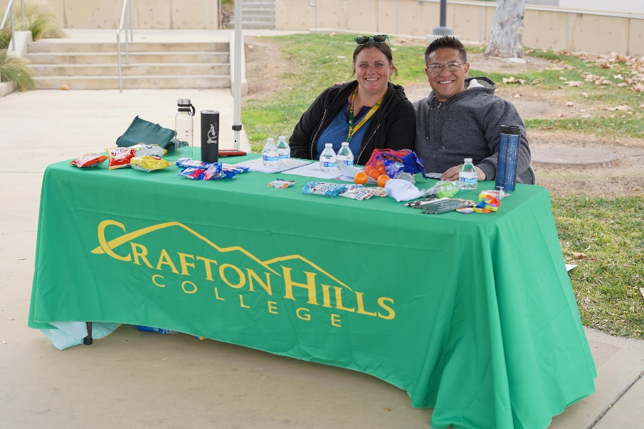
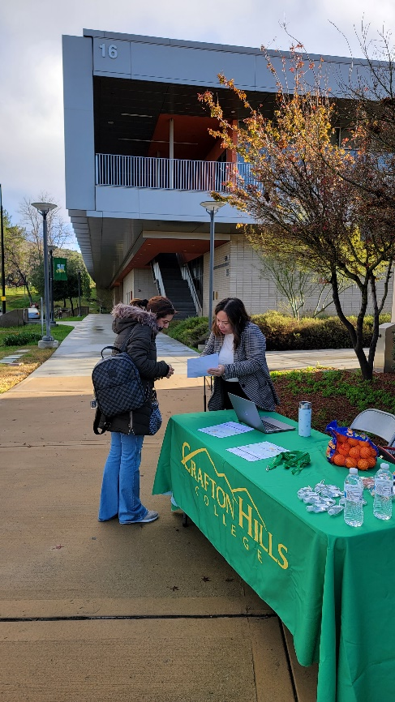
Welcome Tables Volunteers Needed!
Register by completing google doc in Lilibeth Medina’s email sent on 8/5/24.

Slide 35
One Book/One College
2024-2025

Slide 36
Thank you, One Book Team!
Sara Butler
Ciera Divens
Ed Ferrari
Kashaunda Harris
Monica Khalaj-LeCorre
Heather King
Eugenia Livingston
Natalie Lopez
Ericka Paddock
Michelle Riggs
Kay Weiss
More members welcome! Please email Sara to join the team.

Slide 37
Criteria for Book Selections
1
4
Has a message that can develop empathy
Addresses issues of Equity and Inclusion
2
Relevant to the current student population
5
Helps build community amongst students and employees
3
Interdisciplinary and accessible

Slide 38

Precocious and clear-eyed, Lauren must make her voice heard in order to protect her loved ones from the imminent disasters her small community stubbornly ignores.
But what begins as a fight for survival soon leads to something much more: the birth of a new faith . . . and a startling vision of human destiny.¹
^{1 Octavia Butler website}

Slide 39

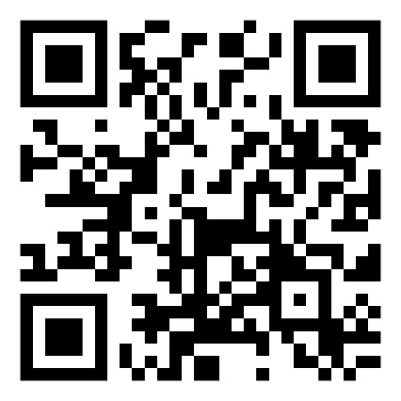
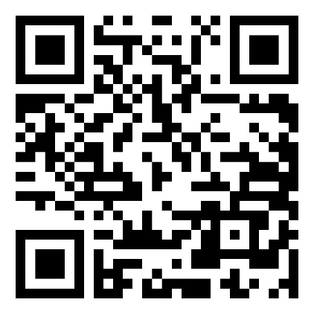
Books and Resources
Faculty wanting to use the book in their curriculum may pick up the book today
Faculty Guide
Lib Guide

Slide 40

Book Club Discussions
Fall Dates will be announced soon. Working with University of Redlands on scheduling!

Slide 41

Additional Activities – Coming this year
Workshops
Speakers
Essay/Art Competition
Watch for details – coming soon!
University of Redlands Instagram
Page for Parable Project 24

Slide 42


Slide 43

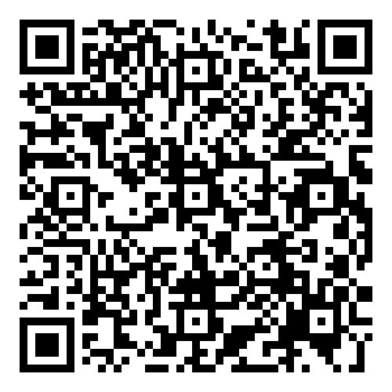
Employee Giving Campaign
2023-2024 = $72,708
92 Employees
20 Managers
41 Faculty
19 Classified Employees
12 District

