Slide 1

Instructional Update Fall 2021
Prepared and Presented by Keith Wurtz

Slide 2
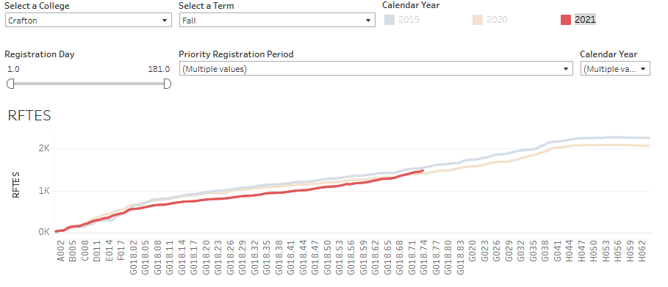
Enrollment Update as of August 11, 2021
A few weeks ago, Crafton was 15% down in enrollments from Fall 2020 to Fall 2021
As of yesterday, Crafton is up 5%, and only 4% down from Fall 2019

Slide 3
Sections by Instruction Method
Notes:
In early July, 55% of the sections were F2F.

Slide 4
Students and Instructors prefer online/remote for Fall 2021 sections

Slide 5
Instructional Goals for 2021-2022
Curriculum
  Develop new programs in Business and Occupational Areas
  Implement Version 2 of CurriQNet
  Develop and implement process for completing narratives for new programs
Improve Course Caps and implement a process for setting course caps to improve efficiency and free up additional resources
Enrollment Management
  Work with marketing and the Enrollment Management Committee to develop a Crafton brand and tag line
  Please complete the survey at the following link this week: https://sbccdir.co1.qualtrics.com/jfe/form/SV_6KHIVPk4oF6kCfI

Slide 6
Instructional Goals for 2021-2022
Equity
  Explore disaggregating PPR data so faculty can see how they are doing at the section level
  Implement new approach to faculty recruitment based on USC Equity Center recommendations
  Revise CORs where possible to incorporate specific content that addresses diversity and inclusion
Instruction
  Up to 11 faculty can participate in reading apprenticeship training from September to October (Please let Kashaunda Harris know as soon as possible if you are interested)
  Develop and Increase the use of OER to increase student access

