Slide 1

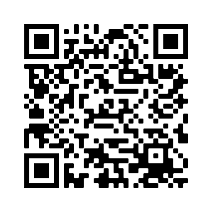

Brand Identity Survey
Goal: Develop a tagline which will set the tone for the creative that follows.
1st Step: We need your opinion!
Fill out the survey by Aug 13!
2nd Step: Use results to develop creative concepts and share with campus.
Example:

Slide 2

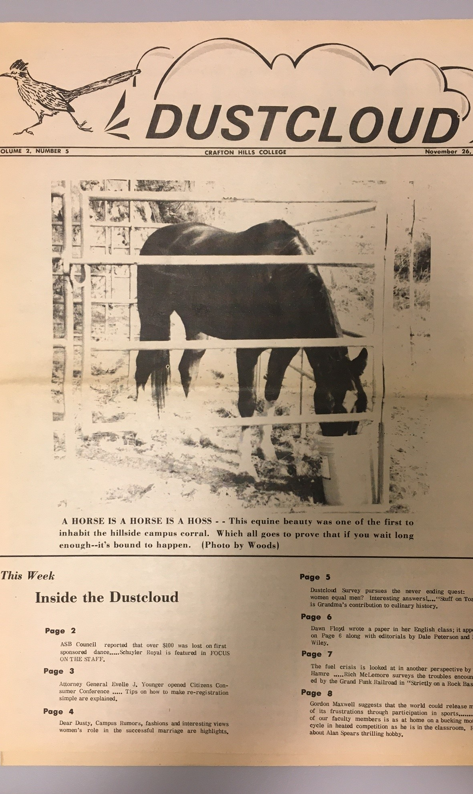
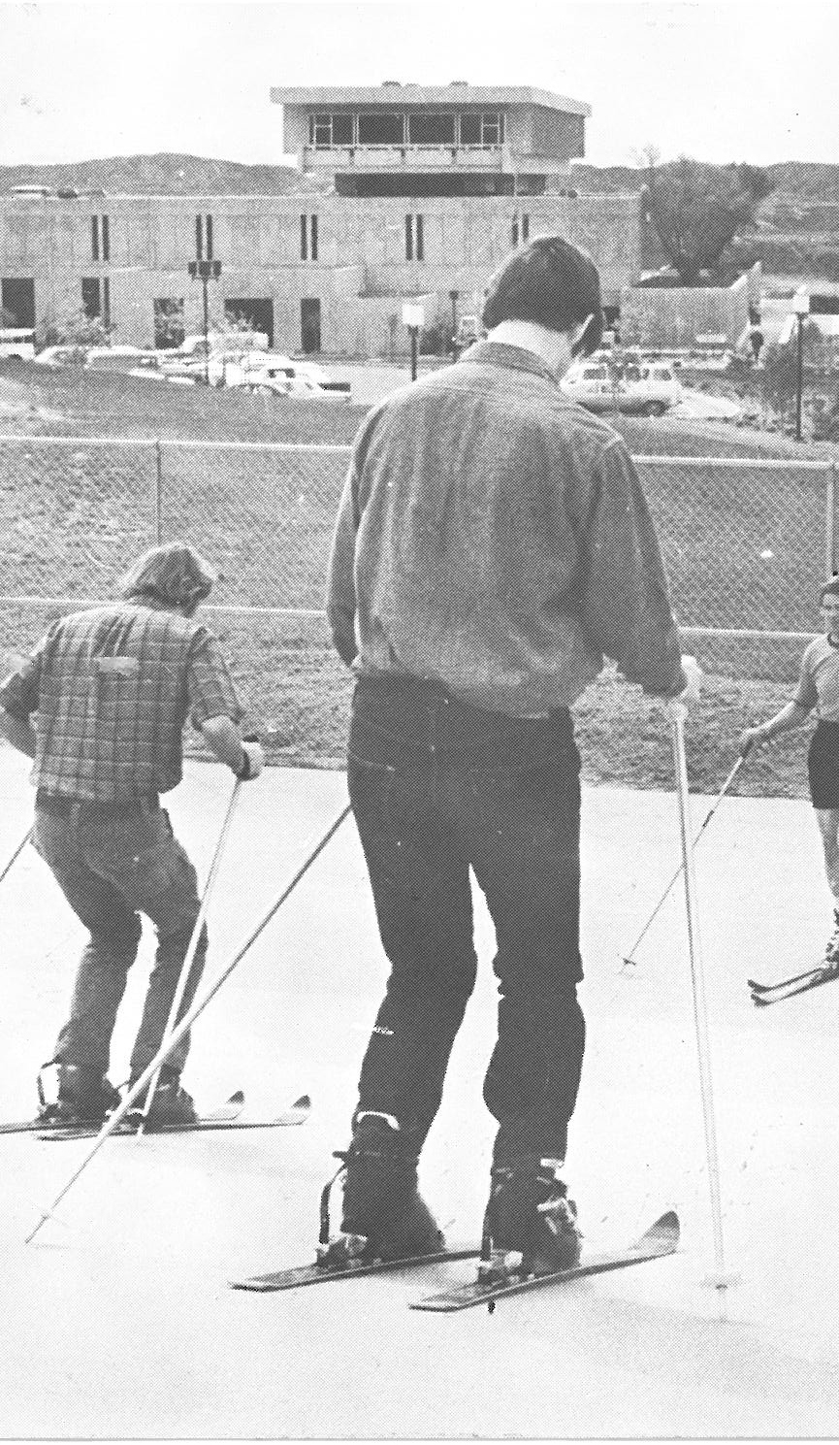
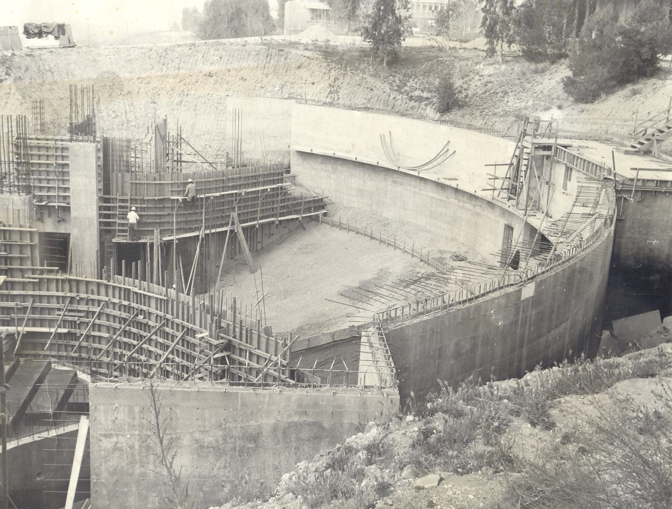


Slide 3

President’s Circle Reaches 94 Members!
Danielle McCoy
Julie McKee
Meridyth McLaren
Marty Milligan
John Muskavitch
Van Muse
Phong Nguyen
Ericka Paddock
Ivan Pena
Diane Pfahler
Michelle Riggs
Diana Rodriguez
Rene Sampay
Mark Snowhite
Gio Sosa
Delmy Spencer
Cyndie St. Jean
Mike Strong
Anne Viricel
Amanda Ward
Deborah Wasbotten
Kay Weiss
Dan Word
Keith Wurtz
Souts Xayaphanthong
June Yamamoto
Mike Alder
Carrie Audet
Larry Aycock
Brandi Bailes
Rejoice Chavira
Heather Chittenden
Larry Cook
Kathy Crow
Cynthia Hamlett
Kevin Horan
Alex Jaco
Shirley Juan
Notes:
31 employees

Slide 4
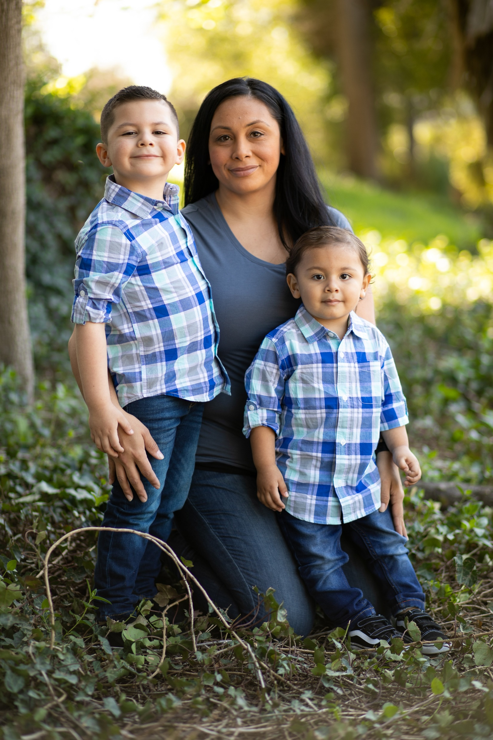
My name is Rena I am a mom of two young boys a 5-year-old and 2-year-old. I work part time, so I do not have quite the income coming in. Thank you for this help allowing me to be able to purchase what I need to enter my first semester in the Respiratory Therapist program here at Crafton. I am beyond grateful for your donations for this program that will allow me to provide a better future for myself and my children.
- Rena
Notes:
31 employees

Slide 5


