Slide 1

Fall 2019 In-Service
Welcome

Slide 2
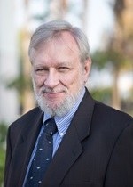
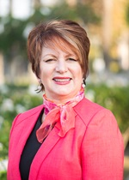
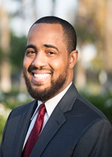
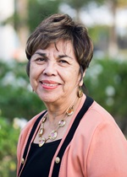
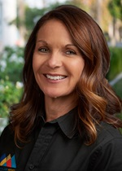
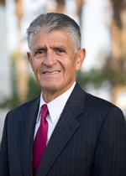
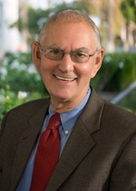
San Bernardino Community College District
Board of Trustees
Board President
John Longville
Board Vice President
Dr. Anne Viricel
Board Clerk
Joseph Williams
Trustee
Gloria Macias Harrison
Trustee
Dr. Stephanie Houston
Trustee
Frank Reyes
Trustee
Dr. Don Singer
Student Trustees
Maritza Mariscal-Medina, San Bernardino Valley College
Elijah Gerard, Crafton Hills College

Slide 3
Kevin Horan
President, Crafton Hills College

Slide 4
What word or phrase would best describe your summer break?
Respond at PollEv.com/kevinhoran986
Or
Text KevinHoran986 to 37607

Slide 5
Welcome new Classified Employees!
Alexa Aslanian, Student Services Technician I, DSPS
Belinda Navarette, Admissions and Records Technician
Diana Vaichis, Research Analyst
Kenneth Byrnes, Lab Tech, Physics
Mary Scott, Child Development Teacher
Susan Burdick, Child Development Assistant
Terquoia Cain, Child Development Teacher
Troy Hall, Senior Student Services Technician, EOPS
Yvonne Oliveras, Research Analyst

Slide 6
Welcome new Faculty!
Paul Jacques, Theater Arts
Shirley Juan, Math
Joshua Robles, Math
Lauren Bond, English
Chloe De los Reyos, English
Isidro Zepeda, English
Ashley Hayes, English
John Grounds, EMS

Slide 7
Welcome new Managers!
Gio Sosa, Dean, Institutional Effective, Research and Planning (IERP)
June Yamamoto, Interim Dean, Letters, Arts and Mathematics (LAM)
Marty Milligan, Director, Disabled Students Program & Services (DSPS)
Melissa Oshman, Director, Technology Services
Michelle Riggs, Director, Institutional Advancement

Slide 8

Crafton Hills College Foundation
50th Anniversary Endowment Challenge

Slide 9
Foundation Financial Contributions

Slide 10
Foundation Financial Investments

Slide 11
How the Foundation Supports Crafton
Support of Students
  Scholarships
  Student Employment (iSEEK)
  Emergency Grants
  Transfer Application Fee Waivers
Support for Programs
  Honors
  Art
  STEM Success Center
  Fire Academy
Support for Events and Activities
  Roadrunner Rally
  High School Visitation Day
  Student Recognition Dinner
  Grad Breakfast
  Tea with the Deans

Slide 12

#TeamCrafton
Total Annual Contributions
16-17 | $19,537
17-18 | $19,282
18-19 | $25,607

Slide 13
#TeamCrafton

Slide 14
50th Anniversary Endowment Challenge
$1,000,000 by Fall 2022
President’s Circle = $1,000 Annually ($84 p/month)
Roadrunner Circle = $600 Annually ($50 p/month)
Patron = $300 Annually ($25 p/month)
Classified: 25% will go into the Classified Senate Account
Faculty: 25% will go into the Academic Senate Account

Slide 15
Collective Impact
Potential
President’s Circle = $1,000 Annually ($84 p/month)
Roadrunner Circle = $600 Annually ($50 p/month)
Patron = $300 Annually ($25 p/month)
204 Permanent Employees (104 Classified, 78 Faculty, 22 Management)
  President’s Circle = $204,000 Annually
  Roadrunner Circle = $122,400 Annually
  Patron = $61,200 Annually

Slide 16

The Golden Gate Bridge
https://youtu.be/KLRCZAXfEa4?t=1m30s

Slide 17
Mark McConnell
Academic Senate President

Slide 18
Brandice Mello
Classified Senate President

Slide 19
Tyrone Ross
CHC Associated Students President

Slide 20
Mike Strong
Vice President, Administrative Services

Slide 21
Administrative Services Update
Construction…again??
  Measure CC
  Facility Master Plan priority projects
  Print Shop – Open end of Sept
Bookstore
Security, Safety, and Emergency Prep
Technology

Slide 22
Capital Improvements
Measure CC Bond Update 2019-20
Master Plan Project Prioritization
Print Shop
Bookstore
Notes:
Measure CC Bond Update
Projects
AECOMM
Programming Meetings
Printshop

Slide 23


Security, Safety, and Emergency Prep
Shakeout Drill, Thursday, October 17th
CERT
Campus-wide Security Project

Slide 24
Techno-Talk
Technology Services

Slide 25
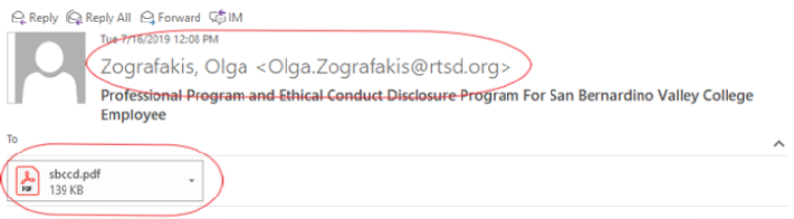
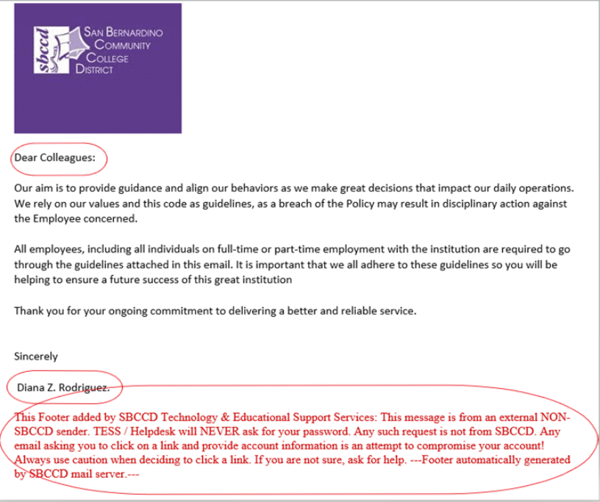
Don't Take the Bait!
HOW TO SPOT A PHISHING EMAIL
  Check the email address for errors
  Look for a generic greeting
  Verify the link or attachment
  Is there a request for personal information?
  Be cautious of requests to take immediate action
CHC • Aug. 16, 2019

Slide 26
Technology Problems?
We’re here to help…
Technology Reference Guide
  Who to contact
  How to submit a technology work order
  Printing issues
  Forgot your password

Slide 27
Keith Wurtz
Vice President, Instruction

Slide 28
The RFTES for summer has increased from 393 in Summer 2017 to 504 in Summer 2019, a 28% increase
Notes:
Summer 2019 is the most FTES in a summer that Crafton has ever generated.
In Fall 2019, if the current trend holds, we are on target to exceed 2,220 RFTES, which is the most RFTES in nine years.

Slide 29
The FTES/FTEF Ratio (Efficiency) for summer has increased from 12.69 in Summer 2017 to 14.78 in Summer 2019, a 16% increase
Notes:
The summer efficiency is the highest that it has been in six years.
The fall efficiency is the highest that it has been in three years.

Slide 30






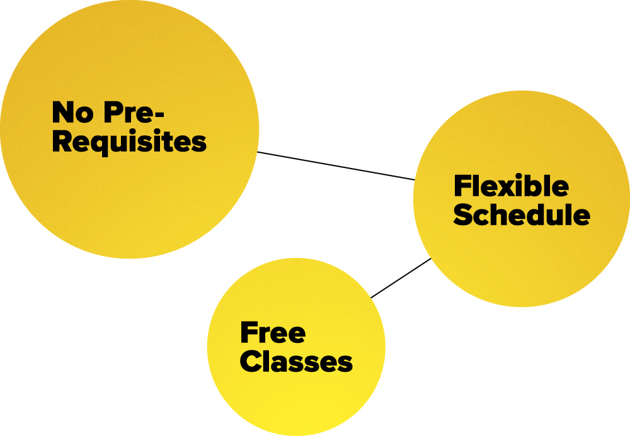

Instructional Objectives for 2019-2020
Implement CCAP Agreements for Spring 2020
Complete draft of ISER by December, 2019
Continue to develop new programs
Continue to develop dual enrollment
Continue to Support AB705
Develop meta-majors
Continue to Increase efficiency & enrollments
Continue to develop non-credit
Notes:
CCAP Agreements
With input from faculty and CTA, CCAP agreements have been written and approved for both RUSD and YCJUSD
Continue to Develop New Programs
Last year in Enrollment Strategies agreed to move forward with exploring new programs like Occupational Therapy, Physical Therapy, and others
Enrollment Management
RP Group will be conducting a focus group with students on enrollment.

Slide 31
AB 705 Update – Placements
The percent of students receiving a transfer level math placement increased from 5% prior to AB705 to 71% after AB 705 was implemented, a 132% increase in the number of students receiving a transfer level math placement

Slide 32
AB 705 Update – Transfer Level Math in First Year
The percent of students receiving a transfer level math placement increased from 5% prior to AB705 to 71% after AB 705 was implemented, a 132% increase in the number of students receiving a transfer level math placement

Slide 33
Promise Update
Kirsten Colvey, Dean of Student Services and Student Success
Soutsakhone Xayaphanthong, Counseling

Slide 34
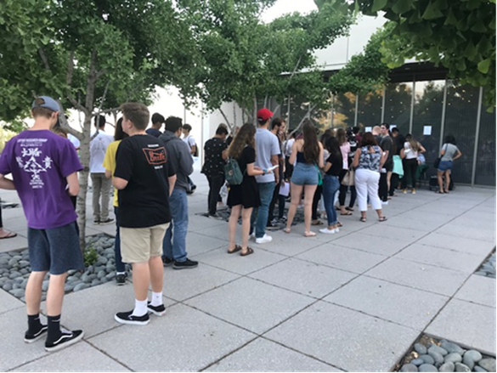
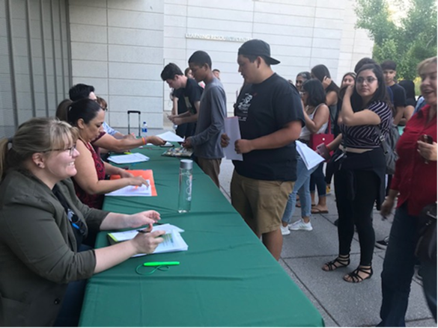
The Free College Promise Program is a new opportunity for students starting with the high school graduating Class of 2019.
The Free College Promise Program allows a student to attend college full-time
  Earn an associates degree
  Transfer to a four-year university
  Get a career training certificate

Slide 35
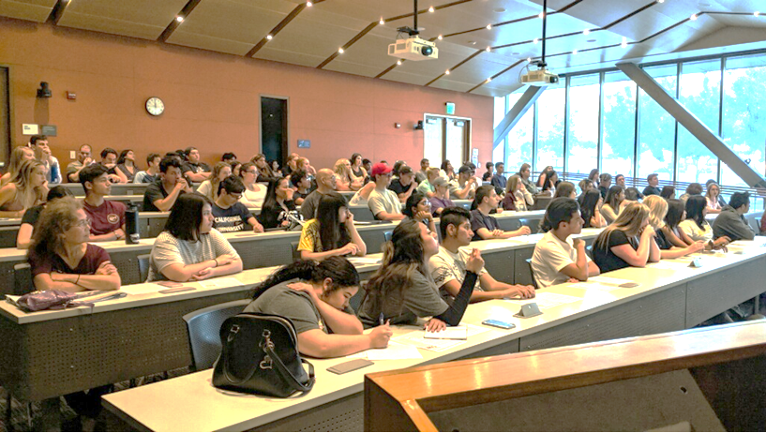
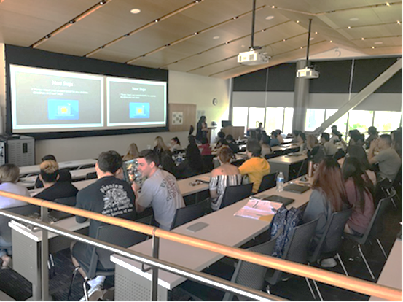
Benefits for Promise Students
2 consecutive years of free tuition
Free access to textbooks
Free access to a Chromebook rental
$300 per year for college expenses
Priority B class registration
Individual student support and college advising
Opportunity for paid work experience
A summer bridge program to help assist transition from high school to college

Slide 36
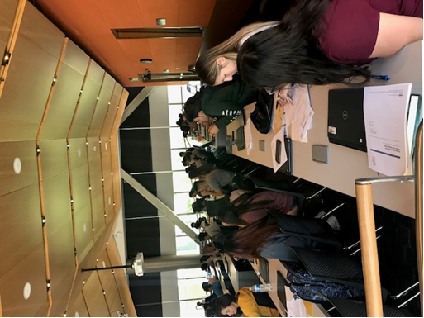
Requirements for Promise Students
Attend a summer bridge program
Enroll in and complete a minimum of 12 units each semester
Maintain a minimum 2.0 GPA or above each semester
Meet with a counselor at least once each semester to update their student educational plan
Attend semester check-in meetings and submit progress reports for all enrolled classes
Participate in at least one campus activity each semester

Slide 37
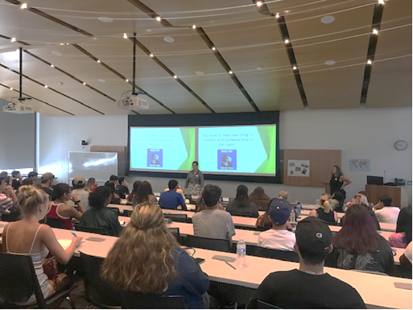
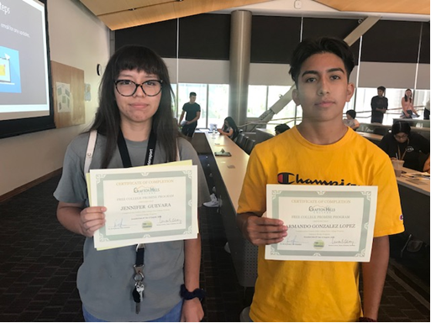
Promise Summer Bridge |  | Students
July 9 - 11, 2019 | 9:00 am – 12:00 pm | 64
July 16 - 18, 2019 | 9:00 am – 12:00 pm | 74
July 23 - 25, 2019 | 9:00 am – 12:00 pm | 65
July 30 – August 1, 2019 | 9:00 am – 12:00 pm | 64
July 30 – August 1, 2019 | 3:00 pm – 6:00 pm | 68
August 6 – 8, 2019 | 9:00 am – 12:00 pm | 62
August 6 – 8, 2019 | 2:00 pm – 5:00 pm | 25
Total
422

Slide 38
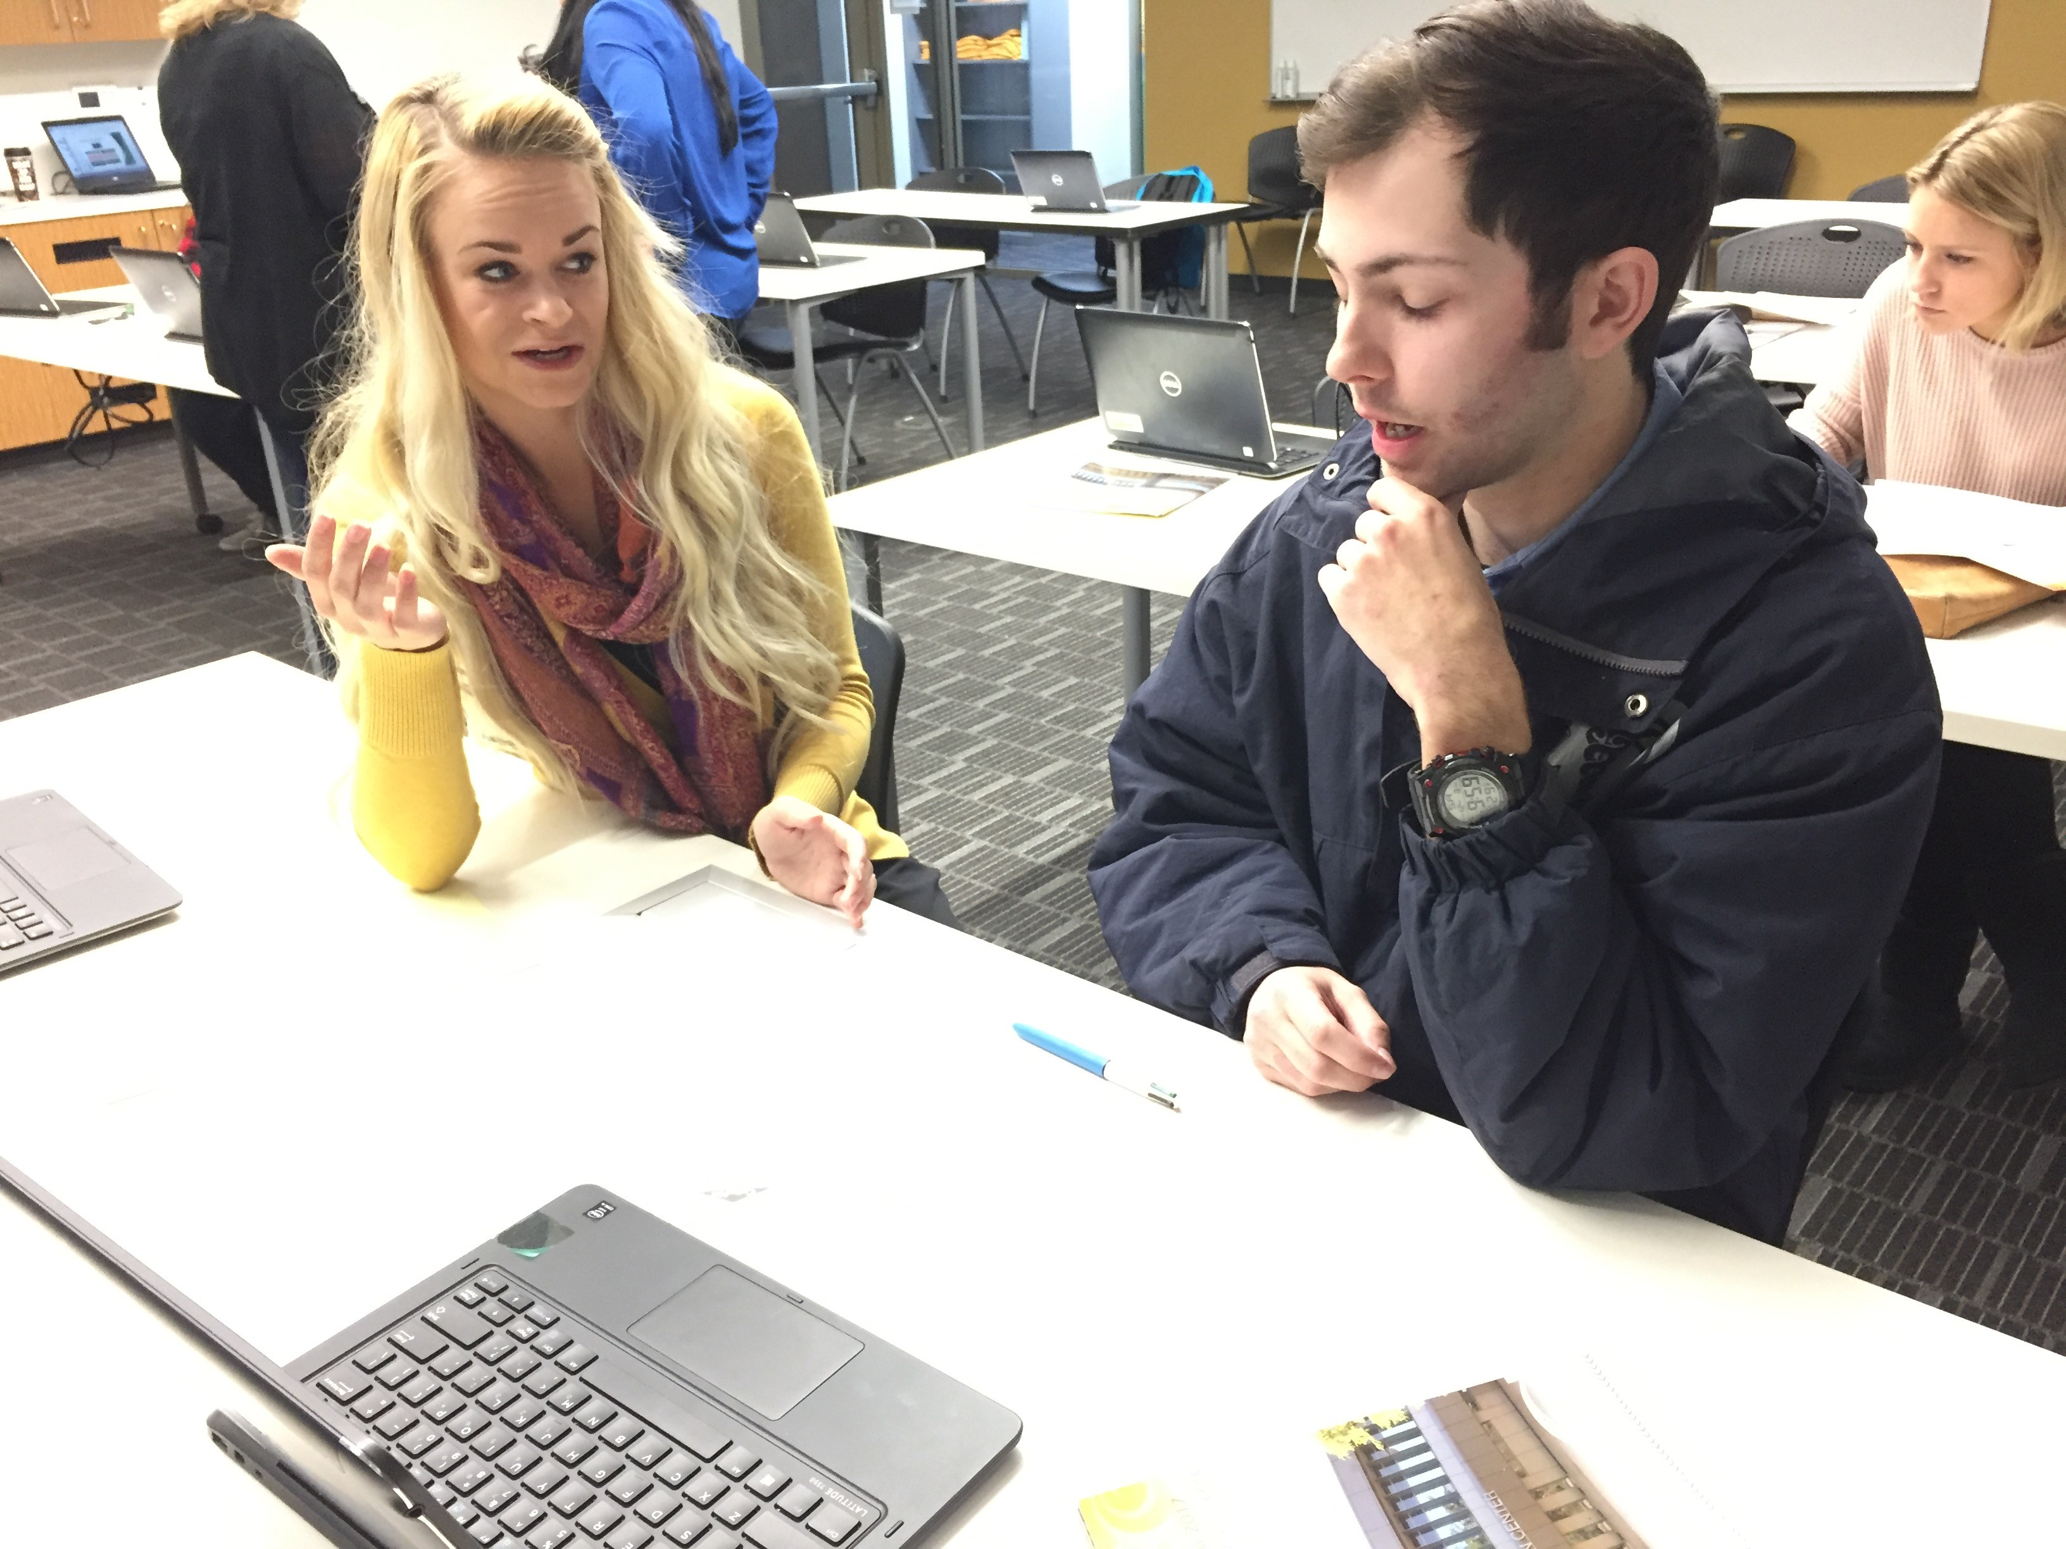
How Can You Help?
Assist students with their academic success by submitting Mid-Semester Progress Reports through Starfish
  Academic Progress
  Attendance
  Referrals for additional support services
  Observations and concerns
  Use Canvas to raise automatic flags
  Kudos!
Encourage the use of the Tutoring Center
Utilize your best retention strategies

Slide 39

Promise 2020
October 1, 2019 – January 31, 2020
  Promise applications will open up for the graduating class of 2020
February 2020 – April 2020
  Promise students will complete the matriculation process
April 2020
  Priority B registration begins
July 2020 – August 2020
  All Promise students will participate in a summer bridge program
August 2020
  Fall semester begins

Slide 40
John Longville
SBCCD Board of Trustees, President

Slide 41
Bruce Baron
SBCCD Chancellor

Slide 42
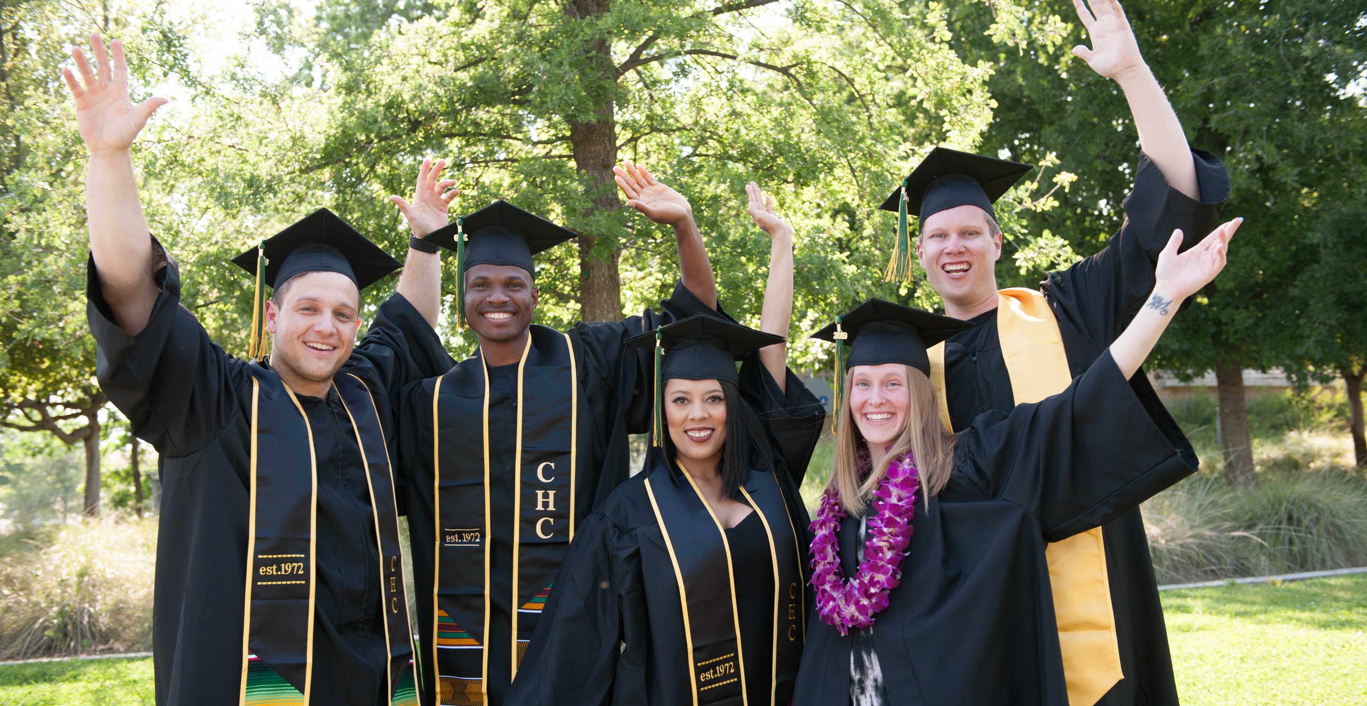
Commencement 2019

Slide 43
Accreditation Mania
Dr. Keith Wurtz

