Slide 1
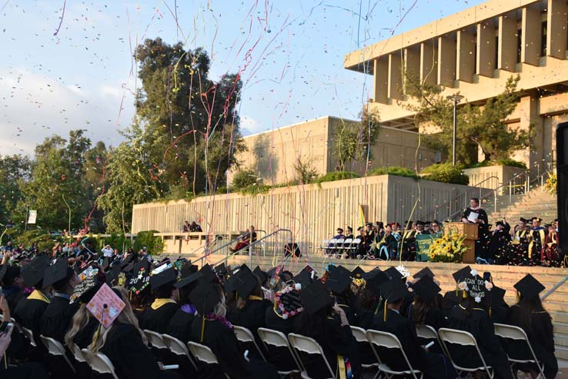

Crafton Hills College Update
Crafton Hills College
In-Service Day - Fall 2018

Slide 2

Welcome New Employees!
Audre Levy, Interim President
Monique Ware, Job Developer
Regina Pinedo, Custodian I
Raquel Rivera, Custodian I
Vincent Adame, Custodian I
Kellori “Kelli” Dower, Dean, LAM
Christopher Olivera, Microbiology
Krista Ivy, Librarian
Frank Madrid, Computer Science faculty
Ali Raventos, Admissions and Records Technician
Iris Kern-Foster, Digital Media Faculty
Maita Dawang, Student Services Technician I, EOPS

Slide 3
Crafton Hills College Update
Crafton Hills College
In-Service Day - Fall 2018

Slide 4
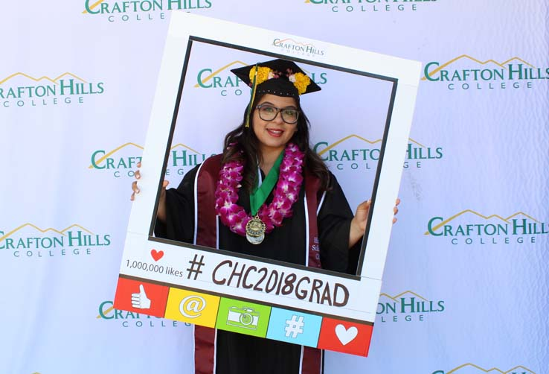
Fall 2018 Campus Update
Enrollment
  Exceeded our 2017-18 Enrollment Target, grew 1.7%
  2018-19 Enrollment Target = +1.5% = 4,587 RFTES
  Summer 2018 +19.3% over 2017
  Fall 2018 is tracking +2.0% over 2017
Degrees and Certificates Awarded
  Increased by 22% in last 5 years
Increased FTES/FTEF efficiency by 1.1%
Notes:
Degrees and Certificates: 825 in 2012-13 vs 1003 in 2017-18

Slide 5
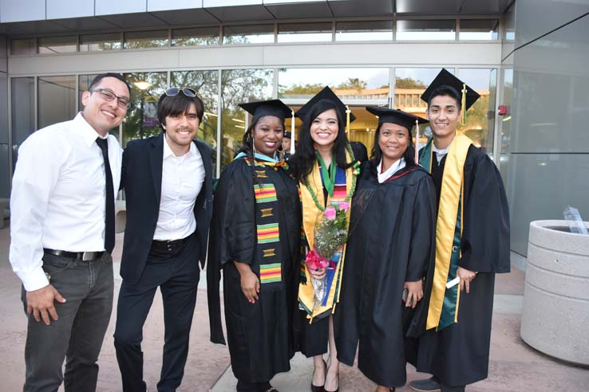
What’s Happening in 2018-19?
Non-Credit (min. target 29 FTES)
  Primary areas: 2018-19
    Wildland Fire
    Job Readiness Certificate
College Promise
Grants
  San Manuel iSeek $303.5K (90 students at 92% success rate), VRC $100K, AVID $150K (w/ RCC), United Way $8K, BofA Charitable Foundation Grant $10K, and more
  IEPI - $200K –Enrollment Management and RAM Revisions

Slide 6
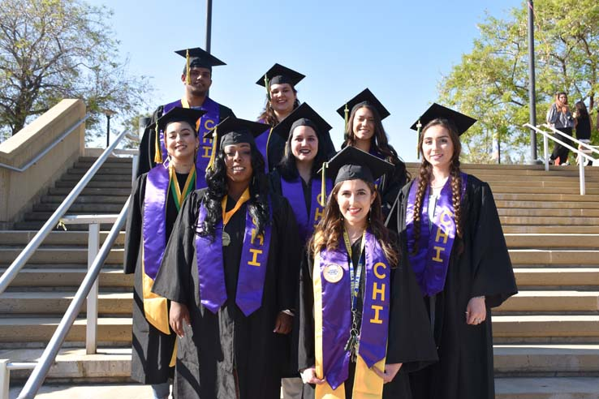
What’s Happening in 2018-19?
Guided Pathways – directing and supporting students from point of entry to attainment of high-quality postsecondary credentials and careers
Bond Measure – Nov. 2018 Ballot
AB705 Implementation
Strong Workforce
Prep for 2019-20 Accreditation Self-Study
CHC Presidential Search
State Funding Model

Slide 7
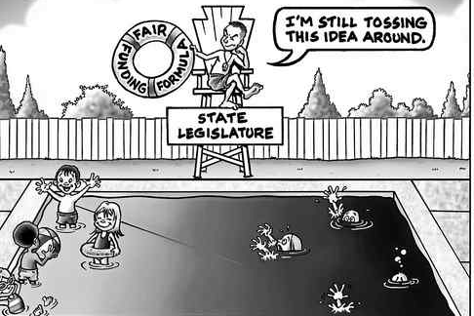
State Funding Formula

Slide 8
State Funding Formula
No longer solely based upon FTES (Access)
New Formula 2018-19
  3 Pronged Approach: Access, Equity, & Success
  70% Access or FTES (reducing to 60% over next few years)
  20% Need (Equity)
    Metrics: Pell Grants, AB540, Promise Grant (BOG)
  10% Student Success (increasing to 20% over next few years)
    Metrics: Associate Degrees, ADT’s, Credit Certificates, 9+CTE units, Transfer, Transfer Level Math and English, Regional Living Wage

Slide 9

Outline for the Day
9:30-12:00 | Keynote Speaker, Dr. Robert Johnstone, Guided Pathways
12:00-1:00 | Lunch - Roadrunner Café (Sponsored by CHC Foundation)
1:00-2:00 | All Faculty Meeting
1:00-2:00 | Classified Workshops
2:15-4:00 | Area/Division/Department Meetings

