Slide 1
Educational Master Plan
January 2023 Update
Educational Master Plan Committee
In-Service (Spring 2023)

Slide 2
Agenda
EMPC member acknowledgements
Purpose of an EMP
Brief review of CHC EMP development process
  Data collection and analysis
  Reflection/sensemaking on collective evidence & review of past EMP
  Open forum (December 2022)
Next steps in Spring 2023
  Development of key results
  Feedback from all senates
Draft of strategic directions & supporting actions

Slide 3
EMPC Members (Fall 2022)
Classified | Faculty | Management | Students | Committee Support
Kevin Palkki | Brandi Bailes | Kevin Horan (Chair) | Sean Ceballos | Ola Sabawi
Diana Vaichis | TL Brink | Michelle Riggs |  | Cyndie St. Jean
[Vacancy 1] | Ruth Greyraven | Delmy Spencer
[Vacancy 2] | Paul Jacques | Gio Sosa
 | Scott Rippy | Mike Strong
 |  | Dan Word
 |  | Keith Wurtz

Slide 4
What is the purpose of an educational master plan?
Roadmap for how the college will actualize its mission and vision
Two chief components:
  Strategic Directions (SD)
    Broad-based long-term goals that guide the work of the college
  Supporting Actions (SA)
    Concrete, measurable objectives that are used to assess the progress towards achieving a given strategic direction; encompassing of activities that could be pursued by many programs
  Example
    SD: Increase Student Enrollment
      SA: Improve and streamline the application and registration process

Slide 5
What is the purpose of an educational master plan?
SBCCD Strategic Plan Goals
Equity
Technology
Facilities
CHC EMP
ProfessionalDevelopment
Enrollment Mangement
Program PPRs

Slide 6
Brief Review of the CHC EMP Process

Slide 7
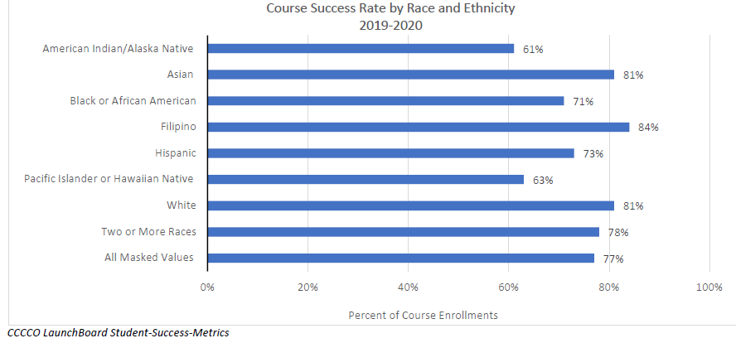
Quantitative Data
Internal scan
  College data

Slide 8
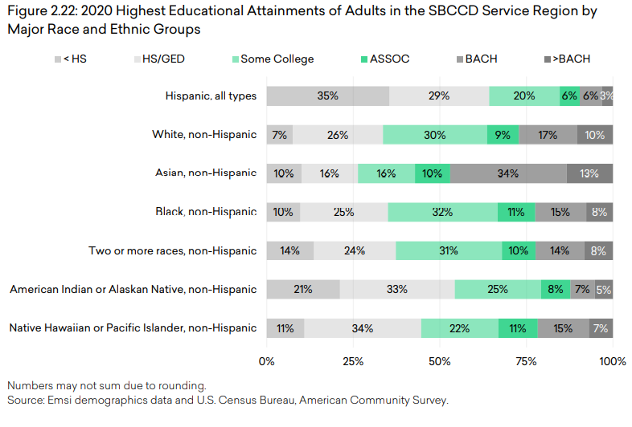
Quantitative Data (Cont’d)
Environmental scan
  Service area statistics

Slide 9
Qualitative Data
Sampling of Internal and External Listening Sessions | External Groups
Internal Groups | External Groups
All senates | CHC Foundation Board
EOPS, SAS, Counseling, Transfer, Tutoring, Library | Chambers of Commerce (Redlands & Yucaipa)
Enrollment Strategies Committee | Adult School & University Partners
Internal and external listening sessions
  What does CHC do well?
  What can CHC do better?

Slide 10
Qualitative Data (Cont’d)
Sampling of Internal and External Listening Sessions | External Groups
Internal Groups | External Groups
All senates | CHC Foundation Board
EOPS, SAS, Counseling, Transfer, Tutoring, Library | Chambers of Commerce (Redlands & Yucaipa)
Enrollment Strategies Committee | Adult School & University Partners
Examples of general themes
  Student access, marketing, outreach
  Enrollment growth and planning
  Student support services
  Diversity, equity, and inclusion
  Program design and delivery
  Community partnerships

Slide 11

EMPC Sensemaking
Review of the 2017 EMP’s strategic directions and supporting actions
Identification of activities consistent with evidence (e.g., threats and opportunities)

Slide 12
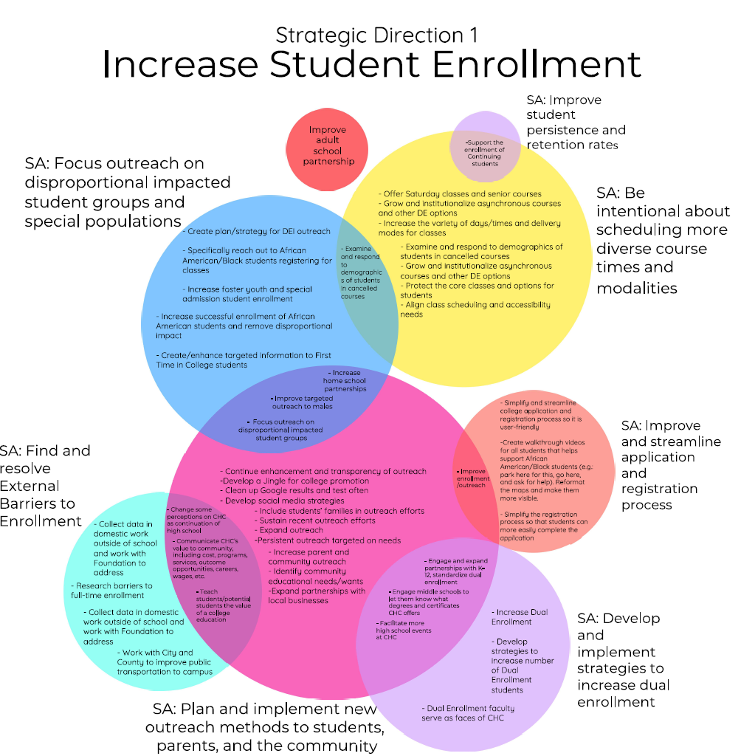
EMPC Sensemaking (Cont’d)
Detailed review of over 200 activities to identify tentative clusters and groupings => strategic directions and supporting actions

Slide 13

Open Forum (12/22)
Approximately 30 attendees
Overview of EMP process
Facilitated breakout sessions focused on garnering feedback concerning tentative SDs and SAs
Informed EMPC’s revisions to SDs and SAs

Slide 14
Next Steps in Spring 2023

Slide 15

Next Steps (Spring 2023)
Senate feedback
  Academic Senate
  Classified Senate
  Student Senate
Identification of key results (measures of progress)
Example
    SD 5: Foster and Support Inquiry, Accountability, & Campus Sustainability
      SA 5: Promote a culture of evidence and inquiry-based decision making
        Key Result: Increase the availability of data dashboards allowing for analysis of student demographics

Slide 16
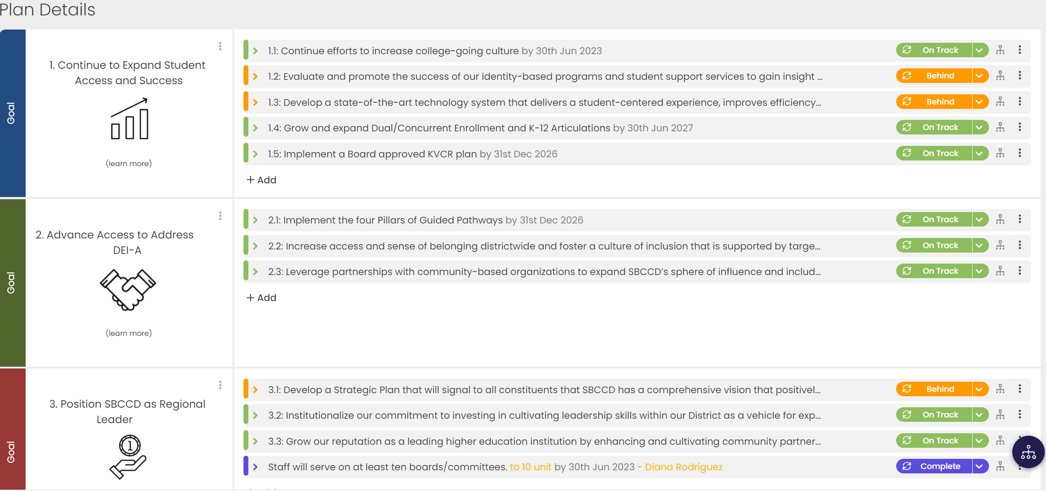
Next Steps (Spring 2023)
Crafton Council & SBCCD Board approval
Cascade Implementation

Slide 17
Next Steps (Spring 2023 – Spring 2028)
EMP Timeline
January—March
Feedback from Senates
Development of Key Results
EMPC Revisions
March—April
SBCCD Board Approval
May—June
Monitoring of Key Results
FA 2023—SP 2028
April—May
Crafton Council Approval
May—June
Cascade Implementation

Slide 18
Draft of Strategic Directions & Supporting Actions

Slide 19

CHC Strategic Directions
1: Increase Student Enrollment
2: Engage in Practices that Prioritize and Promote Inclusivity, Equity, and Anti-Racism
3: Increase Student Success & Equity
4: Develop a Campus Culture that Engages Students, Employees, and the Broader Community
5: Foster and Support Inquiry, Accountability, and Campus Sustainability

Slide 20
Strategic Direction 1: Increase Student Enrollment
Supporting Actions
1: Develop and implement strategies to increase dual enrollment
2: Find and remove internal and external barriers to student enrollment
3: Focus outreach on disproportionately impacted student groups and special populations
4: Improve and streamline the application and registration process
5: Develop, evaluate, and implement CTE programs that meet regional workforce needs
6: Plan and implement intentional outreach/marketing strategies for students, parents, and the community
7: Be flexible in scheduling courses over varied days, times, and modalities

Slide 21
Strategic Direction 2: Engage in Practices that Prioritize and Promote Inclusivity, Equity, and Anti-Racism
Supporting Actions
1: Strengthen communication of shared governance projects and committee work
2: Promote and implement best practices that enhance inclusivity, equity, engagement, and well-being

Slide 22
Strategic Direction 3: Increase Student Success & Equity
Supporting Actions
1: Achieve equity in student success, completion, and enrollment through closing equity gaps for disproportionately impacted groups
2: Enhance programs and services for disproportionately impacted groups and special populations
3: Promote and expand access to resources available to students (e.g., tech devices, food pantry, free textbooks (OER), financial aid, mental health services, etc.)
4: Improve communication with students (e.g., enhance CHC website, Canvas/Pronto SMS)

Slide 23
Strategic Direction 4: Develop a Campus Culture that Engages Students, Employees, and the Broader Community
Supporting Actions
1: Enhance and encourage collaboration between CHC, SBVC, and DSO
2: Explore and develop cultural programs of engagement that support the equity plan
3: Increase, maintain, and promote linger and learn spaces
4: Strengthen and promote partnerships with the community
5: Improve campus facilities by removing barriers to physical access, improving signage and directions

Slide 24
Strategic Direction 5: Foster and Support Inquiry, Accountability, and Campus Sustainability
Supporting Actions
1: Define and enhance budgetary guidelines and processes
2: Evaluate and modify the Resource Allocation Model (RAM)
3: Expand implementation of efficient and sustainable services and practices
4: Develop alternate revenue streams
5: Promote a culture of evidence and inquiry-based decision making

Slide 25

Thank you for your time!

