Slide 1






WELCOME TO FALL 2016
Bruce Baron, Chancellor
San Bernardino Community College District
Notes:
By a show of hands, how many of you share my excitement that this is going to be a great year?
I’m a little bit of a mind reader, so I already know who think this…and why. So, for example,
Because of the good news about accreditation.

Slide 2

ACCREDITATION!
Notes:
This was the best news. How about some high 5s. You all did it. We are off warning. All standards met.
Alright, let’s see why some of the rest of you are excite about this new year.
Two new college presidents. Yes.

Slide 3
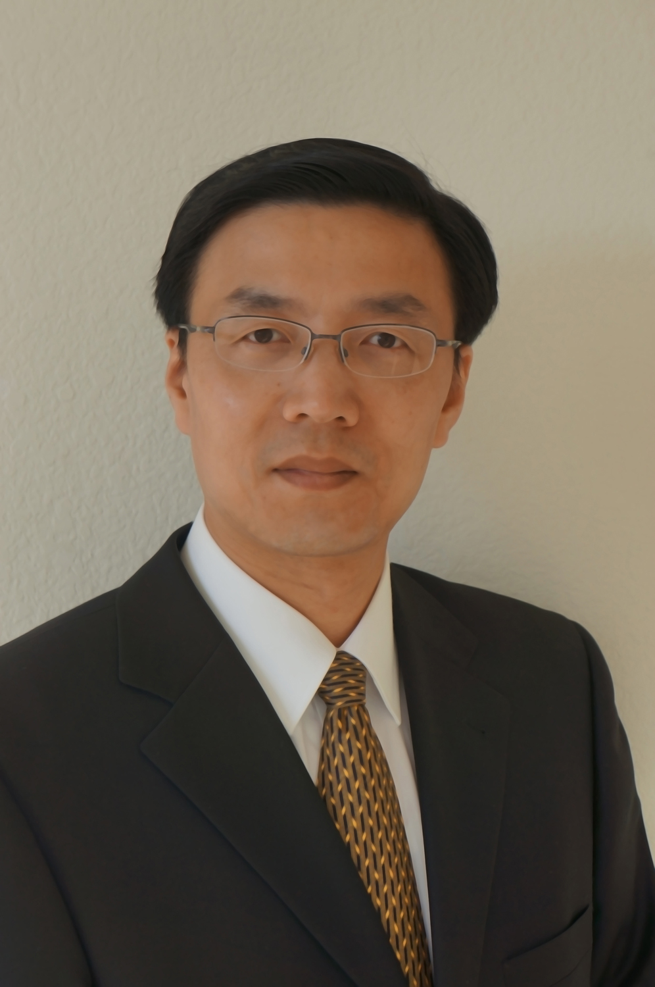
WELCOME, NEW COLLEGE PRESIDENT!
Dr. Wei Zhou, President,
Crafton Hills College

Slide 4
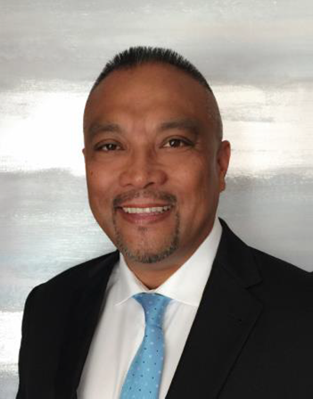
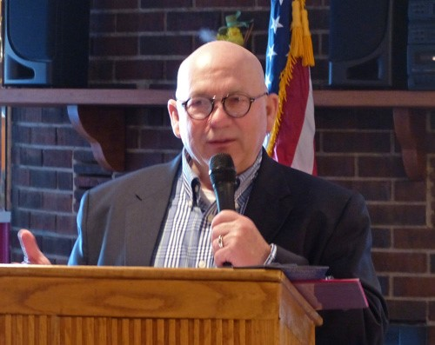
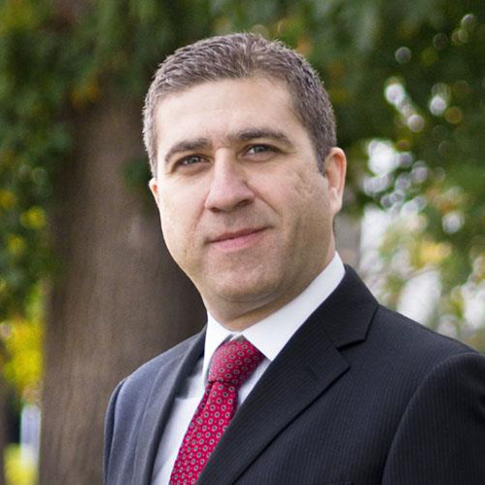
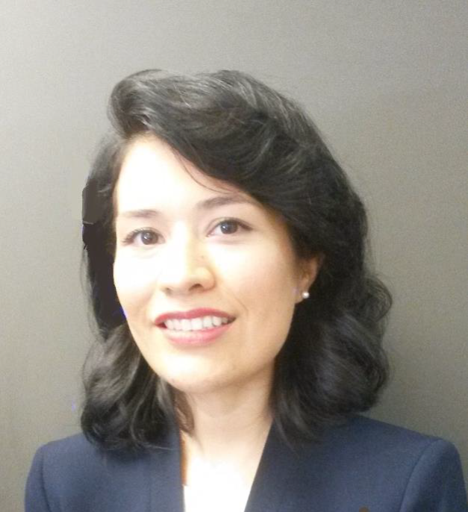
Other new leadership appointments
Richard Galope, Interim Associate Vice Chancellor, EDCT
Karl Sparks, Human Resources Consultant
Hussain Agah, Director, Facilities Planning and Construction
Erika Almaraz, District Internal Auditor
Notes:
Are there other new managers who I did not mention?

Slide 5
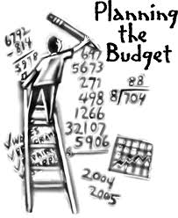
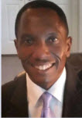

2016-17 Budget
Pencil too heavy
I knew that Jose was unsafe!
Jose
Reaching too far
Rickety ladder
Keurig brewer
Notes:
I am very pleased with the increased amount of transparency in the development of this year’s budget. I want to thank the District Budget Committee for all of their work and recommendations. I also want to acknowledge that our Board of Trustees now had an Ad-Hoc, now full-time, Budget Committee that has been meeting with Jose on a regular basis.

Slide 6


2016-17 District-wide Enrollment
Campus | 2014-2015 FTES Actual | 2015-2016 FTES Goal | 2015-2016 FTES Actual | Difference 2015-2016 Goal to Actual | % + 2014-2015 to 2015-2016 | 2016-2017 Goal | %+ 2015-2016 to 2016-2017
CHC | 4,350 | 4,864 | 4,848 | -16 | +11.45%* | 5,029 | +3.73%
SBVC | 10,117 | 10,504 | 10,504 | - | +3.83% | 10,714 | +2.0%
Totals | 14,467 | 15,368 | 15,352 | -16 | +6.12% | 15,743 | +2.55%
* Includes 250 FTES transferred from FY 2013-2014
Notes:
For the first time, we have an district enrollment management committee, chaired by the VC. And they have done some great work in setting the enrollment targets.
We have been given more growth than other districts because the new state formula considers the economic needs of our community as well as the college going rate. We have been doing a great job in meeting those goals. Crafton is positioned to achieve over 5,000 FTES this year which is a magic revenue target towards sustainability of their funding.

Slide 7

CHC
+4 new
+2 vacancies =
6 FT Positions

Slide 8
MOVING OUR DISTRICT FORWARD THIS YEAR,
WE WILL BUILD on the plan of A.C.T.I.O.N.
2016-2017
WILL BE AN “A.C.T.I.O.N.” YEAR!
We can Accomplish this Shared Vision Together!

Slide 9
A C T I O N
Accountability to all members of the SBCCD community so that we faithfully carry out our roles and meet the commitments that we make to others.
Collegiality at all levels of the organization so that work is accomplished in the spirit of collegial consultation.
Transformation so that we can continue on the path of continuous improvement to become the best community college district based on the indicators of success we measure.
Interaction with others so that we can build meaningful and
consistent communications between individuals and groups.
Objectivity in our interactions so that we can better understand one another without preconceived notions and biases to derive collegial outcomes.
Necessity as the basis for efficiency and effectiveness as stewards of district resources, sustainability, and service.

Slide 10
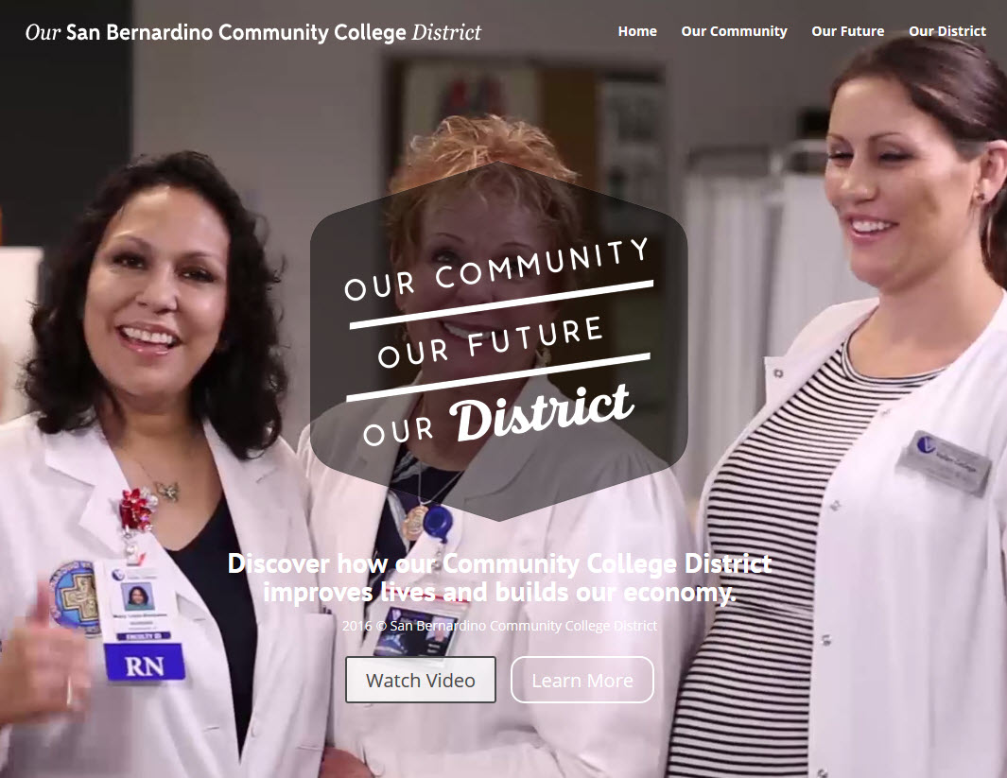

Slide 11

Have a Great Year!

