Slide 1
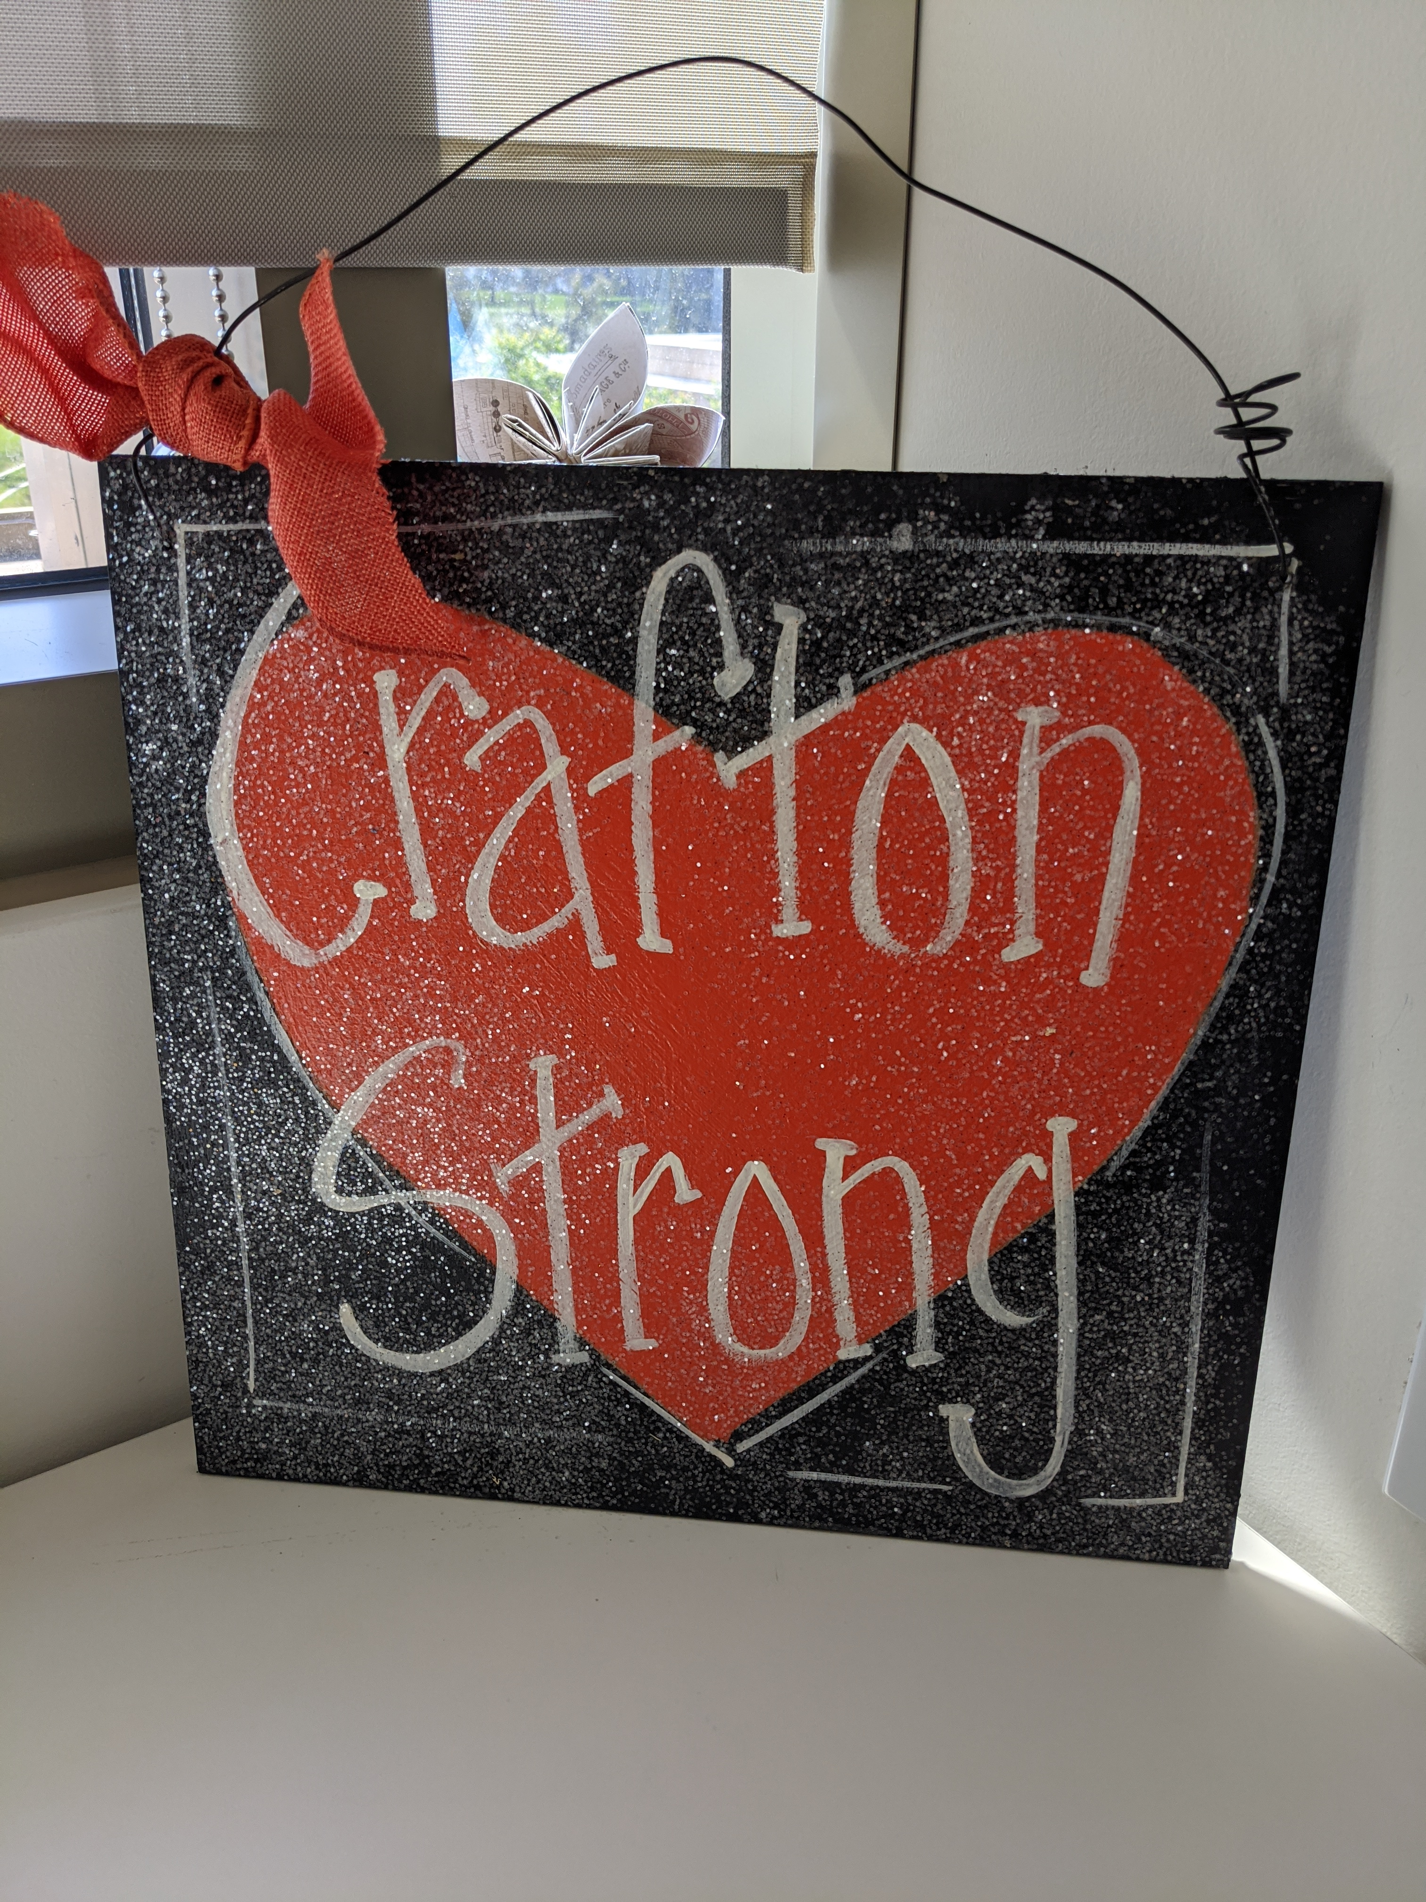
All Campus Zoom
February 19, 2021

Slide 2
ACCJC Full Reaffirmation for 7 Years!

Slide 3
COVID LIFE
Vaccination for Educators, Phase 1B, Tier 1: Includes all of community college personnel
Chancellor’s Cabinet decision timeline for Summer/Fall: Mid-March 2021
All-Campus Monthly Zoom Meetings
Friday, March 19th 2-3pm
Friday, April 16th 2-3pm
Friday, May 14th 2-3pm

Slide 4
Keith Wurtz
Vice President, Instruction

Slide 5
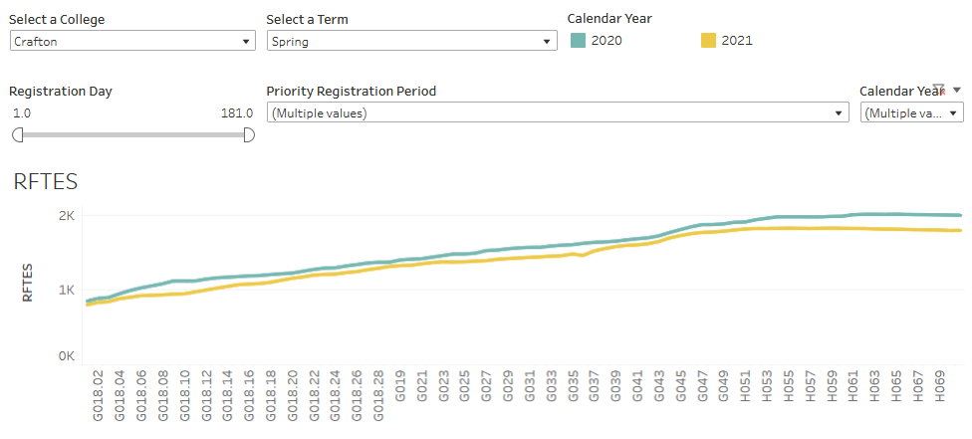
Resident FTES decreased from 1,994 in Spring 2020 to 1,791 in Spring 2021, a 10% decrease
1,994
1,791
Notes:
RFTES at Valley decreased from 4,450 in Spring 2020 to 3,620 in Spring 2021, a decrease of 18.7% (830).
Number of students at Crafton has decreased from 5,982 in Spring 2020 to 5,245 in Spring 2021, a decrease of 737 (12%) students. Suggesting that fewer students are enrolling in more courses.

Slide 6
Spring 2021 Events

Slide 7
Recruiting and Hiring Faculty of Color
January 2021
Van Muse, Mariana Moreno, Iris-Kern Foster, Sam Truong, Brandi Bailes

Slide 9
Confronting Explicit Acts of Racism & Racial Violence On-Campus
February 2021
Souts Xayaphanthong, Trinette Barrie, T.L. Brink, Belinda Navarrete, Rosemarie Hansen

Slide 10
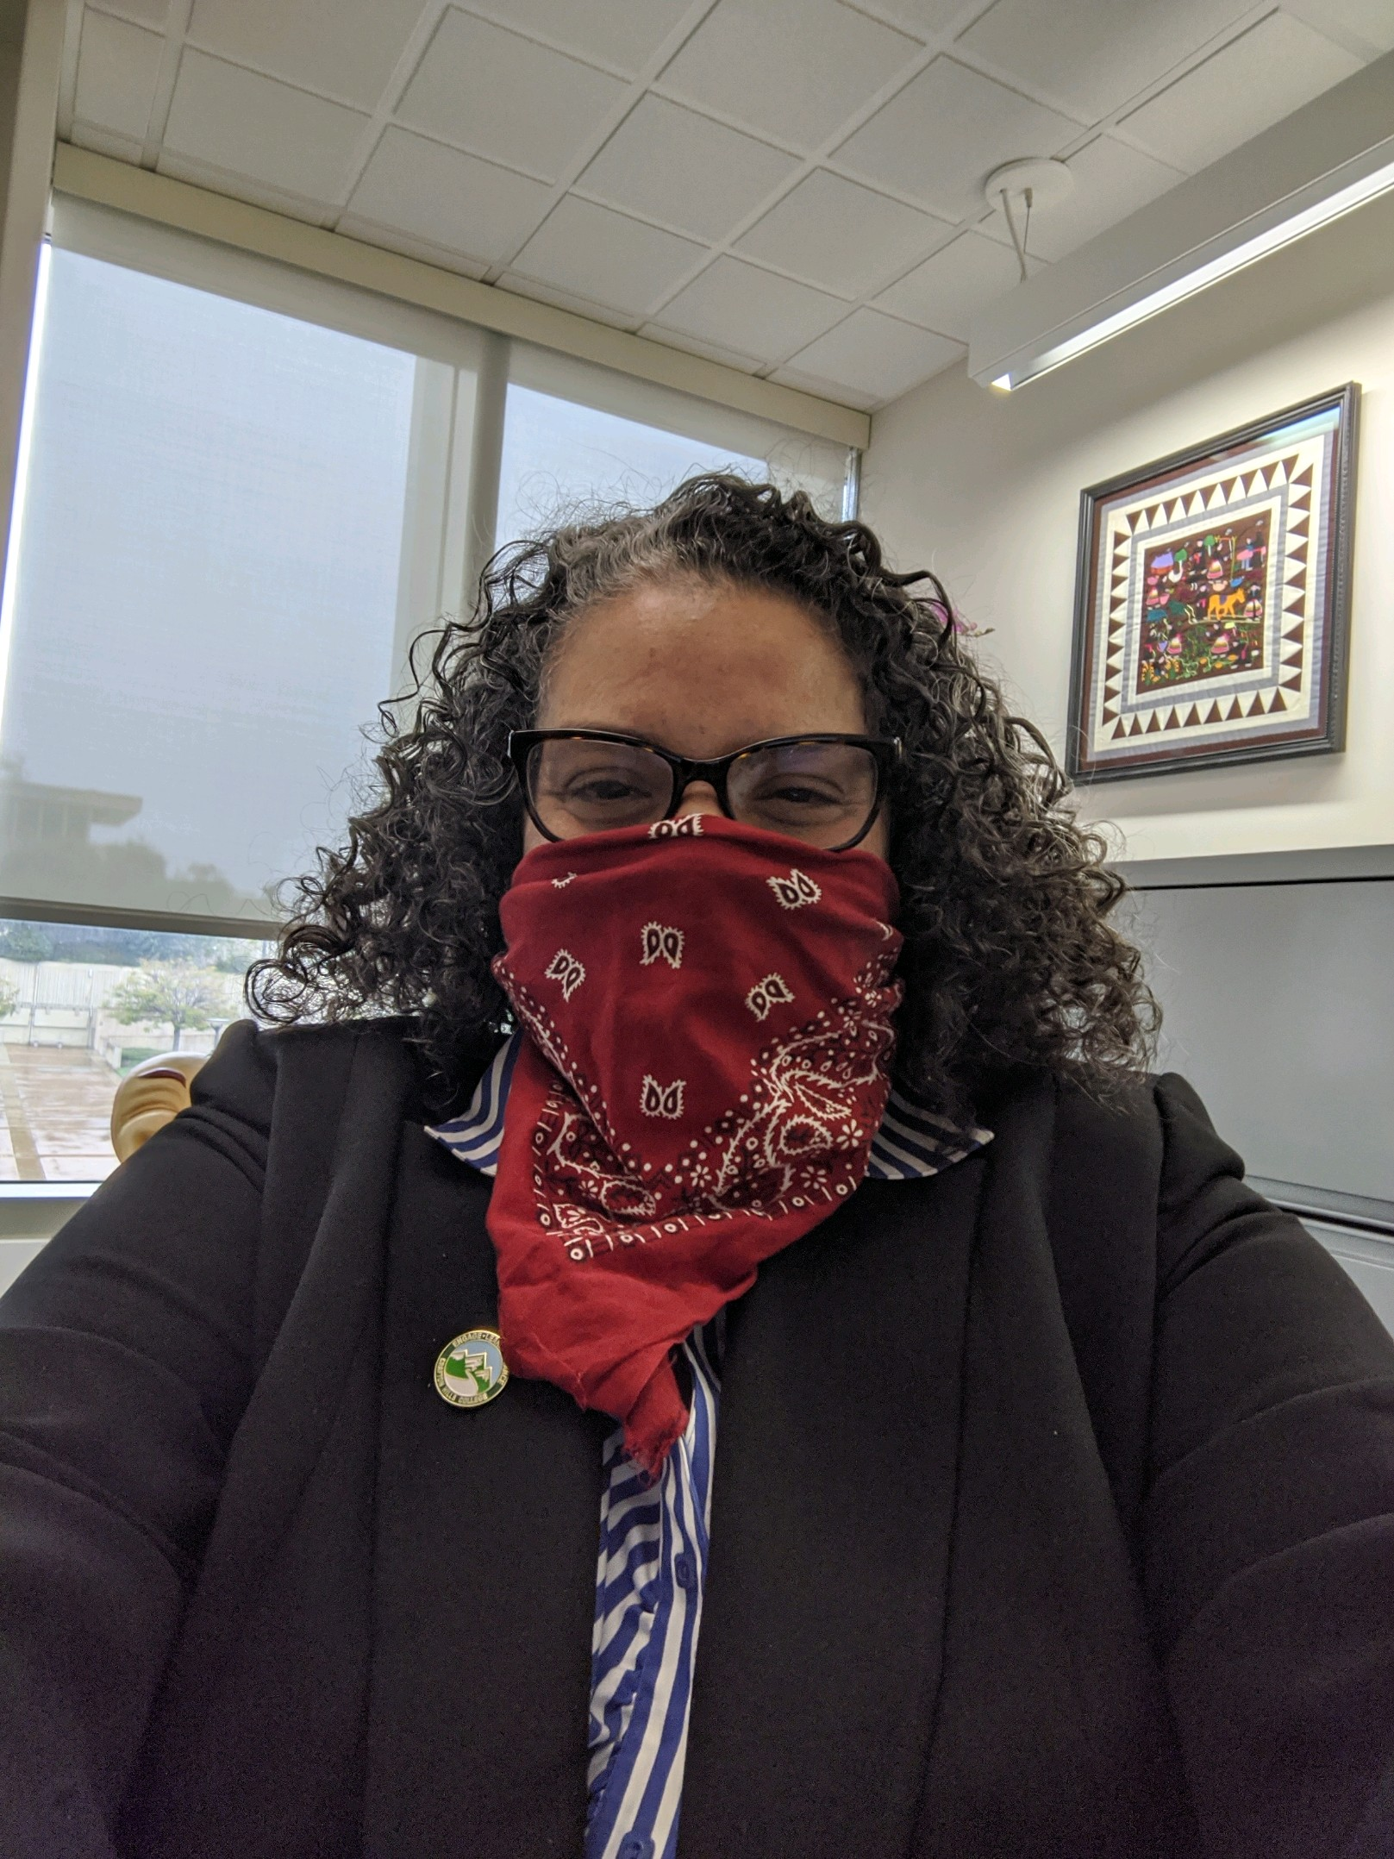
Delmy Spencer
Vice President, Student Services

Slide 11
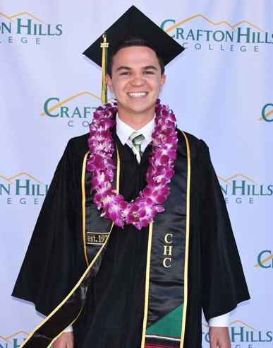
Virtual Commencement 2021
Celebrate Students!
Participate in CHC Celebration Video by following 3 Steps below:
Step 1- Check Your Email
Faculty, Staff and Administration will receive a message from Michelle Riggs in mid April that will contain a link and indirections to upload directly from Full Measure( Our Commencement Vendor)
Step 2 - Upload 8 Second Video
Step 3 – HAVE FUN!!!
CLAP, cheer, wave and show your Crafton spirit!!!

Slide 12
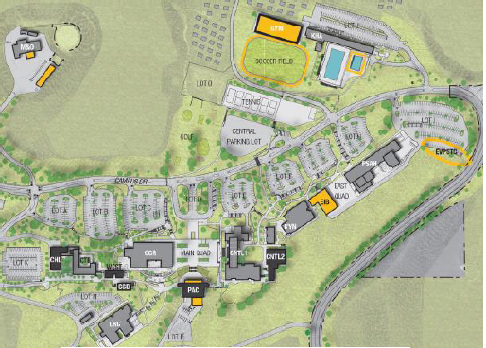
Mike Strong
Vice President, Administrative Services

Slide 13
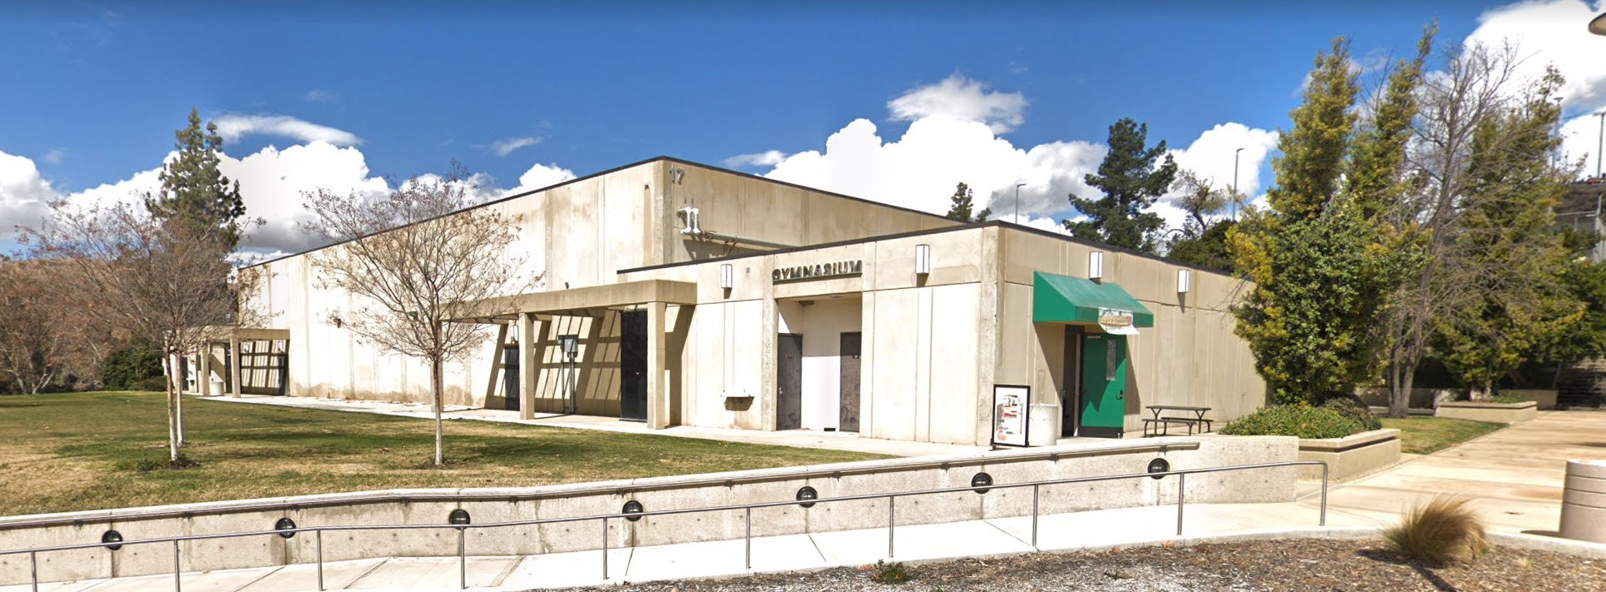
Gymnasium Demolition Update

Slide 14
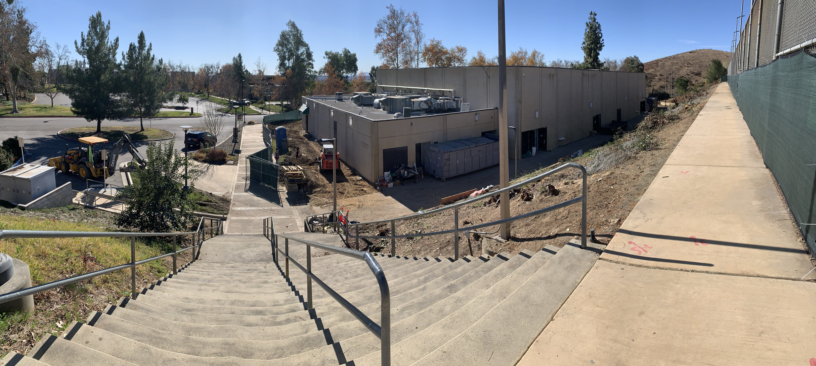

Slide 15
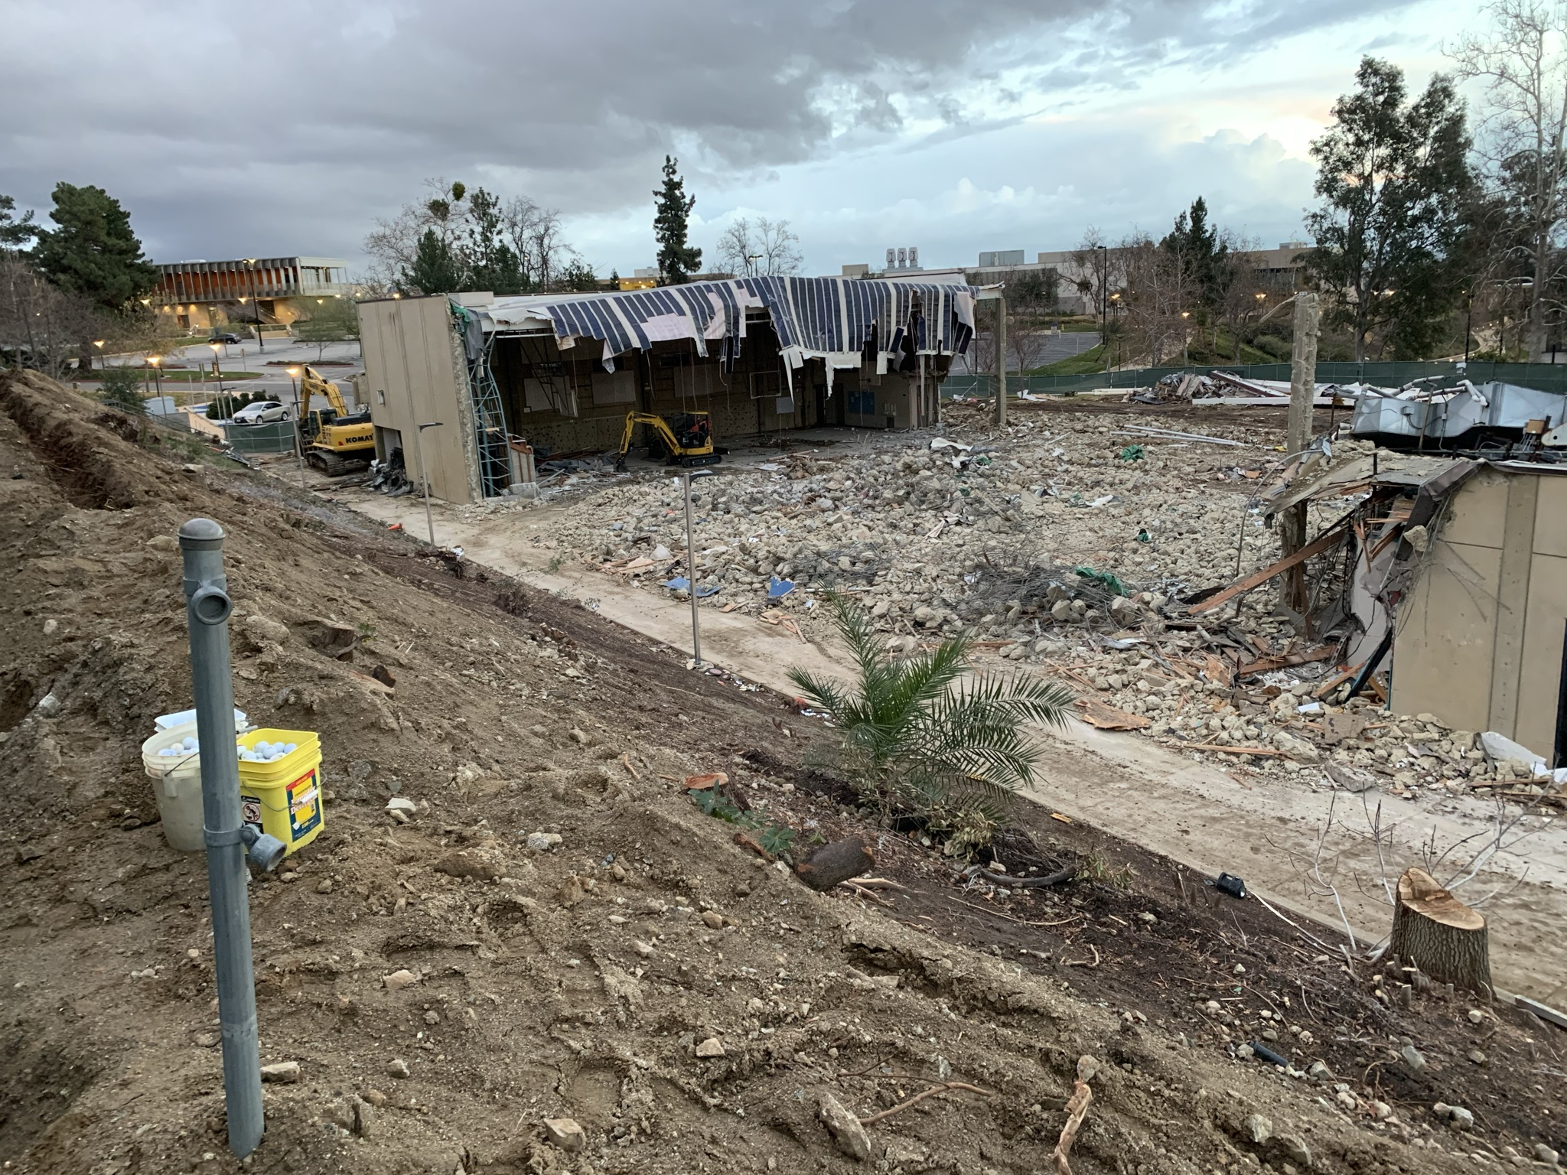

Slide 16
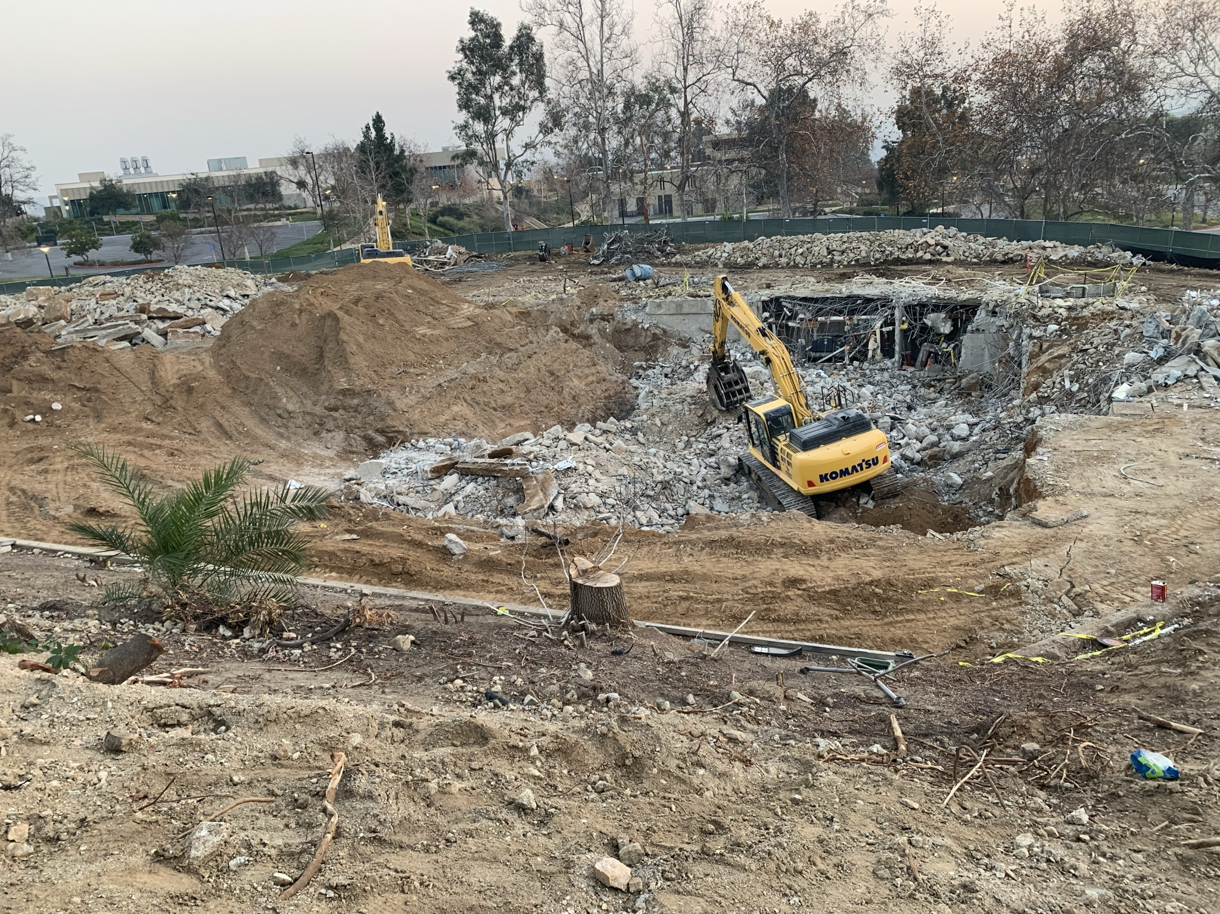

Slide 17
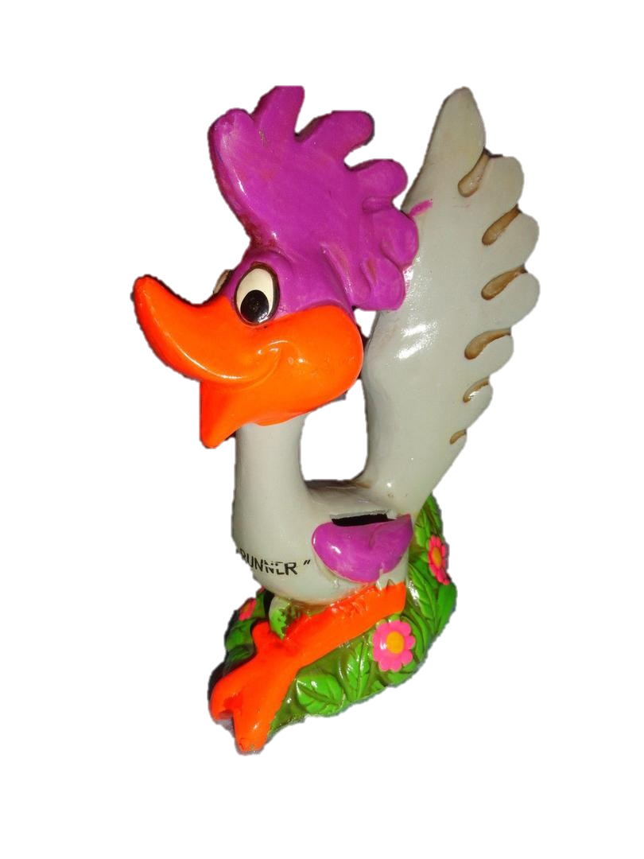
2021-22 Budget Development
Friday, 2/26/21 – Due Date for Managers to submit to VP’s
No projected growth in FTES targets from 2020-21 to 2021-22
Changes to permanent salaries and benefits require a Personnel Requisition Form
Provide justification in Questica for increases over 2020-21 budgeted amounts
Budgeting Help – coordinate a one-on-one with Tina Gimple (tmgimple@craftonhills.edu)
$

Slide 19
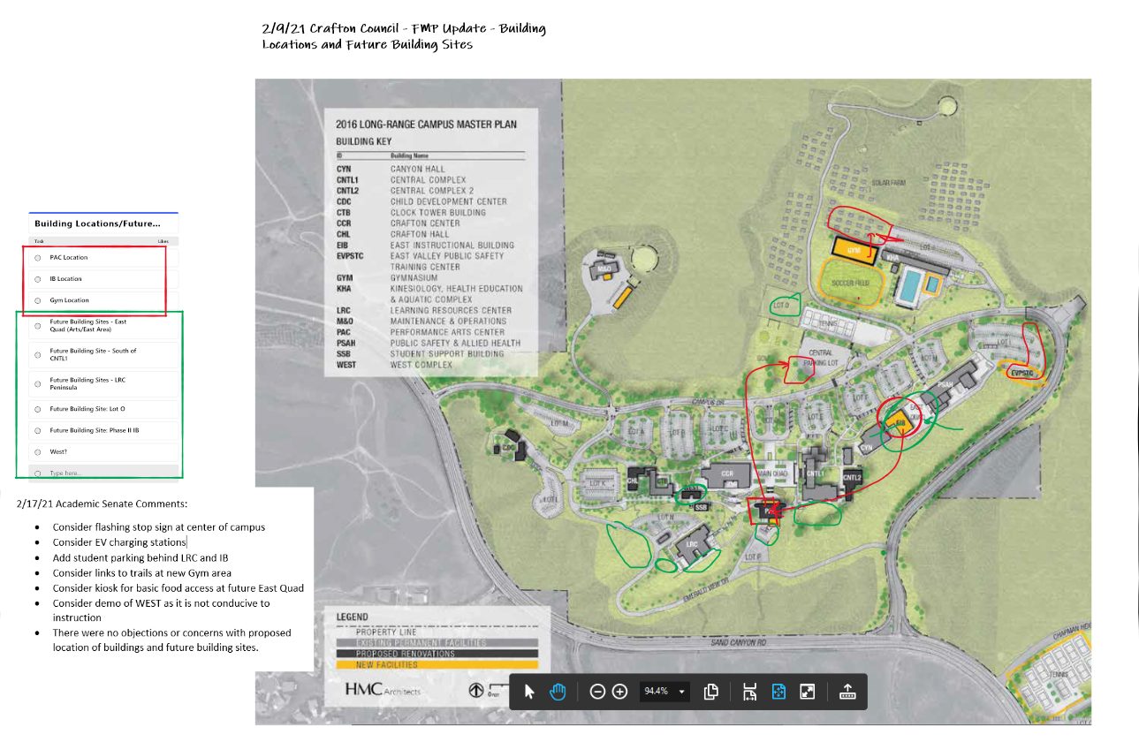

Slide 20
Q&A

