Slide 1
Student Equity Plan 2.0
Steps to Develop Equity Plan

Slide 2
Summary of Groups Disproportionately Impacted
Group | Successful Enrollment (Access – Applied and actually enrolled) | 1. Transfer to four-year institution | 2. Retention: Fall to Spring | 3. Completion both Transfer Level Math and English with the district in the first year | 4. Earned one or more of the following: Chancellor's Office approved certificate, associate degree, and/or CCC baccalaureate degree
Latinx |  | X |  | X
African American |  |  | X |  | X
25-29 years old |  | X | X
30-34 years old |  | X | X
40-54 years old |  |  | X |  | X
Not Eligible for College Promise Grant/BOG Waiver |  |  | X | X | X
Never Received PELL Grant |  |  | X | X | X
Not Perkins Economically Disadvantaged |  |  | X | X | X

Slide 3
Summary of the Center for Urban Education (CUE) Review of Crafton’s Previous Student Equity Plan
Prioritizes the use of data and research to inform and evaluate the effectiveness of activities
Plan is data driven
Data has been collected and analyzed to determine which services were most effective in improving success for DI students
Example: Supplemental instruction was found to positively impact course success for Hispanic students and tutoring was most effective with male, Hispanic, and African American students
Plan also included activity to research the gaps that exist to deepen the understanding of why DI exists

Slide 4
Center for Urban Education’s (CUE) recommendations for Crafton
Focus on specific racially minoritized student populations rather than on all students.
Create equity activities that explicitly align the race-specific metrics to race-specific activity descriptions (Example: The college will conduct targeted outreach activities to increase the number of African American and LGBTQ students that complete the matriculation process.)
Adopt equity-minded language, including operationalizing a definition of equity for the college.
Include transfer-specific equity activities.
Align equity planning with Vision for Success
More classroom specific activities – the primary aim of the activity is focused on what happens in the classroom like training faculty on equitable classroom practice

Slide 5
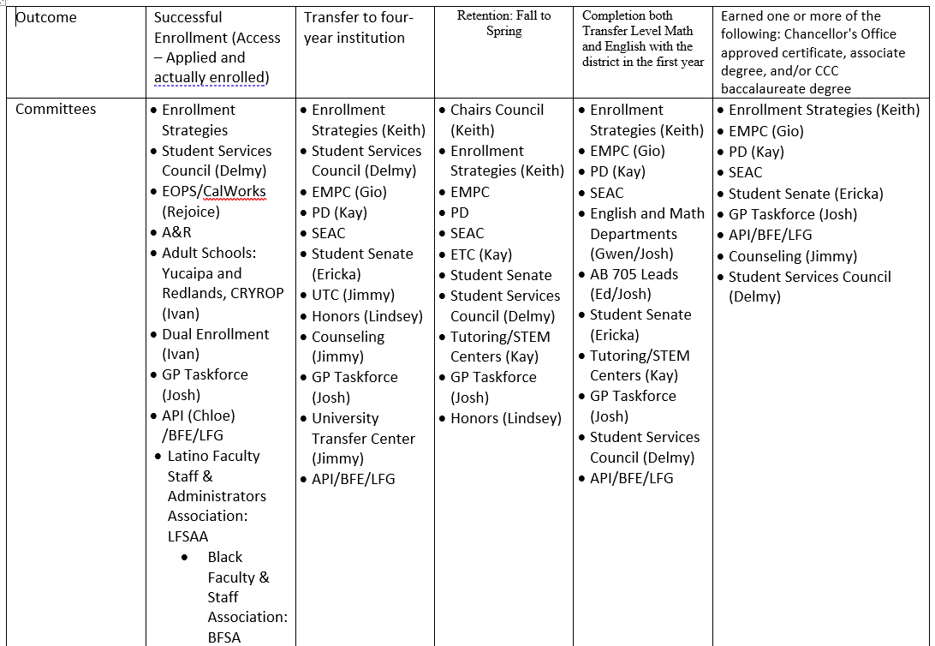
SEAC Committee Aligned outcomes with committees, departments, and groups

Slide 6
Approach to including entire campus to develop equity activities
Align outcomes with committees, departments, and groups
Present this presentation to each committee and group and review activity template
Review data, CUE recommendations, and research identifying which activities are effective with which DI Groups
Send out instructions to identified groups
Review the data
Review the research identifying which activities are effective with which DI groups
Provide activities to increase outcomes (and remove gaps) that are specific to DI groups
Design teams will review activities developed by the committees, departments, and groups and align each activity with the GP Pillars and ensure that the CUE recommendations are being incorporated

