Slide 1
Environmental Scan Overview
Educational Master Plan Committee
October 2021

Slide 2
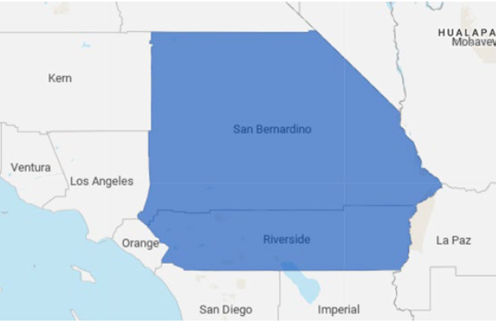
Introduction
The SBCCD Service Region examined in the environmental scan includes Riverside and San Bernardino Counties
Uses the region’s average annual projected job openings between 2020 and 2030 as a measurement of labor market demand
Analyzed how well Crafton’s program offerings satisfy regional workforce demand
Offers recommendations for new program development

Slide 3
Overview of Findings
Job growth of the Inland Empire has outpaced that of the rest of the state, and even more so, in comparison with the rest of the nation.
  SBCCD-area jobs are increasing from 1.4m (2010) to 1.8m (2020) to 2.0m (2030)
SBCCD's service area has a higher concentration of most industries than the national average and are expected to remain above the national average in concentration over the next 10 years.
  Local Govt (K-12 teachers, teaching assistants)
  Specialty Trade Contractors (carpenters, construction workers)
  Social Assistance (childcare workers)
  Warehousing and Storage (laborer & freight, stock, and material mover)
  Truck Transportation (bus and truck mechanics/diesel engine specialist)

Slide 4
Overview of Findings (Cont’d)
The largest group of unemployed individuals in our region is those with "no previous work experience," 3% higher than the California average and 11% higher than the national average.
  If you don't have work experience, it is harder to find a job here than in other places.
359,280 individuals commute into the region for work (next slide for occupation information)
640,330 commute out of region for work
  Business Operations Specialists
  Home Health and Personal Care Aides, Nursing Assistance
  Computer Occupations

Slide 5
Overview of Findings (Cont’d)
93% of commuters into the region are employed as material moving workers.
Material Moving Worker Occupations | Educational Requirements | Median Wage (SB/Riverside)
Laborers and Freight, Stock, and Materials Movers | On-The-Job Training, No College Required | $15.51
Conveyor Operators and Tenders | On-The-Job Training, No College Required | $30.92
Tank Car, Truck, and Ship Loader | On-The-Job Training, No College Required | $15.51
Industrial Truck and Tractor Operators | On-The-Job Training, No College Required | $15.26
Machine Feeders and Offbearers | On-The-Job Training, No College Required | $16.85

Slide 6
Overview of Findings (Cont’d)
SBCCD region has a projected population growth rate of nearly double the projected State rate and about 65% higher than the national rate.
  Hispanics are the demographic group with the lowest level of educational level achieved.
In our region, 48% of adults have a high school diploma (27%) or did not finish high school (21%).
  This is above state (39%) & national (41%) averages.
  Hispanic, American Indian, Alaskan Native have the lowest levels of educational attainment.

Slide 7
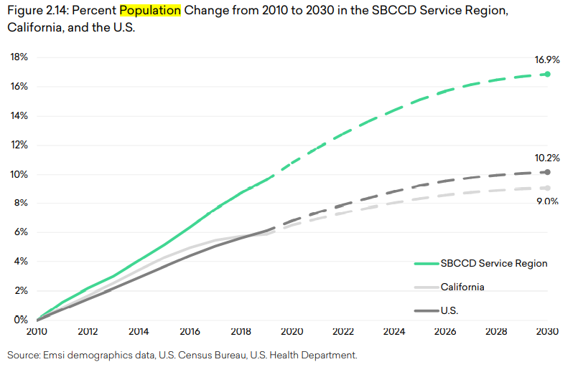
Population Change in the SBCCD Service Region

Slide 8
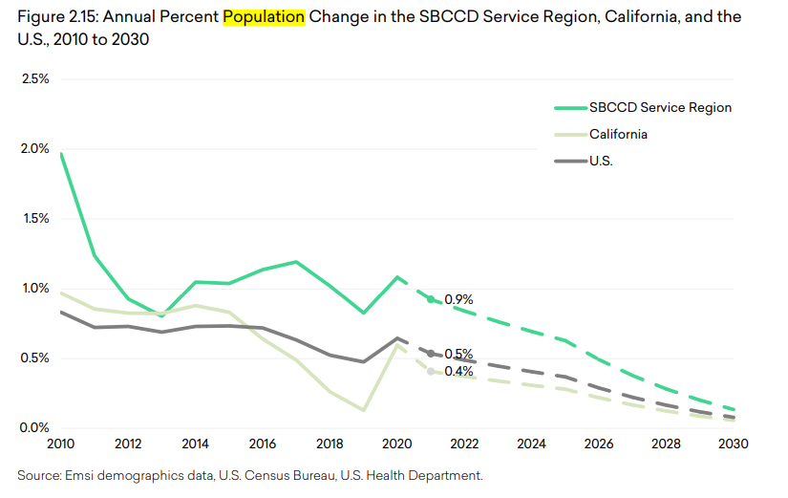
Annual Percent Population Change in SBCCD Service Region

Slide 9
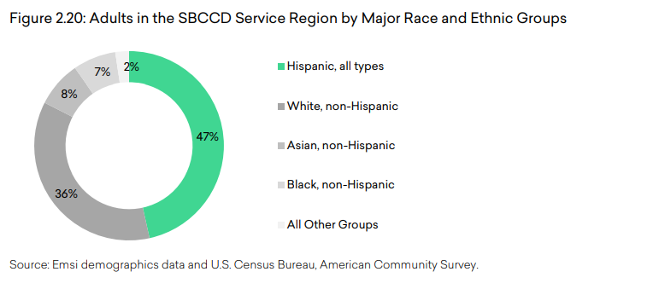
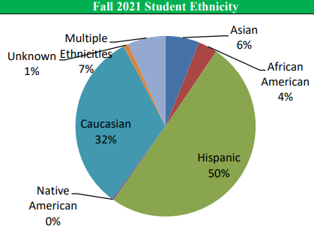
Ethnicity in SBCCD Region and CHC Student Population

Slide 10
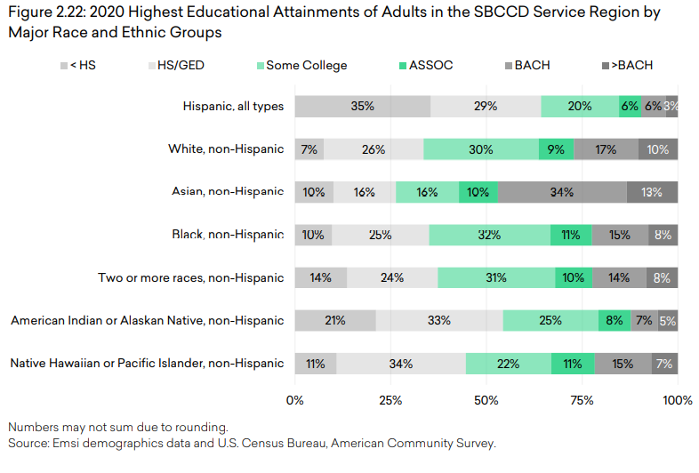
Highest Educational Attainment in SBCCD Service Region

Slide 11
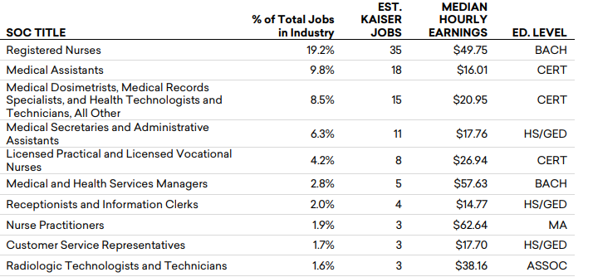
Top 10 Occupations Needed for the Kaiser Facility

Slide 12
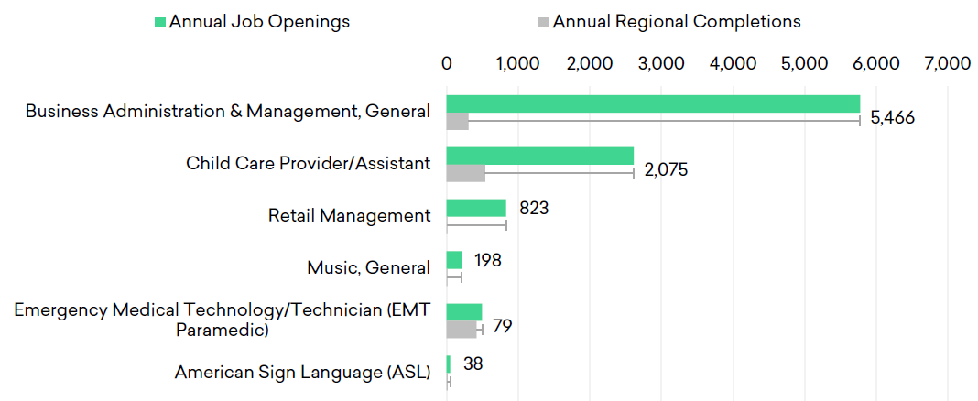
Business Administration, Child Care Provider, and Retail Management all have a gap or surplus larger than 500 between annual job openings and regional completions indicating an area for consideration for Certificate program development
Notes:
Page 58

Slide 13
Occupation Spotlight: Business Administration & Management, General
Business Administration & Management, General | Educational Requirements | Median Wage (SB/Riverside)
Administrative Services Managers | Bachelor’s or higher | $47.16
Cost Estimators | Bachelor’s or higher | $31.48
General and Operations Managers | Bachelor’s or higher | $47.76
Industrial Production Managers | Bachelor’s or higher | $48.06
Management Analysts | Bachelor’s or higher | $37.28
Managers, All Other | On-The-Job Training, No College Required | Not Available
Sales Managers | Bachelor’s or higher | $47.18

Slide 14
Occupation Spotlight: Child Care Provider/Assistant
Child Care Provider/Assistant | Educational Requirements | Median Wage (SB/Riverside)
Childcare Workers | On-The-Job Training, No College Required | $14.56
Preschool Teachers, Except Special Education | Associate's or higher | $21.72
Special Education Teachers, Preschool | Associate's or higher | $21.72

Slide 15
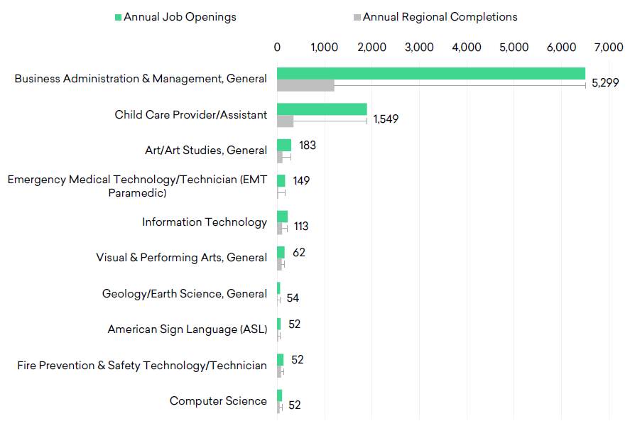
Business Administration and Child Care Provider have a gap or surplus larger than 500 between annual job openings and regional completions indicating an area for consideration for Degree program development
Notes:
Pg. 69

Slide 16
Occupation Spotlight: Art/Art Studies, General
Art/Art Studies, General | Educational Requirements | Median Wage (SB/Riverside)
Art, Drama, and Music Teachers, Postsecondary | Bachelor’s or higher | $45.75
Craft Artists | On-The-Job Training, No College Required | $22.86
Fine Artists, Including Painters, Sculptors, and Illustrators | On-The-Job Training, No College Required | $33.68
Photographers | On-The-Job Training, No College Required | $20.69
Secondary School Teachers, Except Special and Career/Technical Education | Bachelor’s or higher | $43.86

Slide 17
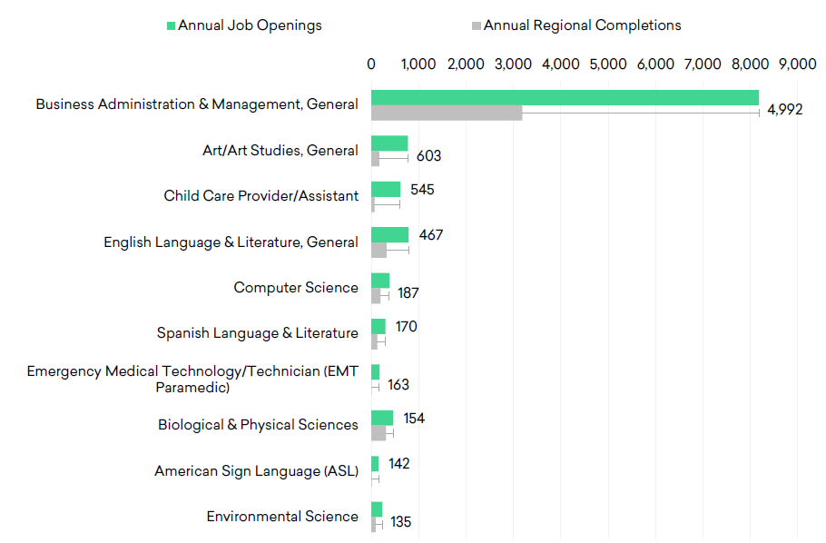
Business Administration, Art, and Child Care Provider have a gap or surplus larger than 500 between annual job openings and regional completions indicating an area for consideration for Transfer Degree program development
Notes:
If students go on to get BA degree. Pg. 81

Slide 18
Occupation Spotlight: English Language and Literature, General
English Language and Literature, General | Education Requirements | Median Wage (SB/Riverside)
English Language and Literature Teachers, Postsecondary | Bachelor’s or higher | $48.35
Secondary School Teachers, Except Special and Career/Technical Education | Bachelor’s or higher | $43.86
Writers and Authors | Bachelor’s or higher | $32.62

