Slide 1
What Makes Math Different?
Math Study Skills, 2nd Edition
Alan Bass

Slide 2
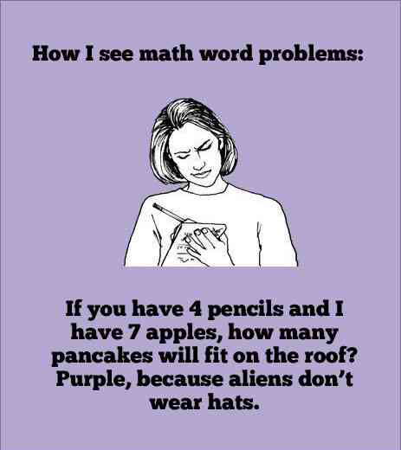
Why Math Can Seem So Tough
Complete Exercise 4 in your Math Study Skills book (p. 8).
  What are some of your
  reasons?

Slide 3
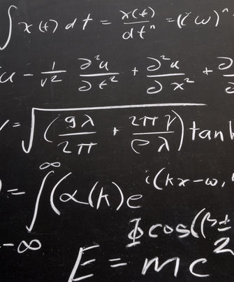
Why Math Can Seem So Tough, continued.
Math is a foreign language.
  This fact can help you study more efficiently.
  Use note cards with definitions of terms on them.
  Write lists of the translated words.
  Make a conscious effort to speak the language correctly.
  Speak translations out loud as you write sentences.
Complete Exercise 5 (p. 9 – 10). Use Section _________.

Slide 4
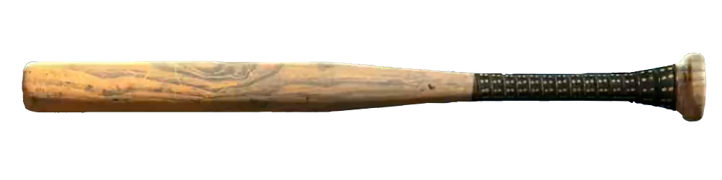

Why Math Can Seem So Tough, continued.
Math is skill-based.
  It must be practiced repeatedly and not just seen in order to be mastered.
  Your professor’s lecture is like a set of instructions telling you how to hit a baseball. You have to step into the batter’s box and try it for yourself.
  “When I’m in class and listening to a lecture, I understand everything. I get it. But when I get home and try the homework it’s like I’ve forgotten everything and I don’t know what I’m doing.”

Slide 5


Why Math Can Seem So Tough, continued.
The college course structure.
  High school and college are very different.
  Consider some of the differences between the two:
High School
Attendance is required.
Teachers closely monitor students.
PreAlgebra is covered over 10 months.
Students see their teacher daily.
Tests are frequent.
Grades are based on participation/effort.
Extra credit is frequently offered.
College
Attendance is often optional.
Students are responsible for themselves.
PreAlgebra is covered in 18 weeks.
Class meets 2-3 times per week.
Tests are infrequent.
Grades are based on a few assignments.
Professors rarely offer extra credit.

Slide 6
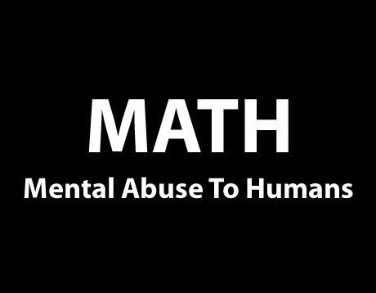
Why Math Can Seem So Tough, continued.
General attitudes toward math.
Common math myths:
  Math is supposed to be struggled through.
  Math is boring.
  You need a “mathematical mind” to succeed.
  Men are better at math than women.
  It is okay to fail in math.
  Math will never be used outside of class.

Slide 7
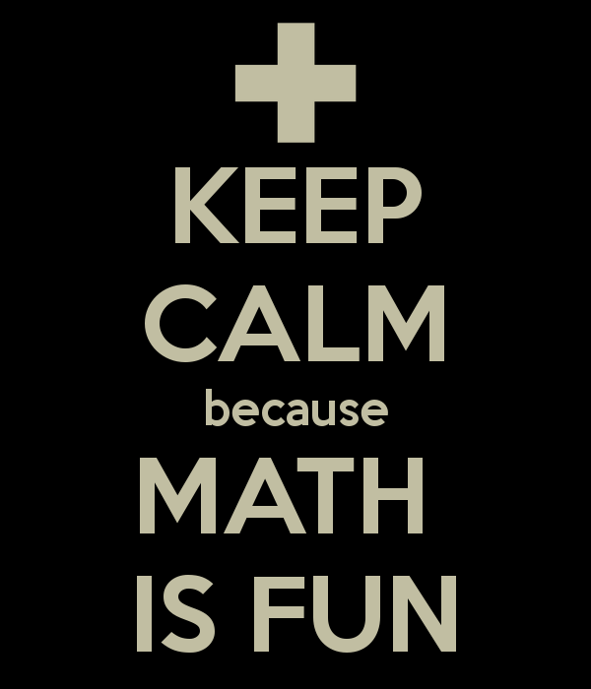
Why Math Can Seem So Tough, continued.
The truth:
  All students can do well in math.
  Math has a long list of useful applications.
  All humans are born with a “mathematical mind.”
  Men are no better at math than women.
  It is only okay to fail in math if you think it is.
  Everyone uses math every day, whether they realize it or not.

Slide 8

Why Math Can Seem So Tough, continued.
A student’s math background.
  The math class you begin within college is very important.
  Sometimes students have gaps in their learning when they take a more advanced course.
  Tell your instructor or tutor if you do not feel prepared for the course you are taking.
  Use a tutor to help you fill the gaps in your understanding- it is free in the Tutoring Center.

Slide 9

Why Math Can Seem So Tough, continued.
“But I had all this in high school.”
  Avoid the “been there, done that” mentality.
  Do not ask, “Did I already have this class in high school?”
  Ask, “Did I learn this in high school?”
    Do you know it well enough to take the next class?

Slide 10

Why Math Can Seem So Tough, continued.
Learning Disabilities.
  Americans with Disabilities Act (ADA)
    Covers all aspects of disability in education, as well as other places.
  If you know or think you have a learning disability, talk to the Disabled Student Services at Crafton
    (909)389-3325
    (909)794-4105 [TTY Number]

Slide 11
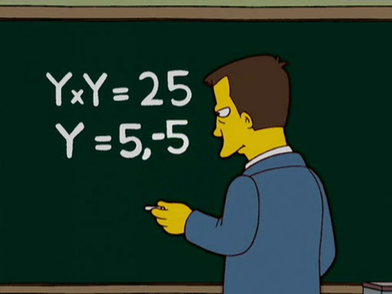
Why Math Can Seem So Tough, continued.
Quality of Instruction.
  You are ultimately responsible for passing/failing this class.
  Find instructors who fit your learning style.
Complete Exercise 6, Finding Professor Right (p. 16).

Slide 12
Works Cited
Bass, A. (2013). What Makes Math Different. In Math study skills
(2nd ed., pp. 8 -16). Boston, MA: Pearson.

