Slide 1
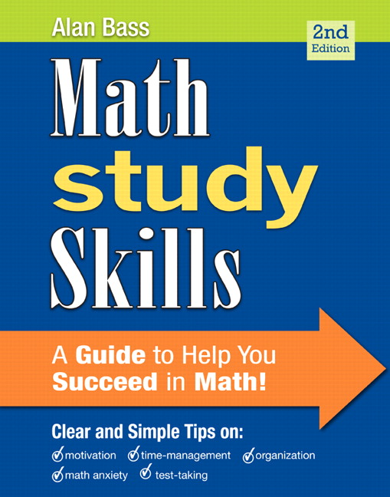
Math Study Skills:
Introduction
A Guide to Help You Succeed in Math
by Alan Bass
2nd Edition

Slide 2

Clear and Simple Tips on:
Motivation
Time-Management
Organization
Math Anxiety
Test-Taking

Slide 3

The Problem
Success in math is one of the biggest challenges facing college students today.
This extends from Math 952 to Math 095.
Students face struggles with math
for a variety of perceived reasons,
whether or not those reasons are
true. It is enough for the individual
to feel it is true.

Slide 4
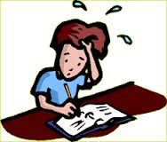
Examples
Some students come to class, understand the instructor’s lectures, take good notes, and do well on homework assignments. When it comes to exams, they freeze up and become anxious.
Their low test scores may cause them to fail the class.

Slide 5
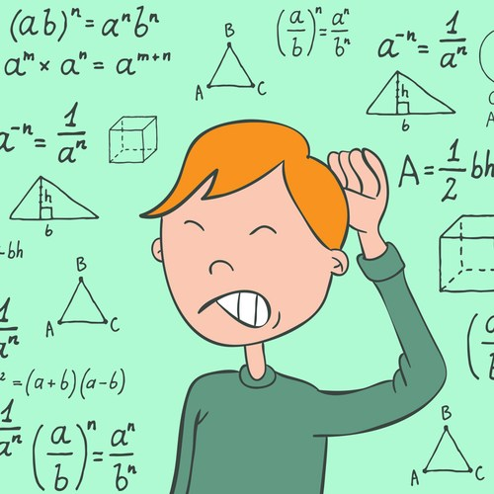
Examples, continued
Some students simply hate math. They always have. They are tired of seeing the same material again and again. They struggle to stay motivated in math class because they do not enjoy it.

Slide 6

Examples, continued
Some students have not taken a math class for many years. They may feel overwhelmed by the quick pace of an 18-week college semester.
These feelings of being overwhelmed may lead to math anxiety.

Slide 7
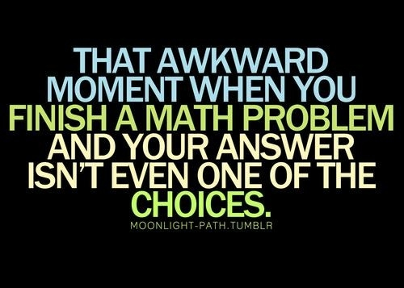
Examples, continued
Some students seem to do well in every class except math. They blame the instructor or the school system for their lack of success, especially since they work hard and try their best.
They may feel like they
simply are not smart
enough to do math.

Slide 8
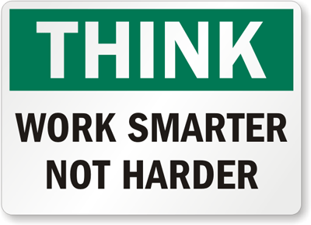
The Solution
This can begin to sound very hopeless. It can sound as though some students have no chance of passing their math class.
That is not true.
The theme of the Math
Study Skills book is to
encourage students to
work smart, instead of only working hard.

Slide 9

The Solution, continued.
Poor performance in math is rarely due to a lack of intelligence.
Math can be mastered if you have good study skills; that is one of the goals of this class.

Slide 10

The Solution, continued.
How you approach studying math is much more important than how “smart” you are.
Math anxiety is a
learned behavior
that can be changed.

Slide 11

Where to Begin?
The course syllabus.
  Complete the Syllabus Quiz in your Math Study Sills book (Exercise 1, p. 2 - 3).
Take a look at your current study habits.
  Complete Exercise 2 (p. 3 – 4).

Slide 12
Overview of the Semester
What topics interest you?
What Makes Math Different?
Motivation and Achieving Goals
Time Management
Math Anxiety
Learning Styles
Organization
Your Textbook & Homework
Class Time & Note Taking
Retention and General Study Strategies
Test Taking

Slide 13

Overview of the Semester
Complete Exercise 3 in your Math Study Skills book (p. 6).
  Review the topics on the last slide if needed.

Slide 14
General Principles of Success
Read “Principles of Success are Self-Evident” on p. 7 of your Math Study Skills book.
  How do you answer the question, “Are you using the information in this book?”
Read “Success Requires Change & Action, Not Just Knowledge” on p. 7.
  Are you willing to put in the time and effort to succeed in this class?

Slide 15
Works Cited
Bass, A. (2013). Introduction. In Math study skills (2nd
ed., pp. 1-7). Boston, MA: Pearson.

