Slide 1
Supporting Mental/Emotional Health and wellness in college
Counseling
Yes, YOU Can!
An “Each Mind Matters” Presentation”

Slide 2
I can’t give away what I don’t possess! What is it that we desire for students, emotionally and mentally?
Counseling
Healthy self-esteem?
Self-Confidence?
Contentment?
Personal awareness and insight?
A sense of purpose?
Hope for the future?
Integrity?
A healthy support system?

Slide 3
“Ordering your private world”
Counseling
“Above all else, guard your heart, for everything you do flows from it.” (Proverbs 4:23)
Every major religious system in the world places a paramount emphasis on nurturance and growth of the inner person!
This includes non-religious systems as well! For example: Existentialism

Slide 4
Has anyone seen my time? I’ve misplaced it.
We have schedule planners, computerized calendars, smart phones, and sticky notes to help us organize our business and social lives every day.
But what about organizing the other side of our lives--the spiritual side?
Counseling

Slide 5
How can we lead students to a place we’ve never been?
What are you doing to care for your inner person?
How are you growing closer to the place you want your students to be?
Have you any vision for where, and who, you want to be, personally?
Today?
Next year?
For the rest of your life?
Counseling

Slide 6
The hidden minority A recent survey indicated that one in five (20%) college students believe that their depression level is higher than it should be, yet only 6% say that they would seek help. That equates to 700 students, depressed but not seeking help, here at Crafton Hills college!
Counseling
The onset of depressive illnesses tends to peak between the ages of 15 and 24 – just as academic pressures are mounting and students are adjusting emotionally to complex life changes.
The challenges of college –learning to live independently, forming new relationships, sleeping irregularly, and being confronted with greater access to alcohol and drugs – can be overwhelming for many students.

Slide 7
Depression: know the signs
Counseling
The persistent feeling of sadness or loss of interest that characterizes major depression can lead to a range of behavioral and physical symptoms.
These may include changes in sleep, appetite, energy level, concentration, daily behavior, or self-esteem. Depression can also be associated with thoughts of suicide.

Slide 8
Depression: know the signs People may experience:
Counseling
Mood: anxiety, apathy, general discontent, guilt, hopelessness, loss of interest, loss of interest or pleasure in activities, mood swings, or sadness
Sleep: early awakening, excess sleepiness, insomnia, or restless sleep
Whole body: excessive hunger, fatigue, loss of appetite, or restlessness
Behavioral: agitation, excessive crying, irritability, or social isolation
Cognitive: lack of concentration, slowness in activity, or thoughts of suicide
Weight: weight gain or weight loss
Also common: poor appetite or repeatedly going over thoughts

Slide 9
5 Tips to Avoid Depression in College Half of college students feel depressed at some point during their time on campus. Learn how to cope!
Counseling
Go to Sleep!
Keep Your Life Balanced.
Avoid using drugs and at least minimize, if not totally avoid, alcohol.
Exercise
Don’t Be a Hermit
Use College Counseling Services
Take Advantage of Technology to Stay In Touch

Slide 10
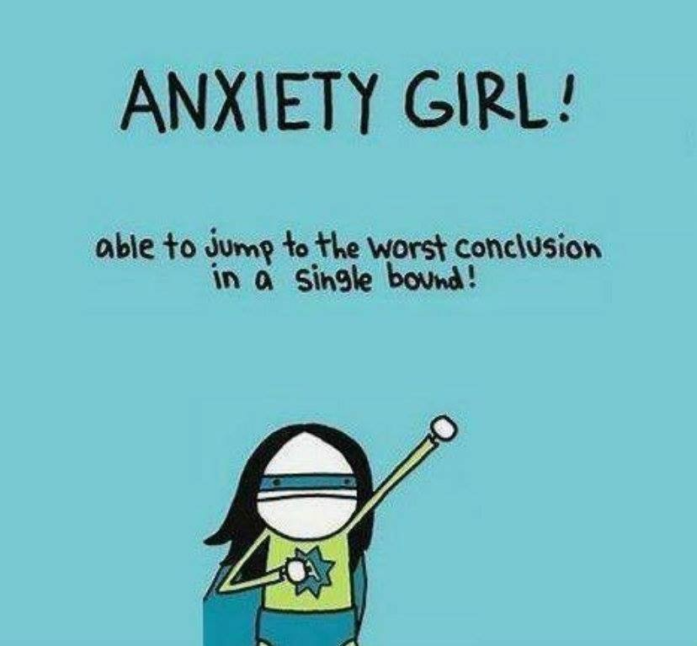
Anxiety Common anxiety signs and symptoms include:
Counseling
Feeling nervous, restless or tense
Having a sense of impending danger, panic or doom
Having an increased heart rate
Breathing rapidly (hyperventilation)
Sweating
Trembling
Feeling weak or tired
Trouble concentrating or thinking about anything other than the present worry
Having trouble sleeping
Experiencing gastrointestinal (GI) problems
Having difficulty controlling worry
Having the urge to avoid things that trigger anxiety

Slide 11
Making an effective referral
Try to put yourself in the students' shoes and communicate understanding.
Think what resources are available to help with this issue and normalize the situation.
Transition from your office to other resources.
Counseling

Slide 12
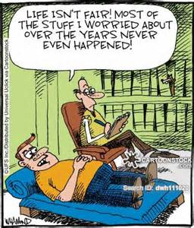
Emotional and Mental Health Resources at Crafton Hills College
Health and Wellness Center:
SSB 101
Mental Health Services
Depression, stress testing and counseling, crisis intervention and short-term situational counseling for relationship difficulties, anxiety, stress and depression. Licensed Marriage and Family Therapist available for psychotherapy.
Counseling Office:
CCR-219
Personal Counseling
Self-awareness
Interpersonal communication
Counseling for educational related personal issues
Referral to on-campus and off campus resources
Decision-making strategies
Counseling

Slide 13
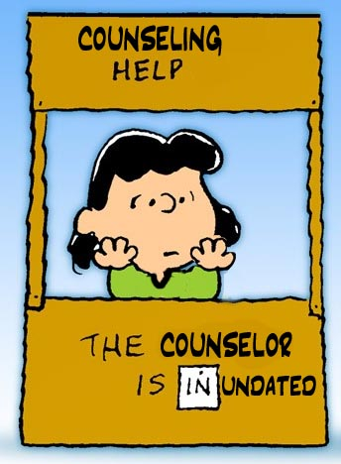
More emotional and mental health resources at Crafton hills college
LiveHelp
Suicide Prevention/Depression & Anxiety Help
Talk or Chat in Real-Time!
https://www.craftonhills.edu/current-students/counseling/suicide-prevention-help.php
Small Groups/Support Groups
“Stress Less” Stress/Anxiety Support Group
“Live Strong” Self-Esteem Group

