Slide 1
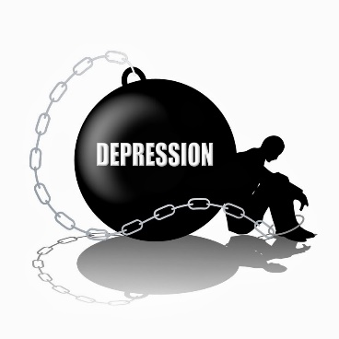
“Handling Depression: Staying Up When You’re Feeling Down” An “Each Mind Matters” Student Seminar Wednesday October 16, 2019 CCR 219
Evan Sternard, M.S.Ed., M.S.
Assistant Professor, Crafton Hills College

Slide 2
Think for a Moment
What are some factors or events, or situations, that might lead to depression in a college student?

Slide 3
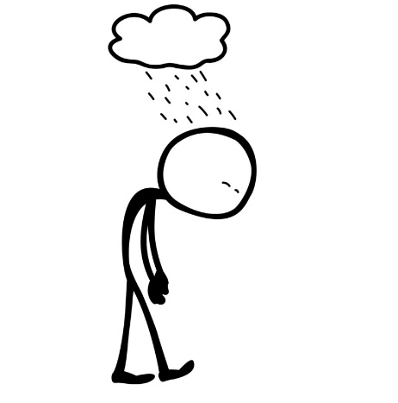
Depression in College Students: What the Numbers Show
Depression is the most common health problem for college students.
Over 39% of college students “felt so depressed that it was difficult to function” at least once during the 2016-2017 academic school year.
Over 60% of college students have felt overwhelmed by anxiety at least once in the last 12 months.
Around 31% of college students have seriously considered suicide.

Slide 4
Causes of Depression in College Students: What Does the Research Say?
A study was conducted over a 6-week period to investigate factors associated with the development of depression among college students.
Subjects were 134 first-semester freshmen conscripted from the general psychology subject pool.
Scores were obtained from self-report questionnaires involving measures of life events, social support, and cognitive appraisal at the beginning of the semester and again later.
The result of stepwise multiple regression analyses of Time 1 and Time 2 administrations indicated that the variables most strongly and consistently associated with depression were loneliness, interpersonal mistrust, and neuroticism.
Two-panel cross-lagged correlational analyses indicated that loneliness preceded depression.
Source: Alexander R. Rich, Martha Scovel
Indiana University of Pennsylvania

Slide 5
Factors Associated with Depression
Contributing familial factors are:
a lack of physical affection among family members and a lack of verbal intimacy with parents (Field, Diego, & Sanders, 2001);
parent divorce (Short, 2002);
lack of positive reinforcement (Lewinsohn et al., 1998); family violence, low family cohesion, and a family history of depression and substance abuse (Reinherz, Paradis, Giaconia, Stashwick, & Fitzmaurice, 2003);
child abuse and neglect (Brown, Cohen, Johnson, & Smailes, 1999);
and trauma (Turner & Butler, 2003)

Slide 6
Intrapersonal Depression Factors
low global self-esteem (Smith & Betz, 2002);
self-criticism, introversion, low assertiveness, dependency, and a need to please others (Gudleski & Shean, 2002);
difficulty in adjusting to new and changing circumstances (Beeber, 1999);
feeling hopeless and helpless (Furr et al., 2001);
and harboring negative beliefs about the self, world, and future (Birmaher et al., 1996).
Source: THE PREVALENCE AND CORRELATES OF DEPRESSION AMONG COLLEGE STUDENTS.
Lindsey, Billie J., Fabiano, Patricia, Stark, Chris, College Student Journal, 01463934, Dec2009 Part A, Vol. 43, Issue 4

Slide 7
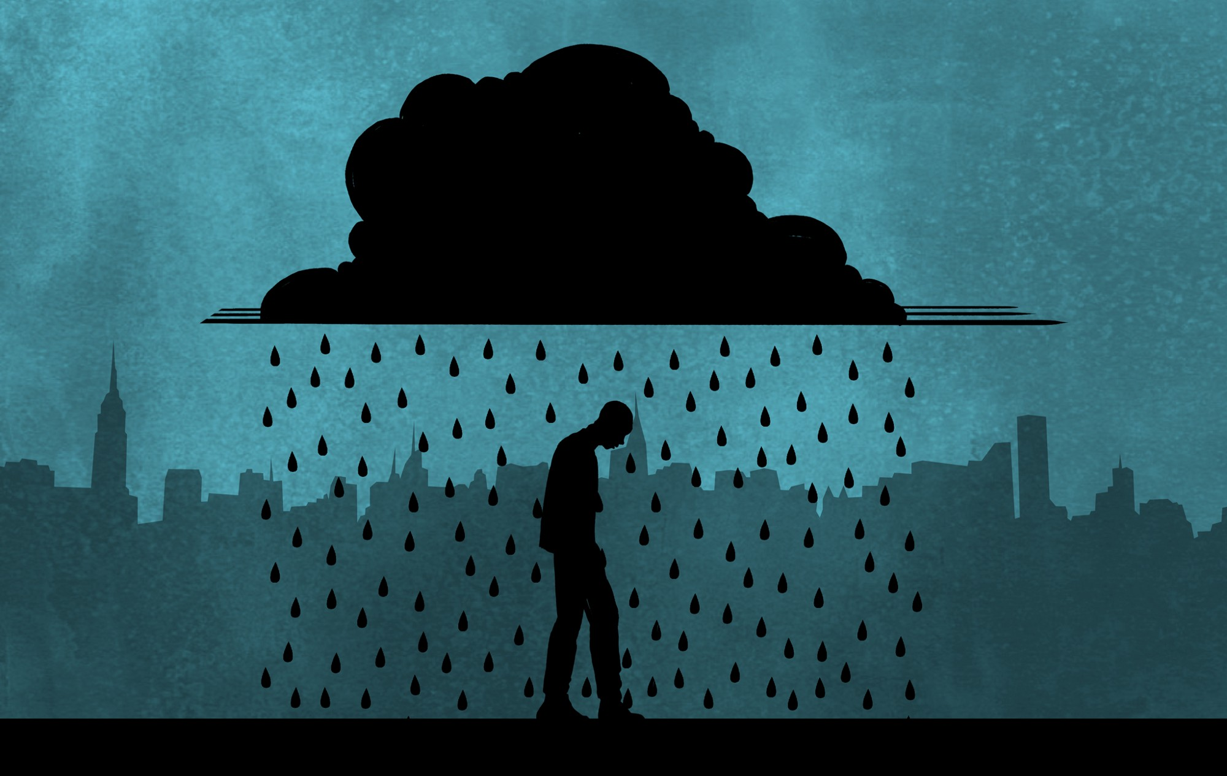
Major (or Clinical) Depression
A constant sense of hopelessness and despair is a sign you may have major depression, also known as clinical depression.
With major depression, it may be difficult to work, study, sleep, eat, and enjoy friends and activities. Some people have clinical depression only once in their life, while others have it several times in a lifetime.

Slide 8
What is Clinical Depression?
Most people feel sad or low at some point in their lives. But clinical depression is marked by a depressed mood most of the day, sometimes particularly in the morning, and a loss of interest in normal activities and relationships -- symptoms that are present every day for at least 2 weeks.

Slide 9
Some Clinical Depression Symptoms
Fatigue or loss of energy almost every day
Feelings of worthlessness or guilt almost every day
Impaired concentration, indecisiveness
Insomnia or hypersomnia (excessive sleeping) almost every day
Markedly diminished interest or pleasure in almost all activities nearly every day (called anhedonia, this symptom can be indicated by reports from significant others)
Restlessness or feeling slowed down
Recurring thoughts of death or suicide
Significant weight loss or gain (a change of more than 5% of body weight in a month)

Slide 10
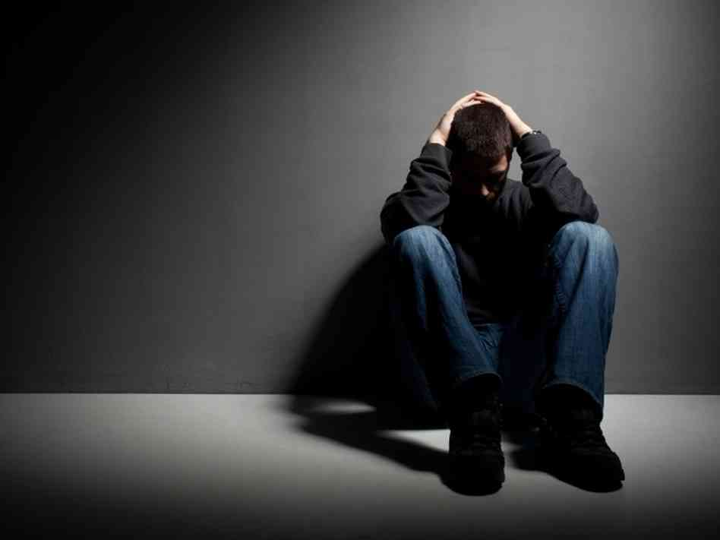
Depression: Your Feelings and Behaviors
When you are depressed, what feelings besides depression are present?
When you hear the word ‘depression,’ what feelings come to your mind?
When you are depressed, what things do you typically do?
What behaviors have you observed in others who may be depressed?

Slide 11
It’s Great to Ask For Help!
If you don’t ask for help, depression may get worse and contribute to other health problems, while robbing you of the academic and social enjoyment and success that brought you to college in the first place.
It can also lead to “self-medication” with high-risk behaviors with their own serious consequences, such as binge drinking and other substance abuse and having unsafe sex.

Slide 12
Clinical Counseling is Available!
Health and Wellness Center
SSB-101
Depression
Stress testing and counseling
Crisis intervention
Short-term situational counseling for relationship difficulties, anxiety, stress and depression.
Licensed Marriage and Family Therapist available for psychotherapy.
CHC students are eligible for eight FREE clinical sessions yearly
with payment of the Student Health Fee!

Slide 13
What Else Can I Do? Don’t expect to get better immediately, but you will feel yourself improving gradually over time.
Besides seeing a doctor and a counselor, you can also help your depression by being patient with yourself and good to yourself.
Remember that, by treating your depression, you are helping yourself succeed in college and after graduation.

Slide 14
Self-Care for Depression
Your counselor may teach you how to be aware of your feelings and teach you relaxation techniques. Use these when you start feeling down or upset.
Avoid using drugs and at least minimize, if not totally avoid, alcohol.
Daily exercise, spending time outside in nature and in the sun, and eating healthy foods can also help you feel better.
Get enough sleep. Try to have consistent sleep habits and avoid all-night study sessions.

Slide 15
(More) Self-Care for Depression
Break up large tasks into small ones, and do what you can as you can; try not to do too many things at once.
Try to spend time with supportive family members or friends, and take advantage of campus resources, such as student support groups. Talking with your parents, guardian, or other students who listen and care about you gives you support.

Slide 16
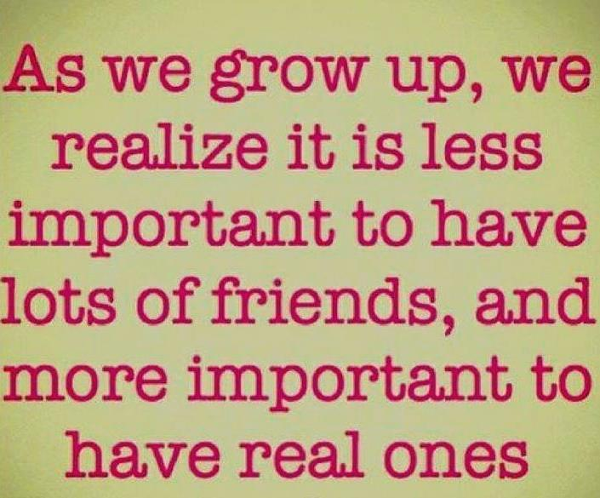
(Still) More Self-Care for Depression
Try to get out with friends and try fun things that help you express yourself. As you recover from depression, you may find that even if you don’t feel like going out with friends, if you push yourself to do so, you’ll be able to enjoy yourself more than you thought.

Slide 17
Self-Help for Depression Five self-help strategies
In 2016, an estimated 16.2 million adults in the United States had at least one major depressive episode – 6.7 percent of all U.S. adults. But with appropriate professional and self-help strategies, recovery from depression is possible. Self-help for depression can help alleviate symptoms and put someone on the path to recovery.
Exercise. Both aerobic exercise like walking or jogging and anaerobic exercise like weight lifting can help alleviate symptoms of depression.
Relaxation training. Focusing on tensing and relaxing muscle groups methodically can help a person with depression relax voluntarily. You can find some guided relaxation training techniques online, like this one from Children’s Mercy Hospital.

Slide 18
More Self-Help for Depression
Light therapy. Exposing the eyes to bright, full-spectrum light that mimics natural outdoor light – particularly in the morning – can help treat certain types of depression, like SAD (seasonal affective disorder). Light therapy is thought to affect brain chemicals linked to mood and sleep, easing SAD symptoms.
Self-help books based on cognitive behavioral therapy (CBT). Self-help books based on CBT can help a person with depression work through some of their symptoms. Feeling Good: The New Mood Therapy and Control Your Depression (revised edition) are two books based on CBT that have been found effective in trials.

Slide 19
What Can I Do to Help Myself? (Thoughts from fellow college students)
I cycle, which helps, and I take long walks in the country.
I try to keep active, even if that's just getting out of bed, washed and ready before 10am, so that the days don't become an endless blur of nothingness.
I make lists of why I feel depressed, what I can change and how I can change it.
Be kind to yourself. If you need 'me time', give it to yourself. You are worth it.
I've made a list of things I usually enjoy, like knitting or playing the guitar, and I try to do little bits of these activities when I'm feeling low.
[What helps is] surrounding myself with friends and family who understand without pointing it out, who treat me normally but recognize that everyday life can be a struggle sometimes.

