Slide 1

Planning and Program Review (PPR) 4-YR Plan Updates
Presented by OIERP

Slide 2
Agenda
Dashboard Updates
PPR Resources & Coaching Support
PPR Schedule & Deadline
Overview of PPR Plan Requirements
Rubric Rating Updates
Question 10 Update

Slide 3
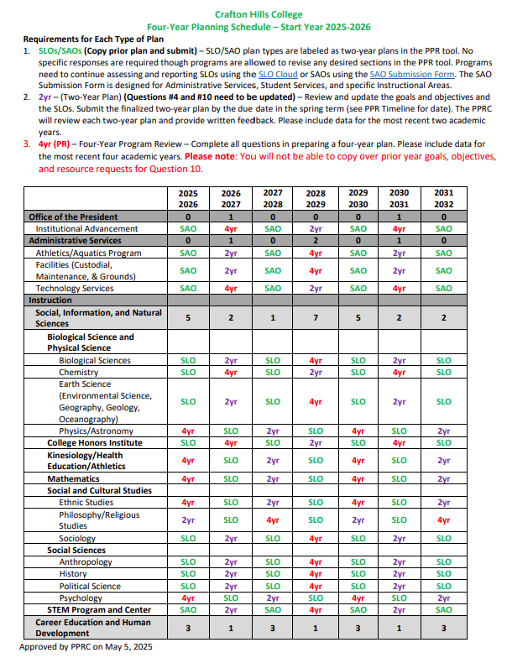
What PPR update do I have scheduled?
A PPR schedule is provided on the PPR resource webpage.
In it you will find the scheduled update (4yr, 2yr, SLO/SAO) by academic year and academic program/service area. SLO updates can be done through the SLO Cloud.
Please note: You will not be able
to copy over prior year goals, objectives, and resource requests for Question 10.

Slide 4
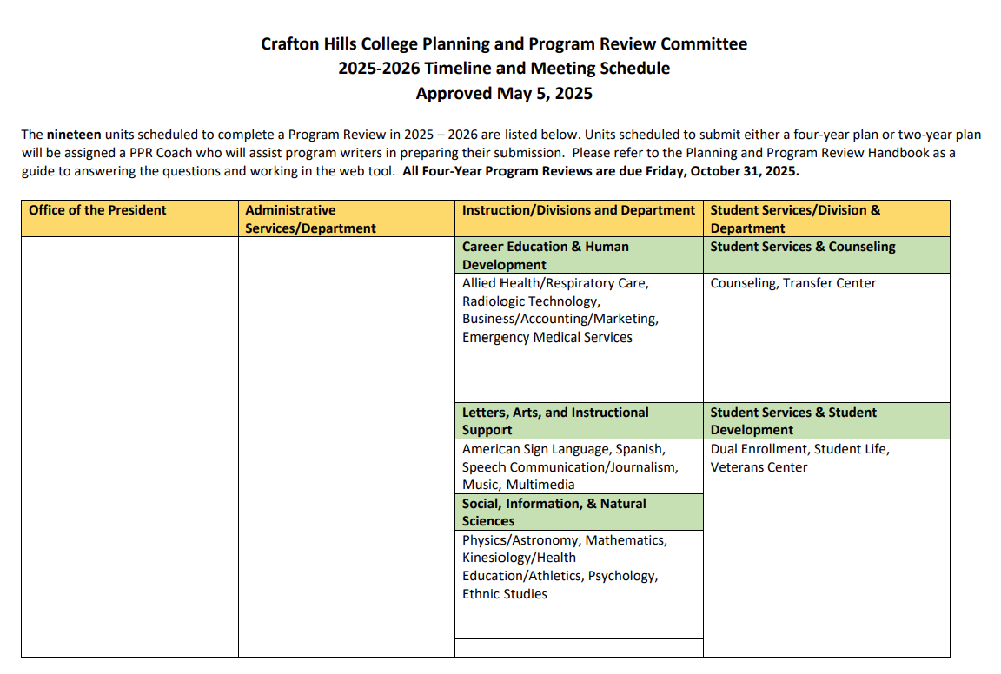
Deadline
4-Yr & 2-Yr PPR Plans are due October 31st.

Slide 5
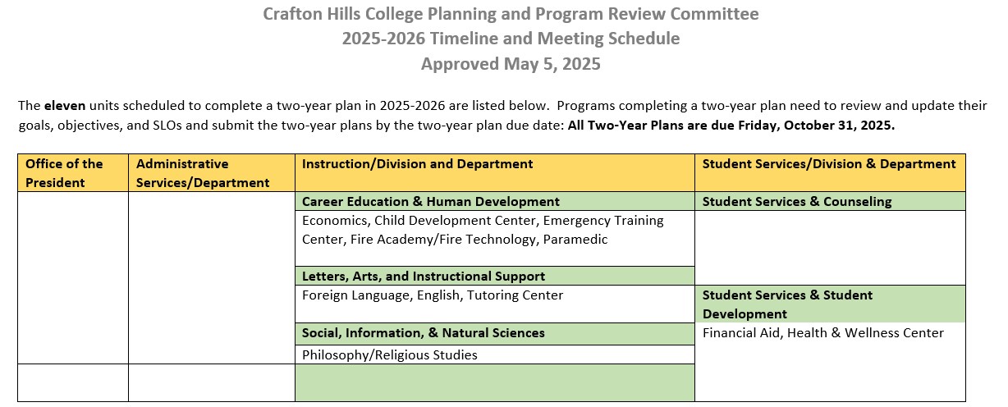
Deadline
4-Yr and 2-Yr PPR Plans are due October 31st.

Slide 6
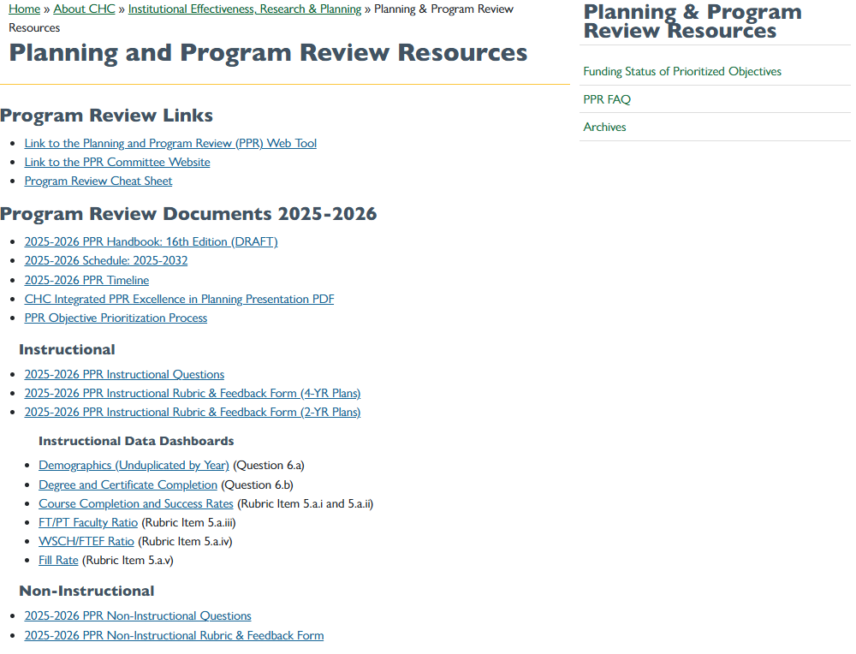
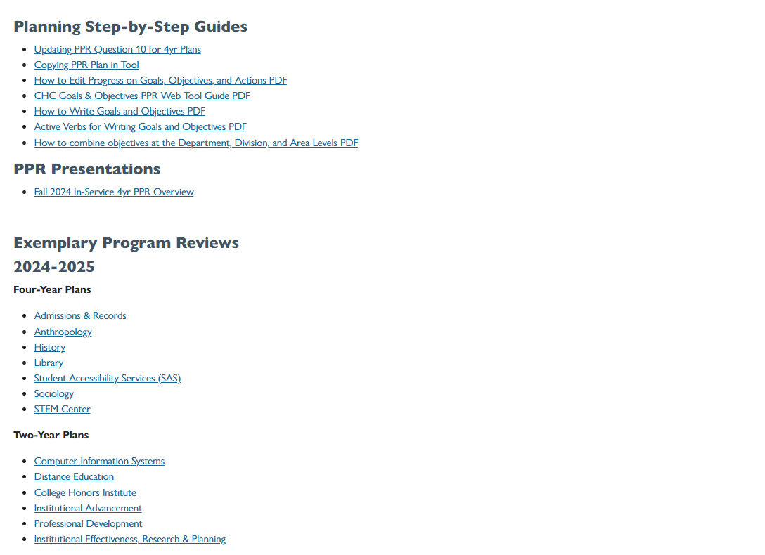
PPR Resources
Program Review and Submission
PPR resource page
PPR web tool
Program Review Documents
handbook and schedule
Dashboards
PPR Dashboards includes course completion and success rates,
demographics, and other helpful resources
Planning Step-by-Step Guides
Updating PPR Question 10 for 4yr Plans
Copying PPR Plan in Tool
Exemplary Program Reviews
Need data, submit a Research Request, also found on the OIERP Home Page

Slide 7
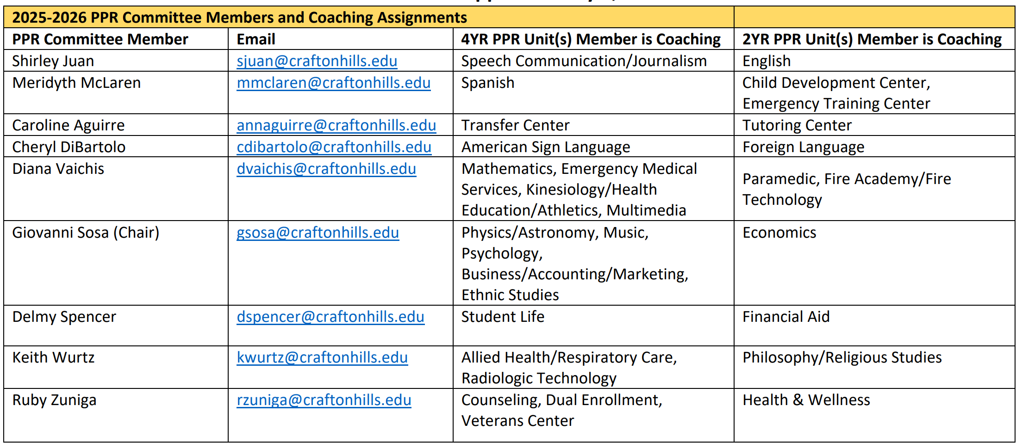
PPR Coaching
A PPR Coach is assigned to every program/service area that is scheduled to submit a four-year or two-year plan.
The role of coaches is multi-faceted:
They offer program writers with the support and resources needed for the development of a comprehensive plan at every step of the process.
They serve as liaisons and advocates for program units during the entire review process.
For more details, please see PPR handbook.

Slide 8
What does the PPR plan require?
Question #2
Description of Program
Question #3
External Factors with Significant Impact
Question #4
Progress on Outcomes Assessment
(SLO & SAO)
Question #7
Self-Evaluation of Program/Service Area
Question #8
Program/Service Area Vision
Question #9
Progress on Prior Goals
Question #10
Four-Year Action Plan (Goals, Objectives, Resources, and Actions)
Question #11
Comments
Question #1 Program/Service Area Mission
Question #5
Unit's Performance on Institutional Quantitative Effectiveness Indicators
Question #6
Other Unit-Specific Quantitative and Qualitative Results
Question #12 Supporting Documents
The two most critical sections in a PPR plan are in relation to outcomes assessment and setting goals and objectives.
NOTE: 4 YR PPR Plans are tasked with updating all questions.

Slide 9

Rubric Rating

Slide 10
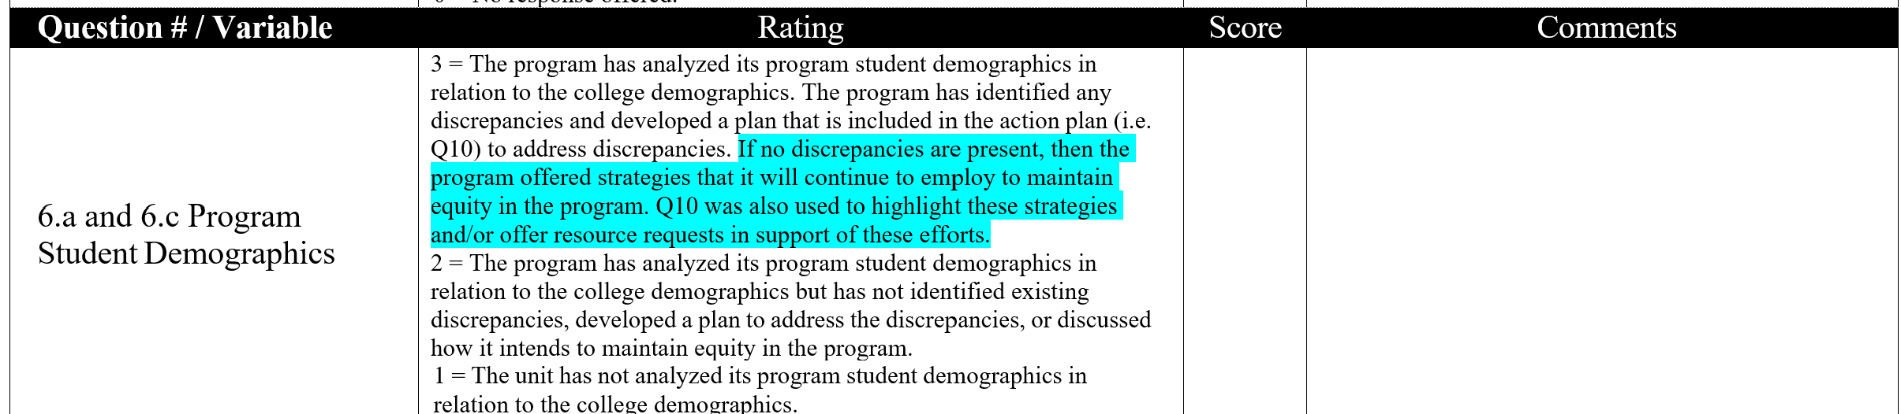
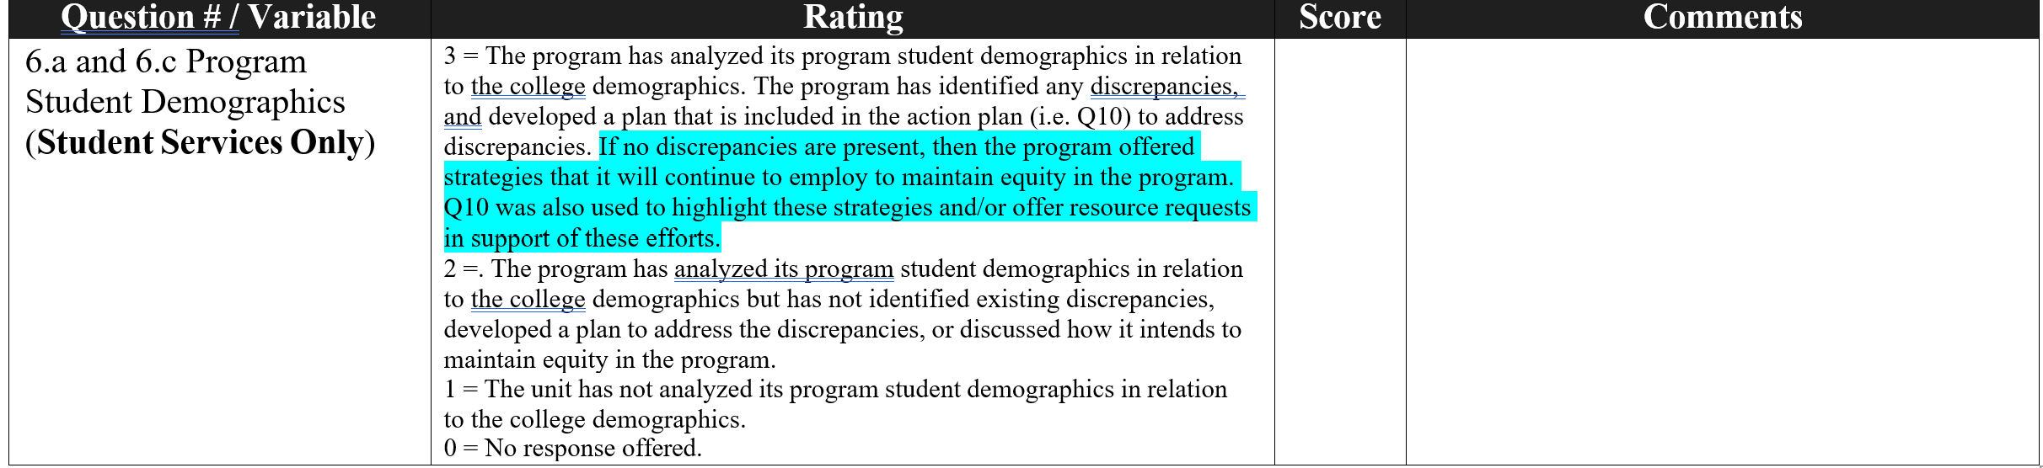
Instructional Rubric
Non-Instructional Rubric

Slide 11

Question 10 Update
Four-Year Action Plan (Goals, Objectives, Resources, and Actions)

Slide 12
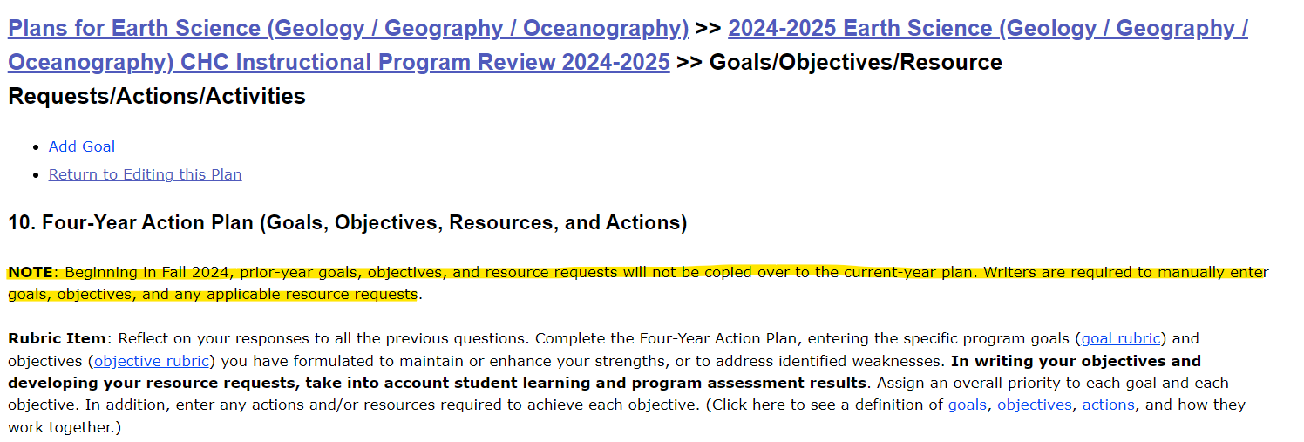


Slide 13
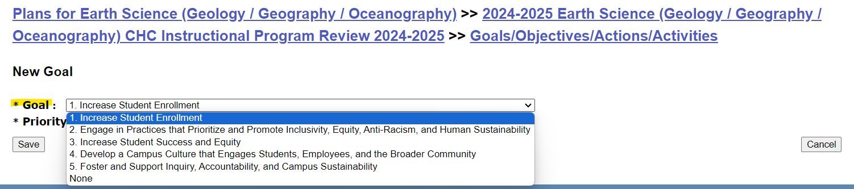

Slide 14
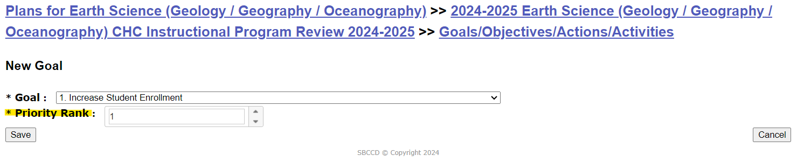
Note: For the step-by-step instructions to update Question 10 (Goals, Objectives, Resources, and Actions), please refer to the Updating PPR Question 10 PDF.

Slide 15
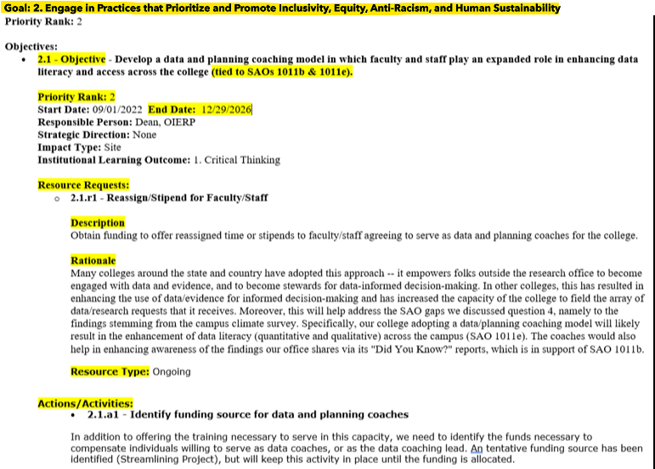
Four-Year Action Plan (Goals, Objectives, Resources, and Actions)
Question #10 of the PPR plan focuses on the four-year action plan.
Updates include:
Goals and objectives revisions
Priority Ranking
End date
Resource request description, rationale revisions
Resource Type
Actions/Activities revisions

Slide 16
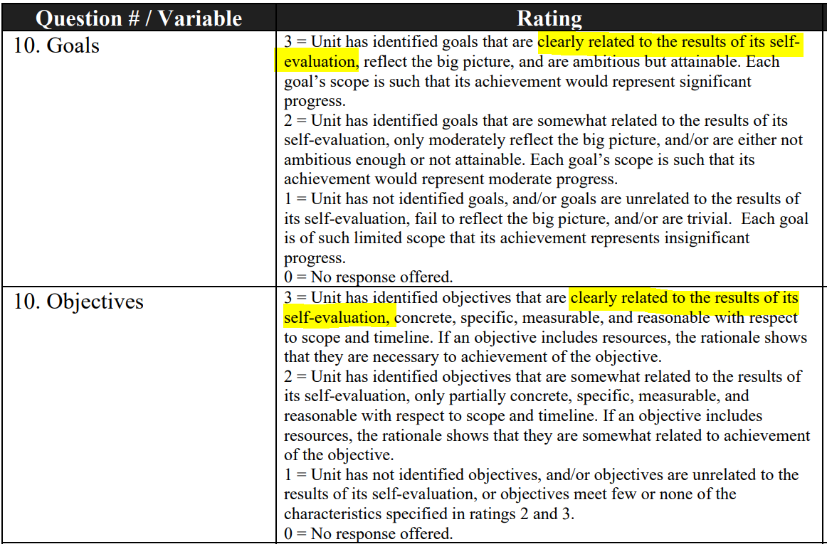
Instructional & Non-Instructional Rubric

Slide 17

The SLO Dashboard

Slide 18
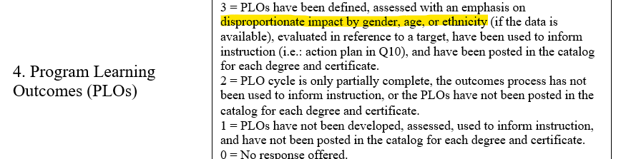
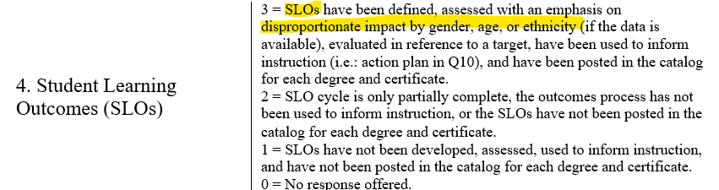
Instructional Rubric (Question 4)
4-YR
2-YR

Slide 19
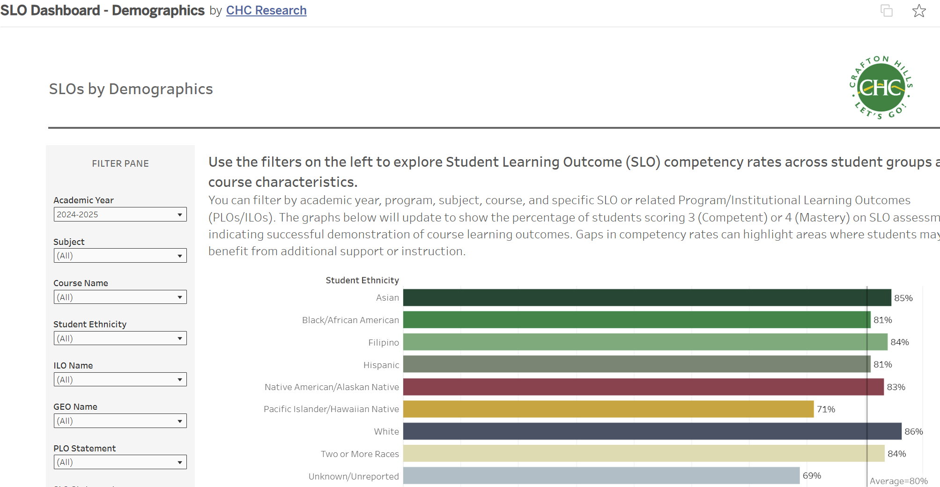
Analyzing Student Learning Using the SLO Dashboard
The SLO Cloud Dashboard is available via the OIERP Page.
1. Identify your subject and/or course
2. Examine SLO data by ethnicity, gender, age group
3. Can also examine data by Outcome (SLO) Statement, ILO, and GEO

Slide 20
Completion & Success Dashboard Updates

Slide 21
Completion & Success Dashboard
Enhancements include
  Inclusion of student programs (e.g., EOPS, SAS)
  Academic probation data
  Disaggregated ethnicity
  Disproportionate impact calculations
Completion and Success Rates Dashboard link:
https://www.craftonhills.edu/about-chc/research-and-planning/dashboards-links/completion-and-success-rates.php

Slide 22

Q/A

Slide 23
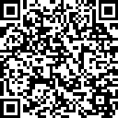
https://rebrand.ly/FA25_Flex/In-Service-Survey
Thank you for attending!
Please take a moment to fill out today’s workshop evaluation. ​

Slide 24

Any questions or suggestions?
Please contact us
Name | Title | Office Location | Phone Number | Email Address
Giovanni Sosa | Dean | CCR 240 | (909) 389-3206 | gsosa@craftonhills.edu
Diana Vaichis | Senior Research & Planning Analyst | CCR 238 | (909) 389-3420 | dvaichis@craftonhills.edu
Ruby Zuniga | Research Data Specialist | CCR 240.1 | (909) 389-3394 | rzuniga@craftonhills.edu

