Slide 1
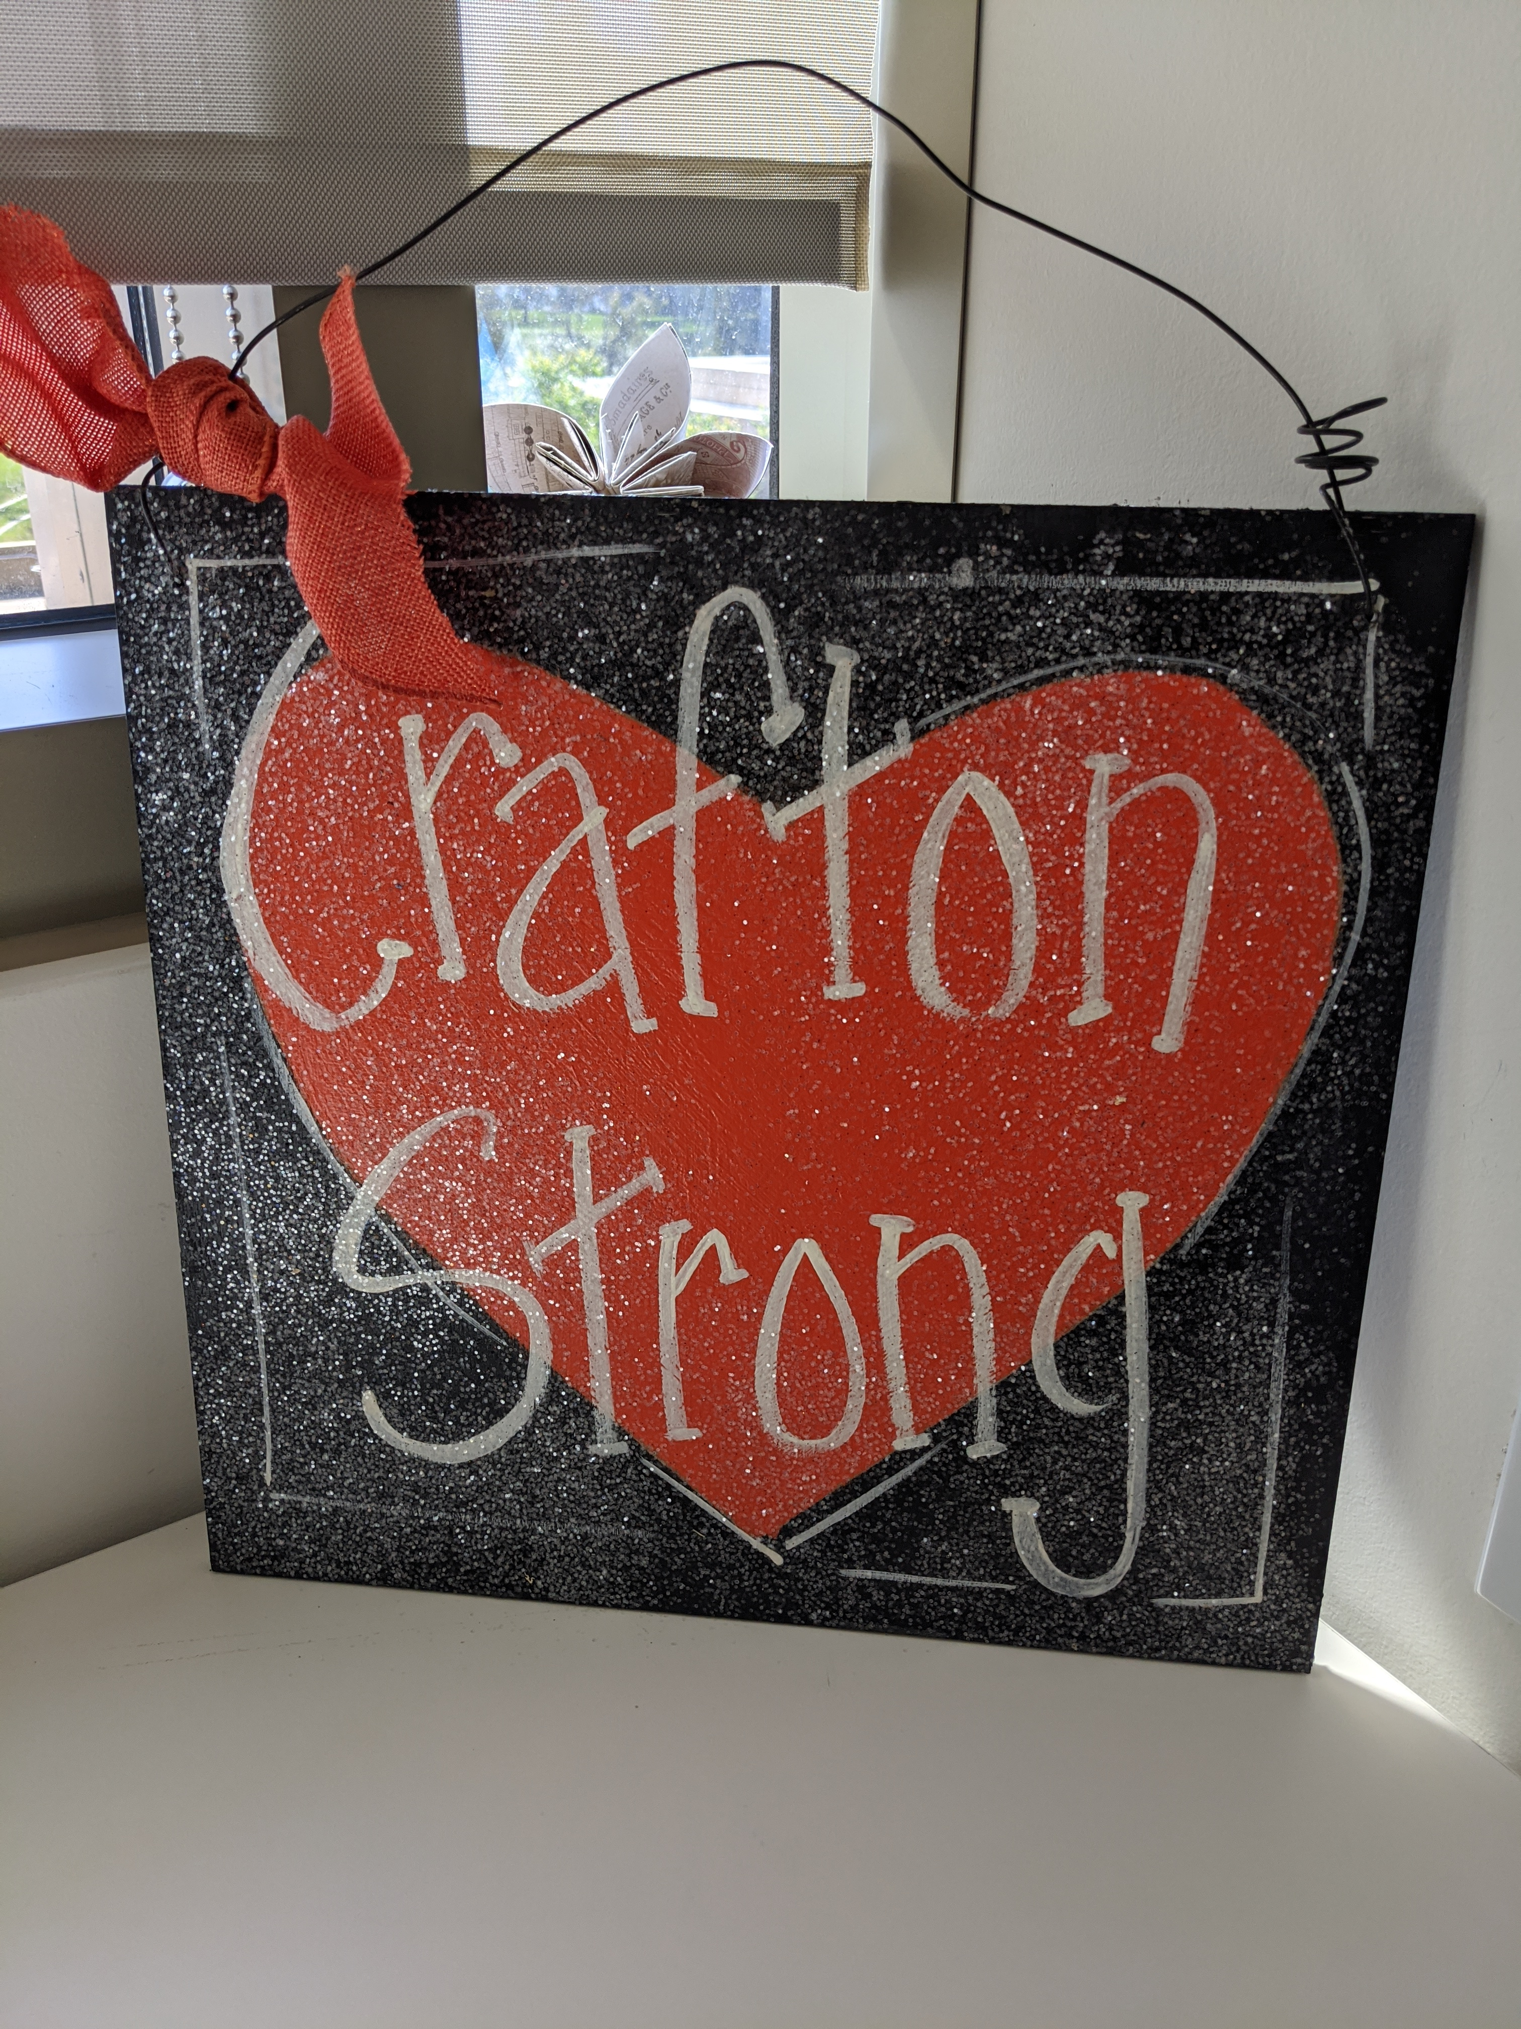
All Campus Zoom
April 16, 2021

Slide 3
Re-Opening
District Task Force
Planning to Enable Re-Opening For Fall 2021
State Tier & County Requirement Changes
Department Meetings to Develop Local Needs Assessment
Collective Bargaining Process
No Summer Blip (it’s an Avengers/Marvel thing)
Q&A Document

Slide 4
Equity Minded Student Support Services
March 2021
Delmy Spencer, Jessica Macias, Rejoice Chavira, Rebecca Abeyta,
Ernesto Rivera

Slide 5
Technology Update
Melissa Oshman

Slide 6
Gala Update
Michelle Riggs

Slide 7
www.craftonhills.edu/gala

Slide 8
Opportunity Drawing

Slide 9
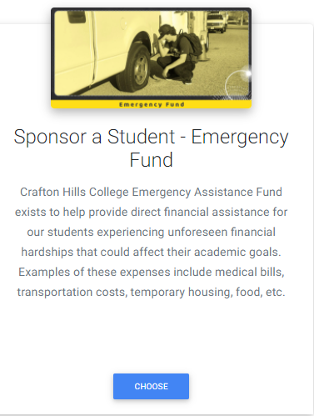
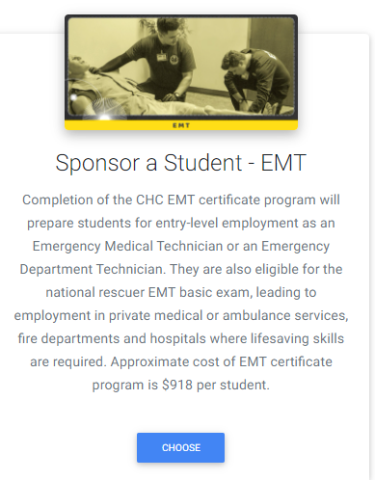
Sponsor a Student – Win Prizes! Weekend Getaway for Memorial Day

Slide 11
Q&A

