Slide 1
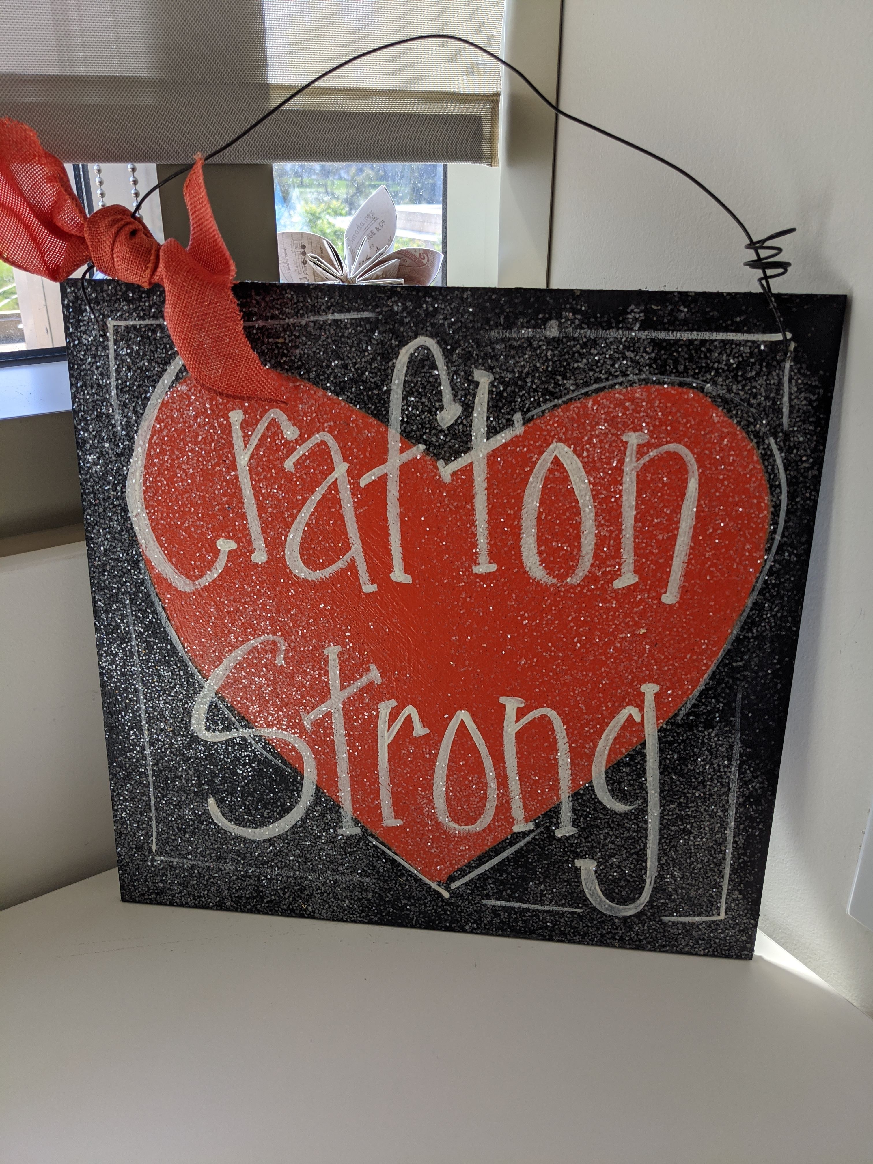

All College Zoom
October 16, 2020

Slide 2
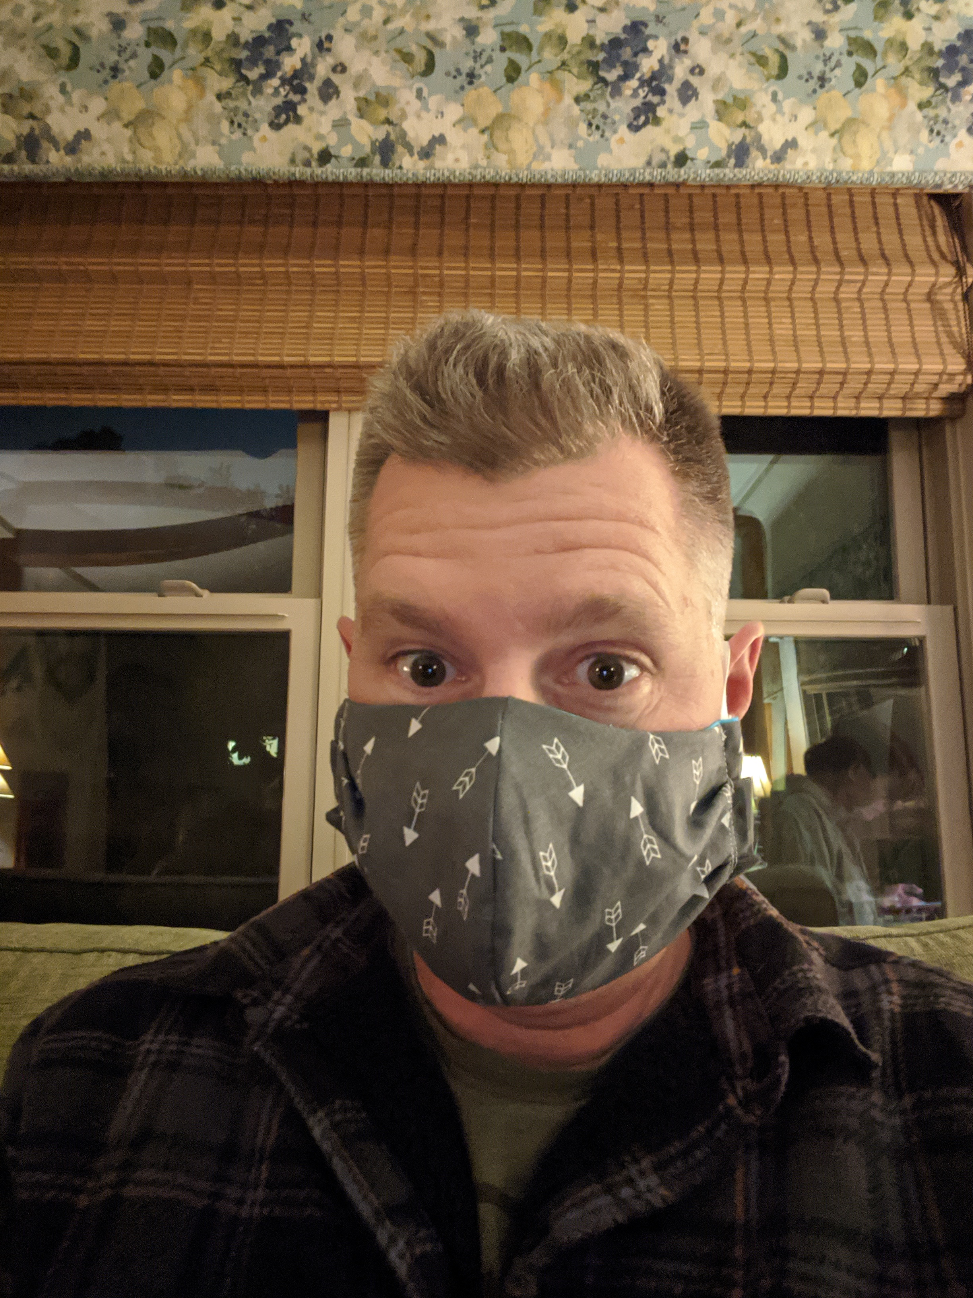
Kevin Horan
President, Crafton Hills College

Slide 3
Equity & Inclusion
  USC Center for Equity, CCC Equity Alliance
    October e-convening: Understanding and Addressing Implicit Bias
    Michelle Riggs, Tina Gimple, Shirley Juan, Artour Aslanian, and Dave Stevenson

Slide 4
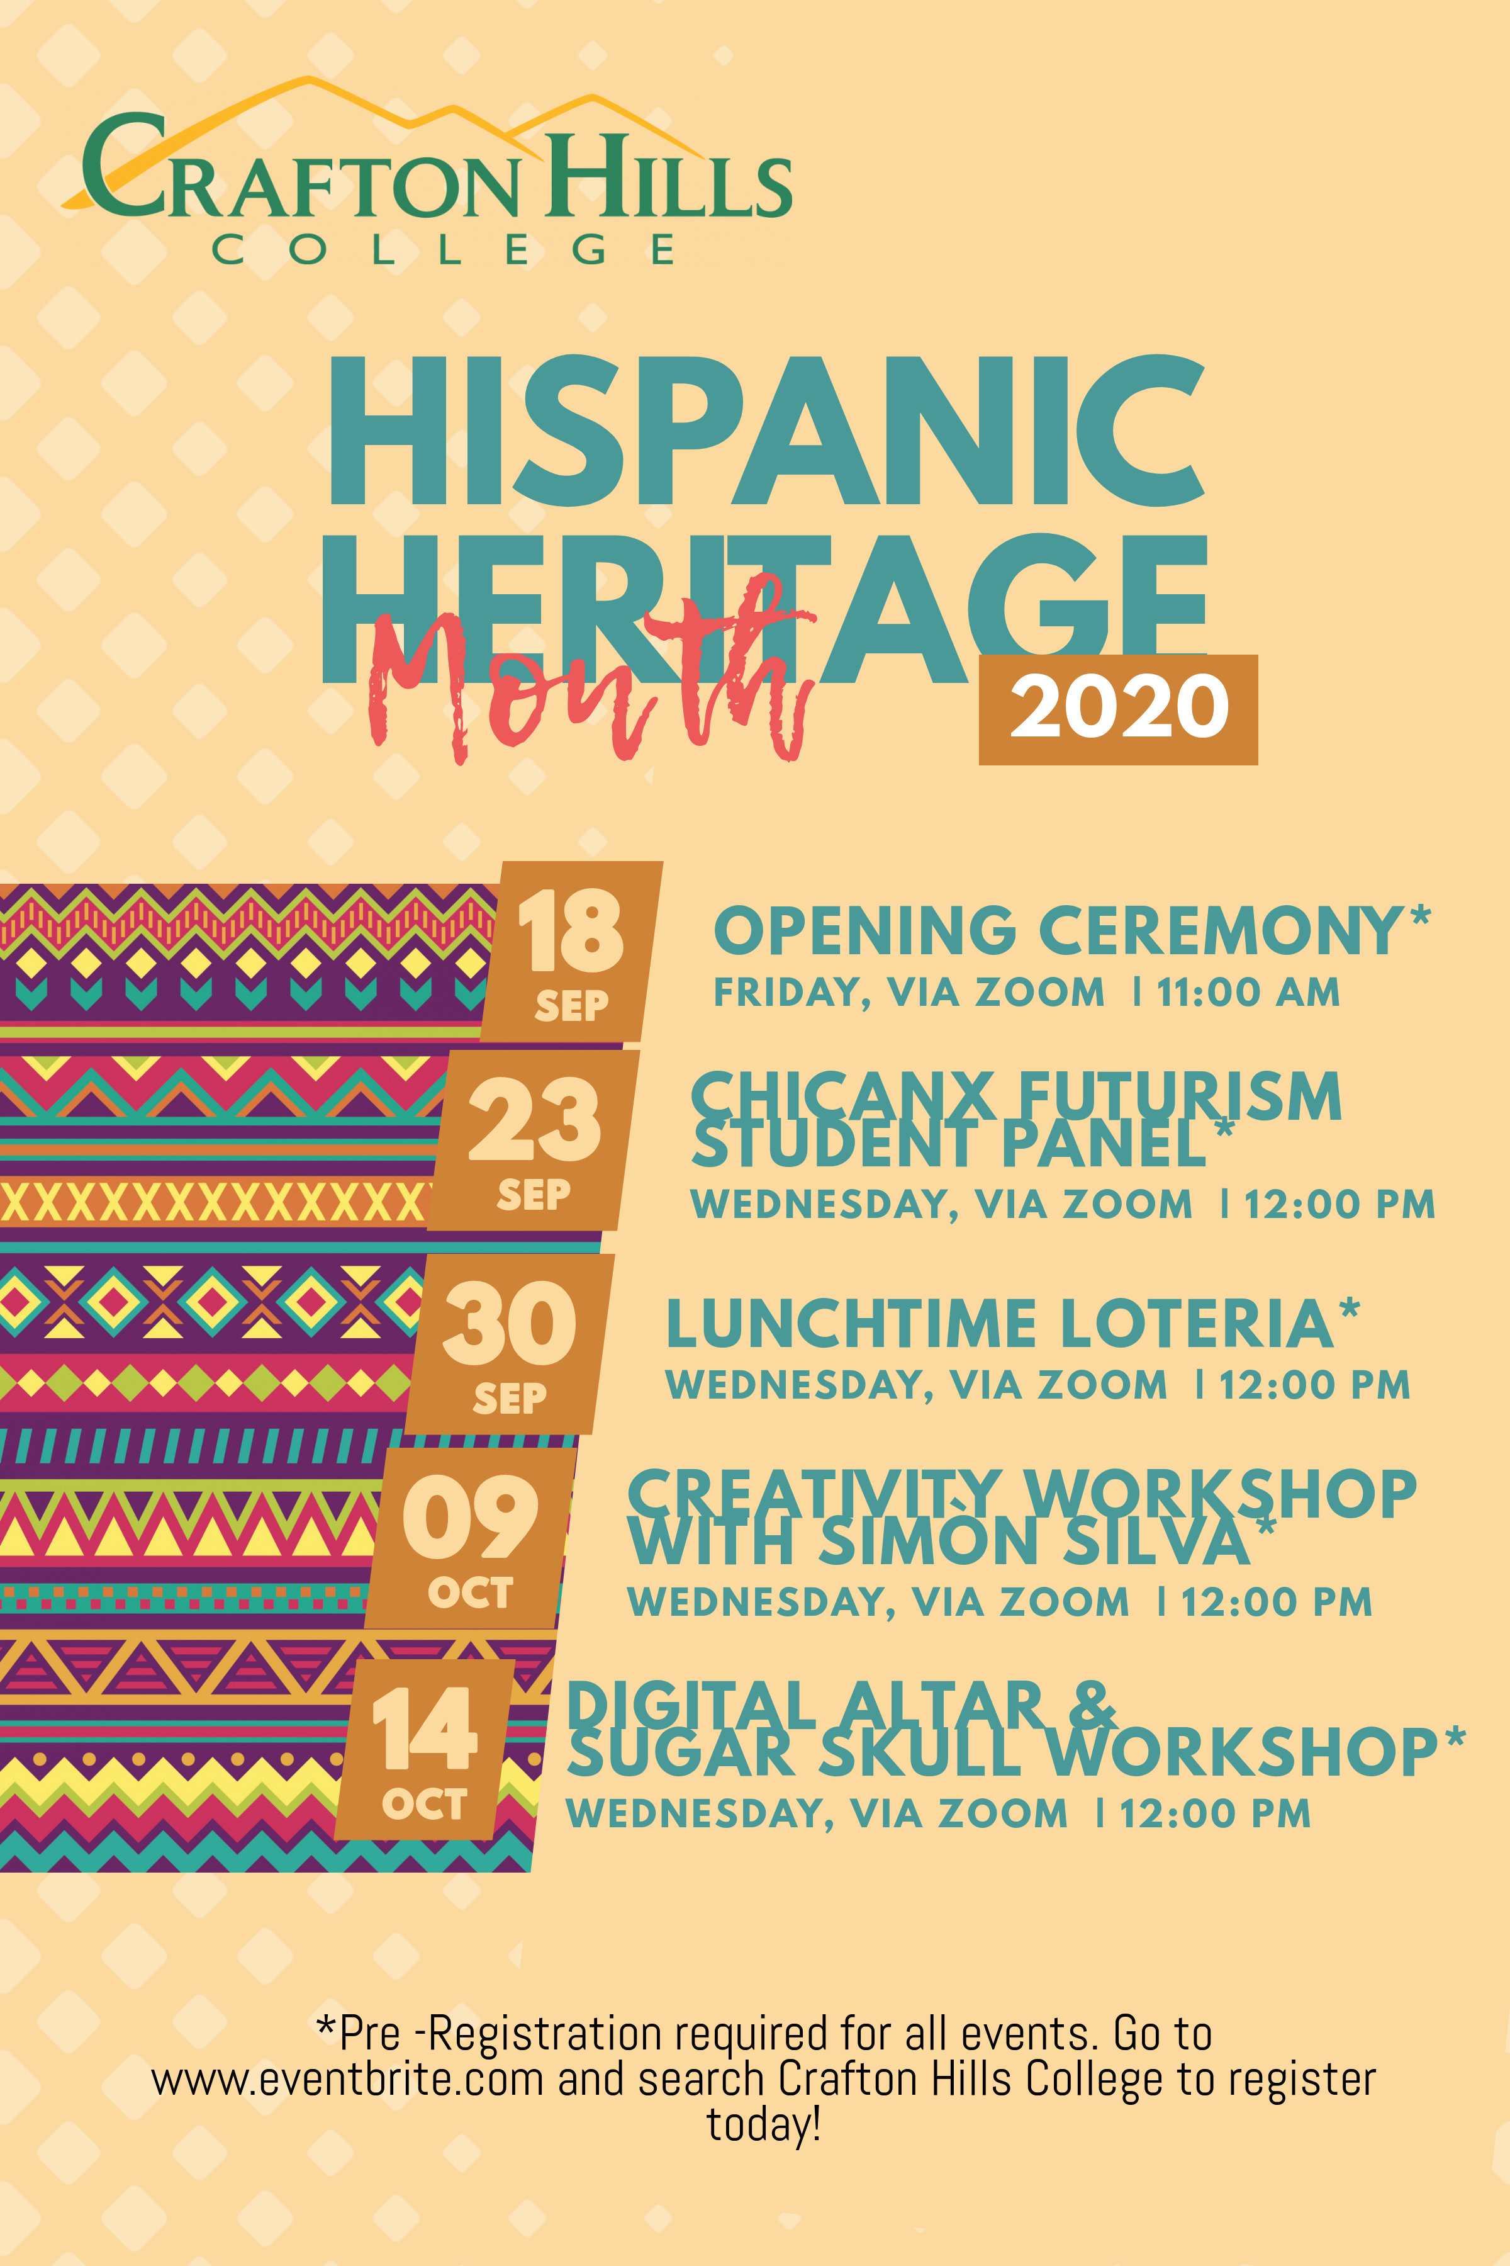
Equity & Inclusion

Slide 5

Equity & Inclusion

Slide 6
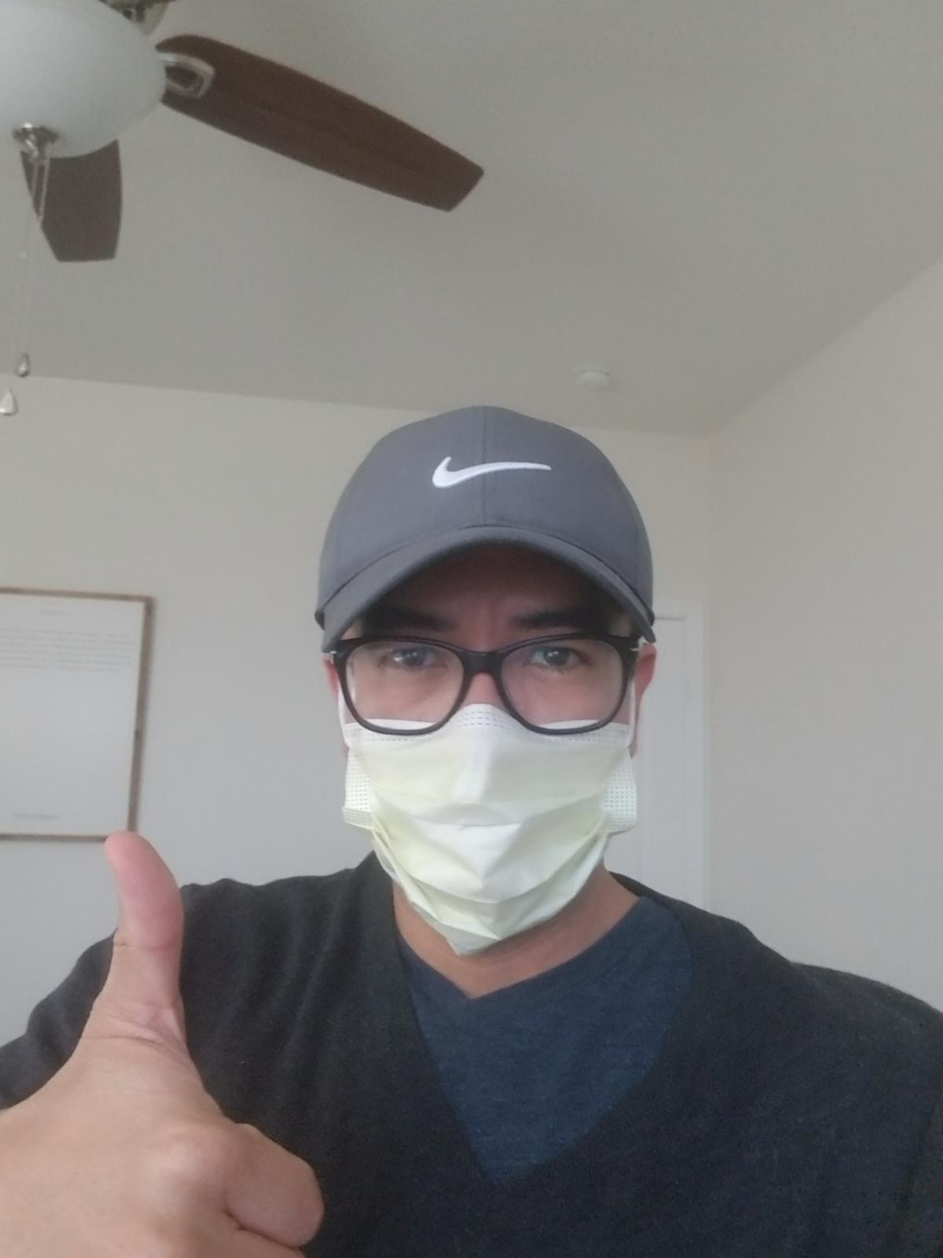
Gio Sosa
Dean, OIERP

Slide 7

CHC Mission, Vision, and Values Survey
November 2020
Open-ended questions
  Purpose
  Student populations
  Aspirations
  Uniqueness of CHC

Slide 8
Revisiting the Mission, Vision, and Values: Timeline for 2020-21
October - November
Refine and finalize survey instrument
December
Findings shared with Crafton Council (i.e., thematic analysis)
February - March
Senate approvals
January
Findings shared with senates
Two-week survey dissemination
Crafton Council Adoption
https://www.craftonhills.edu/faculty-and-staff/committees/educational-master-plan-committee/mission-vision-and-values

Slide 9

Keith Wurtz
Vice President, Instruction

Slide 10
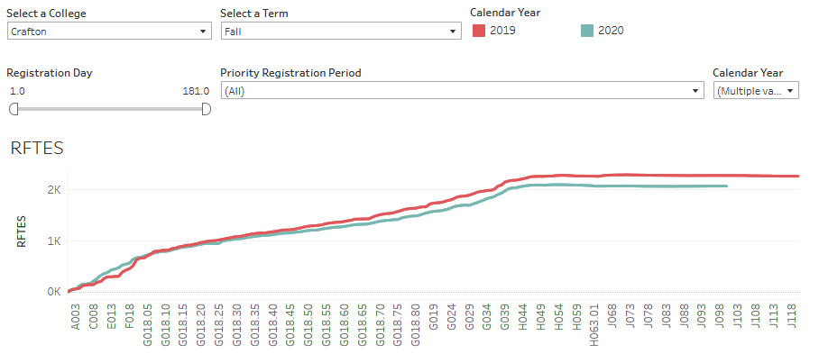
Resident FTES decreased from 2,263 in Fall 2019 to 2,058 in Fall 2020, a 10% decrease
2,263
2,058
Notes:
RFTES at Valley decreased from 4,884 in Fall 2019 to 4,079 in Fall 2020, a decrease of 16.5% (805).
Number of students at Crafton has decreased from 6,655 in fall 2019 to 5,783 in fall 2020, a decrease of 872 (13%) students. Suggesting that fewer students are enrolling in more courses.

Slide 11
Instructional Updates
Spring 2021 classes will be primarily remote.
Have worked with Deans, Chairs, and AS on identification of Synchronous and Asynchronous sections
Worked with Emergency Remote Instruction Taskforce and Academic and Student Senates to develop building and room codes to help inform students

Slide 12
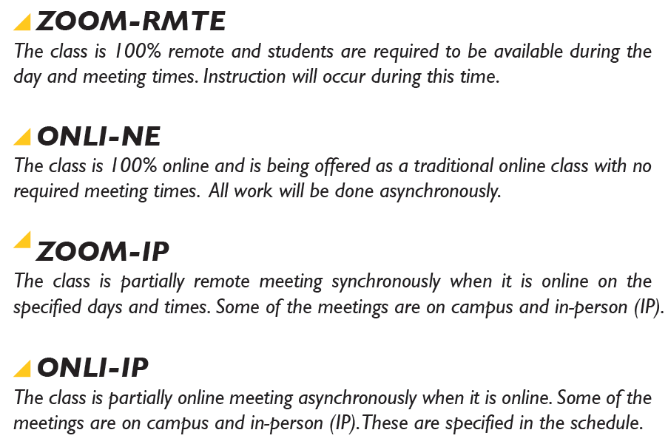
Building and Room Codes to Help Students Understand Schedule

Slide 13
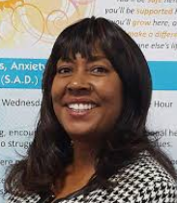
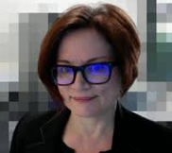

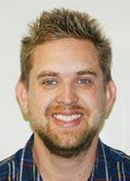
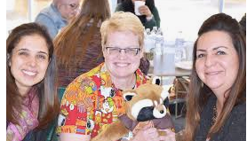
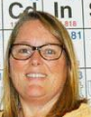
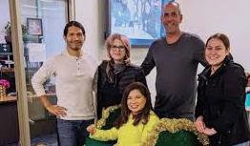
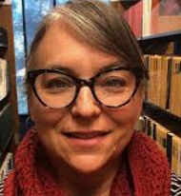
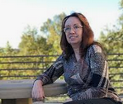
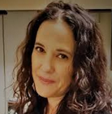
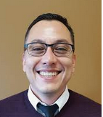
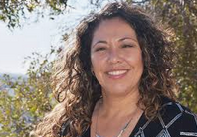

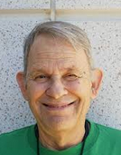
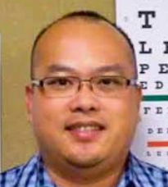
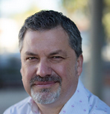
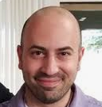
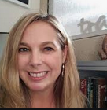

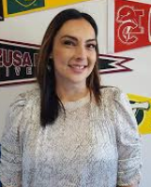
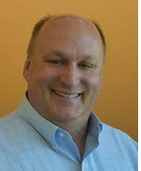


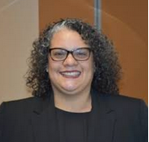
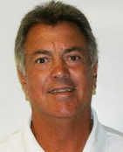
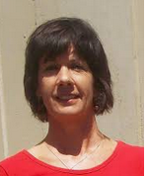
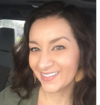
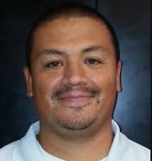
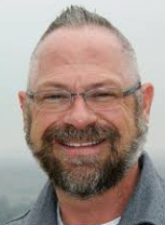
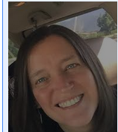

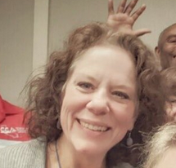
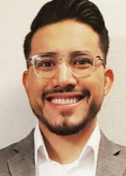
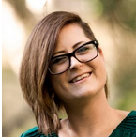
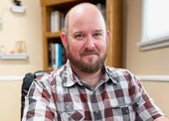
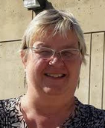
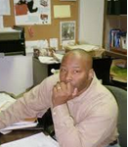
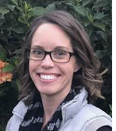
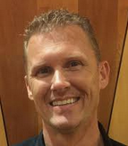
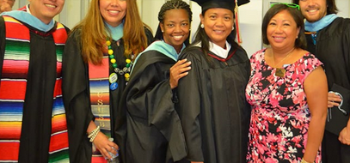
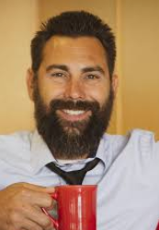
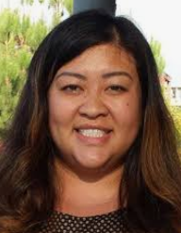
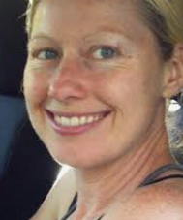
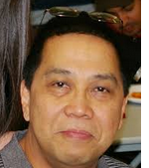

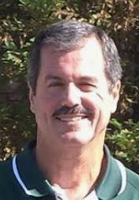
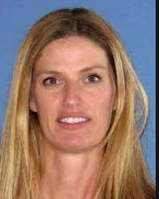
Congratulations – You area all Amazing
Notes:
Amanda Ward, Kristen Clements, Kathy Crow, John Grounds, David Aten

Slide 14
Accreditation Summary
This Week
  38 meetings
  Over 300 People
  Numerous requests for evidence
Identified Strengths by the Team
  English and math AB705 sequence
  Mental Health Services
  Equity services
  Guided Pathways
  Distance Education training and verification processes
  Use of Qualitative and Quantitative data to inform decision-making
Notes:
Distance education training and verification process and the high distance education course success rates
Efforts to support equity and inclusion: USC Equity Alliance, Started One Book/One College with Spare Parts, a book about four undocumented Mexican American students accessing the American Dream to increase diverse cultural awareness, representation, and inclusion in classrooms, campus culture and student life, A2MEN Conference, equitable assessment practices workshops to understand and negotiate instructors’ implicit biases when assess students, Hispanic Heritage Month to increase diverse cultural awareness, representation, and inclusion in classrooms, campus culture and student life, hiring faculty with diverse cultural and pedagogical representation in mind, and continued instructional departmental discussions on privilege and systemic inequality

Slide 15
Accreditation Summary
Next Steps
  October – November 2020 – Opportunity to correct errors of fact in visiting team’s report
  January 2021 – Commission decides on accreditation status for Crafton
Possible Outcomes
  Reaffirm Accreditation – In compliance and required to submit a mid-term report mid-way through the seven-year cycle
  Reaffirm Accreditation and Require a Follow-Up Report – In substantial compliance but required to submit report within specified in eighteen months to meet deficiencies
Notes:
Sanctions
Warning
Probation
Show Cause

Slide 16
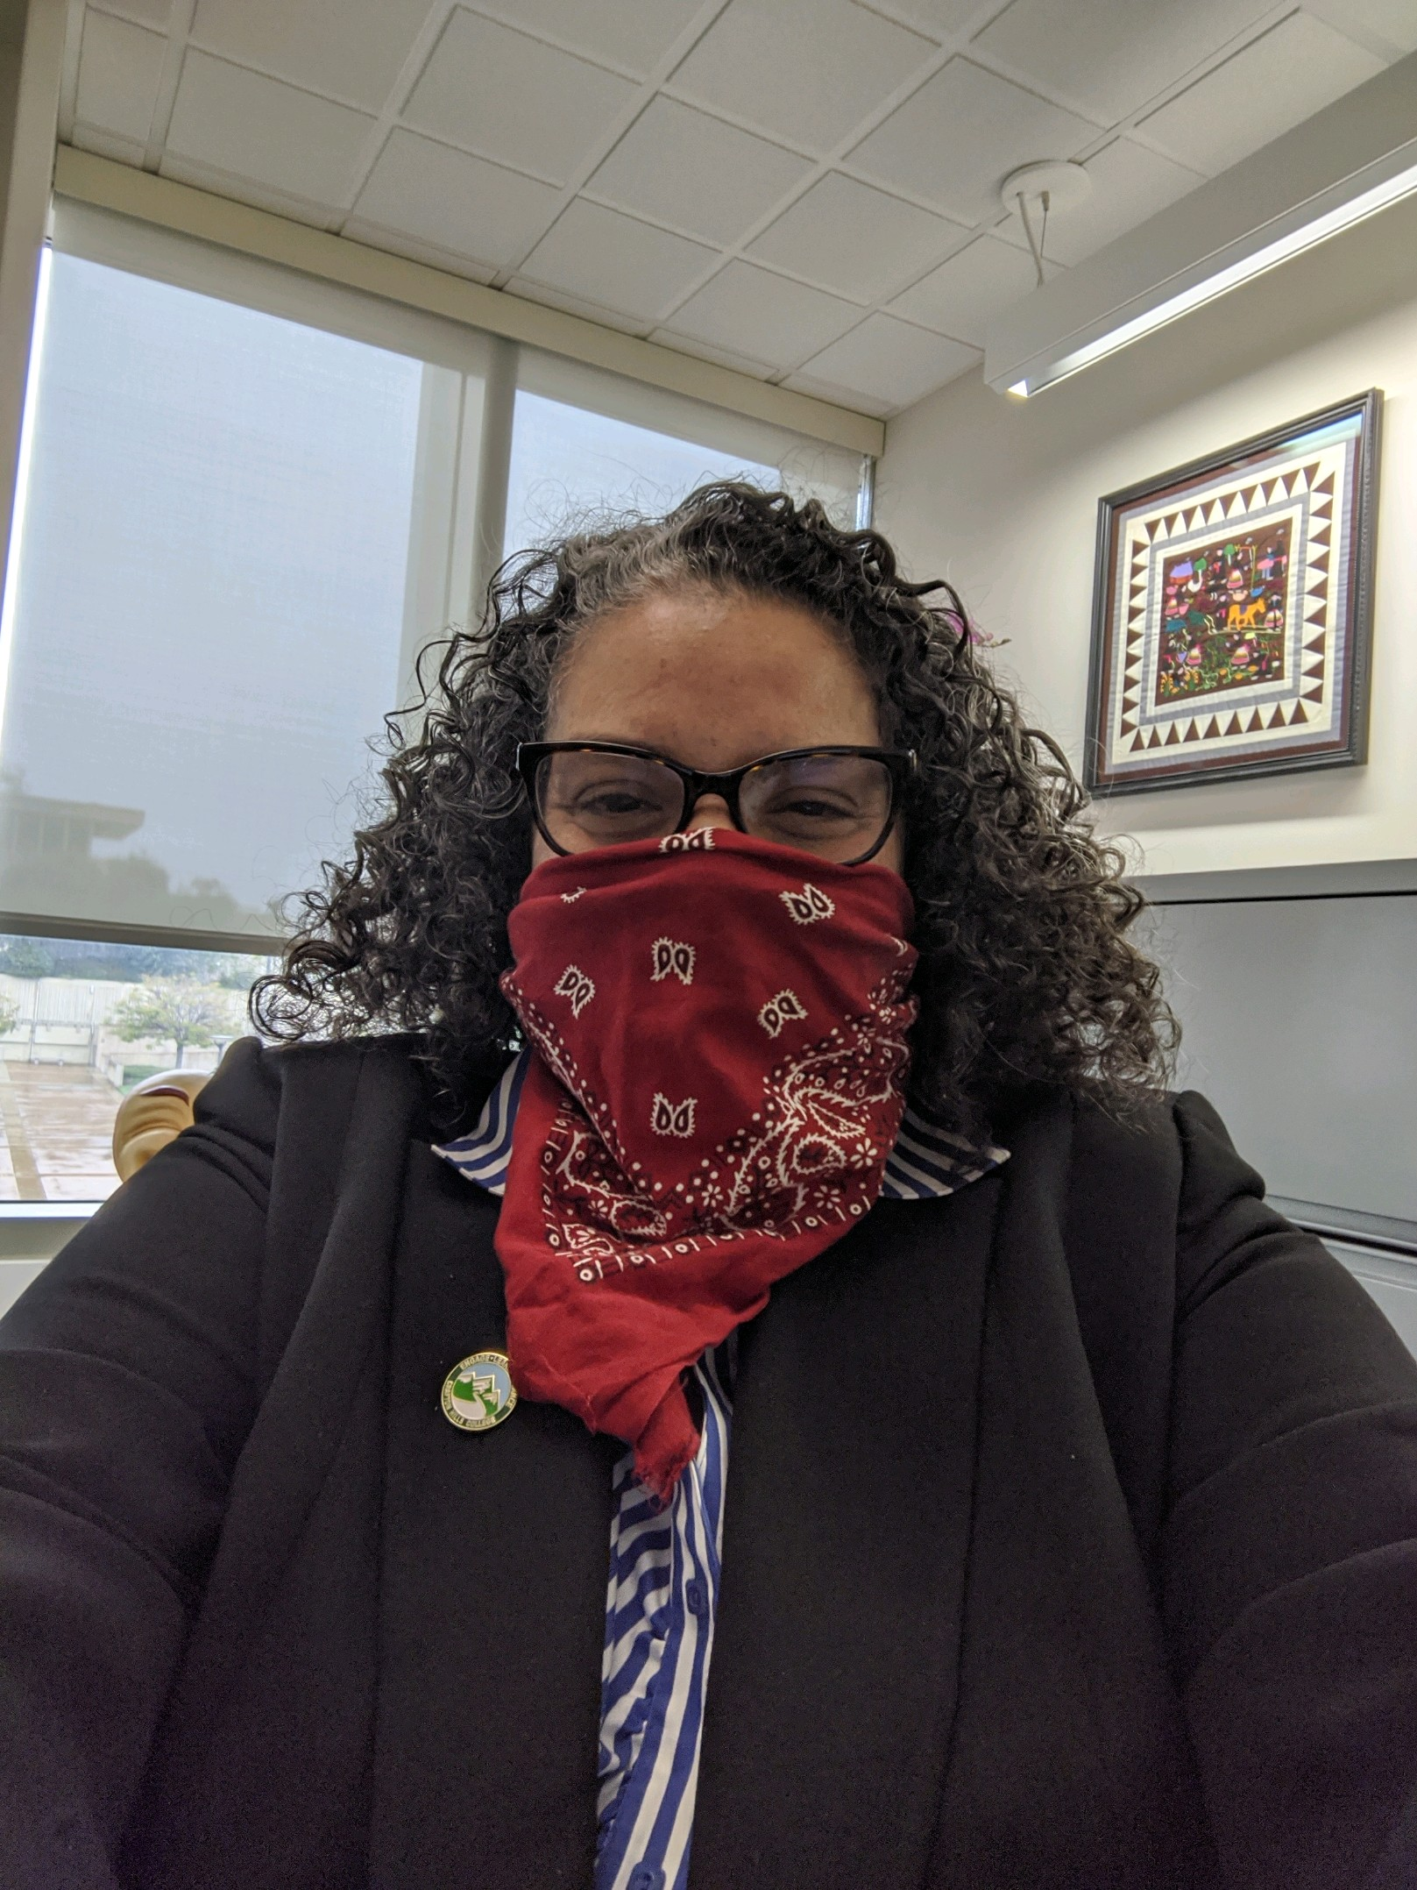
Delmy Spencer
Vice President, Student Services

Slide 17
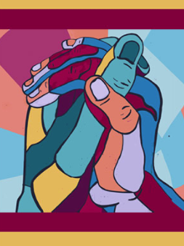
Student Equity and Achievement Committee
Delmy Spencer
Keith Wurtz
Kirsten Colvey
Rejoice Chavira
Gio Sosa
Kashaunda Harris
Alexander Manjarrez
Ericka Paddock
Gwen DiPonio
Chloe de Los Reyes
Diana Vaichis
Herberth “Alex” Jaco
Sabrina Jimenez
Avielah Sprenkle
Kay Weiss
Alvin Jackson
Ken Owens
Violeta Rodriguez
Josh Robles
Laura Van Genderen

Slide 18
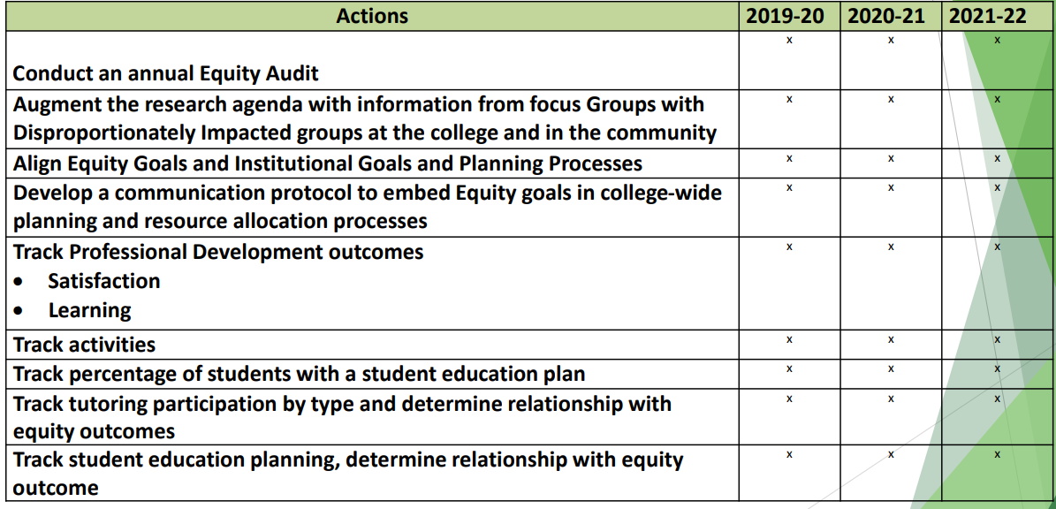
Research and Tracking

Slide 19
Track Activities
Successful Enrollment
Retention: Fall to Spring
Transfer to A Four-Year Institution
Completion of Transfer Level Math and English
Earned Credit Certificate Over 18 Units, Associate Degree

Slide 20
Successful Enrollment
A. Create clear pathways to promote completion and success.
  1. Offer accelerated cohort-style programs (Promise, GP CAPS, Student Senate, EOPS. EMS, CTE Programs. Laurie Green discussed cohorts of 40 students. They have orientation, study groups, etc…
  2. Develop low-unit credit and non-credit skills certificates to meet individual and labor market needs (look at Adult Education –Job readiness skills certificate. ESL non-credit classes coming soon.
  3. Develop scaffolded non-credit/credit/certificate/degree programs
  B. Eliminate policies and practices that impede successful enrollment. (Chairs with scheduling, Student Services is assessing barriers & GP are looking in these areas, CCCApply is going to implement new system)
  4. Simplify enrollment processes i.e English and Math placement is online, entire matriculation is online, laserfish, STARFISH Implemented, Website Redesign workgroup has been created , STARFISH Registration Classes
  5. Simplify Financial Aid processes i.e. Self Service is implemented. FA is now electronic process
  6. Improve scheduling strategies using available educational plan data and current/prospective student preferences
    Student Voices Study, Data Integrity is being conducted, Refine Enrollment Management Plan for DI groups. GP/Counseling Scheduling Conflicts, Create annual scheduling process to include Starfish reports for scheduling and Course Rotational Calendar.
  7. Provide targeted outreach and recruitment, focusing on groups with high disproportionate impact, such as African American females and male Foster Youth
    CHC Marketing in English and Spanish, Adult Education (Hispanic), Promise, CCAP and Dual Enrollment, Guardian Scholars Program i.e Partnerships with County, TODE Legal Center. *Need to Partner with Local Tribes, San Manuel k-12, Department of Education GP and County * Ask Michelle for info. For NA partnerships, San Bernardino Unified School District Foster Youth Program, Redlands Unified School District Foster Youth Program, County of San Bernardino Independent Living Program. Diverse Faculty and Staff Panel for Correctional Program
  8. Fully implement Caring Campus to promote connection. Follow up with Alex
  9. Develop Student Success Teams to meet the transition needs of DI groups i.e GP CAPS Completion Teams
  10. Provide Online Educational Resources for GE courses, and transfer level Math and English * Statistics Courses (OER). English (OER) Gwen, Kay will talk to Keith to get inventory of OER Courses and review marketing. * Open resources are licensed, and online resources include tutoring
  C. Create a research agenda to analyze and understand disproportionate impact. Gio is going to take back items below to his team and provide update on next steps during next meeting. i.e Data couches,
  11. Develop a research strategy to understand why students apply but do not enroll
  12. Create a multidisciplinary task force to guide equity related research at the college

Slide 21
Student Life and Campus Engagement
Virtual "Conversation on Race" with 67 participants (June 2020)
Virtual "Roadrunner Rally" with 124 participants (August 2020)
Virtual "How to Start A Club" Workshops with 36 total participants (August 2020)
Provided in person badges to Respiratory and Paramedic Programs (September 2020)
Virtual "Hispanic Heritage Month" with 226 total participants thus far (September 15- October 15, 2020)
Virtual "National Coming Out Day" Panel with 34 participants (October 8, 2020)
Virtual "Undocumented Student Action" Week (October 19- October 23, 2020)

Slide 22
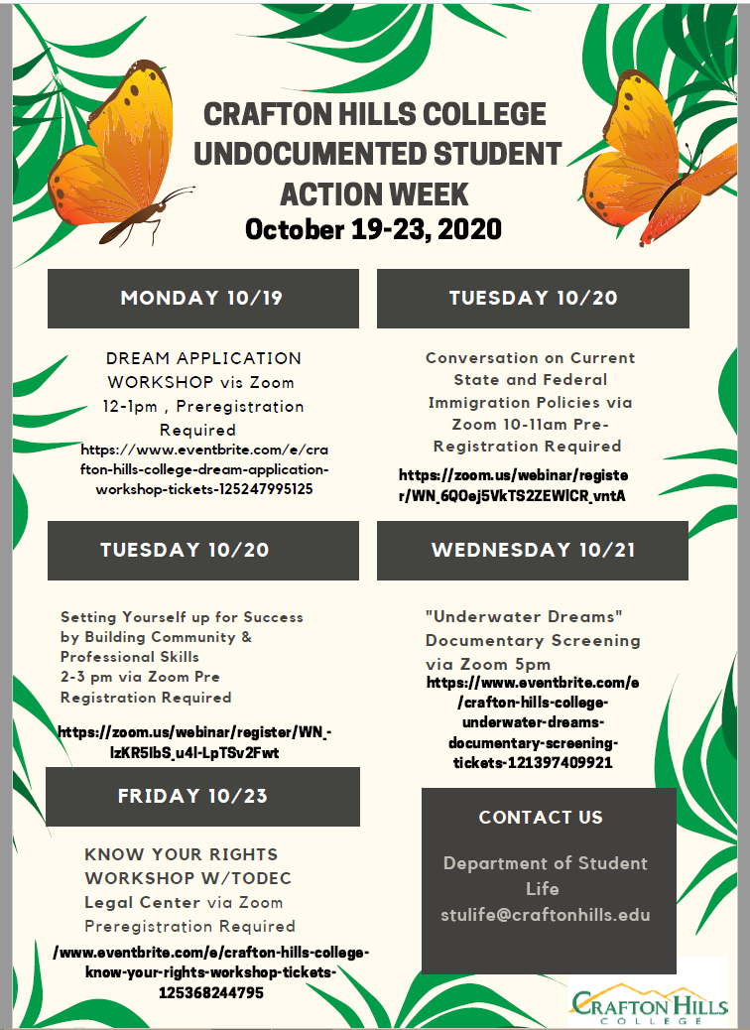

Slide 23

Melissa Oshman
Director, Information Technology & Services

Slide 24
Technology Updates
  Information Security
    District-wide Risk Assessment
    Recommended Security Training
  Copier Updates

Slide 25

Mike Strong
Vice President, Administrative Services

Slide 26


DRAFT - Budget Principles and Guidelines

Slide 27

Measure CC Update

Slide 28

PAC
Programming & Design
  Instructional User Group:
    Mark McConnell, Paul Jacques, Kevin Palkki, Kay Weiss
  Weekly meeting thru Thanksgiving
  Student Feedback Mtg – 10/14/20 (will regroup prior to creating working drawings)
State Submittal/Milestones
Start Preliminary Plans 10/1/20
Start Working Drawings 2/1/21
Complete Working Drawings 8/1/21
DSA Final Approval 2/1/22
Advertise Bid for Construction 3/1/22
Advertise Bid for Equipment 9/1/23
Complete Project 3/1/24

Slide 29

East Valley Public Safety Training Center
Instructional User Group
  Mike Alder, Rick Groff, David Aten, Dan Word, EMS Faculty (as needed)
Programming/Criteria Docs
10/2020-12/2020
Construction
3/2022-2/2023

Slide 30

CHC Emergency Evacuation Drill
10/22/20
at
10:22AM

Slide 31

Michelle Riggs
Director, Institutional Advancement

Slide 32

Website Task Force Project

Slide 33


Latest News

Slide 34


Highlighting Alumni Success
Because of you…
Share your story. CHC Alumni

Slide 35


Our Crafton Family!
“I sent copies of the recognition card and letter to relatives and friends. It is fun for me in that I get phone calls afterwards and we talk about how the students have great aspirations and are grateful for the monetary assistance.”
Crafton Family impacted by Evacuations
Scholarships

Slide 36
Q&A

