Slide 1

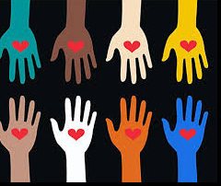
Opposing The Erasure of Asian Americans, Pacific Islanders,and Native Americans
Summary Presented by:
Rejoice Chavira
Chloe de los Reyes
Jimmy Grabow
Ericka Paddock

Slide 2
What ethnic group represents the largest Asian population in the United States?
Korean
Japanese
Filipino
Chinese
Indian
Notes:
Ericka

Slide 3

Notes:
Chloe
Because conversations on race and racism have been mostly centered on the black and white binary and typically focus on explicit, heinous acts, racism towards API has been mostly absent from the dominant narratives.
Generally speaking, minoritized groups experience racism differently, and for APIs, racism is usually experienced in the form of Othering (for instance, the perpetual foreigner myth), erasure (in curricula, history), and exclusion (from conversations, decision-making, and policy). In short, APIs struggle with invisibility. This in turn, has caused APIs to internalize that their experiences don’t matter.
It wasn’t until recently, when anti-API sentiments and violence have dramatically surged at the onset of the coronavirus pandemic, that our stories and our suffering have been (somewhat) spotlighted. Harassment and violence towards API have increased by up to 150% during the height of the pandemic nor have they improved at this point. You may find evidence for the increase in attacks cross-checked by multiple data points, including data from our neighboring institution, CSUSB’s Center for Hate and Extremism.

Slide 4
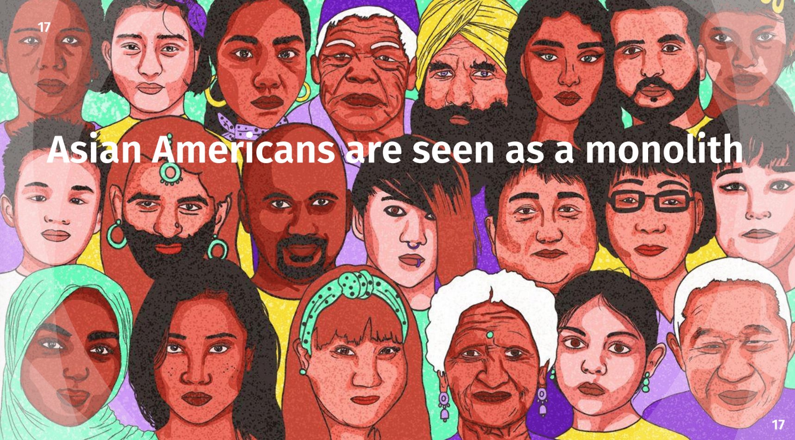
Notes:
Chloe
Despite being an integral part of the American fabric and history (Asians have been in the US since 1587), a number of harmful myths and misperceptions persist today. One of which is that APIs are a monolithic group. In fact, APIs are usually lumped together in the same way that indigenous peoples of the United States have been also lumped together. (Ericka will talk more about this later.)

Slide 5
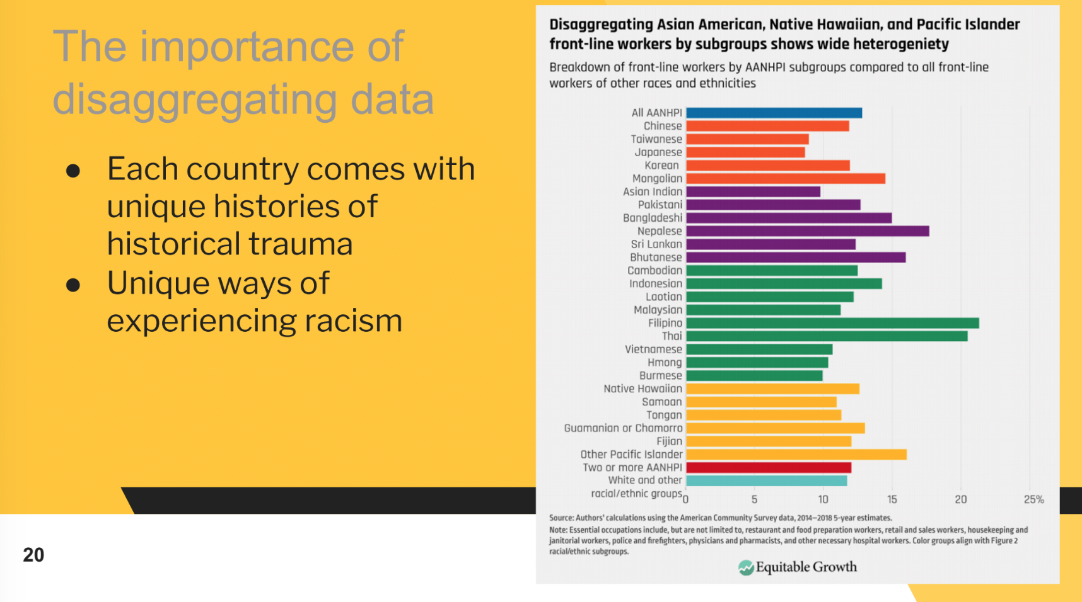
Notes:
Chloe
Asian Americans are made up of many ethnicities, cultures, and experiences, and each country comes with unique histories and historical trauma and even unique ways of experiencing racism. This is why disaggregation of data is important.

Slide 6
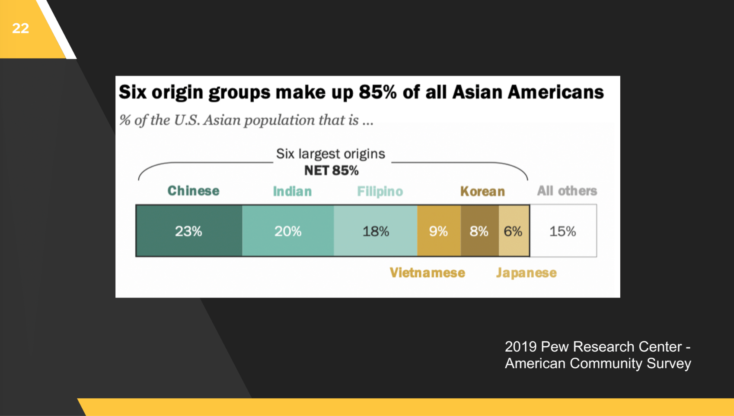
Notes:
Jimmy

Slide 7
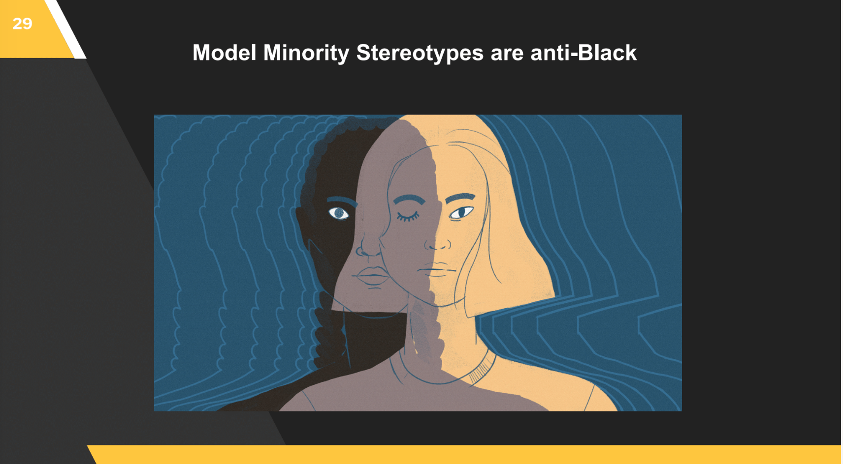
Notes:
Jimmy

Slide 8
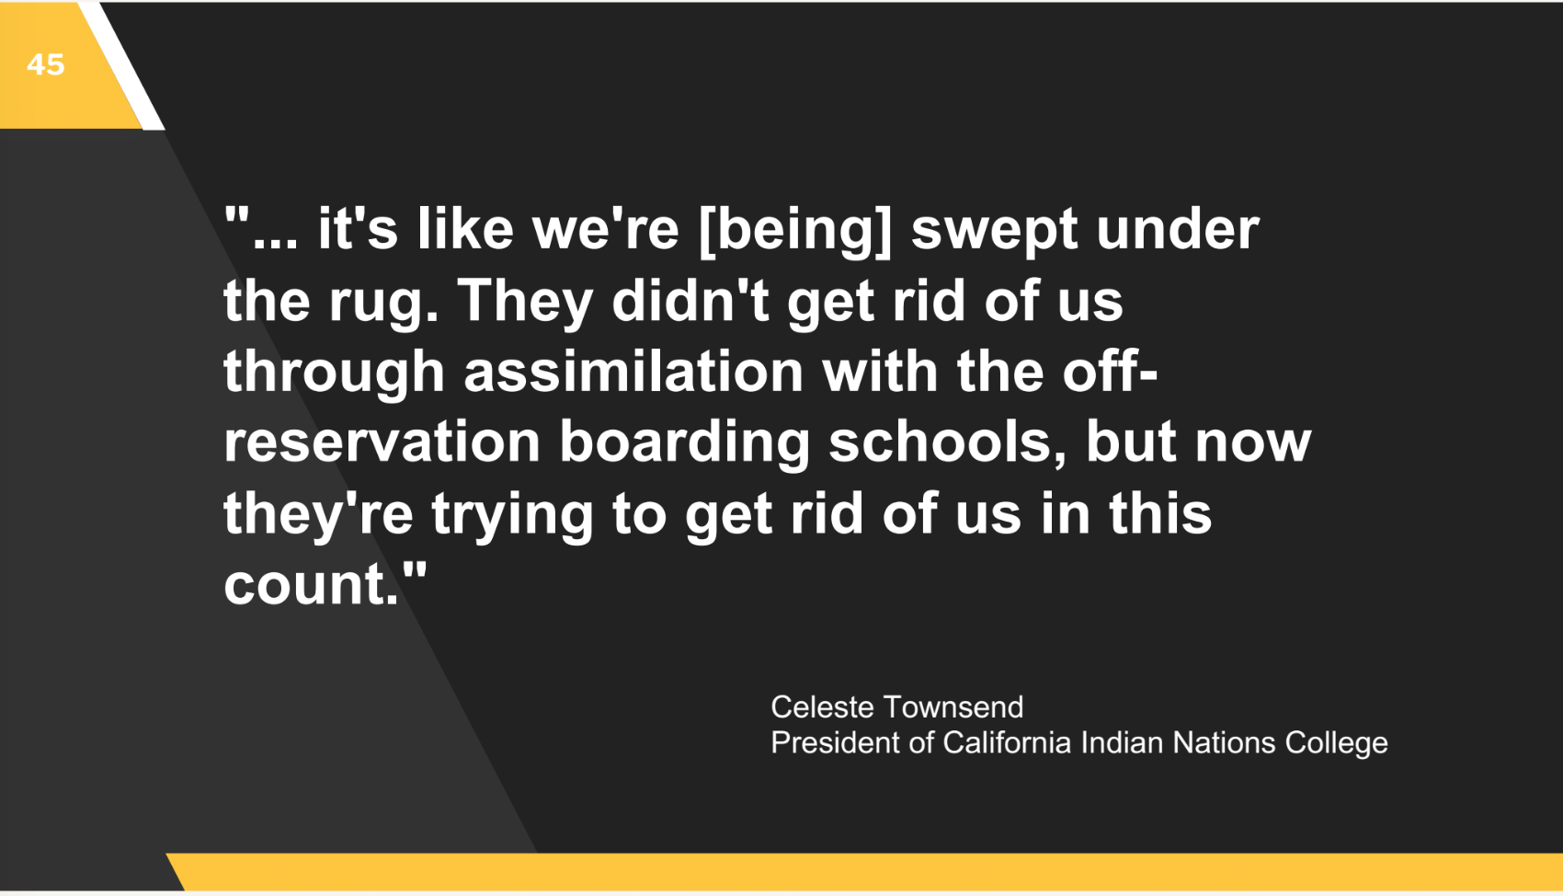
Notes:
Jimmy

Slide 9
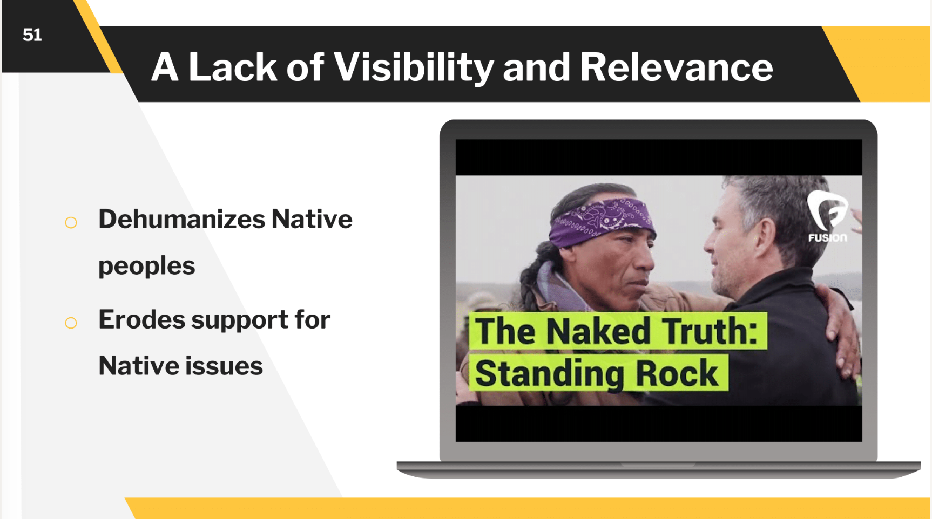
Notes:
Ericka
NA parallel experience to those in our AAPI communities. They too are largely invisibilized in our culture through the preponderance of stereotypes, lack of acknowledgement, and poor school curricula. Hollywood films, sports mascots, and the fashion industry, to name a few, are responsible for making Native people into simple caricatures instead portraying them as the living, diverse, complex people they are. By hosting celebrations such as Native American Hertiage month, our goal is to re-insert Native people into our campus consciousness with an appreciation of their diversity and complexity. Ultimately, we aim to recognize their deep contributions to our community, our continent and our country.

Slide 10
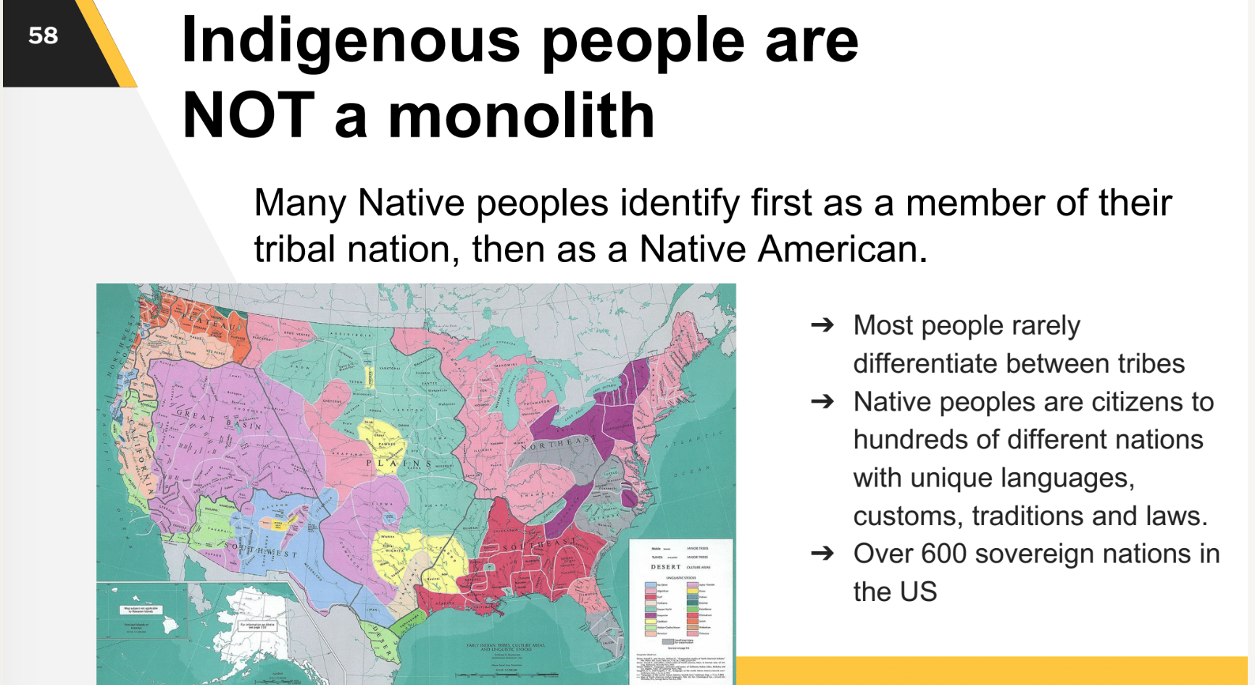
Notes:
Ericka
According to the National Conference of State Legislatures, there are currently over one hundred federally recognized native groups or tribes in California. Of those, 19 federally recognized tribes are found in San Diego, Riverside, San Bernardino, Orange, and Los Angeles Counties.

Slide 11
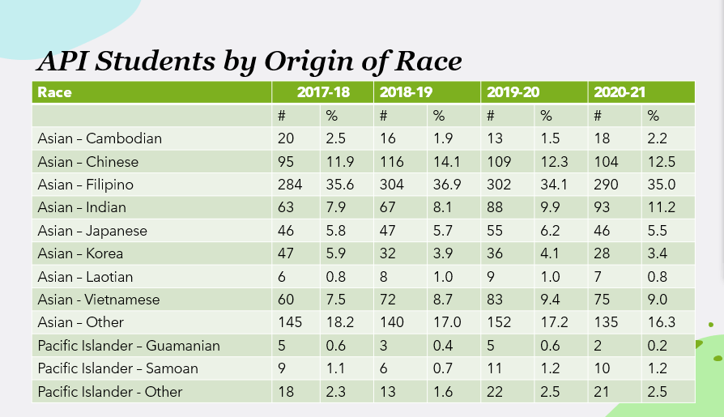
CHC AAPI /Indigenous Peoples Data
Notes:
Ericka
Just as members of our Native American communities represent multiple tribes, our AAPI students come from a variety of Asian countries and cultures. This slide shows a brief snapshot of the many AAPI cultures our students identify with. According to the Office of Research and Planning, the most represented Asian cultures on our campus are Filipino, Other, and Chinese.

Slide 12
Take Action
How can we help make Asian Pacific Islander students, staff, and faculty feel more visible on our campus?
Survey API students on the type of programming they would like to see and allocate DEI funding to support API students, faculty, and staff
Continue to disaggregate data
Hire more API faculty/ staff and offer an Asian American studies class to fulfill ethnic studies requirements by the CSU System
Build API awareness-API Association
Notes:
Rejoice

