Slide 1

Accountability for Racial Equity in Educational outcomes
Presented by: Gio Sosa, Deborah Wasbotten, Carrie Audet and Cyndie St. Jean

Slide 2
Why do we need Racial Equity?
Racial equity is not only needed to eliminate the gap between white people and people of color, but to also increase the success for all groups.
Racial Equity develops overall goals and outcomes.
The strategies we develop to reach those goals/outcomes are based on the needs of a particular group.

Slide 3
Institutional leaders and practitioners need to learn how to be race conscious (in a positive and critical way) and to continuously interrogate why their ways of doing things may work for white students but not for racially minoritized students.

Slide 4
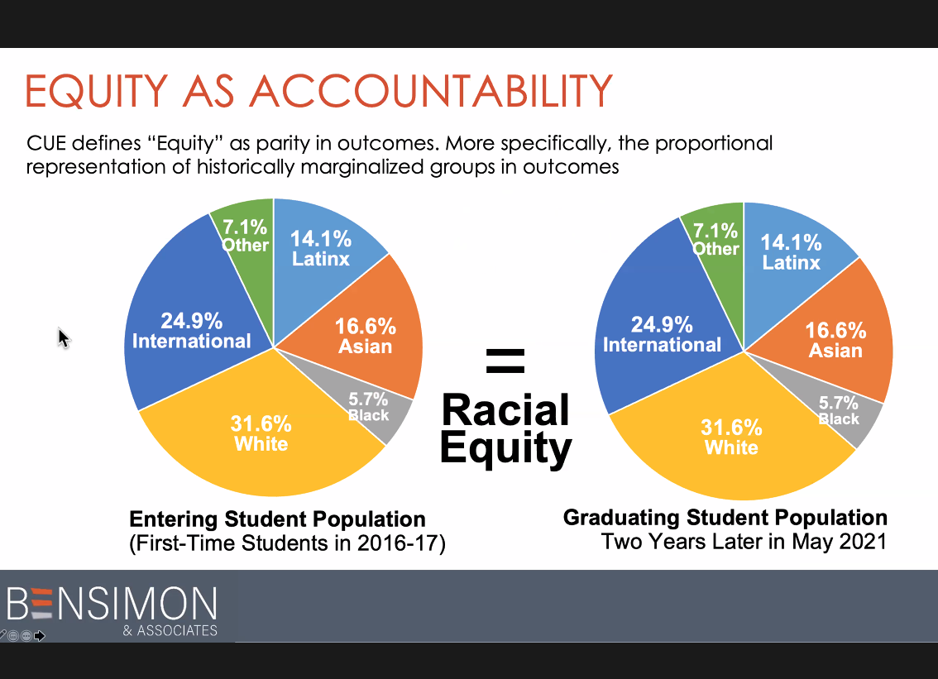
The Goal for Racial Equity
First-Time Students in 2016-2017
Two Years Later in May 2019

Slide 5
C.U.E. Project: Equity-Mindedness via
Race-Conscious Inquiry
Before Course Study
FA17-SP18 Math 121 | # Enrolled | # Successful Completers | % Successful
LatinX | 9 | 3 | 33%
White | 10 | 8 | 80%
After Course Study
FA18-SP19 Math 121 | # Enrolled | # Successful Completers | % Successful
LatinX | 14 | 12 | 85%
White | 11 | 10 | 90%
“I didn’t realize that there was this problem until I ran my data, and then I could see that there is an equity gap in my classes. As soon as I saw that, I wanted to fix it right away.”
– Participating Instructor in Colorado 2-year study.

Slide 6
Engaging in Race-Conscious Inquiry
BEFORE: TEACHER/COURSE CENTERED INSTRUCTION
COURSE DATA – Before this project, the instructor had never been given the data by race & ethnicity for his courses
MINORITIZED STUDENTS – the instructor had never looked at the groups specifically; who were the successful students
INSTRUCTOR-DRIVEN CLASS – instruction had been centered on teacher-needs, not student-needs
AFTER: DEVELOPED STUDENT-CONNECTEDNESS
1ST DAY CHANGES – starting homework in class; classroom activity
Talk “with” the students, more one-on-one and assigned more group work, make feel a part of the class
*LIKE “1ST GENERATION COLLEGE STUDENTS”,
WE ARE ALL “FIRST-GENERATION EQUITY PRACTIONERS”.

Slide 7
Equity-Minded Practices: Instructor Example
Class roster with racial indicators
While tracking students in general, you can look for those who fall into equity gaps at our campus.
Pay attention to:
Who is attending classes
Who is turning in work
Who is asking questions/seeking help
Who is NOT?

Slide 8
Equity-Minded Questions for Programs/Services:
What population are we actually serving?
How is that matched against our student population?
What are our equity gaps?
What are some ways we can address those gaps in our department/area?
What factors (including my own internalized racial biases) play a role in how “I” help to support students?

Slide 9
Think about it: Who comes to see YOU?
  Faculty:
  Who visits during your office hours?
  *Who DOESN’T?
  Student Services:
  Who are you actually serving?
  *Who are you NOT?
  *Consider that you may not be connecting with everyone and may need to reach out or communicate differently to different groups to bridge the gap in your area.

Slide 10
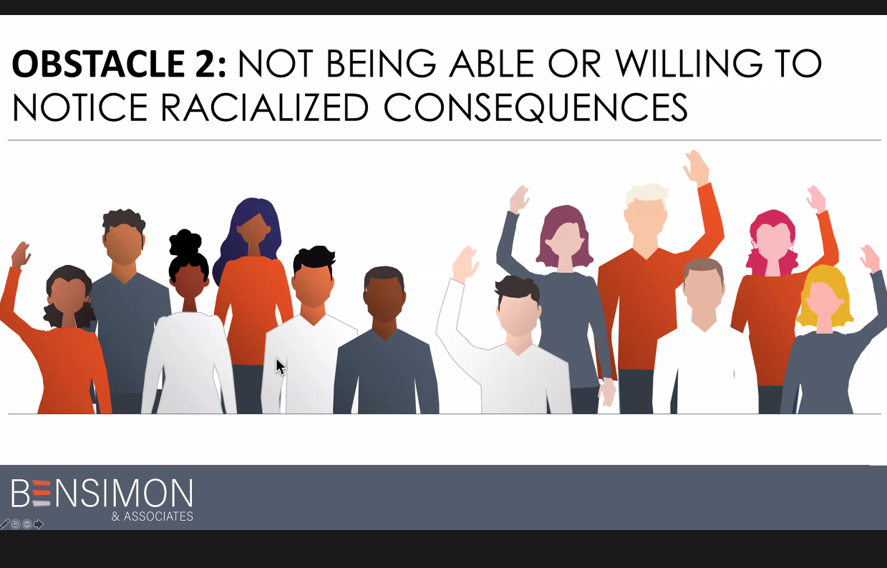

Slide 11
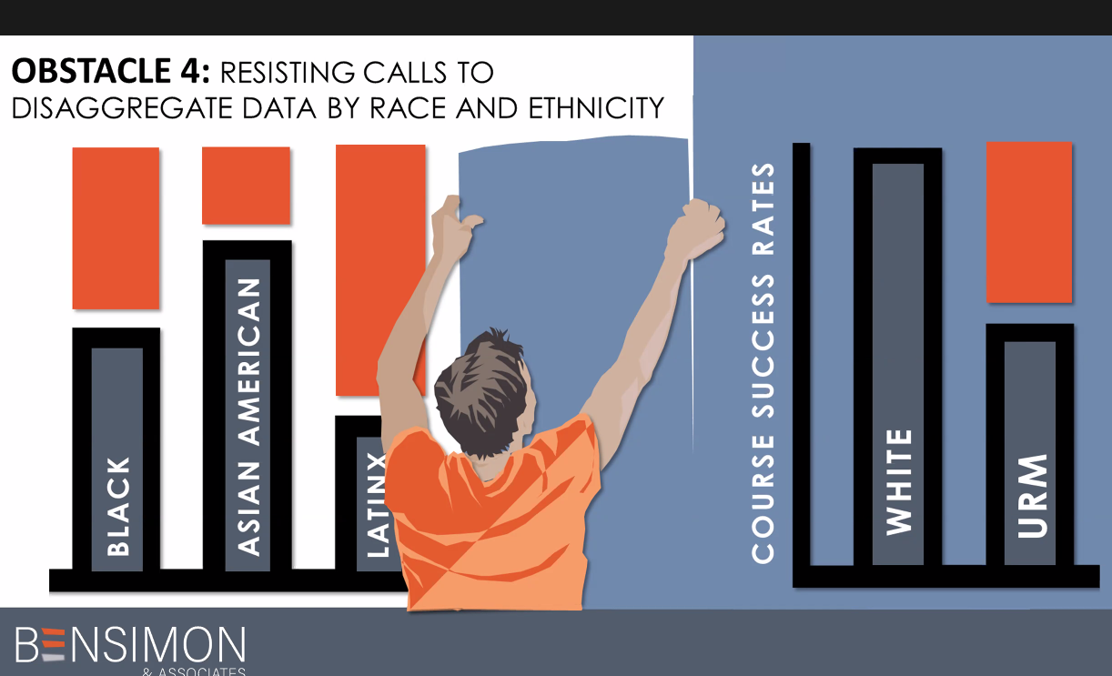

Slide 12
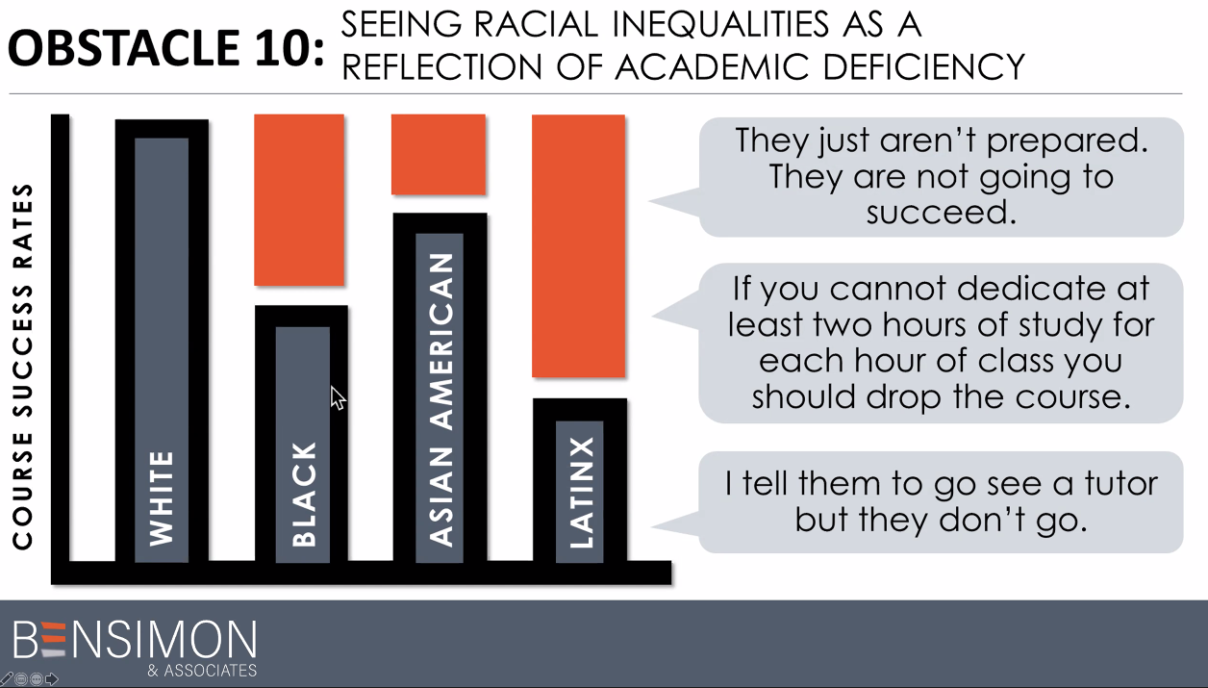

Slide 13
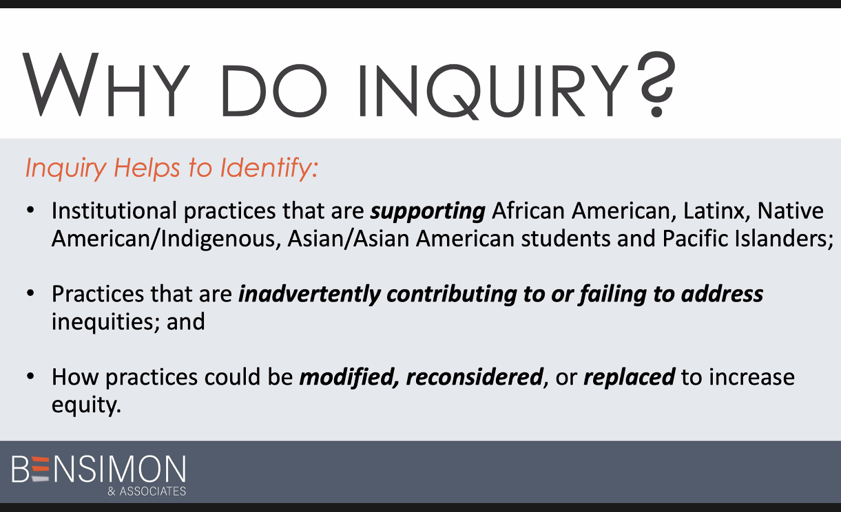
The Purpose of the Inquiry Paradigm
Notes:
Our approach to office hours as contributing to inequities—this concept is new to many students of color who lack the confidence in knowing what to say.
Students selected as lab assistants are highest performing students…others choose less academically successful students, but with potential (using our power to advance equity).

Slide 14
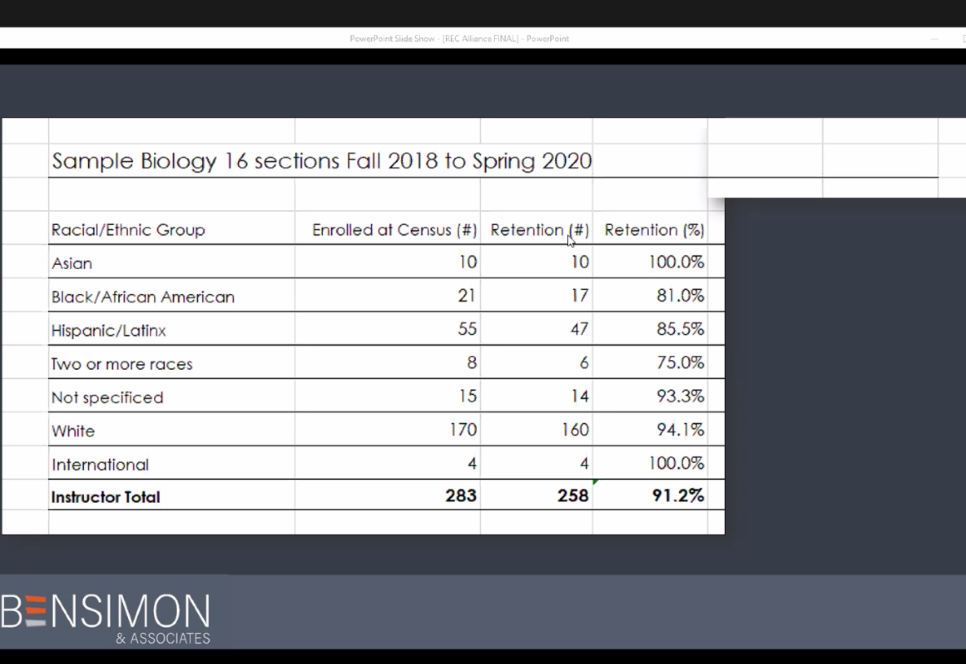
Equity Work in Action
Notes:
Inquiry in Action Paper: https://sbccd-my.sharepoint.com/:b:/g/personal/gsosa_sbccd_cc_ca_us/EWG-G0kt43FMkGHjUc56m1YBAnMxqv9WjpPdKBsPV1zUrw?e=zUWAqB

Slide 15
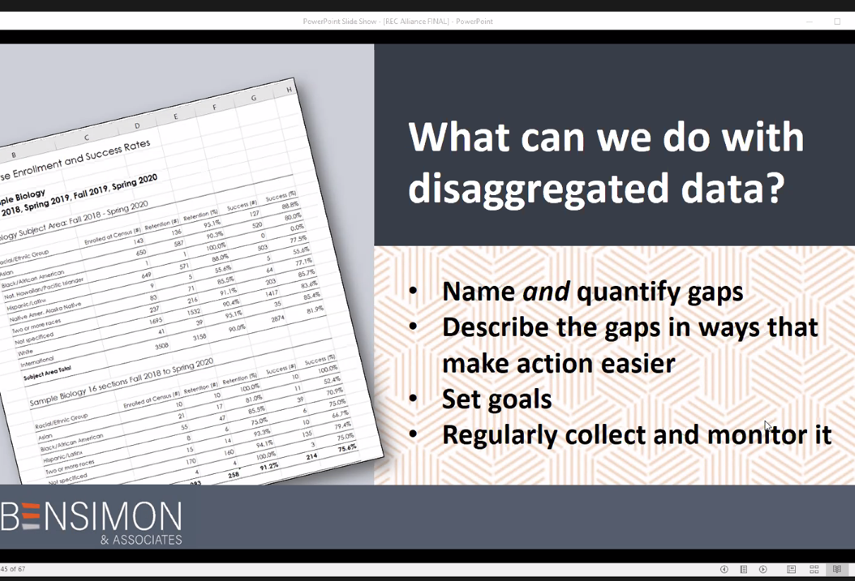
Disaggregated Data and Calculating Equity Gaps
Notes:
Overview of data disaggregation and equity gaps (disproportionate impact): https://sbccd-my.sharepoint.com/:b:/g/personal/gsosa_sbccd_cc_ca_us/EUGyUj5fGhxDpRSynlcYgUMBxfHlBoZ6i_XoRYNz28ROgA?e=LETvXt

Slide 16
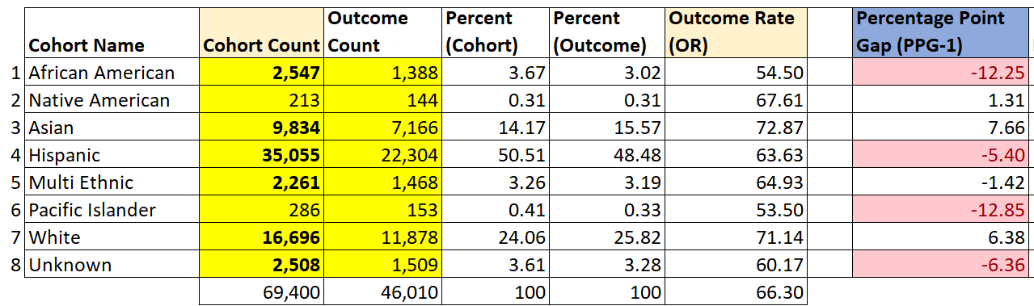
Calculating Equity Gaps
Notes:
Link to Equity Gap Calculator: https://sbccd-my.sharepoint.com/:x:/g/personal/gsosa_sbccd_cc_ca_us/EQwnbO2yswhChHL71cGaDDYBK7yxtv0RnI_KCYBQgcfH3Q?e=bhyEdn

Slide 17
Thank you
Carrie Audet, Deborah Wasbotten, Gio Sosa and Cyndie St. Jean

