Slide 1
COVID-19 Testing Information
Please access the following link for testing registration: https://www.covidclinic.org/sbccd/
SBVC:
  Location: CTS 106
    Weekdays: Tuesdays and Wednesdays
    Times: 11:30 am to 7:30 pm
CHC:
  Location: LRC 110
    Weekdays: Tuesdays and Wednesdays
    Times: 11:30 am to 7:30 pm
District:
    Location: 550 E. Hospitality Lane, 2nd floor, board extension room. (those who need or would like to test from the EDCT, please use this site.)
  Weekdays: Tuesdays and Wednesdays
  Times: 8 am to 4 pm

Slide 2
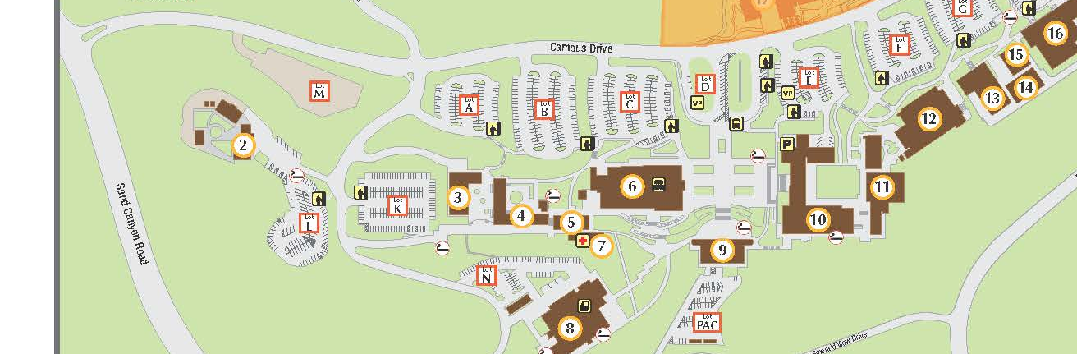
2022 Commencement Information!
Rented Regalia Instructions
Please look for an email next week that will let you know when you can stop by the bookstore to pick-up your regalia.
  You'll drop off Regalia at the bookstore directly after the ceremony.
Parking Instructions for Faculty and Staff on May 25th
Park in Lot N and P

Slide 3
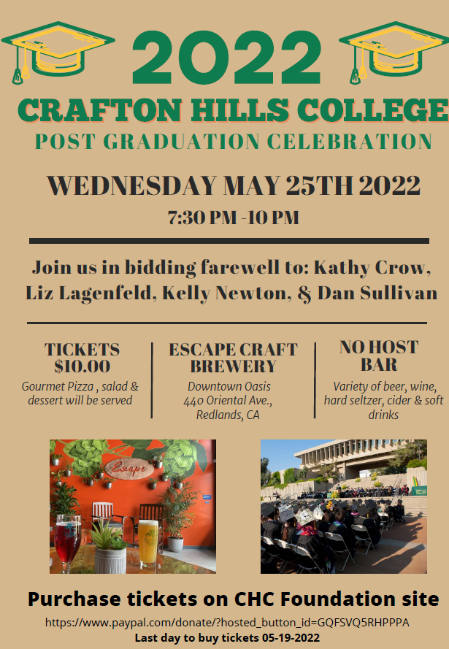
On May 25th at 4:00 PM, bring your regalia to the Student Life area to get help with regalia if needed.
5:00 PM: Faculty will walk in line to the stage (the stairs in front of CNTL).
  Commencement has been expanded to include classes 2020, 2021, and 2022.

Slide 4

College Corps program Information Sessions
Students will learn about the requirements of the program, volunteer sites, how to apply and more.
Deadline to Apply to the program is Friday, June 3.
The program will begin in Fall 2022

