Slide 1
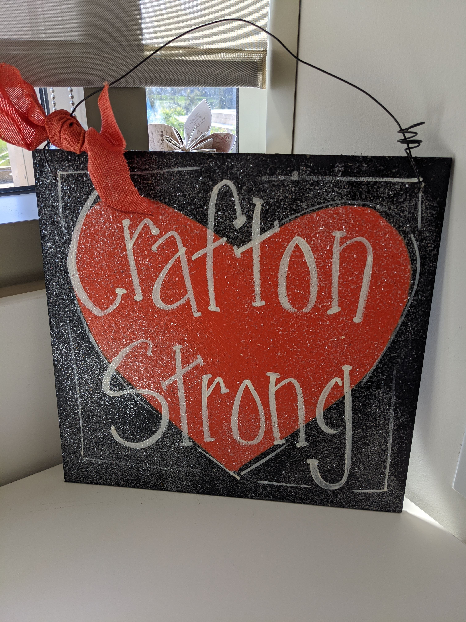

All College Zoom
September 18, 2020

Slide 2
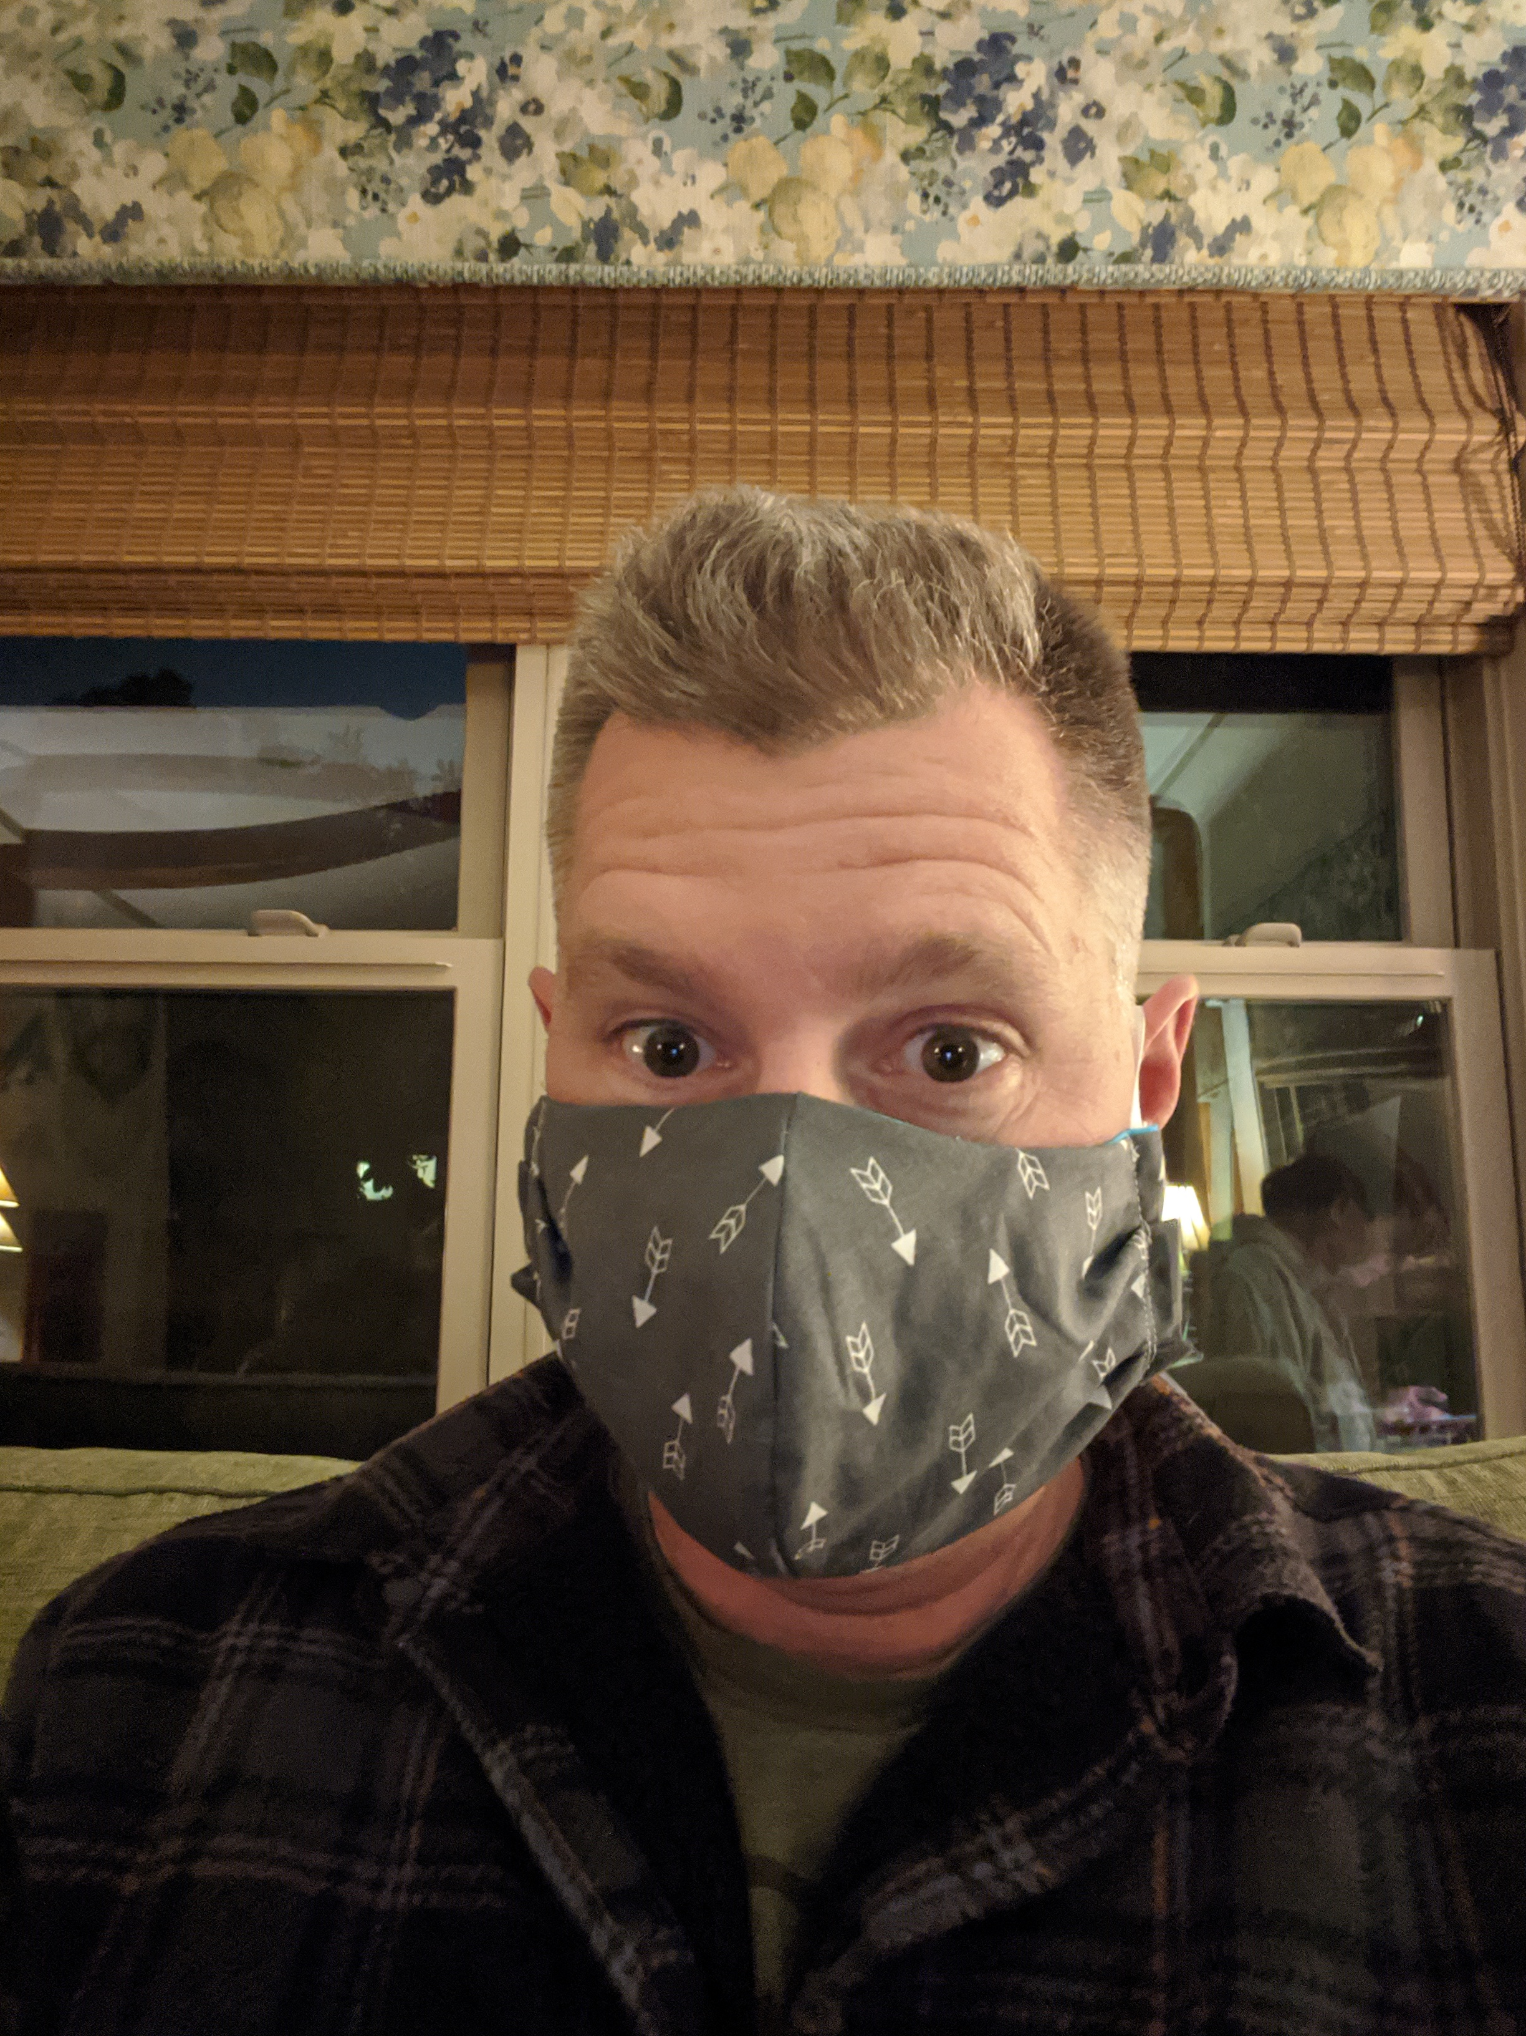
Kevin Horan
President, Crafton Hills College

Slide 3
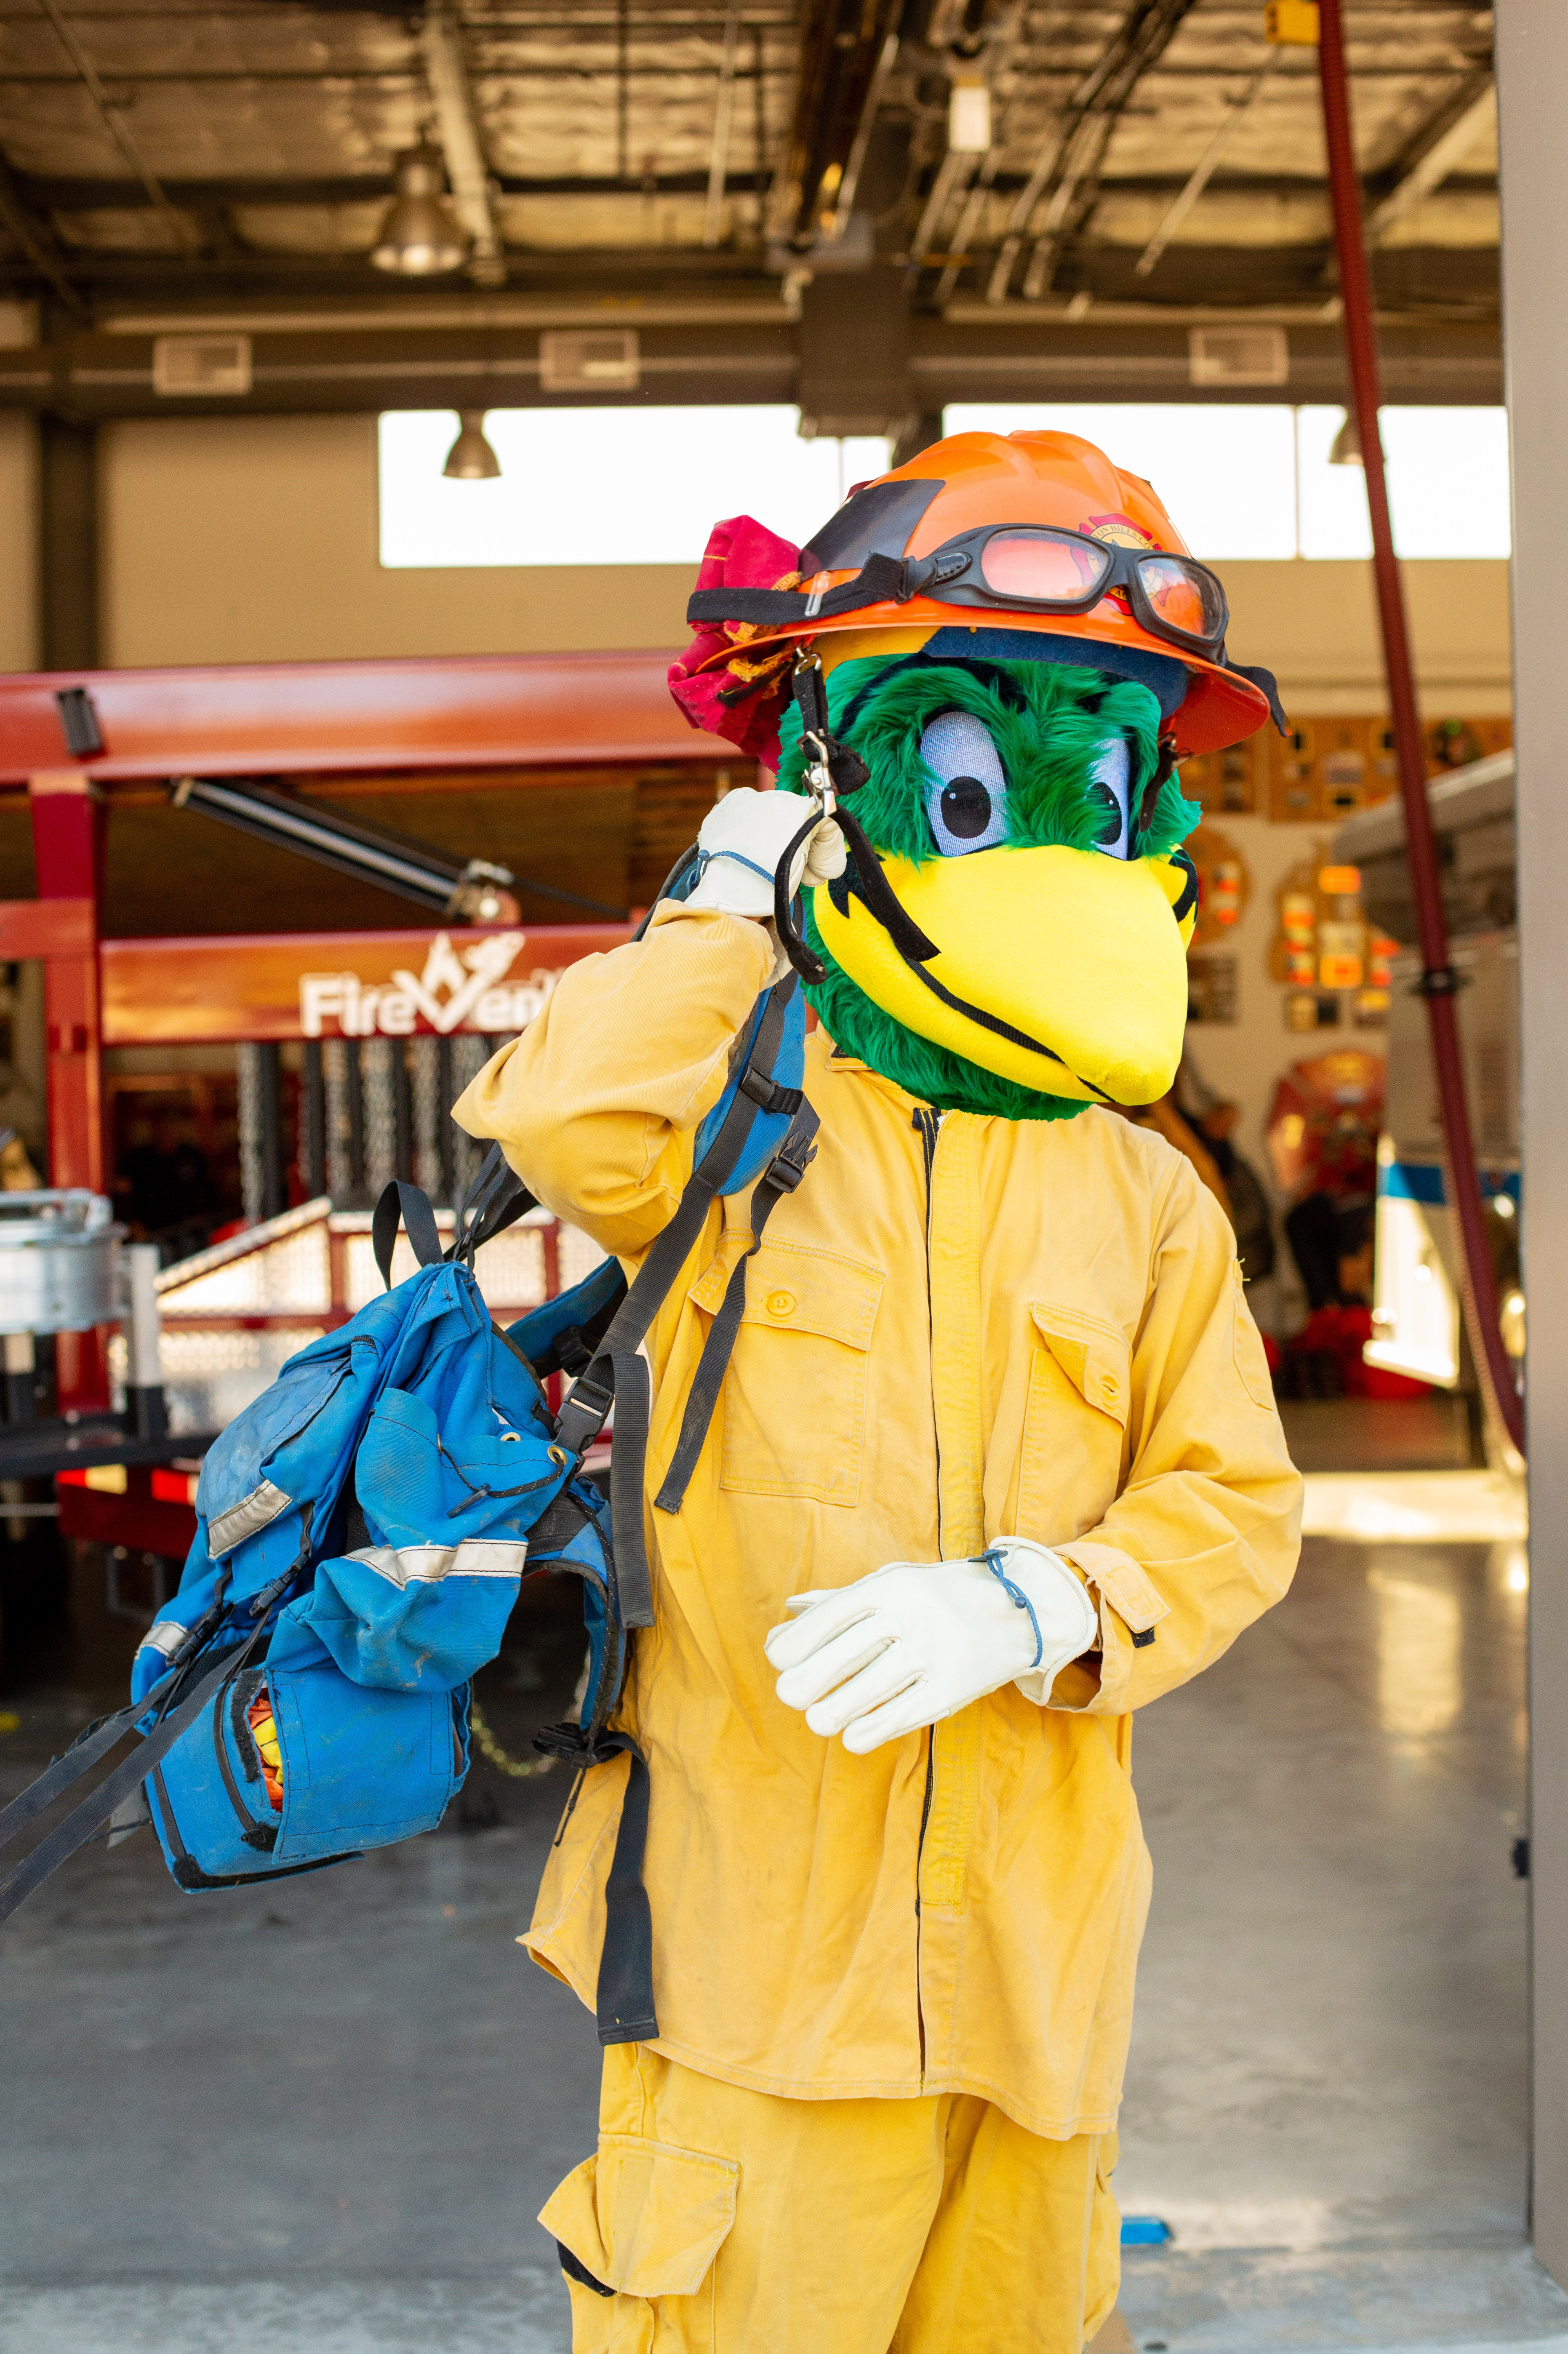
Thank You to All of Our Fire Service Super Heroes!
El Dorado Fire
  21,000+ Acres, 66% Containment
  Active Evacuations Orders:
    Angelus Oaks, Forest Falls, Mountain Home, 7 Oaks, Barton Flats/Jenks Lakes
  Reaching Out to Students & Personnel impacted by ongoing evacuations to offer services and resources

Slide 4
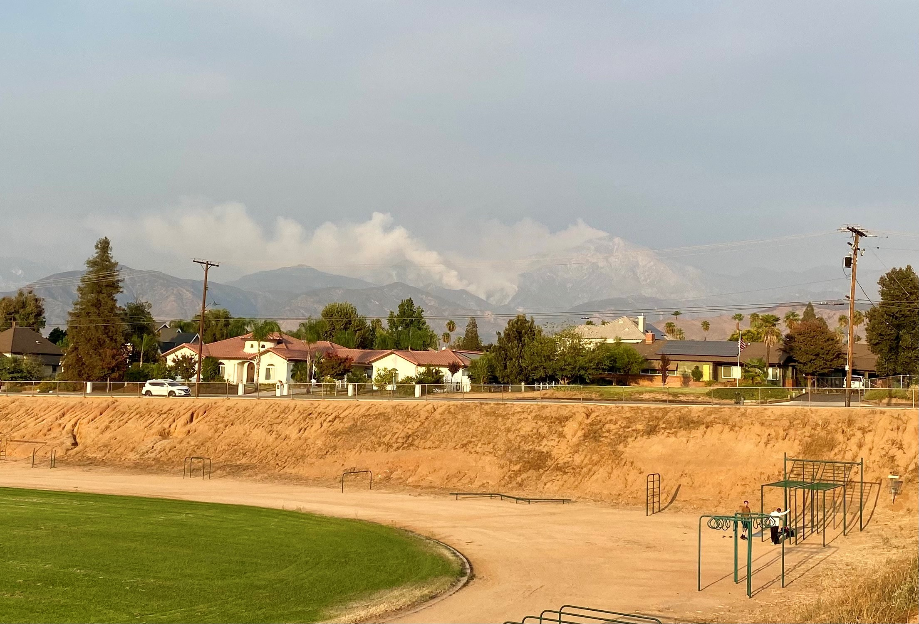

Slide 5
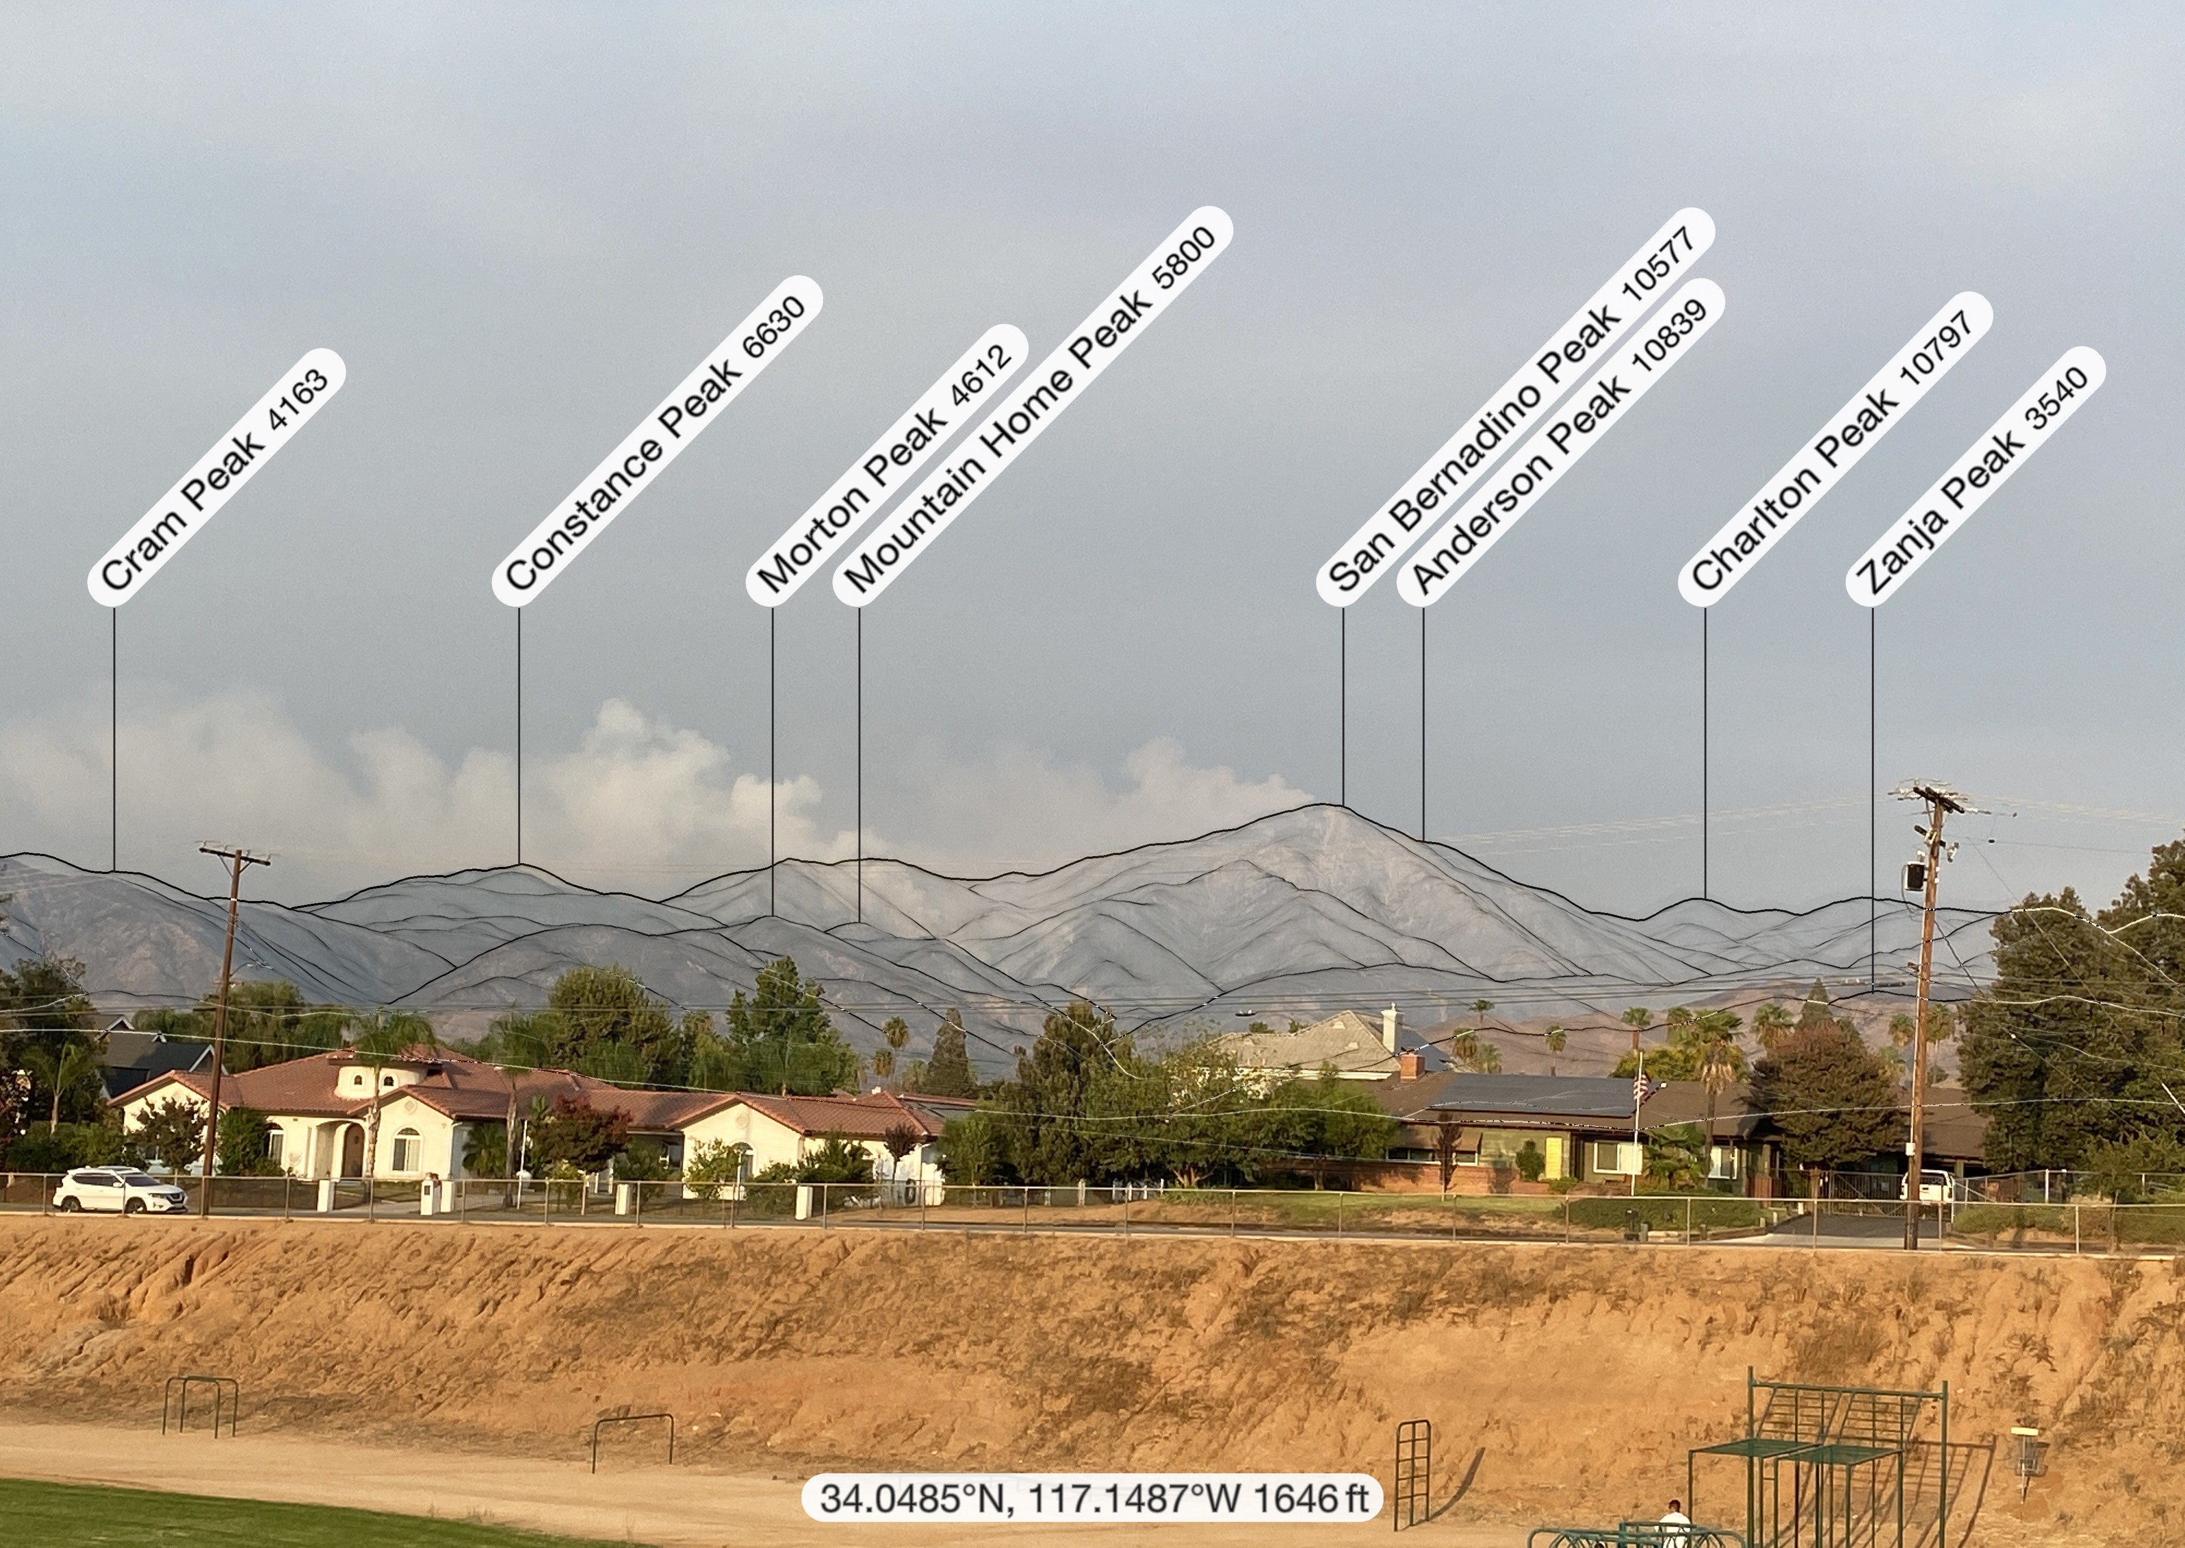

Slide 6
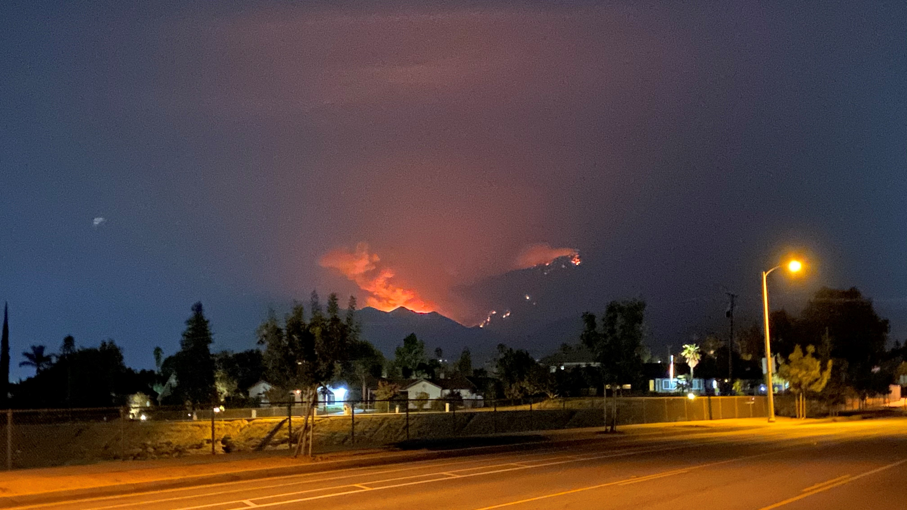

Slide 7
COVID LIFE
  Spring 2021 – Online/Remote
  Chancellor’s Cabinet timeline to make a decision for Summer ’21 - March/April
  All-Campus Monthly Zoom Meetings
    Friday, Oct 16th 2-3pm
    Friday, Nov 13th 2-3pm
    Friday, Dec 11th 2-3pm

Slide 8
Equity & Inclusion
  USC Center for Equity, CCC Equity Alliance
    September e-convening: Fostering & Sustaining Inclusive Classrooms for Students of Color
    Kay Weiss, Kashaunda Harris, Joshua Robles, Sabrina Jimenez, & Chloe De Los Reyes

Slide 9
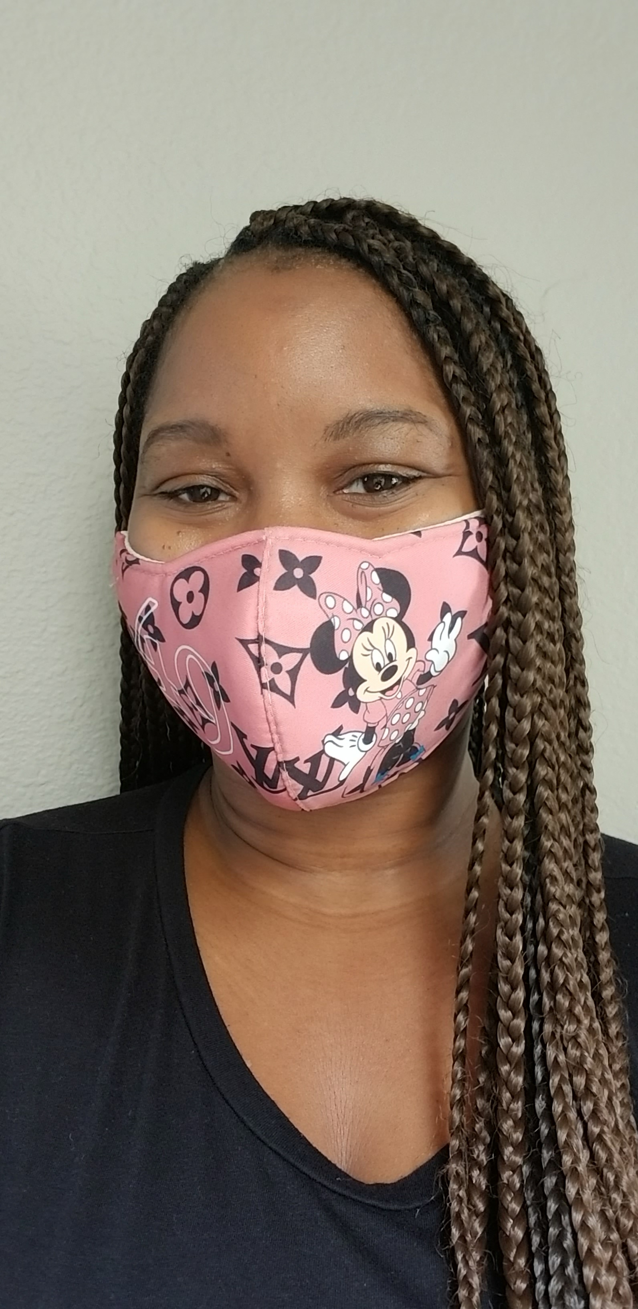
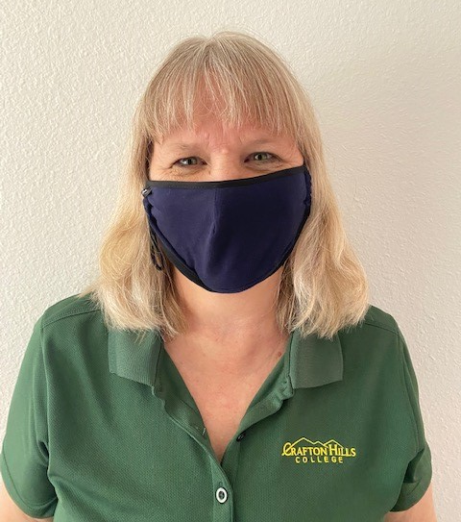
Equity Alliance Report Out
Kashaunda Harris, Faculty Professional Development Coordinator
Kay Weiss, Tri-Chair Professional Development Committee

Slide 10
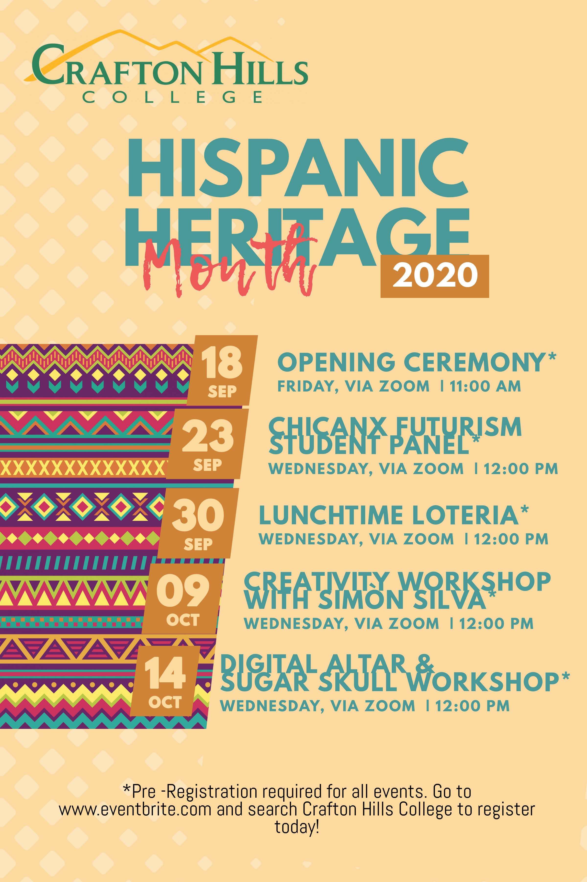
Equity & Inclusion

Slide 11

Equity & Inclusion

Slide 12
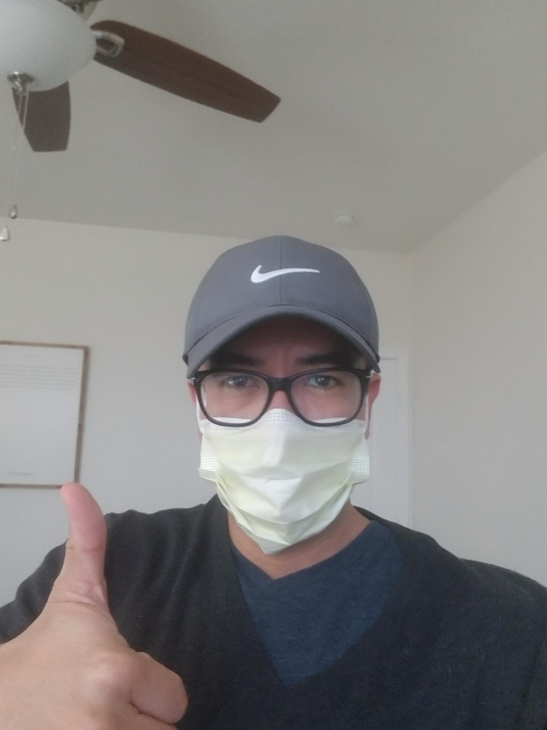
Gio Sosa
Dean, OIERP

Slide 13
CHC Course Success Rates by Academic Year
2019-2020 CHC students achieved the highest course success rate in five years
Spring 2020 Credit Courses from California Community College Chancellor’s Data Mart

Slide 14
CHC Course Success Rates by Ethnicity
Both African American and Hispanic students achieved significantly higher success rates in 2019-20 than in 2018-19
12% Increase
Spring 2019
Spring 2020
Spring 2019
Spring 2020
African American
Hispanic
Spring 2020 Credit Courses from California Community College Chancellor’s Data Mart

Slide 15
UC Admit Rate -- Fall 2019
CHC has the highest admittance rate to the University of California in the region
18% Increase
UC System Infocenter

Slide 16
Transfers to UC and CSU -- 2018-19 & 2019-20
CHC transfers to both UC and CSU increased significantly from 2018-19 to 2019-20
9% Increase
18-19
19-20
18-19
19-20
UC Transfers
CSU Transfers
UC System Infocenter
CSU Institutional Research

Slide 17
CHC Degrees and Certificates by Academic Year
2019-2020 CHC students earned the most degrees and certificates in five years
63% Increase Over Five Years
Crafton Hills College Student Information System

Slide 18
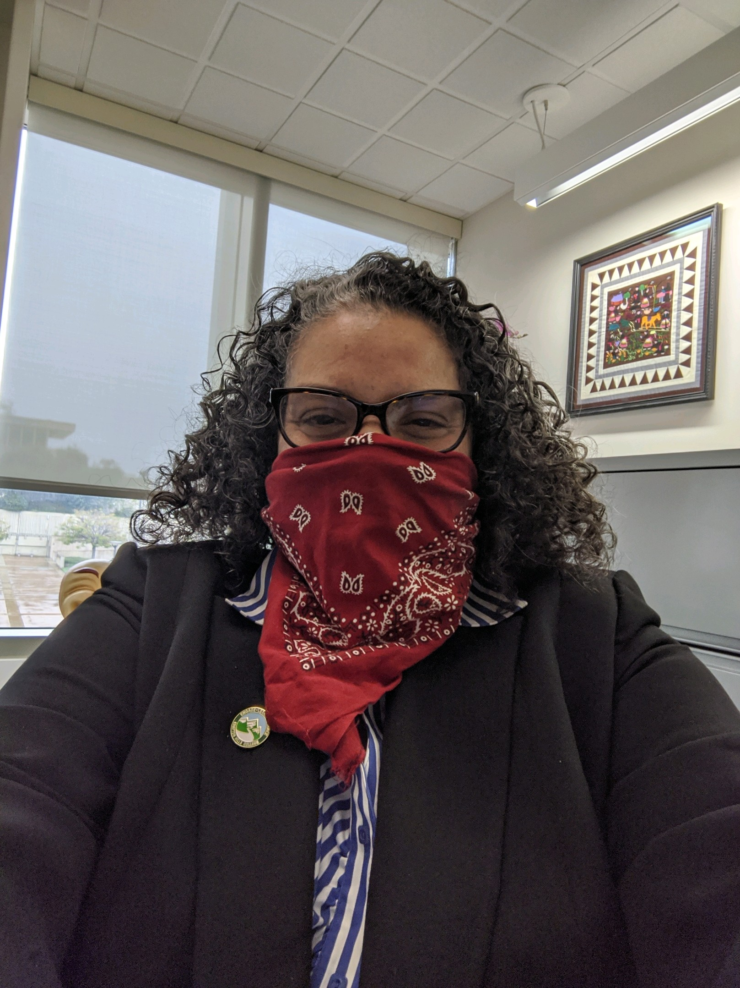
Delmy Spencer-Montenegro
Vice President, Student Services

Slide 19
ISEEK – Alternative Employment Program
The purpose of this program is to prepare students for:
  successful employment
  to be strong candidates for competitive scholarships
  special university programs for transfer
Students will gain skills in an online medium and will develop:
  a career portfolio, (i.e. resume, cover letter, elevator pitch),
  learn hirable leadership and employability skills through online training,
  earn digital badges, and gain interview skill preparation for successful employment or university transfer.
Students will have a higher student engagement with CHC services offered through constant interaction with Career Staff and Counselors.

Slide 20
Mentorship PROGRAM
Career Center - Connecting Academics to Careers
The student/employee mentorship program will identify students that have an interest in learning more about the day to day responsibilities of a professional in their field of interest.
Students will meet with an employer in a variety of formats (online, or phone) to learn more about the career and the steps needed to attain that career both academically and professionally.
Students will also be able to:
  Access to a Canvas Course Shell to view, submit and maintain program requirements
  Participate in a Mock Interview with the Career Professional or Career Center Staff.
  Develop an ideal Career Plan – What steps will the student take to reach this career/career within the industry.
  Submit Major Declaration form by end of the semester (if major has not been declared)
  Participation in JCPenney Suit-Up Event.

Slide 21
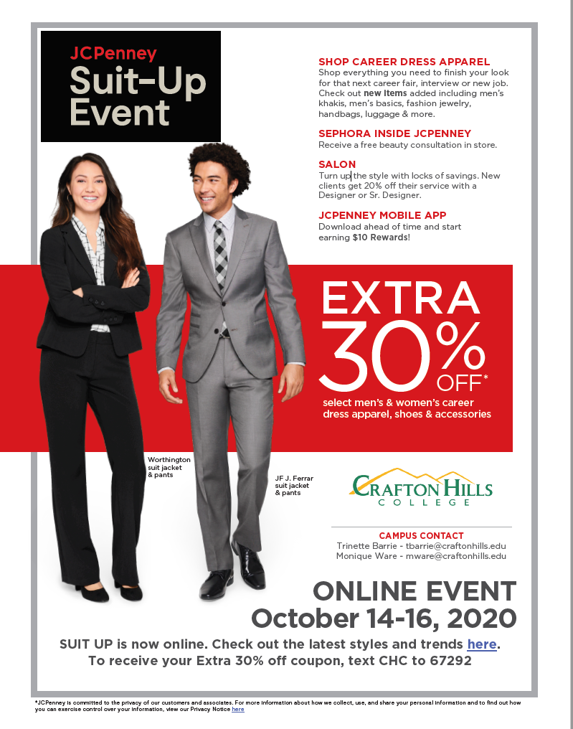
JC Penny and San Manuel Partnership

Slide 22
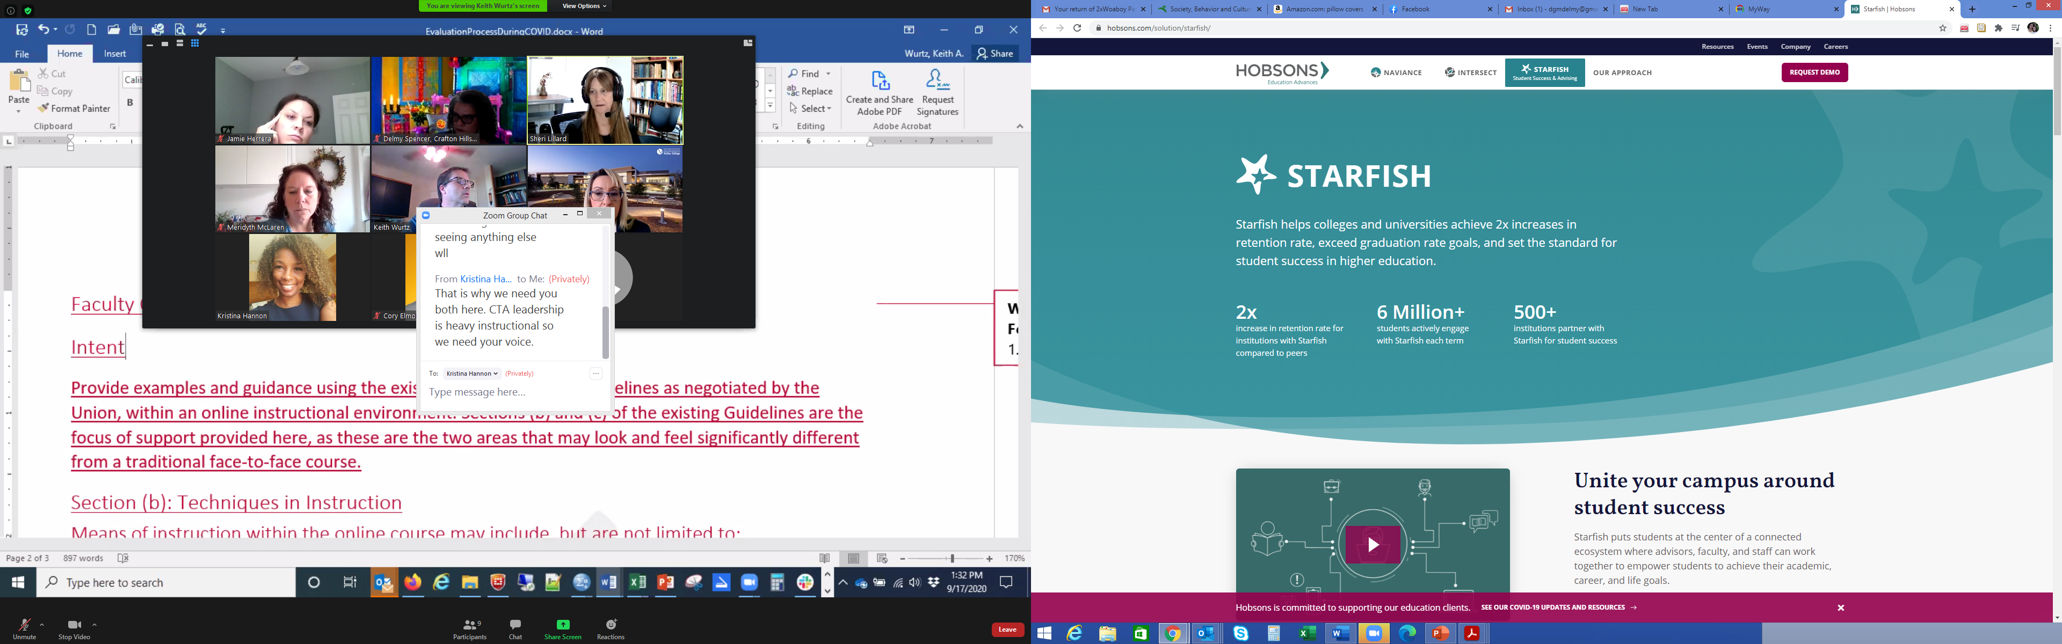
Phase III
Strategic Consulting engagements: Readiness Assessment and Intervention Inventory Workshop
Course Registration Integration
Retention Score Analytics
Degree Planner optimization: Careers, Off-Track Notifications, general optimization
Starfish Early Alert, etc. optimization: Intake form, Success Network modifications, cohorts, general optimization.

Slide 23

Keith Wurtz
Vice President, Instruction

Slide 24
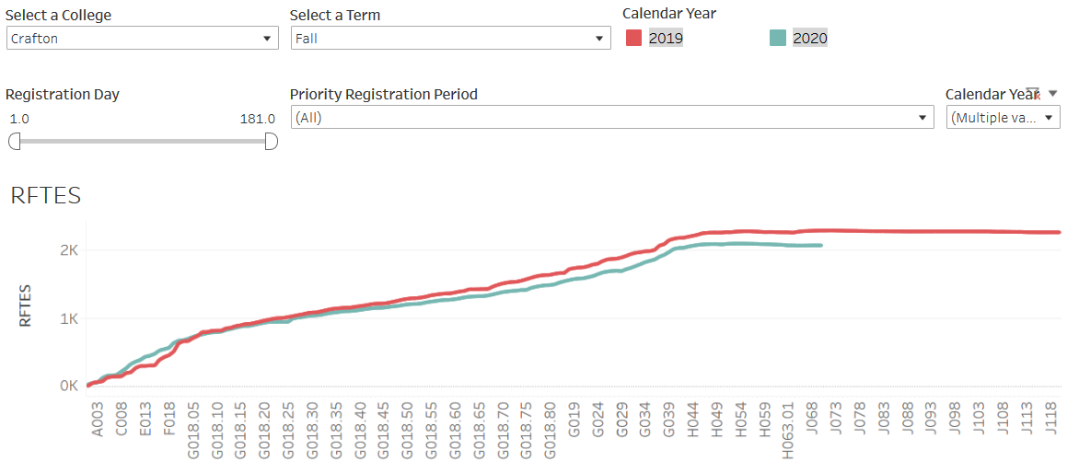
Resident FTES decreased from 2,276 in Fall 2019 to 2,059 in Fall 2020, a 9.5% decrease
2,276
2,059
Notes:
RFTES at Valley decreased from 4,788 in Fall 2019 to 3,992 in Fall 2020, a decrease of 17% (796).
Number of students at Crafton has decreased from 6,822 in fall 2019 to 5,909 in fall 2020, a decrease of 913 (13%) students. Suggesting that fewer students are enrolling in more courses.

Slide 25
Instructional Updates
Spring 2021 classes will be primarily remote.
Will be working with Chairs on identification of Synchronous and Asynchronous sections
The Emergency Remote Instruction Task Force meets on the fourth Friday of each month at 9AM
The All Campus Meeting focusing on Emergency Remote Instruction meets on the fourth Friday of each month at 10AM
Notes:
ERI Update
Tina Gimple helped with sending out information on how to set-up virtual box if student has Mac and needs to run PC. Thanks Tina!
At ERI All Campus Meeting - At last meeting asked if we can change the name of ConnectEd to something more meaningful to students. Rhiannon looked into this and found that we could not. Rhiannon has also contacted company to see if the name can be changed.
At ERI All Campus Meeting - Mental Health Support in Canvas – Delmy working on something that can be added to Canvas like the Transfer Center Shell. Is being worked on. I sent out word file and Student Services is developing the Canvas shell. Cynthia sent out email with link in Canvas Commons: Get assistance! CHC Support Services
At ERI All Campus Meeting - Brandi Mello said she would add to list instructions for students on how t add and drop classes - videos would be great - Check in with Brandi Mello

Slide 26

Congratulations!
To the Paramedic Program
  100% passed the State Written Exam
  100% Job Placement Rate
  88% Retention Rate
To the Art Faculty
  Virtual Duality: Art Faculty Exhibit 2020
  Instagram: chcartgallery

Slide 27
Accreditation Updates
Visiting Team has requested and been provided the following information
  Random samples of syllabi
  Compile and provide random selection of DE sections from Spring 2020. Include 10% of sections, but no more than 50.
Additional Requests for Evidence have been made on Wednesday and Thursday of this week
The Team will be Virtually Visiting Crafton the week of October 12
  Welcome Meeting – October 12 at Noon
  Open Forum – October 13 at 5:00 PM
  Open Forum – October 14 at 11:00 AM
  Exit Meeting – October 15 at 11:00 AM

Slide 28
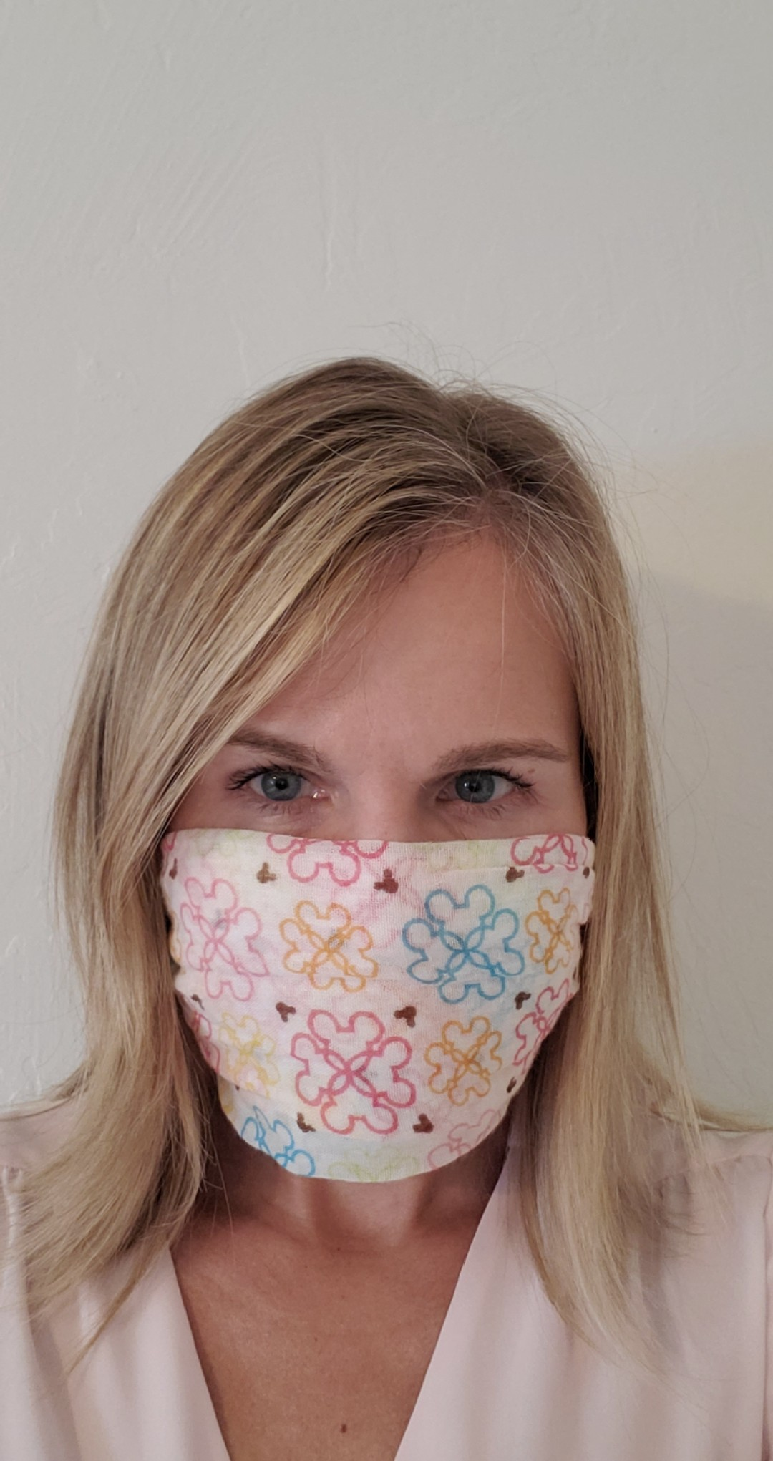
Melissa Oshman
Director, Information Technology & Services

Slide 29
Technology Updates
  Faculty/Staff Laptops & Hotspots
  2nd Monitors
  Hotspots for Students
  Virtual Workstations for Students

Slide 30
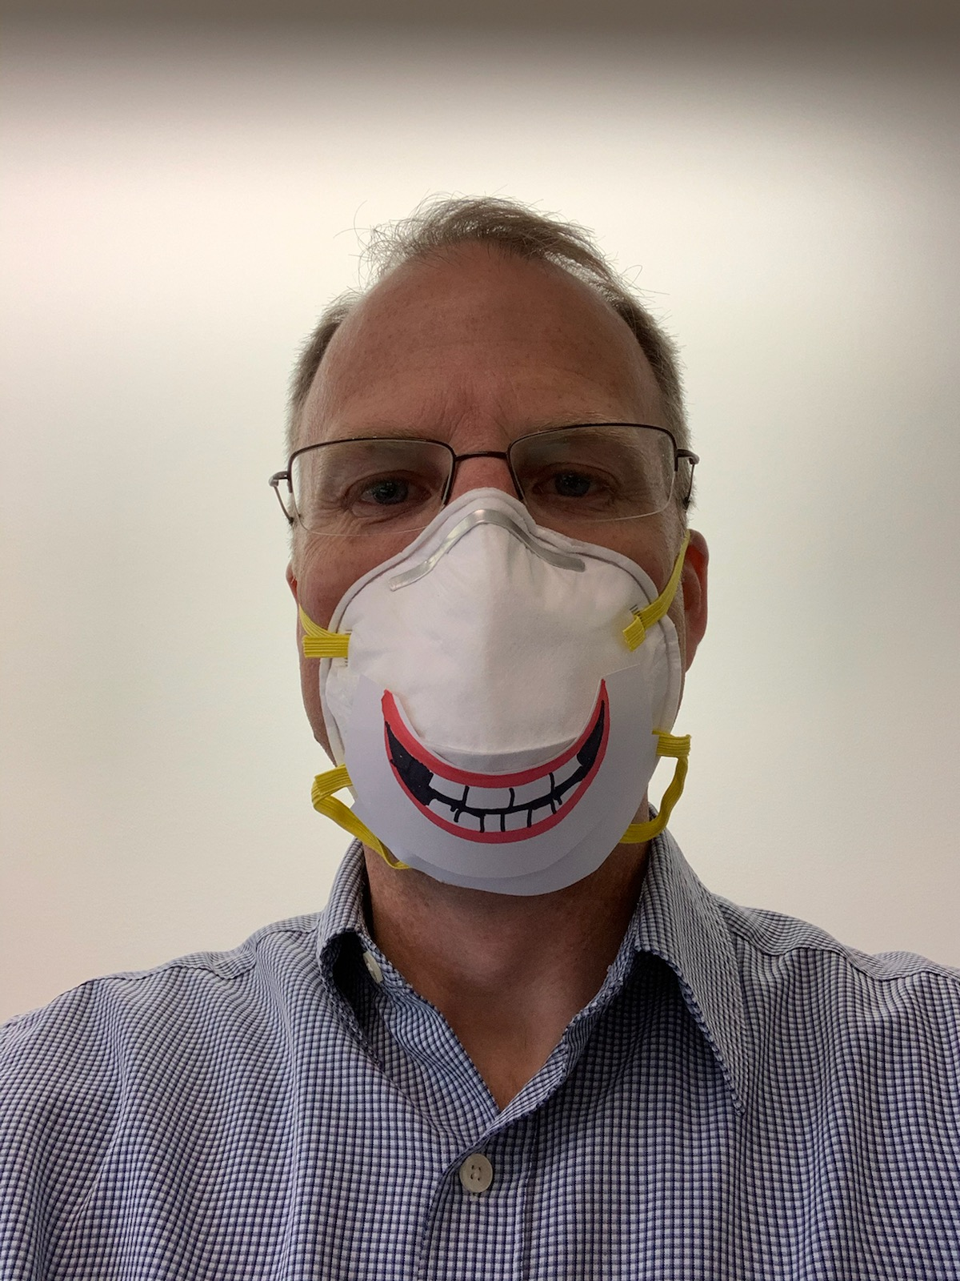
Mike Strong
Vice President, Administrative Services

Slide 31

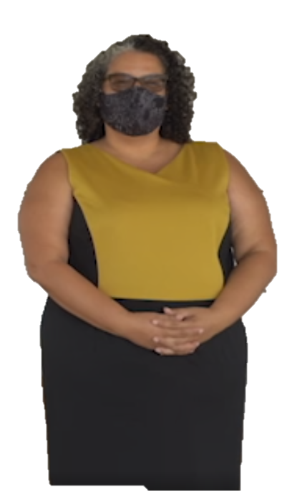


PPR Funding Update
$336K PPR $$ in 2019-20
Objectives requesting funding = 252
Objectives Funded or Partially Funded = 141
141/252 = 56% Funded
Request: Update objectives and resource requests
PPR

Slide 32
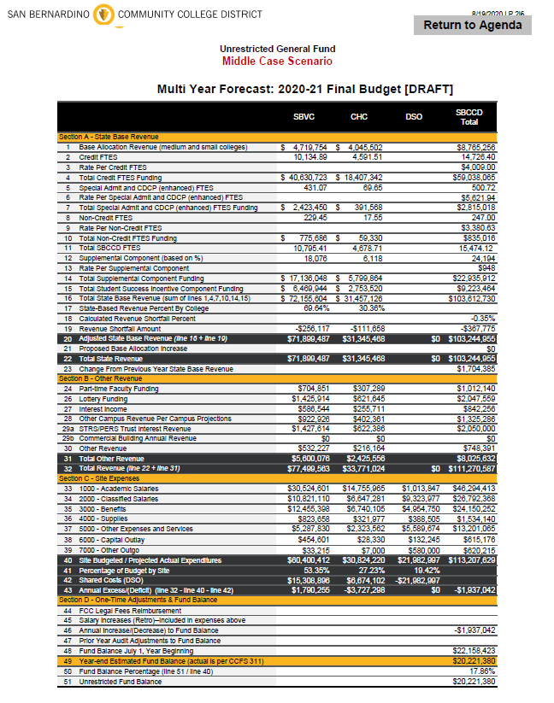
CHC Budget Update
2019-20 = 2020-21
Deferrals? a.k.a IOU’s
COVID $$
  CARES and Federal Grant Funding

Slide 33

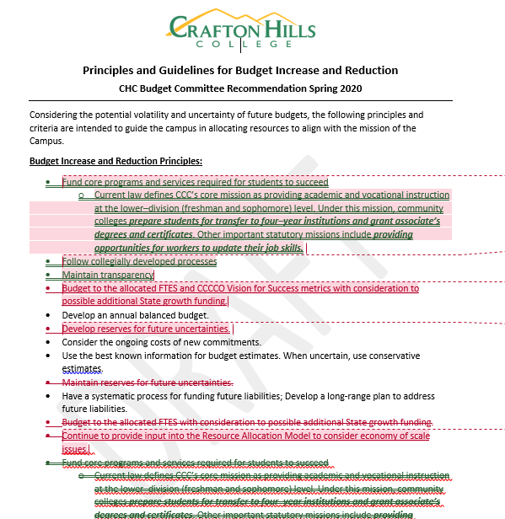
DRAFT - Budget Principles and Guidelines

Slide 34

Measure CC Projects

Slide 35
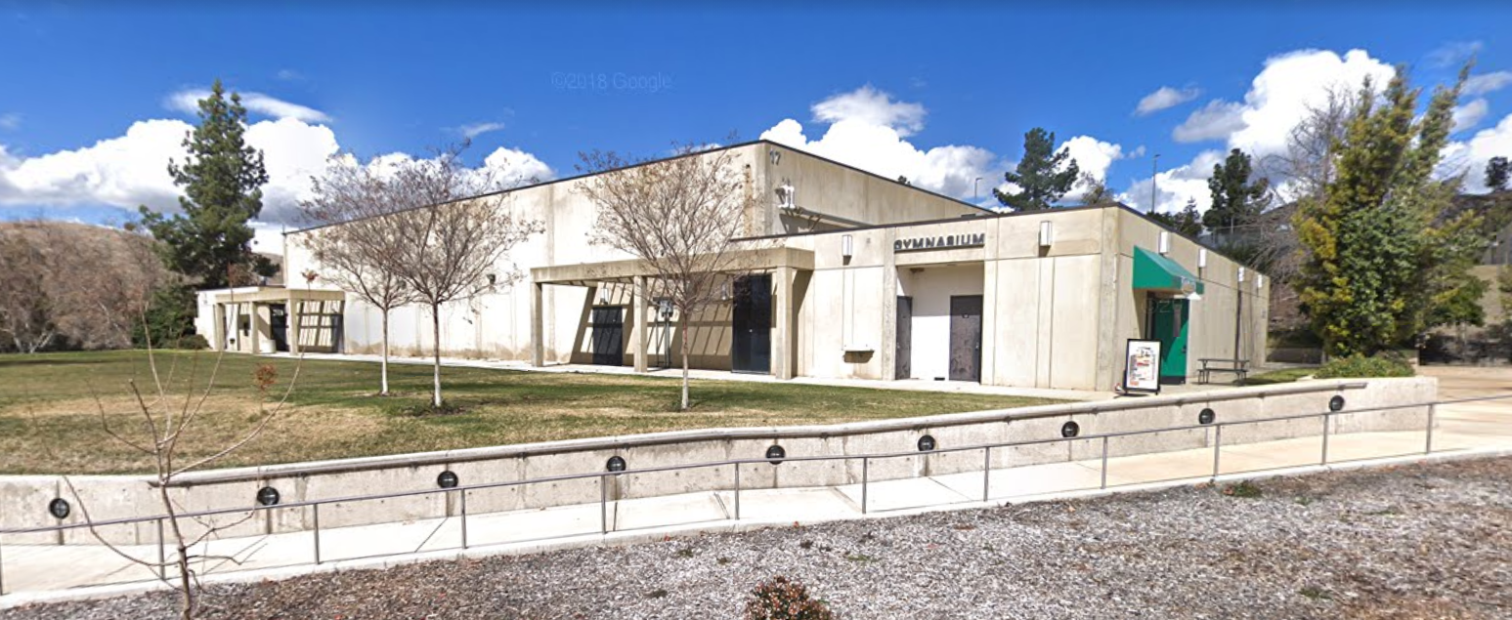
Gym Demo
Design Complete
10/1/2020
Demolition
12/2020-2/2021

Slide 36
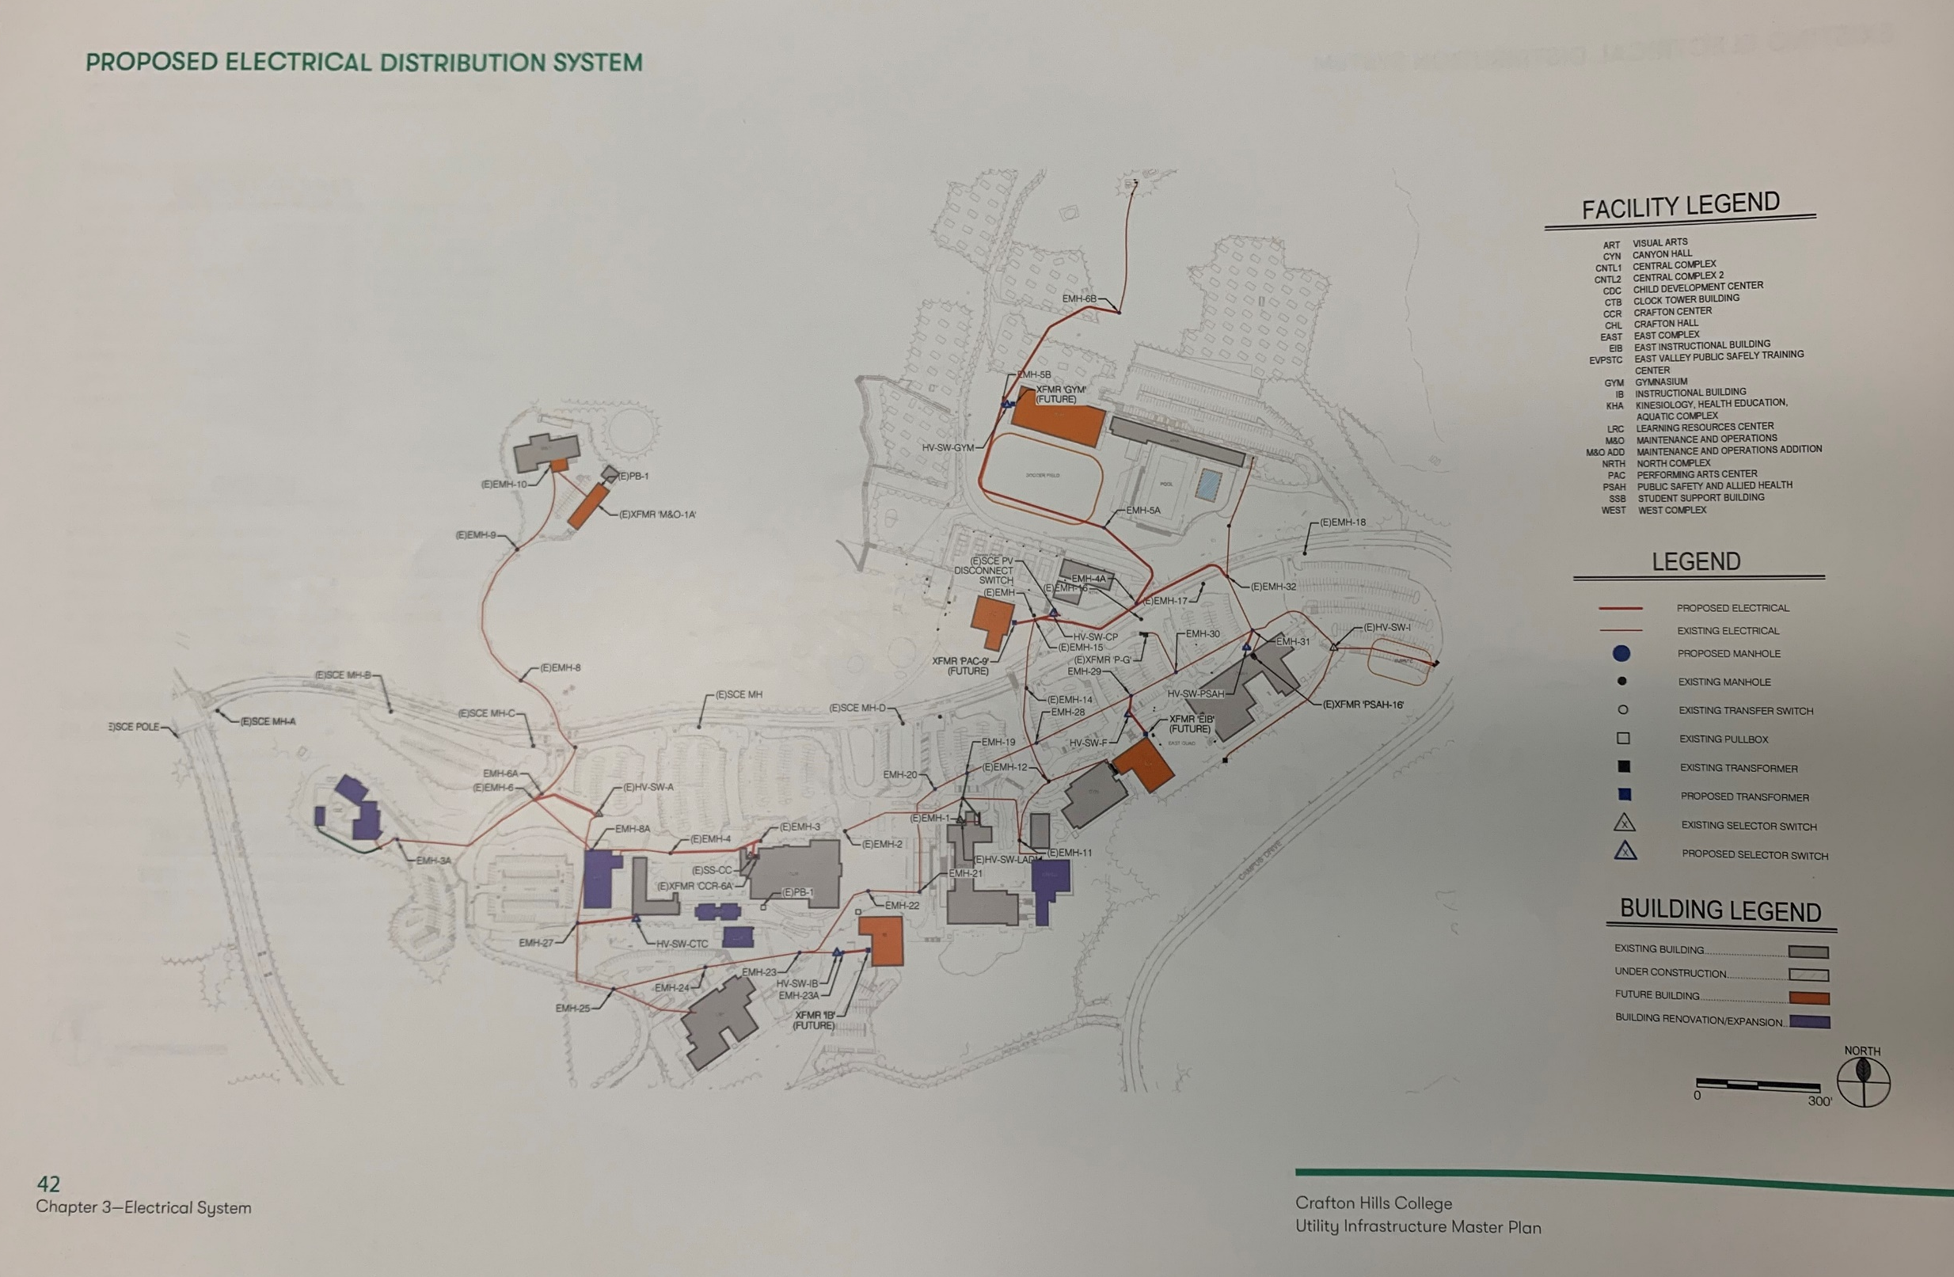
Infrastructure
Exterior Lighting Controls
Construction
11/2020-12/2020
Irrigation Controls Upgrade
Design Complete
11/2020
Construction
3/2021-5/2021
Future Measure CC Infra. Projects
Central Plant Upgrades
Building Roofing Improvements
Campus-wide Security Improvements
ADA Improvements

Slide 37
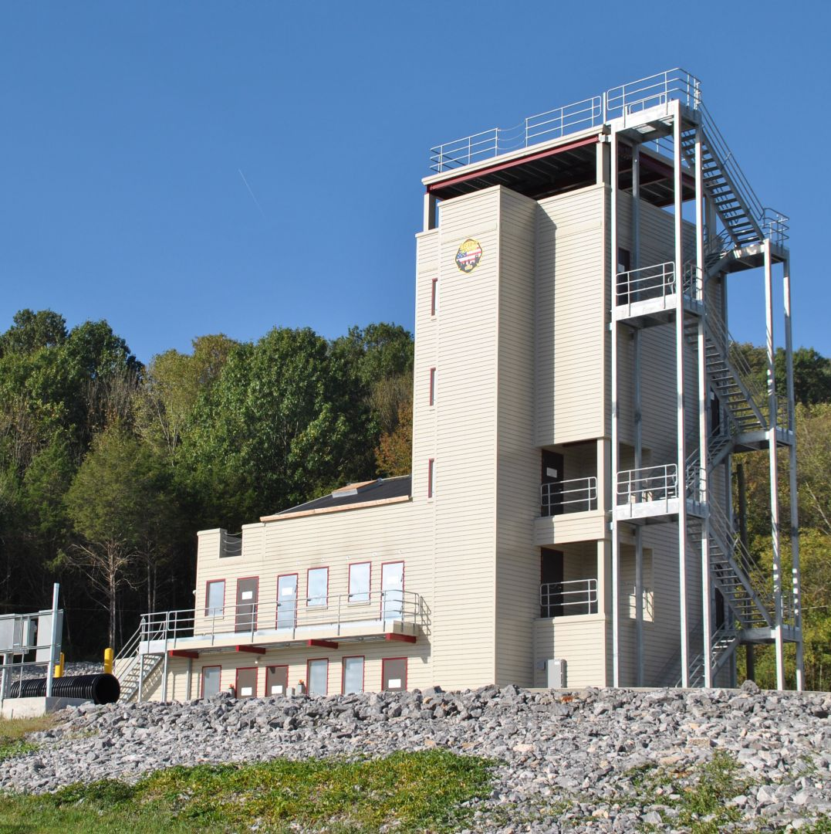
East Valley Public Safety Training Center
Design Build
Criteria Docs
10/2020-12/2020
Design
3/2021-9/2021
Construction
3/2022-2/2023

Slide 38
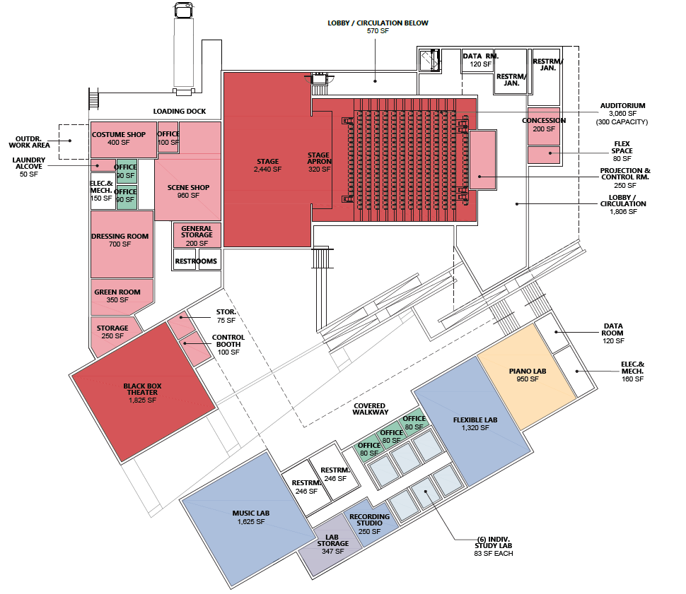
PAC Preliminary Scope
Schedule:
Programming and Design 12/2020 – 8/2021
Construction
4/2022 – 12/2023

Slide 39
More Design Coming…2021
What to Expect 2021 (design w/ construction to follow)
  Central Complex 2 Renovation Child Development Center Renovation
  Student Support Building Renovation
  Child Development Center Renovation
2022+
  Crafton Hall Renovation
  Arts Demo
  Instructional Building (new construction)

Slide 40

CHC Emergency Evacuation Drill
10/22/20
at
10:22AM

Slide 41
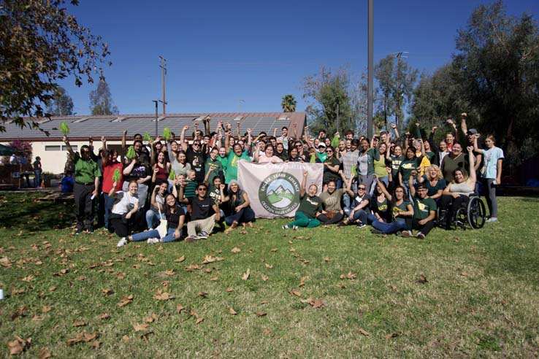
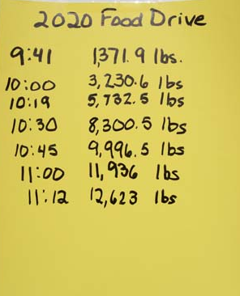

CHC 3 Peaks Challenge
Redlands Family Services Food Drive
SAVE THE DATE
Saturday, November 14, 2020

Slide 42
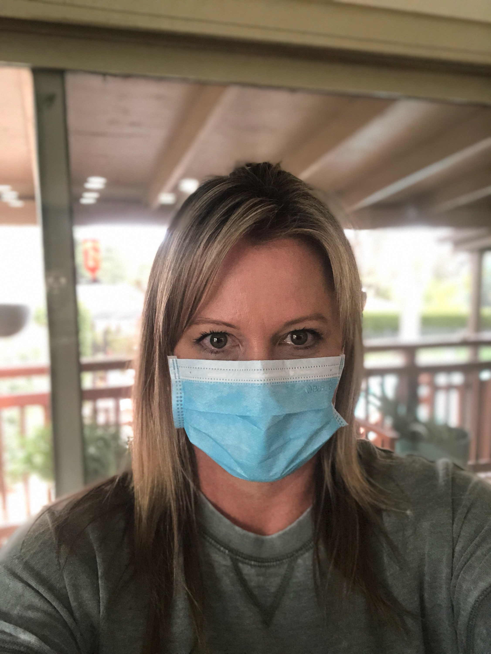
Michelle Riggs
Director, Institutional Advancement

Slide 43
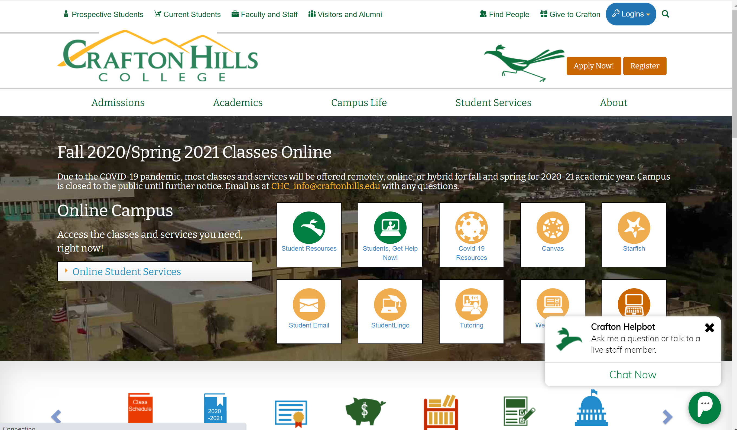
Website Optimization

Slide 44
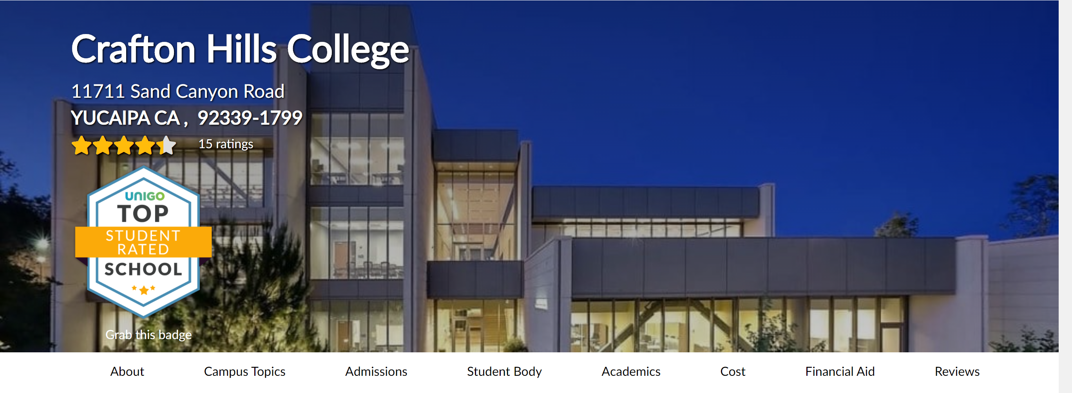
Search Optimization and Reviews

Slide 45
Emergency Assistance Funds for Students
Apr- Sep $29,835

Slide 46
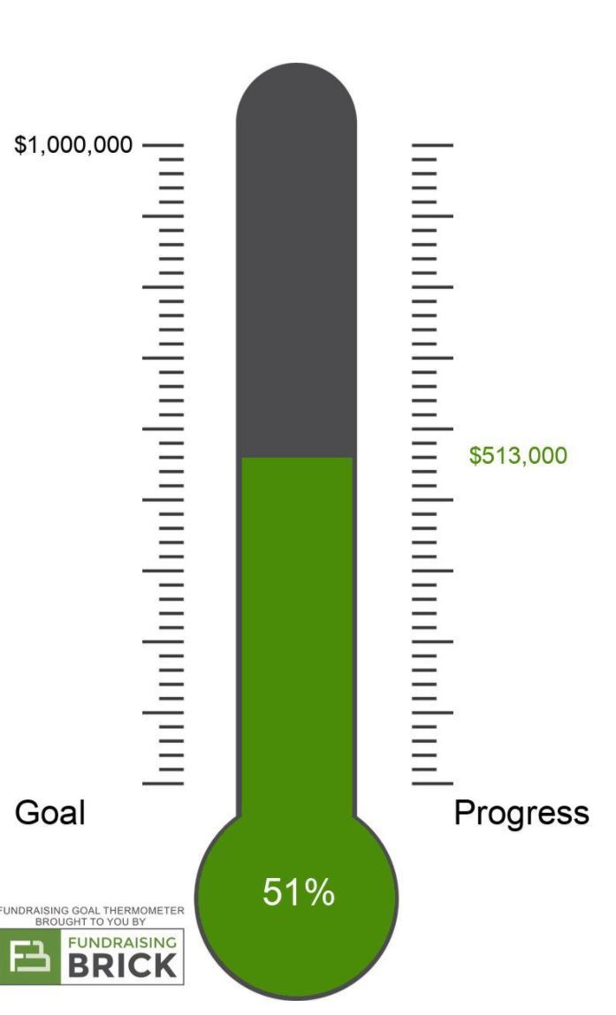


#TEAMCRAFTON – Endowment Challenge

Slide 47
Q&A

