Slide 1
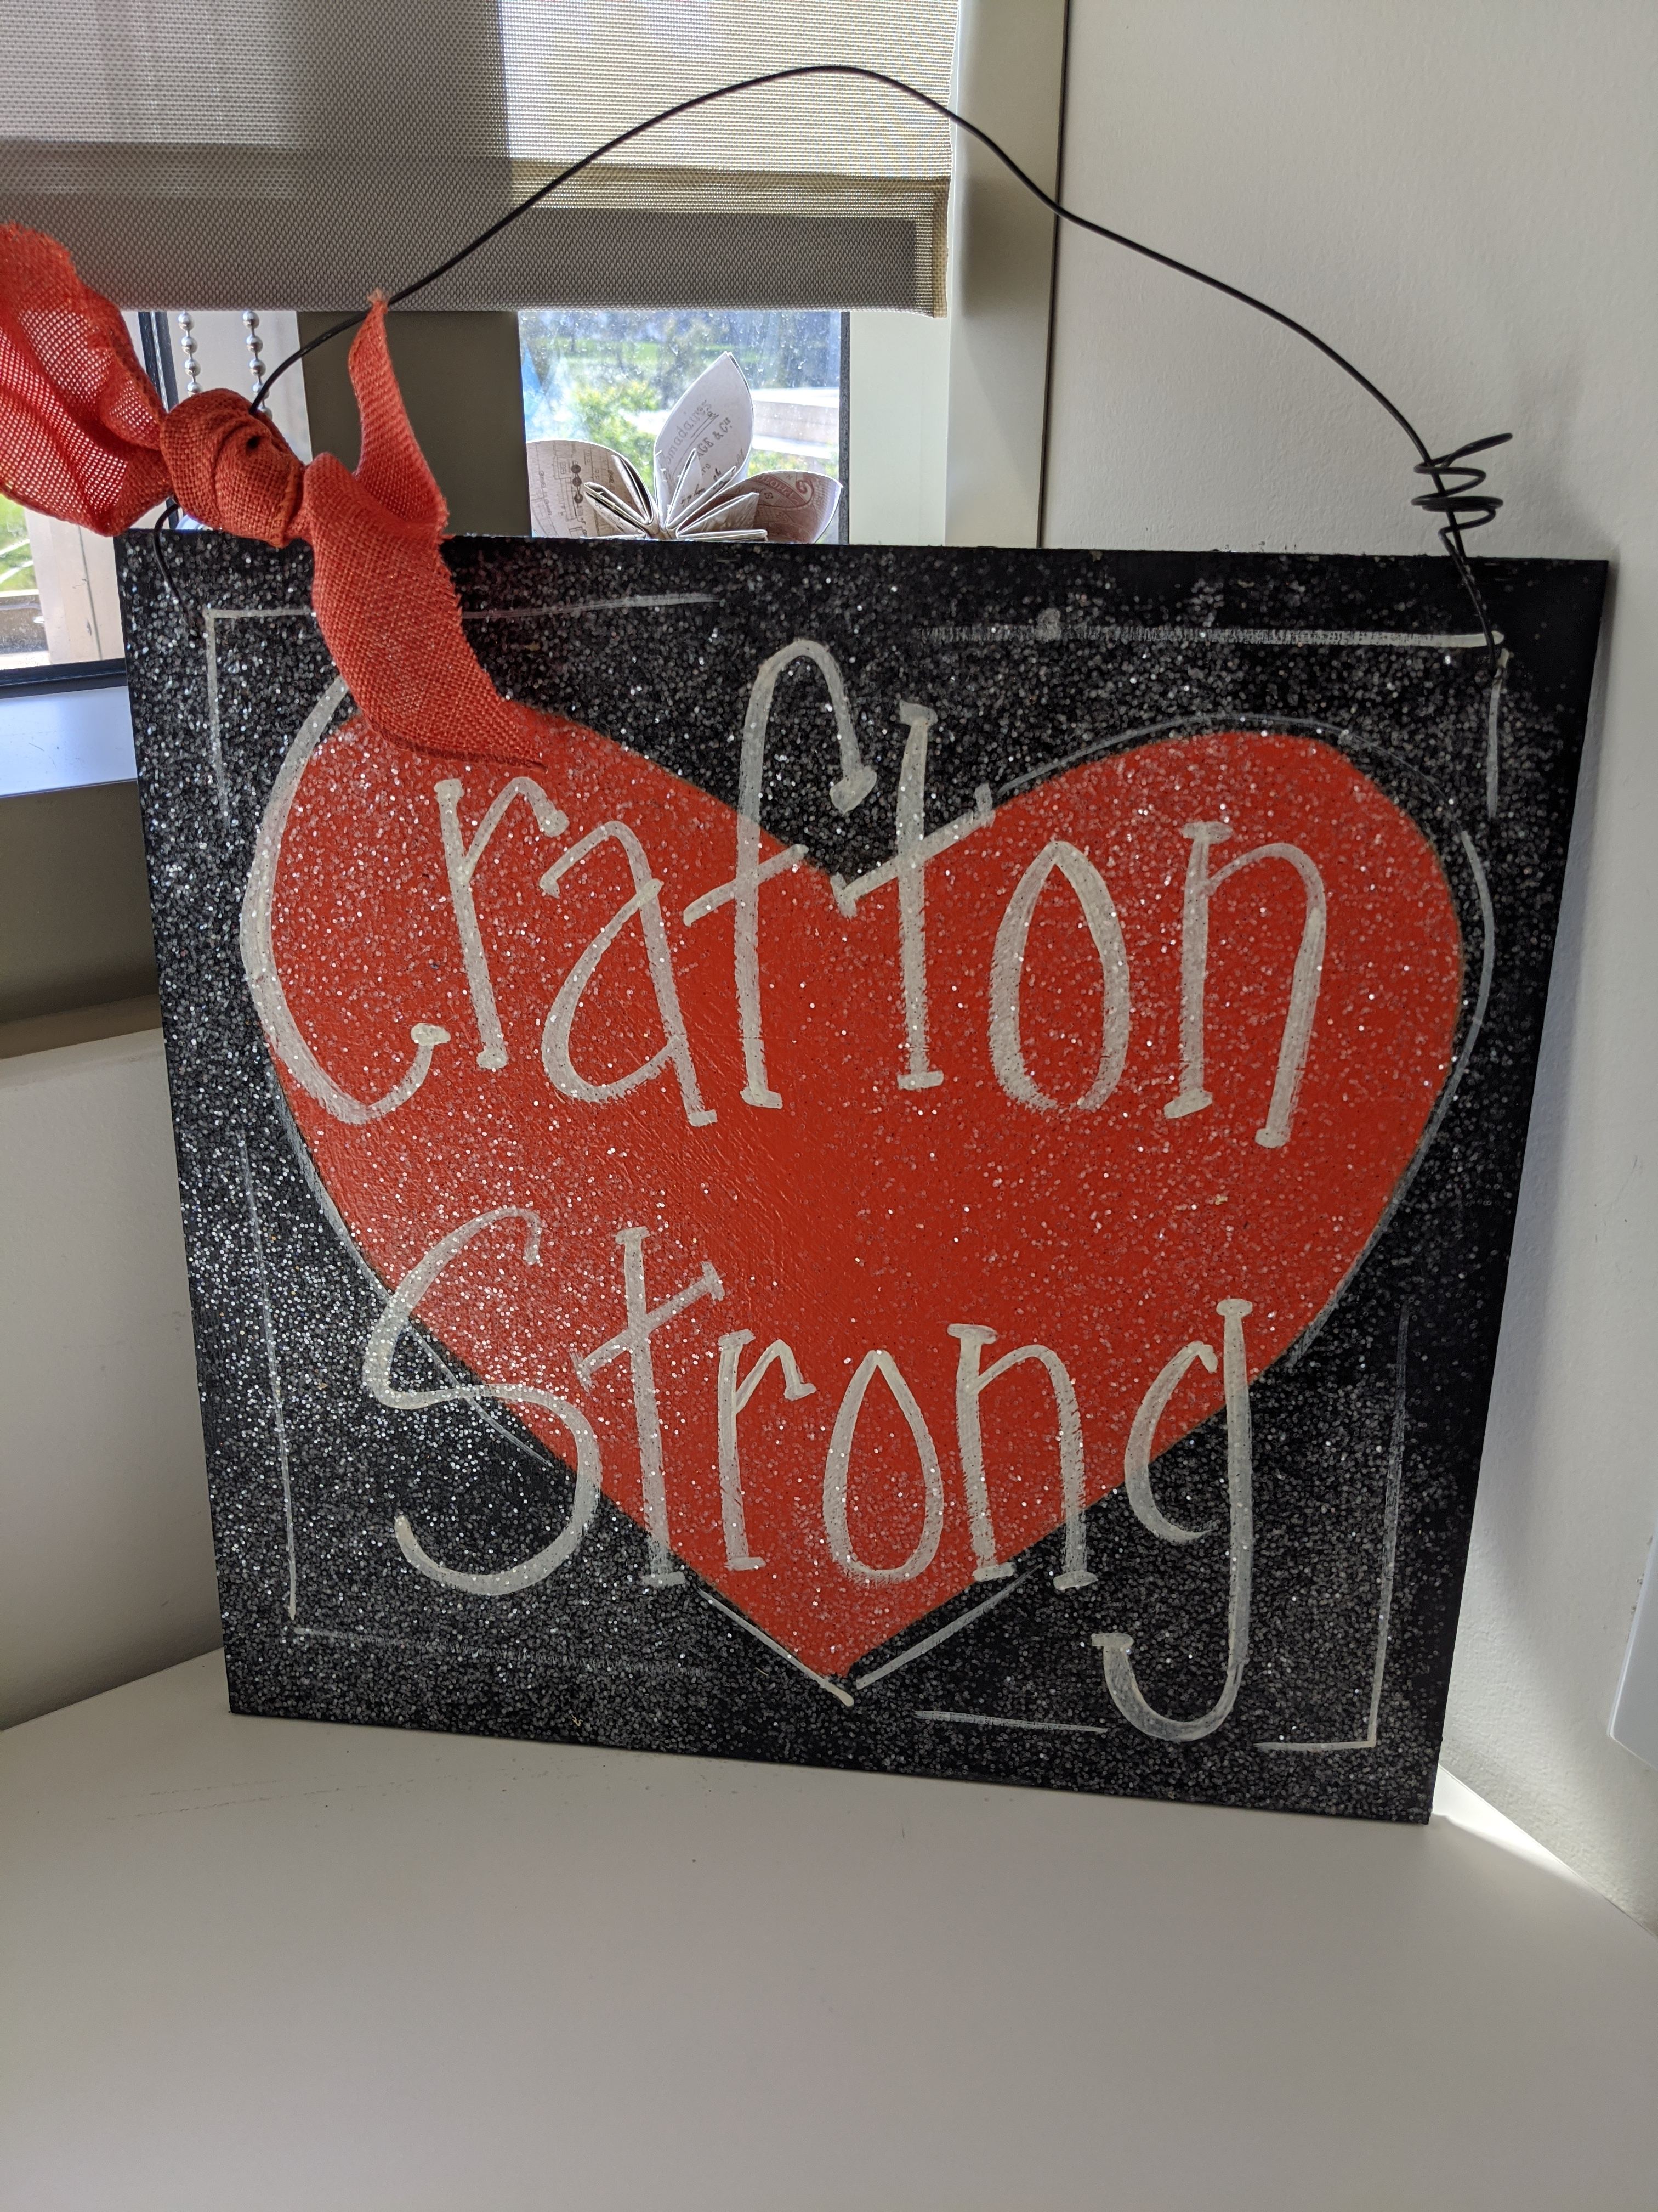

All Campus Zoom
May 14, 2021

Slide 2
Agenda
Career & Academic Pathways (Josh Robles & Shella Scott)
Re-Opening FAQs (Mike Strong)
One Book-One College (Kay Weiss & Team)
Virtual Gala (Michelle Riggs)
Academic Senate Recognitions
Keith’s Last Top 10 of the Pandemic
Q&A Document

Slide 3
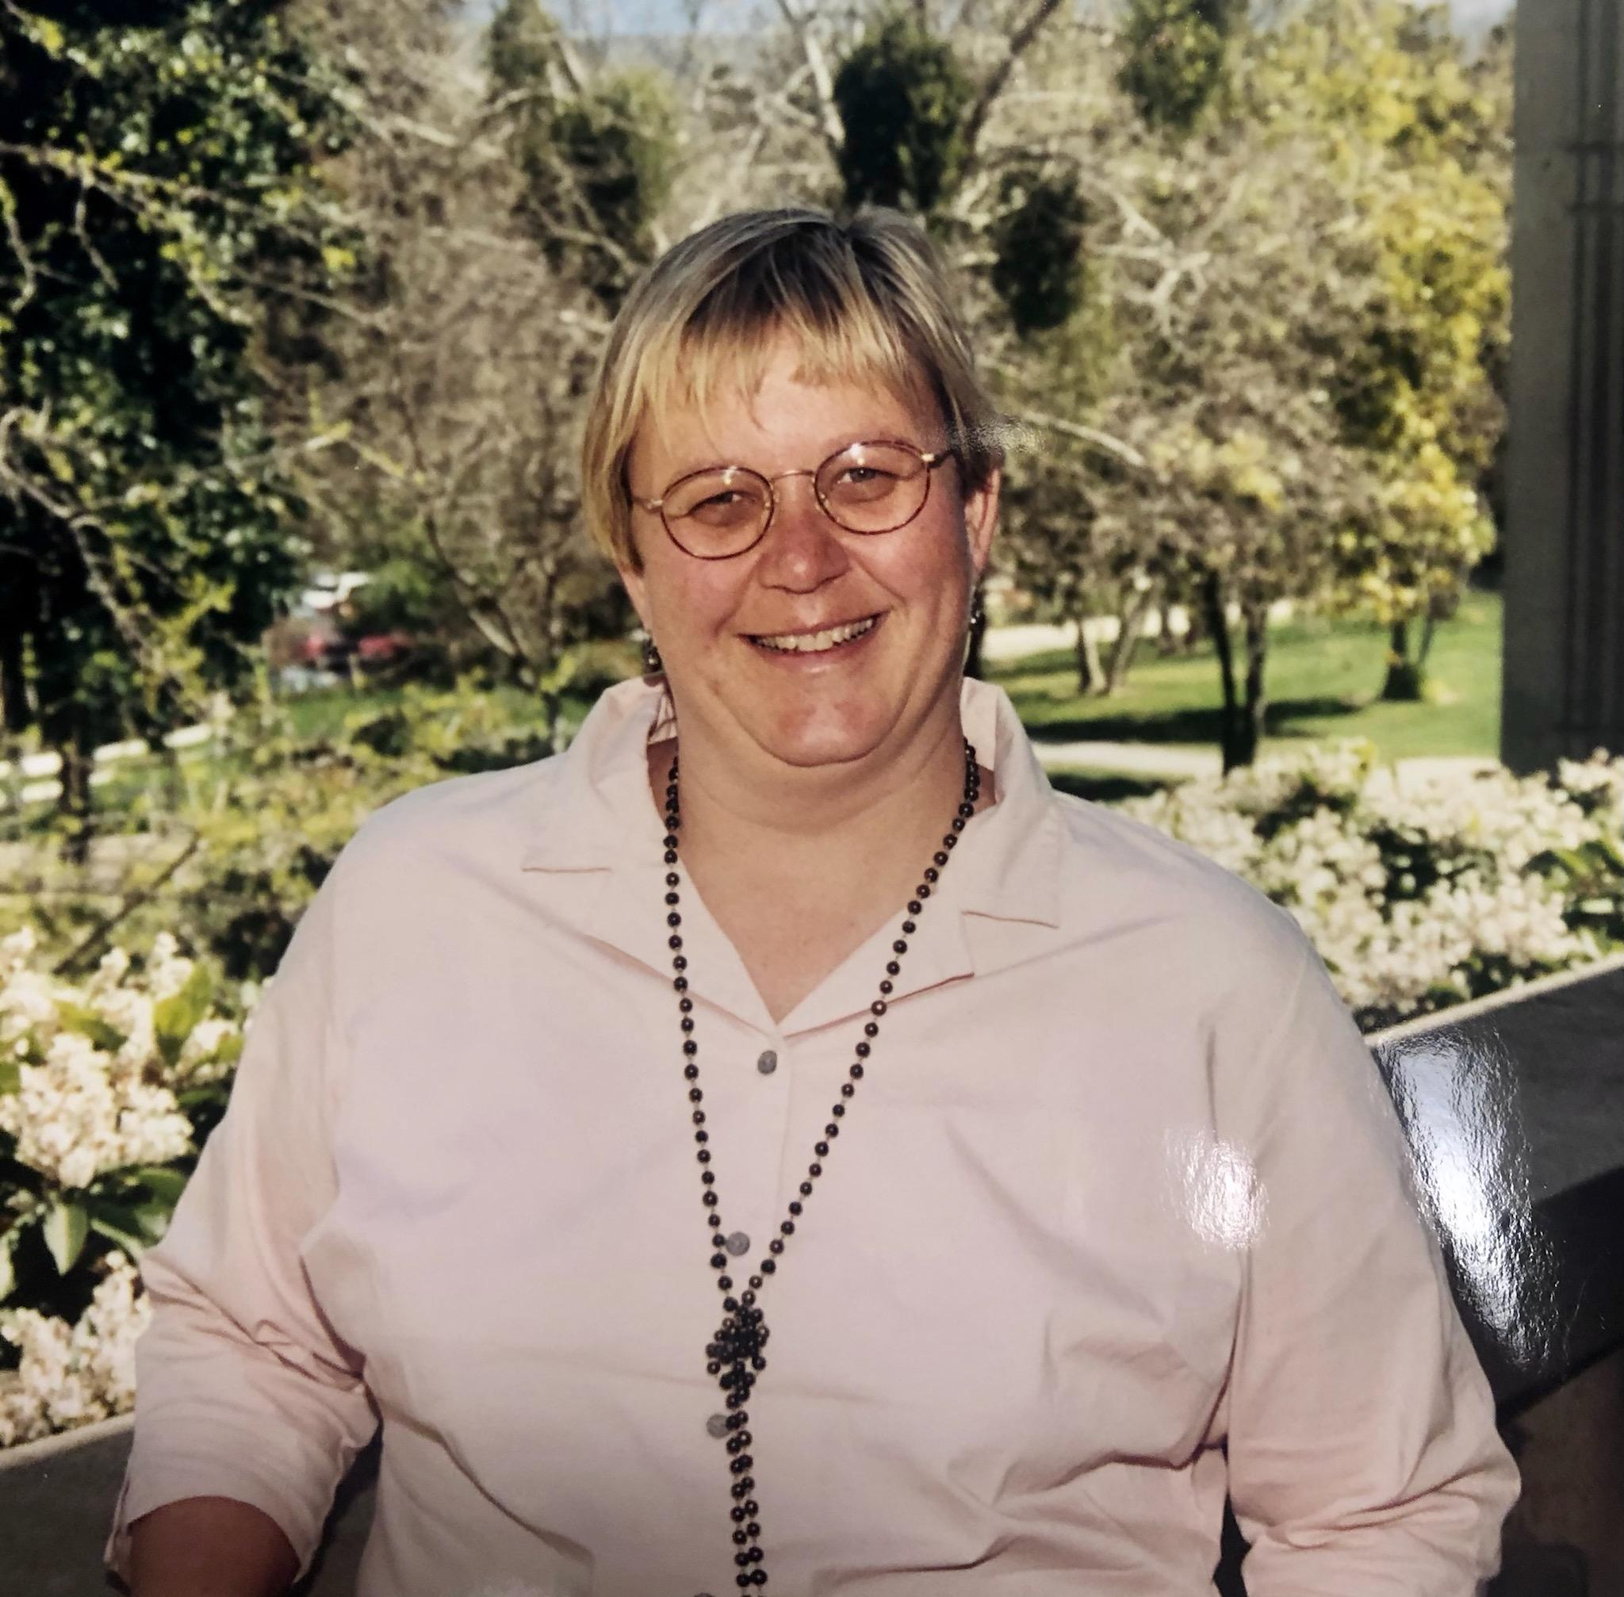

Kirsten Colvey
40 Years of Dedicated Service

Slide 4
Q&A

