Slide 1
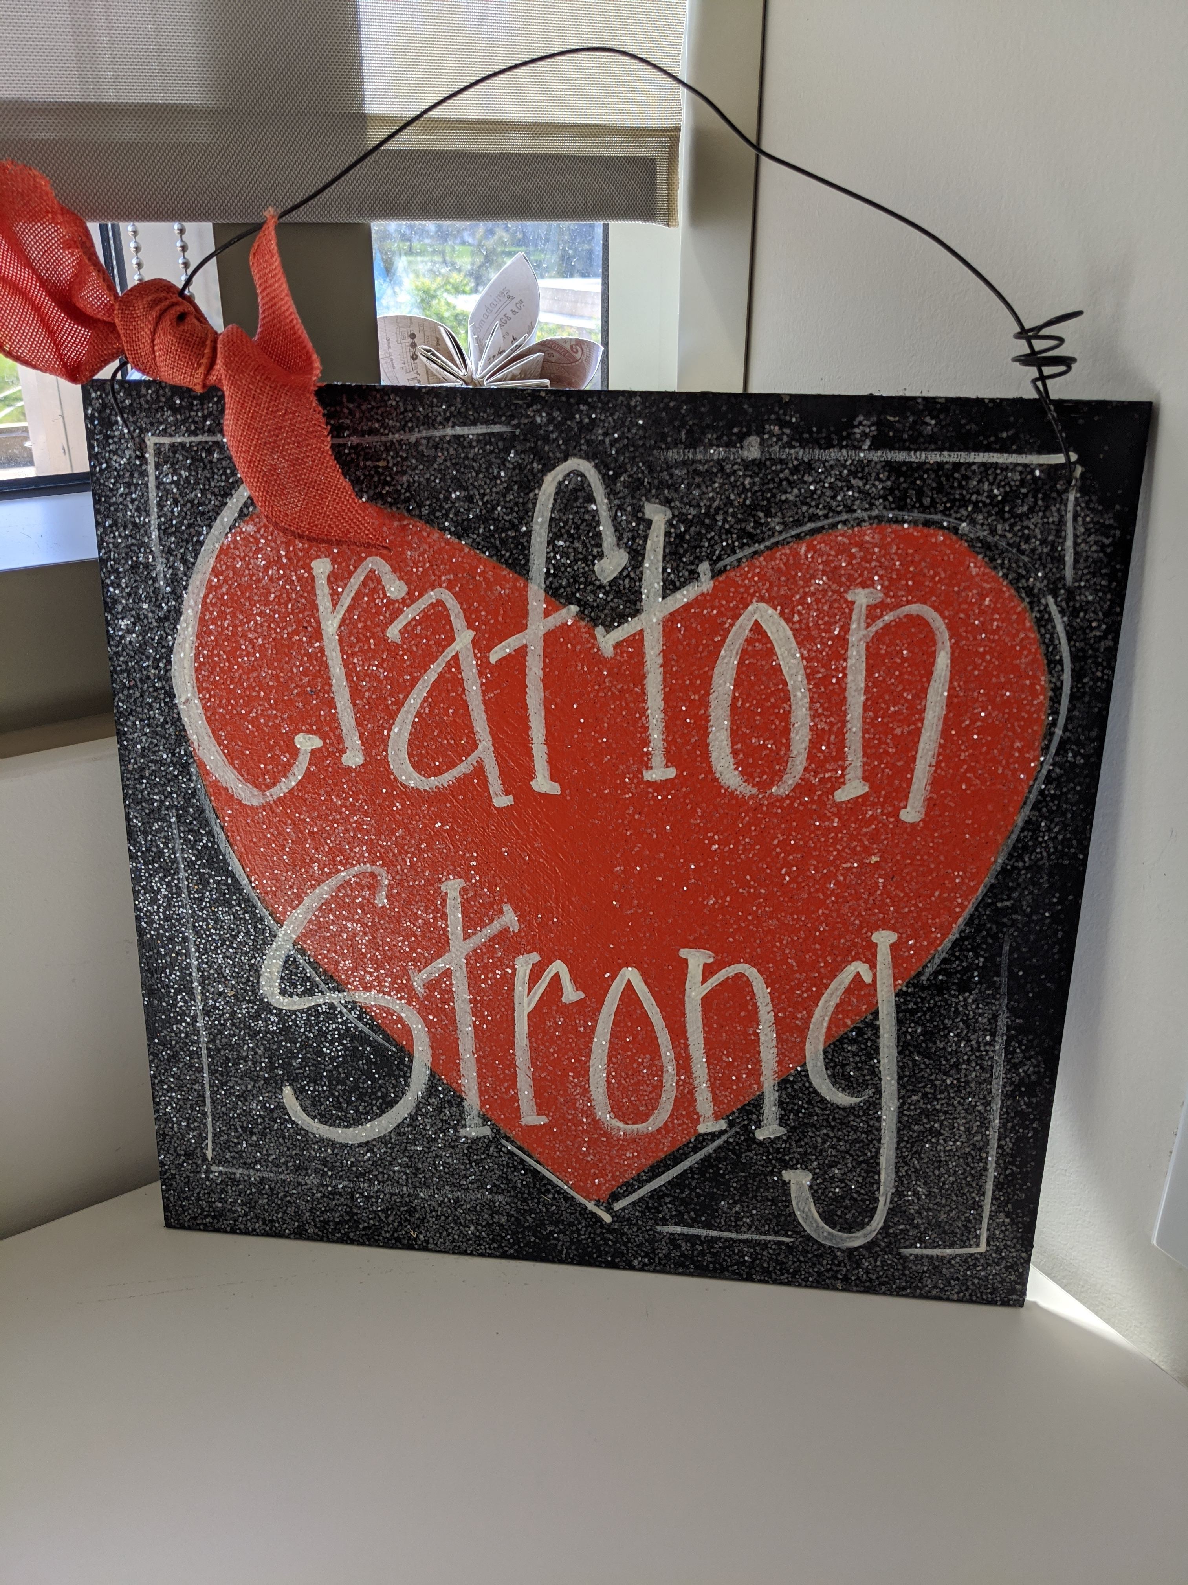

All Campus Zoom
April 16, 2021

Slide 2
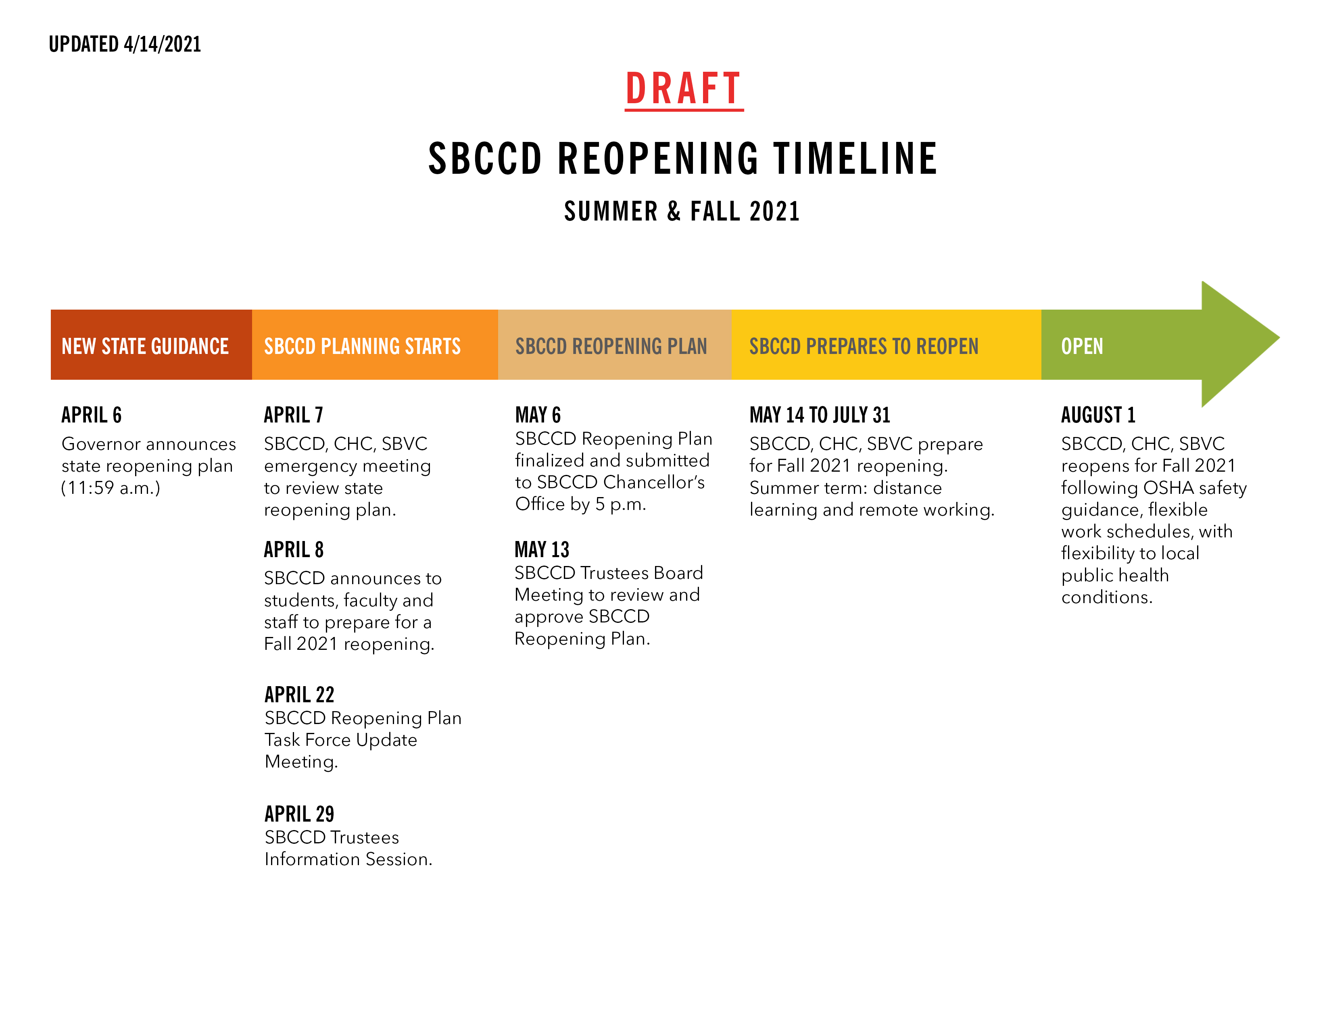

Slide 3
Re-Opening
  District Task Force
  Planning to Enable Re-Opening For Fall 2021
  State Tier & County Requirement Changes
  Department Meetings to Develop Local Needs Assessment
  Collective Bargaining Process
  No Summer Blip (it’s an Avengers/Marvel thing)
  Q&A Document

Slide 4

Equity Minded Student Support Services
March 2021
Delmy Spencer, Jessica Macias, Rejoice Chavira, Rebecca Abeyta,
Ernesto Rivera

Slide 5

Technology Update
Melissa Oshman

Slide 6

Gala Update
Michelle Riggs

Slide 7

www.craftonhills.edu/gala

Slide 8
Opportunity Drawing

Slide 9

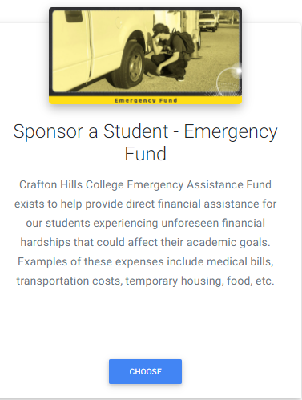
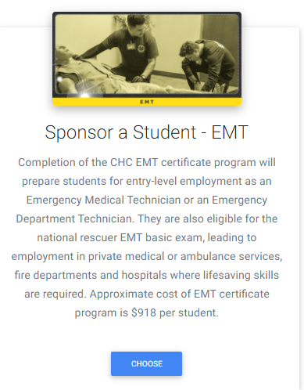
Sponsor a Student – Win Prizes!
Weekend Getaway for Memorial Day

Slide 10



Slide 11
Q&A

