Slide 1


All College Zoom

Slide 2
Anti-Black Racism
November 13, 2020
Laurie Green, Veronica Lehman,
Krista Ivy, Monique Ware, Melissa Oshman

Slide 3

Anti-Black Racism
Having an intense disdain for black people, black history, black intellect, and sociopolitical progress for blacks.
It is a mindset and a practice
It is sustained by social stereotypes making is socially acceptable
It is a global issue

Slide 4
Anti-Racism Institutional Actions
Examine the History of Racism on Campus
Identify concrete ways to reconcile for history of racism
Lift Minoritized Voices
Seek student, staff, & faculty voices and experiences of racism
Address Racism in Teaching and Learning
African-American contributions are absent from curricula

Slide 5
Anti-Racism Institutional Actions
Address Racism in Student Services
Three persistent patterns of anti-blackness
Underserved
Unwelcomed
Underchallenged
Address Racism in Campus Policing
Analysis of Data
Performance Evaluation
Complaints by Students
Professional Development
Hiring Process
Advisory Board / Events
Address Racism in Human Resources
Job Descriptions
Application Assessment
Employee Grievances
Hiring Committees
Visits and Forums
Performance Evaluations

Slide 6
Anti-Racism Institutional Actions
Critically Examine Student Conduct Data
Using hyper surveillance
How does student conduct at CHC contribute to Black students learning outcome
Does our process involve state expectations for black student outcomes?
Integrate Anti-Racism Actions
First step we must acknowledge that the events of our society impact the practice and activities of students
We must make ourselves incredibly familiar with the positive history that centers the perspectives and stories of Black people.
Embrace multiple, factual perspectives in our curriculum and actively work to integrate anti-racism into our teaching.
What narratives are you telling yourself about students, and how does that affect grading, behavior management and other interactions?
Disaggregate Student Success Data To Reveal Hidden Patterns Of Racial Inequity
Disaggregated data can highlight trends and disparities that may otherwise go unnoticed and help educators allocate resources and target efforts to close educational achievement gaps and improve educational outcomes for all students

Slide 7

What Can We Do??
Student Participation
Campus Climate Surveys
Town Halls
Social Justice Groups
Campus Participation
Social Justice Committees
College Strategy Courses
Inclusive Curriculum
Equity in Strategic Plan and PPR
Data Disaggregation

Slide 8


Slide 9
Career and Academic Pathways (CAPs)
Prepared and Presented by: Sabrina Jimenez, Joshua Robles, Shella Scott, Giovani Sosa, Delmy Spencer, and Keith Wurtz
Notes:
Sabrina
20 minutes each. Materials due 10/21. Presentation on November 5. Kevin would like GP lead(s) and both Delmy and I to participate in presentation to demonstrate collaboration that is taking place.

Slide 10

Objectives
Review the four pillars of Career and Academic Pathways (CAPs)
Review the progress on each pillar and next steps
Provide a snapshot of research on each pillar where available
Review the objectives for the year
Notes:
Keith

Slide 11
Four Pillars of Career and Academic Pathways (CAPs)
Clarifying the Path
Enter (Hopping on) the Path
Staying on the Path
Ensuring Learning
Notes:
Keith

Slide 12

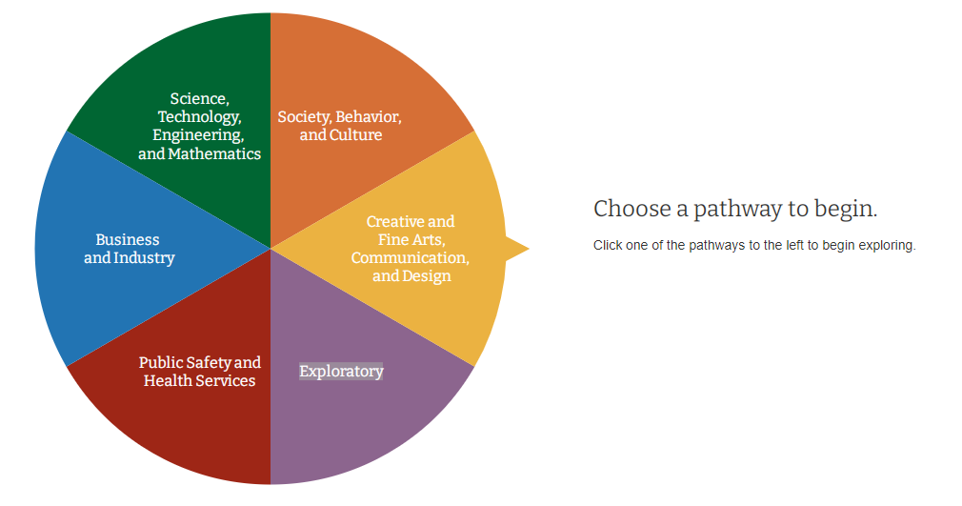
Clarifying the Path
Progress to Date
Developed and refining five Career and Academic Pathways (CAPs)
Developed and refining the CAPs student website
Next Steps
Finalize the CAPs and the student website
Notes:
Still in the process of getting input on CAPs and website
Shella, Sabrina as backup.

Slide 13

Enter (Hopping on) the Path
Progress to Date
Starfish-based degree planner
Career Exploration
College Promise
AB 705 – Placement into transfer level math and English
AB 705 – Co-Requisite math and English courses
Embedded Tutoring and Supplemental Instruction
Next Steps
Integrate career exploration into the onboarding process and the first-educational plan
Increase faculty use of Starfish to connect students to the appropriate campus support
Examine relationship of embedded tutoring and co-requisite classes with course success
Notes:
Starfish-based degree planner allows the college to determine students’ progress towards achieving an award, identify students nearing the completion of an award, and determine how changes in an individual student’s enrollment activity affects their attainment of a given award
Delmy and Shella

Slide 14
Getting on the Path AB705 Research
Transfer-Level Math Placement: The percentage of students placing into transfer-level math has almost tripled from 29% to 86%.

Slide 15
Getting on the Path AB705 Research
Transfer-Level English Placement: The percentage of students placing into transfer-level English has more than doubled from 45% to over 99%.

Slide 16
Getting on the Path AB705 Research
Math Enrollments: The number of enrollments in transfer-level math increased from 1,044 in Fall 2017 to 1,568 in Fall 2019, a 50% increase.
Notes:
The number of non-transfer-level math course sections has declined since Fall 2017. The Fall 2017 to Fall 2019 offerings have declined by 51%, and the Spring 2019 to Spring 2020 offerings have declined by 53%.
The math department began the work of aligning its placement to AB 705 regulations in Fall 2018; therefore, Fall 2017 data are included to depict a time point prior to AB 705 implementation.
The number of transfer-level math course sections in math has increased since Fall 2017. Specifically, 32 transfer-level math course sections were offered in that term compared to the 53 offered in Fall 2018, a 66% increase. The math department began the work of aligning its placement to AB 705 regulations in Fall 2018; therefore, Fall 2017 data are included to depict a time point prior to AB 705 implementation.

Slide 17
Getting on the Path AB705 Research
English Enrollments: The number of enrollments in transfer-level English increased from 1,292 in Fall 2018 to 1,760 in Fall 2019, a 36% increase.
Notes:
The number of non-transfer-level English course sections has declined since Fall 2018. From Spring 2019 to Spring 2020, the number of sections declined from 24 to 9, a 63% decline from year-to-year.
The number of transfer-level English course sections has increased since Fall 2018. Specifically, the number of offerings has increased by 33% between Fall 2018 and Fall 2019, and by 30% between Spring 2019 and Spring 2020.

Slide 18

Staying on the Path
Progress to Date
Starfish as a Student Retention Tool
Process in place that is designed to contact at-risk students and connect them with counselors and other support staff
College Promise
EOPS
Counseling
Tutoring
Next Steps
Increase faculty use of Starfish
Fully implement ability for students to register for classes off of their educational plans
Further develop process of scheduling classes that is informed by educational plans, research, and enrollment management strategies
Notes:
When faculty identify students in need of additional supports, staff are in place to intervene.
Delmy

Slide 19
Staying on the Path Starfish Research
Starfish Usage (Flags, Kudos, Referrals, etc.): CHC has observed a 562% increase in the use of Starfish between Fall 2017 and Fall 2019
Notes:
The number of student progress reports, kudos, referrals, and to-do Starfish items has increased from 1,432 in Fall 2017 to 9,480 in Fall 2019, a 562% (8,084) increase.
Students in a course that used Starfish had a substantially and statistically significantly higher course success rate (71%) than students in a comparison course that did not use Starfish (66%)

Slide 20
Staying on the Path Starfish Research
Success Rates by Starfish Usage among African American and Hispanic Students in 2018-19: African and Hispanic students achieve significantly higher success rates when their instructors use Starfish.
Notes:
African American, Hispanic, and Multiple Race students in a Starfish supported course had a substantially and statistically significant higher course success rate (68%) than students in a comparison course that did not use Starfish (61%)
Gaps are closing (no starfish, starfish – respectively): 4.606193 (based on 66.2 overall SR for no Starfish) 3.943708 (based on 72.9 overall SR for Starfish)

Slide 21
Staying on the Path AB705 Research
Successful Completion of Transfer-Level Coursework in Math: The number of successful grade earners in transfer-level math increased from 483 in Fall 2017 to 879 in Fall 2019, an 82% increase.
Notes:
Josh (this is additional/background information)
The number of non-transfer-level English course sections has declined since Fall 2018. From Spring 2019 to Spring 2020, the number of sections declined from 24 to 9, a 63% decline from year-to-year.
The number of transfer-level English course sections has increased since Fall 2018. Specifically, the number of offerings has increased by 33% between Fall 2018 and Fall 2019, and by 30% between Spring 2019 and Spring 2020.
The number of non-transfer-level math course sections has declined since Fall 2017. The Fall 2017 to Fall 2019 offerings have declined by 51%, and the Spring 2019 to Spring 2020 offerings have declined by 53%.
The math department began the work of aligning its placement to AB 705 regulations in Fall 2018; therefore, Fall 2017 data are included to depict a time point prior to AB 705 implementation.
The number of transfer-level math course sections in math has increased since Fall 2017. Specifically, 32 transfer-level math course sections were offered in that term compared to the 53 offered in Fall 2018, a 66% increase. The math department began the work of aligning its placement to AB 705 regulations in Fall 2018; therefore, Fall 2017 data are included to depict a time point prior to AB 705 implementation.
The number of enrollments in transfer-level English have increased since Fall 2018. From Fall 2018 to Fall 2019, the number of sections increased from 1,292 to 1,760 (36% increase). Similarly, from Spring 2019 to Spring 2020, they increased from 1,265 to 1,715 (36% increase).
Equity results in Gio’s report….

Slide 22
Staying on the Path AB705 Research
Successful Completion of Transfer-Level Coursework in English: The number of successful grade earners in transfer-level English increased from 970 in Fall 2018 to 1,270 in Fall 2019, a 31% increase.
Notes:
Josh (this is additional/background information)
The number of non-transfer-level English course sections has declined since Fall 2018. From Spring 2019 to Spring 2020, the number of sections declined from 24 to 9, a 63% decline from year-to-year.
The number of transfer-level English course sections has increased since Fall 2018. Specifically, the number of offerings has increased by 33% between Fall 2018 and Fall 2019, and by 30% between Spring 2019 and Spring 2020.
The number of non-transfer-level math course sections has declined since Fall 2017. The Fall 2017 to Fall 2019 offerings have declined by 51%, and the Spring 2019 to Spring 2020 offerings have declined by 53%.
The math department began the work of aligning its placement to AB 705 regulations in Fall 2018; therefore, Fall 2017 data are included to depict a time point prior to AB 705 implementation.
The number of transfer-level math course sections in math has increased since Fall 2017. Specifically, 32 transfer-level math course sections were offered in that term compared to the 53 offered in Fall 2018, a 66% increase. The math department began the work of aligning its placement to AB 705 regulations in Fall 2018; therefore, Fall 2017 data are included to depict a time point prior to AB 705 implementation.
The number of enrollments in transfer-level English have increased since Fall 2018. From Fall 2018 to Fall 2019, the number of sections increased from 1,292 to 1,760 (36% increase). Similarly, from Spring 2019 to Spring 2020, they increased from 1,265 to 1,715 (36% increase).
Equity results in Gio’s report….

Slide 23
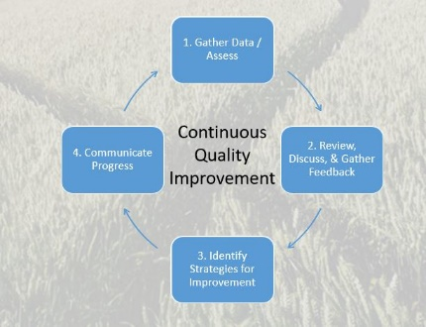
Ensuring Learning
Progress to Date
Learning outcomes for CTE programs align closely with relevant employment skills and labor market demand
Each CTE program has an advisory committee comprising employers in the field
Continue to apply the results of learning outcomes assessment to improve the effectiveness of instruction across programs
Next Steps
Fully implement six-year outcomes assessment with disaggregated student learning outcome results
Provide data at every committee meeting to inform decision making
Increase those trained in how to access, interpret, and apply data to decision making
Notes:
Gio and Keith
When faculty identify students in need of additional supports, staff are in place to intervene.

Slide 24

Objectives for the Year
Finalize the CAPs and the student website
Increase faculty use of Starfish
Improve registration process
Further develop process of scheduling classes
Fully implement six year outcomes assessment with disaggregated student learning outcome results
Data informed decision making
Equity and inclusion
Professional development
Notes:
Sabrina
Web site examples: https://www.chaffey.edu/acc/, https://pasadena.edu/explore-your-career/index.php
I like the PCC example better, start with career, then pathway, then program.
Evaluate and propose changes to the hiring processes of the district with a lens toward racial justice and equity.

Slide 25

Notes:
Possible Question: Connection to K-12 and Adult Ed pathways – Dual enrollment high school pathways with 6-12 units in high school. Help with decreasing needed units, transferability, carry a lower load. Started some of conversation.

Slide 26
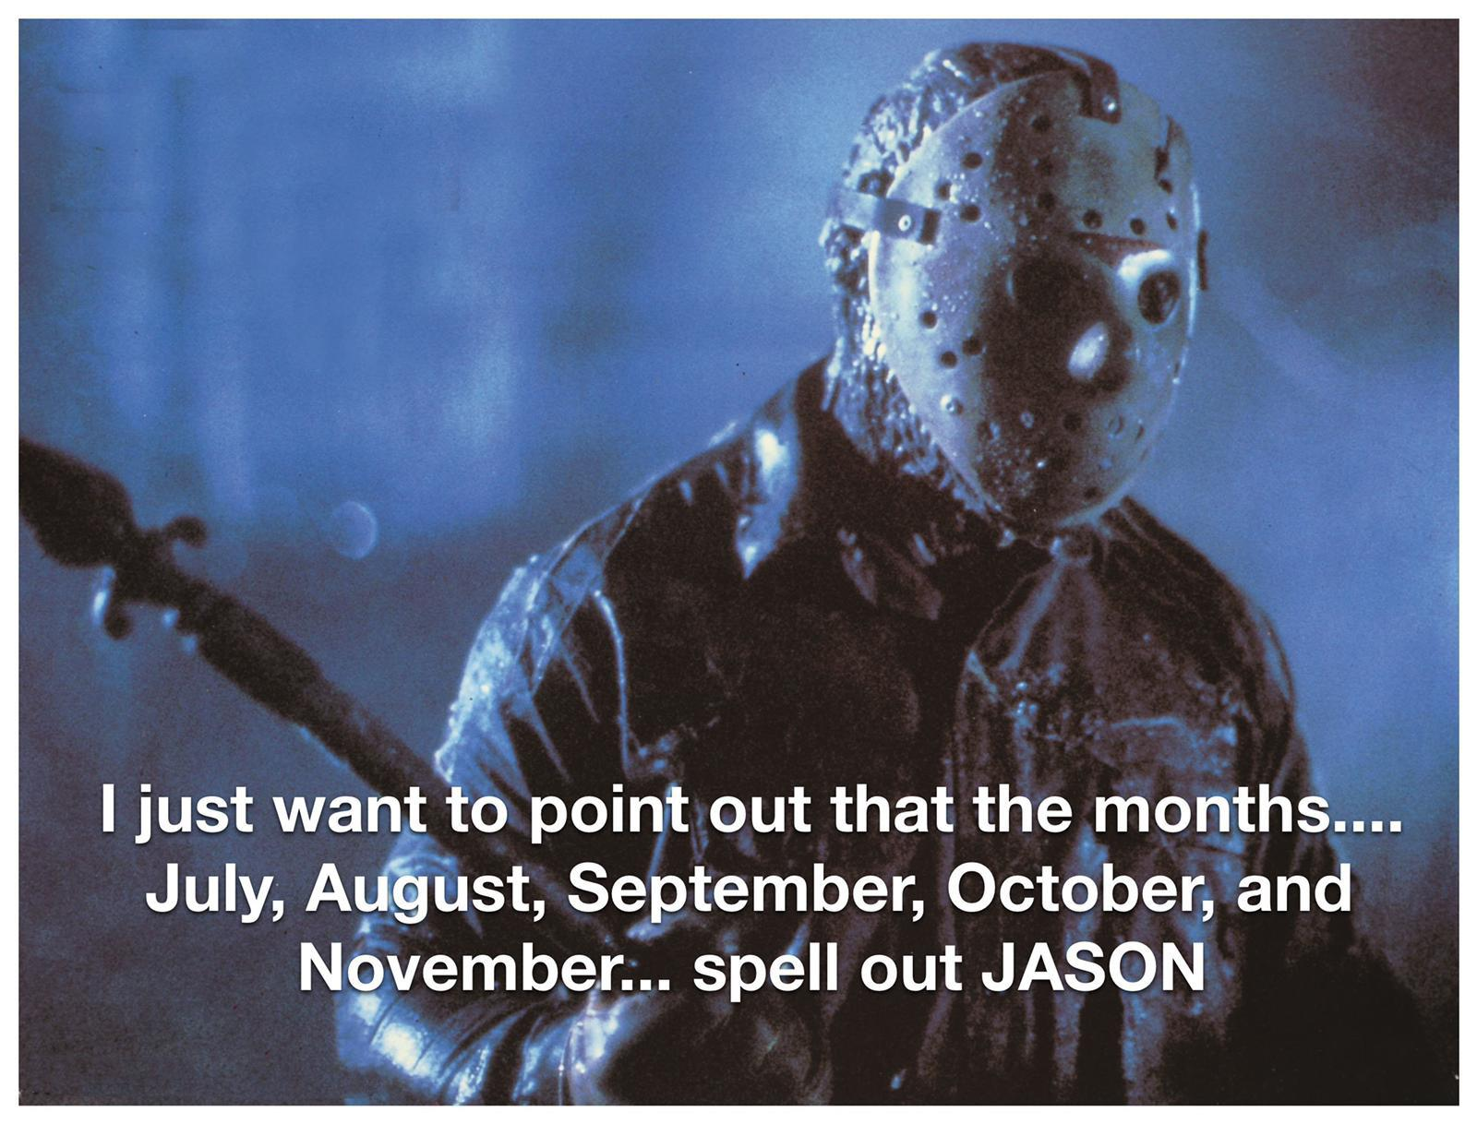

Slide 27
Distance Education Cameras On Policy
Keith Wurtz and Brandi Bailes
Notes:
Sabrina
20 minutes each. Materials due 10/21. Presentation on November 5. Kevin would like GP lead(s) and both Delmy and I to participate in presentation to demonstrate collaboration that is taking place.

Slide 28


Slide 29
Q&A

