Slide 1
Fall 2021 Possible COVID-19 Exposures
The following number of people were potentially exposed to COVID-19
Approximately…
700 students
18 faculty and staff
34 sections were potentially exposed
3 sections were required to meet remotely for ten days because of possible exposure to Covid
Approximately 65 people who needed to quarantine

Slide 2
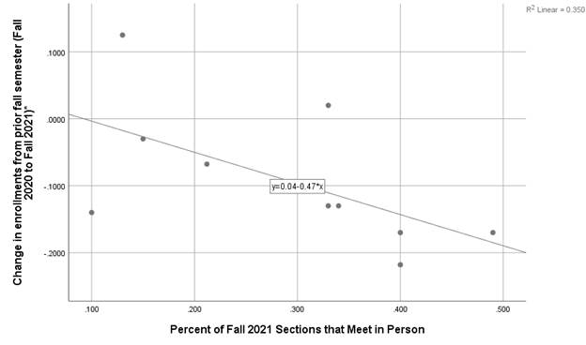
When looking at ten of the community colleges in Region 9, students are statistically significantly more likely to enroll at colleges with a higher proportion of online sections
When looking at ten of the community colleges in Region 9, students are statistically significantly less likely to enroll at colleges with a higher proportion of in-person classes

Slide 3
80% of the Fall 2021 students are enrolled in the online/remote learning format
Instruction Type | Number of Unduplicated Students | Number of Unduplicated Students Enrolled | Percent of Students
Online/Remote | 4,593 | 5,749 | 80%
In Person | 3,105 | 5,749 | 54%
Hybrid (In Person and Online) | 768 | 5,749 | 13%

Slide 4
40% of the Fall 2021 students are enrolled in online sections only
60% of students are enrolled in some form of F2F section
Instruction Type | Number of Unduplicated Students | Number of Unduplicated Students Enrolled | Percent of Students
Online Only | 2303 | 5749 | 40.1%
F2F Only | 953 | 5749 | 16.6%
Online and F2F | 1725 | 5749 | 30.0%
Hybrid Only | 117 | 5749 | 2.0%
Hybrid and Online | 224 | 5749 | 3.9%
F2F and Hybrid | 86 | 5749 | 1.5%
Online, F2F, and Hybrid | 341 | 5749 | 5.9%
Notes:
40% of students are taking online only
30% are taking online and F2F
17% are taking F2F only
Keep in mind we also cancelled more in-person classes and the in-person classes had lower fill rates.

Slide 5
Fall 2021 Enrolled Students Prefer the Online Instruction Learning Format for Spring 2022 (49%)
Notes:
N = 507

Slide 6
A higher proportion of Fall 2021 In-Person students (32%) completed the Spring 2022 Interest Survey than Fall 2021 students enrolled in an online class only (17%)
Notes:
N = 507

Slide 7
Spring 2022 Schedule in relation to results from currently enrolled Fall 2021 students as of September 19, 2021

Slide 8
43% of the Spring 2022 classes can be classified as “in residence” for veterans
Notes:
Veterans can take hybrid or in person sections. 43% of sections are available to Vets. In addition, we made adjustment to schedule based on feedback we received from Vets.
https://www.knowva.ebenefits.va.gov/system/templates/selfservice/va_ssnew/help/customer/locale/en-US/portal/554400000001018/content/554400000149088/School-Certifying-Official-Handbook-On-line

