Slide 1
Resource Development and Grants
August 16, 2013

Slide 2
Office of Resource Development and Grants
Summer 2013
Grants in 2012-13
What Donations Do

Slide 3
Summer 2013
$57,928
19 classes

Slide 4
Summer Classes Supported
Allied Health
Anatomy & Physiology
Arabic
Art
ASL
Biology
Chemistry
Computer Information Systems
Economics
English
Health
History
Mathematics
Microbiology
PE
Philosophy
Political Science
Sociology
Speech
$57,928

Slide 5
With Title V-HSI and STEM: $1,682,869
Grant | Purpose | Amount
LibQual | Survey | $3,200
San Manuel | Student employment, Summer classes | $100,000
NEH Challenge | Arabic | $12,825
Google | Summer Workshop | $12,500
CTE Transitions | Career Technical | $49,389
Community Stories | Play “The Dream Act” | $10,000
Total 2012-13 |  | $187,914
Grant Support to CHC 2012-13

Slide 6
What Donations Do
Summer 2013
Textbook loans
Field trips
Outreach
Scholarships
Supplies / Equipment
Across departments, divisions
Campuswide fun stuff
And much more!

Slide 7
Scholarships

Slide 8
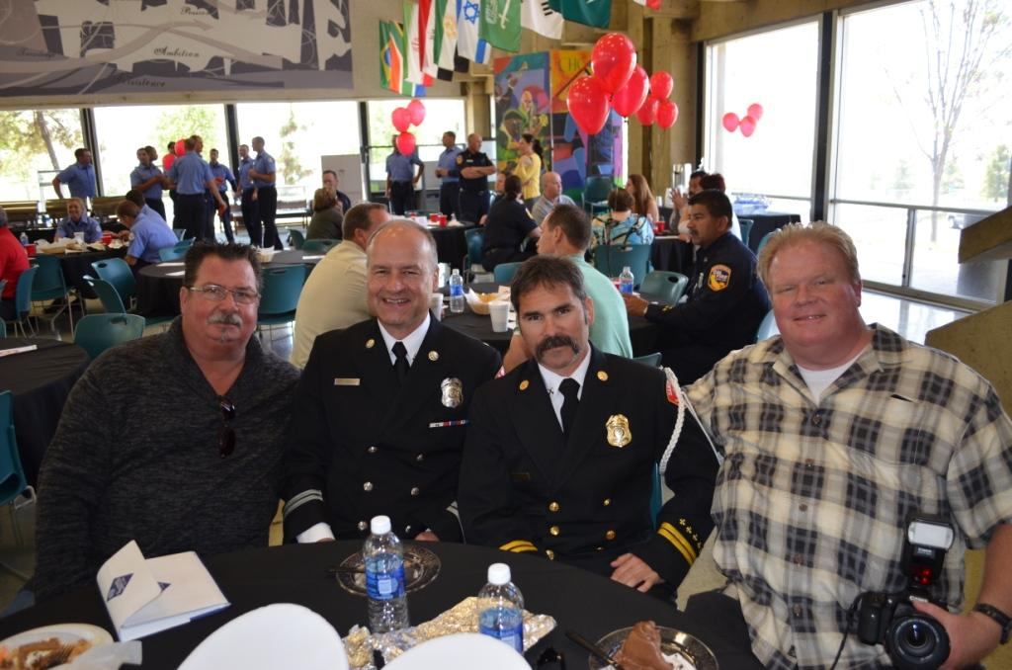
Outreach, Field Trips

Slide 9
Textbooks

Slide 10
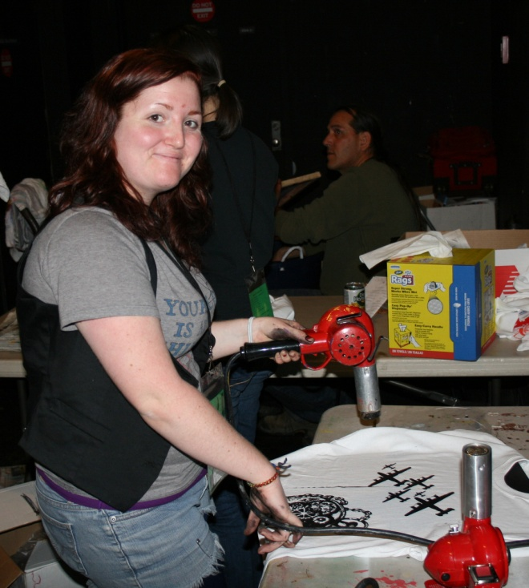
Across Divisions, Departments

Slide 11
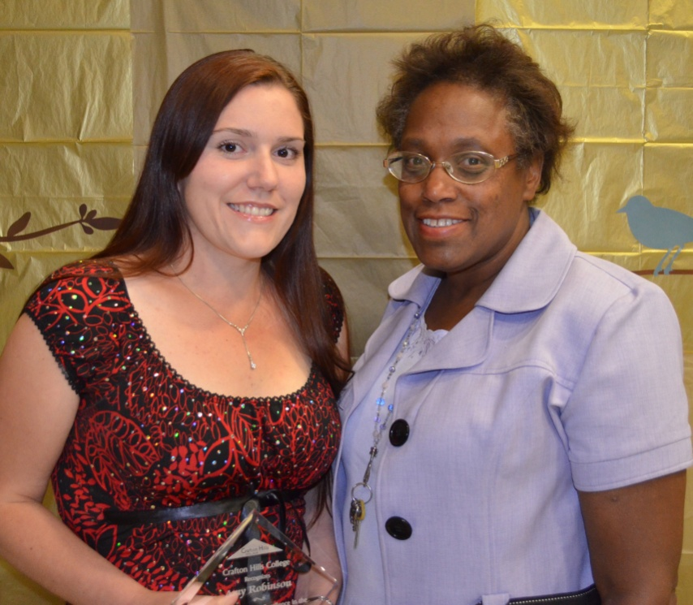
Campuswide Fun Stuff

Slide 12
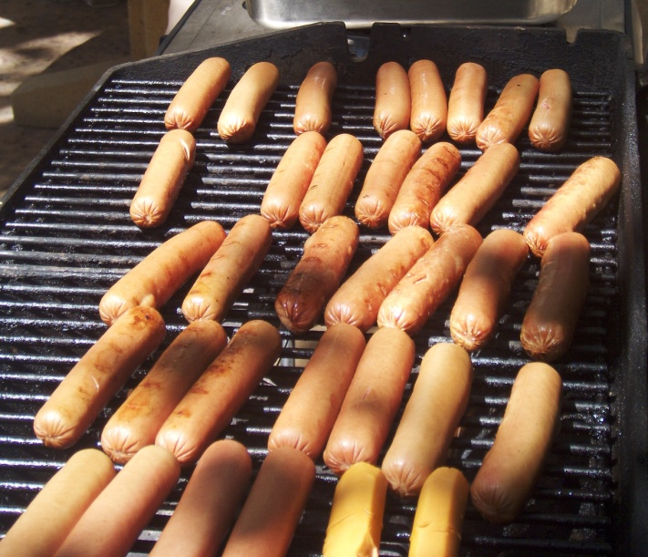
More Fun Stuff

Slide 13
Best Fun Stuff

Slide 14
How to Support

