Slide 1
Welcome to Opening Day
Fall 2015

Slide 2
Welcome!
Patty Quach – Tutoring Center Coordinator
Brandi Bales – Mathematics Faculty
Daniel Rojas – Respiratory Faculty
Shohreh Rahbarnia – Chemistry Faculty
Mike Alder – Fire Faculty
Soutsakhone Xayaphanthong – Counseling Faculty
Larry Armstrong – Custodian
Jason Lee – Custodian
Keila Mendez – Counseling Secretary
Brandice Mello – Transfer Center, SST II
Melinda Wallace – Teacher, CDC

Slide 3
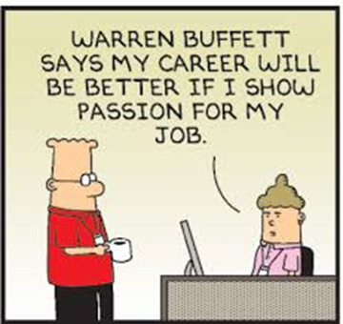
Congratulations on Educational Achievements
Ben Mudgett – MA, Management
Elizabeth Mealey – MS, Library and Information Science
Daniel Bahner – Ed.D.
Ericka Paddock – Ed.D.
Keith Wurtz – Ph.D.

Slide 4
Classified in Teaching Roles
Thomas Crane – Oceanography
Tina Gimple – CIS
Alicia Hallex – Learning Resources
Elizabeth Mealey – Librarian
Ben Mudgett – Business
Ginger Sutphin – Business
Michelle Tinoco – Counseling/Student Development (SBVC)
Jonathan Townsend – English

Slide 6
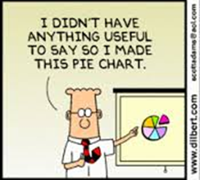
President’s Remarks

Slide 7
Synergy & People

Slide 8
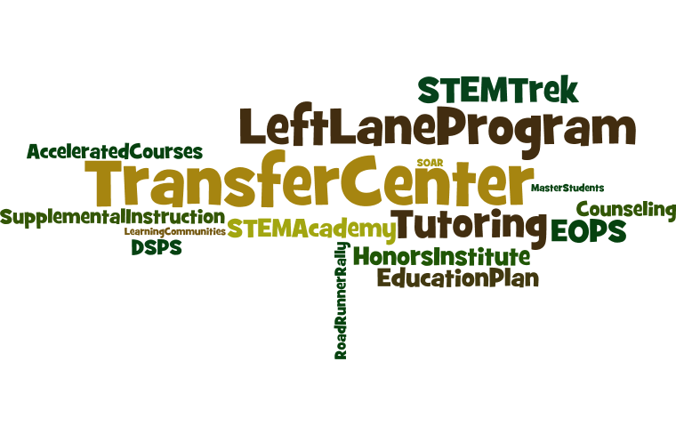

Slide 9
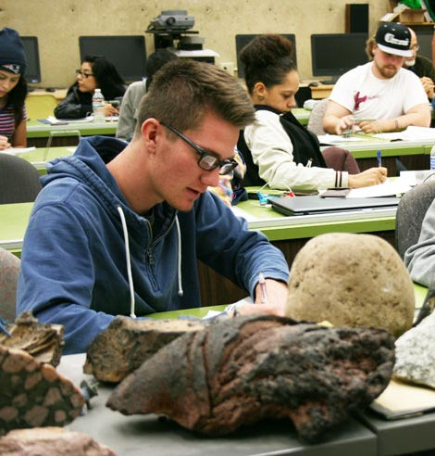
Why Crafton?
Great Teaching
Great Support
Great Campus

Slide 10
Great Teaching
95% satisfied with instruction/overall education experience
93% believe receiving a great education
Course Retention Rates
Course Success Rates
91.0%
74.0%
6th Highest in California
16th Highest in California
Crafton Hills College
From California Community College Chancellor’s Data Mart
All California CCs

Slide 11
Great Teaching
Great Teaching
Retention and Success Comparisons—Inland Empire
#1 in Inland Empire for Combined Score
#1
 | Enrollment Count | Retention Rate | Success Rate | Combined Rate | CA Rank | IE Rank
Crafton Hills | 14,372 | 91.0% | 74.0% | 82.5% | 4 | 1
Chaffey | 49,681 | 90.3% | 71.5% | 80.9% | 17 | 2
Desert | 23,026 | 87.5% | 71.9% | 79.7% | 28 | 3
Moreno Valley | 16,470 | 86.7% | 71.3% | 79.0% | 47 | 4
Copper Mountain | 4,066 | 87.6% | 70.2% | 78.9% | 50 | 5
Palo Verde | 4,953 | 87.1% | 70.9% | 78.6% | 55 | 6
Norco | 17,922 | 86.1% | 70.6% | 78.3% | 60 | 7
Victor Valley | 28,520 | 91.2% | 64.6% | 77.9% | 71 | 8
San Bernardino | 31,691 | 87.9% | 66.8% | 77.3% | 78 | 9
Riverside | 39,474 | 85.6% | 66.8% | 76.2% | 89 | 10
Mt. San Jacinto | 36,894 | 84.6% | 67.4% | 76.0% | 92 | 11
Spring 2014 Credit Courses from California Community College Chancellor’s Data Mart
Combined Rate = Average of Retention and Success Rates

Slide 12
Great Support
Transfer Rates (General)
Transfer Rates (Honors Institute)
80% intend to transfer
Expanded Transfer Center
63% admit rate to UC (F2014)
Nation-wide transfer eligibility
Rigorous curriculum
Research opportunities
100% transfer rate in 2015!
Many receive full scholarships
CHI Students Accepted to . . .
Yale | UC Santa Barbara
Sarah Lawrence | UC San Diego
UC Berkeley | CSU Fullerton
UCLA | San Francisco State
UC Riverside | CSU Los Angeles
UC Davis | CSU East Bay
UC Irvine | CSU San Bernardino
UC Santa Cruz | Long Beach State
Loma Linda | Cal Poly Pomona
 | HS Avg | CCC Avg | Crafton
Berkeley | 17% | 23% | 28%
UCLA | 18% | 27% | 42%
UCSD | 33% | 45% | 71%
UCR | 56% | 62% | 63%
CSUSB | 64% | 73% | 94%
Cal Poly | 39% | 41% | 53%
U of R | 63% | 50% | 78%

Slide 13
Great Support
96% feel library resources meet needs; tutoring readily available
92% satisfied with overall services for students
Degree/Certif Completion
Completion Rate Comparison
 | CA Rank | IE Rank
Crafton Hills | 18 | 1
Chaffey | 19 | 2
Riverside | 30 | 3
Norco College | 38 | 4
Mt. San Jacinto | 41 | 5
San Bernardino | 42 | 6
Victor Valley | 45 | 7
Copper Mountn | 62 | 8
Palo Verde | 69 | 9
Desert | 73 | 10
Moreno Valley | 86 | 11
18th Highest in California
2013-2014 All Degree and Certificate Completion from California Community College Chancellor’s Data Mart.
Rate = (#of Degree and Certificate Completers)÷(Enrolled Students)

Slide 14
Thank You

Slide 15
What’s Going On
From August 2008

Slide 16
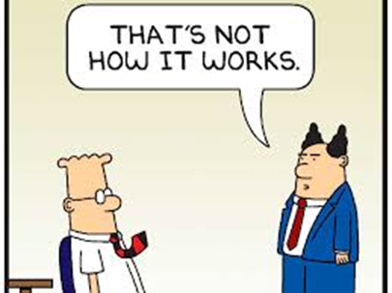
Becoming a Comprehensive College
The definition from literature: A comprehensive community college has programs and services in:
Transfer Education
Career Education
Developmental Education
Online Education
Continuing Education – Non-credit, Fee Based, and Contract Education
Cheryl’s Definition:
Full complement of funded programs and services
85% of students achieve their goals
A highly valued educational institution
A resilient, learning, kick-butt organization

Slide 17
Moving Forward
Becoming a Comprehensive College
Keep the pipeline flowing
Capitalize on new facilities
Aim for excellence

Slide 18
Keep the Pipeline Flowing - Access
High School Partnerships
Dual Enrollment
Information Campaign
Adult Education Partnerships

Slide 19
Keep the Pipeline Flowing - Access
Target Populations
Athletics
Vets
Re-entry
Online
International Students
FTES

Slide 20
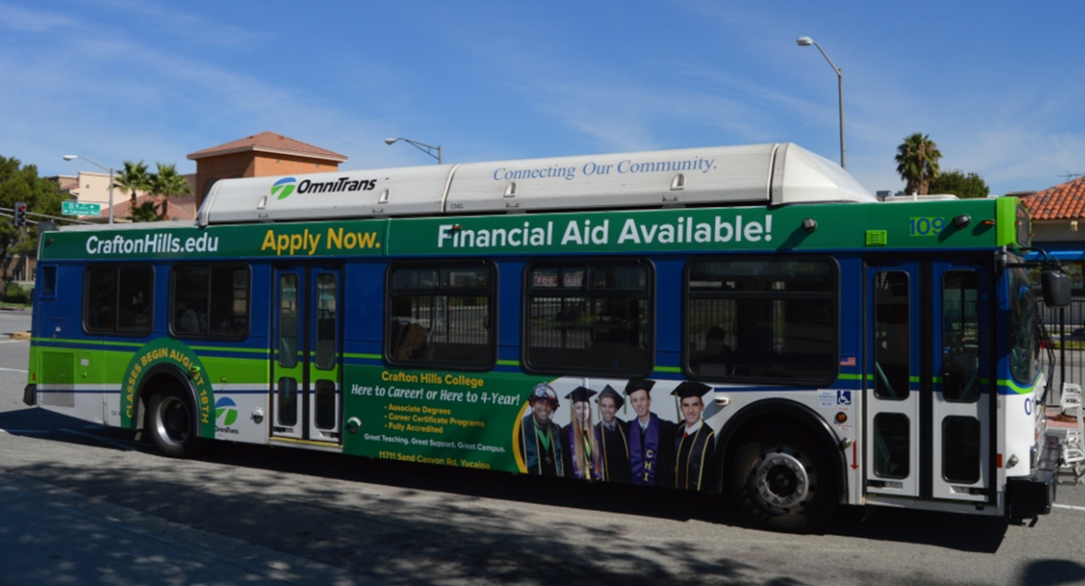
Keep the Pipeline Flowing - Access
Branding
Consistent message
New look

Slide 21
Keep the Pipeline Flowing - Success
Keep up the good work!!
Continue to be explorers and revolutionaries

Slide 22
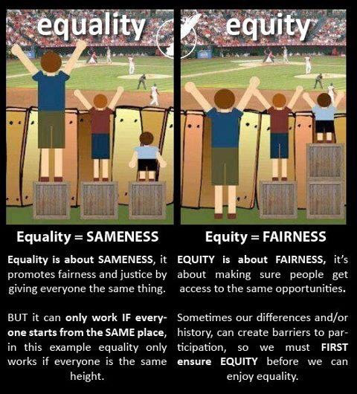
Success - Equity
Sameness
vs
Fairness

Slide 23
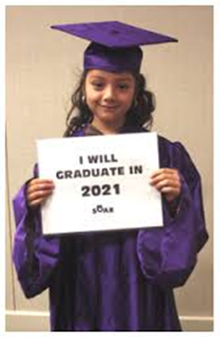
Success - Equity
Address the “achievement gaps” for individuals with disabilities, foster youth, African American & Hispanic students, and economically disadvantaged students
Examples:
African American students are the least likely group to complete transfer level math & English
Hispanic students are the least likely to transfer
Notes:
Goals
Equity and institutional planning will focus on six major goals.
1. Increase access for individuals with disabilities and students aged 20-39.
2. Improve course success rates among foster youth.
3. Increase mathematics throughput rates among African American and economically
disadvantaged students.
4. Increase English throughput rates among African American and Hispanic students.
5. Increase degree and certificate completion rates among males, African Americans,
Hispanics, Native Americans, and students aged 20-34.
6. Increase transfer rates among African Americans, Hispanics, and students aged 20-24

Slide 24
Addressing Equity
Long-term, proactive commitment to closing the achievement gap
Developing “cultural competence” and creating a deeper understanding of biases and barriers
Real, honest, courageous
conversations about race,
class, and disability
Move beyond words to actions

Slide 25
Addressing Equity
Invest some professional development time and energy
Look at your data and do something at the department and classroom level
Embed tutoring in your class and program
Provide intrusive advisement and follow up
Offer a variety of instructional delivery methods and assessments

Slide 26
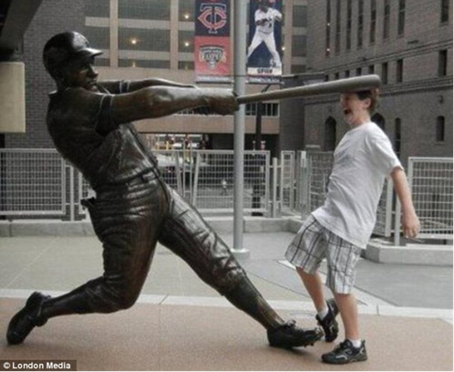
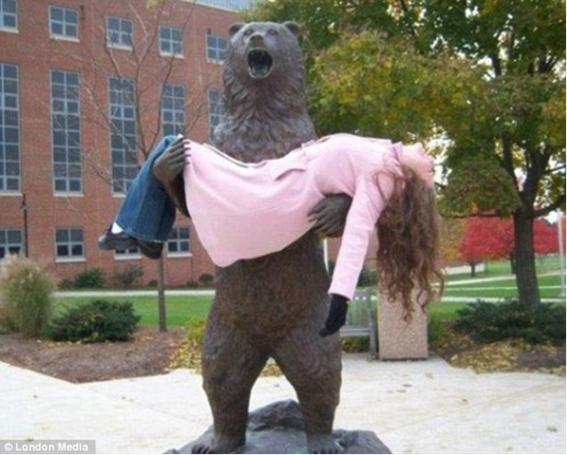
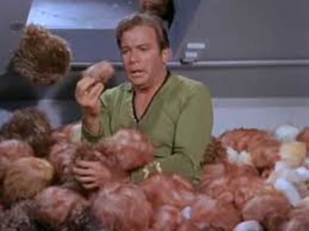
Capitalize on New Facilities
Let the churn begin

Slide 27
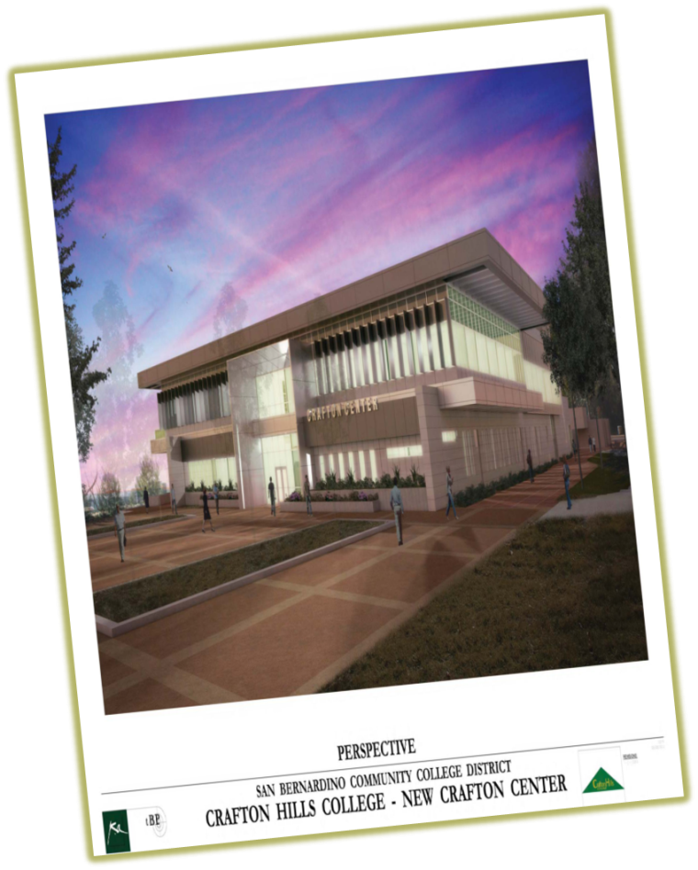
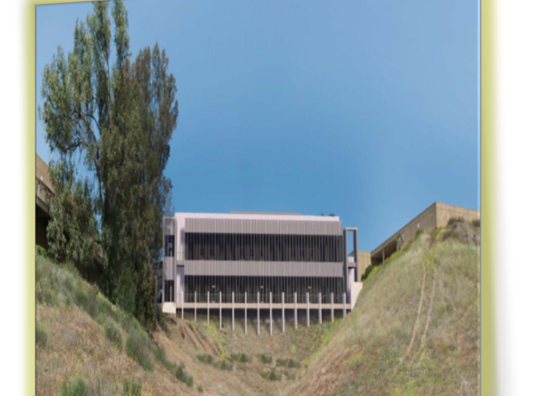
Capitalize on New Facilities
Capacity for up to 11,000 FTEs
Great instructional space
Opportunity for bringing the community to campus

Slide 28
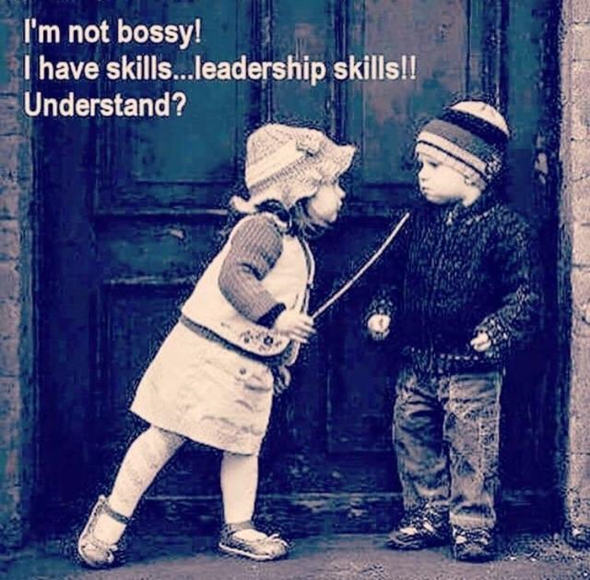
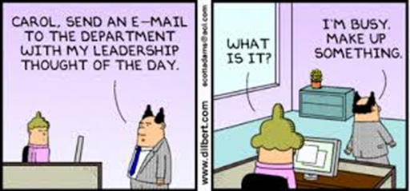
Aim for Excellence
Leadership

Slide 29
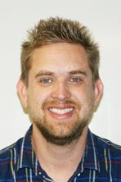
Aim for Excellence
Thank you, Ryan Bartlett

Slide 30
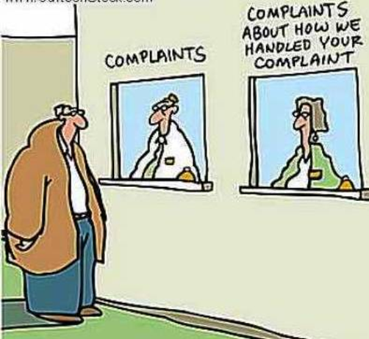
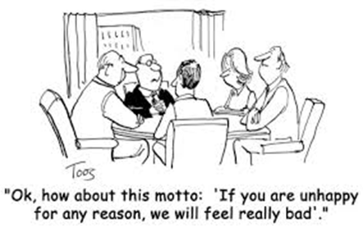
Aim for Excellence
Service

Slide 31
Aim for Excellence
Teaching & Learning
Inspire students to be learners – metacognition and self-regulation
Be role models of learning
Be a learning organization

Slide 32
Big Conversations for Becoming a Comprehensive College
Enrollment Management
HS Partnerships
Non Credit & Adult Ed
Equity
Facilities Planning
Equipment Planning
Hiring Priorities
Expand: Athletics, Vets, Re-entry, Online Ed, International Students
EPI
Accreditation
Leadership

