Slide 1

Sexual Misconduct and the Law:
Promoting a Culture of Civility at CHC
Rebeccah Warren-Marlatt, Ed.D.
Title IX Coordinator
VP Student Services

Slide 2
Title IX Education Amendments, 1972
Prohibits sex-based discrimination in higher education
“No persons in the United States shall, on the basis of sex, be excluded from participation in, be denied the benefits of, or be subjected to discrimination under any education program or activity receiving federal financial assistance.”

Slide 3
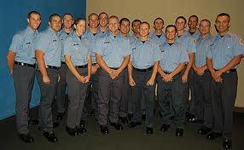
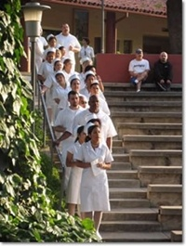
The law prohibits discrimination on the basis of sex in:
Admissions
Recruitment
Educational Programs
Housing
Access to course offerings
Comparable facilities
Counseling and Assessment
Financial Assistance

Slide 4

And
Employment assistance
Health and insurance benefits
Marital or parental status (student’s)
Employment, including recruitment, compensation, job classification, etc.

Slide 5
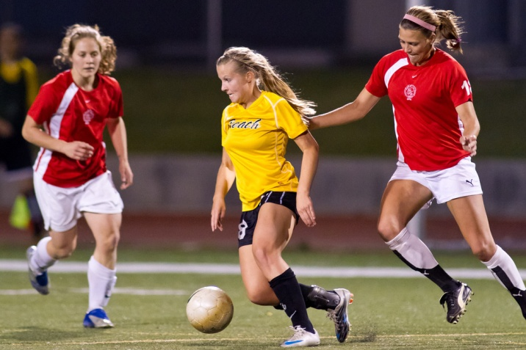

And Athletics
Equipment and supplies
Games and practice time
Travel and per diem allowance
Coaching and tutoring
Assignment and compensation of coaches
Provision of locker rooms
Medical and training facilities
Housing and dining facilities
Publicity

Slide 6
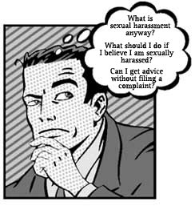
Title IX also protects students from sex-based harassment
  Behavior that is physically threatening, humiliating, unwelcome, interferes with the student’s learning. A reasonable person would consider the harassment hostile and offensive

Slide 7
Sexual harassment, in all its forms:
“Can Deny or limit, on the basis of sex, the student’s ability to participate in or to receive benefits, services, or opportunities in the college or university’s program.”

Slide 8

Sexual Violence is an extreme form of harassment:
Sexual violence
  Stalking, rape, date rape, groping, grabbing, coercion of any sort, impeding or blocking movement. Sexual assault is an extreme form of sexual harassment.

Slide 9
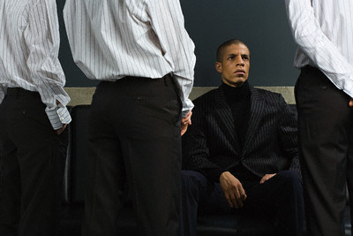

Examples of Sexual Harassment:
“They harass me because I’m gay.”
“She won’t stop texting me.”
“He always makes jokes about women in the locker room.”

Slide 10
Examples of Sexual Misconduct
Alcohol-fueled
Coercive
“I met this girl at a party last night..she was pretty hammered.”
“Oh man, what happened?”
“We hooked up! ..but she probably doesn’t remember. :) It was 2 easy, she was so wasted.”
“He totally grabbed my butt.”
“She wouldn’t let me get out of the car until I had sex with her.”
“We were just talking…flirting a little then he pushed me up against the wall and raped me.”

Slide 11
Office of Civil Rights
Dear Colleague Letter, April 4, 2011
Investigate all complaints preliminarily
  Pursue appropriate initial remedies or accommodations
Formal investigation if there are repeat offenses, patterns, predation, and/or future violence
  Apply remedies while safeguarding victim privacy
Breach victim privacy only when formal resolution and comprehensive investigation are necessary.

Slide 12
Grievance procedures must provide for:
“Prompt and equitable resolution of complaints”
  Impartial, fair, thorough
A college-appointed coordinator who has been trained
Coordinator’s contact info must be advertised to students

Slide 13
Violence Against Women Act (VAWA)
Education Department Ruling on 10/14, amendment to the Student Assistance General Provisions regulations under the Higher Education Act
Implements changes made to Clery Act by the VAWA Reauthorization Act of 2013
Dating violence, domestic violence, hate crimes, stalking are reportable
Services for victims must be provided
Prevention programs must be provided

Slide 14
Campus Sexual Violence Elimination (SaVE) Act
Amends the Clery Act to require colleges to provide prevention and awareness programs.
Covers rape, acquaintance rape, domestic violence, dating violence, sexual assault, and stalking

Slide 15

SBCCD AR3430:
Prohibition of Harassment
Individual complains to Title IX Coordinator
Discuss with student options for informal and formal action, explain the grievance process
    Informal investigation takes place
      Informal resolution
    Or
    Formal investigation takes place
      Formal resolution

Slide 16
Sexual and Other Assaults on Campus, BP 3540
Prohibits sexual assault or physical abuse, including but not limited to rape
Covers students, faculty, and staff
Victims are to receive appropriate information and treatment
Educational information about prevention of sexual violence must be provided

Slide 17
Affirmative Consent (SB967)
SBCCD must adopt an affirmative consent standard
“Affirmative, conscious, and voluntary agreement to engage in sexual activity”
You can’t consent if:
  You are incapacitated
  You can’t communicate due to a physical or mental condition
  You are asleep or unconscious
  You are under the influence of drugs, alcohol, or medication

Slide 18
No Excuses
In evaluating complaints, the following are not valid excuses
We used to date
She/he didn’t say no, and I didn’t ask for consent
She/he was wasted
She/he wanted it at first but changed her/his mind when it was too late

Slide 19
Reporting: What if the student doesn’t want action?
Under Title IX:
College must prevent harassment
College must still investigate
  Has a duty to keep the student’s identity confidential when possible
  Must give each party a chance to rebut
  Interview all identified witnesses
  Inform students of their options

Slide 20
During the Title IX investigation
May need to make alternative arrangements to prevent harassment
  Change student schedules, short-term suspension, notification of law enforcement
Notification of law enforcement does not absolve the college of its duty to prevent a hostile environment

Slide 21


If a college violates Title IX, what remedy is there?
Department of Education, Office of Civil Rights (filed within 180 days from the last harassment act).
Civil lawsuit. Student must prove a school has actual knowledge of the harassment. Equitable relief, such as revision of the college’s policy, may be ordered. (Student has a year from last date of discrimination).

Slide 22
How do colleges prevent harassment?
Publicize the policy and process
  Catalog, “orientation” courses, New Student Orientations, Student Code of Conduct, webpage, twitter, etc.
Active awareness campaigns
  Online information, Health and Wellness, Student Organizations, Signage, Video feeds
Culture of civility and responsibility

Slide 23


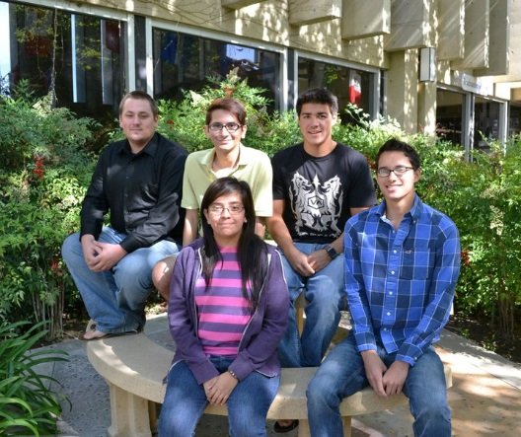
How To Promote Civility?
Bystander intervention is encouraged
Reporting is encouraged
Action is taken
Survivors are supported
Diversity is celebrated

