Slide 1
Grant Management
Crafton Hills College
March 2015

Slide 2
Part I
Finding Grants

Slide 3
Types of Grants
Federal
State
Local
Foundations

Slide 4
Where Are They?
Grant Search Websites
www.grantstation.com
www.foundationcenter.org
www.grants.gov
Grants Office web page: www.craftonhills.edu
  Click on “Faculty and Staff”
  Click on “Grants Office”

Slide 5
www.Grantstation.com
Enter username and password (get from the Grants Office)
“Tour” link
Use the links on the left:
  Search Tips
  Getting Started
  The Grant Proposal
Right side: webinars
U.S. Grants link

Slide 6
www.Grants.gov
Find Grant Opportunities
Browse by Category
Browse by Agency
Basic / Advanced Search

Slide 7
What Do They Want?
What gets funded?
Partnership
Collaboration
Innovation
Research
Lunch special vs. cafeteria: Be specific.

Slide 8
Part II
Grant Management

Slide 9
We got the grant! Now what?
Grant Award Notification (GAN)
Grant terms and conditions
Meet with the Grants Office
Read the proposal again
Set up the budget
Start a filing system
Meet with your team

Slide 10
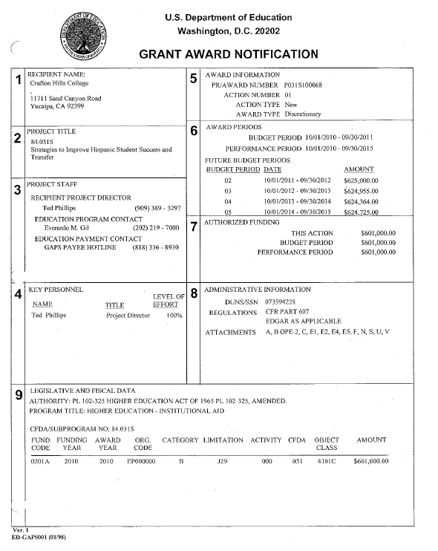
Grant Award Notification

Slide 11
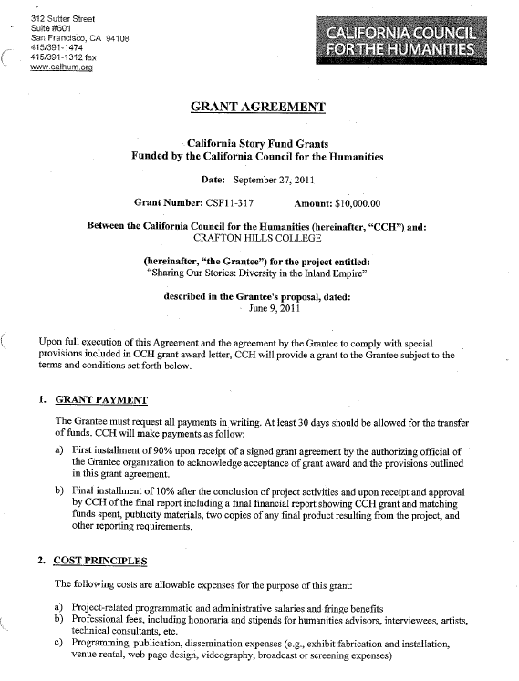
Grant Terms and Conditions

Slide 12
Set up the Budget
Schedule Purchasing 2000 training with district (Jason Oberhelman) and CHC (Tina Gimple)
SBCCD Budget Adjustment form
Purchasing 2000 Account Set-Up
  Include Grants Office Director in the purchasing path

Slide 13
Start a Filing System
Grant Binder
  GAN, grant proposal, grant agreement, Board approval, hire documents, reports, correspondence
  See example of index tabs
Files
  Subcontractors, budget transfers, requisitions, purchase orders, packing slips, location of equipment, timesheets, time and effort forms, verification of insurance
Keep everything in one place
Keep for three years after grant ends, then discard.

Slide 14
Meet with your Team
Schedule regular team meetings
Make sure that each individual written into the grant has a clear understanding of recordkeeping requirements, general grant and spending guidelines and his/her role and responsibilities in achieving grant objectives

Slide 15
Which Regulations Apply to Your Grant?
Education Department General Administrative Regulations apply to all grants awarded by the U.S. Department of Education, and is referenced by many other federal agencies as well. EDGAR can be found at http://www.ed.gov/policy/fund/reg/edgarReg/edgar.html

Slide 16
Evaluation and Reports
Follow the evaluation plan in your grant proposal
Internal versus external
Involve the evaluator in all discussions related to data collection and evaluation
Incorporate data collection into the day-to-day operations of the program

Slide 17
Evaluation and Reports, continued
Consider your data needs and the timing of requested evaluation reports
  Formative vs. summative evaluation
  Incorporation of evaluation data and reported outcomes into required reports
A contract agreement will be needed for the external evaluator and should be done very early on
Use evaluation data to make program improvements on an ongoing basis and include program improvements in your reports

Slide 18
Fiscal Management
Ongoing considerations
  Are all expenditures allowable?
  Have all required approvals been obtained?
  Are remaining funds adequate to complete all work?
  Have you remained within the specified transfer privilege limit?
  Is there a need for a budget transfer?

Slide 19
Fiscal Management, continued
A Budget Transfer form is used to transfer funds between object codes
Funds must be available in an object code before they are obligated

Slide 20
Expanded Authorities Provision
Department of Education
  Pre-award costs
  No cost extensions
  Budget transfers
  Carryover

Slide 21
Resources
Library of Resources
CHC Grants Office in the Learning Resource Center (LRC)
Grants Office web page
EDGAR
NSF Grant Proposal Guide
Grant leads by agency

