Slide 1
For a Career
Entrance
Requirements

Slide 2
As a Respiratory Therapist

Slide 3
What is a Respiratory Therapist

Slide 4
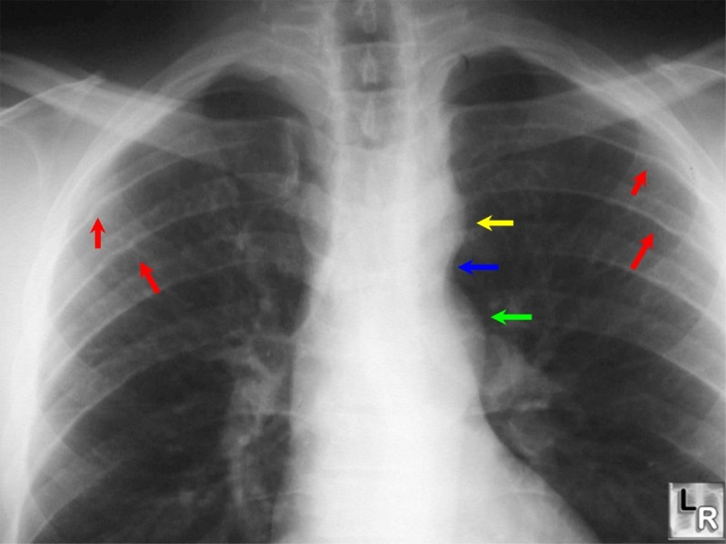
A respiratory therapist is a
life supporting
life enhancing
healthcare professional who practices under qualified medical direction.

Slide 5
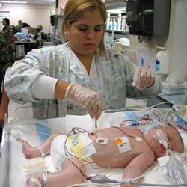
A respiratory therapist provides patients with disorders of the cardiopulmonary system diagnostic testing therapeutics, monitoring, and rehabilitation.

Slide 6
Steps To Enter CHC
Respiratory Program

Slide 7
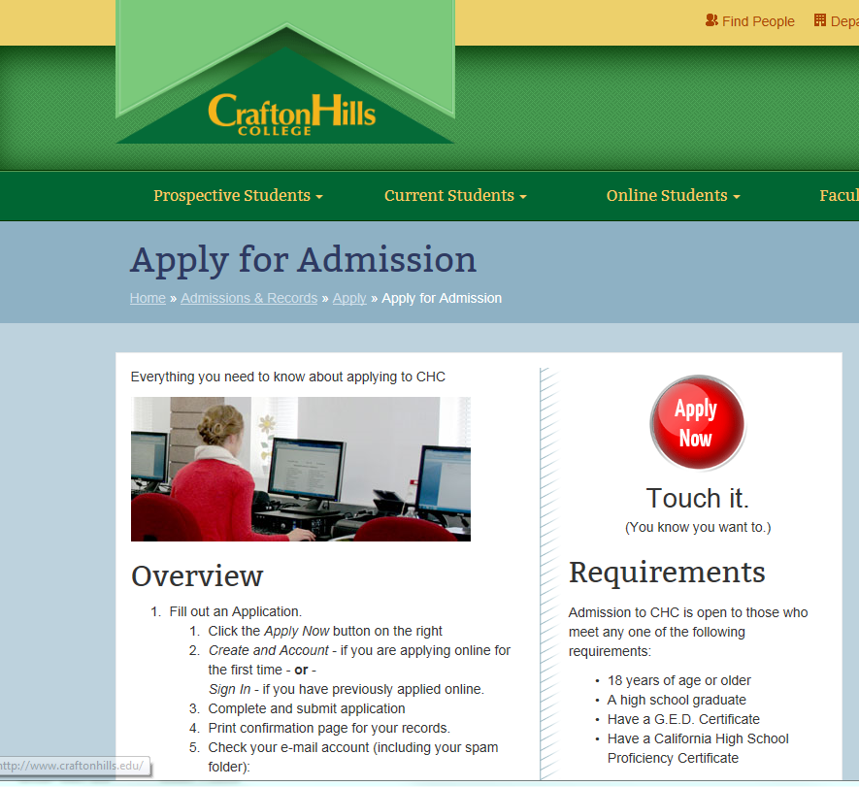
STEP 1
SUBMIT AN APPLICATION TO THE COLLEGE ON-LINE
APPLY

Slide 8
STEP 2
Order (2) two “sealed” official transcripts from all the colleges you attended and want to apply to your associates in respiratory care.
Submit (1) to Admissions and Records
Ask to fill out an Evaluation Form so the evaluator will verify that the classes you took will qualify towards your AS in Respiratory
YOU DO NOT WANT ANY SURPRISES
ORDER TRANSCRIPTS

Slide 9
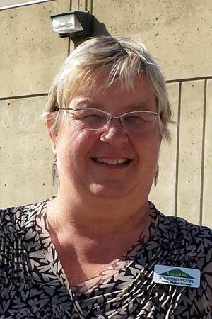
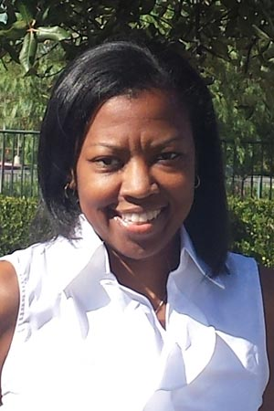
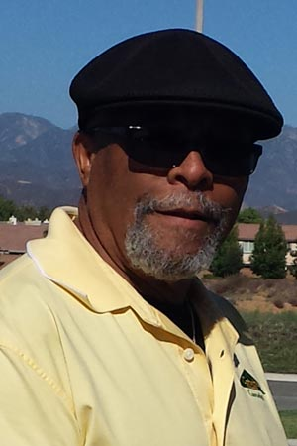
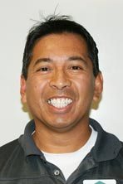
STEP 3
A COUNSELOR CAN HELP YOU MAKE AN EDUCATIONAL PLAN
THEY CAN ANSWER ALL YOUR QUESTIONS ABOUT WHICH CLASSES YOU STILL NEED TO TAKE
SEE A COUNSELOR

Slide 10
ALL CLASSES
May be transferred from another accredited college or university
Grade must be a C or higher
ROP Redlands is acceptable for AH 101
There is no expiration date for any class

Slide 11
POINT SYSTEM
Entry into the Respiratory Program is based on points
RESP 050
AH 101
ANAT/PHYSIO
MICROBIOLOGY
CHEMISTRY

Slide 12
1ST POINT
PRE-REQUISITES
RESP 050 – Introduction to Respiratory Care Training
This class will go over:
What it is like to be a therapist
What is required of you
Opportunities for a respiratory therapist
What you need to do to qualify
It is only offered at Crafton because it pertains to our program
RESPIRATORY 050

Slide 13
2ND POINT
MEDICAL TERMINOLOGY

Slide 14
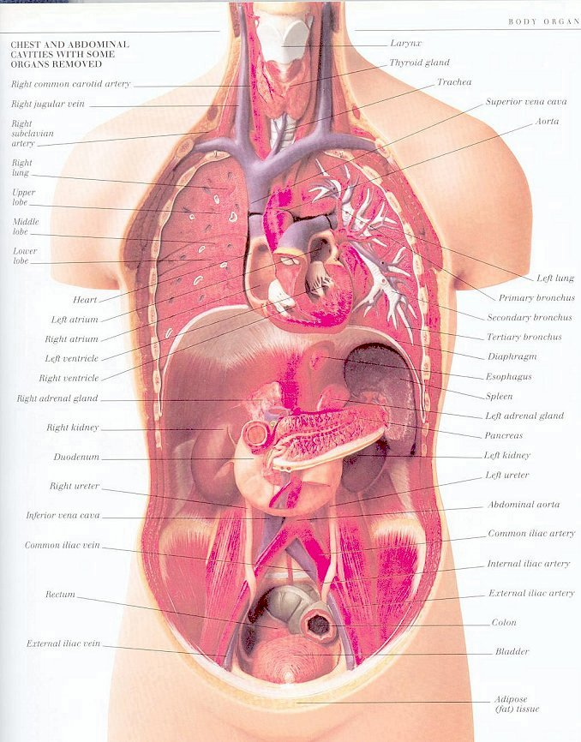
3RD POINT
ANATOMY/PHYSIOLOGY

Slide 15
4TH POINT
Microbiology

Slide 16
5TH POINT
Chemistry

Slide 17
6th Point
VERIFICATION OF GENERAL EDUCATION FORM
THIS FORM MUST BE FILLED
OUT BY A COUNSELOR.
A counselor will not fill this out until all grades have been posted

Slide 18
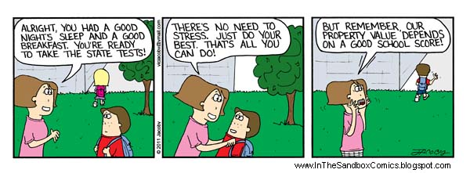
Step 4
TEAS V
ASSESSMENT EXAM

Slide 19
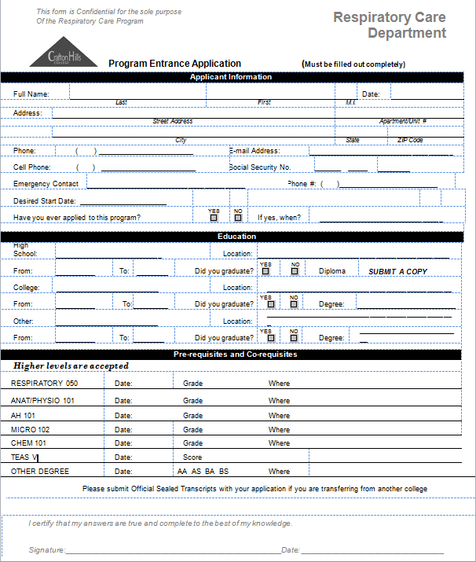
STEP 5
RESPIRATORY APPLICATION
Pick up an application
At the Respiratory Department

Slide 20
Required Documents
Application
Verification of General Education
Teas V Results
Official Transcripts
Copy of High School Diploma
GED is okay
Copy of Transcript is okay
Documents you will need to turn in with your application

Slide 21
What Happens Next ???
Your name will be put on a list according to the number of points you have earned and then by date of application

Slide 22
Questions?
Answer
Yes. You must have at least three points to turn in an application. However, we have not accepted anyone with less than six points for the last five years.
It is best for you to turn it in at least six points.
Can I turn in my application if I don’t have all six points?

Slide 23
Question
Answer
No. You must have all pre-requisites, including the Verification of General Education to earn extra points on your TEAS V.
If I don’t have all the pre-requisites finished, but I scored a high percentage on the TEAS V, will that give me six points?

Slide 24
Question
Answer
Your name will go on next year’s list and your documents will be retained for another year.
What happens to my application if I don’t get in this year?

Slide 25
