Slide 1
Creating Web Content
Tips and Tricks for Editing Your Crafton Pages

Slide 2
Agenda
How We Use the Web
Writing for the Web
Organizing Your Content
Naming Stuff
Headings
Links
Images
Why it Doesn’t Work: Updating Menus, Page Titles, and Employee Profiles
Delight
Snippets
Bonus Areas
Icons

Slide 3
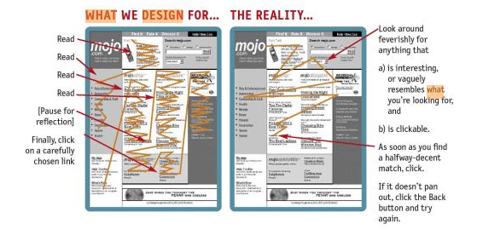
How does the Average User* Look at a Web Page?
*The actual Average User is kept in a hermetically sealed vault at the International Bureau of Standards in Geneva Switzerland.

Slide 4
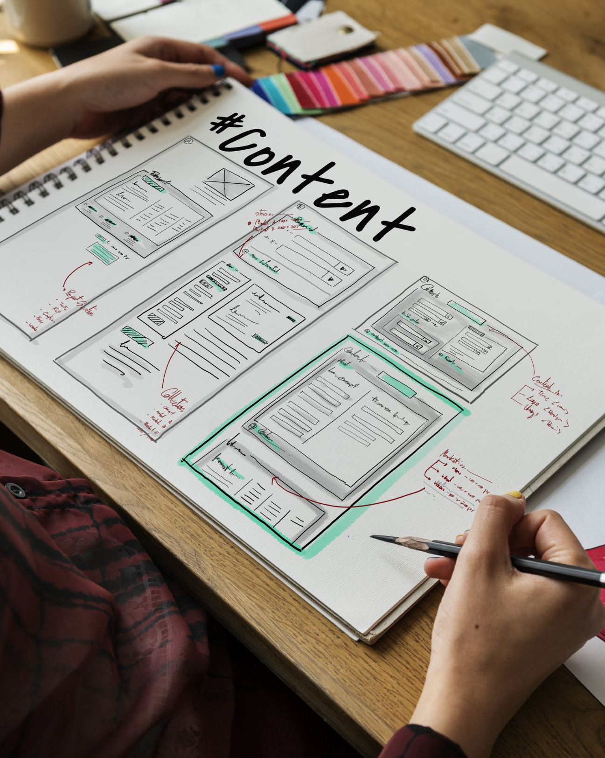
Writing for the Web

Slide 5
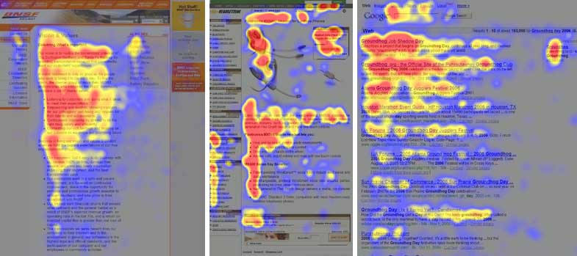
F-Patterns
Users first read in a horizontal movement, usually across the upper part of the content area. This initial element forms the F's top bar.
Next, users move down the page a bit and then read across in a second horizontal movement that typically covers a shorter area than the previous movement. This additional element forms the F's lower bar.
Finally, users scan the content's left side in a vertical movement. Sometimes this is a fairly slow and systematic scan that appears as a solid stripe on an eyetracking heatmap. Other times users move faster, creating a spottier heatmap. This last element forms the F's stem.

Slide 6
What does this mean?
Users won't read your text thoroughly.
The first two paragraphs and the first lines of those paragraphs must state the most important information.
Start lines of text with information-carrying words.

Slide 7
Example
“Important Crafton Hills College Announcement! Tuition Has Been Reduced to $20 Per Unit!”
“Tuition Reduced to $20 Per Unit”

Slide 8
Create Scannable Text
highlighted keywords (hypertext links serve as one form of highlighting; typeface variations are another)
meaningful sub-headings (not "clever" ones)
bulleted lists
one idea per paragraph (users will skip over any additional ideas if they are not caught by the first few words in the paragraph)
the inverted pyramid style, starting with the conclusion
half the word count (or less) than conventional writing

Slide 9
Example: Before
Promotional writing (control condition) using the "marketese" found on many commercial websites
Nebraska is filled with internationally recognized attractions that draw large crowds of people every year, without fail. In 1996, some of the most popular places were Fort Robinson State Park (355,000 visitors), Scotts Bluff National Monument (132,166), Arbor Lodge State Historical Park & Museum (100,000), Carhenge (86,598), Stuhr Museum of the Prairie Pioneer (60,002), and Buffalo Bill Ranch State Historical Park (28,446).

Slide 10
Example: Concise Text
Concise text with about half the word count as the control condition
In 1996, six of the best-attended attractions in Nebraska were Fort Robinson State Park, Scotts Bluff National Monument, Arbor Lodge State Historical Park & Museum, Carhenge, Stuhr Museum of the Prairie Pioneer, and Buffalo Bill Ranch State Historical Park.

Slide 11
Example: Scannable Layout
Scannable layout using the same text as the control condition in a layout that facilitated scanning
Nebraska is filled with internationally recognized attractions that draw large crowds of people every year, without fail. In 1996, some of the most popular places were: Fort Robinson State Park (355,000 visitors)
Scotts Bluff National Monument (132,166)
Arbor Lodge State Historical Park & Museum (100,000)
Carhenge (86,598)
Stuhr Museum of the Prairie Pioneer (60,002)
Buffalo Bill Ranch State Historical Park (28,446).

Slide 12
Example: Objective Language
Objective language using neutral rather than subjective, boastful, or exaggerated language (otherwise the same as the control condition)
Nebraska has several attractions. In 1996, some of the most-visited places were Fort Robinson State Park (355,000 visitors), Scotts Bluff National Monument (132,166), Arbor Lodge State Historical Park & Museum (100,000), Carhenge (86,598), Stuhr Museum of the Prairie Pioneer (60,002), and Buffalo Bill Ranch State Historical Park (28,446).

Slide 13
Example: Combined Version
Combined version using all three improvements in writing style together: concise, scannable, and objective
In 1996, six of the most-visited places in Nebraska were:
Fort Robinson State Park
Scotts Bluff National Monument
Arbor Lodge State Historical Park & Museum
Carhenge
Stuhr Museum of the Prairie Pioneer
Buffalo Bill Ranch State Historical Park

Slide 14
Text Don’ts
Don’t use underlined text. Underlining implies a link.
Don’t use colored text. Color usually indicates a link.
Exception: You may use the “red” style from the drodown occasionally.
Don’t combine italics and bold on the same text as it makes it harder to read.

Slide 15
Organizing Your Content

Slide 16
Organizing
Don’t overwhelm the user. Subdivide!
“Groups of five to seven are generally what people are capable of perceiving before attempting to break them down into subgroups.”
“Six groups of five are much easier to comprehend that one group of thirty.”

Slide 17
Example
On the home page, we wanted to display five links to encourage students and employees to get involved with the activities and read the publications Crafton offers.

Slide 18
Example
We had the following five links
Current Events
Student Newspaper
Literary Journal
Master Calendar
President’s Message
Even though this list is short, the items don’t go together under anything but a very broad header like “Spiffy Stuff” or “Look Here!”

Slide 19
Example
We subdivided the list into two groups.
Calendars
Current Events
Master Calendar
Writings
Student Newspaper
Literary Journal
President’s Message
These headings are easy to scan.

Slide 20
Keep it “Above the Fold”
As screens get smaller, the user will have to scroll more to see everything.
Place the most important information as high on the page as you can.
Keep menus and content as brief as possible.

Slide 21
Naming Stuff

Slide 22
What is SEO?
SEO stands for Search Engine Optimization
It makes it easier for Google and other search engines to find things on your page
It makes it easier for users to find things on your page
Naming links and headings well is an important part of SEO. It also helps with accessibility.

Slide 23
Headings and Links
Make it short
Make it meaningful
Make it obvious

Slide 24
Naming Example

Slide 25
Using Headings Correctly

Slide 26
Using Headings Correctly
Pages content is organized by headings.
The headings are coded with tags such as <h1> and <h2>
In OmniCMS, you can select text and set the dropdown to Heading 1, Heading 2, etc.

Slide 27
Using Headings Correctly
Always use your headings like an outline:
Right:
Heading 1
Heading 2
Heading 2
Heading 3
Heading 3
Heading 2

Slide 28
Using Headings Correctly
Always use your headings like an outline:
Wrong:
Heading 1
Heading 3
Heading 2
Heading 6
Heading 3
Heading 2

Slide 29
USE HEADINGS FOR ORGANIZATION, NOT FOR STYLE.
This means you.

Slide 30
Use Headings for Organization, Not for Style
Never use a heading just because you like the font size or style.
Using headings correctly
Keeps the site presentation consistent from one page to another.
Makes the page accessible to screen readers.

Slide 31
Headings in OmniCMS
Never use Heading 1. It is already in use for the page title.
You may, however, use more than one Heading 2.

Slide 32
Links
Do:
Give your links informative names:
“Additional Web Guidelines” is better than “More Info” because search engines can index it better and it is easier for the reader to scan.

Slide 33
Sample Headlines
Headlines:
Last Tango in Detroit? (business magazine site)
Set Bugs Free! (technology blog)
24 lucky number for Sutherland with $40m deal (newspaper site)
Ancient sloth bones unearthed in Everglades (Yahoo homepage)

Slide 34
Score
1 = I have no idea 2 = I have a faint guess 3 = I have some idea 4 = I’m pretty sure I know 5 = I know exactly what the article is about

Slide 35
Answers
1. It’s about the possibility of General Motors going bust
2. About Bugs Bunny
3. It’s about Kiefer Sutherland and his deal for his TV show 24
4. It’s about ancient sloth bones unearthed in Everglades

Slide 36
Links
Don’t
Use expressions like “Click to go to the Admissions page.”
Users know that links are clickable, so it looks condescending.
Visitors using screen readers and other accessibility programs may not be using a mouse at all, so they do not “click”.
It adds unnecessary words.
Users assume they’re going to a page. You don’t need to say so.
Instead: Admissions

Slide 37
Links
Don’t
Include the URL of the page you’re linking to as the text of the link
http://www.craftonhills.edu/Courses_and_Programs/College_Catalog.aspx
Providing the full link is ugly, uninformative, and takes up space.
Better option: College Catalog

Slide 38
Links
Don’t
Use the word “here” as a link: Go here to see the Enrollment Policies.
It can’t be easily indexed by search engines. (Not SEO-Friendly)
It adds unnecessary words.
Instead: Enrollment Policies

Slide 39
Images

Slide 40
Images
Use jpeg, gif, or png images for the Web.
Use a resolution of 72dpi
Don’t stretch images out of proportion
Hold down the SHIFT key while resizing to avoid distortion (works in most programs).
Use alt text.

Slide 41
Alt Text
It’s the law.
It’s the right thing to do.
It’s easy.
If your image contains text, duplicate that text in the alt tag. (Yes, all of it.)
Otherwise, use the alt text to describe the image to the user.

Slide 42
Why it Doesn’t Work (and Why It’s Not Your Fault)
Editing Menus, Page Titles, and Employee Profiles

Slide 43
Your Side Menu Won’t Update Because:
You’re publishing the wrong file. (It’s not obvious.)
After you edit and save your menu, you need to…
Go up to “Pages.”
Look in the directory.
Find the _nav.inc file.
Publish it.

Slide 44
You Can’t Update Your Page Title Because:
It’s under the Properties tab at the top of the editing page. (It’s easy to forget it’s there.)
Click on “Properties.”
Change the Title, Page Heading, and Breadcrumb to your new title.
Save the Changes to Properties, then Publish.

Slide 45
You Can’t Update Staff or Faculty Profiles on Your Page Because:
You just can’t.
Please send your updates along with the page URL to the Web Developer.

Slide 46
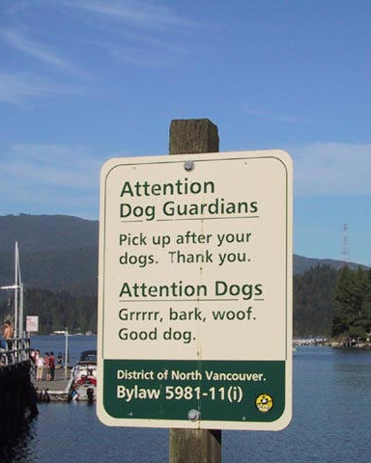
Delight
Sometimes a fun or quirky idea can grab attention and is worth exploring.

Slide 47
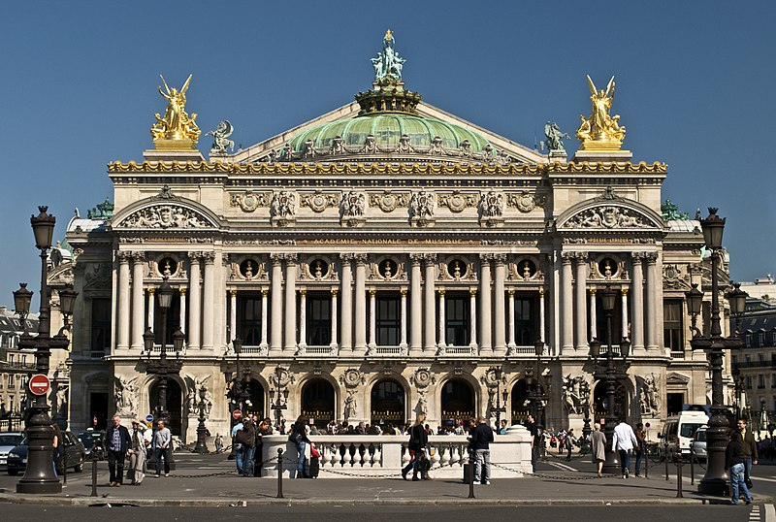
Paris Opera

Slide 48
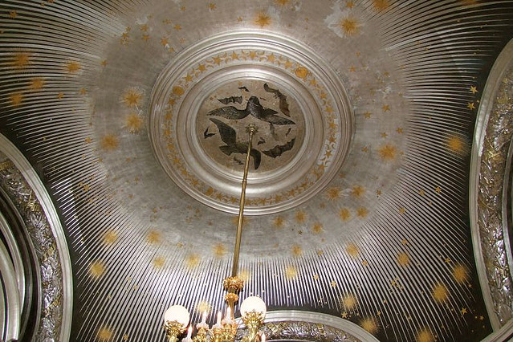

Slide 49
Snippets

Slide 50
Available Snippets
Accordion
Boxes
Box (Gray-Centered)
Buttons
Events List
Two Columns
Three Columns

Slide 51
Bonus Areas
Announcements Area
Contact Box

Slide 52
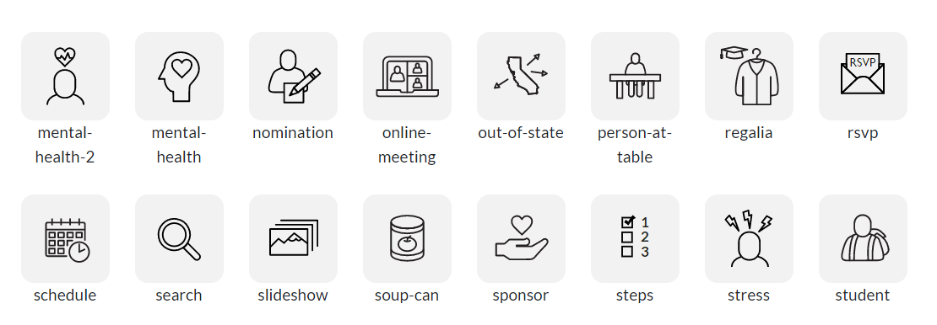
Icons

Slide 53
Icons
Use to add visual interest to a list item, box, etc.
Located in the Sites > chc > images > icons directory
Set the size to 30x30 up to 80x80 as needed.
In the Insert/Edit Image popup you must select (custom) from the Class dropdown.
In the Custom Class box you must type “disable-resize” (without the quotes) or the image will not display.
Icon Cheat Sheet: www.craftonhills.edu/icons
If you do not see the icon you want, you may request one from the Web Developer.

Slide 54
Additional Resources
Jacob Nielsen’s Alertbox: useit.com
Don’t Make Me Think: Revisited by Steve Krugg

