Slide 1
Spring 2020 In-Service Welcome

Slide 3
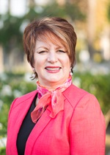
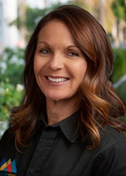
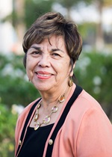
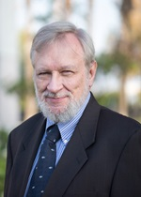
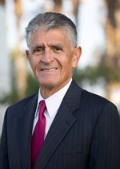
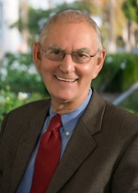
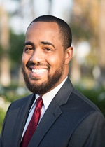
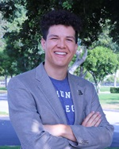
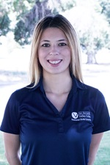
San Bernardino Community College District
Board of Trustees
Board President
Dr. Anne L. Viricel
Board Vice President
Dr. Stephanie Houston
Board Clerk
Gloria Macias Harrison
Trustee
John Longville
Trustee
Frank Reyes
Trustee
Dr. Donald L. Singer
Board Clerk
Joseph Williams
Student Trustee, CHC
Elijah Gerard
Student Trustee, SBVC
Maritza, Mariscal-Medina

Slide 4
New Permanent Employees
Suzanne Delahanty, Alternate Media & Assistive Technology Specialist
Juan Nevares, Technology Support Specialist
Alek Kunf, Aquatics Center Pool Attendant
Dr. Delmy Spencer, Vice President, Student Services
Dr. Kay Weiss, Dean of Letters, Arts and Mathematics (LAM)

Slide 5
NEW Interim FT Faculty
Lisa Mills, Counselor Veteran’s Resources
Suzann Youssef, Chemistry
Edward Ferrari, English

Slide 6
New Assignments
Souts Xayaphanthong, Interim Director of Outreach and Educational Partnerships
Christina Sweeting, Administrative Secretary, Office of Instruction (SINS)

Slide 7
Priorities
Preparing for a Deep Dive into Equity & Inclusion
In/Dignity (January 20th – 31st)
One College/One Book – Leading from the Middle (LFM) Planning Group (Spring 20)
CCCCO Faculty & Staff Diversification Symposium (March 19 & 20)
National Conference on Race & Ethnicity (NCORE – May 26th – 30th)

Slide 8
Priorities continued..
Accreditation – Institutional Self Evaluation Report (ISER)
Measure CC & Measure M Priorities & Allocation
District Resource Allocation Model
Professional Development
Foundation & Institutional Advancement
Academic Program & Student Support Expansion

Slide 9
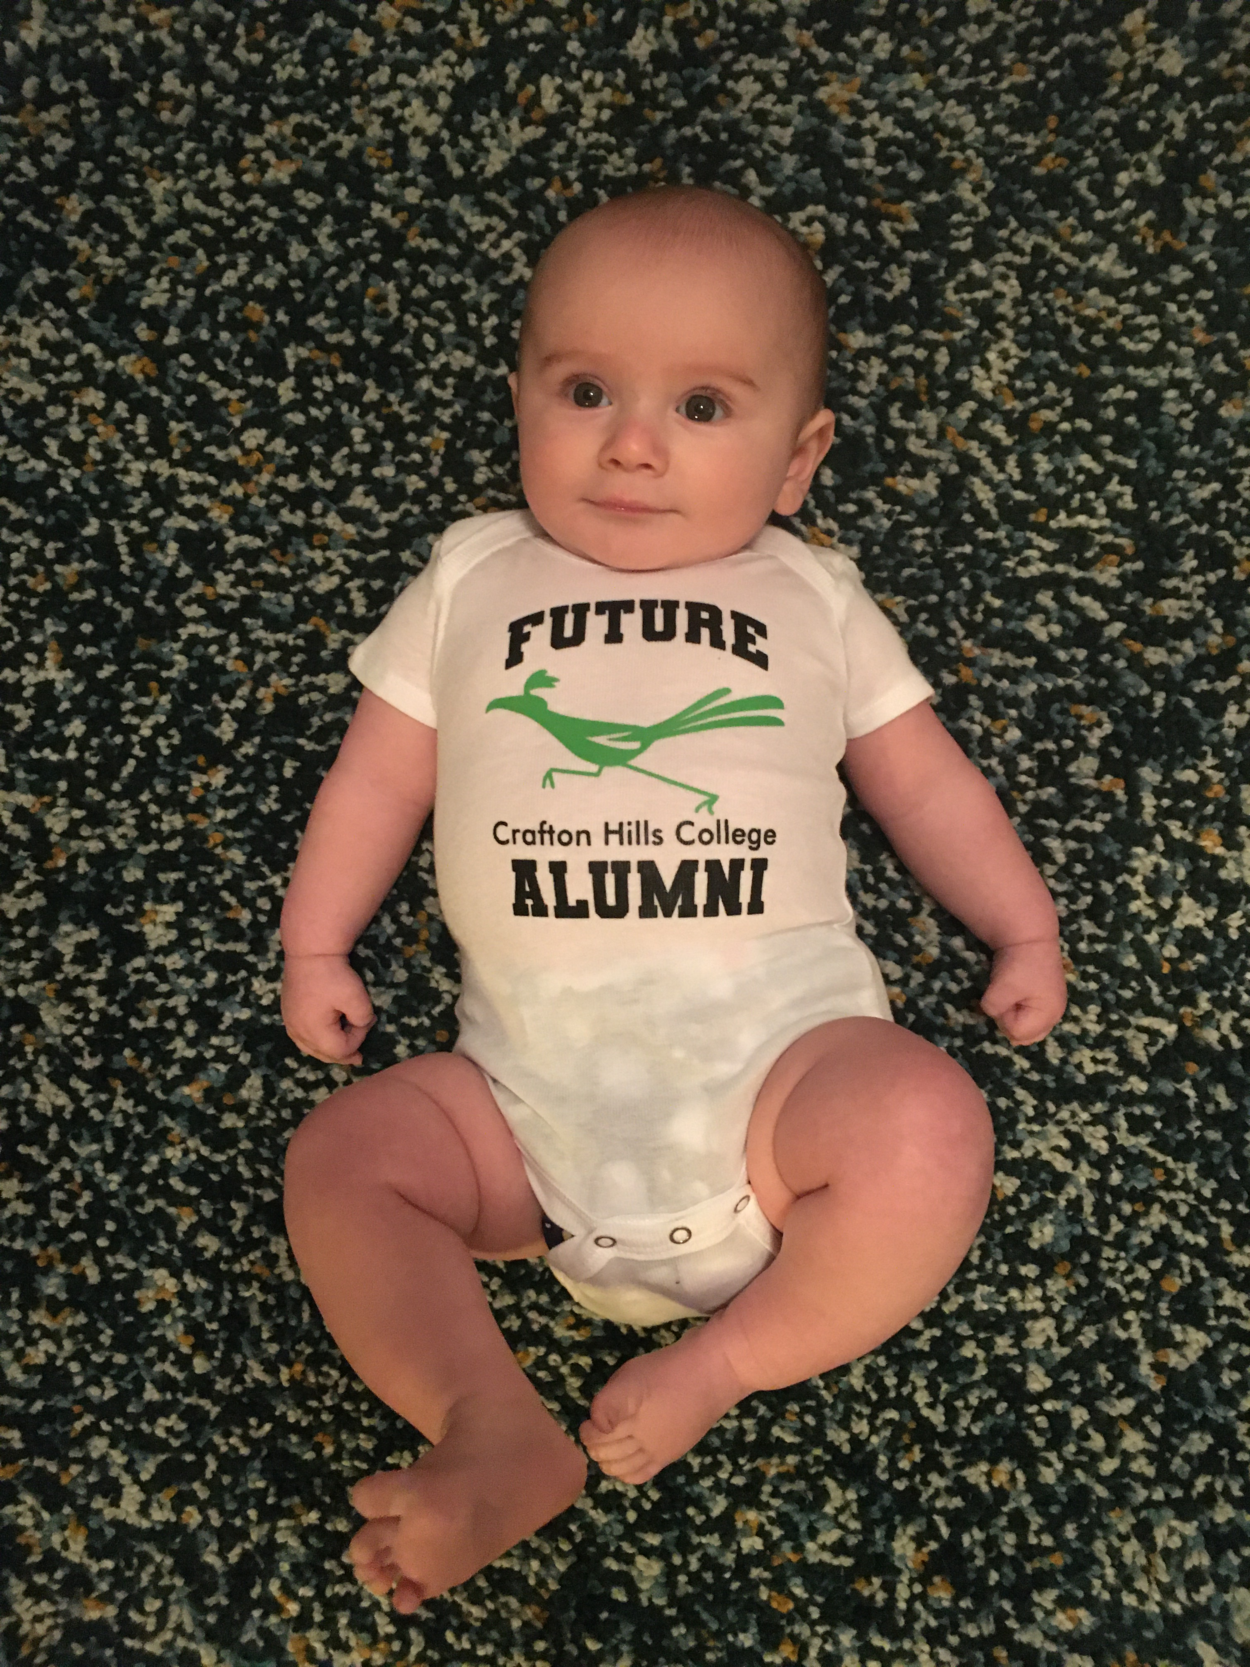
#babyroadrunnersofinstagram
Julien
Lauren Bond (English)
Alexander
Ernesto Rivera (Counseling)
Inari
Jimmy Grabow
(Counseling)

Slide 10
CHC Safety
In-Service Day
January 10, 2020

Slide 11
Safety Report
Safety Summary Report
Safety Toolbox
In the Works 2020
Safety Concerns 2019
“Emergencies” 2019
Notes:
Safety Committee Introduction
Discussed an annual safety report
Heightened concerns and awareness

Slide 12
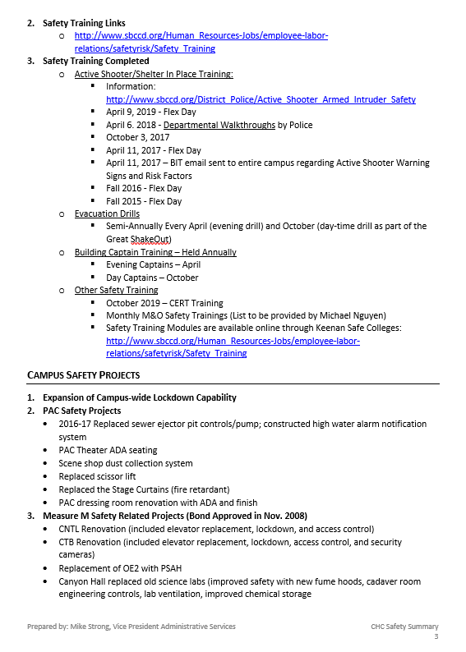
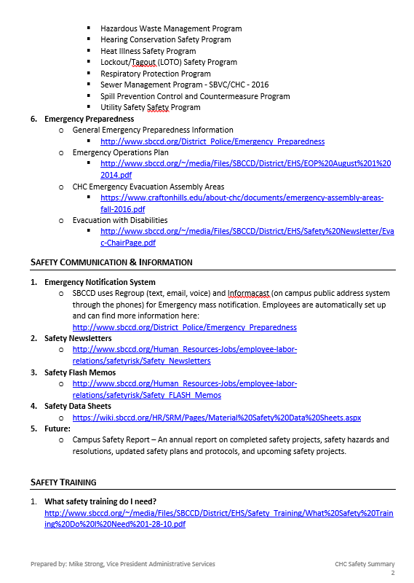
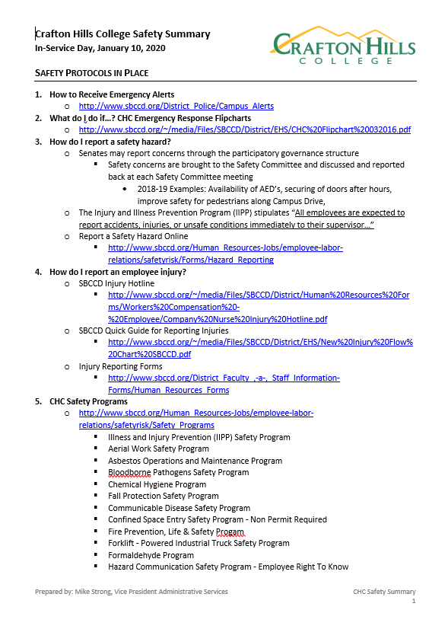
Safety Summary Report
See Handout
Protocols
Communication
Training
Projects

Slide 13
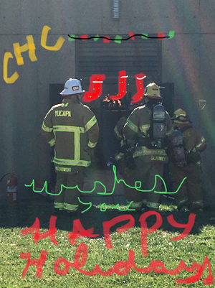

Slide 14
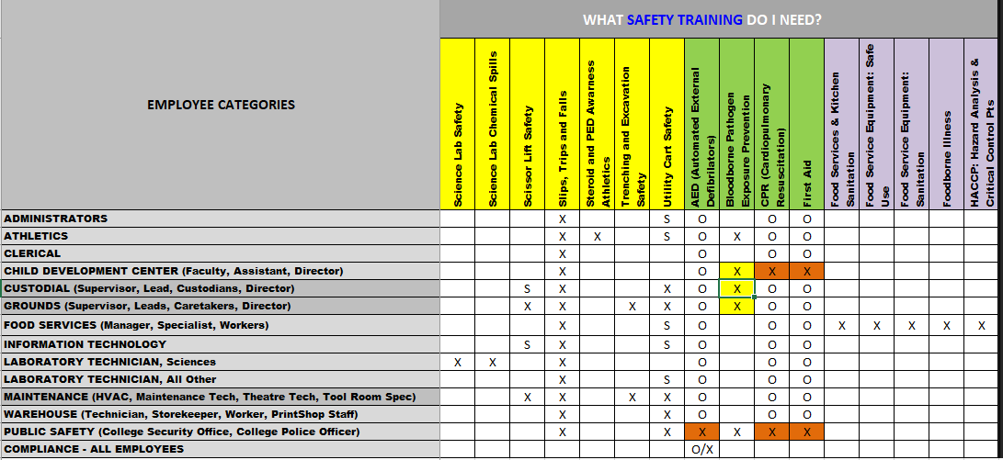
In the Works 2020
AP 3550 – Emergency Response Procedure
Safety Plan Reviews
Safety Inspections
Safety Training
What safety training do I need?
Lockdown Capability

Slide 15
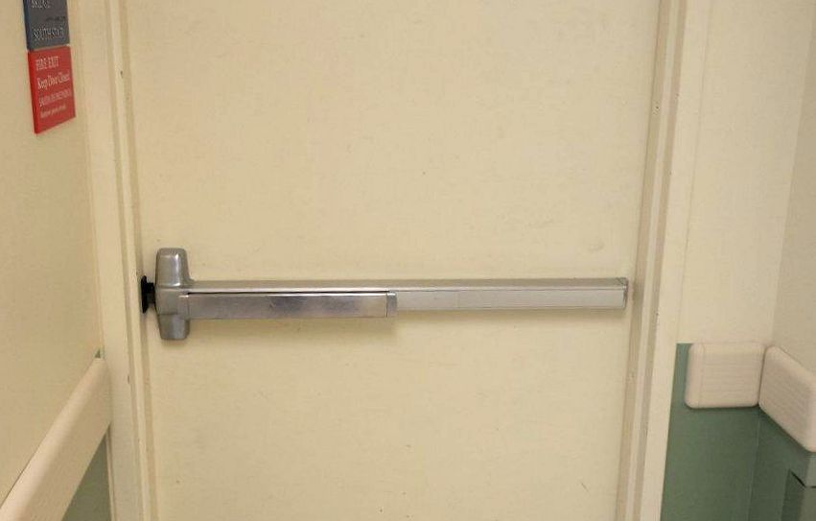
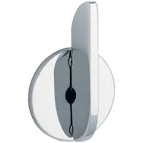
CHC Lockdown Capability
Total Doors in Occupied Areas | 500
Lockdown Capability Upgrades
Door Hardware Standards
Measure CC – More Upgrades to Come
1025 +/- Total Doors
Outside Lockdown Only | 106/500 | 21%
With Key, Hex, or Thumbturn | 394/500 | 79%
With Thumbturn | 268/500 | 54%

Slide 16
Safety Toolbox
Emergency Flipcharts
Safety Plans
Emergency Operations Plan
First Aid Kits
Trauma Kits
AED’s

Slide 17
First Aid Kit Locations
1 | CYN Hall, Room 201 |  | 14 | CDC, Pre-School Classroom 1
2 | CYN Hall, Room 203 |  | 15 | CDC, Pre-School Classroom 2
3 | CYN Hall, Chemistry Lab Prep Area |  | 16 | CCR, Admin Storage Room
4 | CYN Hall, Biology/MicroBiology Lab Prep |  | 17 | LRC, Tech Services
5 | CNTL, 249, Physics Storage Room |  | 18 | LRC, Library Circulation Desk
6 | PSAH, EMS Copy Room |  | 19 | KHA, 104
7 | PSAH, Fire Academy Classroom |  | 20 | KHA, Aquatic Director's Office
8 | PSAH, Fire Academy Apparatus Bay |  | 21 | KHA Fitness Center
9 | ART, 101 |  | 22 | Queen Bean
10 | ART, 130 |  | 23 | Follett (Shipping and Receiving, Break Room)
11 | PAC, Tech Booth |  | 24 | Health and Wellness
12 | PAC, Theatre Tech Office (Backstage) |  | 25 | Police - Police Station
13 | M&O, Conf Room |  | 26 | Police - Patrol Cars

Slide 18
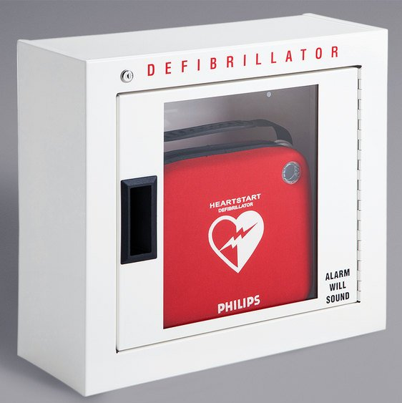
Trauma Kit & AED Locations
Trauma Bags
20 bags in custodial closets throughout the campus
Building Captain Bags (Emergency Prep)
23 bags throughout the campus
AED’s
1 | PSAH, Fire Academy Apparatus Bay
2 | CCR, 1st Floor Elevator Area
3 | LRC Circulation Desk
4 | KHA, First Aid Room next to the Pool
5 | KHA, Fitness Center

Slide 19
Active Shooter Preparedness Training

Slide 20
Next Steps
Training
Departmental Walk-Throughs

Slide 21
Interim Chancellor, Jose Torres

Slide 22
Board of Trustees President, Dr. Anne Viricel

Slide 23
Campus Safety – Part Two
Mike Strong

Slide 24
CHC Safety Scenarios
In-Service Day
January 10, 2020

Slide 25
Safety Scenarios – What do I do?
What actions do you take?
1st few minutes
Considerations for 1st few hours
What questions & concerns arise
Notes:
David Stevenson to assist
Scribe and Spokesperson
Fill out form

Slide 26
Safety Scenarios – What do they do?
SBCCD Police
CalFire
EMS
M&O
BIT
CHC Administration
Notes:
Questions for the Panel:
1) In the earthquake scenario, what should we expect if AMR is unable to respond for several hours? How should we respond.

Slide 27
Scenario A:
During finals week, a student comes to you and says this is the worst day of my life. As he walks away, he states “I’m going to get a gun and end it.” What actions would you take?
Read after a few minutes of discussion:
After 10 minutes, the police have not been able to locate the person.

Slide 28
BIT (Behavioral Intervention Team)
When Should I make a B.I.T. Report?
If someone you know is...
Experiencing a decline in work and/or academic performance.
Demonstrating disruptive and/or disturbing behavior.
Showing dramatic changes in appearance, behavior, and/or weight.
Having problems at home, with classes and/or work.
Making disturbing comments in conversation, email, letters, social media postings and/or papers.
Sad, anxious and/or experiencing dramatic mood shifts.
Abusing alcohol and/or drugs.
Isolating himself/herself socially.
Acting paranoid and/or suspicious.
Frequently angry and/or easily frustrated.
Struggling with heal problems.
Reporting Form:
https://cm.maxient.com/reportingform.php?SanBernardinoCCD&layout_id=2

Slide 29
Scenario B:
From your location, you see someone walk by with what appears to be a gun. What actions would you take?
Read after a few minutes of discussion:
After 10 minutes, the police have not been able to locate the person.

Slide 30
It is another wonderful Monday and you’re excited to be at work, at 10:15am the building starts shaking violently. What actions do you take?
Read after a few minutes of discussion:
When you exit the building, you notice there are multiple injuries and some people are in a panic. You notice severe building damage. You have no cell signal. Power is down in some places and people are calling for help.

Slide 31
You’re on campus, it’s 11:00am on a Thursday—one more day and you can relax for the weekend. You’re a bit stressed about a big task you are working on when the power goes out. What actions do you take?
Read after a few minutes of discussion:
It’s 15 minutes later and the power is still out. You’ve not heard anything from those lousy administrators and you can’t get anyone to pick up their phone.

Slide 32
It’s a hot and windy October day in sunny SoCal. Shortly after lunch, you see plumes of smoke that appears to be very close to the east side of the college.
Read after a few minutes of discussion:
You can now hear the fire alarm in the distance and people are starting to evacuate the PSAH building.

Slide 33
Transformational Success Stories

Slide 34
Transformational Success: AB705
Scott Rippy and Jonathan Anderson
Spring 2020 In-Service

Slide 35
Background on AB705 Efforts

Slide 36
Student Access and Achievement: Data Overview

Slide 37
Transfer-Level Math Placement: The percentage of students placing into transfer-level math has almost tripled from 29% to 86%.

Slide 38
Successful Completion of Transfer-Level Math Courses: The number of students successfully completing transfer-level math increased from 483 in Fall 2017 to 777 in Fall 2019, a 61% increase.
61%

Slide 39
Transfer-Level English Placement: The percentage of students placing into transfer-level English has more than doubled from 45% to over 99%.

Slide 40
Successful Completion of Transfer-Level English Courses: The number of students successfully completing transfer-level English increased from 955 in Fall 2017 to 1,349 in Fall 2019, a 41% increase.
41%

Slide 41
Future Directions

Slide 42
Crafton Hills College
Free College Promise Program
First Semester Update
Souts Xayaphanthong & Gio Sosa
Spring 2020 In-Service

Slide 43
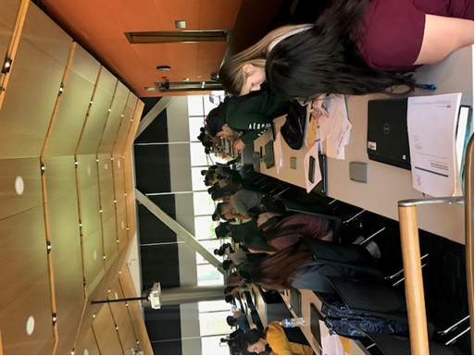
Requirements for current Promise Students
Attend a summer bridge program.
Enroll in and complete a minimum of 12 units each semester.
Maintain a minimum 2.0 GPA or above each semester.
Meet with a counselor at least once each semester to update their student educational plan.
Attend semester check-in meetings and submit progress reports for all enrolled classes.
Participate in at least one campus activity each semester.

Slide 44
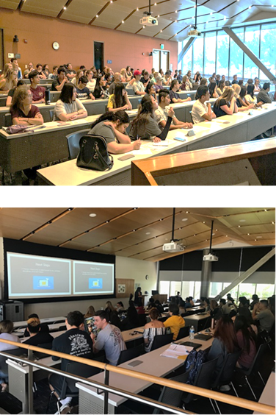
Benefits for current Promise Students
2 consecutive years of free tuition
Free access to textbooks
Free access to a Chromebook rental
$300 per year for college expenses
Priority B class registration
Individual student support and college advising
Opportunity for paid work experience
A Summer Bridge program to help assist transition from high school to college

Slide 45
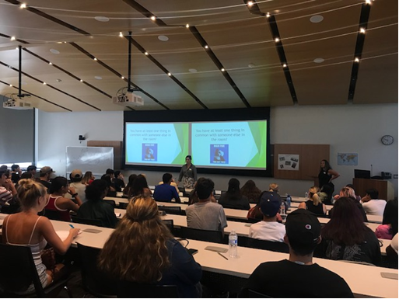
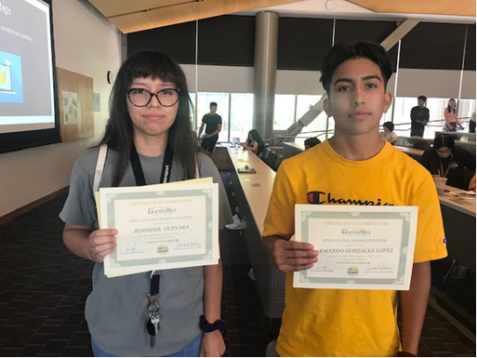
Promise Summer Bridge |  | Students
July 9 - 11, 2019 | 9:00 am – 12:00 pm | 64
July 16 - 18, 2019 | 9:00 am – 12:00 pm | 74
July 23 - 25, 2019 | 9:00 am – 12:00 pm | 65
July 30 – August 1, 2019 | 9:00 am – 12:00 pm | 64
July 30 – August 1, 2019 | 3:00 pm – 6:00 pm | 68
August 6 – 8, 2019 | 9:00 am – 12:00 pm | 62
August 6 – 8, 2019 | 2:00 pm – 5:00 pm | 30
Total
427

Slide 46
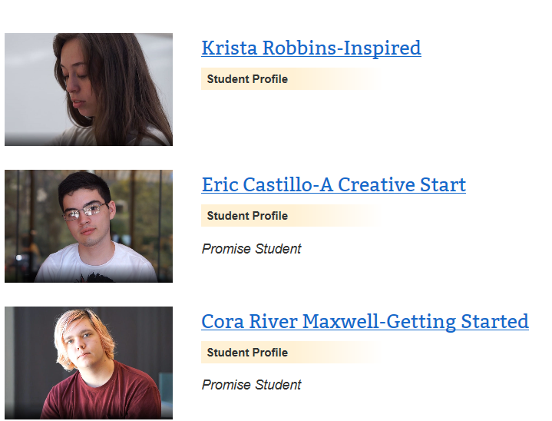
Spotlight on Promise:
https://www.craftonhills.edu/spotlight-on-promise/index.php

Slide 47
Unduplicated Headcount in Fall 2019
6.4% of Student Population

Slide 48
Ethnicity Comparison Between Promise and Non-Promise Students in Fall 2019

Slide 49
Gender Comparison Between Promise and Non-Promise Students in Fall 2019

Slide 50
Age Comparison Between Promise and Non-Promise Students in Fall 2019

Slide 51
Achievement Outcomes in Fall 2019: A Comparison to Students 19 or Younger

Slide 52
Full-Time Status Comparison by Promise and Non-Promise Students (19 or Younger)
N = 1,831

Slide 53
Average (Median) Units Attempted by Promise and Non-Promise Students (19 or Younger)
N = 427

Slide 54
Average (Median) Units Completed by Promise and Non-Promise Students (19 or Younger)
N = 427

Slide 55
Success Rate Among Promise and Non-Promise Students (19 or Younger)
N = 1,831

Slide 56
Retention Rate Among Promise and Non-Promise Students (19 or Younger)
N = 1,831
N = 427

Slide 57
Fall 2019 to Spring 2020¹ Enrollment by Promise and Non-Promise Students (19 or Younger)
¹Through 1/7/2020

Slide 58
Applications accepted October 1, 2019 – January 31, 2020
www.freecollegepromise.com

Slide 59
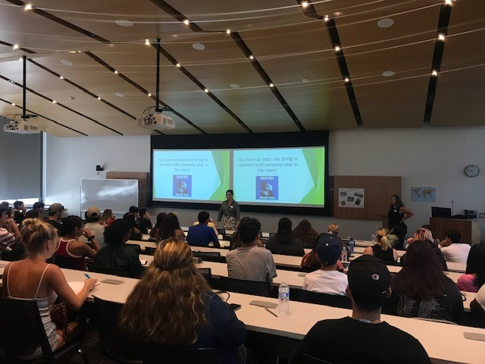
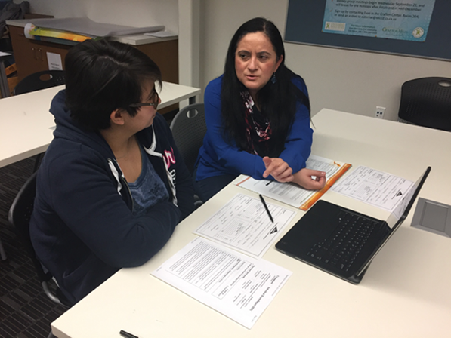
Program Benefits:
2 consecutive years of free tuition
Free access to textbooks
Priority B class registration
Individual student support and college advising
A Summer Bridge program to help you transition from high school to college

Slide 60
Students Who Are Accepted Must:
Attend a summer bridge program
Enroll in and complete a minimum of 12 units each semester
Maintain a minimum 2.0 GPA or above each semester
Meet with a counselor at once each semester
Submit mid-term progress reports each semester
Participate in assigned campus activities and workshops

Slide 61
Frequently Asked Questions:
Is there a minimum high school GPA required to qualify?
No. However, you are required to submit an official high school transcript to the Admissions and Records Office at your chosen college.
How will I know if I am accepted?
An email of acceptance will be sent in February 2020 to students inviting them to attend a mandatory Free College Promise Orientation. Dates to be determined.
Is it mandatory that I participate in Summer Bridge the summer after high school graduation?
Yes, it is mandatory that Promise students attend Summer Bridge.

Slide 62
Frequently Asked Questions:
When is Summer Bridge offered at Crafton Hills College?
Summer Bridge will be held between June through August 2020. Students will be assigned to one session.
If I do not have a high school diploma from a priority school district, am I still eligible to apply?
Yes, but students who earned their high school diploma in the priority School Districts will receive priority consideration.
When do classes start in Fall 2020?
Monday, August 17, 2020

Slide 63
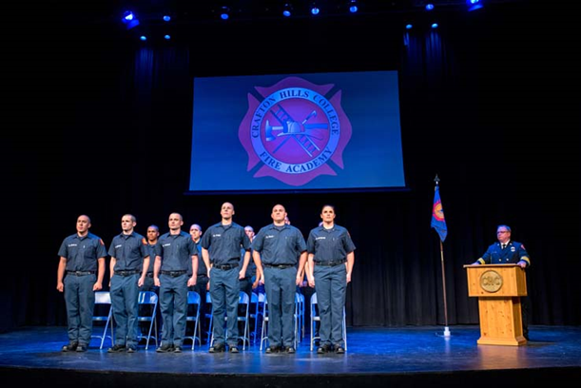
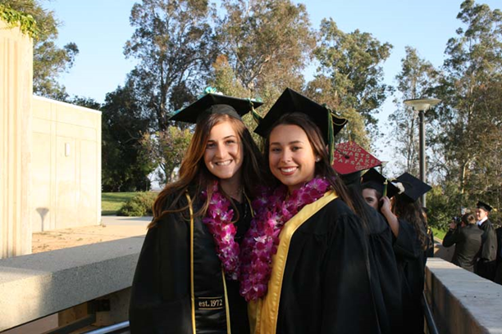
Contact us at Crafton Hills College
Student Support Building (SSB) - 201
(909) 389-3267
chccollegepromise@sbccd.edu

Slide 64
Swimmin’ with STARFISH
A look at Backstroke and Freestyle (translation: past data and where we’re headed)
by Breanna Andrews and Ernesto Rivera
Spring 2020 In Service

Slide 65
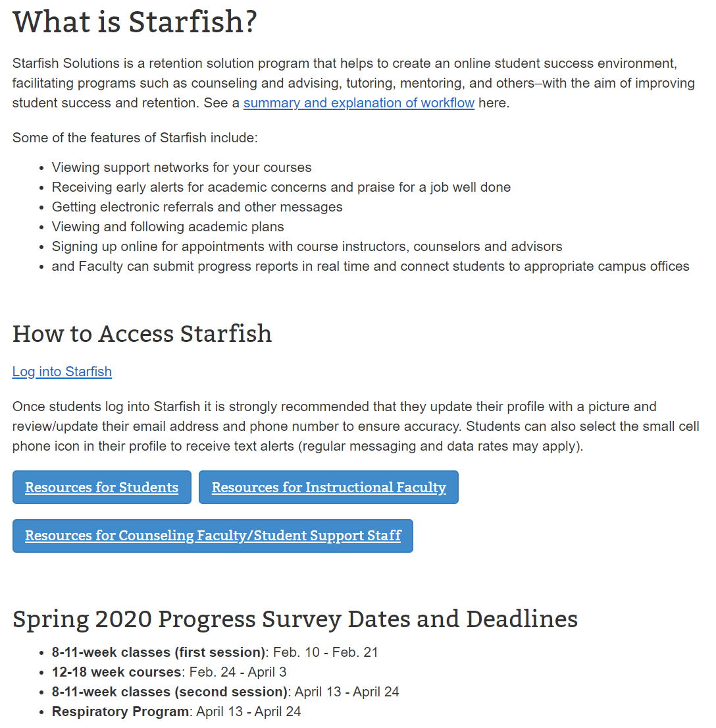
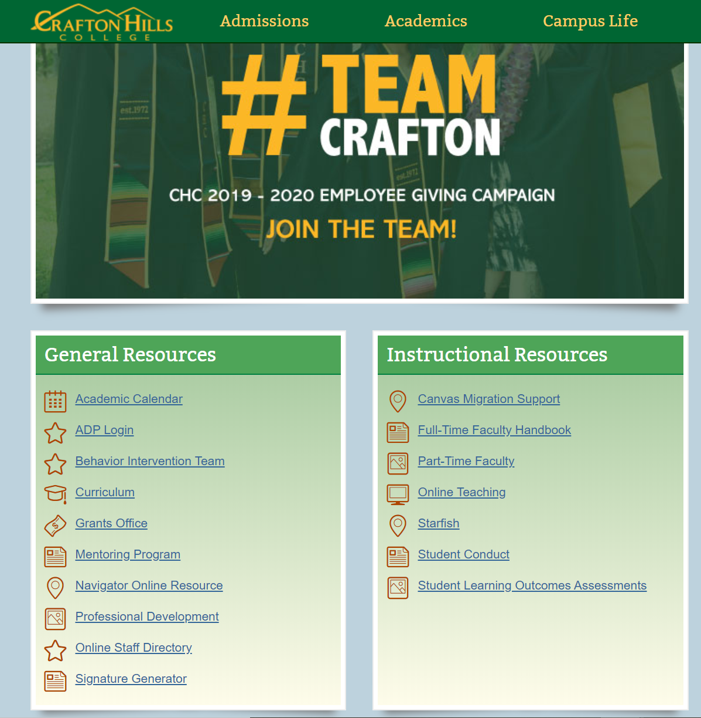
Video Tutorials and Resources

Slide 66
Communication Tool
Campus Pilot in Spring 2017
Full campus rollout in Fall 2017

Slide 67
Usage Report
 | Flags (manual, automatic, and progress reports) | Kudos (manual and progress reports) | Referrals | To-Do | Total Tracking Items Raised
Fall 2017 | 387 | 999 | 33 | 13 | 1,432
Spring 2018 | 1,532 | 1,263 | 7 | 2 | 2,804
Fall 2018 | 1,746 | 2,091 | 57 | 3 | 3,897
Spring 2019 | 1,403 | 2,191 | 16 | 7 | 3,617
Fall 2019 | 4,347 | 5,078 | 33 | 22 | 9,480
In fall 2019, 73% of courses completed a progress report through Starfish during our main release for 12-18wk classes

Slide 68
Student Success: The Data
Courses with sections that used Starfish were compared to other sections that did not.
if at least 1 section of ACCT-208 used Starfish, then all ACCT-208 courses were included in the analysis
if no sections of ACCT-209 used Starfish, it was removed from the dataset
Research was conducted through the Office of Research and Planning

Slide 69
Success Rates Among Courses Using Starfish by Race (2017-2018)
 | Courses Not Using Starfish |  | Courses Using Starfish
Race | # of Successful Grades | % of Successful Grades | # of Successful Grades | % of Successful Grades | Difference (Percentage Points)
African American | 86 | 56.6% | 199 | 67.0% | 10.4%
Asian | 177 | 72.2% | 407 | 80.6% | 8.3%
Caucasian | 1095 | 71.8% | 2355 | 74.3% | 2.6%
Hispanic | 1316 | 60.9% | 3005 | 66.8% | 5.9%
Multiple Races | 189 | 67.5% | 443 | 75.0% | 7.5%
Native American | 4 | 50.0% | 16 | 45.7% | -4.3%
Unknown | 5 | 83.3% | 14 | 70.0% | -13.3%
Note: A successful grade is defined as any grade that is an A, B, C, or P.

Slide 70
Success Rates Among Courses Using Starfish by Race (2018-2019)
 | Courses Not Using Starfish |  | Courses Using Starfish
Race | # of Successful Grades | % of Successful Grades | # of Successful Grades | % of Successful Grades | Difference (Percentage Points)
African American | 170 | 58.0% | 367 | 59.4% | 1.4%
Asian | 403 | 75.6% | 783 | 81.4% | 5.8%
Caucasian | 2200 | 71.4% | 4871 | 77.1% | 5.8%
Hispanic | 2884 | 61.8% | 6043 | 69.6% | 7.7%
Multiple Races | 426 | 68.8% | 837 | 73.9% | 5.1%
Native American | 21 | 60.0% | 43 | 75.4% | 15.4%
Unknown | 14 | 87.5% | 31 | 83.8% | -3.7%
Note: A successful grade is defined as any grade that is an A, B, C, or P.

Slide 71
Success Rates … by Age (2017-2018)
 | Courses Not Using Starfish |  | Courses Using Starfish
Age Group | # of Successful Grades | % of Successful Grades | # of Successful Grades | % of Successful Grades | Difference (Percentage Points)
19 or Younger | 1147 | 64.8% | 2573 | 70.5% | 5.7%
20-24 Years Old | 998 | 64.1% | 2208 | 67.7% | 3.6%
25-29 Years Old | 334 | 67.3% | 822 | 73.0% | 5.7%
30-34 Years Old | 167 | 65.0% | 367 | 76.1% | 11.2%
35-39 Years Old | 104 | 73.2% | 198 | 76.4% | 3.2%
40-49 Years Old | 87 | 82.1% | 162 | 81.0% | -1.1%
50 or Older | 35 | 67.3% | 109 | 79.0% | 11.7%
Note: A successful grade is defined as any grade that is an A, B, C, or P.

Slide 72
Success Rates … by Age (2018-2019)
 | Courses Not Using Starfish |  | Courses Using Starfish
Age Group | # of Successful Grades | % of Successful Grades | # of Successful Grades | % of Successful Grades | Difference (Percentage Points)
19 or Younger | 2339 | 64.0% | 4712 | 71.8% | 7.8%
20-24 Years Old | 2242 | 66.1% | 4709 | 72.6% | 6.5%
25-29 Years Old | 786 | 68.1% | 1771 | 73.3% | 5.2%
30-34 Years Old | 344 | 71.2% | 720 | 74.8% | 3.5%
35-39 Years Old | 205 | 74.0% | 501 | 76.1% | 2.1%
40-49 Years Old | 139 | 69.2% | 376 | 77.4% | 8.2%
50 or Older | 63 | 76.8% | 186 | 80.2% | 3.3%
Note: A successful grade is defined as any grade that is an A, B, C, or P.

Slide 73
Success Rates … by Gender (2017-2018)
 | Courses Not Using Starfish |  | Courses Using Starfish
Gender | # of Successful Grades | % of Successful Grades | # of Successful Grades | % of Successful Grades | Difference (Percentage Points)
Female | 1656 | 67.8% | 3572 | 72.2% | 4.4%
Male | 1214 | 63.0% | 2862 | 68.9% | 5.9%
Unknown | 2 | 25.0% | 5 | 41.7% | 16.7%
Note: A successful grade is defined as any grade that is an A, B, C, or P.

Slide 74
Success Rates … by Gender (2018-2019)
 | Courses Not Using Starfish |  | Courses Using Starfish
Gender | # of Successful Grades | % of Successful Grades | # of Successful Grades | % of Successful Grades | Difference (Percentage Points)
Female | 3462 | 67.08% | 7447 | 74.03% | 6.9%
Male | 2650 | 65.06% | 5500 | 71.32% | 6.3%
Unknown | 6 | 54.55% | 28 | 71.79% | 17.2%
Note: A successful grade is defined as any grade that is an A, B, C, or P.

Slide 75
Success Rates … by Types of tracking items raised (2017-2018)
Item Type | # of Successful Grades | % of Successful Grades
Flag | 242 | 54.6%
Kudos | 789 | 87.5%
Referral | 36 | 61.0%
To-Do | 6 | 75.0%
Note: A successful grade is defined as any grade that is an A, B, C, or P.

Slide 76
Success Rates … by Types of tracking items raised (2018-2019)
Item Type | # of Successful Grades | % of Successful Grades
Flag | 813 | 60.45%
Kudos | 1907 | 88.95%
Referral | 8 | 40.0%
To-Do | 1 | 16.67%
Note: A successful grade is defined as any grade that is an A, B, C, or P.

Slide 77
Wipe Out! Our short comings
Success rates are high for students with kudos… We recognize those may be our “higher achieving” students anyway.
We are understaffed in terms of reaching out to students and closing flags

Slide 78
Education Planning Tool
Campus Pilot in Spring 2018
Full campus rollout in November 1, 2018

Slide 79
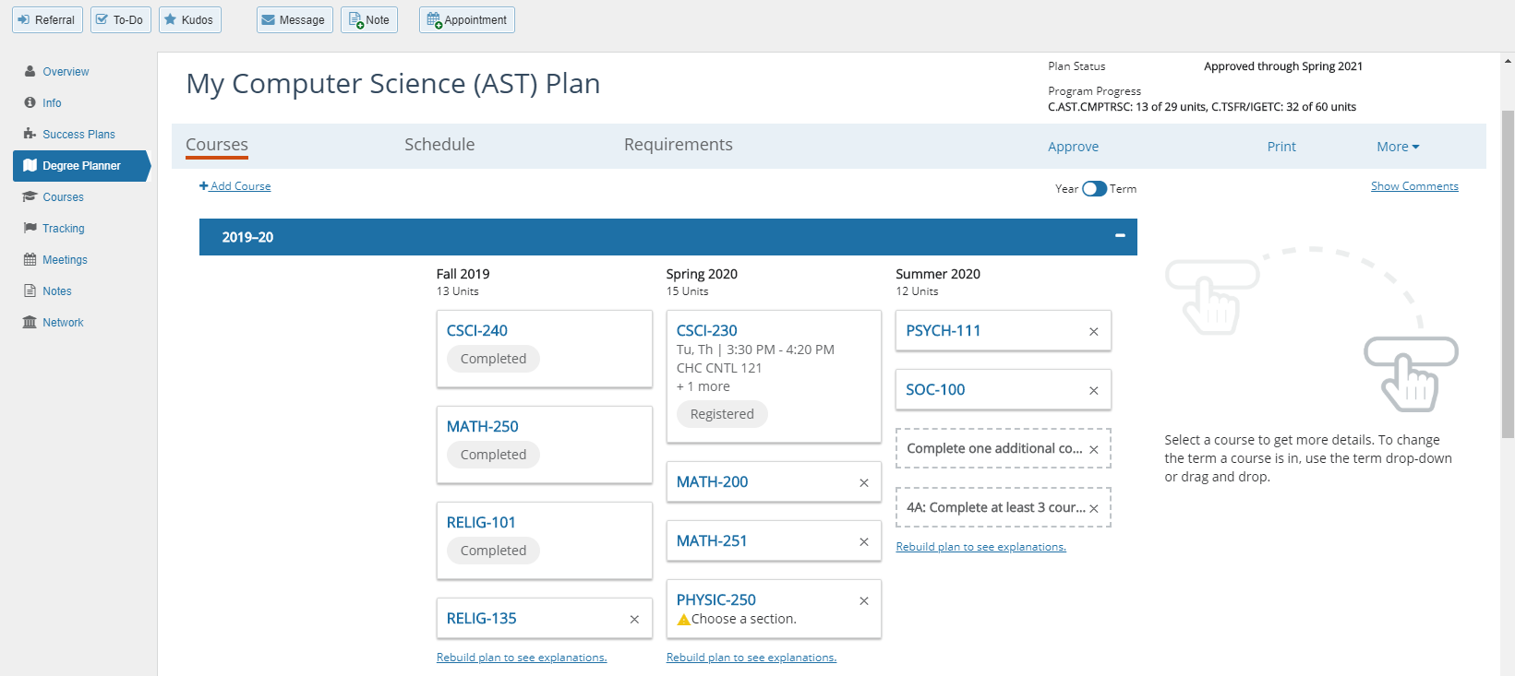
What is Degree Planner and What does it look like?

Slide 80
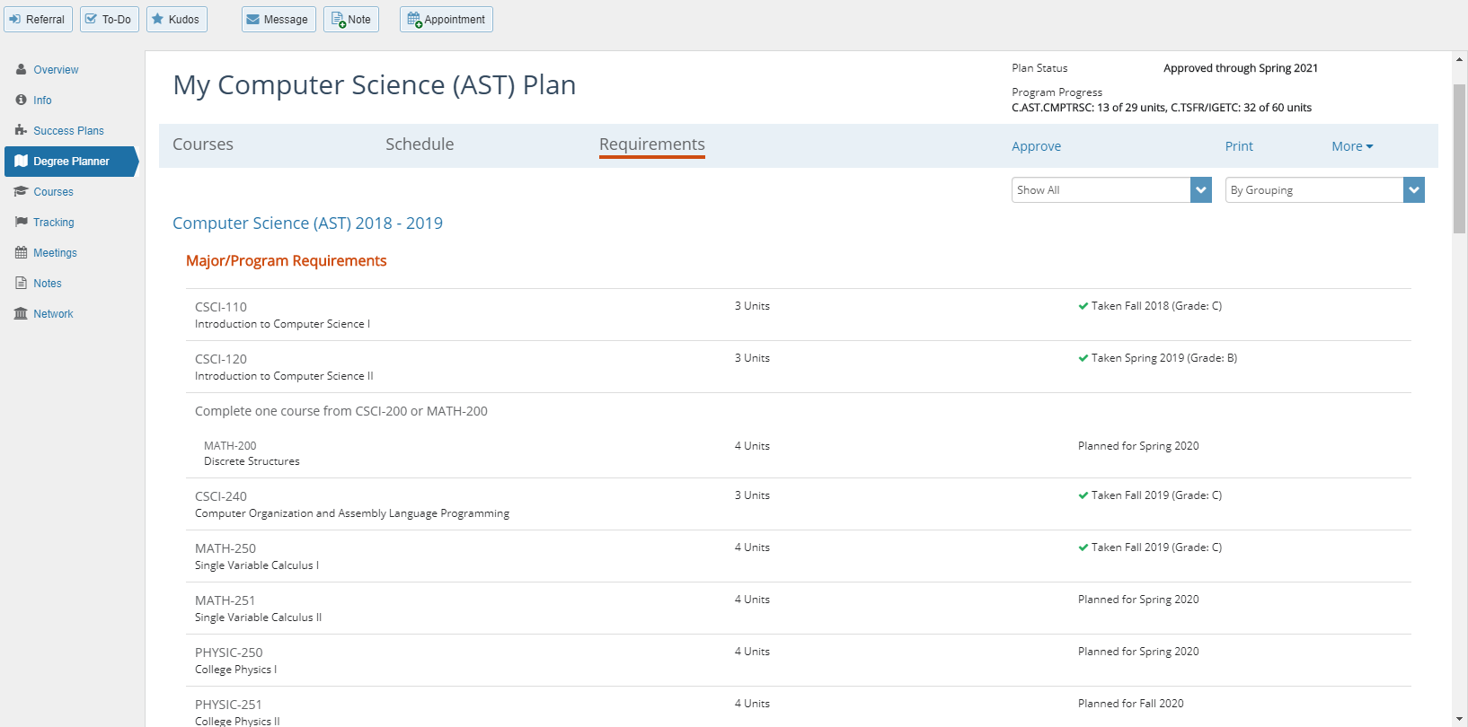

Slide 81
Data
Here are the total educational plans created in Starfish as of 1/8/2020:
Total Ed Plans since Nov 1st launch = 9,219
Total Undeleted = 8,489
Total Approved = 5,979
Total Comprehensive = 3,149

Slide 82
Data
Term | # of Ed Plans Entered in Starfish*
Fall 2017 | 234
Spring 2018 | 107
Summer 2018 | 43
Fall 2018 | 1399
Spring 2019 | 2893
Summer 2019 | 1819
Fall 2019 | 3455
*Includes all plans created and/or approved by Counseling during this time.

Slide 83
What’s Next?
For Degree Planner and the Communication Tool

Slide 84
Goals
80% Ed Plans completed and approved by end of spring 2020 (and beyond).
80% course submission of Progress Reports in Starfish by end of spring 2020 (and beyond).
Continue to increase student retention, completion, and success, as well as degree/certificate attainment

Slide 85
Help?
Visit our campus’s online Starfish Resource Page at https://www.craftonhills.edu/current-students/counseling/starfish/index.php
Contact Breanna Andrews (bandrews@craftonhills.edu) if you…
would like to set up Automatic flags for your courses
want a personalized demo or tutorial on Starfish Communication tool
have questions or need to troubleshoot an issue
have an idea to make the system better
Contact Ernesto Rivera (erivera@craftonhills.edu) if you…
have a question about Degree Planner
want to schedule a class presentation

Slide 86
Guided Pathways
Sabrina Jimenez, Kenny George, Joshua Robles, Shella Scott

