Slide 1

In-Service Opening Day Fall 2023

Slide 2

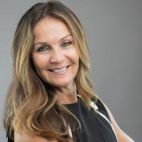
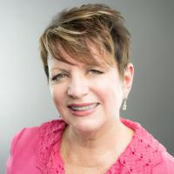
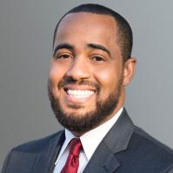
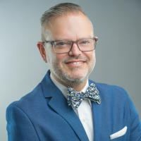
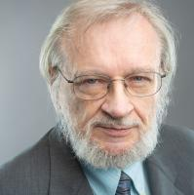
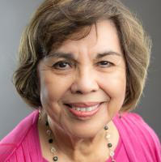
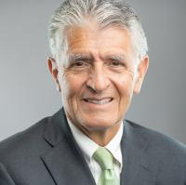
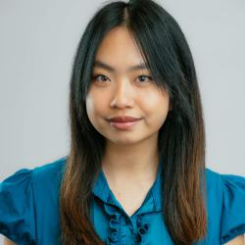
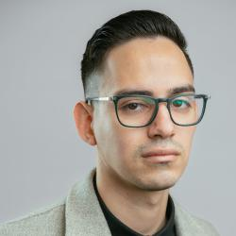
SBCCD Board of Trustees
Board Chair
Dr. Stephanie Houston
Board Vice Chair
Dr. Anne Viricel
Board Clerk
Joseph Williams
Trustee
Dr. Nathan Gonzales
Trustee
John Longville
Trustee
Gloria Macias Harrison
Trustee
Frank Reyes
Student Trustee
Michelle Ly
Student Trustee
Dyami Ruiz-Martinez

Slide 3
New Roadrunners

Slide 4
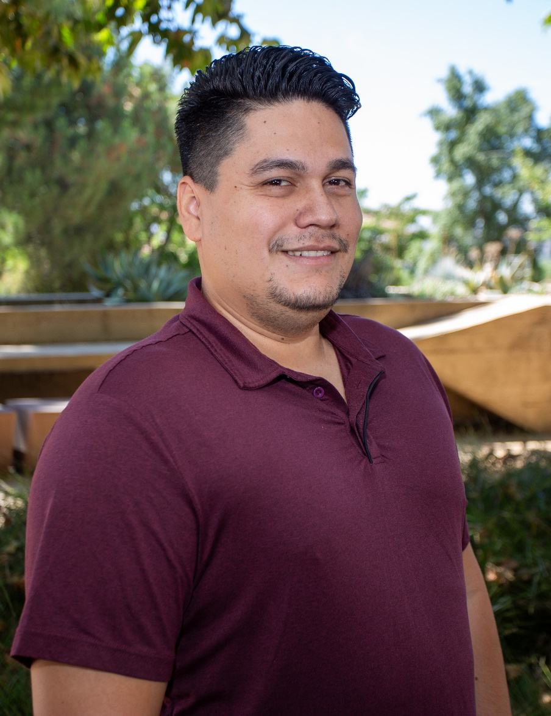
Welcome!
Herbeth “Alex” Jaco
Counseling Instructor

Slide 5
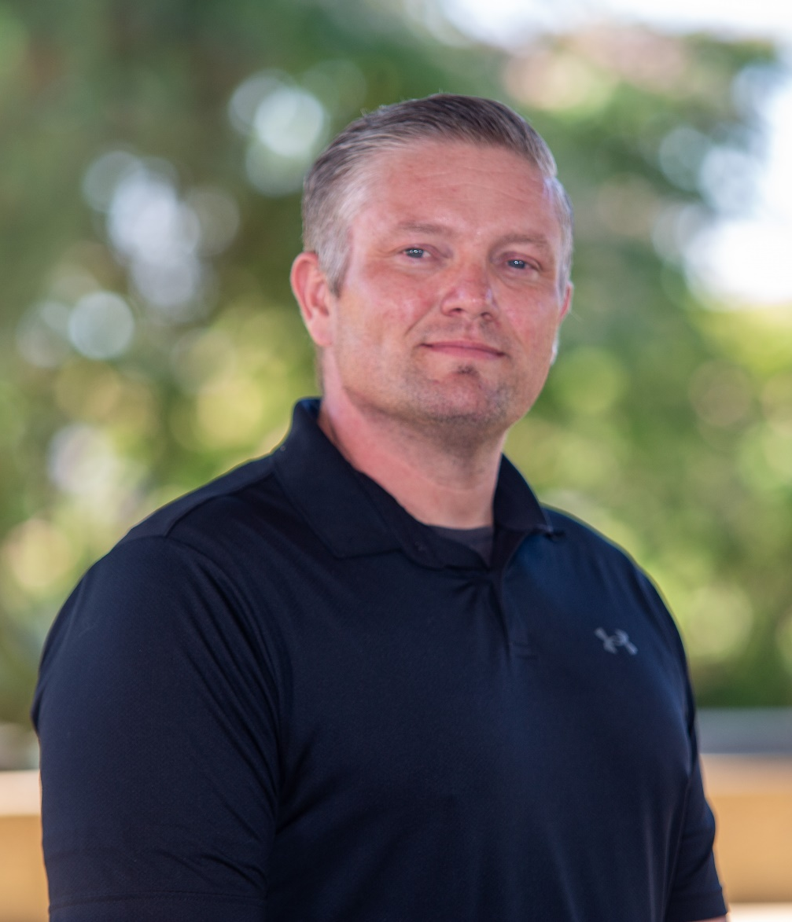
Welcome!
Glen Thronson
EMS Instructor

Slide 6
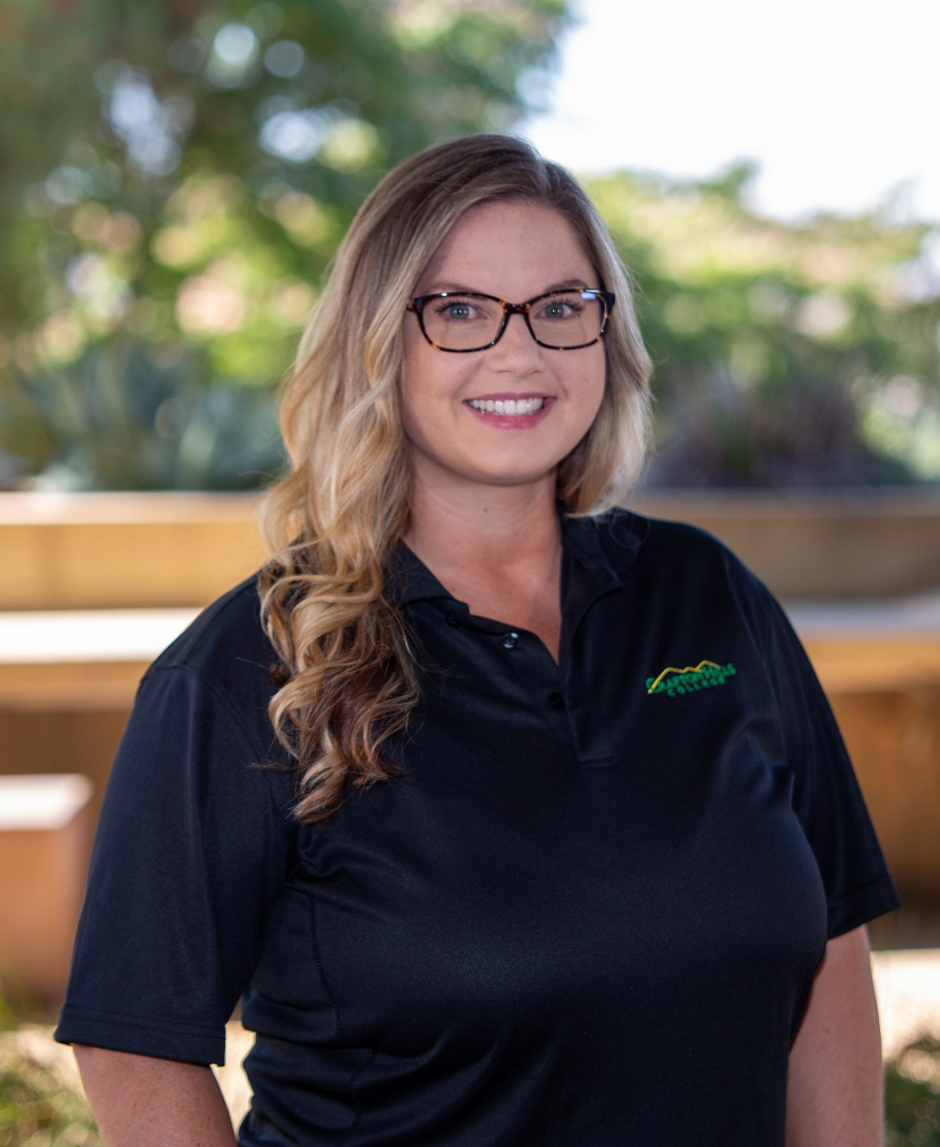
Welcome!
Krysten Audibert
Director, Mesa Program/STEM

Slide 7
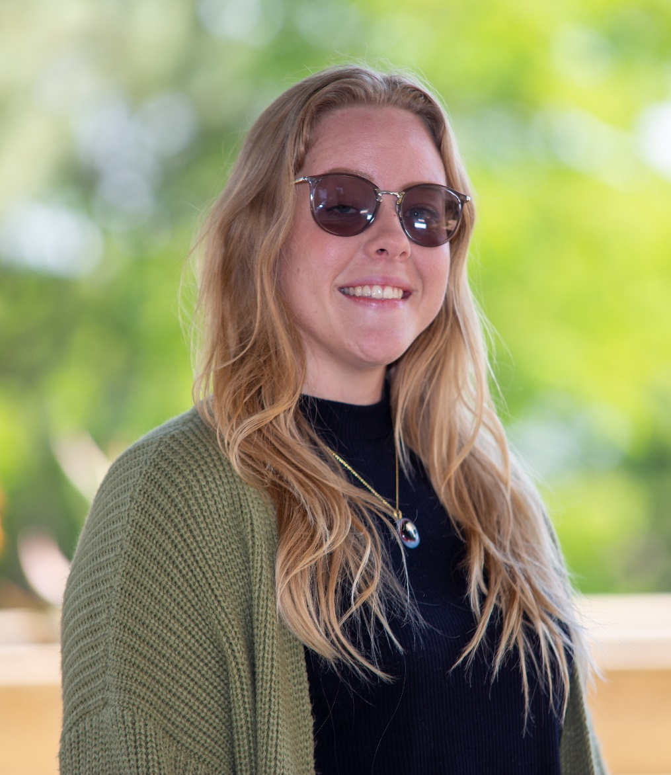
Welcome!
Jessica Beverson
Research and Planning Analyst

Slide 8
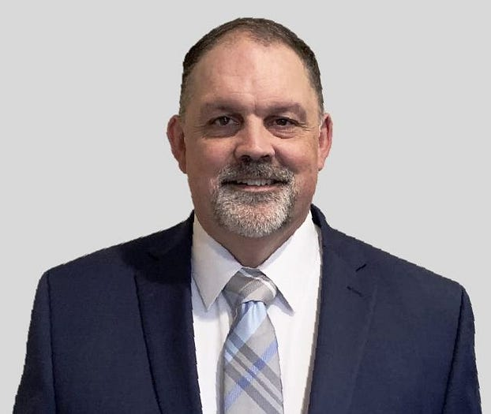
Welcome!
Luke Bixler
SBCCD Chief Technology Officer

Slide 9
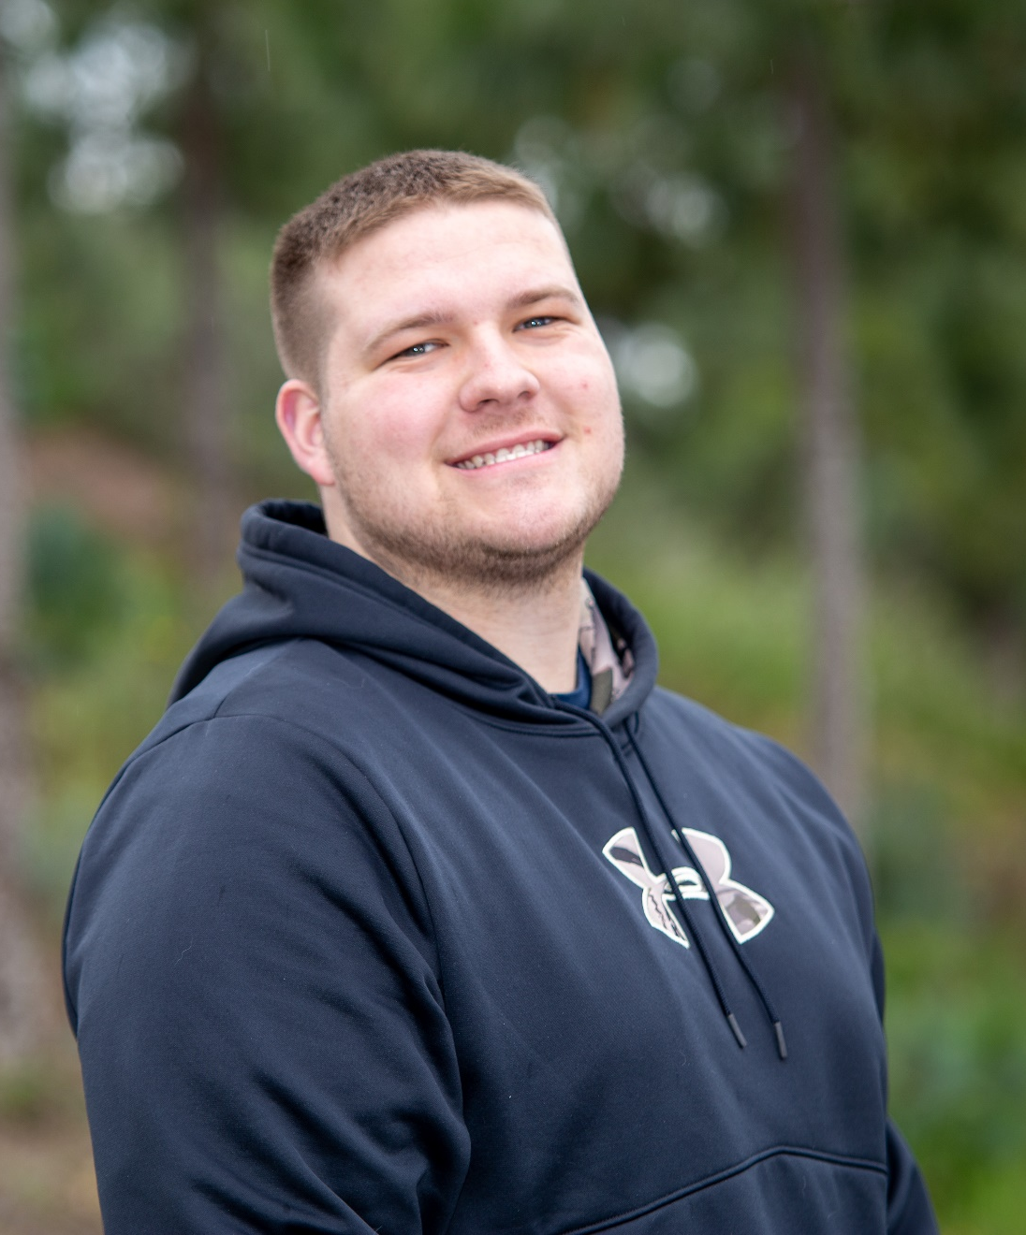
Welcome!
Blake Cole
Custodian

Slide 10
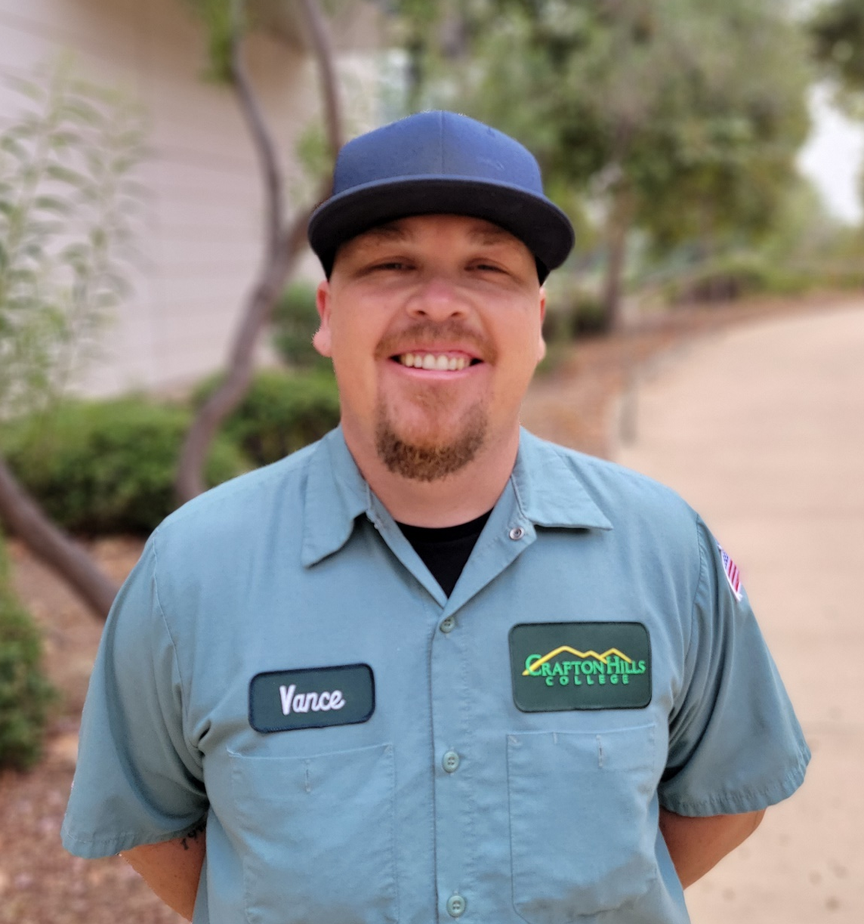
Welcome!
Vance Davidson
Maintenance Technician

Slide 11
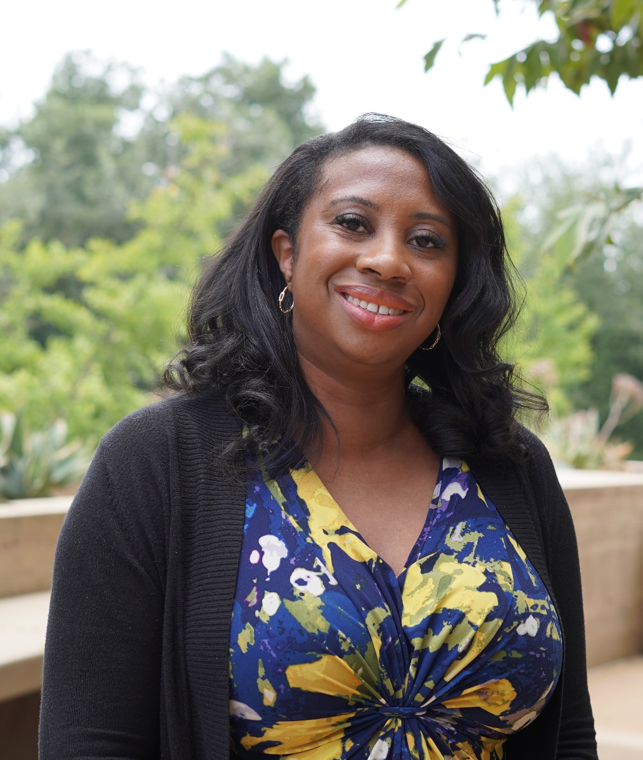
Welcome!
Ciera Divens
Library Technical Assistant

Slide 12
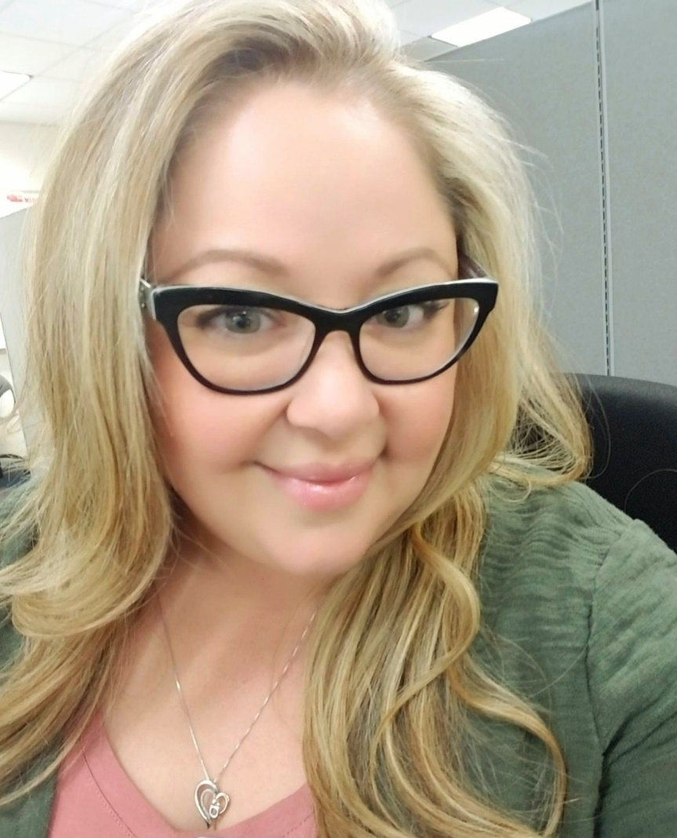
Welcome!
Jeanette Frausto
Interim Specialist, Financial Aid

Slide 13
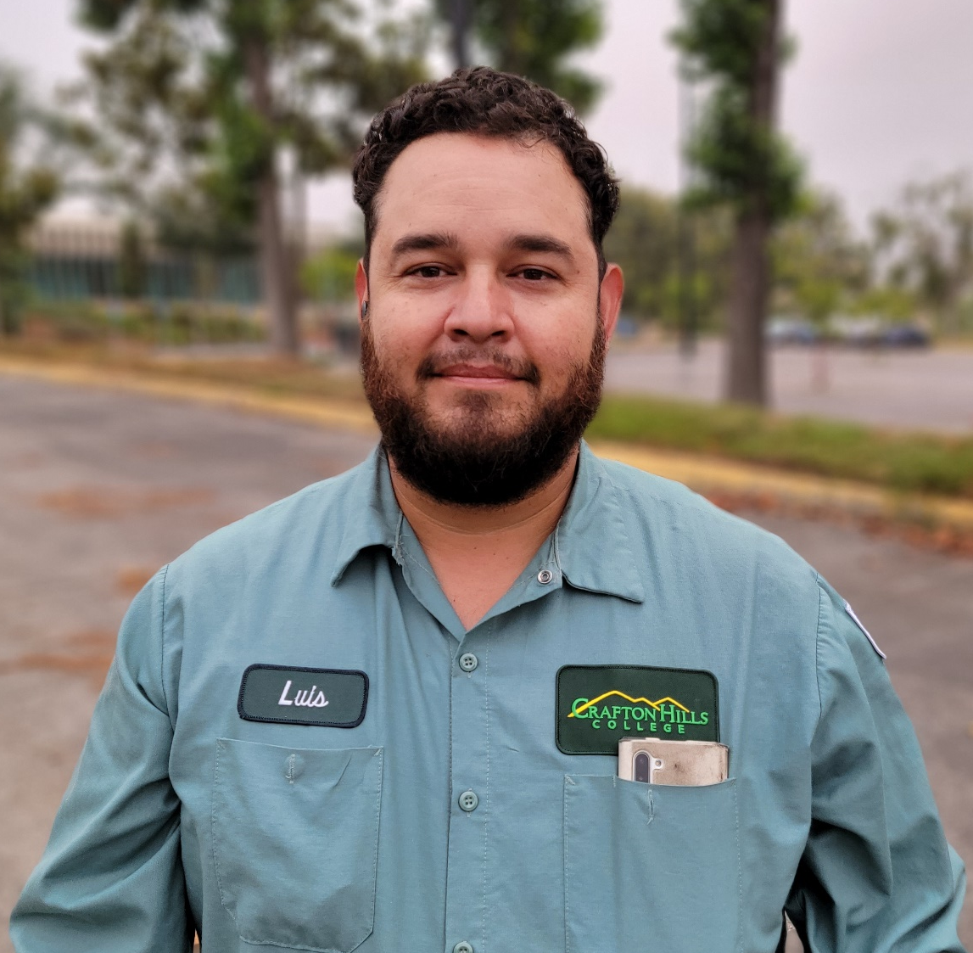
Welcome!
Luis Gomez
Grounds Caretaker - Facilities

Slide 14
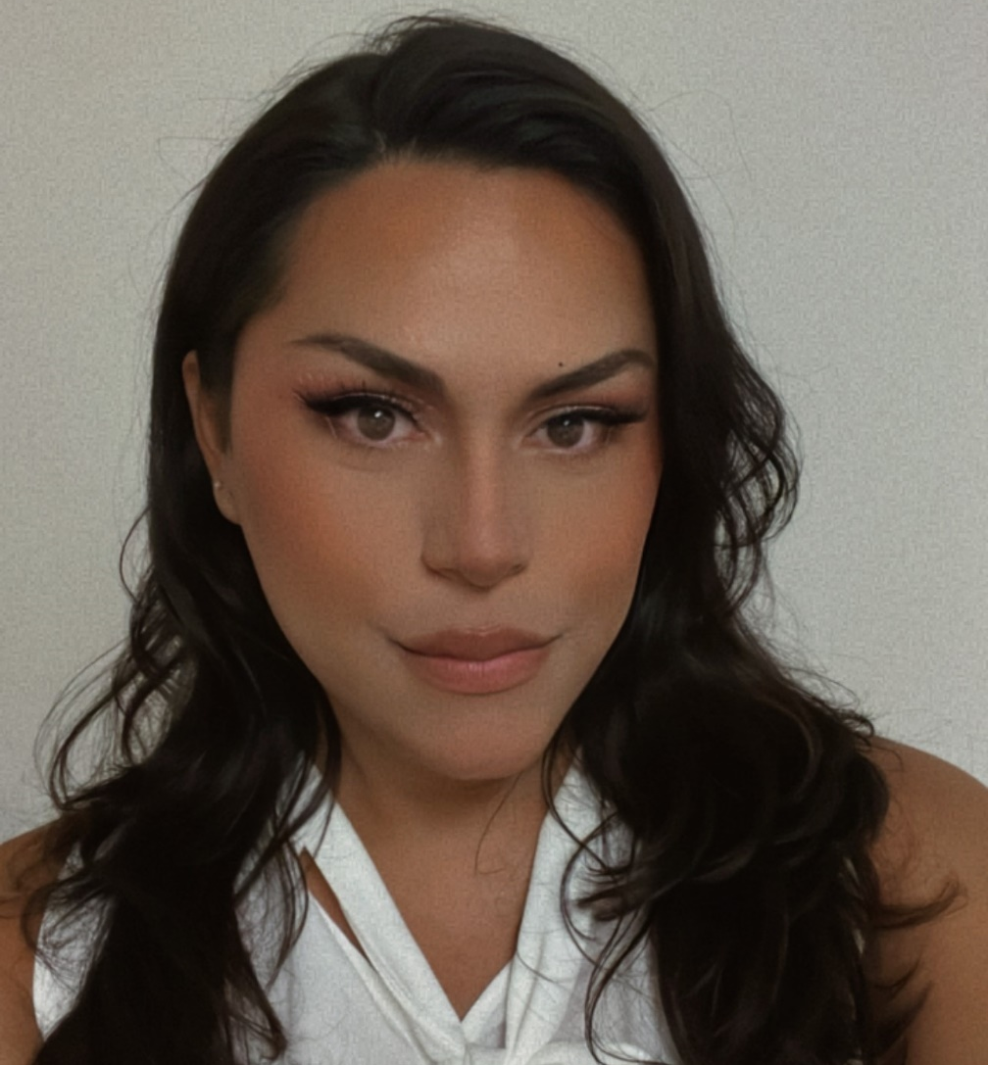
Welcome!
Luna Lagrima
Student Service Technician, Admissions and Records

Slide 15
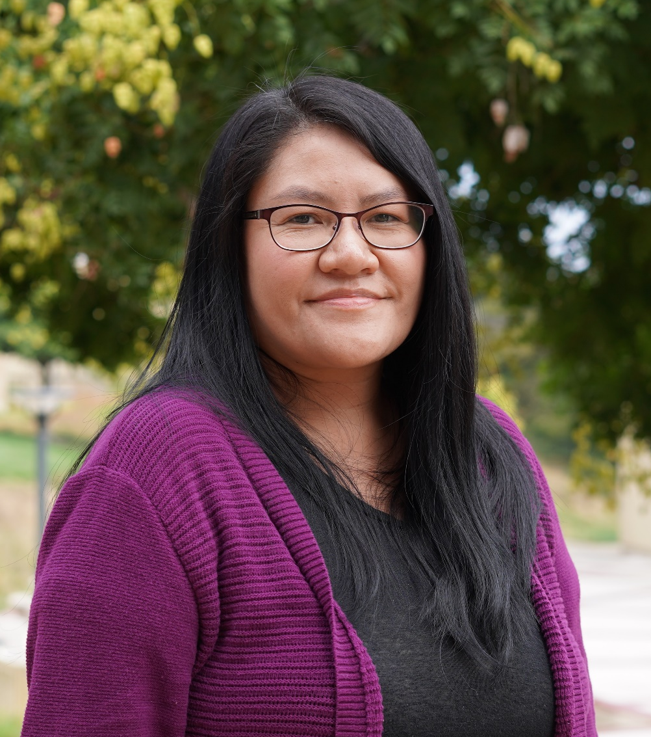
Welcome!
Eugenia Livingston
Library Technical Assistant

Slide 16
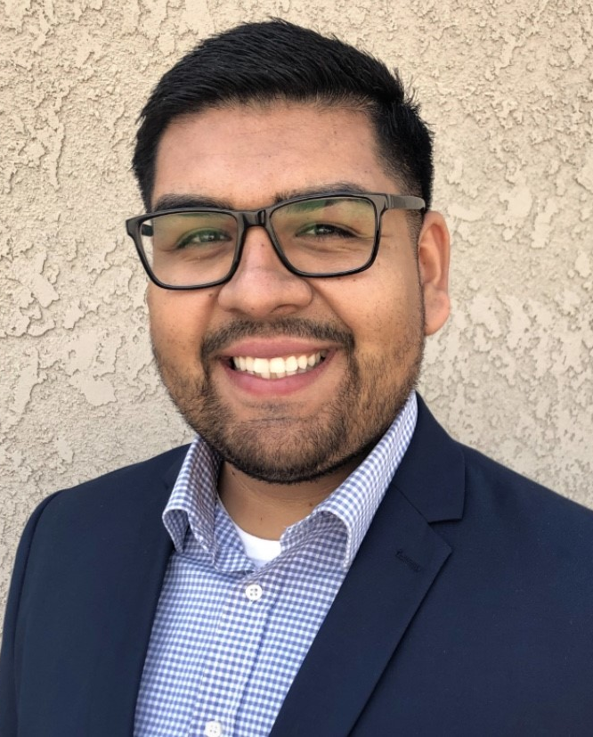
Welcome!
George Mora
Student Service Technician, EOPS

Slide 17
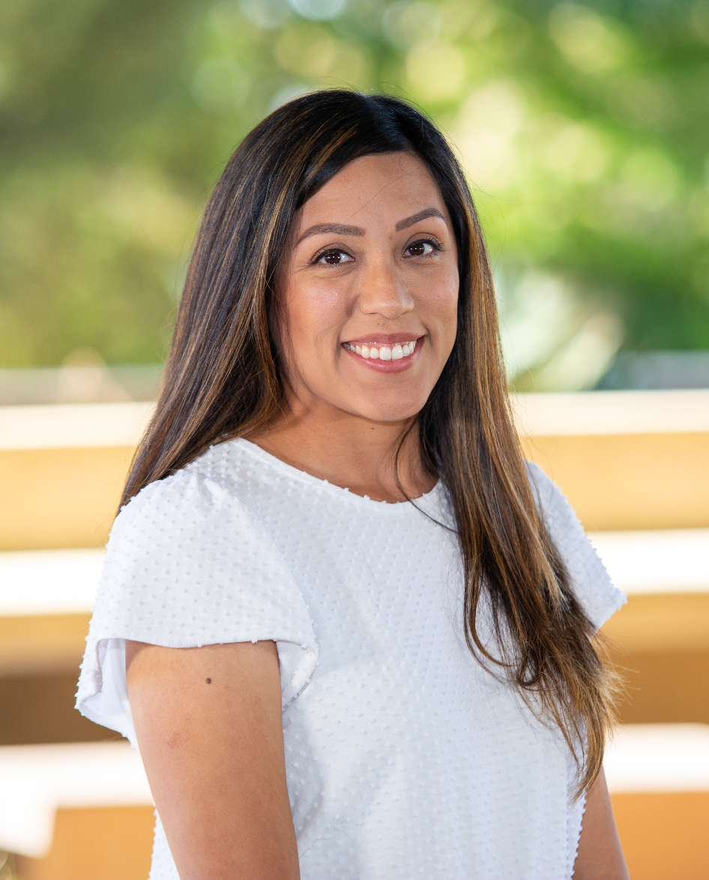
Welcome!
Krista Ornelas-Mora
Student Service Technician, Counseling

Slide 18
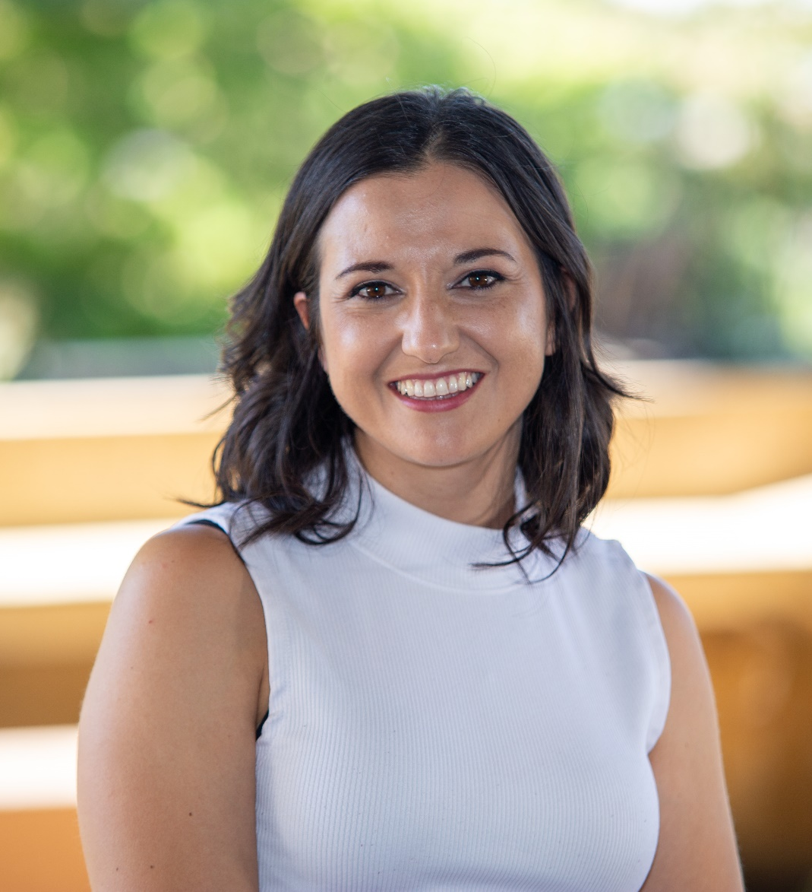
Welcome!
Vannesa Ramirez
Interim Director of Student Accessibility Services

Slide 19
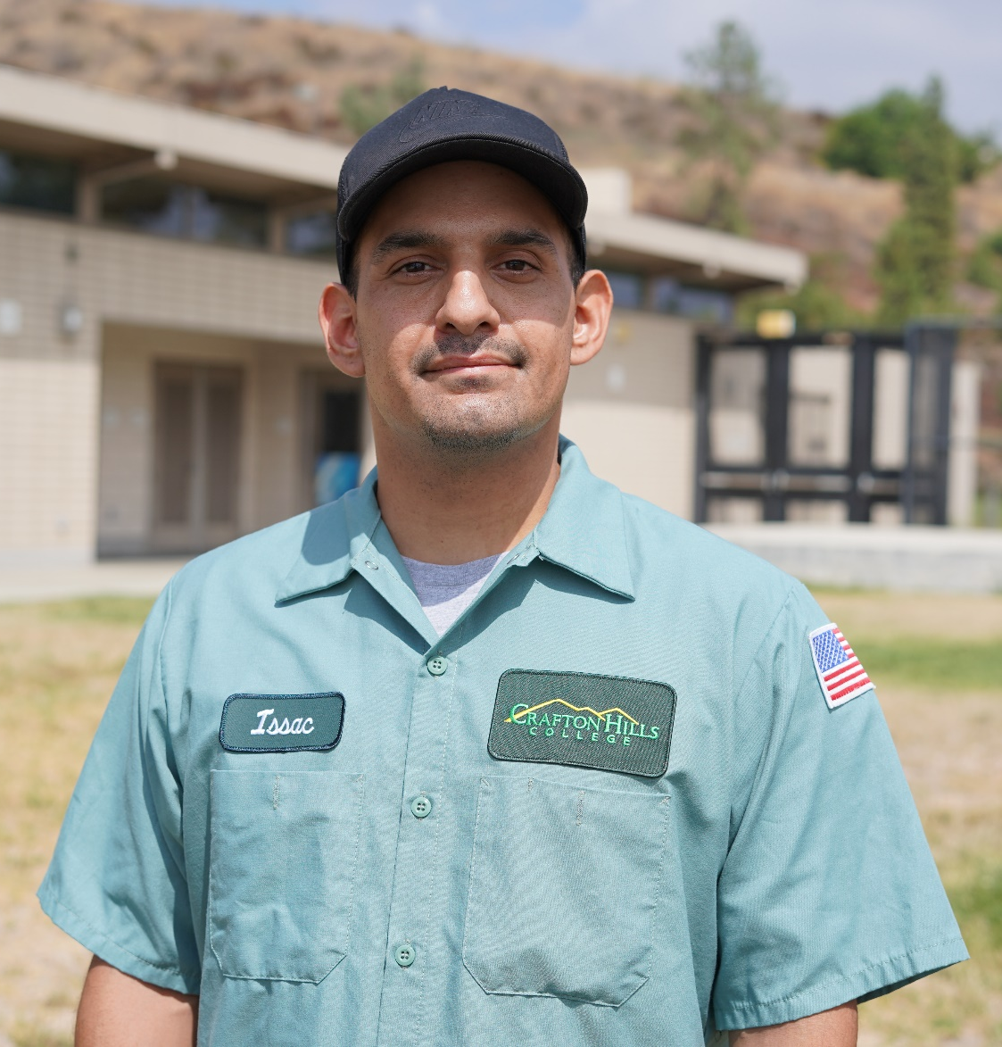
Welcome!
Issac Santibanez
Custodian

Slide 20
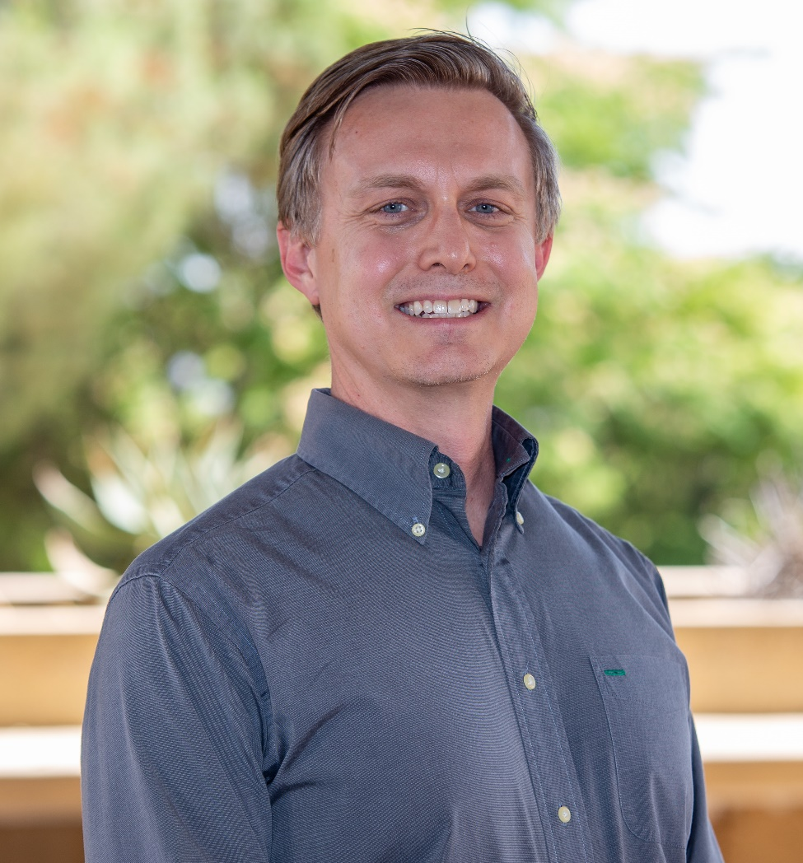
Welcome!
Jeffrey Smith
SINS Dean

Slide 21

Congratulations!
Geoffrey Booth
Full time temp Faculty, Respiratory

Slide 22
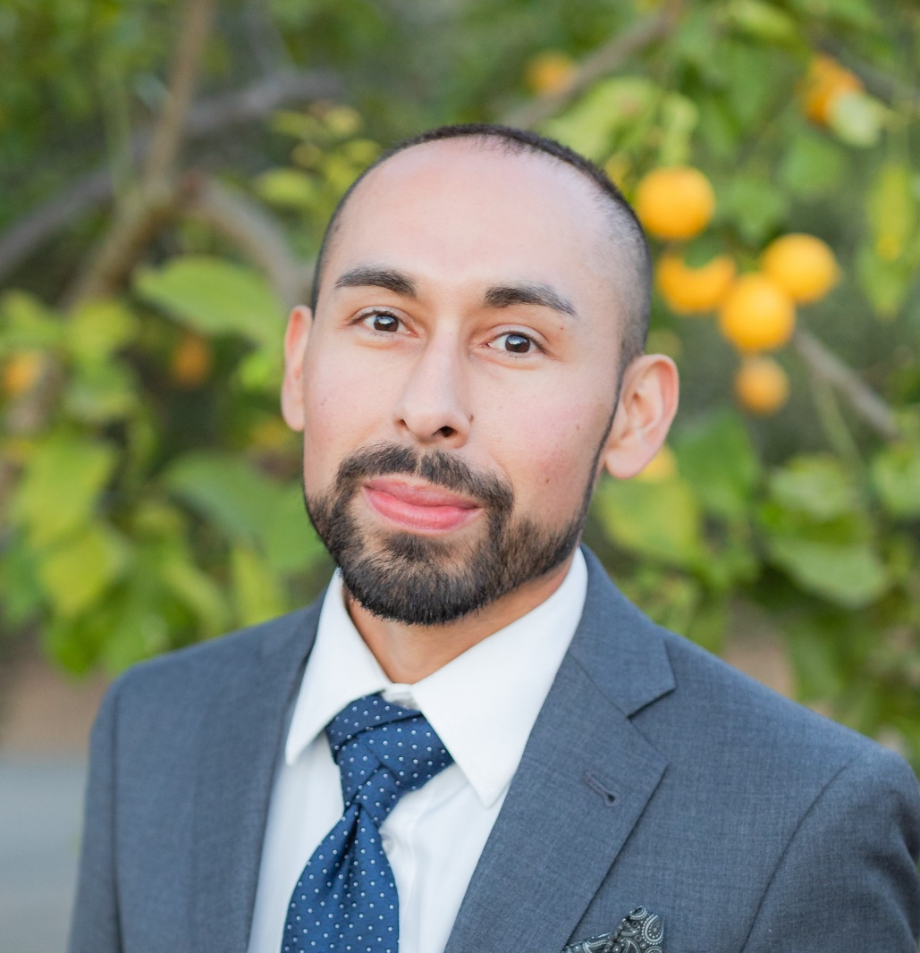
Congratulations!
Josh Estrada
Full time temp Faculty, Kinesiology

Slide 23
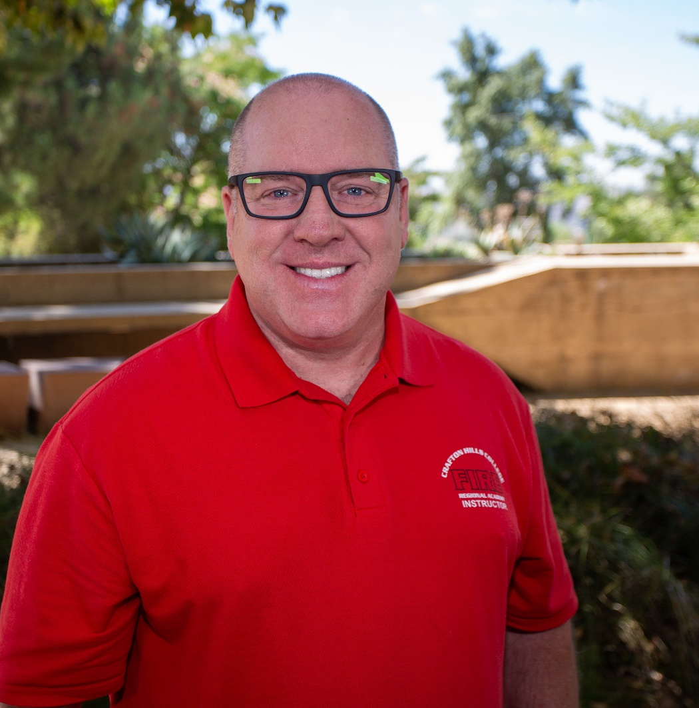
Congratulations!
Ryan Harold
Interim Fire Chief

Slide 24


Slide 25
“As of March 2021, almost 43 million Americans - one in five adults - collectively hold approximately $1.6 trillion in federal student loans.”
https://www.institutmontaigne.org/en/expressions/university-challenged-higher-education-and-student-debt-america

Slide 26
Data on postsecondary outcomes show our most vulnerable students are disproportionately likely to leave college with considerable debt and no degree, or at best one that took far more than four years to earn; and post-college earnings for low-income students are generally lower than those of their wealthier peers.
https://www.forbes.com/sites/scottpulsipher/2023/01/10/3-ways-higher-education-can-flip-the-script-on-value/?sh=5f1b71722acd

Slide 27
Americans’ confidence in the nation’s colleges and universities has plummeted, according to a new Gallup poll. If that lack of support continues, it could have long-term ramifications for both higher education and the U.S. economy as a whole. Fewer educated workers could stymie innovation, aggravate labor shortages and hinder social mobility.
https://hechingerreport.org/proof-points-american-confidence-in-higher-education-hits-a-new-low-yet-most-still-see-value-in-a-college-degree/

Slide 28
“We’ll be graduating our lowest high school classes by population in 2025. And most enrollment professionals have been wringing their hands about this date of 2025, but many schools have seen those enrollment declines already.”
https://www.cnbc.com/2023/06/17/why-more-and-more-colleges-are-closing-down-across-the-us.html

Slide 29
Holy Names University in Oakland, which opened in 1868, announced in a news release that it will cease operations in May 2023 after the completion of the spring semester.
https://www.usnews.com/news/best-states/california/articles/2022-12-19/154-year-old-california-university-to-close-next-year#:~:text=Holy%20Names%20University%20in%20Oakland,completion%20of%20the%20spring%20semester.
Mills College merger with Northeastern University raises unanswered questions, concerns
https://huntnewsnu.com/68799/campus/mills-college-merger-with-northeastern-university-raises-unanswered-questions-concerns/
Stanford takes steps to acquire Notre Dame de Namur University campus in Belmont
https://news.stanford.edu/2021/09/28/stanford-takes-steps-acquire-notre-dame-de-namur-university-campus-belmont/
Plunging enrollment, financial woes, trustee exodus. Whittier College confronts crisis
https://www.latimes.com/california/story/2023-03-30/whittier-college-hit-with-low-enrollment-financial-woes

Slide 30
Presidio is the second graduate institution that Redlands has absorbed in recent years, after acquiring the San Francisco Theological Seminary in 2019. The move caps off a year of high-profile mergers, which have become an increasingly common strategy for struggling institutions on the brink of closure.
https://news.stanford.edu/2021/09/28/stanford-takes-steps-acquire-notre-dame-de-namur-university-campus-belmont/
Budget concerns cause University of Redlands layoffs (July 2020)
https://www.redlandscommunitynews.com/news/education/budget-concerns-cause-university-of-redlands-layoffs/article_8bb8f5c6-bc8d-11ea-8c5c-473c54ef49a1.html
Enrollment declines at University of Redlands prompt layoffs, reorganization (June 2021)
https://www.redlandsdailyfacts.com/2021/06/04/enrollment-declines-at-university-of-redlands-prompt-layoffs-reorganization/

Slide 31
Why are new laws shrinking our community colleges?
https://edsource.org/2023/why-are-new-laws-shrinking-our-community-colleges/685056
Associate Degrees for Transfer SB 1440 (2010)
https://www.ccccurriculum.net/associate-degrees-for-transfer/
Repeatability: Dealing with the New Regulations (2012)
https://www.asccc.org/content/repeatability-dealing-new-regulations#:~:text=Under%20new%20Title%205%20regulation,subject%20to%20the%20limitations%20on
Guided Pathways (2017)
https://rpgroup.org/guided_pathways
AB 705 and Its Unintended Consequences (2018)
https://www.asccc.org/content/ab-705-and-its-unintended-consequences
AB-928: Student Transfer Achievement Reform Act of 2021
https://asccc.org/sites/default/files/2022-10/FAQ%20AB928%20and%20General%20Education%20final%20R.pdf

Slide 32
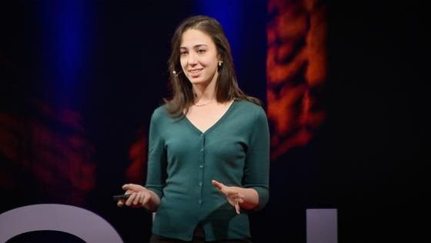

Slide 33

One Book/One College
2023-2024

Slide 34
Thank you, One Book Team!
Judy Cannon
Rejoice Chavira
Chloe de los Reyes
Ed Ferrari
Kashaunda Harris
Krista Ivy
Monica Khalaj-LeCorre
Natalie Lopez
Ericka Paddock
Michelle Riggs

Slide 35
Criteria for Book Selections
1
4
Has a message that can develop empathy
Addresses issues of Equity and Inclusion
2
Relevant to the current student population
5
Helps build community amongst students and employees
3
Interdisciplinary and accessible

Slide 36


Slide 37

Books and Resources
Faculty wanting to use the book in their curriculum may pick up the book today
Faculty resource guides are available today. Watch for updates online in our Canvas shell

Slide 38

Dr. Virginia Loh-Hagan
September 12 @ noon (Zoom)
Dr. Loh-Hagan will join us via Zoom on Sept. 12. She will discuss the Japanese incarceration and the importance of learning about this history
Dr. Loh Hagan is an author of children’s literature focusing on the Asian American experience. She has been on the faculty at San Diego State University and is the Co-Executive Director of the Asian American Education Project.

Slide 39

Book Club Discussions
August 30-December 6
1st and 3rd Wednesdays
Library
2:00-3:00

Slide 40
Additional Activities – Coming this year
Workshops
Speakers
Essay/Art Competition
Watch for details – coming soon!

Slide 41


Slide 42

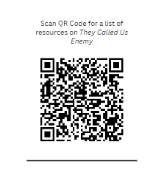
Additional Resources

Slide 43
Institutional Advancement Update

Slide 44


Marketing
Fall Recruitment Campaign
Billboard
Mailer
Digital Display
Pay Per Click
Social Media

Slide 45

Website Instructional Page Updates

Slide 46
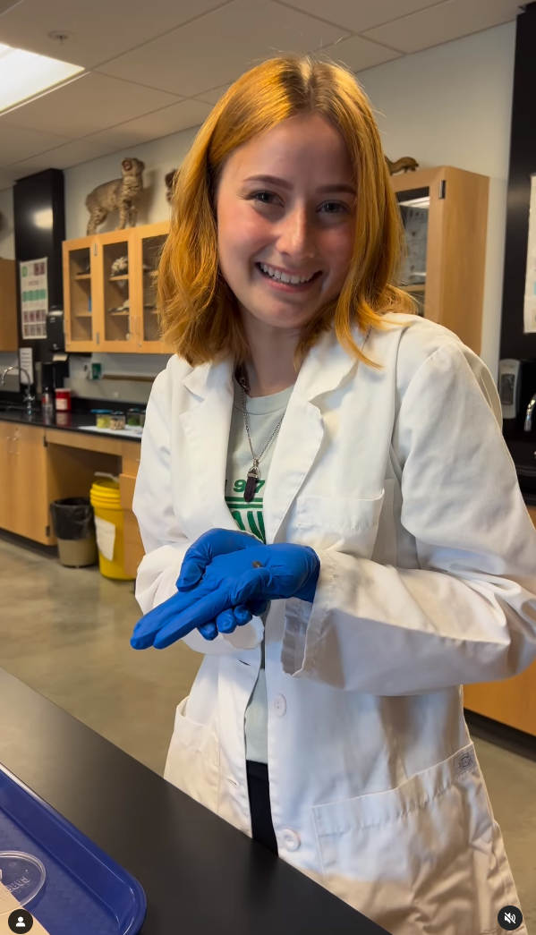

Help Us Promote Your Class / Department
Let us know when you are doing something fun!
Follow us on Social Media

Slide 47

WE invite YOU to join #TEAMCrafton
Employee Giving Campaign – 93 Employees Give through payroll deduction
53 are President’s Circle Members!

Slide 48
CHC Foundation Endowment

Slide 49

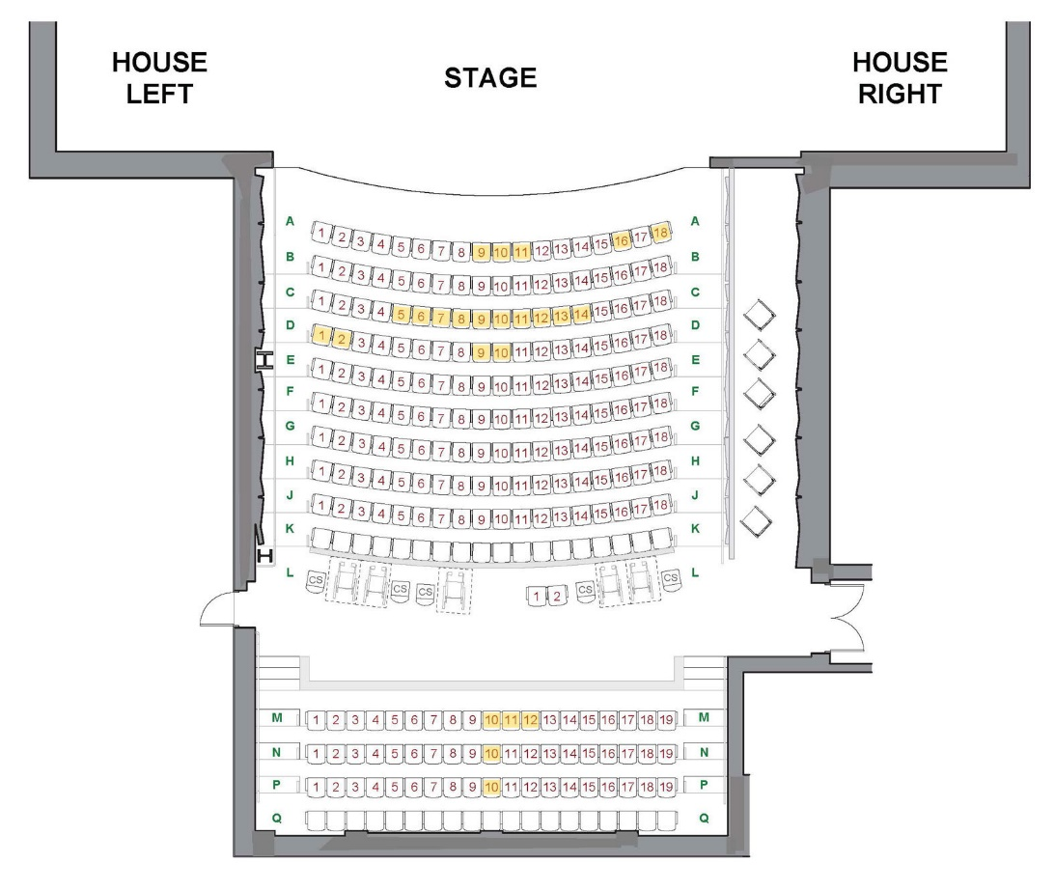
Rows | Seat Cost | 1 Year Pledge | 2 Year Pledge
A - C | $1,000 | $84.00/mo | $42.00/mo
D - L | $750 | $63.00/mo | $32.00/mo
M - P | $500 | $42.00/mo | $21.00/mo

Slide 50

SAVE THE DATE – APRIL 18, 2024

Slide 51

50th Anniversary Publication

Slide 52
Instruction Update

Slide 53
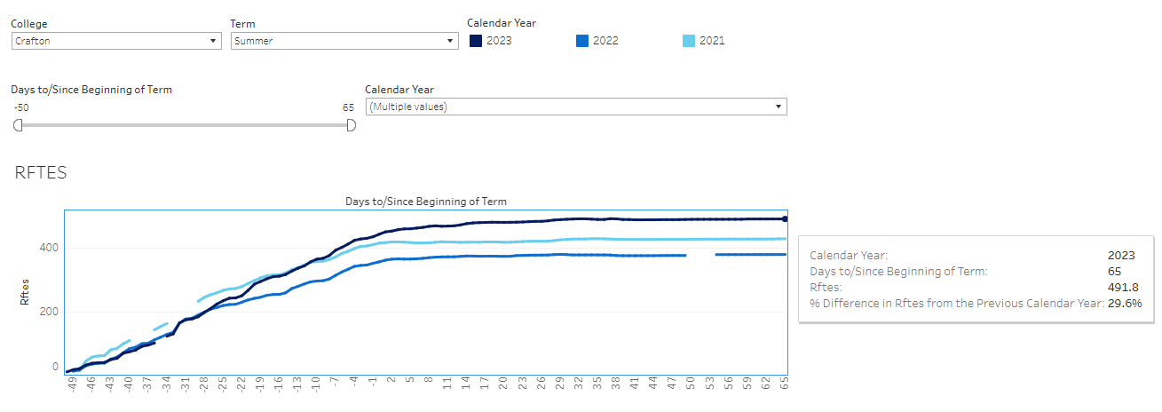
Summer 2023 Enrollments
The RFTES increased from 380 in Summer 2022 to 492 in Summer 2023, a 30% increase
Great Job Everyone!

Slide 54
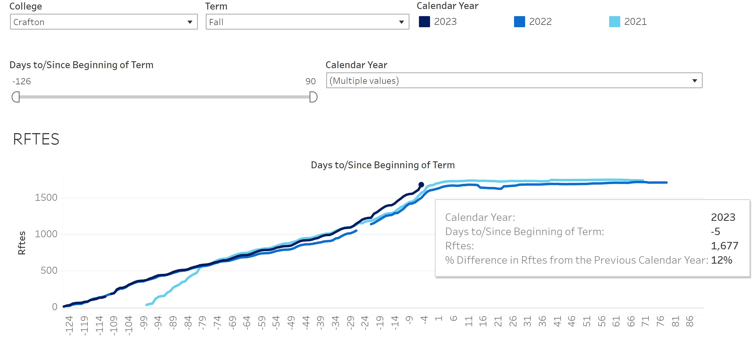
Fall 2023 Enrollments
The RFTES increased from 1,495 in Fall 2022 to 1,677 in Fall 2023, a 12% increase
Great Job Everyone!

Slide 55
Crafton is on track to surpass Fall 2023 RFTES target of 1,764
Fall 2023 Target is 1,764

Slide 56

Office of Instruction New Divisions
Purpose was to better balance the FTE in each division and align divisions with Career and Academic Pathways

Slide 57
Language, Arts, and Mathematics (New Division Name Under Development)
Department of Communication and Language | Department of English | Department of Performing Arts | Department of Visual and Media Arts
American Sign Language | English | Dance | Art
Communication Studies | English as Second Language Non-credit | Music | Dance
Japanese |  | Theater Arts | Multimedia
Spanish

Slide 58
Social, Information, and Natural Sciences (Division Name under Review)
Department of Kinesiology and Health Education | Department of Mathematics | Department of Physical and Biological Sciences | Department of Social and Cultural Studies | Department of Social Sciences
Athletic Training | Mathematics | Anatomy | Ethics | Anthropology
Health |  | Astronomy | Humanities | History
Kinesiology |  | Biology | Philosophy | Political Science
 |  | Chemistry | Religious Studies | Psychology
 |  | Geography/Geology | Social Work
 |  | Microbiology | Sociology
 |  | Oceanography
 |  | Physical Science
 |  | Physics

Slide 59
Division of Career Education and Human Development
Department of Allied Health Services | Department of Business and Economics | Department of Computer Information Sciences | Department of Human Development | Department of Public Safety
Allied Health | Accounting | Computer Information Systems | Child Development | Emergency Medical Services
Health Information Technology | Business Administration | Computer Science | Education | Fire Technology
Radiologic Technology | Economics |  |  | Public Safety and Services
Respiratory Care | Marketing
Certified Nursing Assistant | Real Estate
 | Workforce Preparation Noncredit

Slide 60
New Programs Starting in 2023-2024
BS in Respiratory Care Program starts Spring 2024
Home Health Aid
Acute Care Nursing (Starts Fall 2024)

Slide 61
Programs Examining (Continuing Conversation) in 2023-2024
Paralegal (Need Viability Study)
Physical Therapy Assistant (Program Viability Study has been completed)
Phlebotomy
LVN – Need Viability study
Library Tech Aid (Write Curriculum)
Registered Behavior Tech Cert (K-12)
Behavior Health Initiative (Might be the same as Registered Behavior Tech)
Community Health Worker

Slide 62
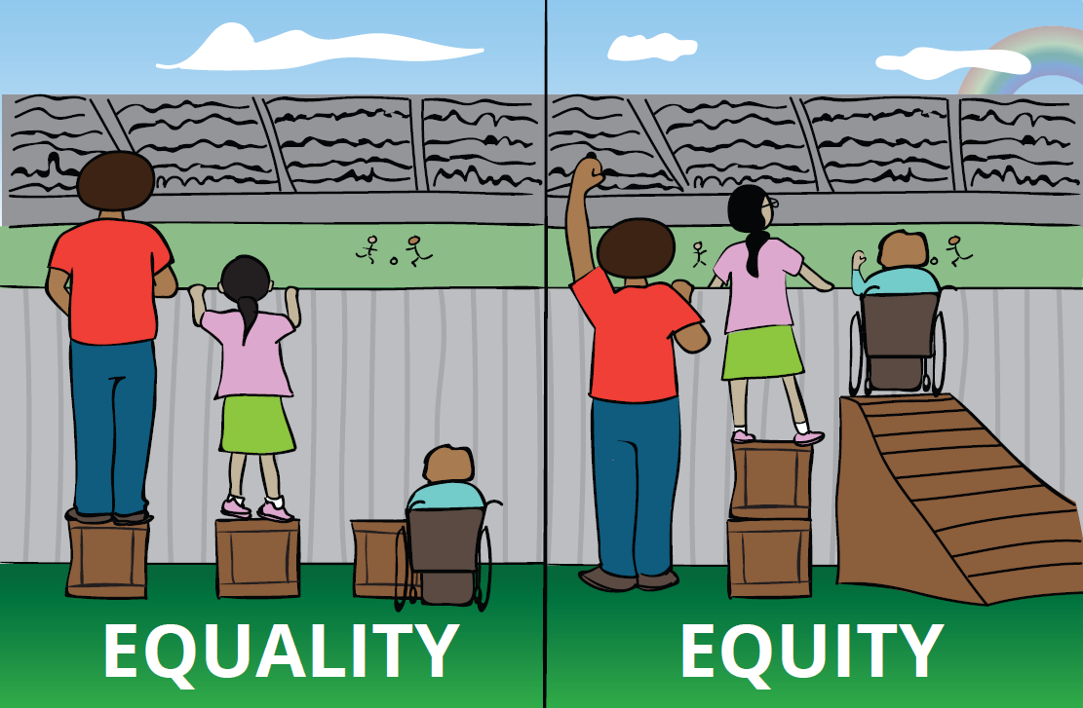
Primary Instructional Area Goal is to continue instructional focus on Diversity, Equity and Inclusion

Slide 63
CHC Disaggregated Course Success Rate from 2021-22 to 2022-23
The course success rate increased for all four disproportionately impacted (DI) groups and no longer is apparent for Native American and Pacific Islander students. DI is still occurring in course success rate among African American and Latinx students.
Notes:
In 22-23 when compared to the reference group, Filipino students (84.8%), one group had DI (84.8*80% = 67.9%).
That was black students, with 66.6% DI.
In 21-22 when compared to the reference group, Filipino students (79.4%), one group had DI (79.4*80% = 63.5).
That was Native American students

Slide 64
Recruitments
Based on USC Race and Equity Center Training, recruiting emails sent to individuals at institutions communicating that Crafton is looking for diverse applicant pool
Development of equity question and rubric for current recruitments
Improved implementation and use of adverse impact analysis

Slide 65
Self-Evaluation
Provide disaggregated course success and roster data to all instructional faculty as an option to inform their self-evaluation.

Slide 66
Disaggregated Course Success Data
Provided disaggregated data by course success for classes taught by instructors based on USC Race and Equity Center Training
Provided class rosters with ethnicity for classes taught by instructors based on USC Race and Equity Center Training
Classroom DEI training provided by USC Race and Equity Center in 2022-23 for 30 teaching faculty
Classroom DEI training provided by USC Race and Equity Center in 2023-24 for 29 teaching faculty
Working to improve accessibility for faculty to be able to regularly access their own class rosters that include race to track patterns in homework, grades, and attendance (USC Race and Equity Center Training)
Working to improve accessibility for faculty to be able to regularly access their own course success data disaggregated by race, gender, and age (USC Race and Equity Center Training)

Slide 67
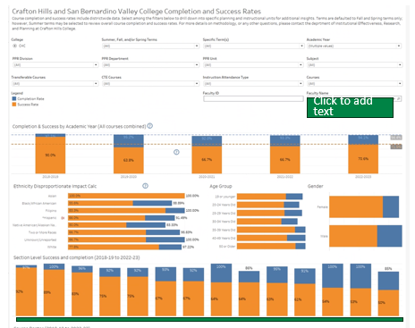
Draft Dashboard to Access Disaggregated Data with Login

Slide 68
Student Services Update

Slide 69
Student Services Division Highlights
Financial Aid disbursed $3,244,638.26 in Pell Grants for the 2022-2023 Academic Year.
Mental Health Services will increase services for Fall 2023-2024.
A&R currently has twenty-six (26) LIVE Laserfiche Forms, six (6) of which went live last week.
CCCApply applications are now imported automatically every hour during the weekdays.
  A&R is working with TESS to change the imports to every hour, 24/7.

Slide 70
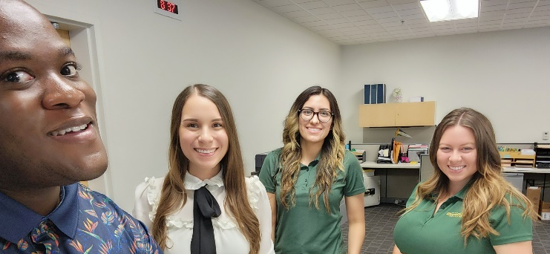
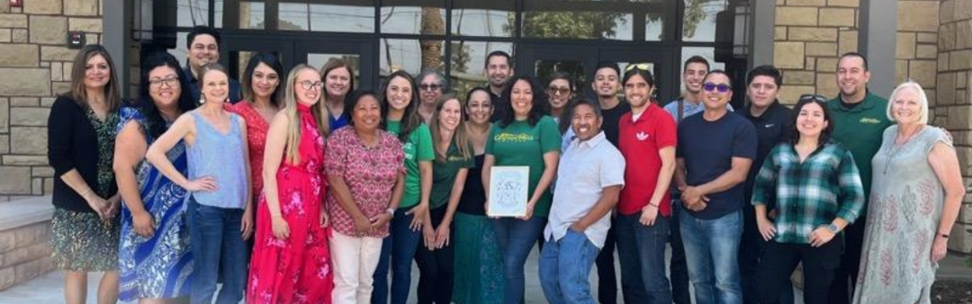
Outreach and Counseling Kudos
Our new Outreach and Educational Partnership department served over 1,800 High School students at the high school sites.
Our Counselors had a busy Summer and saw 1,919 unduplicated students.
  They developed Educational Plans for these students who then enrolled for the Fall semester.

Slide 71
EOPS, CARE, CalWORKs, NextUp, & Dreamers
  These programs support first generation, low-income, foster youth and/or single parents with:
  We successfully launched a Student Support Services Common Online Application.
    Students can now apply to one single application to receive services from multiple programs.
Academic counseling support | Financial assistance
Academic supplies | Priority registration

Slide 72
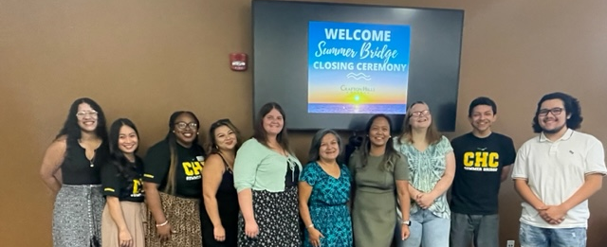
EOPS Summer Bridge
  Our EOPS department successfully launched our inaugural Summer Bridge Program.
  Students took an ENGL 101 course linked with a COUN 100 course.
  Students took part in various activities including fieldtrips to universities and museums.

Slide 73
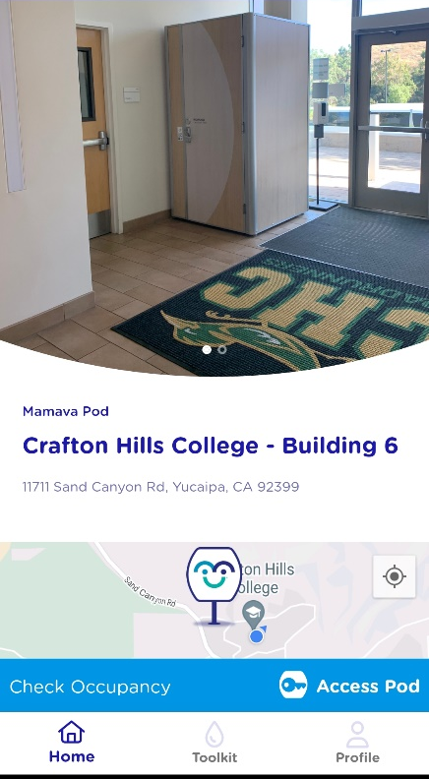
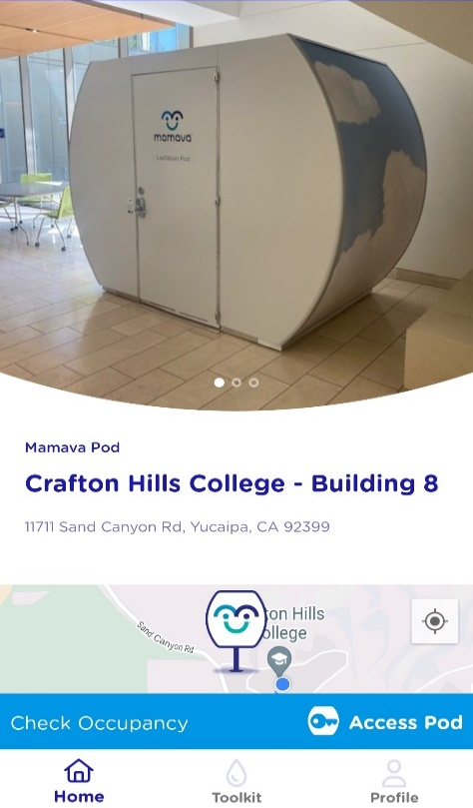
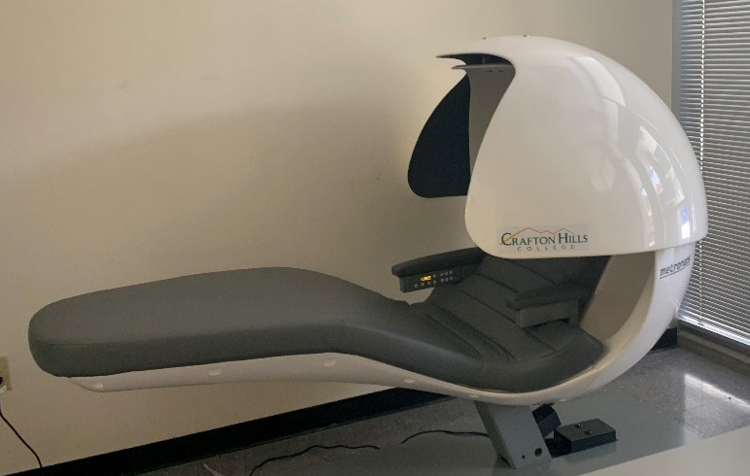
New Basic Needs Services
2 New Sleep/NapPods were placed in the Health and Wellness Center.
2 New Lactation Pods were placed in the LRC and CCR buildings.

Slide 74
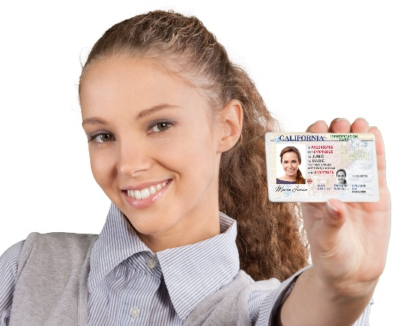
Reduced Fee or FREE ID Voucher
Reduced Fee California DMV ID Vouchers are available to eligible students through one easy visit with Erika Sherman, Basic Needs Coordinator.
Through this program, we’re able to provide our students with a voucher for a reduced fee that they can take to the DMV to obtain an identification card for a low cost.

Slide 75
Equity in Student Services
For the past three years, Academic and Student Support programs are focus on examining internal data to identify equity gaps to support students who are:
    African American/Black,
    Hispanic/Latinx,
    Economically disadvantaged
  Our college’s work group, has dedicated time to discuss patterns in the data findings and have identified activities designed to eliminate observed equity gaps.
2019-2020 Streamlining Project focused on identifying services and activities to disaggregate data.

Slide 76
Student Success Completion Grant Recipients
Ethnicity | 2020-2021 Statistics Collegewide | 2020-2021 Percent Served | 2020-2021 Equity Gap Baseline |  | 2021-2022 Statistics Collegewide | 2021-2022 Percent Served | 2021-2022 Equity Gap Baseline
Black/African American | 4.3% | 1.5% | 0.35 |  | 4.0% | 4.7% | 1.18
Hispanic/Latinx | 48.8% | 53.7% | 1.10 |  | 51.3% | 53.0% | 1.03
Economically Disadvantaged | 50.3% | 100%¹ | 1.99 |  | 26.9% | 99.5%² | 3.70
Note: Equity Gap is identified 0.85 or below. ¹2019-2021 CCCCO Economically Disadvantaged students were defined as any student receiving any form of financial aid. ² 21-22 CCCCO Economically Disadvantaged students’ definition was narrowed. Economically Disadvantaged students only include students receiving Method A or B of CPPG, Pell, or CalWORKs.

Slide 77
Transfer Center Student Workshops Participation
Ethnicity | 2020-2021 Statistics Collegewide | 2020-2021 Percent Served | 2020-2021 Equity Gap Baseline |  | 2021-2022 Statistics Collegewide | 2021-2022 Percent Served | 2021-2022 Equity Gap Baseline
Black/African American | 4.3% | 2.9% | 0.67 |  | 4.0% | 5.0% | 1.25
Hispanic/Latinx | 48.8% | 51.8% | 1.06 |  | 51.3% | 51.1% | 0.99
Economically Disadvantaged | 50.3% | 67.4%¹ | 1.34 |  | 26.9% | 39.2%² | 1.46
Note: Equity Gap is identified 0.85 or below. ¹2019-2021 CCCCO Economically Disadvantaged students were defined as any student receiving any form of financial aid. ² 21-22 CCCCO Economically Disadvantaged students’ definition was narrowed. Economically Disadvantaged students only include students receiving Method A or B of CPPG, Pell, or CalWORKs.

Slide 78
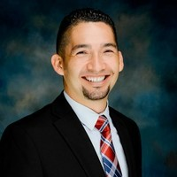
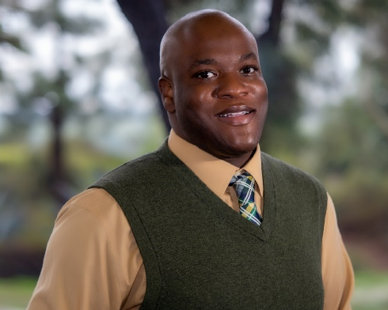
Student Services Organizational Updates
Scholarships have transitioned from the Foundation Office to Financial Aid.
Dr. Gio Sosa, Starfish Administrator
Dr. Ivan Peña, Dr. Willie Blackmon,
Conduct Officer Tittle IX Coordinator

Slide 79
Administrative Services Update

Slide 80
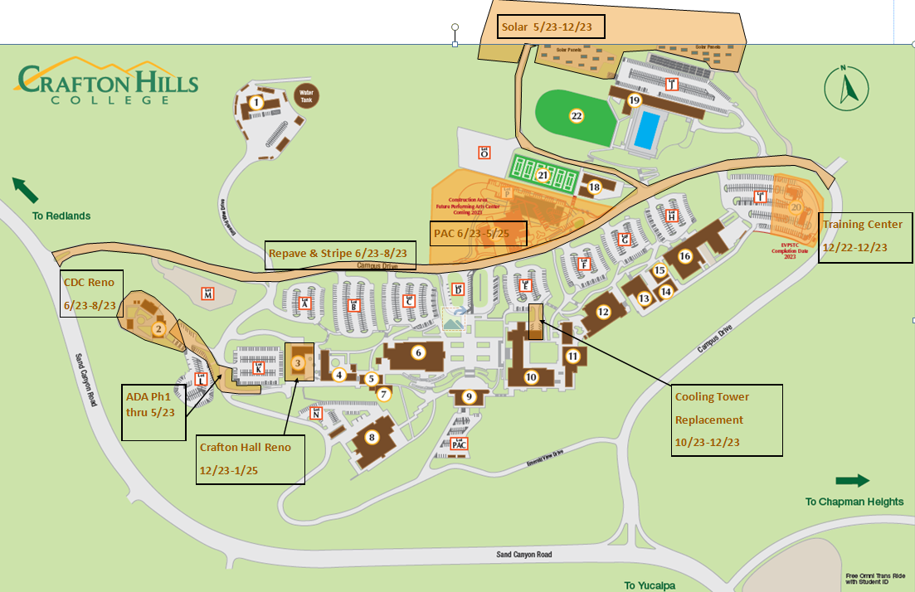

Fall 2023
Construction Impacts
Repave/Restripe 6/24-7/24

Slide 81
Repave/Restripe 6/24-7/24
Notes:
Review Projects – Handout
Inflation
Tree Removal

Slide 82
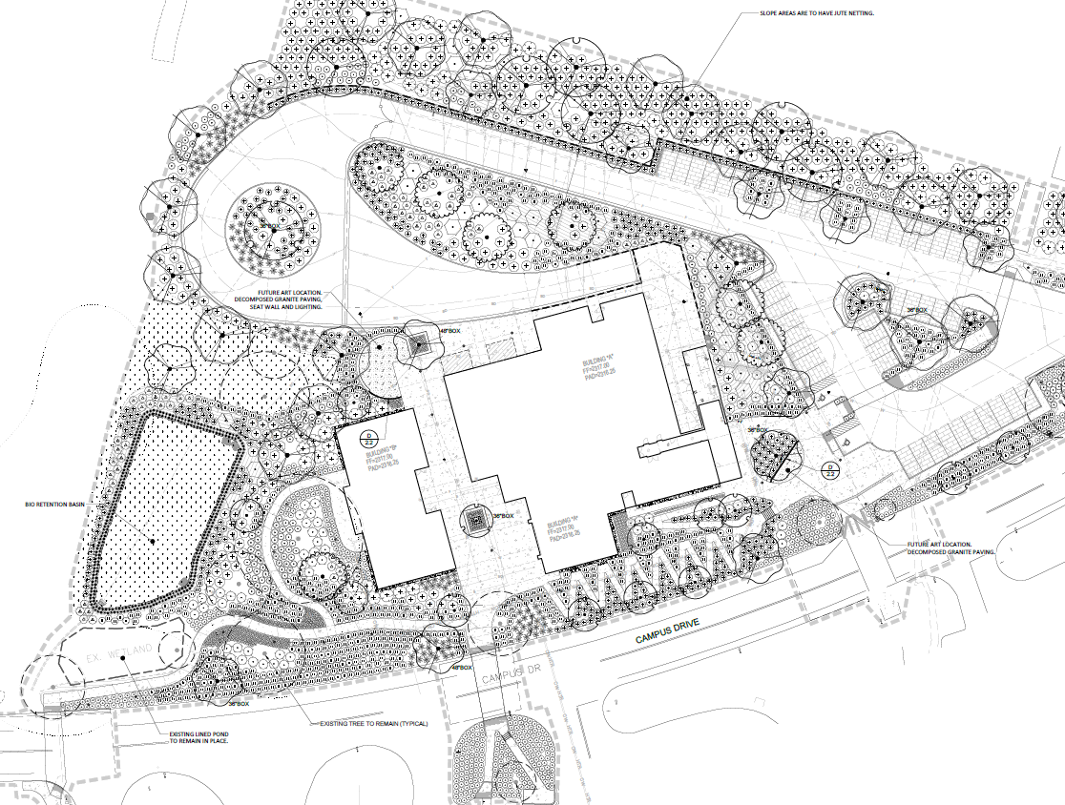

Finkelstein Performing Arts Center
Construction: June 2023-June 2025

Slide 83
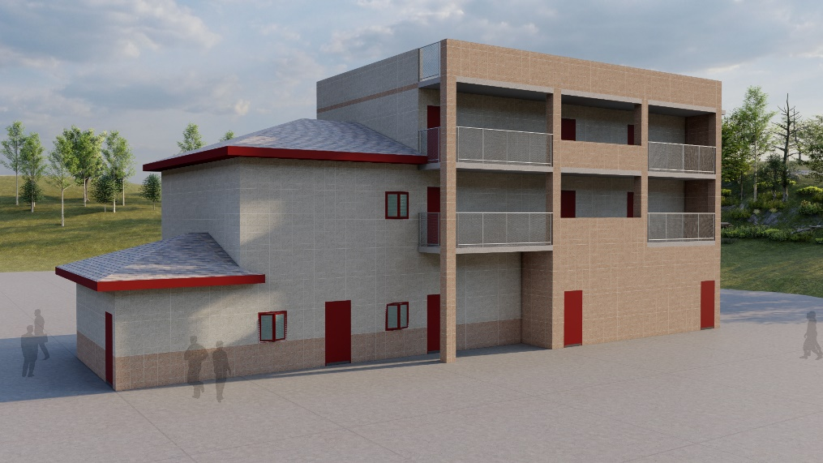
Training Center
Construction: January 2023- December 2023

Slide 84
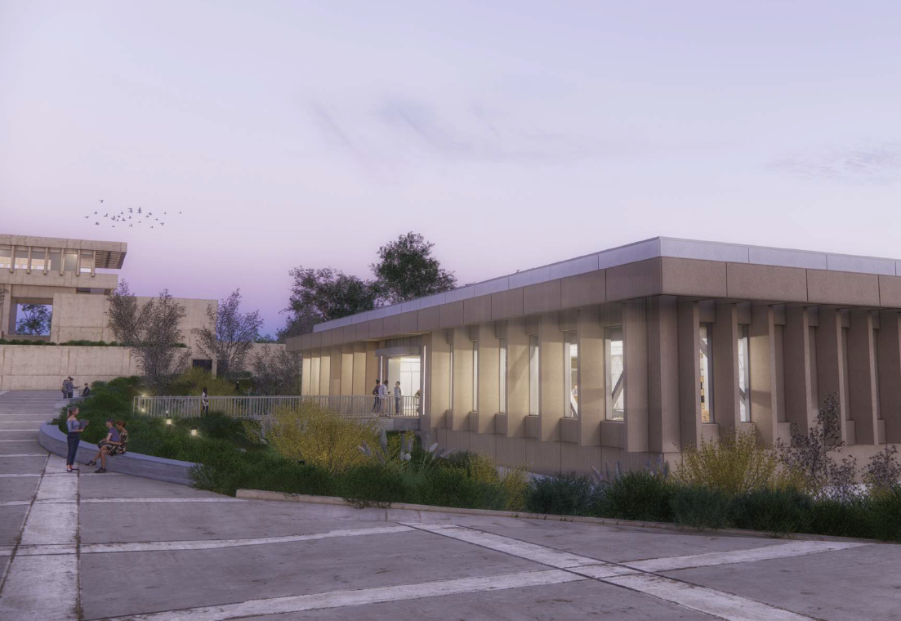
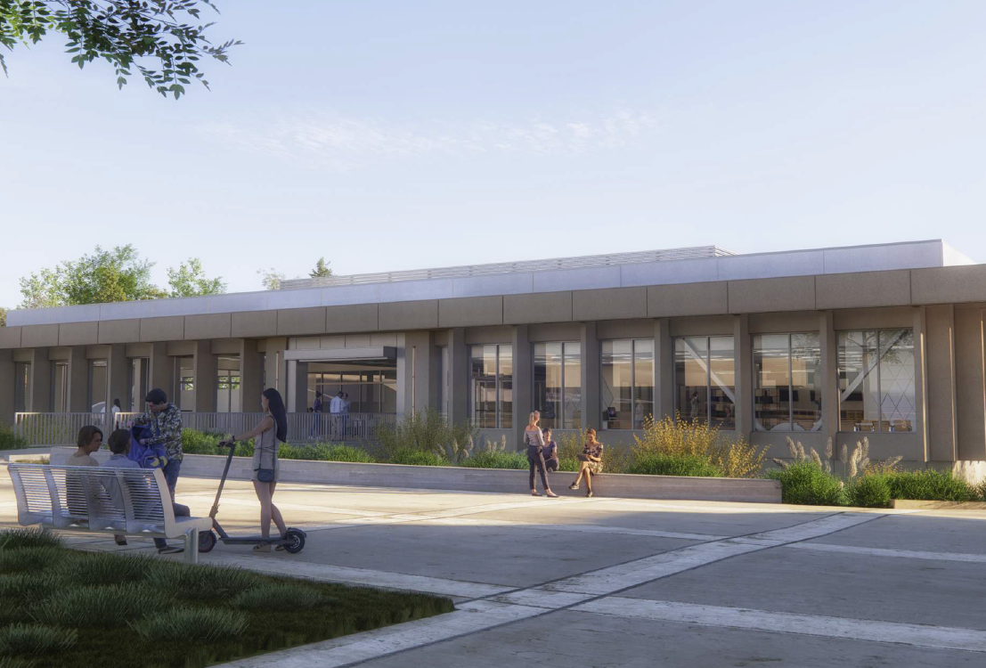
Instruction Building
Spring 2023 – Fall 2023
Construction: June 2025-Summer 2027

Slide 85

Crafton Hall Renovation
Construction: December 2023-September 2024

Slide 86

Virtual Parking Permits
Notes:
Virtual Annual Parking Permit
Employees can register 2 license plates
If you’re a new employee, and you get an error message, contact Tina Gimple (temporary permit, and make sure you get added to the database)
Permits required 8/28
Students will need a permit - Semester

Slide 87


Multi-Factor Authentication (MFA)
What is MFA?
  Extra layer of protection to ensure it’s really you
Why do we need MFA?
  Set it up or no more Cyber Insurance
Notes:
What is MFA? – This adds an extra layer of protection to ensure that only you are logging into your account.
Why do we need MFA? - Our Cyber Insurance Policy requires us to have MFA implemented in our District.
How does it work? – You install an application on your smart phone, and when you log in, you will be prompted to approve the login
How do I get this setup? – We will be contacting you to schedule a time to get your account setup. You can also submit a help desk ticket when you are ready.
Technology Services will coordinate with your departments to setup time to setup MFA and to make sure you are working properly.

Slide 88


How does MFA work?
Notes:
How does it work? – You install an application on your smart phone, and when you log in, you will be prompted to approve the login
How do I get this setup? – We will be contacting you to schedule a time to get your account setup. You can also submit a help desk ticket when you are ready.
Technology Services will coordinate with your departments to setup time to setup MFA and to make sure you are working properly.

Slide 89

Campus Directory Update

Slide 90


Slide 91


