Slide 1
Fall 2021
In-Service Day

Slide 2
Agenda
Welcome
Diana Z. Rodriguez, Chancellor
Dr. Anne Viricel, Chair SBCCD Board of Trustees
Dr. Kevin Horan, President
Instruction, Dr. Keith Wurtz
Student Services, Dr. Delmy Spencer
Administrative Services, Mike Strong
Institutional Advancement, Michelle Riggs
Q&A

Slide 3
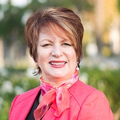
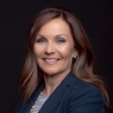
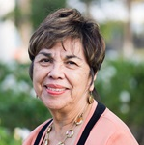
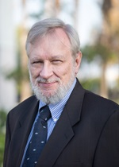
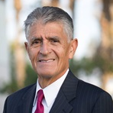
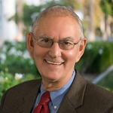
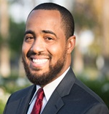
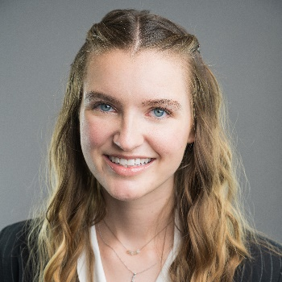
Board of Trustees
Dr. Anne Viricel
Chair
Dr. Stephanie Houston
Vice Chair
Gloria Macias Harrison
Clerk
John Longville
Frank Reyes
Dr. Don Singer
Joseph Williams
Lauren Ashlock
Student Trustee
Crafton Hills College
Elena Sanchez
Student Trustee
San Bernardino Valley College

Slide 4
New Employees

Slide 5
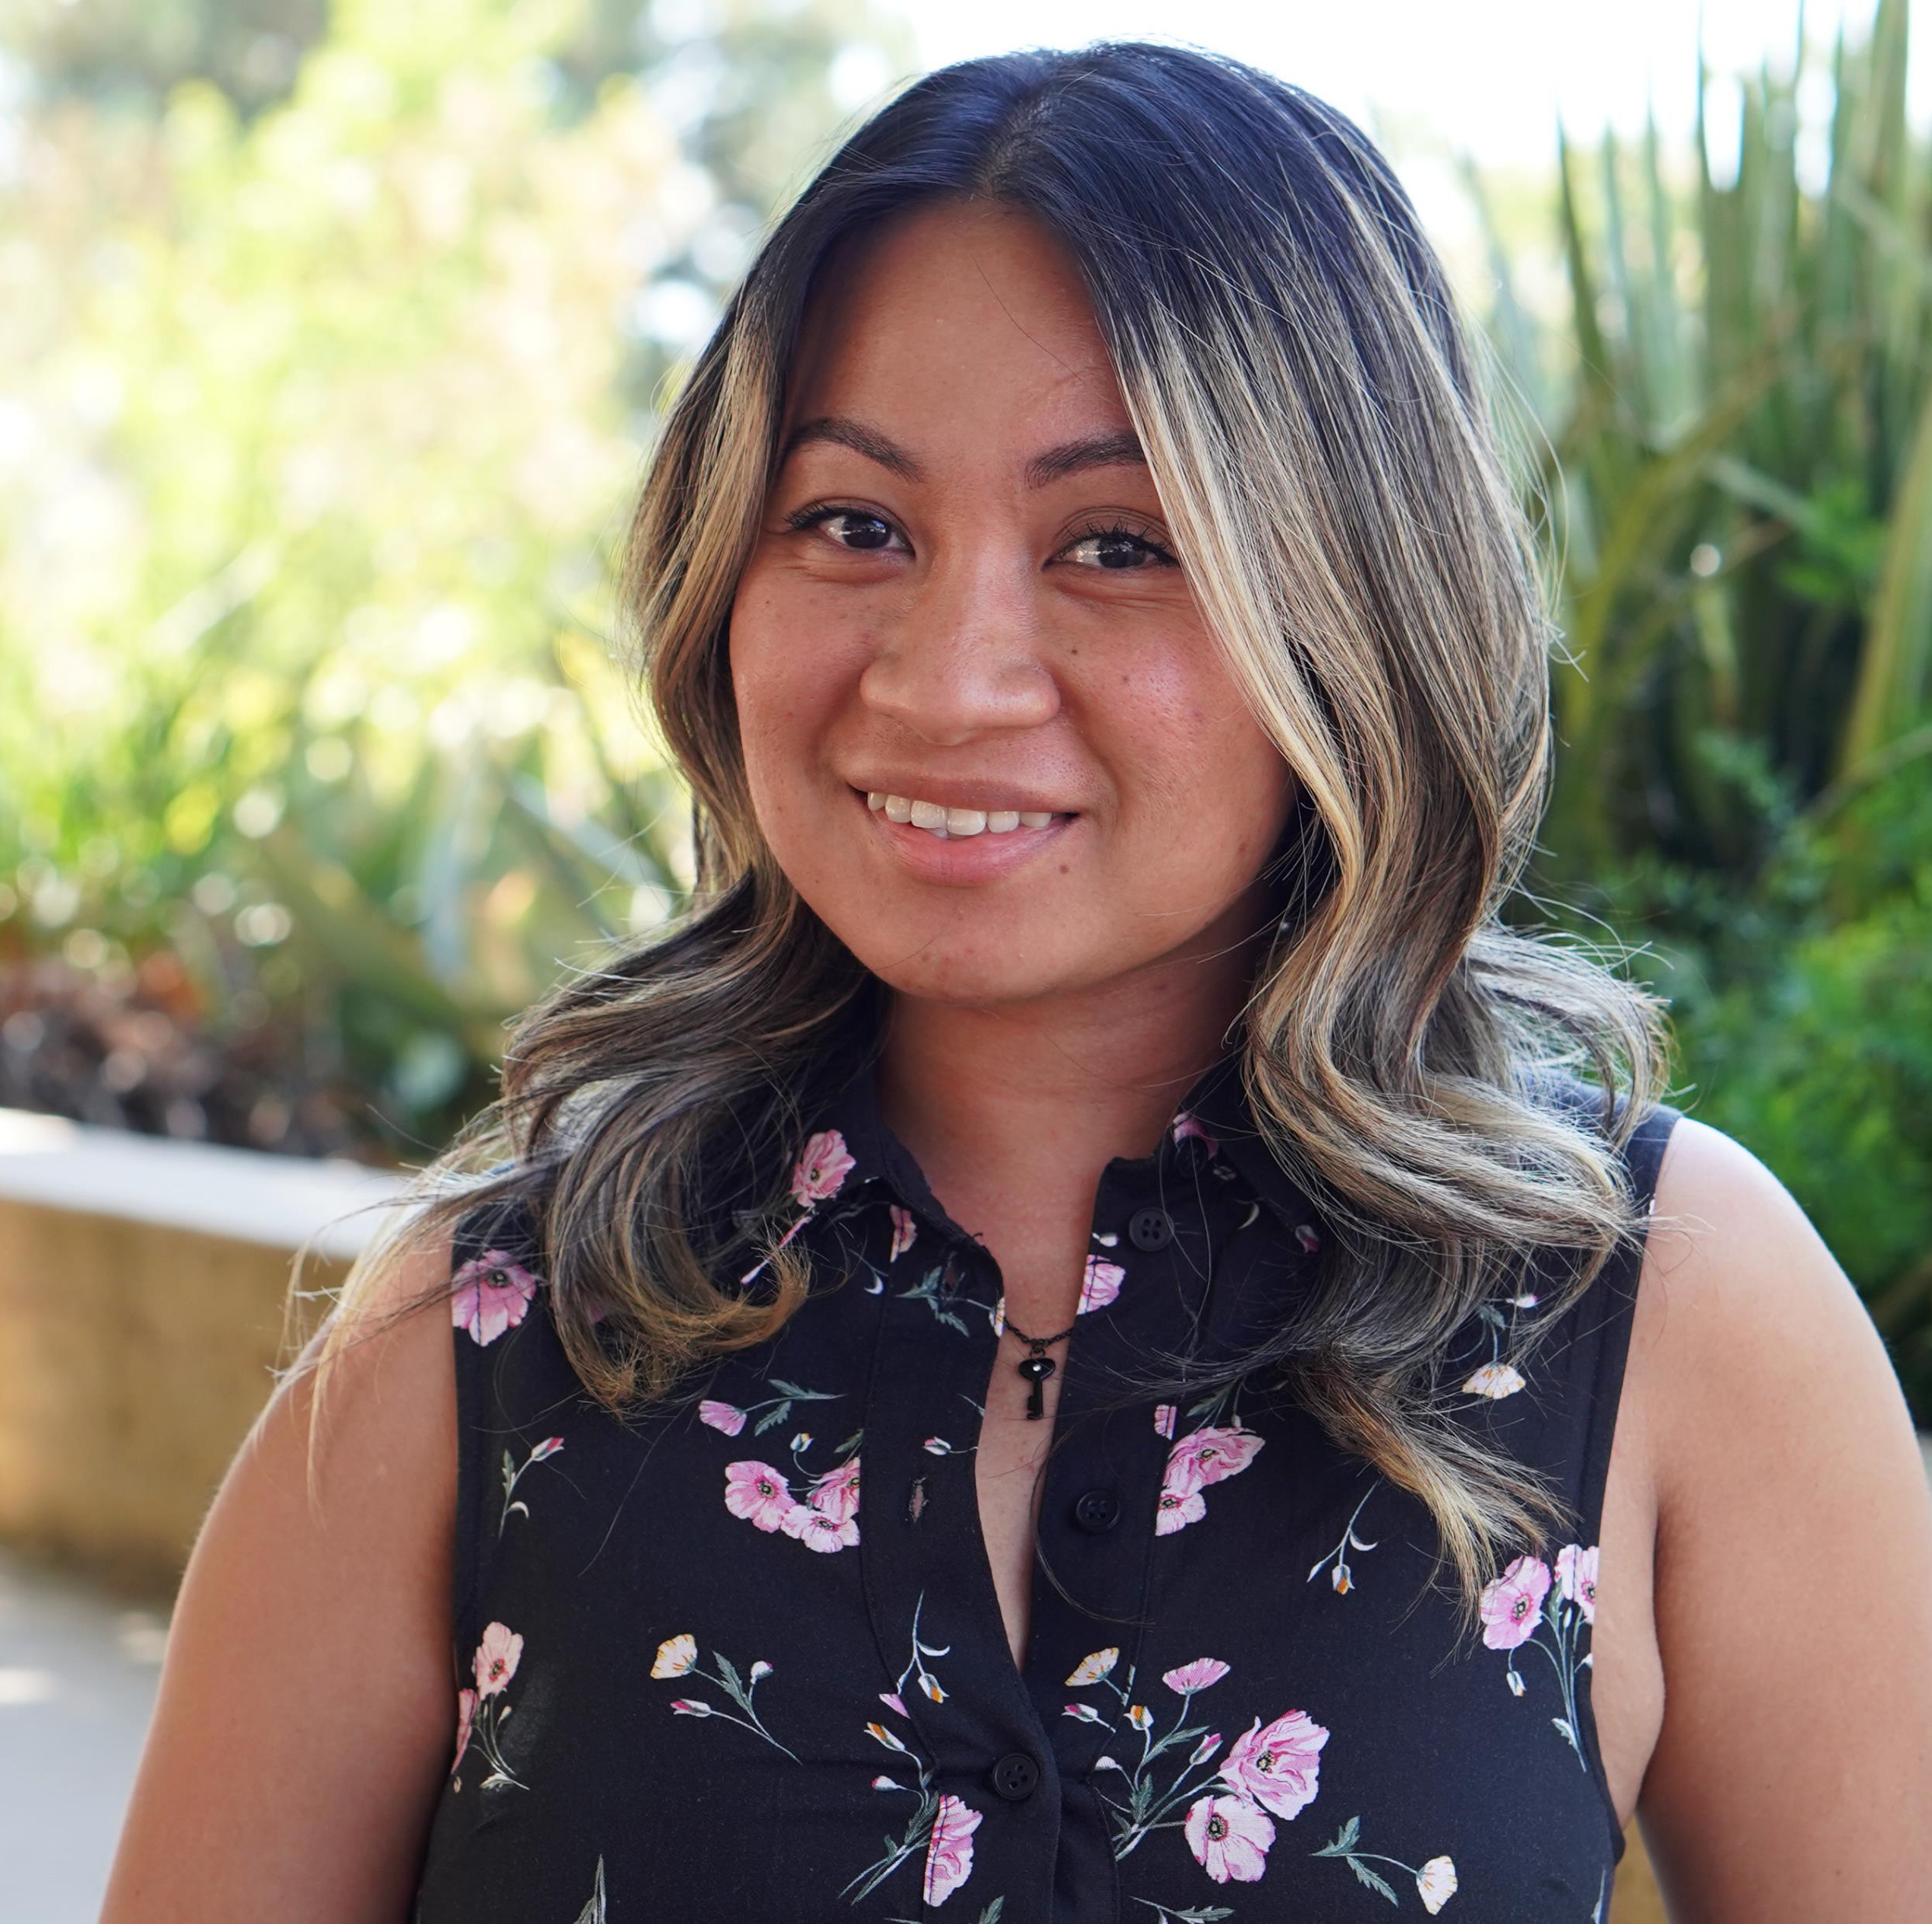
Classified Professionals
Maita Dawang
Senior Student Services Technician
EOPS

Slide 6
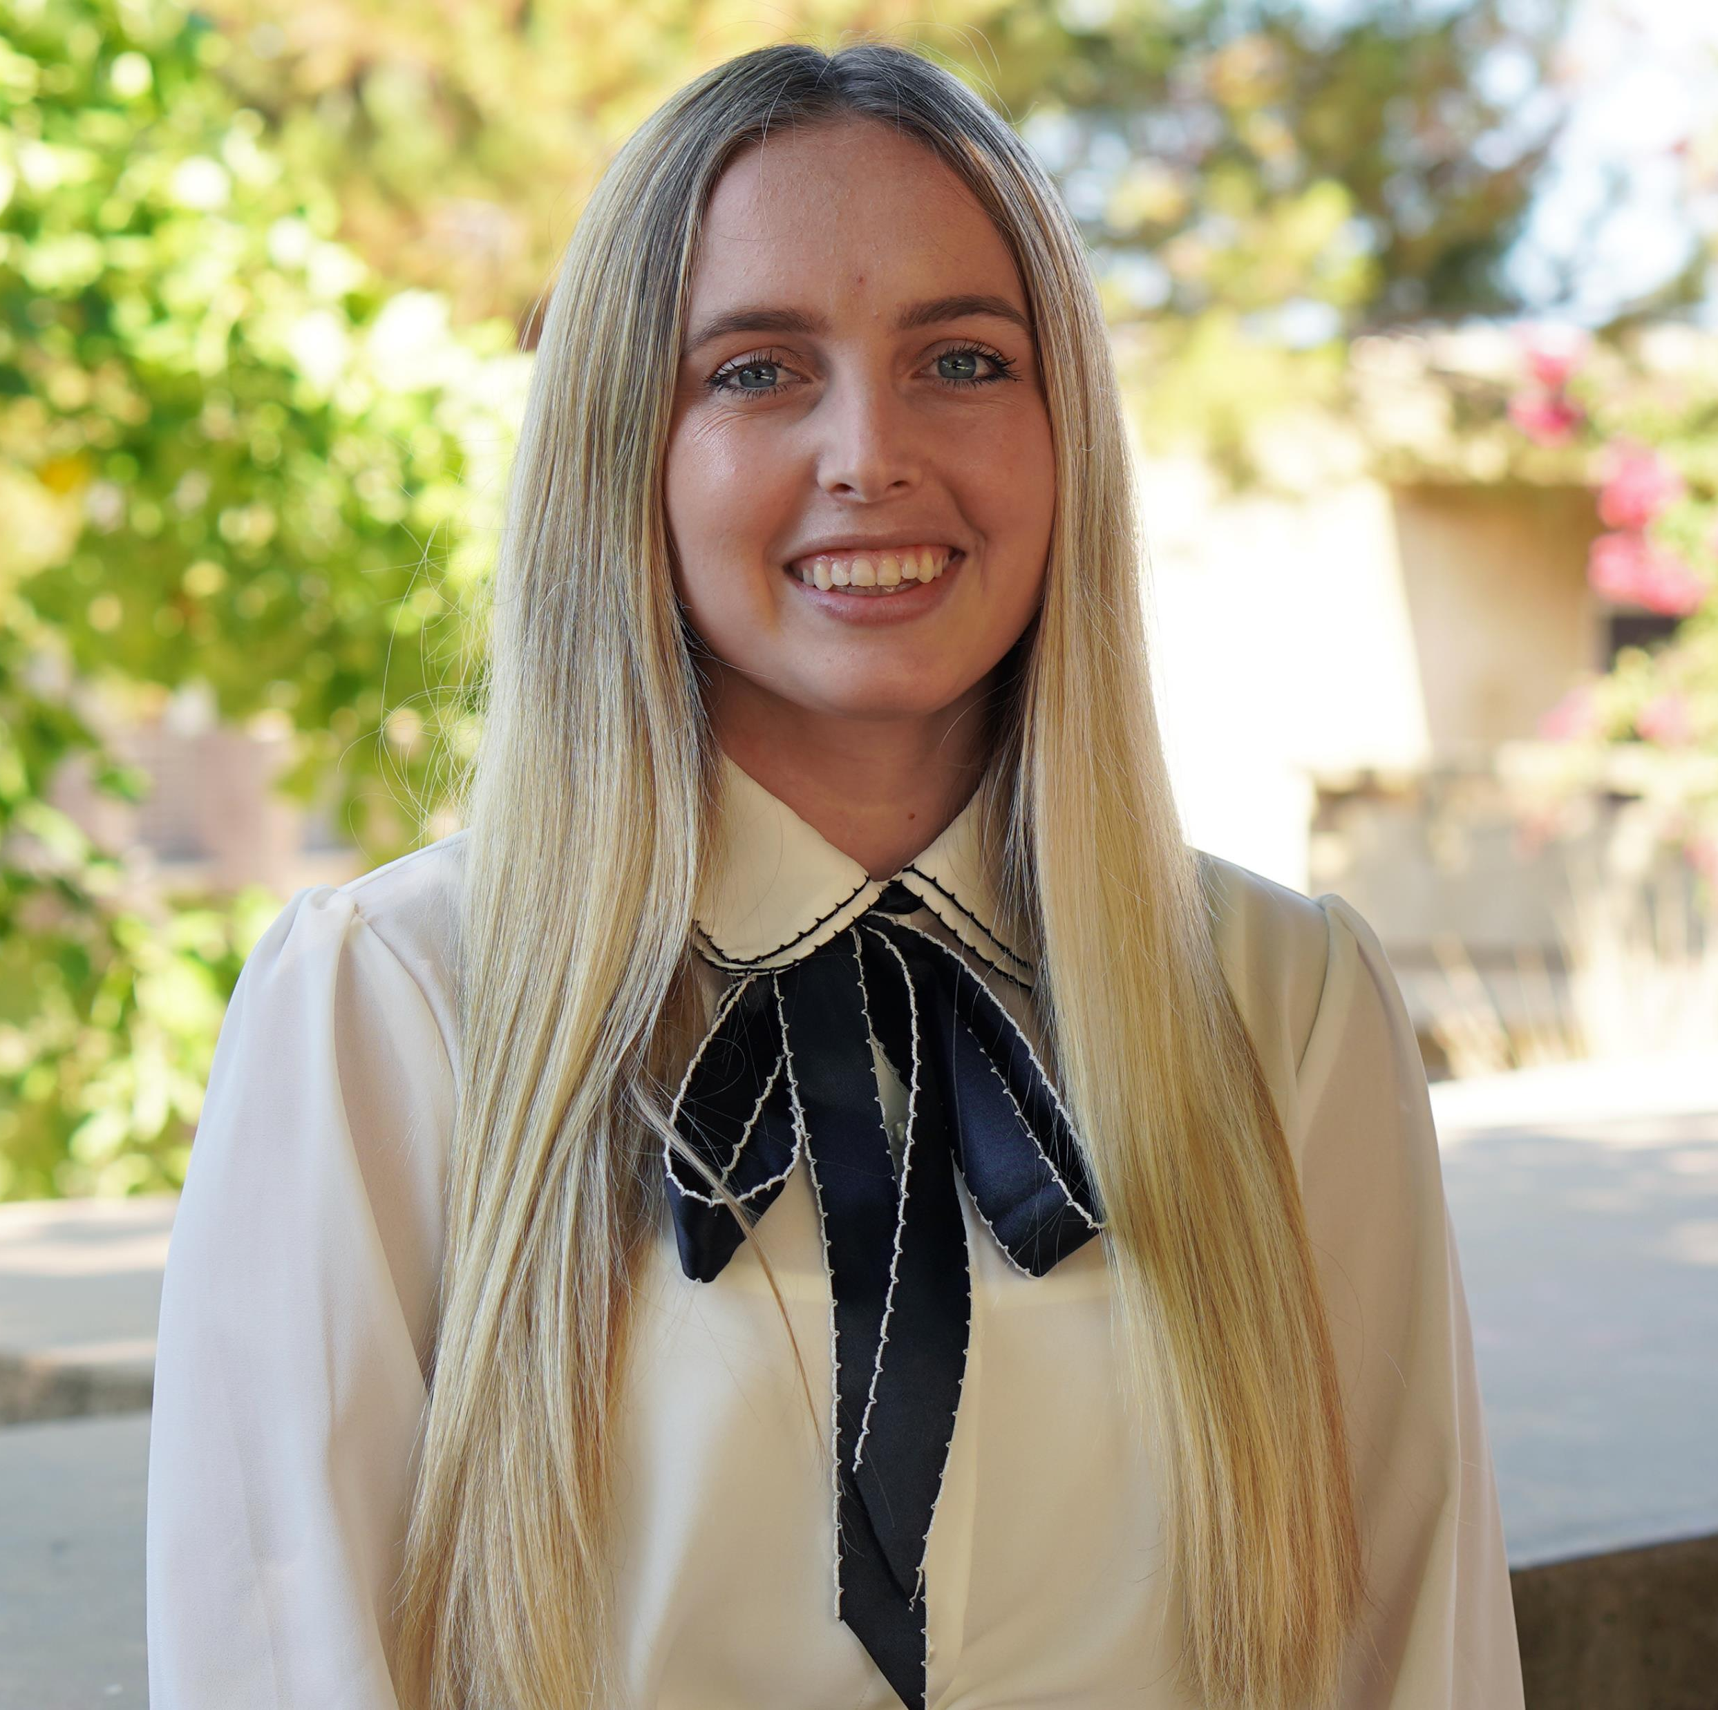
Classified Professionals
Haly Mount
Student Services Technician
EOPS

Slide 7
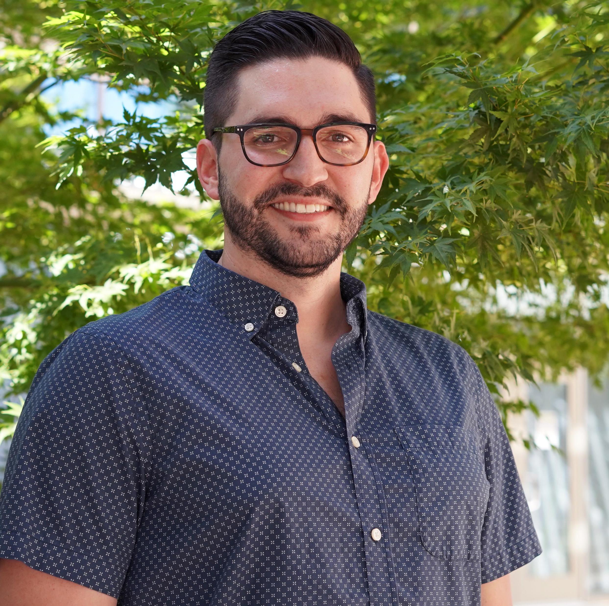
Full-Time Faculty
Alex Beechko
Anatomy & Physiology

Slide 8
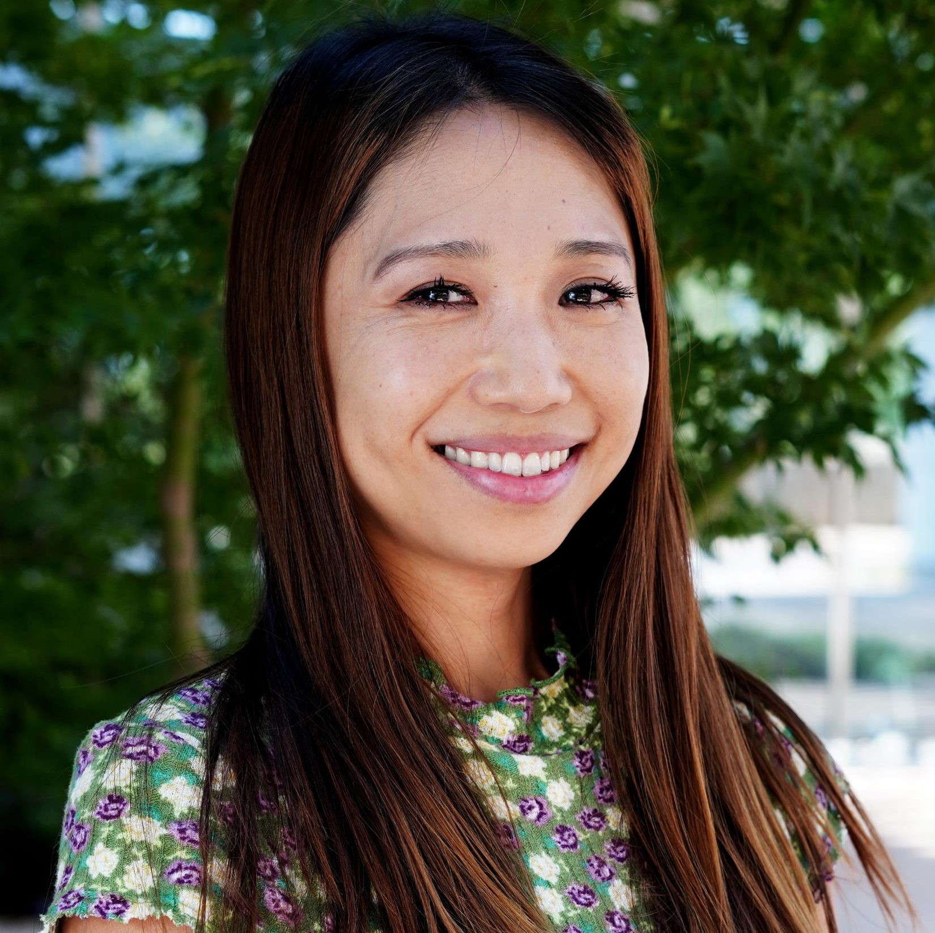
Full-Time Faculty
Yuki Toyooka Smith
Art

Slide 9
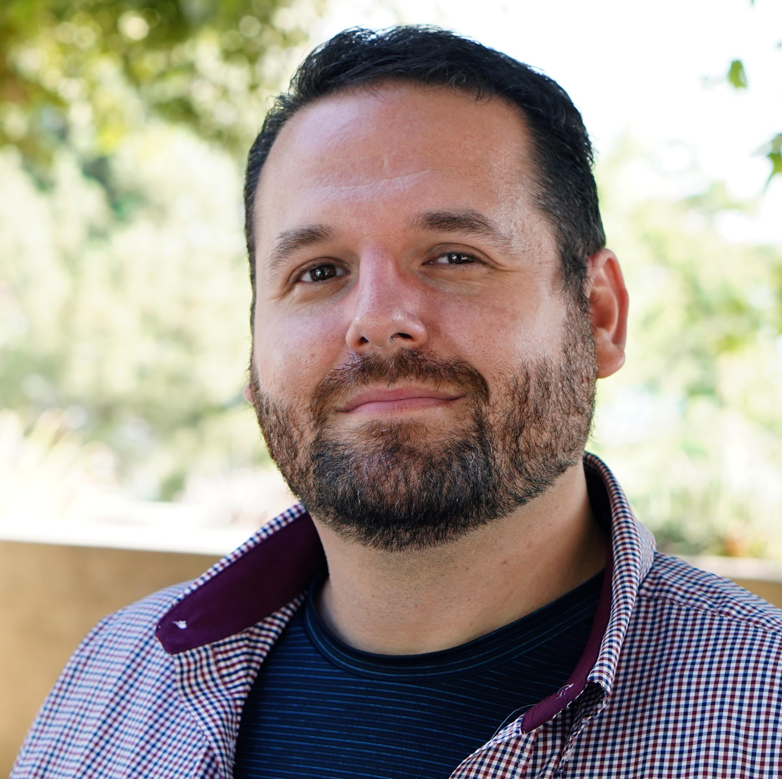
Full-Time Faculty
Peter Gend
Digital Media

Slide 10
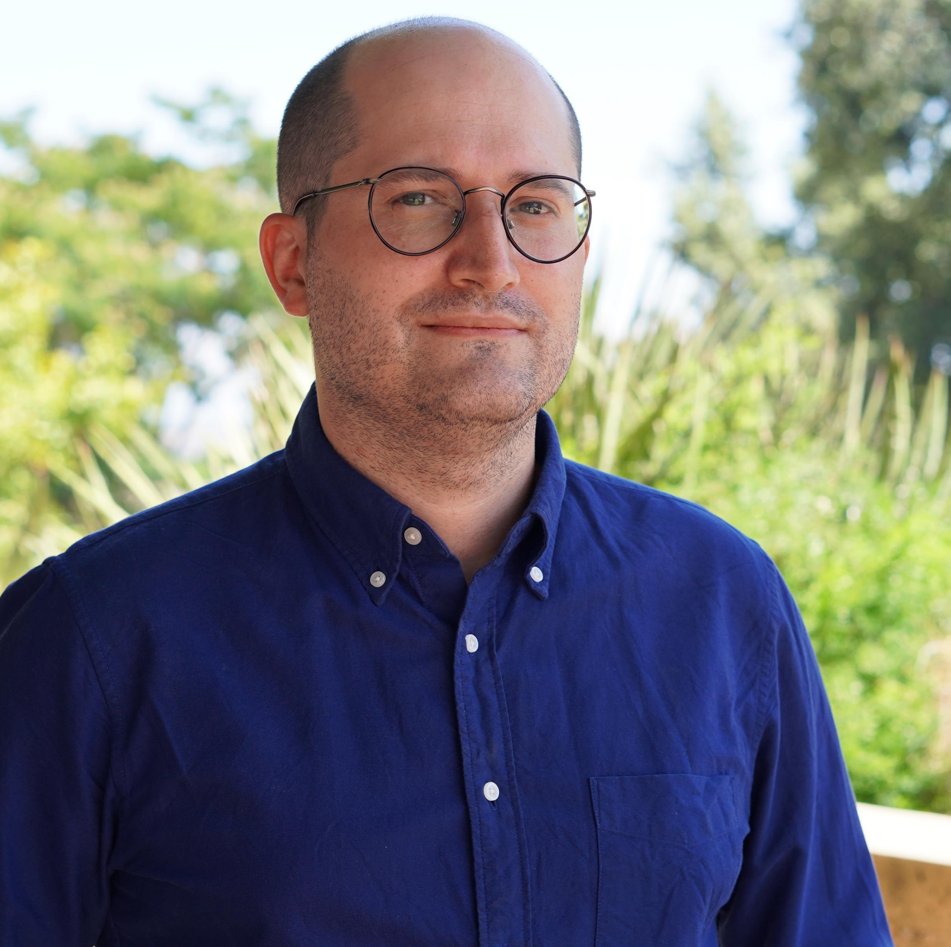
Full-Time Faculty
Ed Ferrari
English

Slide 11
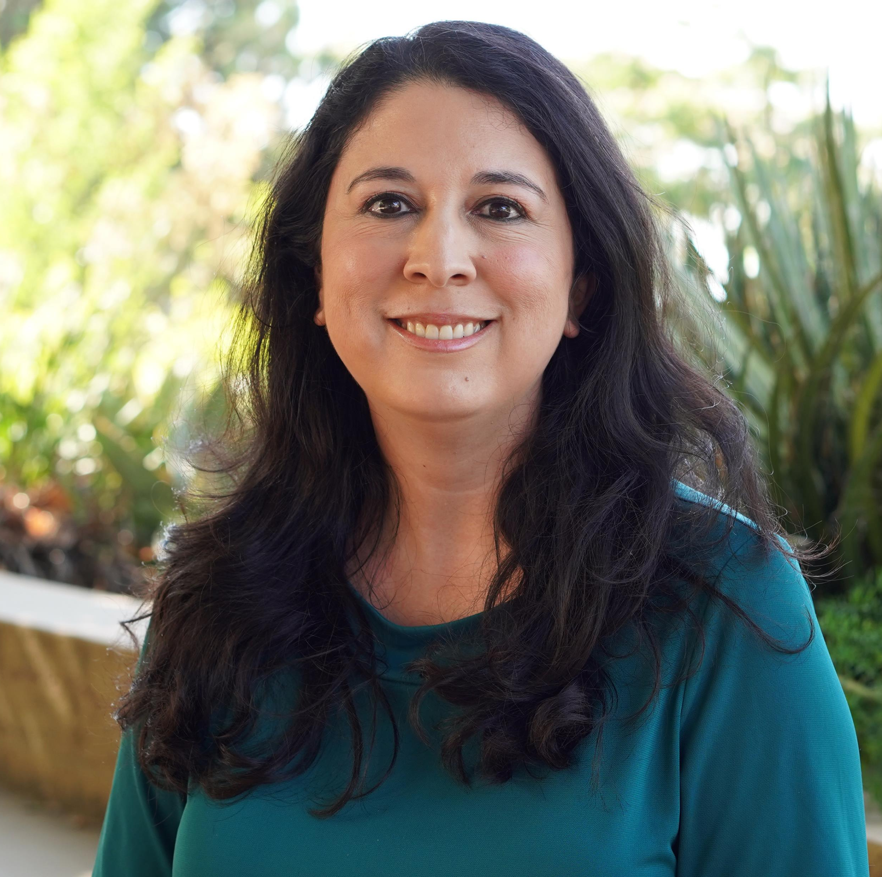
Full-Time Faculty
Natalie Lopez
Librarian

Slide 12
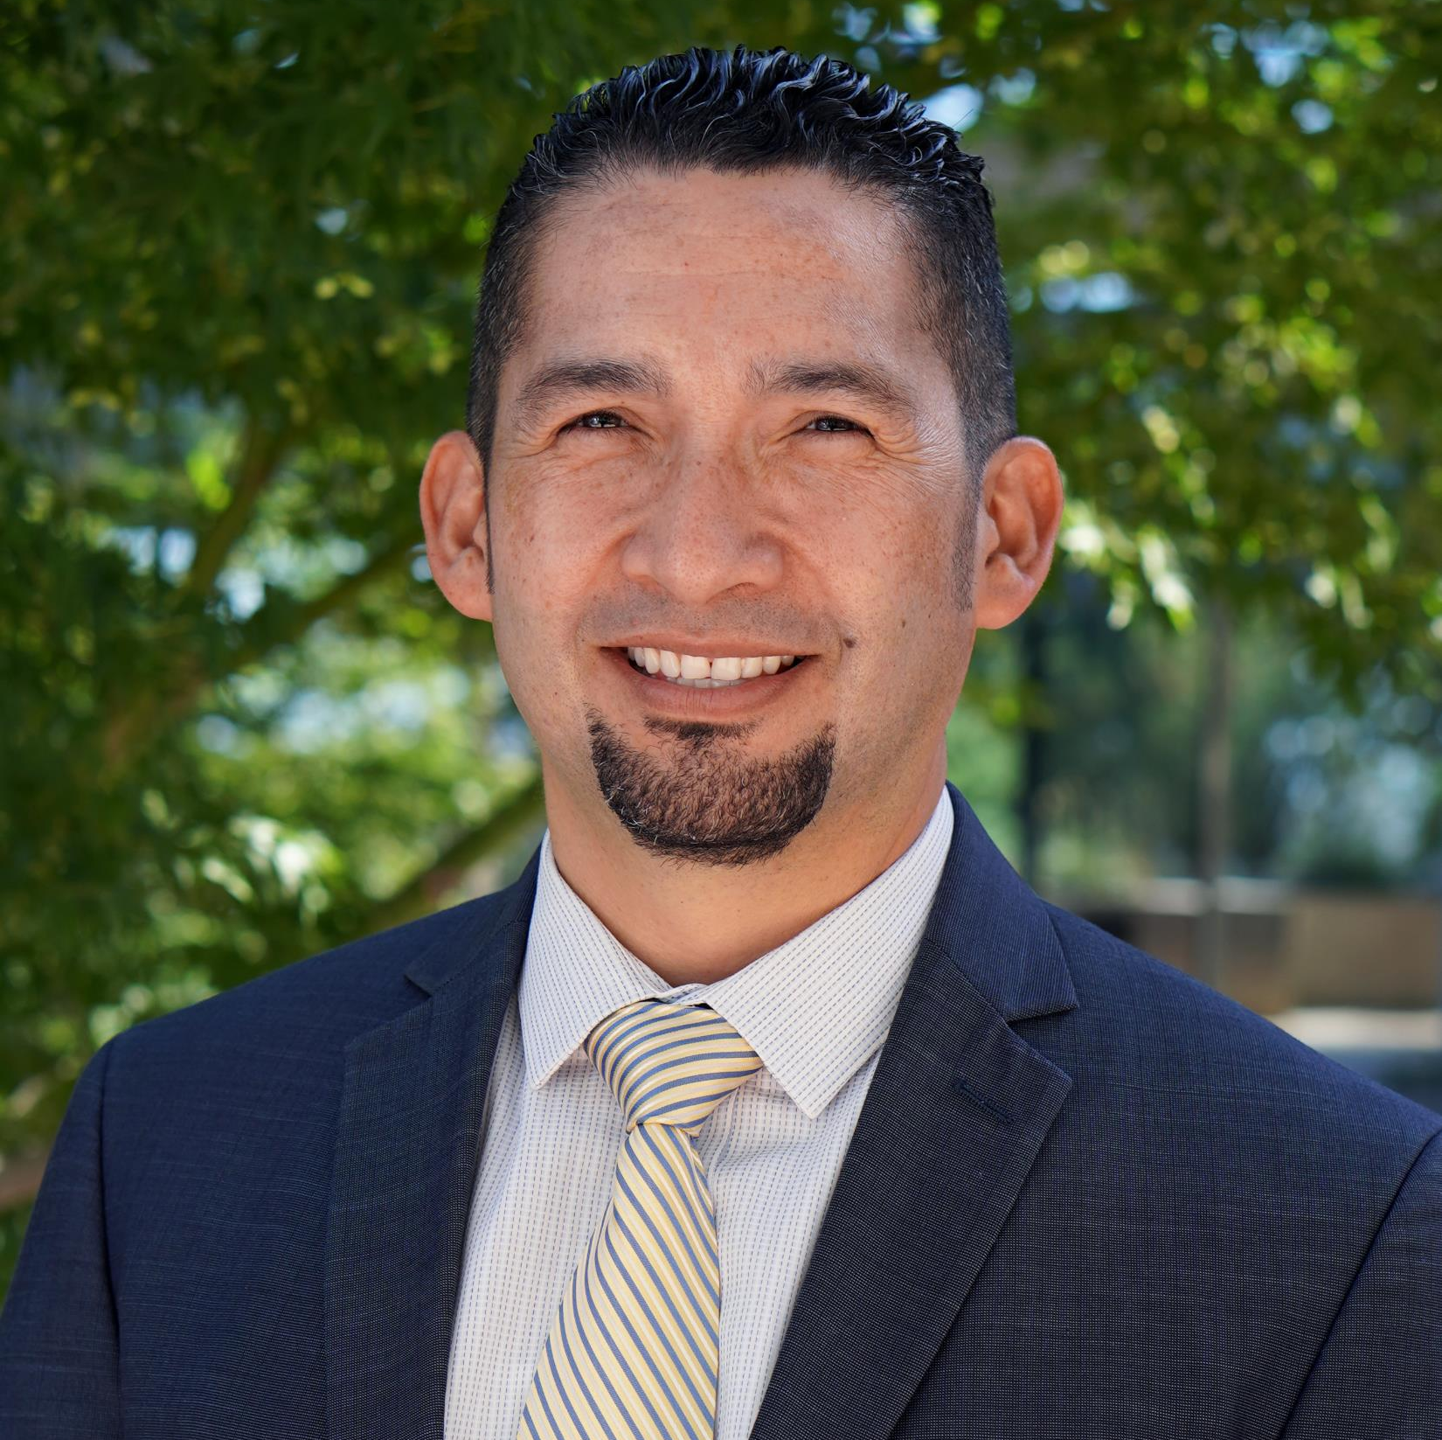
Management Team
Dr. Ivan Pena
Dean of Equity and Student Success

Slide 13
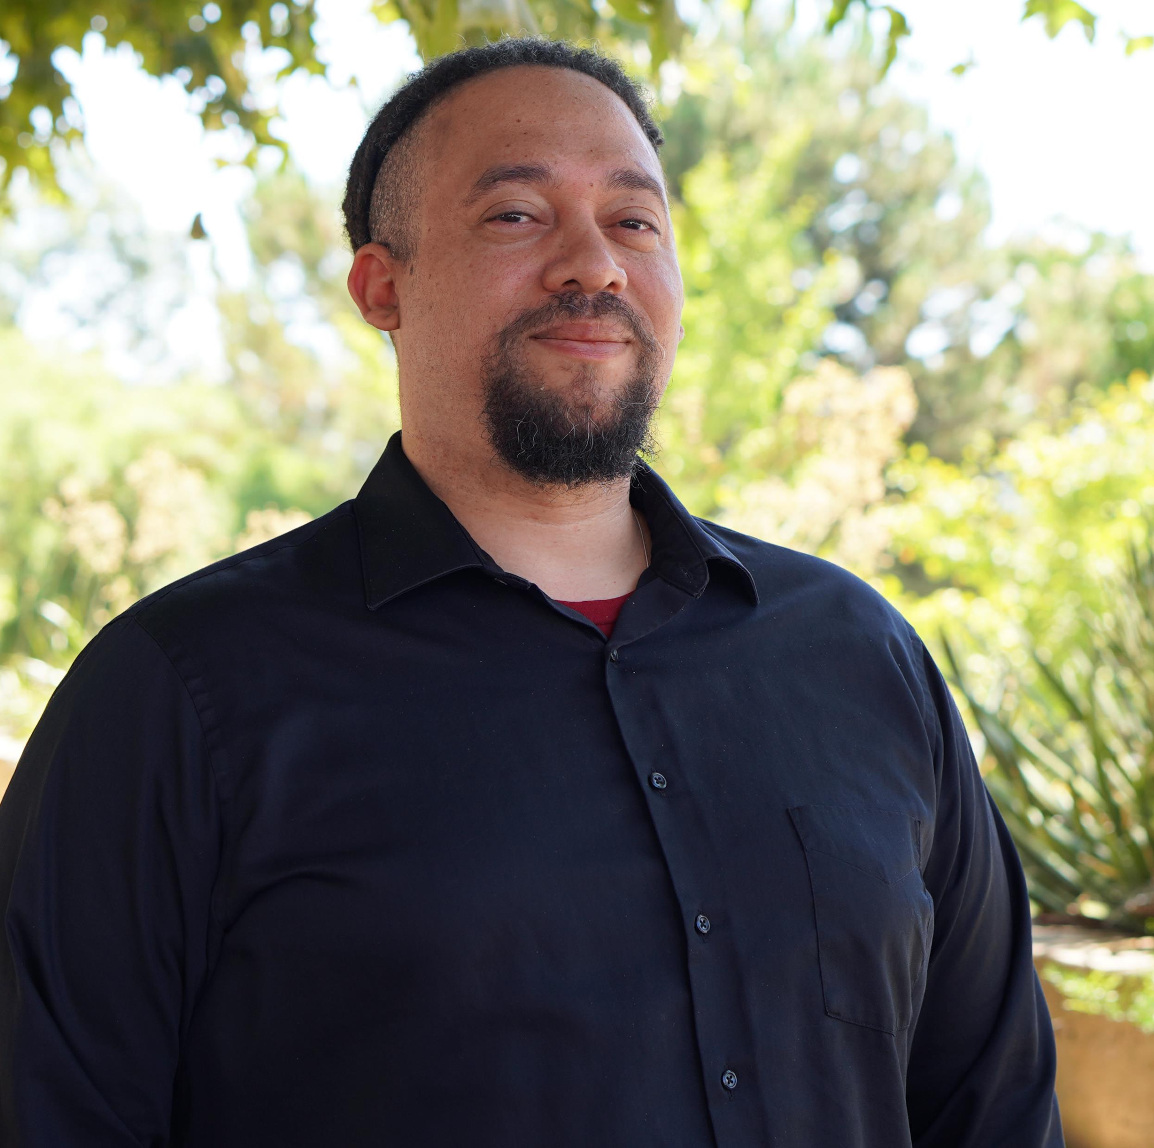
Management Team
Anthony White
Interim Director of Technology Services

Slide 14
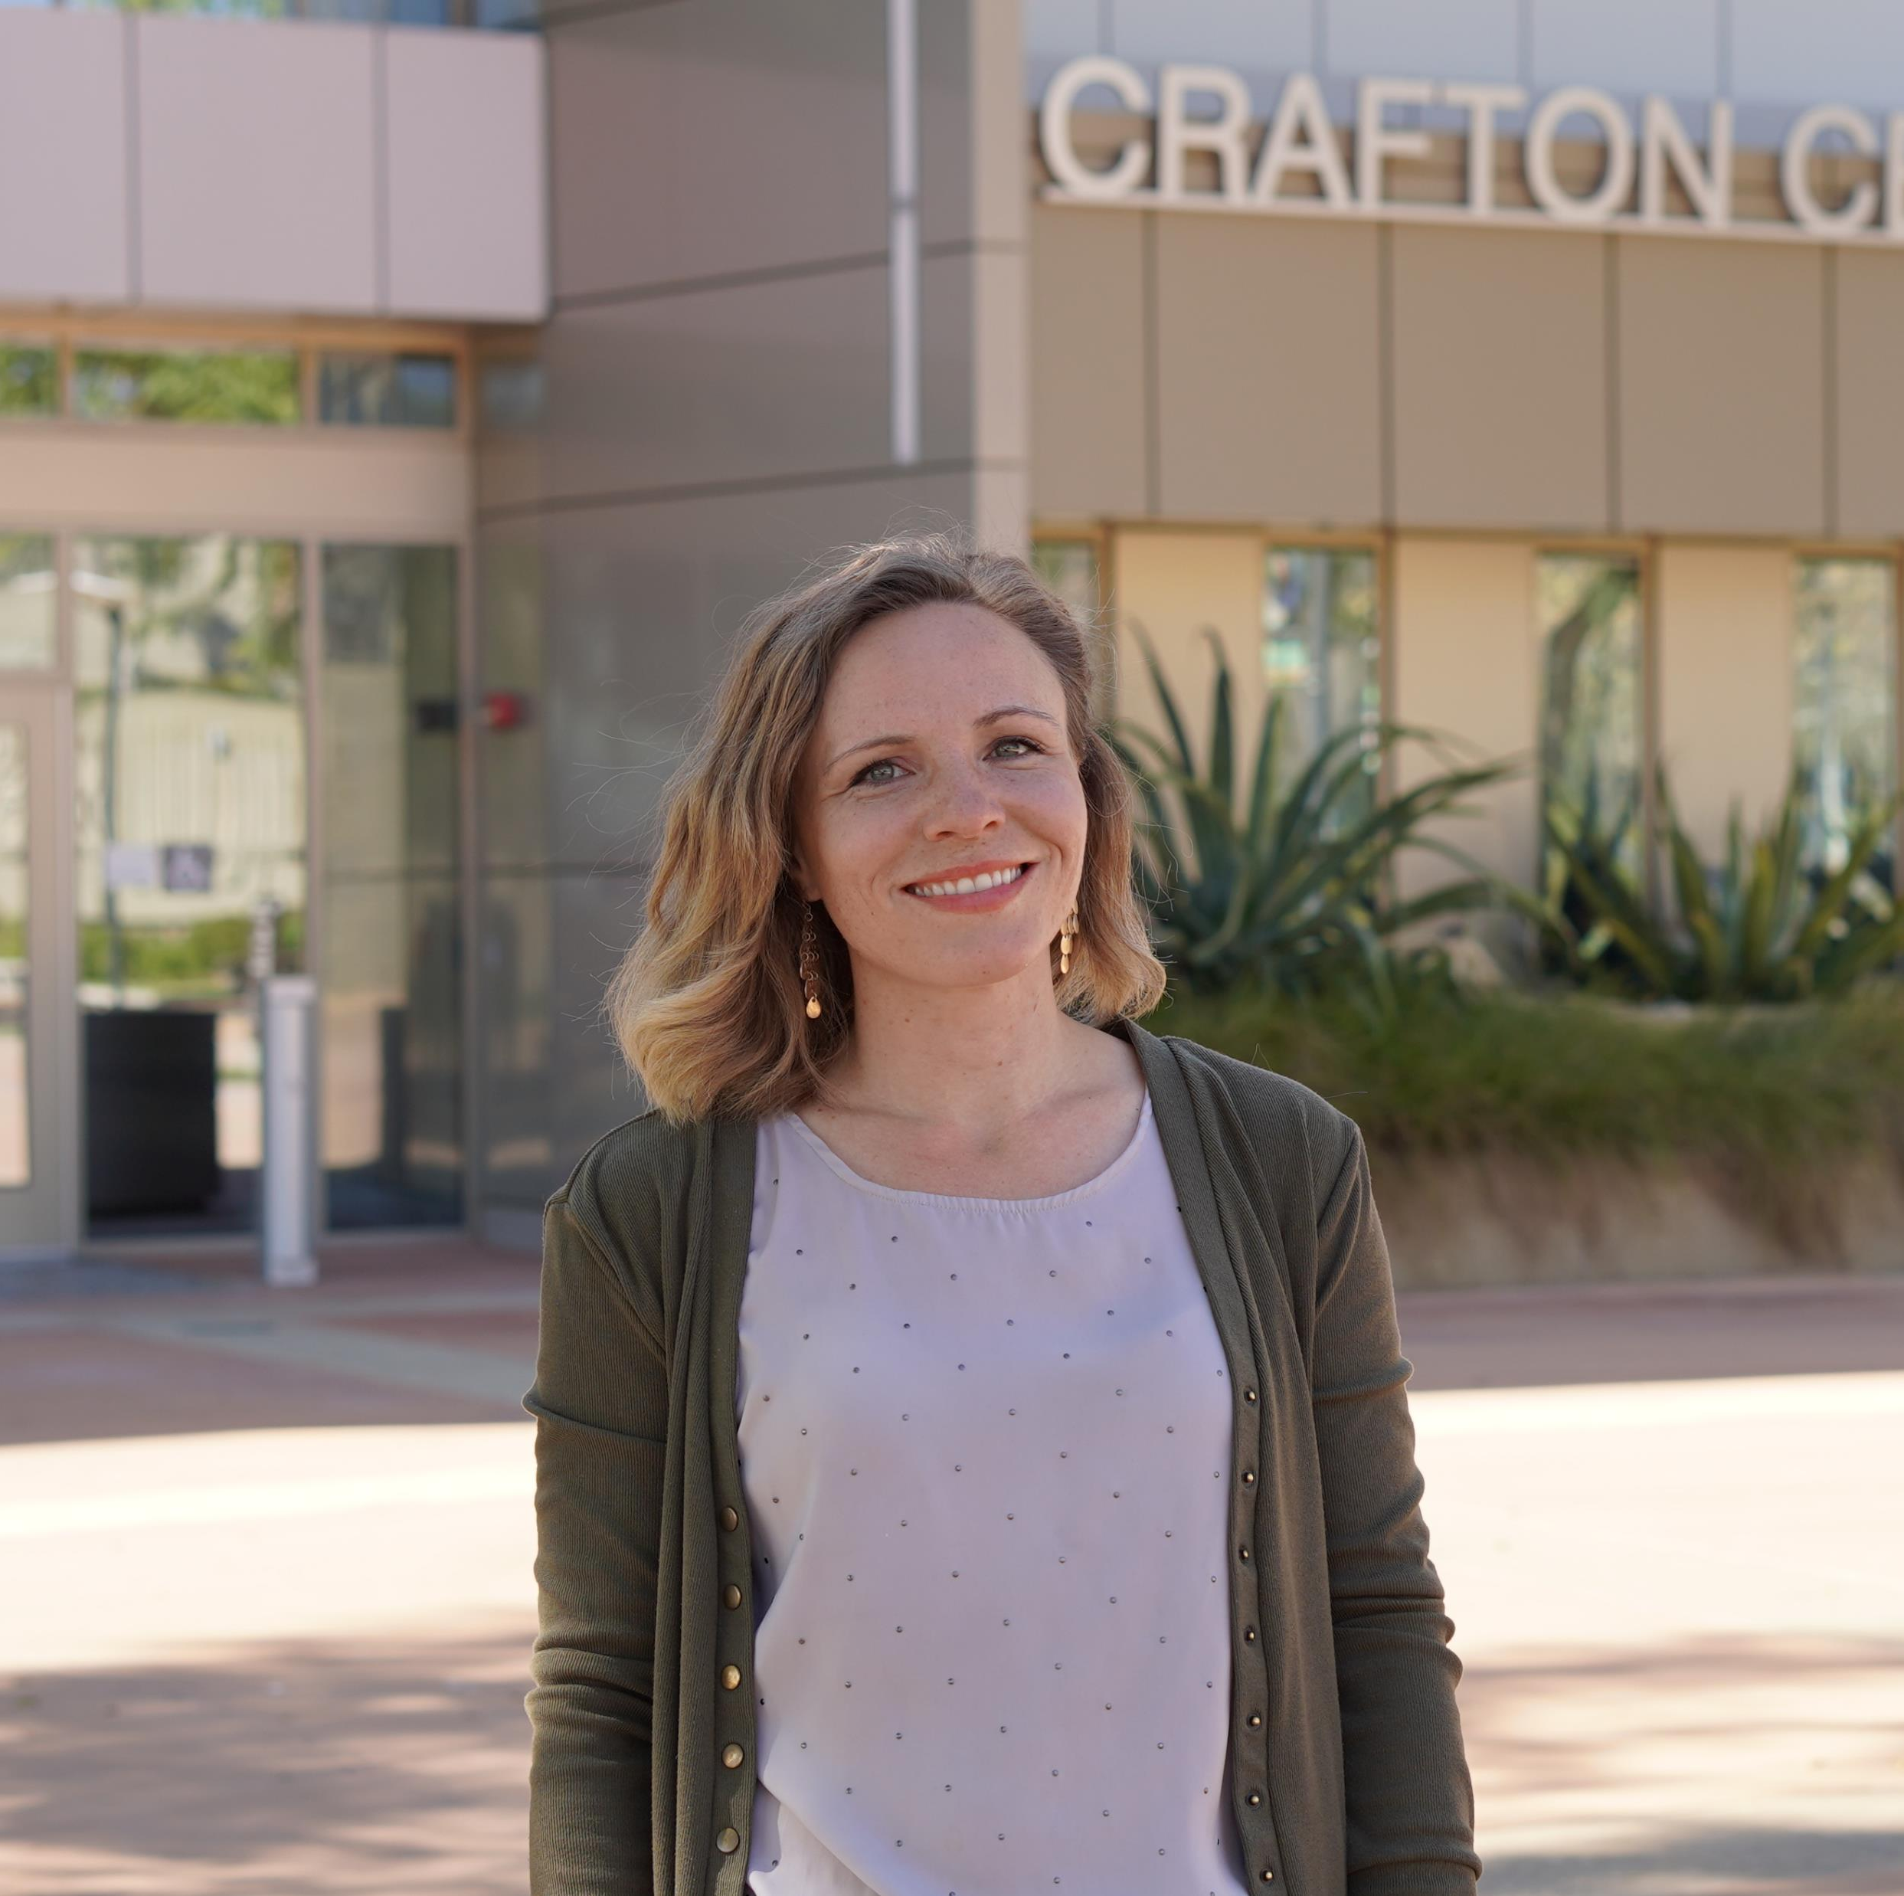
Senate Leadership
Academic Senate
Brandi Bailes, President

Slide 15
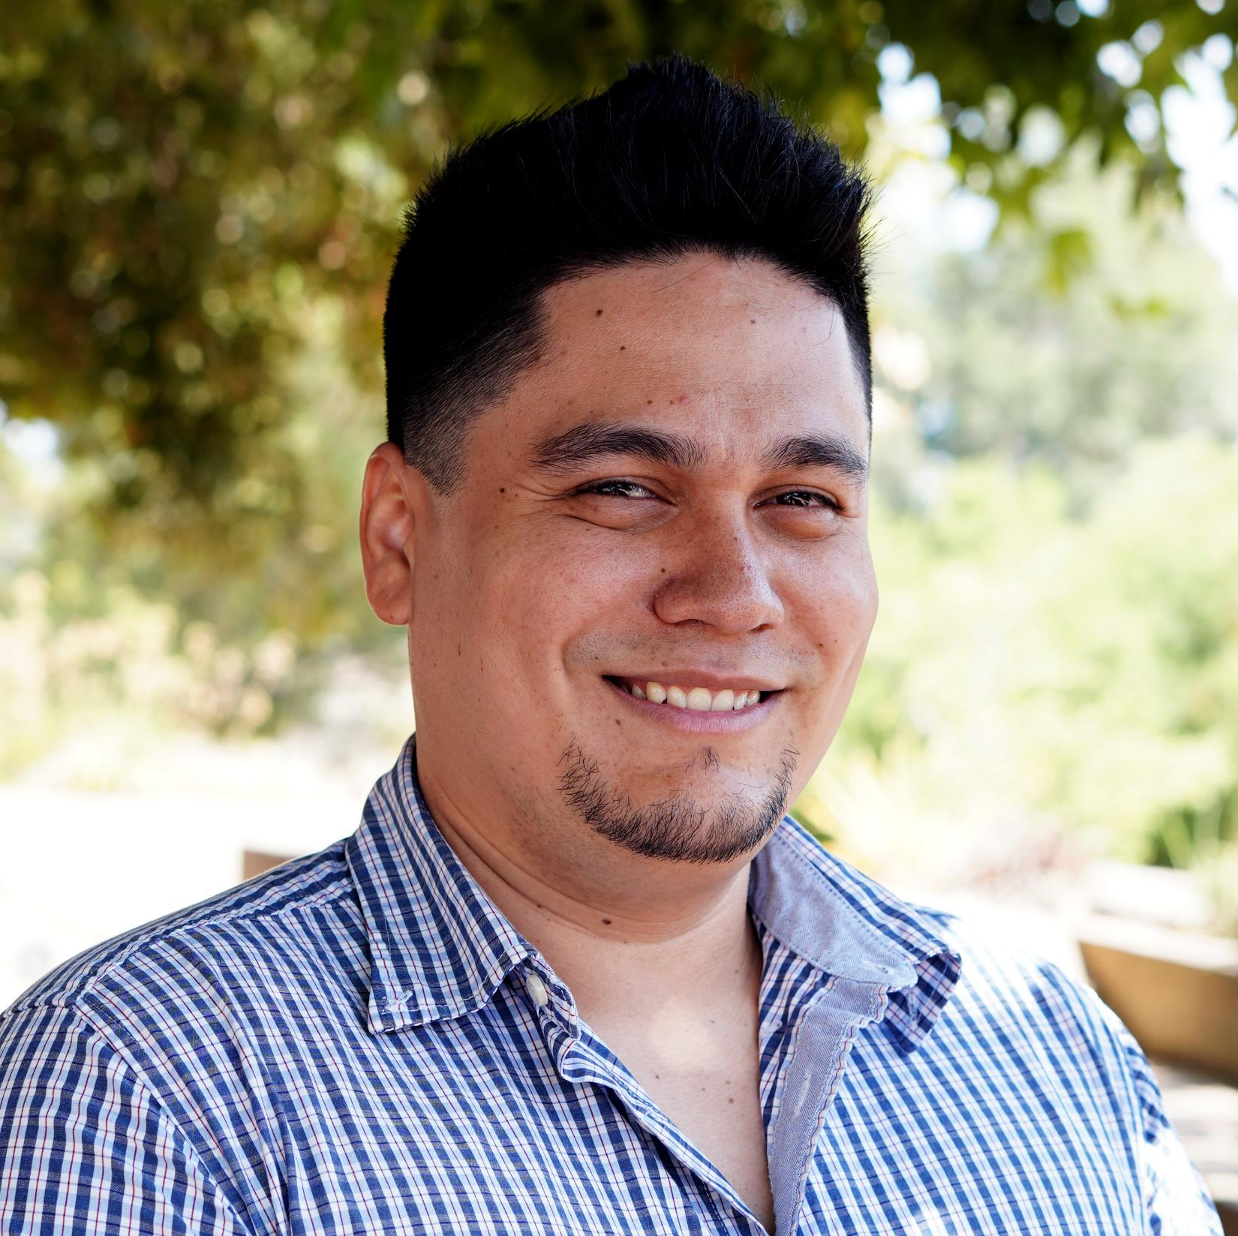
Senate Leadership
Classified Senate
Alex Jaco, President

Slide 16
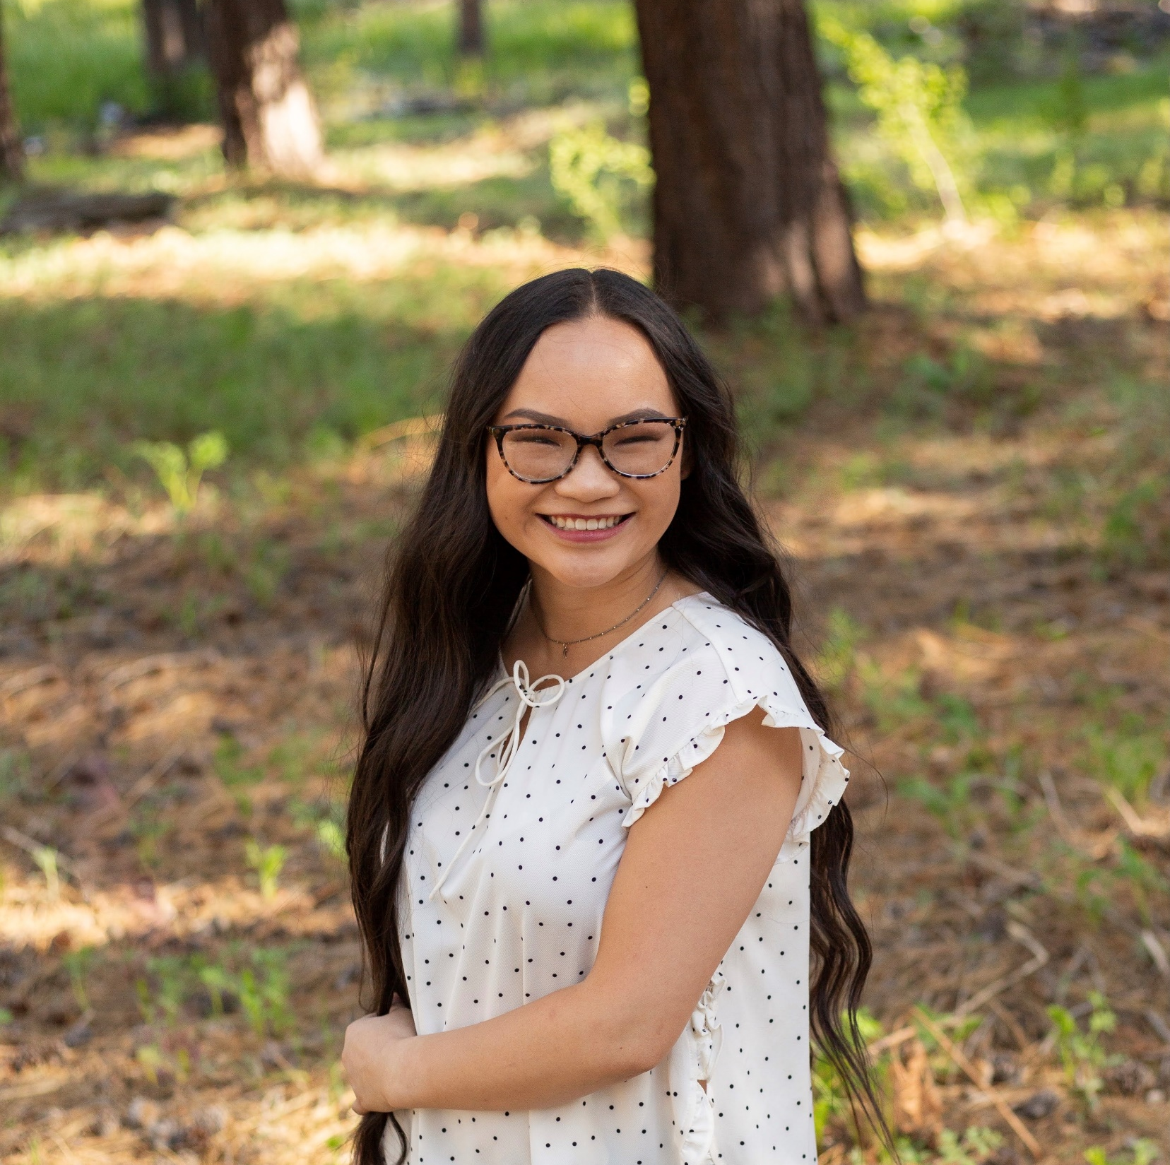
Senate Leadership
Associated Students Senate
Madeleine Boone, President

Slide 17
Classified Senate Awards

Slide 18
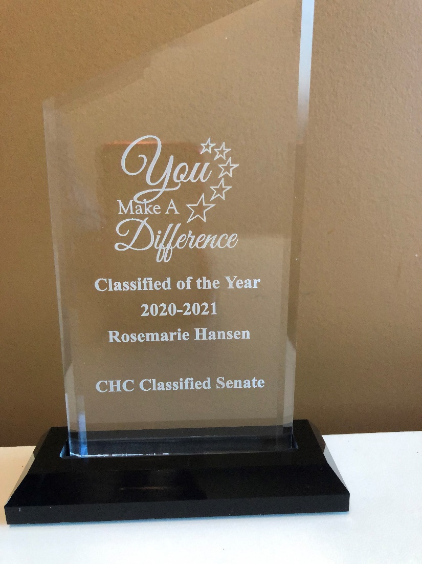
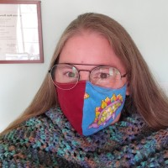
Classified of the Year
Rosemarie Hansen
Laboratory Technician, Anatomy/Physiology

Slide 19
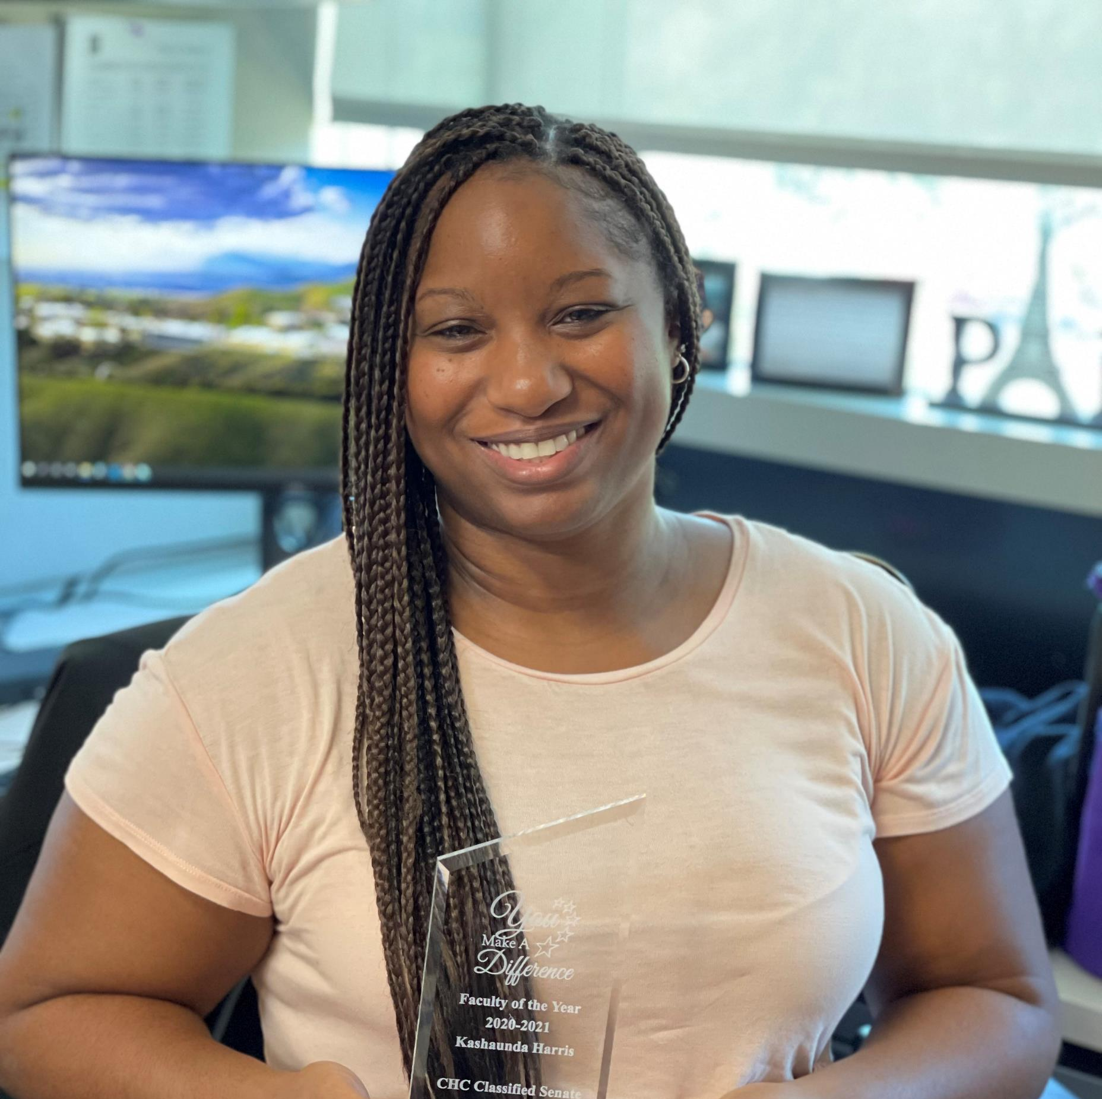
Faculty of the Year
Kashaunda Harris
Counselor, EOPS/CARE/CalWORKS

Slide 20
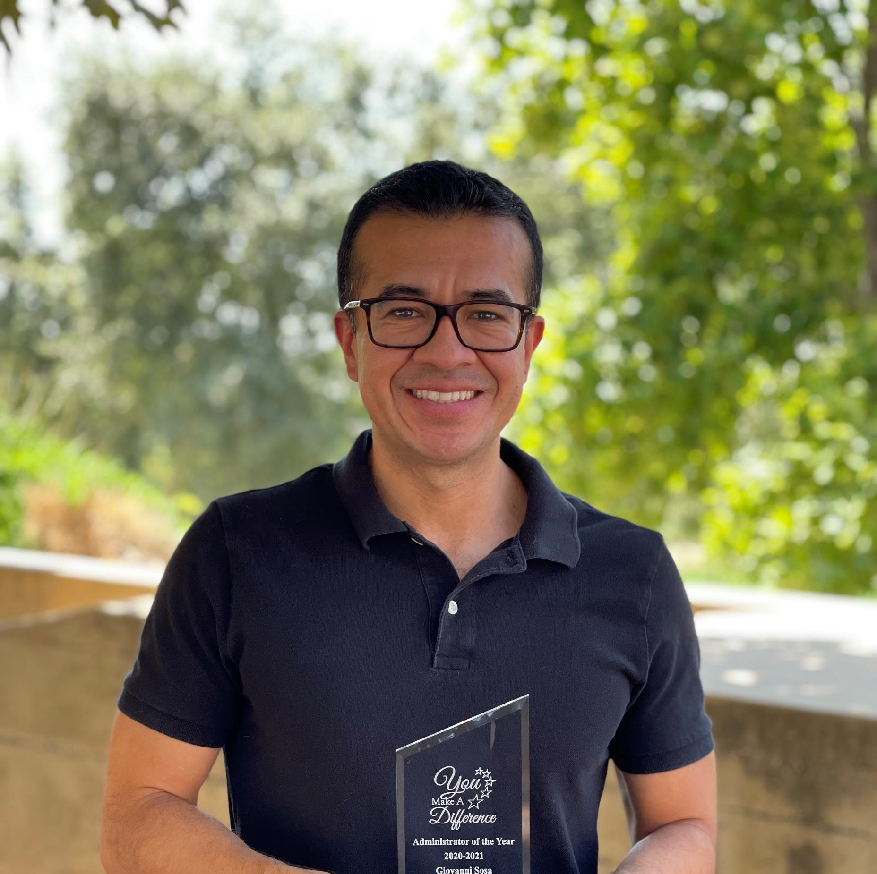
Manager of the Year
Dr. Gio Sosa
Dean, Institutional Effectiveness, Research & Planning

Slide 21
Know your ‘Why’

Slide 22
Moving forward…
Slow Spread
of COVID-19
Distance & F2F Learning
Strategic Planning
Race, Healing
and Action

Slide 23
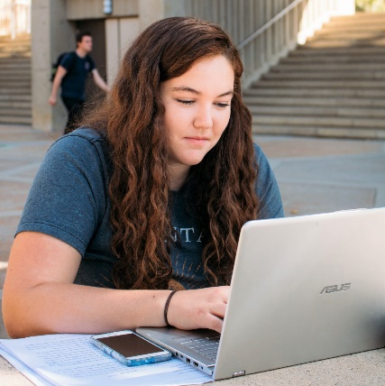
Our students are at the center of what we do
2021 Strategic Directions
Strategic Planning
Guided Pathways Implementation
Equity & Diversity
Operational Efficiencies
Facilities
Vision for Success Goals
Increase the Number of Associate Degrees, Credentials, Certificates, or Specific Job Skills
Increase the Number of Associate Degrees for Transfer
Decrease the Number of Units Accumulated by Students
Increase Living Wage
Decrease Equity Gaps
Decrease Regional Gaps

Slide 24
Good News

Slide 25
Success Highlights
Annual Total Awards
2018-2019 = 1,347 Certificates (571) & Degrees (776)
2019-2020 = 1,580 Certificates (780) & Degrees (800)
2020-2021 = 1,471 Certificates (616) & Degrees (855)
176% Increase in President’s Circle Members
December 2018 = 34 Members
December 2019 = 56 Members
August 2021 = 94 Members

Slide 26
Success Highlights
Diversity, Equity, Inclusion & Anti-Racism
USC Equity Alliance (50 personnel participated)
District & College Critical Conversations on Race
Monthly Virtual Cultural Events
One Book, One College
’20 – ’21 Spare Parts, Joshua Davis
’21 – ’22 Between the World and Me, Ta-Nehisi Coates
AB 705 English
2019 = 69% of students complete transfer level English (highest in the Inland Empire)
Eliminated Disproportionate Impact (DI) for LatinX and African American students

Slide 27
Success Highlights
Transfer
Fall 2020 UC Admit Rate (75%) highest in the Inland Empire
100% of students accepted into CSUSB completed “Golden Four” requirement
Financial Aid
Over $1.9 million in Emergency COVID Aid distributed directly to students
Books+ Partnership with Follett

Slide 28
Our graduates are ready for the workforce

Slide 29
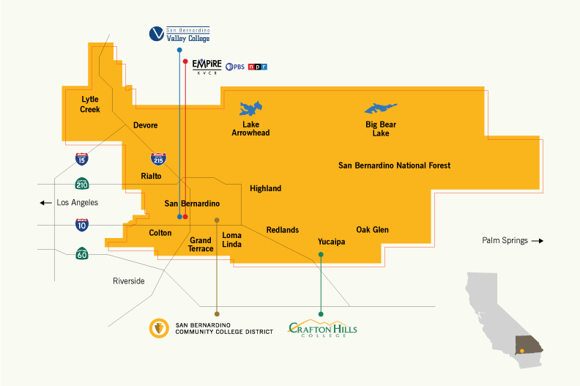
San Bernardino
Community College District
Saves Taxpayers $19.6 Million

Slide 30
We add $621,800,000 to the regional economy every year
Our students re-enter the workforce with new skills, empowering them to earn higher wages and salaries.

Slide 31
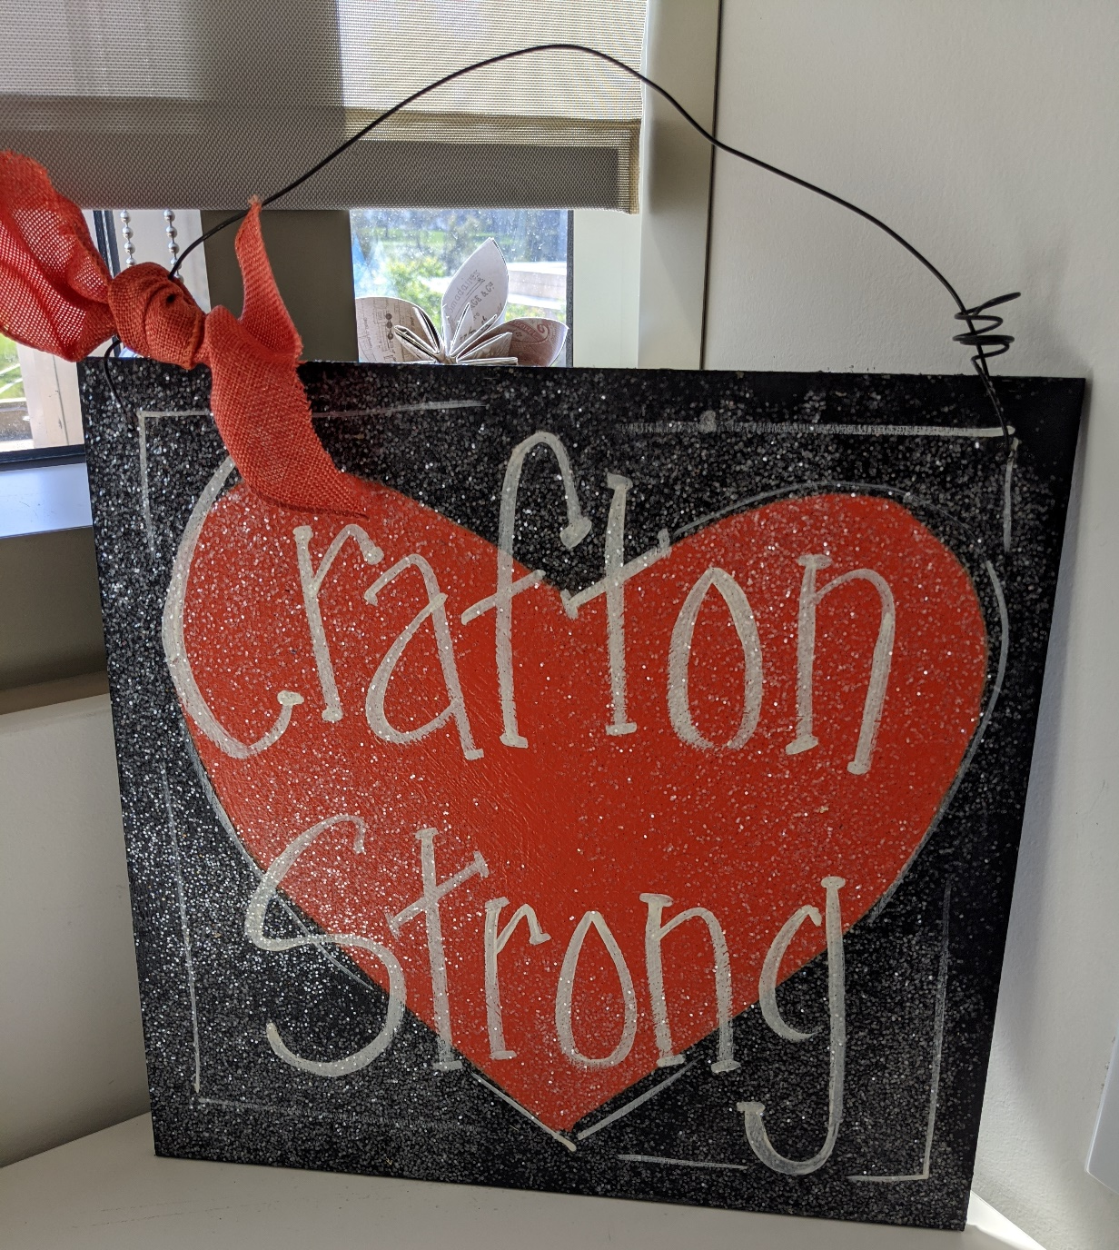

Slide 32
Agenda
Welcome
Dr. Anne Viricel, Chair SBCCD Board of Trustees
Diana Z. Rodriguez, Chancellor
Dr. Kevin Horan, President
Instruction, Dr. Keith Wurtz
Student Services, Dr. Delmy Spencer
Administrative Services, Mike Strong
Institutional Advancement, Michelle Riggs

