Slide 1
In-Service Opening Day: Grit & Engagement
Fall 2022 In-Service

Slide 2
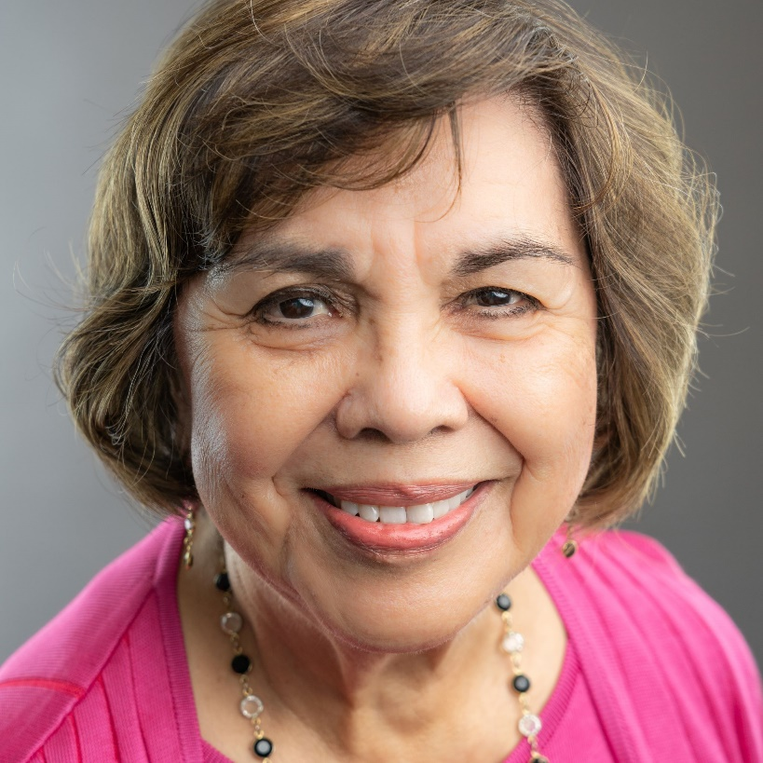
Gloria Macias Harrison
Chair

Slide 3
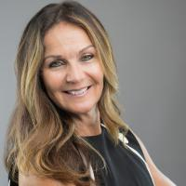
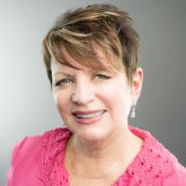
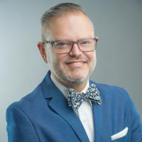
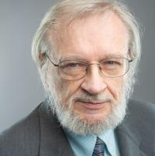
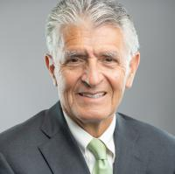
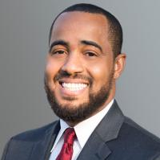
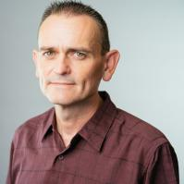
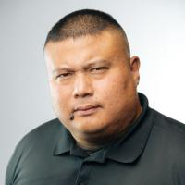
Gloria Macias Harrison
Chair
Dr. Stephanie Houston
Vice Chair
Dr. Anne L. Viricel
Clerk
Dr. Nathan D. Gonzales
Trustee
John Longville
Trustee
Frank Reyes
Trustee
Joseph R. Williams
Trustee
Robert Alexander
Student Trustee, CHC
Paul Del Rosario
Student Trustee, SBVC

Slide 4
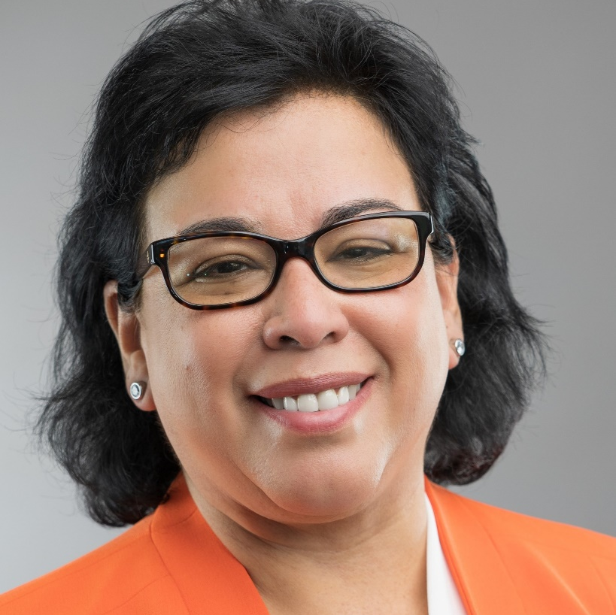
Diana Z. Rodriguez
Chancellor

Slide 5
New Roadrunners

Slide 6
Welcome! Andrew Guevara English Instructor

Slide 7
Welcome! Jillian Robertson Math Instructor

Slide 8
Welcome! Sandra Ruiz CIS Instructor

Slide 9
Welcome! George “Butch” Zein American Sign Language Instructor

Slide 10
Welcome! Dr. Willie Blackmon Director of Outreach and Educational Partnerships

Slide 11
Welcome! Brenden Lazzar Grounds

Slide 12
Welcome! Lilibeth “Lily” Medina Administrative Coordinator Student Services

Slide 13
Welcome! Cynthia Lemus Academic Support Specialist LRC

Slide 14
Welcome! Jazmin Navarro Child Development Assistant

Slide 15
Welcome! Ola Sabawi Senior Analyst OIERP

Slide 16
Welcome! Sharon Zerbel Administrative Coordinator Office of Instruction

Slide 17
Congratulations! Anthony White Director of Technology Services

Slide 18
Congratulations! Maria Davila Interim Admissions & Records Tech

Slide 19
Congratulations! Belinda Navarrete Interim Coordinator Outreach and Educational Partnerships

Slide 20
Congratulations! Ali Raventos Interim Admissions & Records Specialist

Slide 21
Congratulations! Heather Stephens Interim Director of Child Development Center

Slide 22
The Changes in the Student Body Since Fall 2018: Enrollment

Slide 23
Enrollments by Instructional Modality: Fall 2018, Fall 2019, and Fall 2021 54% Decline in In-Person Enrollments Between Fall 2018 and Fall 2021

Slide 24
CHC Students by Academic Year (Unique Counts) The Sharpest Decline (-21%) Over a Four-Year Period Observed in Last 30 Years
21% Decline

Slide 25
CHC Students by Academic Year and Ethnicity (Unique Counts) African American, Caucasian, and Hispanic Students Account for the Largest Share of the Decline
19% Decline (-877 Students)

Slide 26
CHC Students by Academic Year and Gender (Unique Counts) The College Experienced a Larger Decline in Male (27% Decline) than Female Students (21% Decline)
27% Decline (-1,141 Students)

Slide 27
Percent of Students Enrolled Full-Time (12+ Units): Fall 2018—Fall 2021(Unique Counts) Declined by 8% since FA18, but by 14% since FA20.
14% Decline

Slide 28
Percent of Students Enrolled Full-Time (12+ Units) by Ethnicity: Fall 2018 & Fall 2021(Unique Counts) Full-Time Rates Among African American and Asian Students Have Declined Most Significantly
14% Decline

Slide 29
Percent of Students Enrolled Full-Time (12+ Units) by Age Group: Fall 2018 & Fall 2021(Unique Counts) Full-Time Rate Among 20-24 Age Group Dropped Significantly

Slide 30
First-Time CHC Students by Academic Year (Unique Counts) Our First-Time Student Population Has Decreased by 26% Since FA18
26% Decline

Slide 31
CHC Student Headcount, Enrollments, and Resident FTES One Week Prior to Start of Term (Fall 2021 & Fall 2022) Slight Decline in Enrollments and Resident FTES Compared to Fall 2021 (as of 8/8/22)
0.1% Increase (+5 Students)

Slide 33
Showcasing Our Grit: Success Stories Since 2018-2019

Slide 34
Number of Degrees & Certificates by Academic Year Awards Increased by 13% Between 2018-19 and 2021-22
13% Increase

Slide 35
Number of CSU Transfers by Academic Year CSU Transfers Increased by 14% Between Fall 2018 and Fall 2021
14% Increase

Slide 36
Number of UC Transfers by Academic Year UC Transfers Increased by 45% Between 2018-19 and 2021-22
45% Increase

Slide 37
The Number of Dual Enrollment CCAP Sections has increased from 8 in Fall 2018 to 25 in Fall 2022, an increase of 213% (n = 17)

Slide 38
CHC Foundation
90 Employees #TEAMCrafton
111 President’s Circle Members
44 Employees are members of President’s Circle through #TEAMCrafton

Slide 39
$1.8 Million Grant
For the next 5 years, each cadet will receive $3,000 to cover the costs of uniforms, equipment, supplies, testing, licensing, and certifications.
Remove financial barriers to recruit a more diverse cadet pool.
Build a $5M endowment – graduates asked to “pay it forward”

Slide 41
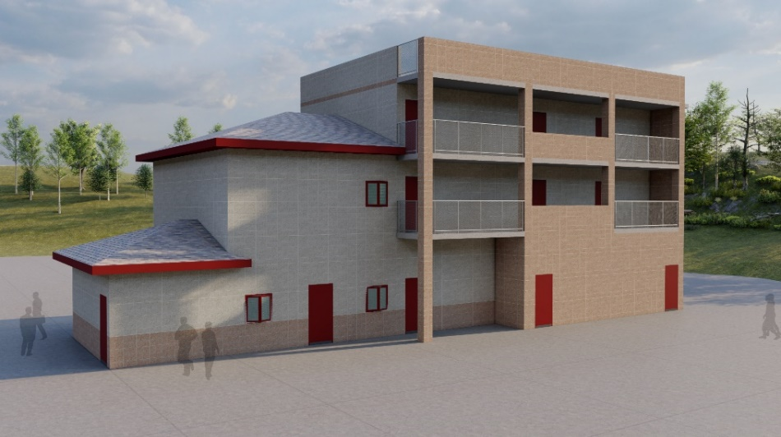
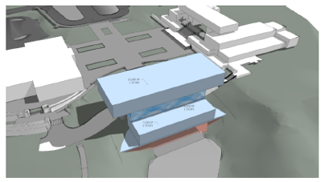
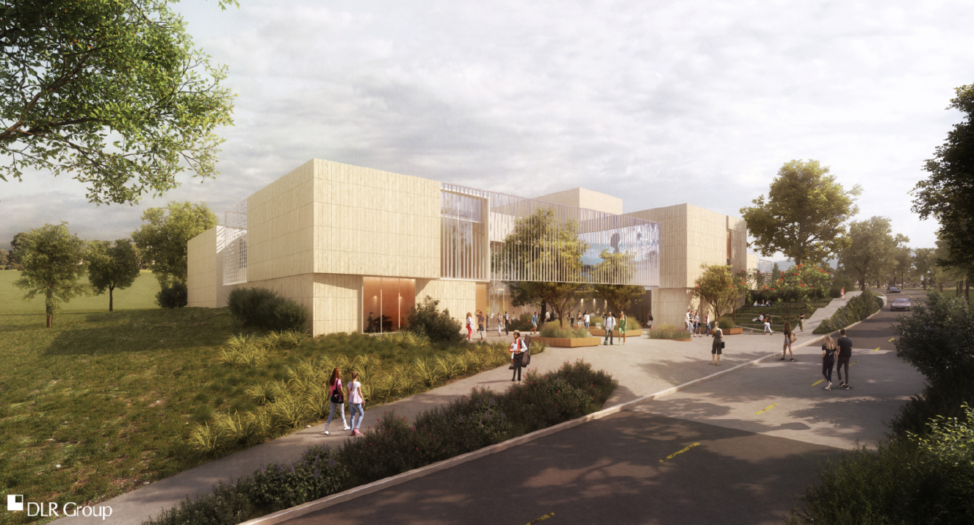
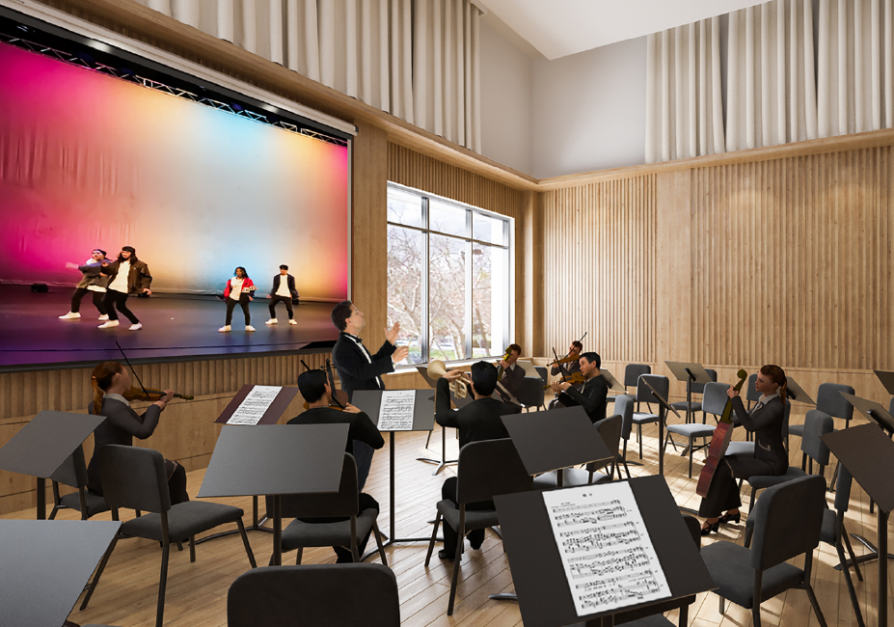
Measure CC Construction Highlights Fall 2022
JANUARY 20th
Training Center
Construction Dec. 2022-Jan. 2024
Instruction Building Design:
Fall 2022-Spring 2023
Preparing Projects:
Central Complex 2 Renovation (CC2)
Finalizing design Fall 2022
Crafton Hall Renovation
Finalize design Fall 2022
ADA Improvements Project – Phase 1
Construction Fall 2022
Child Development Center- Phase 2
Construction Summer 2023
December 2nd
Performing Arts Construction: Nov. 2022-Aug 2024

Slide 42
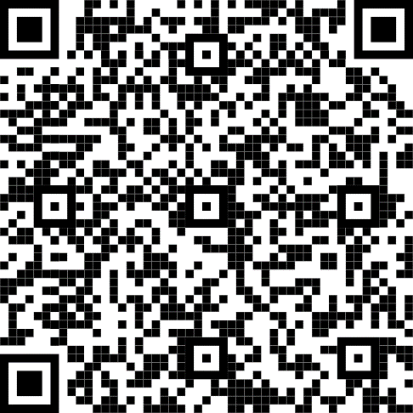
CHC Brand Identity
Brand Guide Book
Logos
Colors/Patterns
Fonts
Pathways Icons
Zoom Backgrounds
PowerPoint Templates
Signature Generator

Slide 43
Mission Statement The Crafton Hills College mission is to change lives. We seek to inspire our students, support our colleagues, and embrace our community through a learning environment that is transformational. Crafton Hills College welcomes everyone and is committed to working with students from diverse backgrounds. The College has an exceptional learning environment built on a tradition of excellence, a talented faculty, a driven student body, a committed staff, with passionate leadership and community support.

Slide 44
Vision Statement To empower the people who study here, the people who work here, and the people who live in our community through education, engagement, and innovation.

Slide 45
Institutional Values We rely on the following values to support our vision and mission: Respect: To champion active listening and open dialogue within our community. Integrity: To uphold honesty in our interactions and academic pursuits and maintain community collaboration. Diversity & Inclusion: To promote a welcoming environment through equitable and antiracist practices in all aspects of our work. Innovation: To actively grow and adapt to support our mission and vision through a willingness to embrace new perspectives and new ideas. Leadership: To develop and inspire current and future leaders through professional development, mentorship, education, and experience. Sustainability: To be a leader in our community by reducing environmental impact with practices that meet the needs of the present without compromising the future.

Slide 46
Crafton has completed the following Guided Pathways Projects
Two-Year Maps
Pathways
Business and Industry
Creative and Fine Arts, Communication, and Design
Public Safety and Health Services
Science, Technology, Engineering, and Mathematics
Society, Behavior, and Culture
Exploratory (Undecided)
Everything including career information and pathways is available online
This year…
Finish the three-year maps
Incorporate into CurriQnet Meta to map programs with maps

Slide 47
Equity Efforts
30 Faculty started the USC Race and Equity training this week and had access to their own disaggregated data
In English and Math
Provided disaggregated data by course success for classes taught by instructors based on USC Race and Equity Center Training
Provided class rosters with ethnicity for classes taught by instructors based on USC Race and Equity Center Training
Revised Program Review to include and address DEI in the curriculum and in the achievement measures
Developed and implemented equity question and rubric for all faculty recruitments this year

Slide 48
Statewide Streamlining Pilot Project
CHC is 1 of 16 participating colleges in the state (since Fall 2020)
Focus on examining the extent to which student/instructional supports are adequately reaching African American, Hispanic, and economically disadvantaged students
Develop plans for closing observed equity gaps for special populations
Involves efforts from student and instructional support programs, including the Transfer Center, Veterans Resource Center, and Strong Workforce
CHC is Shaping a Statewide Approach to Equity
The state chancellor’s office has showcased CHC’s equity efforts at a CCC Board of Governors meeting (September 2021) and frequently seeks CHC-specific input on equity efforts among student and instructional support programs.

Slide 49
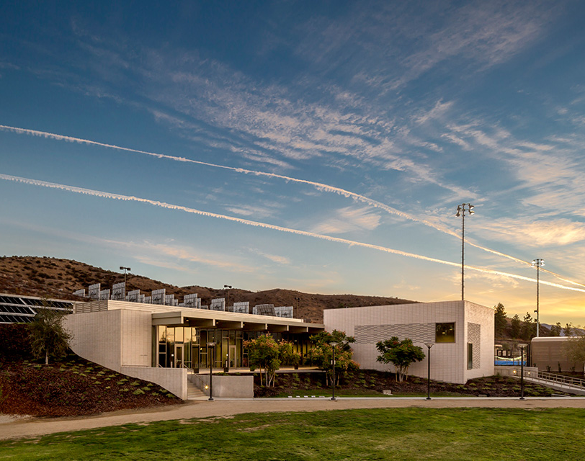
Thought Question 1
Our college data suggest that students, faculty, and staff have demonstrated grit in the face of challenges posed by the pandemic.
Please identify at least one accomplishment on your part that contributed to this success and briefly describe to your table mates.
What stood out to you in your table discussion? (to be reported out)

Slide 50
Success and Equity Since Fall 2018
Dr. Gio Sosa, Dean of Office of Institutional Effectiveness, Research & Planning

Slide 51
CHC’s Framework for Student Success: Success vs. Success with Equity¹
Success Without Equity
Success With Equity
¹Center for Urban Education (2009)
Notes:
Old model vs new model
Leads with vision for success….. It is the right ask of all colleges to do both -- increasing success and decreasing gaps
Focus area is on increasing success and equity. Used CCCCO and CUE as sources in identifying this focus area. Reflects an examination of various collegewide data – including leading and lagging indicators
Target population: All students, especially those that are found to be disproportionately impacted. The focus is on embedding equity into everything that is done
Outcomes: both leading and lagging indicators. Attempted units in first year; completion of transfer-level math/English in first year; enrolling after applying…..

Slide 52
Comparison of Collegewide Enrollments to Awards in 2018-2019 by Ethnicity African American, Asian, and Hispanic Students Completed at Lower-Than-Expected Rates

Slide 53
Comparison of Collegewide Enrollments to Awards in 2021-2022 by Ethnicity In comparison to 2018-19, the Gap for African American Students Declined by 10% but the Gap for Hispanic Students More than Doubled; the Gap was Eliminated for Asian Students
117% Increase Since 18-19
10% Decline Since 18-19
Gap Eliminated; Earned More Awards than Expected

Slide 54
What May Explain the Partial Closing of Gaps for African American Students?

Slide 55
Course Success Rates (SR) by Ethnicity in Fall 2018 and Fall 2021 The SR Increased for African American Students, and the Equity Gap was Partially Closed in FA21.

Slide 56
Course Withdrawal Rates (WR) by Ethnicity in Fall 2018 and Fall 2021 The WR Decreased for African American Students, and the Equity Gap was Partially Closed in FA21.

Slide 57
Everyone plays a role in student success….

Slide 58
Thought Question 2
Our college data suggest that while we are making progress in closing equity gaps, we still have work to do.
Please identify at least one goal you have for this academic year to continue the momentum of closing equity gaps.
Discuss with your table mates.
What stood out to you in your discussion? (to be reported out)

Slide 61
One Book/One College
Natalie Lopez
Ericka Paddock
Michelle Riggs
Kay Weiss
Chloe Delos Reyes
Kashaunda Harris
Krista Ivy
Monica Khalaj-LeCorre
Notes:
Kay

Slide 62
2022-2023
20 nominated books were evaluated against our criteria
Addresses issues of equity and inclusion
Is relevant to the current CHC student population
Inspires critical dialogue and an opportunity to test one’s own ideas
Is interdisciplinary
Has a message that can develop empathy
Can build community amongst students and staff
Is accessible
Notes:
Kay

Slide 63
Introducing the
CHC One Book/One College
Common Read
2022-2023
Notes:
Kay

Slide 64
Notes:
Chloe

Slide 65
Meet Josselynn
Notes:
Krista

Slide 66
One Book/One College
2022-2023
This is How it Always Is
Fall Activities
Date | Time | Activity | Registration
Sept. 14 | 12:00 – 12:50 | Appreciating the Transgendered Child (Panel Discussion) | https://www.eventbrite.com/e/crafton-hills-college-appreciating-the-transgendered-child-panel-tickets-399801867147
Oct. 11 | 12:00-12:50 | Documentary Screening (Part 1) | https://www.eventbrite.com/e/crafton-hills-college-documentary-screening-gender-revolution-part-1-tickets-371726472887
Oct 18 | 12:00-12:50 | Documentary Screening (Part 2) | https://www.eventbrite.com/e/crafton-hills-college-documentary-screening-gender-revolution-part-2-tickets-399235452987
Nov. 16 | 12:00-12:50 | Creating a trans-inclusive campus | https://www.eventbrite.com/e/crafton-hills-college-creating-a-trans-inclusive-campus-tickets-399808767787
Watch for more information including our full calendar of spring activities
Notes:
Kashaunda

Slide 67
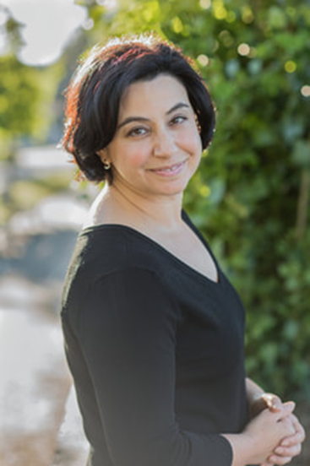
Save the Date!
Laurie Frankel will join us at Crafton Hills College
April 19
12:00-Campus Book Talk
Afternoon with our Composition and Creative Writing Students
6:00-President’s Circle Event
Notes:
Ericka

Slide 68
Questions?

