Slide 1
Welcome Back!
Chancellor Diana Z. Rodriguez
San Bernardino Community College District
Notes:
Good morning everyone, welcome back!
It’s great to see everyone again. The last time we saw each other was at commencement.
As you know, this May, we had our first in-person commencement ceremony in two years.
Let’s take a look again at that exciting moment.https://www.youtube.com/watch?v=FhjLAi92FnU

Slide 3
We’re Changing Lives
Notes:
Thank you
Thank you for everything you did help the class of 2022 get to the finish line and walk across the graduation stage.
When we do well, when you do well, our students do well.
We have so much to be proud of…

Slide 4
1. We’re eliminating barriers to student success
$22 Million
Amount of financial aid dollars we awarded to students in 2021-22 to make college financially accessible
Notes:
We are making college financially accessible to our community. Last year, we disbursed more than $22 million in financial aid to students.

Slide 5
1. We’re eliminating barriers to student success
100,000+
More adult learners in California will qualify
for financial aid because we successfully advocated for Cal Grant reform in Sacramento
Notes:
Add to that, we advocated in Sacramento to fix our financial aid system.
Before, students would be shut out of Cal Grants because of their age, GPA, or how long ago they graduated from high school.
These barriers would leave out thousands of adult learners from getting a Cal Grant to afford college.
The good news is that this year, the Governor and state legislature heard our voices and passed Cal Grant reform. That means that the state will eliminate financial aid barriers and 100,000 more California adult learners will be eligible for Cal Grant to afford a college education.
We advocated for this policy change on behalf of our students, and we applaud our state leaders for listening to our voices.

Slide 6
2. We’re promoting diversity, equity, and inclusion
+25
Our faculty have created 25 new general education pathways to ethnic studies to lift the history and contributions of diverse groups as part of the full American story
Notes:
We know that when our students see themselves reflected in history books, literature, and other subject areas, they become more academically engaged.
I am proud that our faculty have worked to make our curriculum more culturally-responsive to our diverse student body.
In the last year, across our district, our faculty have created 25 new general education pathways for ethnic studies.
Our students can now learn about the contributions and impact of Native Americans, Latinos, African-Americans, and Asian Americans as part of the full American story.

Slide 7
3. We’re a regional leader and partner
Notes:
COVID underscored our belief that we cannot take a back seat to the issues and challenges that happen outside of the walls of our college.
Many of you have heard me say that we are the community’s college. And I really mean it.
Now, we’ll have more of a positive impact in the life of our community because we are recruiting 100 students from Crafton Hills and Valley College to volunteer with local non-profits.
Starting this month, we are sending 100 student volunteers to organizations that are tackling food insecurity, mentoring K-12 students, improving our environment, and providing COVID relief.
To reward their public service, we are giving each student a $10,000 stipend to cover their education and living expenses.
We call this the College Corps program.
We are proud to be two of 46 colleges in universities across the state selected to bring this opportunity to our students.
We are so excited for the difference our College Corps students will make in our community.

Slide 8
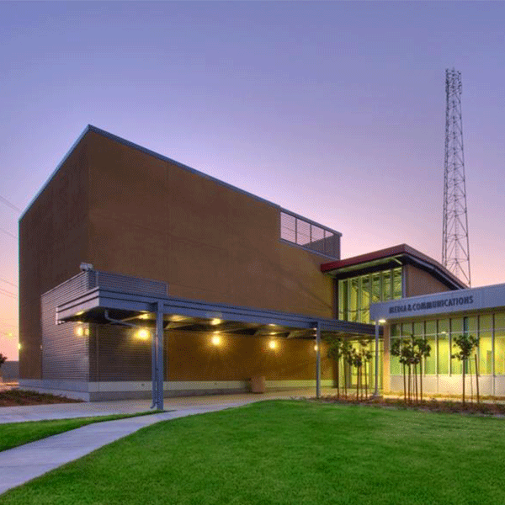
4. We’re ensuring fiscal sustainability
91.9 FM and TV Channel 24
KVCR.org
Notes:
As many of you know, KVCR is a vital part of our community and our educational mission.
KVCR provides educational content to the 4.6 million people of the Inland Empire through PBS TV Channel 24 and through NPR news on 91.9 FM.
When the LA media market only focuses on LA, KVCR focuses on the stories of the Inland Empire.
But as many of you know, KVCR was struggling financially for many reasons.
But that has changed in the last 14 months.
Thanks to our Board of Trustees, we have a long-term plan to strengthen KVCR. Not only will it continue serving as the PBS and NPR provider for the region, it will become a living laboratory for students to prepare for careers in California’s billion-dollar media industry.
Thanks to our state and federal policymakers, in the last 18 months, KVCR has received about $20 million to keep it operating for years to come.
When KVCR is financially stable, our college district is also financially stable, and THAT is good news for our students, faculty, and staff.

Slide 9
Student Enrollment
Notes:
Looking ahead, we must tackle one big issue:
Enrollment.
Across our district, we have seen a 25 percent decline in our student body.
If COVID-19 was a crisis, this enrollment decline is a crisis for our community colleges locally and across the state.
We know that when students don’t pursue an education after high school, they are less likely to have a living wage, they are less likely to be able to buy a home, they are less likely to vote, and they are more likely to depend on government assistance.
Thanks to your work, we are making headway to bring new students, and students who stopped out, back to college.
In the last 30 days, we launched a Districtwide Enrollment Marketing Committee that is overseeing a $1 million marketing campaign.
You’ll start seeing billboards, ads online, and other promotional strategies to elevate the visibility of Crafton Hills College and San Bernardino Valley College.
This semester, we will also launch a Districtwide Enrollment Management Committee that will strategize how to make college more accessible to students.
Some of the strategies we will look into is increasing dual enrollment partnerships with our K-12 feeder schools, and simplifying our application process so that students fill out one application to take classes at both Crafton Hills College and San Bernardino Valley College.

Slide 10
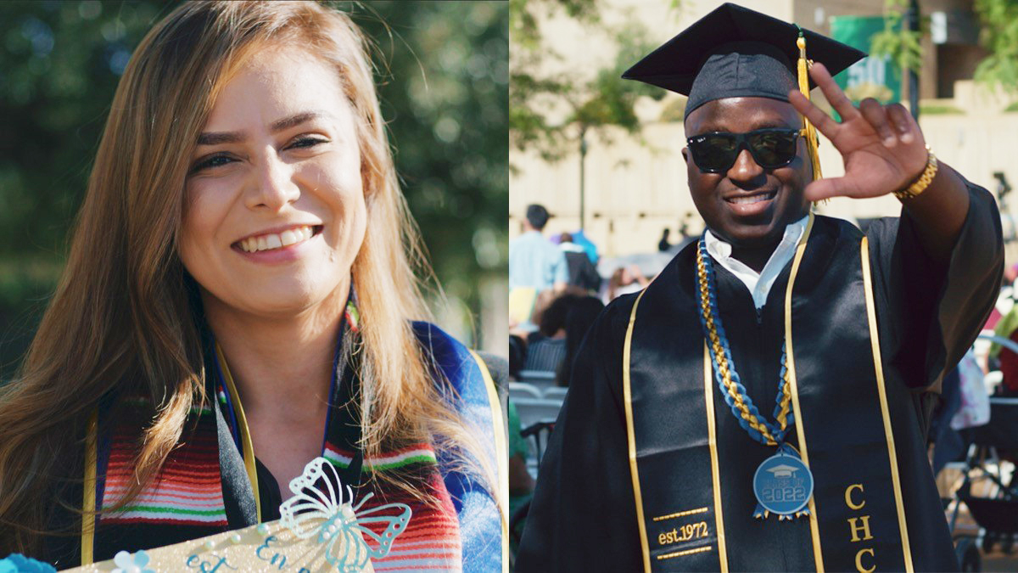
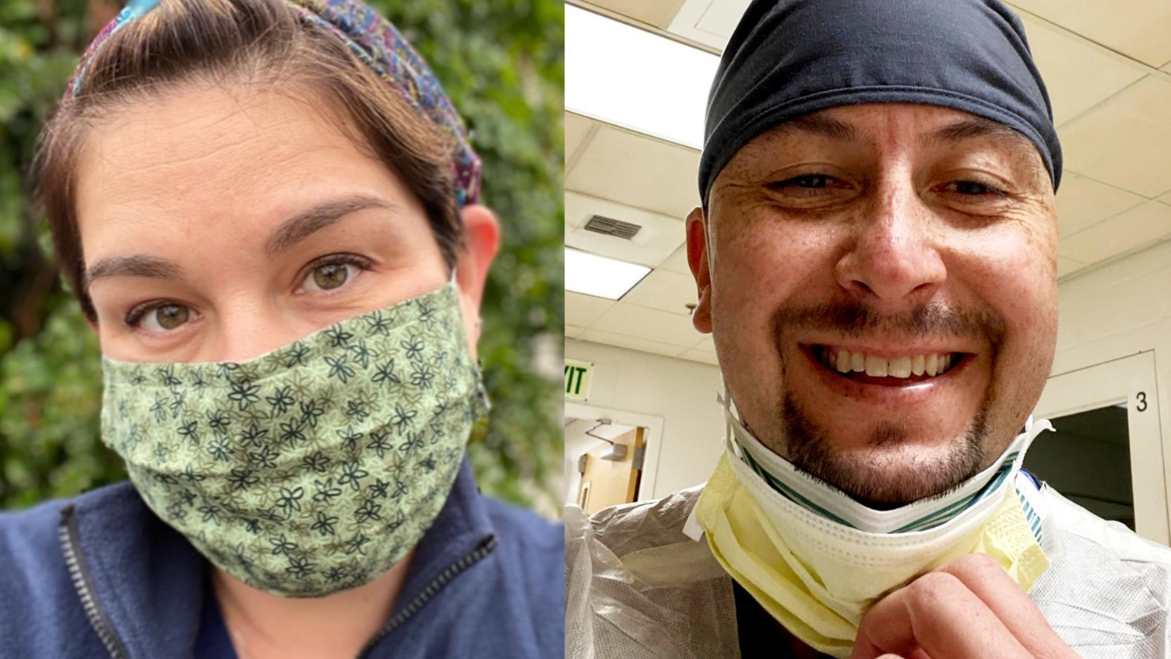
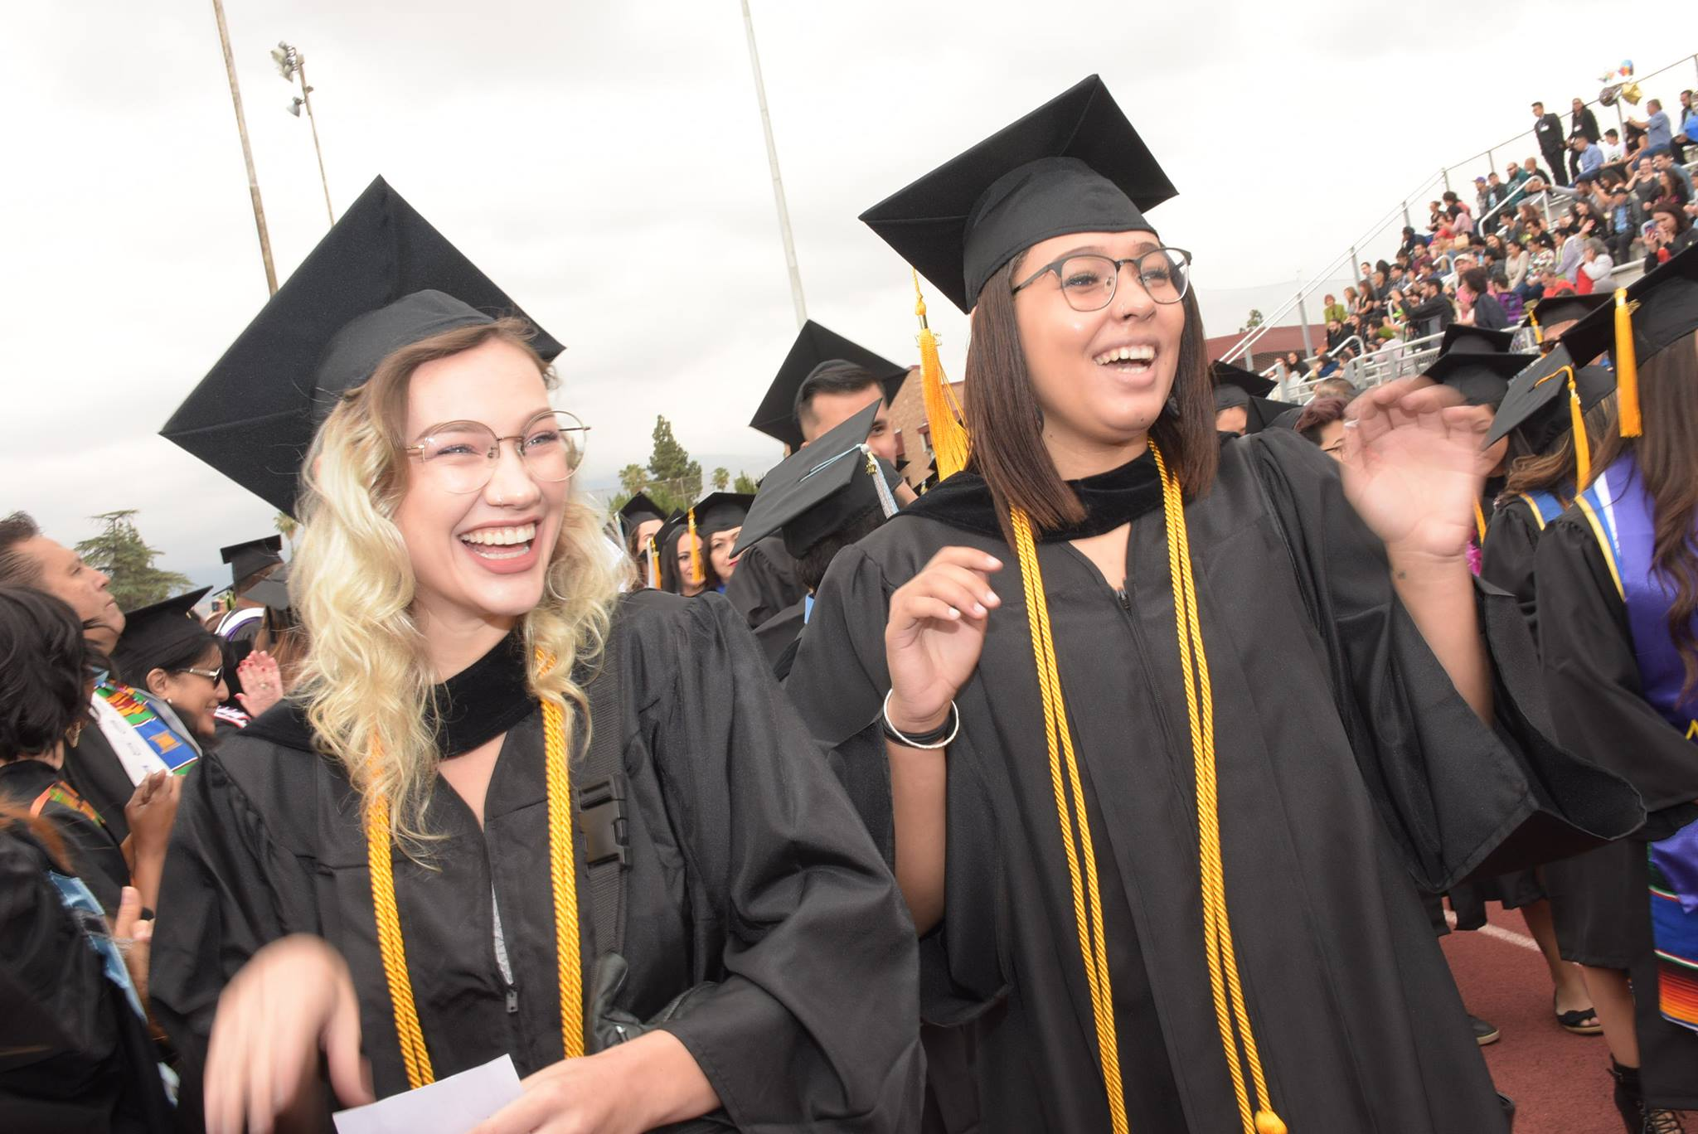
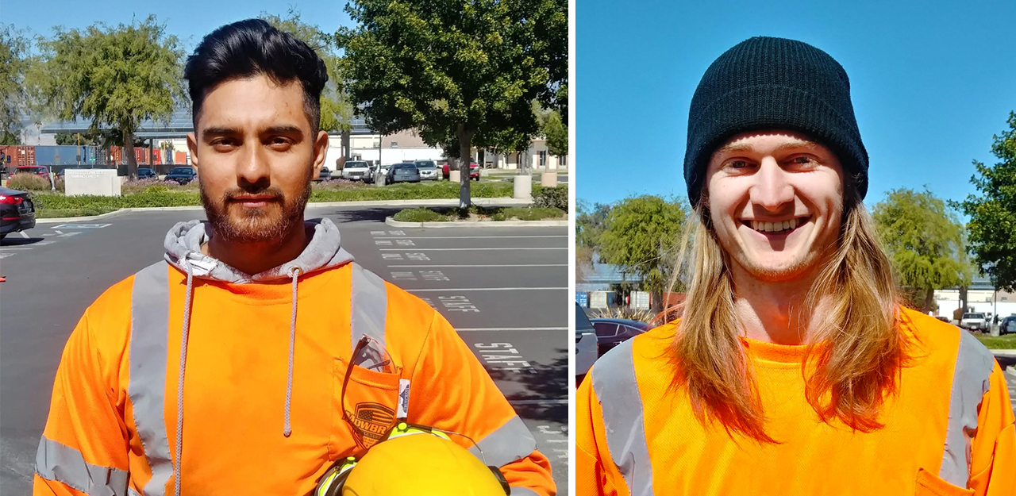
Notes:
When it comes down to it, our work is more than strategic plans and funding, it’s about students.
We are on a strong footing because we have the brainpower in this room. We have people like you who care about the success of every student.
Our work matters because we care about the next generation of leaders -- the next generation of people who have the same stories as people in this room.
Many of our students have overcome many life challenges to sit in our classrooms.
I was one of those community college students who felt lost at one point. I never thought that I would be a college president, let alone a chancellor.
The lives of students you are about to touch will have a long-lasting impact in the future.
So, when you do well in your work, our students do well too.
Please know that we’ve got your back.
I am here for you. Our district is here for you.
It may be cliché to say, but it’s true, we are in this together.
When you do your best, it’s a domino effect, and we all do our best.
More importantly, our students do their best.
Thank you everybody.

