Slide 1
Respiratory Care Program
Crafton Hills College

Slide 2
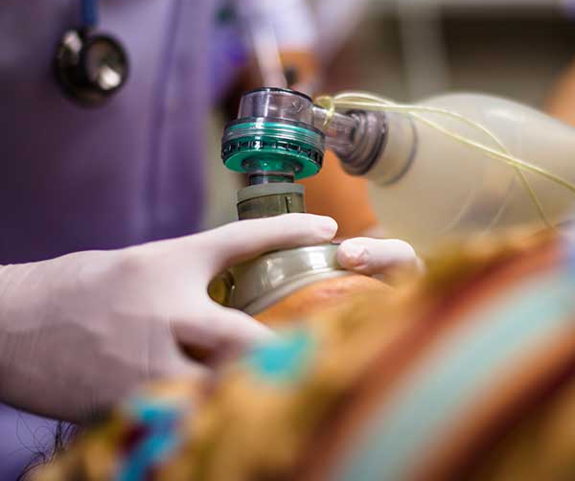
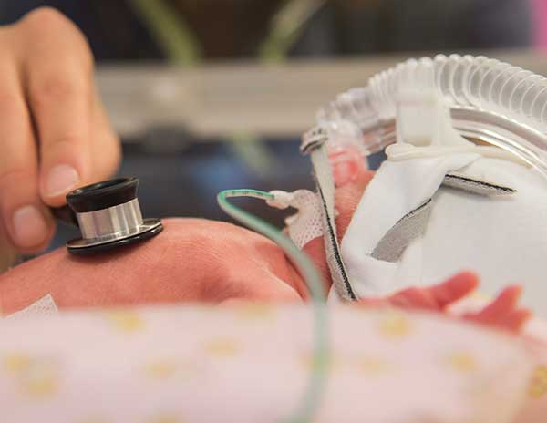
What is Respiratory Therapy?
Respiratory Therapy is a specialized health care field where practitioners are trained in pulmonary medicine in order to work therapeutically with people suffering from pulmonary disease.

Slide 3
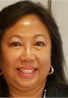
Applying to the program Schedule to see a CTE counselor
Rejoice Chavira
CTE Program Counselor
rchavira@craftonhills.edu
Brooke Clement
CTE Program Counselor
bfyfe@craftonhills.edu
A counselor will ensure that you are on the right track to be accepted
This may help to eliminate taking unnecessary courses
Counseling department can be reached at (909) 389-3366
You can also try to obtain online support through Cranium Cafe

Slide 4
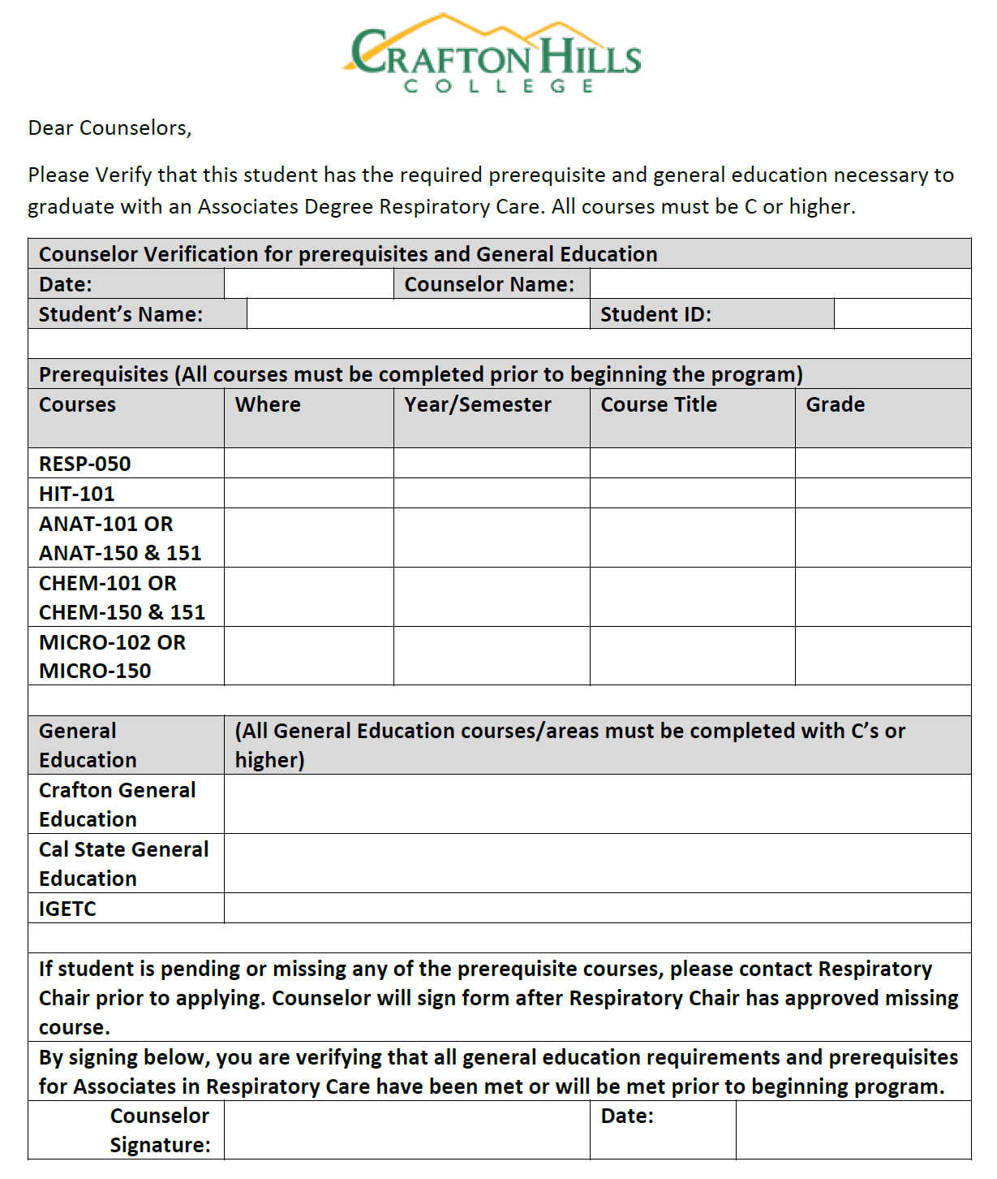
Verification of General Education Must be completed by counselor
Specific counseling form required
Courses must be completed for sign off
A grade of "C" or better is required for all courses
Counselor must sign form as confirmation.

Slide 5
Overview of Point System
Six-point Goal!!
Places you in best position for success:
RESP 050 Intro to Respiratory
Health Information Technology 101 (Medical Terminology)
Anatomy & Physiology 101
Microbiology 102
Chemistry 101
Completion of General Education requirements

Slide 6
Additional Considerations
Any coursework completed at another college/university requires transcript evaluation through Admissions & Records (Process requires 6-8 weeks)
Completed coursework has no expiration dates
Health Information Technology (Medical Terminology) accepted from Redlands ROP & certain high school equivalencies
Application deadline is July 1st

Slide 7
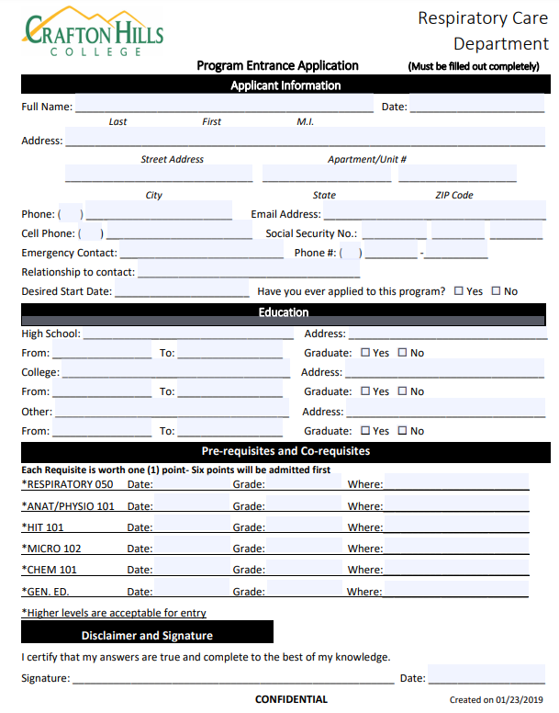
Preparing to Apply
Double check all documentation
Official/Unofficial transcripts must be sent to Admissions & Records in advance
Note official transcripts not required from CHC or SBVC
The following documents must be submitted to: CHC_RCP@craftonhills.edu
Counselor verification of GE
Program Entrance Application

Slide 8
Have Additional Questions?
Contact department secretary or program director
Campus Building PSAH Office 120 (1st Floor)
(909) 389-3286
Register for RESP 050 Intro to Respiratory
This course will answer all of your questions

Slide 9
Frequently Asked Questions
Question:
Question:
How will I find out if I am accepted into the program?
Answer:
Within 2 weeks of the application deadline, acceptance and waitlist letters will be sent by email.
What happens if I don't get accepted for the current year?
Answer:
You will be placed on the following year’s list; all documentation is retained for one year.

